Slide 1
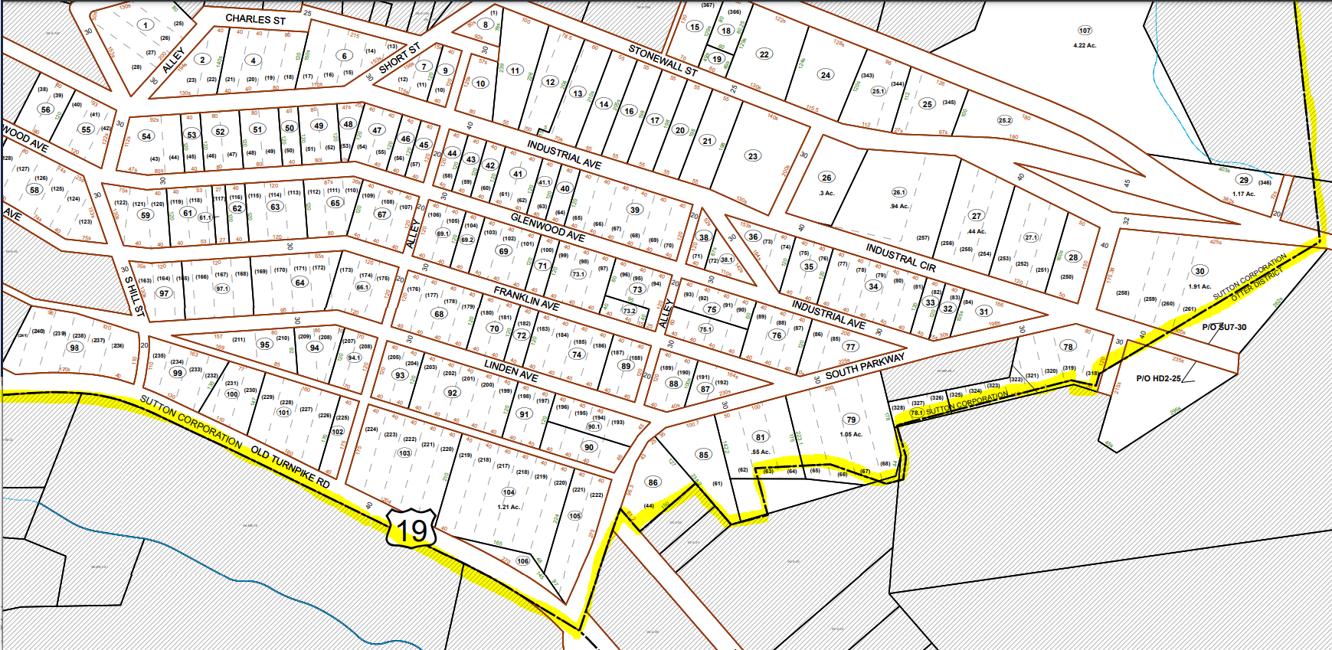
Sutton: Tax Map 8-7
Tax Map 8-2
https://data.wvgis.wvu.edu/pub/Clearinghouse/planningLanduseCadastres/wv_tax_maps/PDF/04_Braxton_County/08_Sutton_Corp/08-0007.pdf

Slide 2
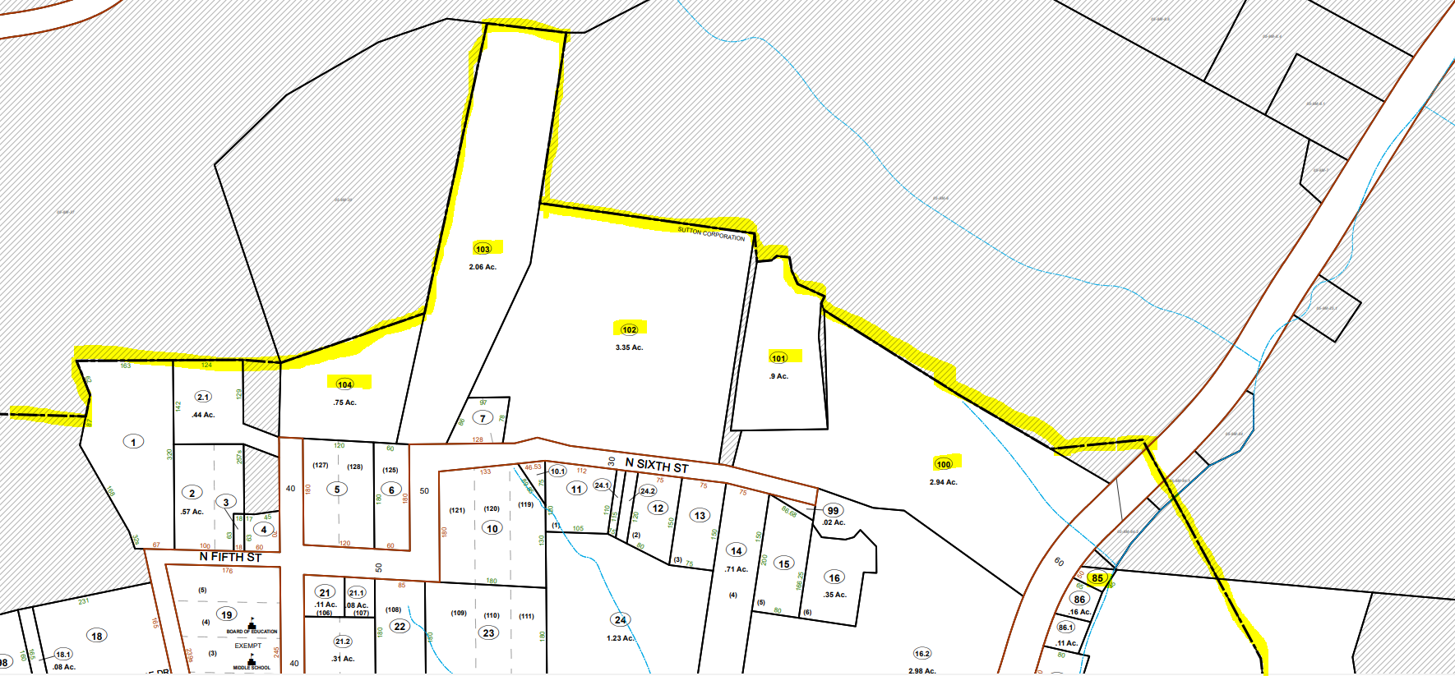
Sutton: Tax Map 8-3
Tax Map 8-2
https://data.wvgis.wvu.edu/pub/Clearinghouse/planningLanduseCadastres/wv_tax_maps/PDF/04_Braxton_County/08_Sutton_Corp/08-0003.pdf

Slide 3
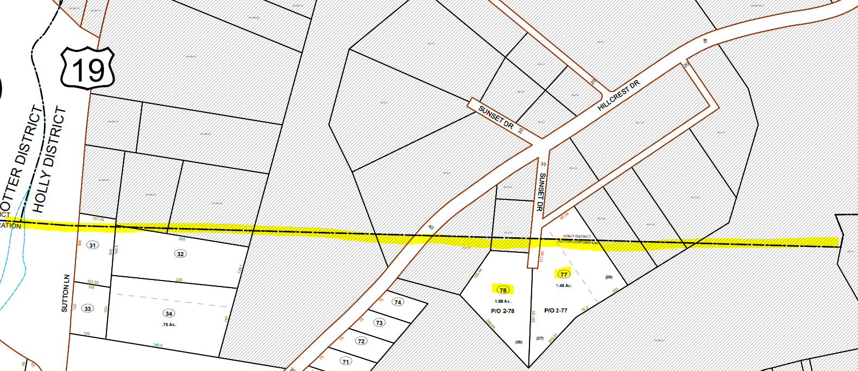
Sutton: Tax Map 8-2
Tax Map 8-2
https://data.wvgis.wvu.edu/pub/Clearinghouse/planningLanduseCadastres/wv_tax_maps/PDF/04_Braxton_County/08_Sutton_Corp/08-0002.pdf

Slide 4
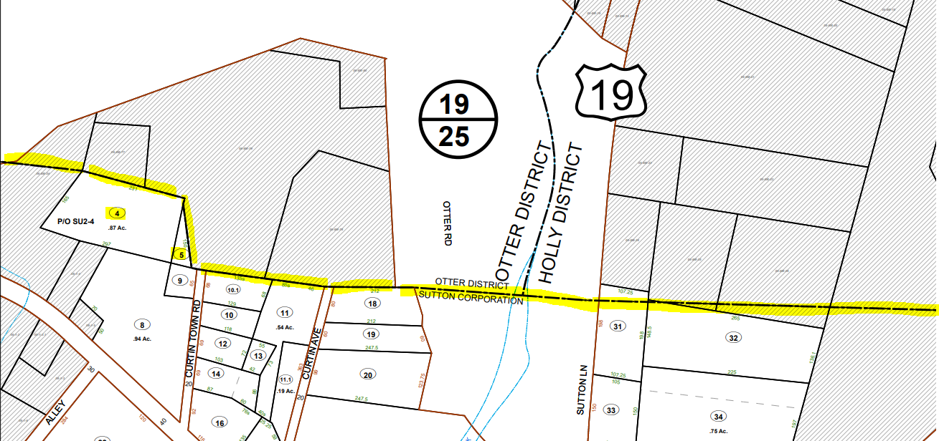
Sutton: Tax Map 8-2
Tax Map 8-2
https://data.wvgis.wvu.edu/pub/Clearinghouse/planningLanduseCadastres/wv_tax_maps/PDF/04_Braxton_County/08_Sutton_Corp/08-0002.pdf

Slide 5
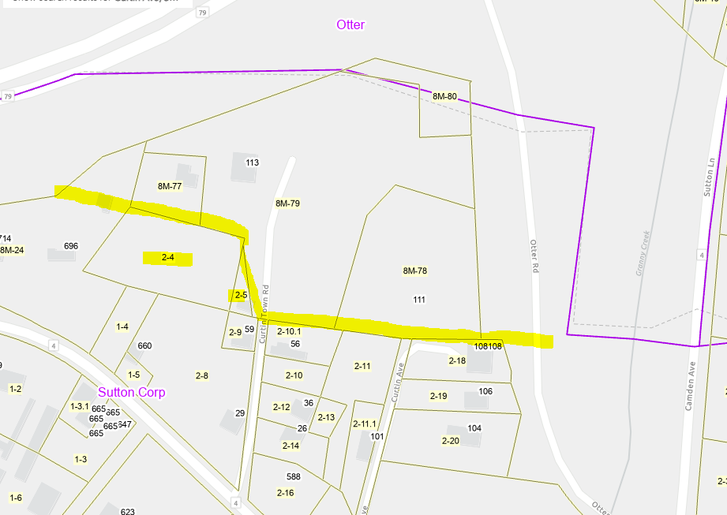
Sutton: Tax Map 8-2
Tax Map 8-2
https://data.wvgis.wvu.edu/pub/Clearinghouse/planningLanduseCadastres/wv_tax_maps/PDF/04_Braxton_County/08_Sutton_Corp/08-0002.pdf

Slide 6
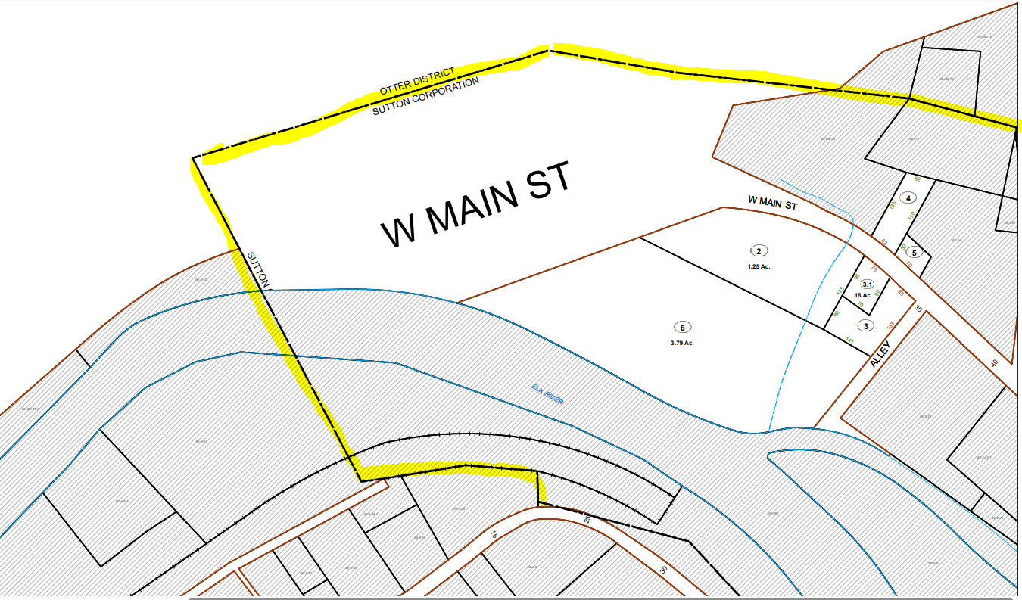
Sutton: Tax Map 8-1
Tax Map 8-1
https://data.wvgis.wvu.edu/pub/Clearinghouse/planningLanduseCadastres/wv_tax_maps/PDF/04_Braxton_County/08_Sutton_Corp/08-0001.pdf

Slide 7
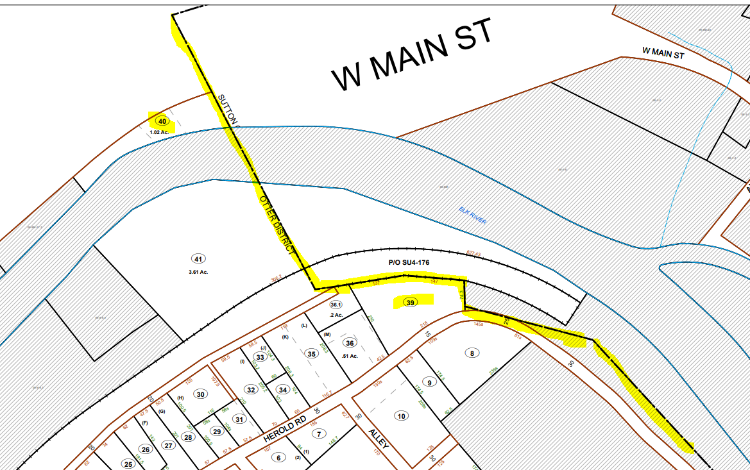
Sutton: Tax Map 6-3
Tax Map 6-3 https://data.wvgis.wvu.edu/pub/Clearinghouse/planningLanduseCadastres/wv_tax_maps/PDF/04_Braxton_County/06_Otter_Dist/06-0003.pdf

Slide 8
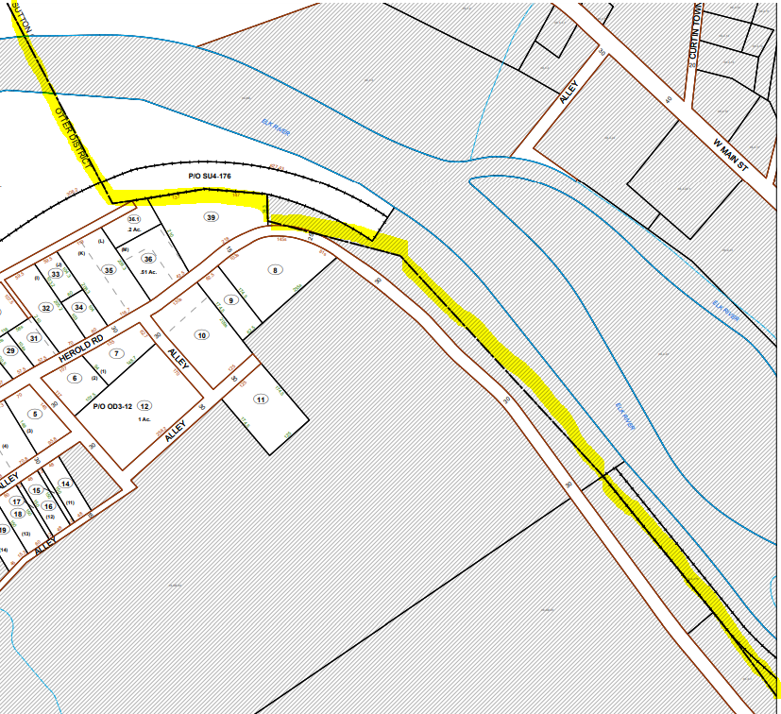
Sutton: Tax Map 6-3
Tax Map 6-3 https://data.wvgis.wvu.edu/pub/Clearinghouse/planningLanduseCadastres/wv_tax_maps/PDF/04_Braxton_County/06_Otter_Dist/06-0003.pdf

Slide 9
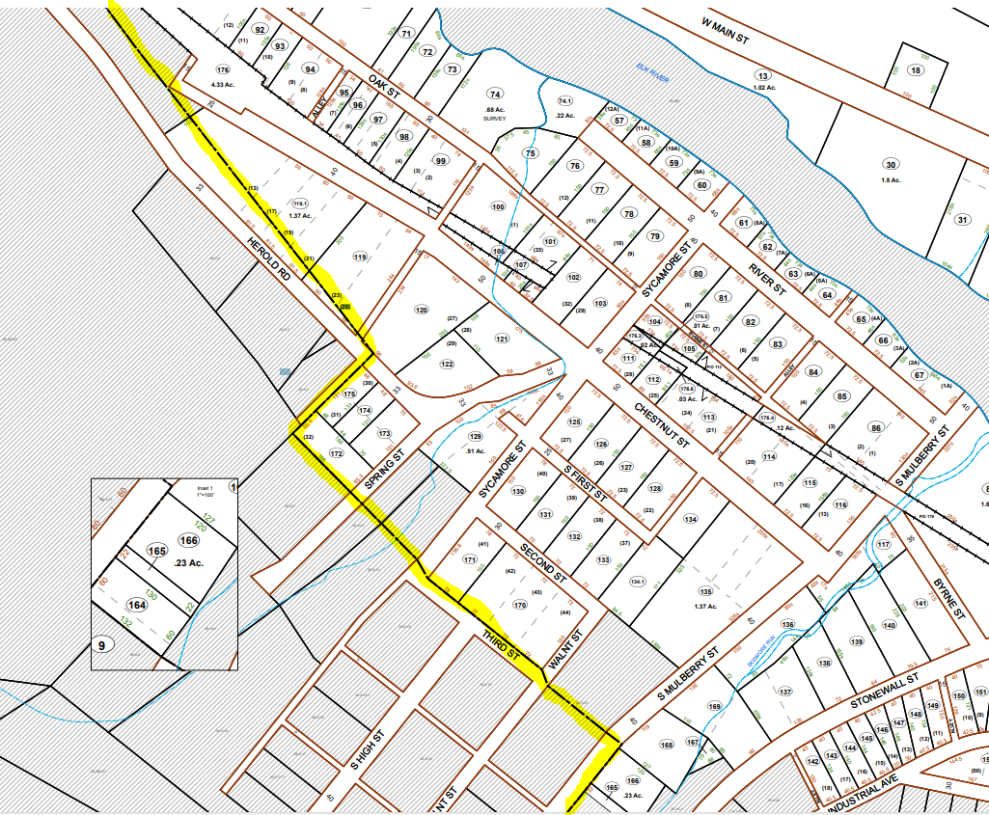
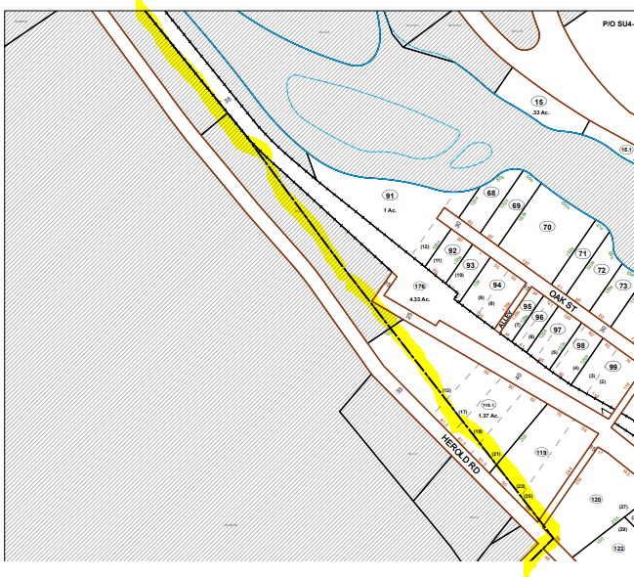
Sutton: Tax Map 8-4
Tax Map 8-4 https://data.wvgis.wvu.edu/pub/Clearinghouse/planningLanduseCadastres/wv_tax_maps/PDF/04_Braxton_County/08_Sutton_Corp/08-0004.pdf

Slide 10
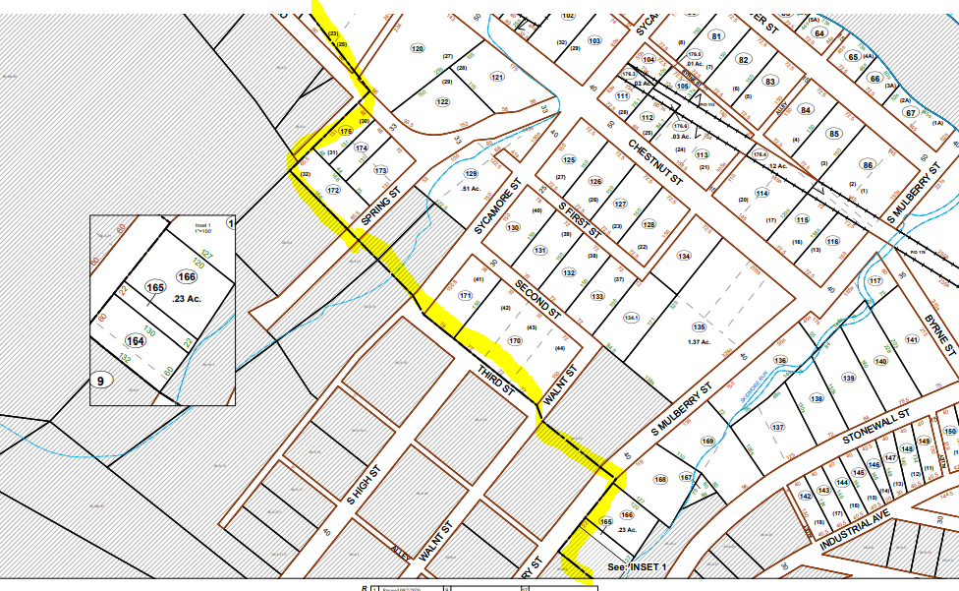
Sutton: Tax Map 8-4
Tax Map 8-4 https://data.wvgis.wvu.edu/pub/Clearinghouse/planningLanduseCadastres/wv_tax_maps/PDF/04_Braxton_County/08_Sutton_Corp/08-0004.pdf

Slide 11
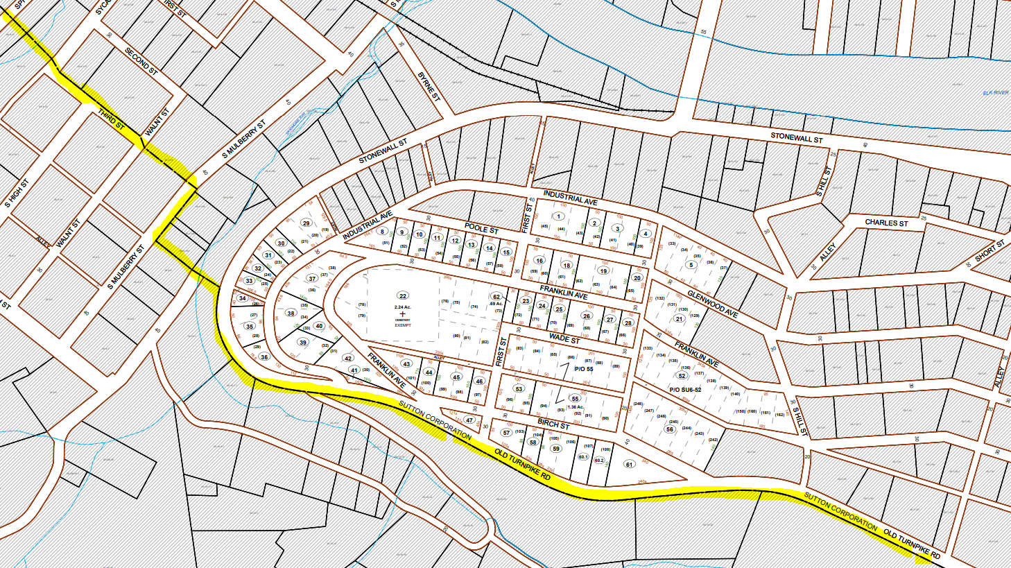
Sutton: Tax Map 8-6
Tax Map 8-6 https://data.wvgis.wvu.edu/pub/Clearinghouse/planningLanduseCadastres/wv_tax_maps/PDF/04_Braxton_County/08_Sutton_Corp/08-0006.pdf

