Slide 1
Rainelle New Reconstruction
First Floor Height ABOVE 2016 Flood HWM; 1-percent chance (100-yr) flood
First Floor Height BELOW 1%+, 0.2-percent chance (500-yr) floods
 | HEIGHT (ft.)
BUILDING
First Flood Height | 9
Freeboard (FBD) | 2
FLOOD DEPTH
FSF 20% (5-Yr) | 2.3
FEMA 1% (100-Yr) | 3.9
FEMA 100-Yr + 2.0 Ft. Freeboard | 5.9
2016 Flood HWM | 6.5
FSF 1% (100-Yr) | 8.2
FEMA 1%+, 0.2% | 9.9
FSF 0.2% (500-Yr) | 12.2
Building 13-13-0001-0054-0000_182
12.2’ (FSF 0.2% / 500-Yr )
9.9’ (FEMA 1%+ / 100-Yr; 0.2%)
8.2’ (FSF 1% / 100-Yr)
6.5’ (2016 High Water)
5.9’ (FEMA 1%/100-Yr + 2’ FBD)
3.9’ (FEMA 1% / 100-Yr)
2.3’ (FSF 20% / 5-Yr)
182 Seventh Street, Rainelle, WV, 25962
FLOOD DEPTHS:
FEMA
First Street Foundation (FSF)
USGS 2016 Flood High Water Mark

Slide 2
Building 13-13-0001-0054-0000_182

Slide 3
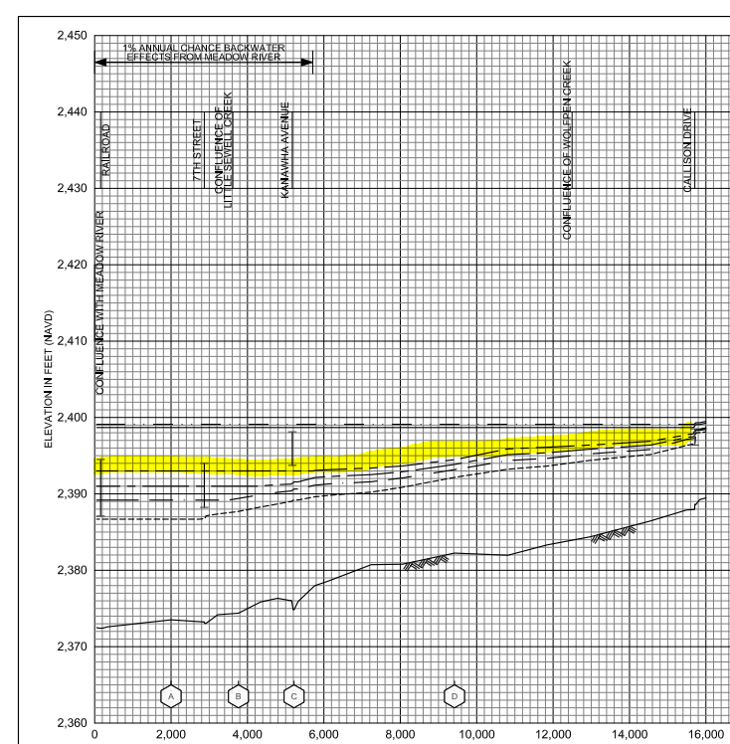
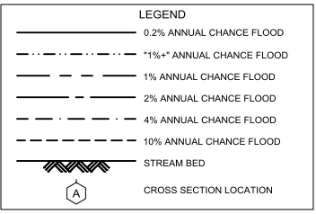
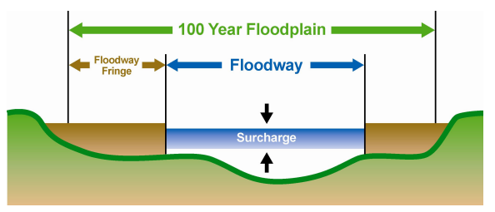
Sewell Creek Flood Study Profile
2022 Preliminary 1% Base Flood (100-Yr) Elevation 1850.7 ft for Building 13-17-0009-0026-0000_138
New 2022 FEMA Maps
Only the floodway or main channel of the 2012 FEMA flood maps was mapped and not the floodway fringe of the 1% chance (100-yr) floodplain.
The 2022 base flood elevation (100-yr) for a majority of Rainelle between 1st and 14th Streets is 2,393 feet. A similar base flood elevation was mapped for the 1987 flood maps for structures northwest of Main Street (U.S. 60).
The “1-percent plus” is a measure of how high the 1% flood even could be given the statistical uncertainties in flood modeling. The backwater flooding from Meadow River results in more uncertainty of the flood model and thus a wider confidence level. The 1%+ flood elevation is six feet higher than 1% elevation and same as the 02%.
Confluence of Little Sewell Creek
Confluence of Wolfren Creek
182 7th Street (Bldg.13-13-0001-0054-0000_182
The "Regulatory Floodway" is the channel of a river or other watercourse and the adjacent land areas that must be reserved in order to discharge the base flood without cumulatively increasing the water surface elevation more than a designated height. Source: FEMA
Sewell Creek 2022 Flood Study Profile

Slide 4
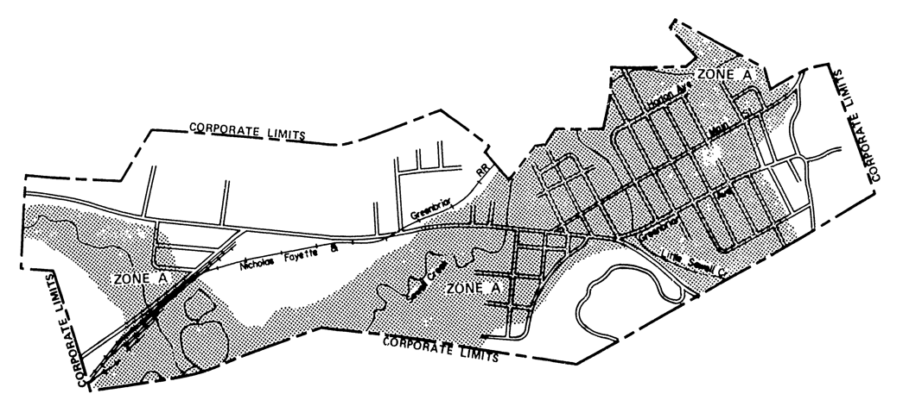
Rainelle 1977 FHBM
https://map1.msc.fema.gov/firm?id=540228

Slide 5
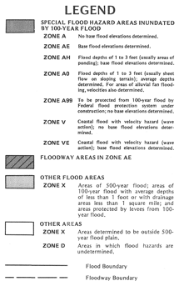
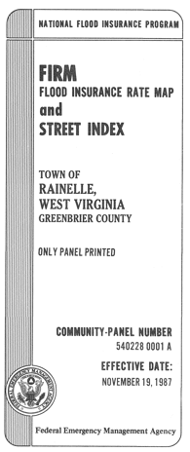
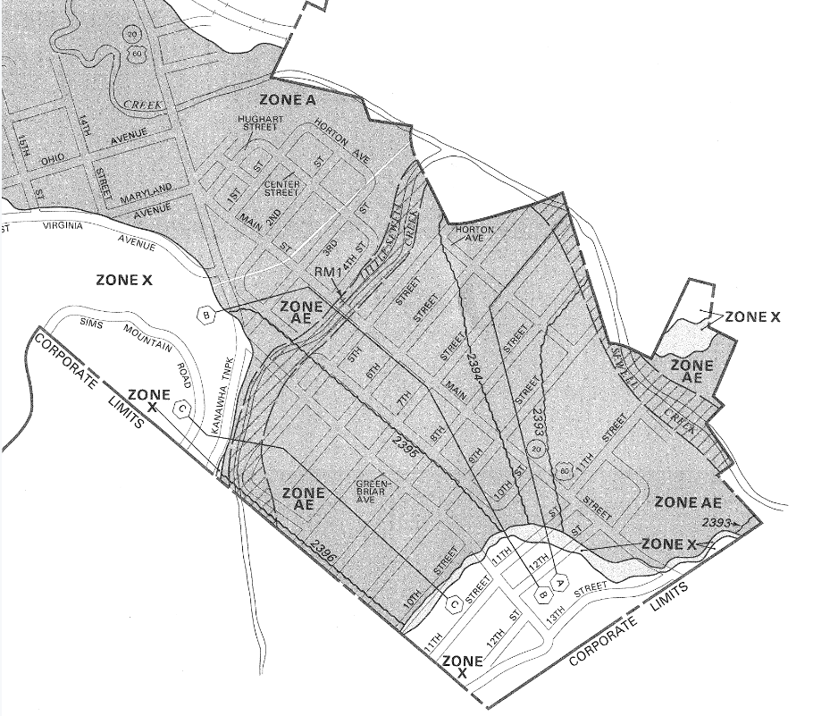
Rainelle 1987 FIRM
https://map1.msc.fema.gov/firm?id=5402280001A

Slide 6
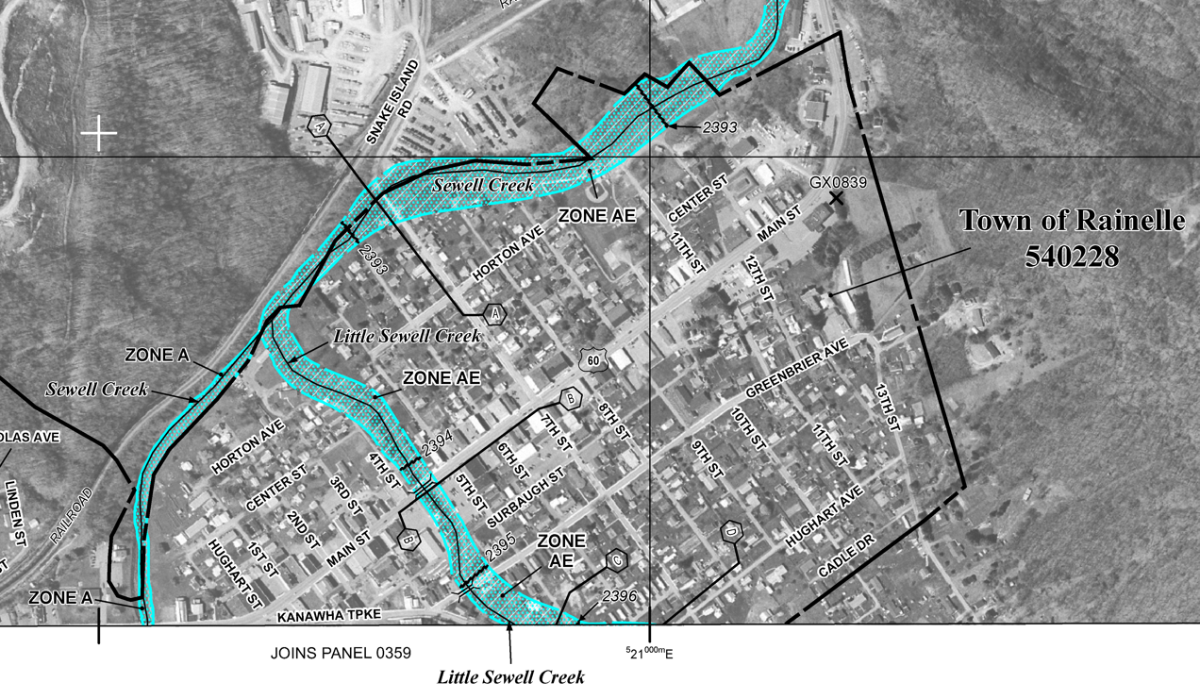
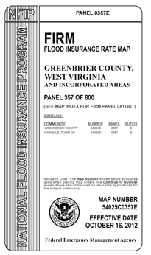
Rainelle 2012 FIRM
https://map1.msc.fema.gov/firm?id=54025C0357E

Slide 7
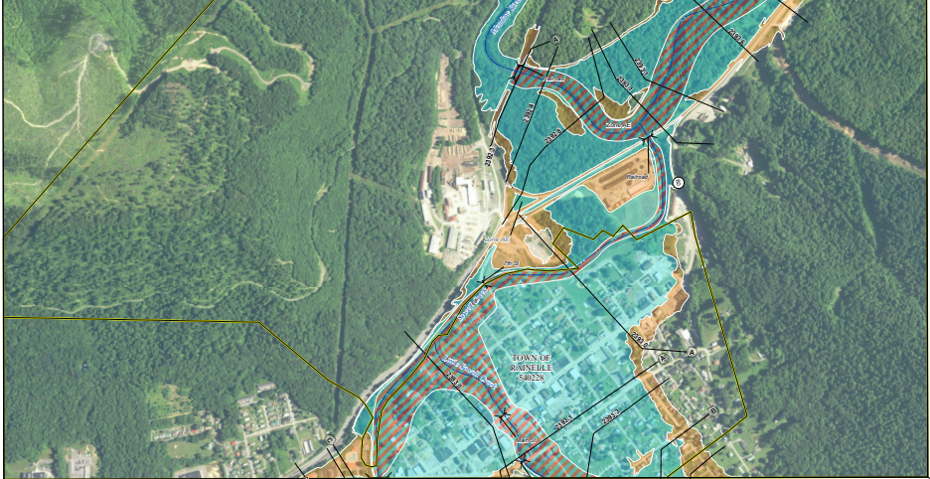
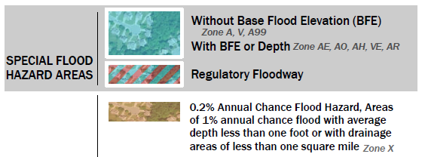
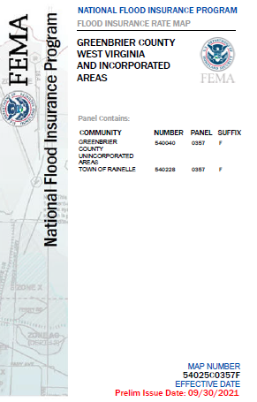
Rainelle 2022 Preliminary FIRM
Panels FIRM Index and Panels

Slide 8
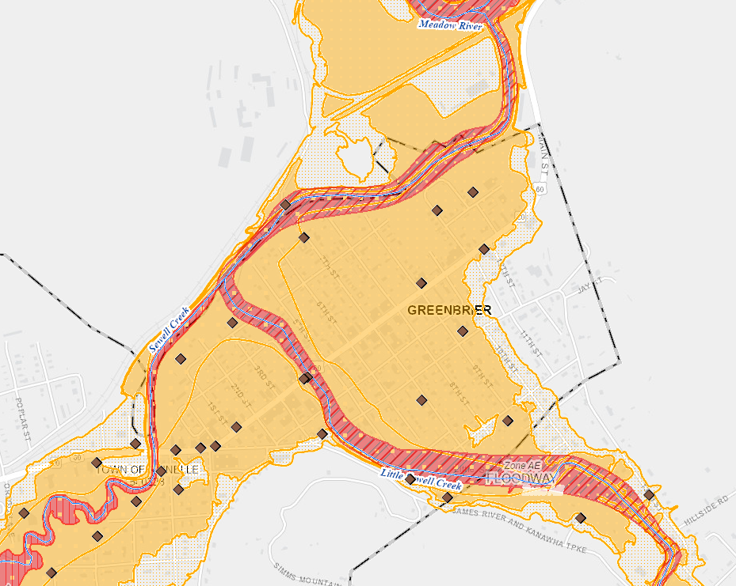
Rainelle 2022 Preliminary FIRM
WV Flood Tool

Slide 9
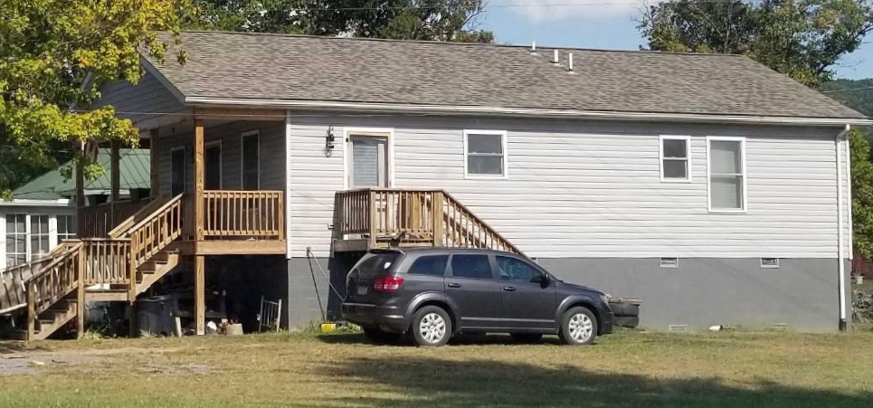
WSS New Reconstruction
First Floor Height (FFH) ABOVE 1-percent chance (100-yr) flood
First Floor BELOW 2016 HWM; 1%+,0.2-percent chance (500-yr) floods
 | HEIGHT (ft.)
BUILDING
First Flood Height | 6.4
Freeboard (FBD) | 2.0
FLOOD DEPTH
FSF 20% (5-Yr) | 3.4
FEMA 1% (100-Yr) | 5.4
FSF 1% (100-Yr) | 5.7
FEMA 1%+; Climate (BFE + 1ft) | 6.4
2016 Flood HWM | 6.5
FEMA 0.2% (500-Yr) | 7.2
FEMA 100-Yr + FBD | 7.4
FSF 0.2% (500-Yr) | 7.4
7.2’ (FEMA 0.2% / 500-Yr )
7.4’ (FEMA 1%/100-Yr + 2’ FBD)
7.4’ (FSF 0.2% / 500-Yr)
6.5’ (2016 High Water)
6.4’ (FEMA 1%+; Climate BFE+1)
5.4’ (FEMA 1% / 100-Yr)
Building 13-17-0009-0026-0000_138
3.4’ (FSF 20% / 5-Yr)
138 Mill Street, White Sulphur Springs, WV, 24986
FLOOD DEPTHS:
FEMA
First Street Foundation (FSF)
USGS 2016 Flood High Water Mark

Slide 10
Building 13-17-0009-0026-0000_138

Slide 11
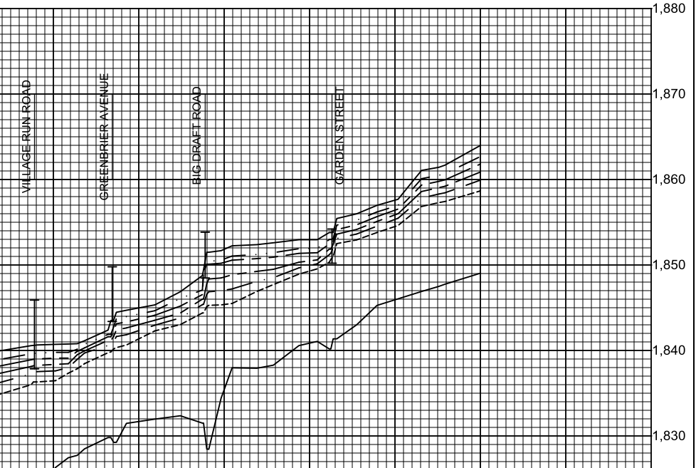
Howard Creek Flood Study Profile
2022 Preliminary 1% Base Flood (100-Yr) Elevation 1850.7 ft for Building 13-17-0009-0026-0000_138
New 2022 FEMA Maps
2022 Base Flood Elevation increased 1 to 1.5 feet from 2102 FEMA Map between Dry Creek Bridge (Big Draft Rd) and Wades Creek Bridge (Garden St)
Confluence of Dry Creek
Confluence of Wades Creek
Bldg. 13-17-0009-0026-0000_138 1% WSEL 1850.7 ft.
https://data.wvgis.wvu.edu/pub/NSF/FloodProfiles/54025CV002B.pdf#page=43

