Slide 1
Social Vulnerability Indicators
White Sulphur Springs and Rainelle
Vulnerability Indicators |  | White Sulphur Springs | Rainelle | State Ratio | National Ratio
 | Poverty Rate | 14.4% | 37.0% | 17.3% | 12.9%
 | Unemployment Rate | 21.4% | 33.6% | 23.8% | 14.7%
 | Vulnerable Ages Ratio | 41.7% | 39.8% | 30.8% | 28.3%
 | Disability Ratio | 17.8% | 26.9% | 18.7% | 13.0%
 | Population Growth Ratio | -9.1% | -20.9% | -3.2% | 7.4%
 | Renter-Occupied Ratio | 42.8% | 43.0% | 26.8% | 36.0%
 | Housing Values Less than $50K Housing Median Value | 3.9% $125,700 | 37.5% $59,400 | 16.9% $119,600 | 6.6% $229,800
The red texts show more than 5% of difference, to the vulnerability side, from the state ratios.

Slide 2
Description, Rationale, and Data Sources
Vulnerability Indicator | Description | Rationale | Data Source
Poverty Rate | Percentage of households with incomes below poverty level | The poor are less likely to have the income or assets needed to prepare for a possible disaster or to recover after it occurs (Cutter et al., 2003; Flanagan et al., 2011; Morrow, 1999; Thomas, 2017). | Census 2019 ACS 5-Year Estimates
Unemployment Rate | Percentage of families (two or more people residing together and related by birth, marriage, or adoption) with no workers in the past 12 months (from 2019) | In addition to income problems, unemployed persons lack benefit plans providing health cost assistance when injuries or deaths occur due to disasters (Brodie et al., 2006; Flanagan et al., 2011). | Census 2019 ACS 5-Year Estimates
Vulnerable Ages Ratio | Percentage of population younger than 15 or older than 65 | Children and the elderly are generally more vulnerable to disasters such as flooding due to the lack of experience or physical and cognitive limitations to protect themselves (Cutter et al., 2003; Flanagan et al., 2011; Morrow, 1999). | Census 2019 ACS 5-Year Estimates
Disability Ratio | Percentage of civilian noninstitutionalized population with disabilities of independent living, self-care, ambulatory, cognitive, vision, or hearing difficulties | Disabled people are more vulnerable to natural hazards such as flooding (Cutter et al., 2003; Flanagan et al., 2011; Morrow, 1999). | Census 2019 ACS 5-Year Estimates
Population Growth Ratio | Percentage of population change from 2010 to 2020 | Although rapid population growth in dense urban areas can contribute to the risk (Cutter et al., 2003) we believe population decrease can be a factor of social vulnerability in WV communities. | Decennial Census (DEC) of 2010 & 2020
Renter-Occupied Ratio | Percentage of renter-occupied residential units of the total occupied housing units | Low ratios of home ownership can indicate a community with a faltering economy and a population with less long-term commitment to the community. Renters generally have less ability or motivation to make their homes resistant structurally or buy flood insurance (Cutter et al., 2003; Morrow, 1999). | Census 2019 ACS 5-Year Estimates
Housing Values Less than $50K Housing Median Value | The dollar values of owner-occupied residential units (Percentages of less than $50K and median) | The value can be an indicator of building quality. Buildings of low quality cannot withstand flooding adequately and are more vulnerable. It can also be related to the personal wealth. Therefore, the physical and social vulnerabilities to floods are generally tied at this point (Flanagan et al., 2011; Morrow, 1999; Thieken et al., 2008). | Census 2019 ACS 5-Year Estimates

Slide 3
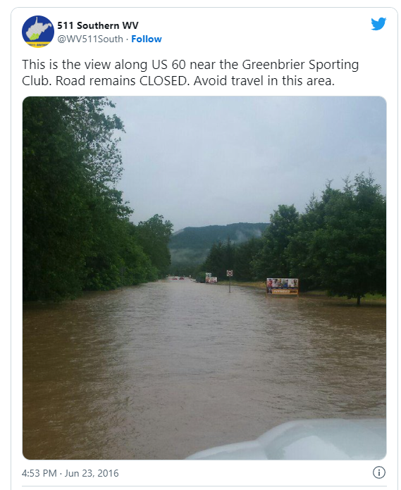
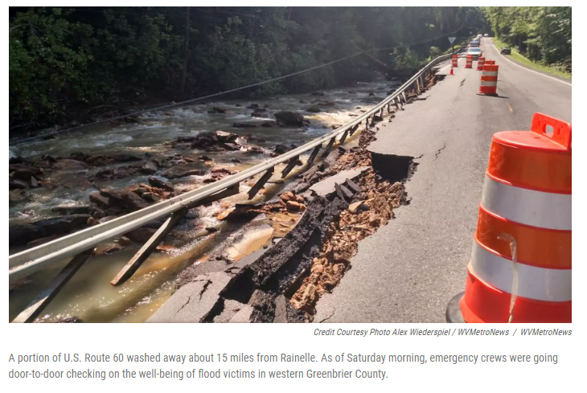
Transportation
One hundred twenty-three bridges were damaged, and five were destroyed. Floodwaters closed 250 roads were closed, and pavement washed out on 1,300 separate sites.
Source: WV DOT Remembering the 2016 flood five years on Flood (2021)
Source: WV Public Broadcasting 2016

Slide 4
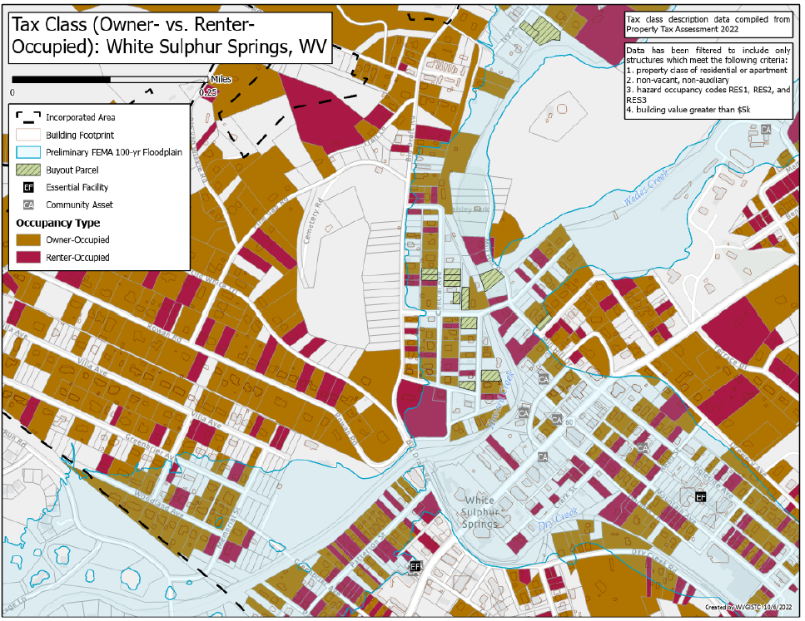
Owner versus Renter Occupied

Slide 5
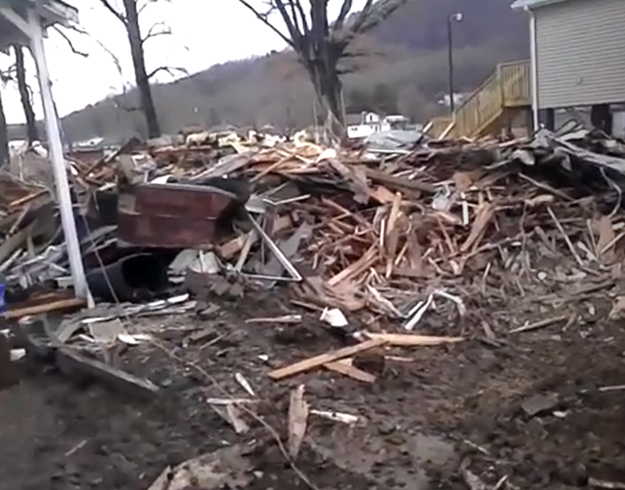
Relocation
A “prior owner” search query of the WV Property Assessment data shows that John Hutsenpiller moved from 212 11th St. to 202 Chestnut Street in Grace Village, Rainelle. Eight new homes were built for flood survivors at Grace Village on two acres of land donated by a local dentist.
Video testimony by John Hutsenpiller Jr. of home destroyed on 11th Street in Rainelle. He relocated to a new home in Grace Village.
Media Links
WV Press
Metro News Grace Village 5 new homes
Local Dentist Donates Land for Flood Victims

Slide 6
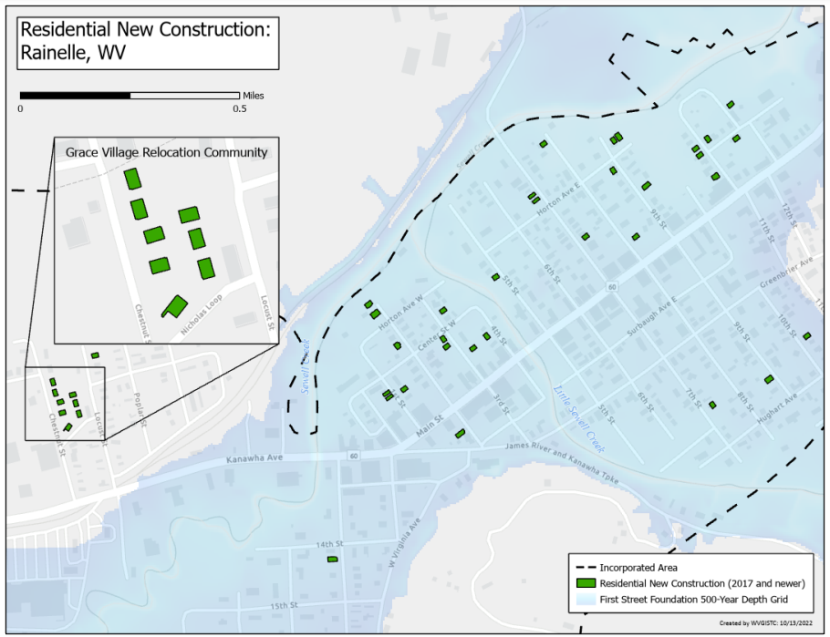
Rainelle Relocated Settlement
Maps are created from BUILDING YEAR of tax assessment data. White Sulphur Springs relocated flood survivors to 28 new homes in Hope Village. Although Rainelle built 8 new homes in Grace Village located outside the floodplain, the majority of the new construction was in the floodplain.

Slide 7
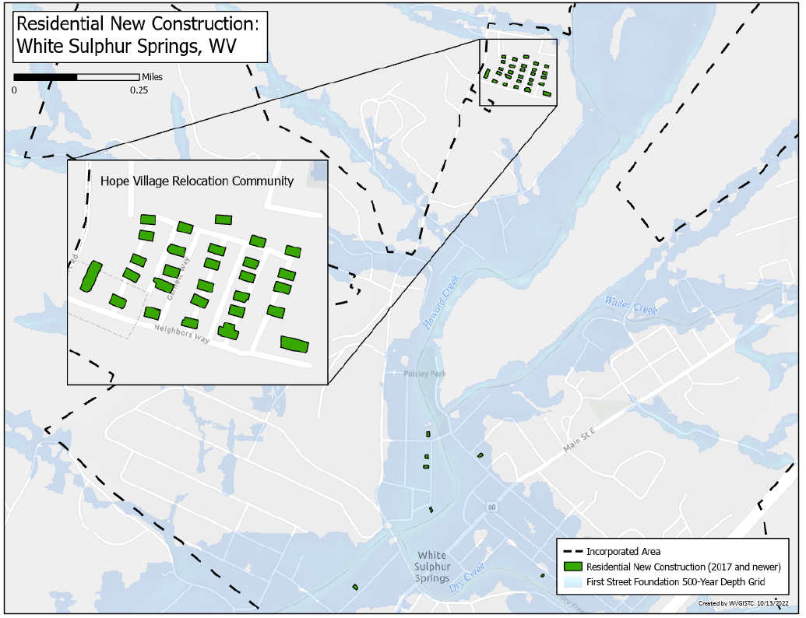
WSS Relocated Settlements

Slide 8
Floodplain Building Value (2015-22)
COMMUNITY | 2015 | 2016 | 2017 | 2018 | 2019 | 2020 | 2021 | 2022
Rainelle (n=329) | 13.2 Million | 13.2 Million | 5.1 Million | 9.4 Million | 11.0 Million | 11.1 Million | 11.4 Million | 12.2 Million
White Sulphur Springs (n=417) | 23.0 Million | 23.4 Million | 13.5 Million | 21.5 Million | 22.4 Million | 23.0 Million | 26.3 Million | 29.0 Million
After the 2016 flood the Assessors Office marked flooded buildings at 10% of their market value, and then subsequent years verified and re-valued structures that were rebuilt or remodeled.

