Slide 1
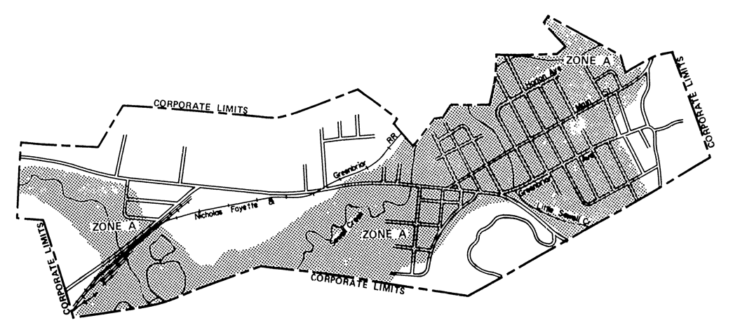
Rainelle 1977 FHBM
https://map1.msc.fema.gov/firm?id=540228

Slide 2
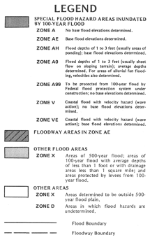
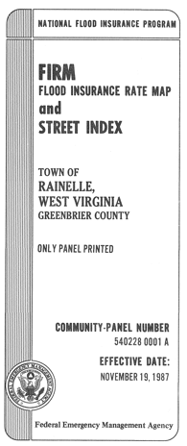
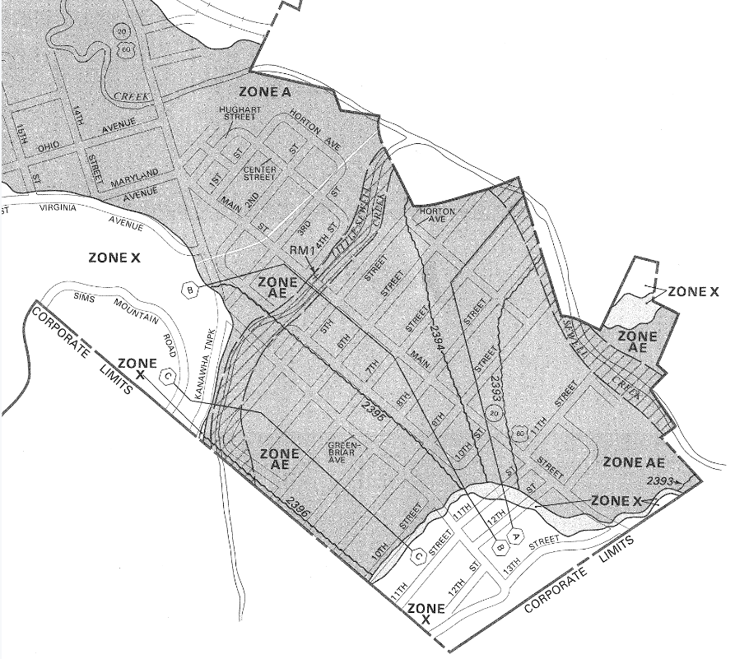
Rainelle 1987 FIRM
https://map1.msc.fema.gov/firm?id=5402280001A

Slide 3
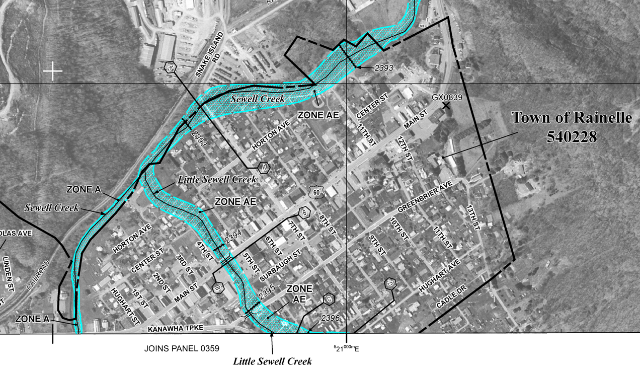
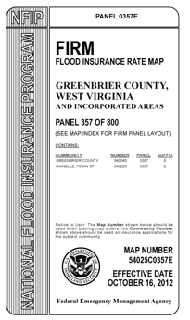
Rainelle 2012 FIRM (Incomplete)
https://map1.msc.fema.gov/firm?id=54025C0357E
Incomplete mapping of SFHA resulted in:
Residents underinsured for major flood in 2016
FEMA damage assessments not conducted outside the SFHA
Only the floodway was shown on FEMA’s 2012 Flood Insurance Rate Map (FIRM). The floodway fringe, a major portion of the Special Flood Hazard Area (SFHA) that previously covered Rainelle, significantly narrowed and was not included in the 2012 FIRM.

Slide 4
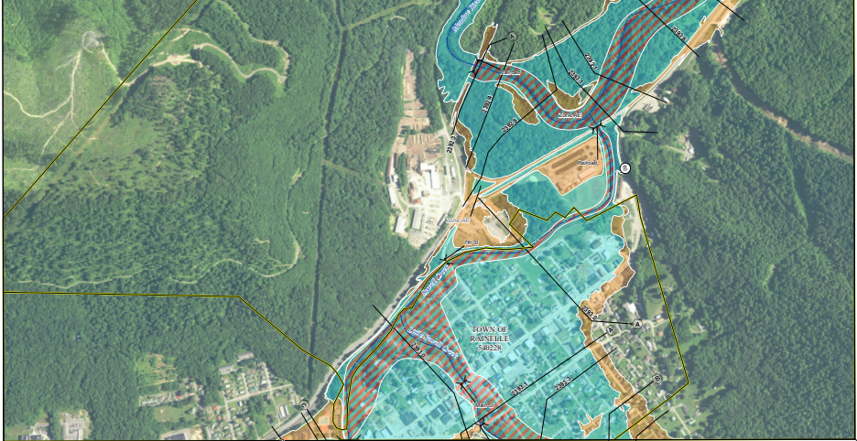
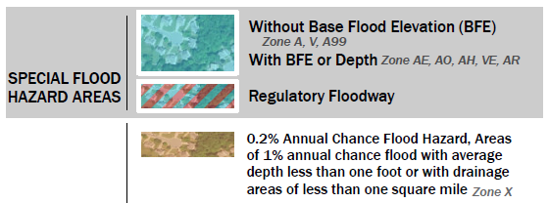
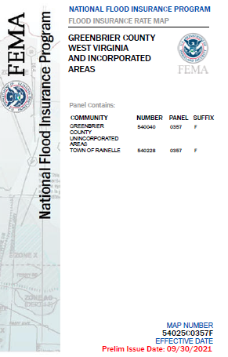
Rainelle 2022 Preliminary FIRM
Panels FIRM Index and Panels

Slide 5
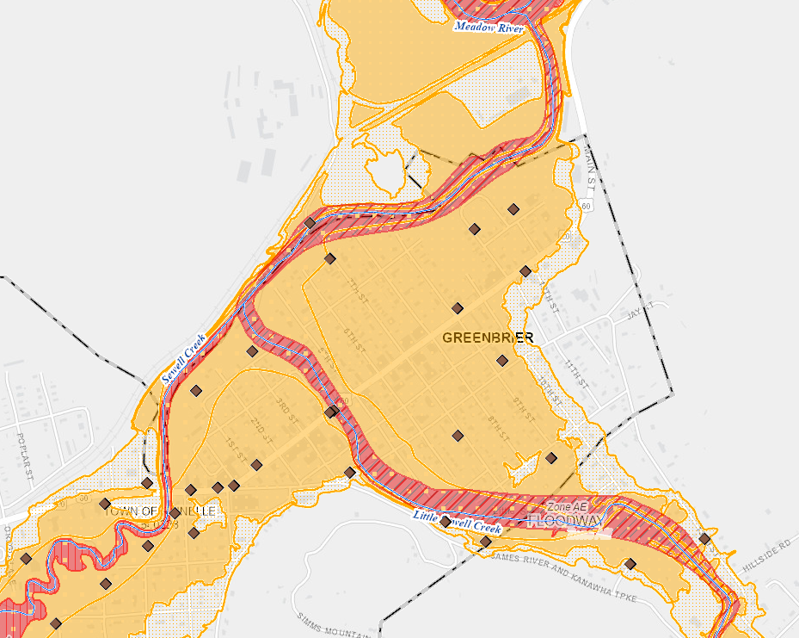
Rainelle 2022 Preliminary FIRM
2012 FIRM (floodway only mapped)
The Special Flood Hazard Area (SFHA) is the land in the floodplain subject to a one percent (100-year) or greater chance of flooding in any given year
2022 FIRM (floodway and fringe)
High Risk Flood Zones for 1%-chance (100-yr) flood
2022 Flood Map: Total acreage of high-risk flood zones increased significantly by 143 acres
Rainelle
WV Flood Tool

Slide 6
Rainelle 2012 FIRM (Map Issues)
County Comments
2012 Flood Zone Map Error: “2012 FEMA map goof not caught during evaluation period when maps went digital and the Town [Rainelle] wished to leave the wrong maps AS-IS versus prove FEMA wrong. They said it would save people money not having to buy flood insurance. We argued...requested Town Hall meetings, etc. [Previous] Mayor refused. Everyone in Rainelle knew that they were in the floodplain.
Source: Paula Brown, Deputy Director of Homeland Security & Emergency Management Agency, Greenbrier County, personal communications 10/2022.

Slide 7
Rainelle 2012 FIRM (Map Issues)
State NFIP Comments
PRE-FLOOD: FEMA and the State agreed that the new 2012 flood maps were wrong and underestimated flood risk but it was past the appeal period. The focus of the 2012 maps was to create a digital maps using the redelineation methodology. Rainelle had the option to keep the old maps as well to regulate to 1987 maps but did not. Mayor Andrea Pendleton and State NFIP Coordinator had meetings with the town authorities and citizens. FEMA representatives attended the map meetings as well about the issues, but the 2012 FEMA flood maps were released anyway. Apparently there was not enough money to fund a restudy. During the meetings citizens were encouraged to buy Preferred Risk Insurance policies at a discounted rate since the floodplain had narrowed significantly and most of the town was no longer in the Special Flood Hazard Area (SFHA).
POST-FLOOD: After the 2017 flood, the 1987 maps were adopted for regulatory purposes. The State also requested that a mapping contractor create Advisory Flood Heights for damage assessments. At the time, the Town Clerk, who died recently of COVID, assisted with updating the ordinance. The Mayor was in a lose-lose position. If the Mayor adopted the old floodplain maps that were more restricted then the community would be upset.
CONSEQUENCES Everybody stopped buying flood insurance since mandatory flood insurance for properties located in the Special Flood Hazard Area (SFHA) was not longer required. In hindsight, the Mayor should have more closely reviewed the flood maps during the preliminary state to ensure the high-risk flood areas were fully mapped and complete. Another detrimental consequence regarding the 2012 maps not completely mapping the full flood risk was that the damage assessments by FEMA for the 2016 flood were not conducted for most of the flooded buildings in Rainelle because the 2012 flood maps had removed these structures from the high-risk floodplain.
Kevin Sneed, former State NFIP Coordinator, personal communications 10/2022.

Slide 8
Rainelle 2012 FIRM (Map Issues)
Mapping Contractor Comments
It's not that the fringe is not shown exactly. It's coincident with the floodway. Please reach out to Bob [Pierson] for anything official, but this is an example of the worst-case scenario for redelineation. Redelineation is the practice of mapping older BFEs on new topography. WVU has done this on an advisory basis for many areas throughout the state, so I'm sure you are familiar with it. In broad strokes, it can be really useful. The larger the system, the more reliable the practice is (provided no major changes in the watershed). However, it has fallen out of favor within the program for its weaknesses. In a previous era, while the program digitized FIRMs and focused on modernization/digitization of FIRMs ahead of restudying flooding sources from scratch, redelineation was a popular tool. In cases where the redelineated floodplain was more narrow than the effective regulatory floodway, the floodway was maintained. Rainelle was a case where the redelineated floodplain pinched way in and so what you see on this map is really the previous floodway carried forward. It was flagged at the time and coordinated, but it was the best information available, so it ultimately moved forward. Unfortunately, when the floodplain narrowed, the mandatory purchase requirement was removed, and many residents dropped their insurance. The floods of 2016 devastated Rainelle and the Town was underinsured.
So, redelineation can be very useful and served an important purpose in the program for a long time. This instance and similar ones proved to be major setbacks and I know Region 3 hasn't ordered redelineation for years.
Matt Breen, PE, CFM
Water Resources Service Line Manager
Mobile: (703) 725-7923
matt.breen@woodplc.com
Personal communications 10/2022

Slide 9
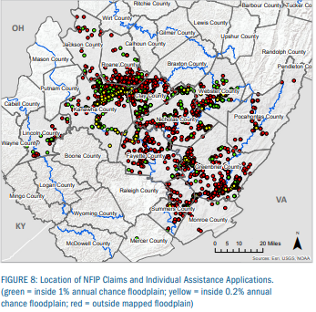
2016 Flood Claims Outside SFHA
Homeowners also need to know that there’s really no such thing as a flood-free zone. In fact, FEMA makes a regular point of noting that 25 percent of flood claims come from areas outside the Special Flood Hazard Area with low-to-moderate risk.
Source: https://www.kin.com/blog/fema-flood-maps/
2016 Flood Insurance Claims. Of the nearly 1,000 flood insurance claims in the declared counties, 77% were in the 1% annual-chance floodplain and approximately 23% of the insurance claims were outside. On average, in floods across the country, about 25% of claims are outside the Special Flood Hazard Area, so this is consistent with the national trend.
Source: https://www.fema.gov/sites/default/files/documents/Region_III_WV_FloodReport.pdf#page=9
23% of the 2016 Flood Insurance Claims were outside the SFHA or 1% annual chance (100-year) floodplain

Slide 10
Impact of Flood Map Issues
The outcome of having incomplete flood maps is that people don’t know the risks they face. This could create a false sense of security for property owners outside of FEMA-designated high-risk flood areas that aren’t required to have flood insurance. As a result, they may:
Unknowingly move to areas with a high risk for flood.
End up underinsured when a flood hits.
Build homes that can’t withstand flooding.
Source: https://www.kin.com/blog/fema-flood-maps/
Incomplete flood maps increase the danger to the public health, safety, and welfare of the community. It also increases financial burdens imposed on the communities, its governmental units, and its residents, by not preventing the unwise design and construction of development in areas subject to flooding.
Source: https://www.whitesulphurspringswv.org/documents/floodplain-ordinance/

Slide 11
Uninformed Homeowners
The outcome of having incomplete flood maps is that people don’t know the risks they face. This could create a false sense of security for property owners outside of FEMA-designated high-risk flood areas that aren’t required to have flood insurance. As a result, they may:
Unknowingly move to areas with a high risk for flood.
End up underinsured when a flood hits.
Build homes that can’t withstand flooding.
Video of new homeowners
Real Estate Disclosure Laws
“Lack of flood disclosure laws is putting home buyers at risk as extreme storms become more frequent” CNN
https://www.cnn.com/2022/10/01/us/flood-disclosure-laws-home-buyers-climate
“Lack of flood insurance in hard-hit Central Florida leaves families struggling after Hurrican Ian” CNN

Slide 12
Economy vs. Floodplain Mgmt.
2012 Flood Zone Map Error: “2012 FEMA map goof not caught during evaluation period when maps went digital and the Town [Rainelle] wished to leave the wrong maps AS-IS versus prove FEMA wrong. They said it would save people money not having to buy flood insurance. We argued...requested Town Hall meetings, etc. [Previous] Mayor refused. Everyone in Rainelle knew that they were in the floodplain. Rent to own is [also] a huge problem in the Greenbrier County flood-prone areas.”
Source: Paula Brown, Deputy Director of Homeland Security & Emergency Management Agency, Greenbrier County, personal communications 10/2022.
Economy versus Floodplain Management in the Community: Smaller communities are under constant pressure to allow development that preserves the community’s tax base and economic stability, perpetuating the existence of repetitively flooded communities. Earth Economics 2017
This includes the justification by community leaders that by not mapping the full extent of the high-risk flood zones, property owners will not be mandated to buy flood insurance for federally-backed loans, and thereby increasing the community’s economic vitality and stability.

