Slide 1
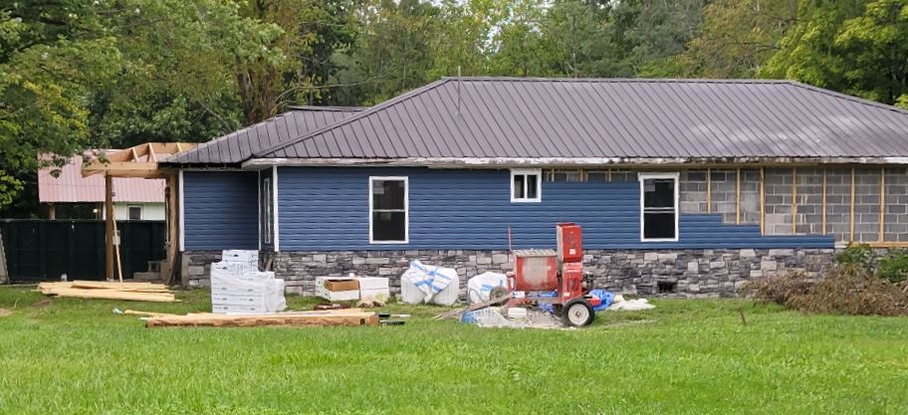
WSS Unmitigated
First Floor Height (FFH) BELOW FEMA 1-percent chance (100-yr) flood
First Floor BELOW 2016 HWM; 1%+,0.2-percent chance (500-yr) floods
 | HEIGHT (ft.)
BUILDING
First Floor Height | 2.0
Freeboard (FBD) | 2.0
FLOOD DEPTH
FSF 20% (5-Yr) | 0.0
FSF 1% (100-Yr) | 1.5
FSF 0.2% (500-Yr) | 3.4
FEMA 1% (100-Yr) | 4.0
2016 Flood HWM | 4.0
FEMA 1%+ (Climate) | 4.5
FEMA 0.2% (500-Yr) | 5.3
FEMA 100-Yr + FBD | 6.0
6.0’ (FEMA 1% / 100-Yr + 2’ FBD)
4.5’ (FEMA 1%+; Climate)
5.3’ (FEMA 0.2% / 500-Yr )
4.0’ (FEMA 1% / 100-Yr)
3.4’ (FSF 0.2% / 500-Yr)
4.0’ (2016 High Water)
1.5’ (FSF 1% / 100-Yr)
220 Central Avenue, White Sulphur Springs, WV, 24986
Building 13-17-0008-0139-0000_220
FLOOD DEPTHS:
FEMA
First Street Foundation (FSF)
USGS 2016 Flood High Water Mark

Slide 2
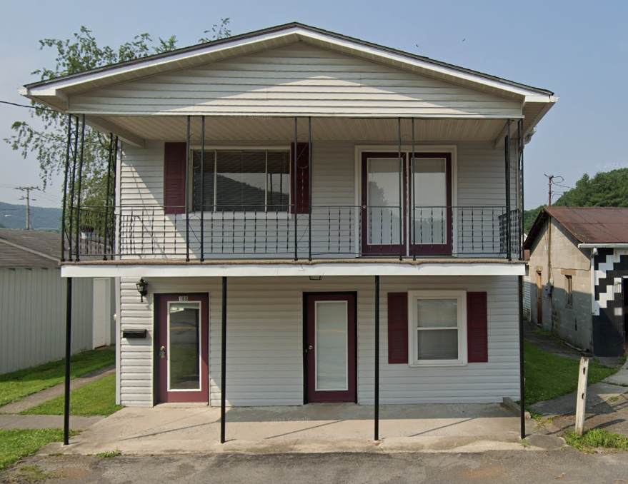
Rainelle Unmitigated
First Floor Height (FFH) BELOW FEMA 1-percent chance (100-yr) flood
First Floor BELOW 2016 HWM; 1%+,0.2-percent chance (500-yr) floods
 | HEIGHT (ft.)
BUILDING
First Floor Height | 0.0
Freeboard (FBD) | 2.0
FLOOD DEPTH
FSF 20% (5-Yr) | 2.1
FEMA 1% (100-Yr) | 4.0
FEMA 100-Yr + FBD | 6.0
FSF 1% (100-Yr) | 8.1
2016 Flood HWM | 8.3
FEMA 0.2% (500-Yr) | 9.9
FEMA 1%+ (Climate) | 10.1
FSF 0.2% (500-Yr) | 12.1
12.1’ (FSF 0.2% / 500-Yr)
9.9’ (FEMA 0.2% / 500-Yr )
10.1’ (FEMA 1%+; Climate)
8.1’ (FSF 1% / 100-Yr)
8.3’ (2016 High Water)
6.0’ (FEMA 1% / 100-Yr + 2’ FBD)
4.0’ (FEMA 1% / 100-Yr)
2.1’ (FSF 1% / 100-Yr)
166 7th Street, Rainelle, WV, 25962
Building 13-13-0001-0047-0000_166
FLOOD DEPTHS:
FEMA
First Street Foundation (FSF)
USGS 2016 Flood High Water Mark

Slide 3
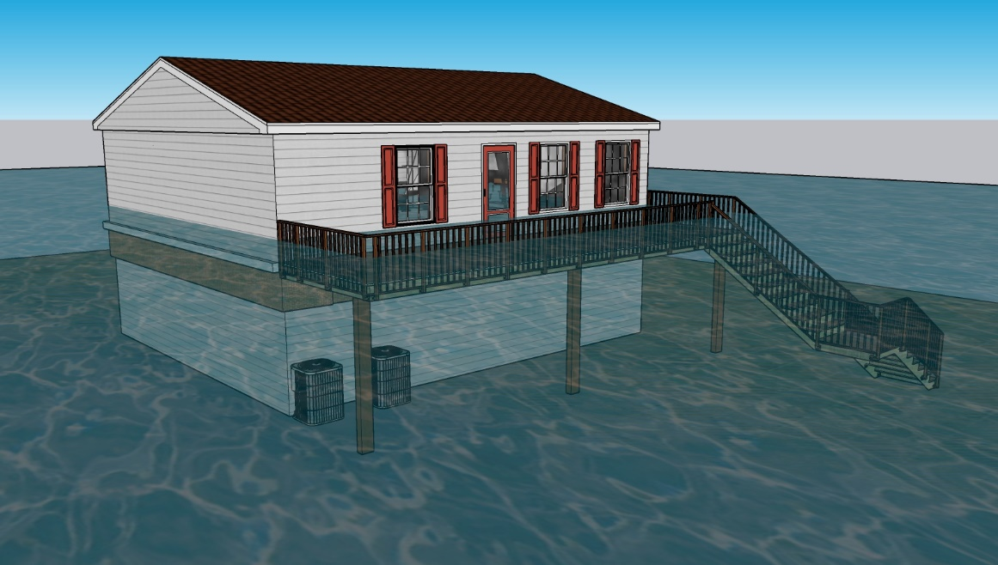
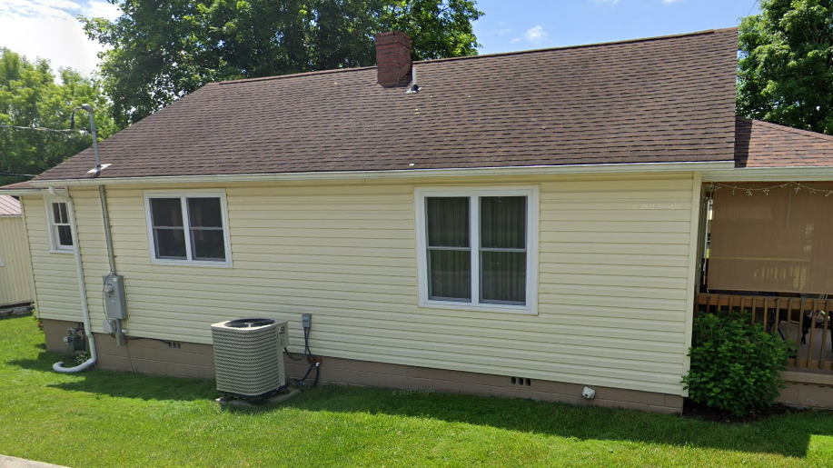
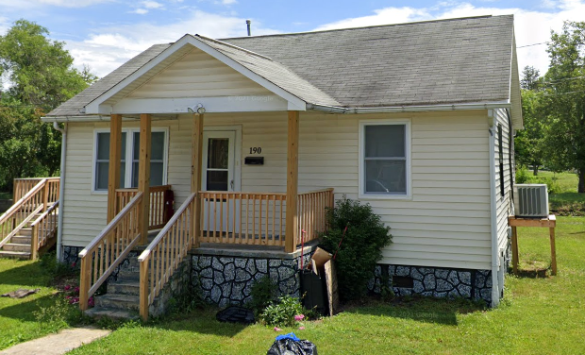
Partial Mitigation
Elevated
No flood vents
Mechanicals at ground level
Flood vents < 1ft from ground
Elevated (potentially to BFE), but not to DFE (highest depth for structure = 2.5 ft)
Mechanicals at ground level
354 Horton Ave. E, Rainelle, WV, 25962
Some flood vents < 1 ft from ground
Some vents > 1ft from ground; Elevated but not to BFE (3.4 ft)
Mechanicals at ground level
Flood vents < 1 ft from ground
Mechanicals elevated
Elevated, but not to BFE (3.9 ft)
184 Central Venue, White Sulphur Springs, WV, 24986
190 Crescent Avenue, White Sulphur Springs, WV, 24986

