Slide 1
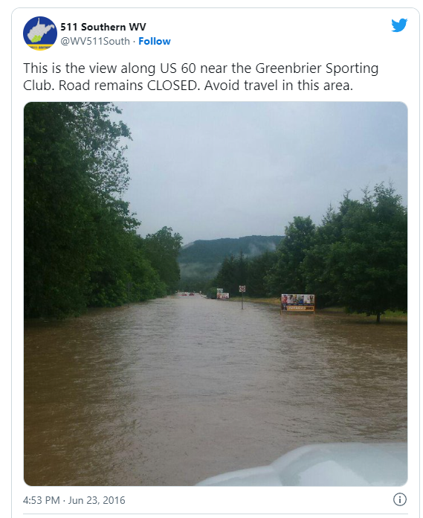
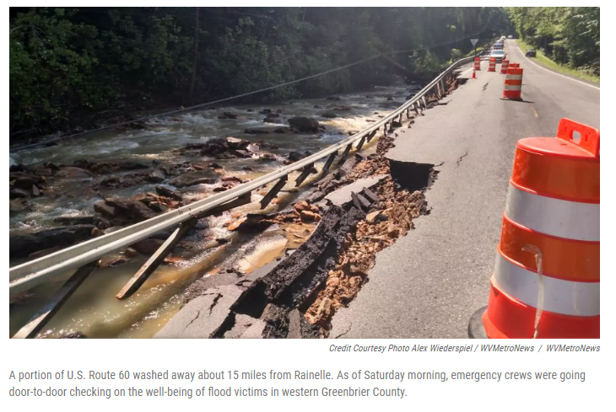
Transportation
One hundred twenty-three bridges were damaged, and five were destroyed. Floodwaters closed 250 roads were closed, and pavement washed out on 1,300 separate sites.
Source: WV DOT Remembering the 2016 flood five years on Flood (2021)
Source: WV Public Broadcasting 2016

