Slide 1
Mitigation Measures
Category | Mitigation Indicator | White Sulphur Springs | Rainelle
Mitigated Structures | Mitigation Reconstruction or Elevated Structures to Design Flood Elevation (DFE) | 14 | 39
 | Rehabilitated/Repaired Structures | 394 | 278
 | Unmitigated Low Value Structures | 14 | 47
 | Structures Removed (vacant parcel) | 49 | 41
Open Space Preservation | Buyout Parcels (Deed Restricted) | 16 | 18
 | Community-Owned Vacant Parcels | 66 | 88
 | Area of Open Space Preservation (OSP) | 5 Acres | 3 Acres
 | Ratio of Open Space Preservation (OSP to SFHA) | 2.6% | 4.5%
Building Value Recovery | Net Value 2016-2022 Tax Assessment Value | + $6.1 Million | - $1.0 Million
Loss Avoidance 100-year Flood | Loss Avoidance by Elevating or Removing Structures (preliminary results) | $2.6 million | $2.3 million

Slide 2
Mitigation Measures (continued)
Category | Mitigation Indicator | White Sulphur Springs | Rainelle
Resiliency to Future Floods | Percent Residential Structures in 100-year floodplain elevated to Design Flood Elevation (DFE) | 58% | 30%
Higher Standards | Freeboard (safety elevation factor above BFE) | 2 ft. | 2 ft.
 | Community Rating System (above min. requirements) | No | No
Floodplain Management | Incorporated Place a compacted floodplain management area to enforce floodplain ordinance | Yes | Yes
 | Continuity of operations and immediate response to disasters | ? | ?
 | Record keeping (permits, EC’s, substantial damage) | ? | ?
Flood Insurance | Number of Policies 2019 | 133 | 44
Risk Communications | Flood Risk Disclosure Laws in West Virginia | F grade | F grade
 | Outreach to property owners about changes to flood maps (mapped in/mapped out of SFHA) | ? | ?

Slide 3
Floodplain Building Value Recovery
COMMUNITY | 2015 | 2016 | 2017 | 2018 | 2019 | 2020 | 2021 | 2022
Rainelle (n=326) | 13.1 Million | 13.3 Million | 5.0 Million | 9.4 Million | 11.0 Million | 11.1 Million | 11.3 Million | 12.3 Million
White Sulphur Springs (n=409) | 22.6 Million | 23.0 Million | 13.4 Million | 21.5 Million | 22.4 Million | 22.9 Million | 26.2 Million | 29.2 Million
Source: Tax assessment database. May not include values for tax exempt properties.

Slide 4
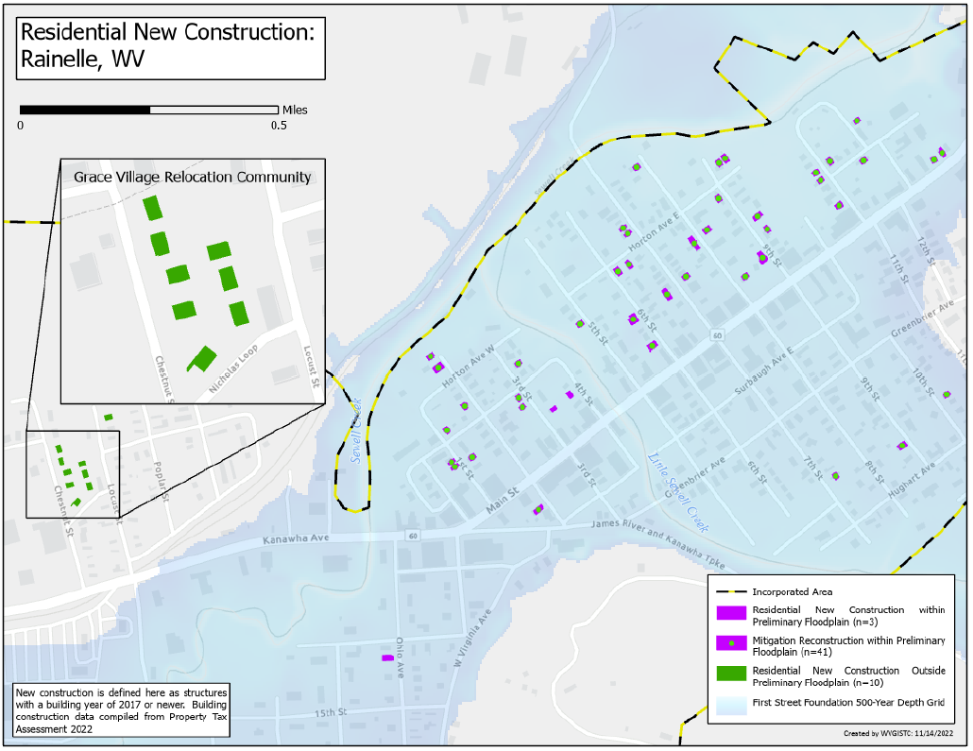
Rainelle Relocation Community

Slide 5
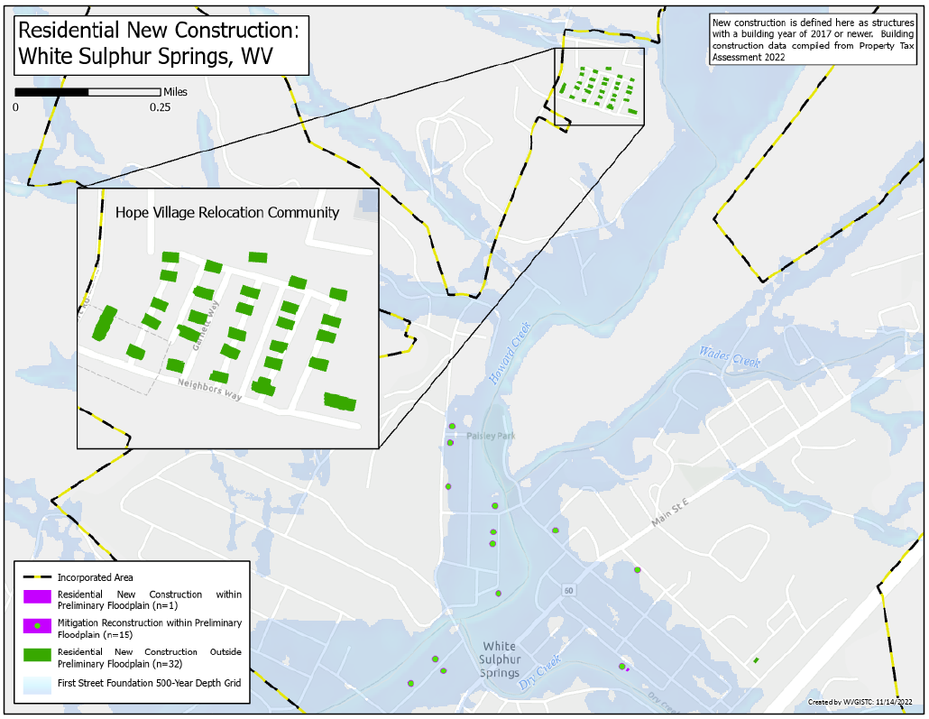
WSS Relocation Community

Slide 6
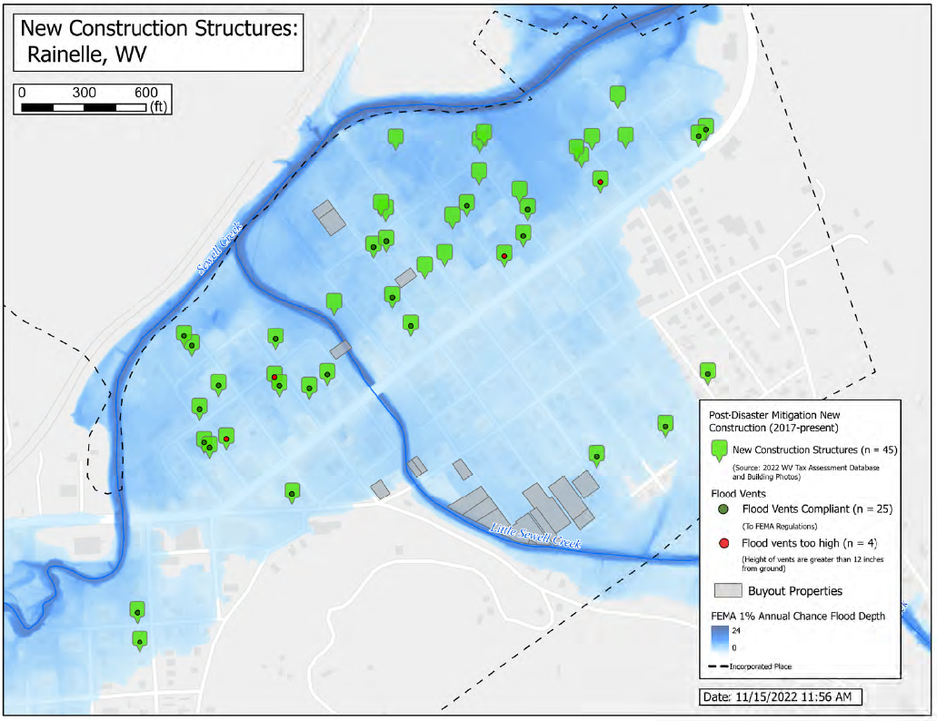
Rainelle Mitigated Properties

Slide 7
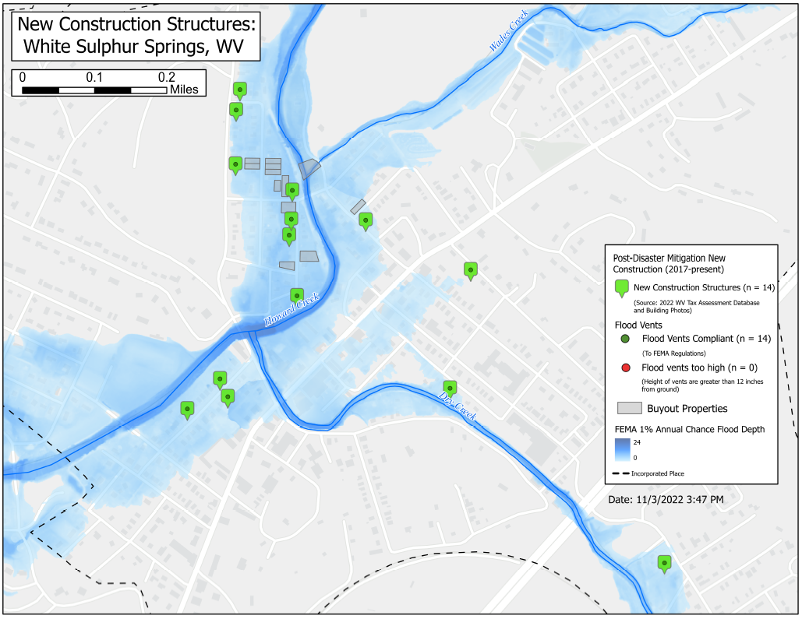
WSS Mitigated Properties

Slide 8
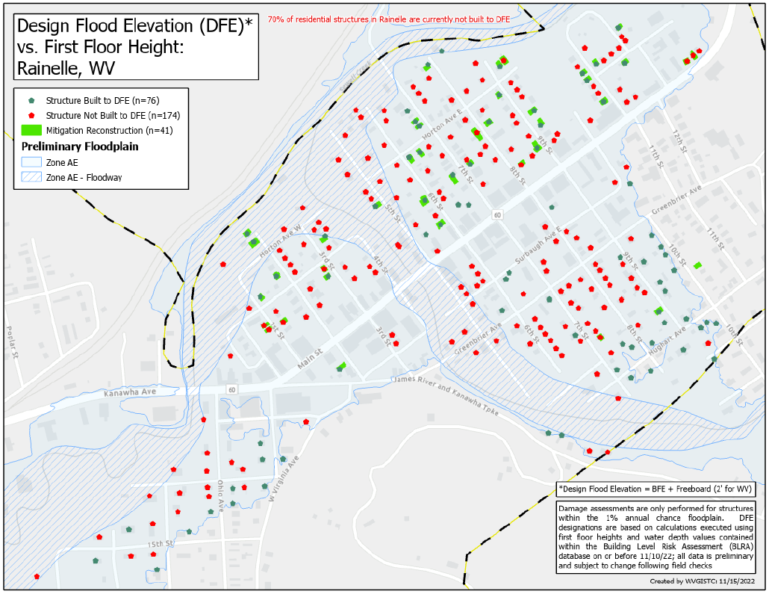
Building Design Flood Elevation

Slide 9
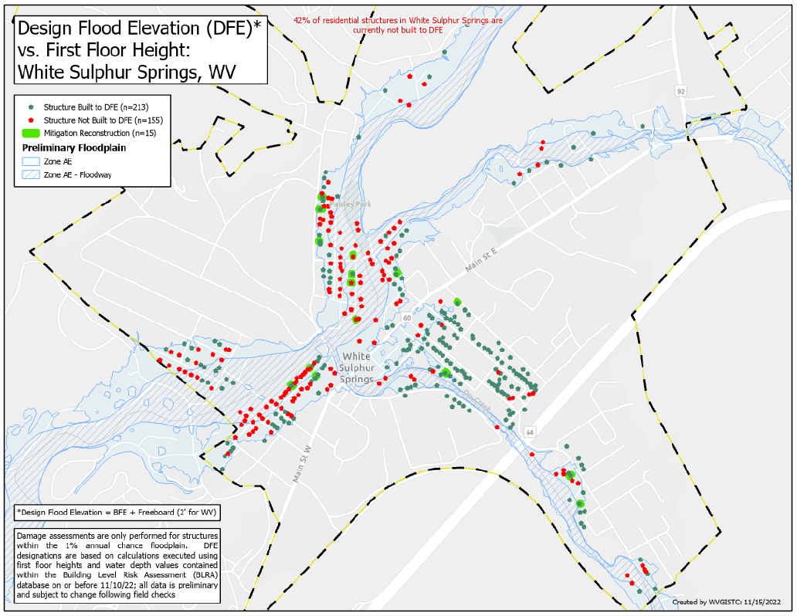
Building Design Flood Elevation

Slide 10
Rainelle Mitigation Reconstruction
First Floor Height ABOVE 2016 Flood HWM; 1-percent chance (100-yr) flood
First Floor Height BELOW 1%+, 0.2-percent chance (500-yr) floods
 | HEIGHT (ft.)
BUILDING
First Flood Height | 9
Freeboard (FBD) | 2
FLOOD DEPTH
FSF 20% (5-Yr) | 2.3
FEMA 1% (100-Yr) | 3.9
FEMA 100-Yr + 2.0 Ft. Freeboard | 5.9
2016 Flood HWM | 6.5
FSF 1% (100-Yr) | 8.2
FEMA 1%+, 0.2% | 9.9
FSF 0.2% (500-Yr) | 12.2
Building 13-13-0001-0054-0000_182
12.2’ (FSF 0.2% / 500-Yr )
9.9’ (FEMA 1%+ / 100-Yr; 0.2%)
8.2’ (FSF 1% / 100-Yr)
6.5’ (2016 High Water)
5.9’ (FEMA 1% + 2’ FBD)
3.9’ (FEMA 1% / 100-Yr)
2.3’ (FSF 20% / 5-Yr)
The Design Flood Elevation (DFE) should be the BFE plus 2 feet of freeboard. The DFE should also be above the high-water marks of the 2016 flood plus freeboard.
182 Seventh Street, Rainelle, WV, 25962
FLOOD DEPTHS:
FEMA
First Street Foundation (FSF)
USGS 2016 Flood High Water Mark

Slide 11
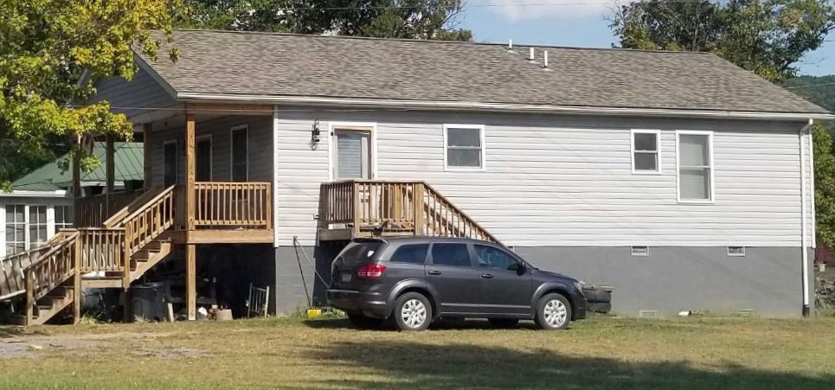
WSS Mitigation Reconstruction
First Floor Height (FFH) ABOVE 1-percent chance (100-yr) flood
First Floor BELOW 2016 HWM; 1%+,0.2-percent chance (500-yr) floods
 | HEIGHT (ft.)
BUILDING
First Flood Height | 6.4
Freeboard (FBD) | 2.0
FLOOD DEPTH
FSF 20% (5-Yr) | 3.4
FEMA 1% (100-Yr) | 5.4
FSF 1% (100-Yr) | 5.7
FEMA 1%+; Climate (BFE + 1ft) | 6.4
2016 Flood HWM | 6.5
FEMA 0.2% (500-Yr) | 7.2
FEMA 100-Yr + FBD | 7.4
FSF 0.2% (500-Yr) | 7.4
7.2’ (FEMA 0.2% / 500-Yr )
7.4’ (FEMA 1% / 100-Yr + 2’ FBD)
7.4’ (FSF 0.2% / 500-Yr)
6.5’ (2016 High Water)
6.4’ (FEMA 1%+; Climate BFE+1)
5.4’ (FEMA 1% / 100-Yr)
Building 13-17-0009-0026-0000_138
3.4’ (FSF 20% / 5-Yr)
138 Mill Street, White Sulphur Springs, WV, 24986
FLOOD DEPTHS:
FEMA
First Street Foundation (FSF)
USGS 2016 Flood High Water Mark

Slide 12
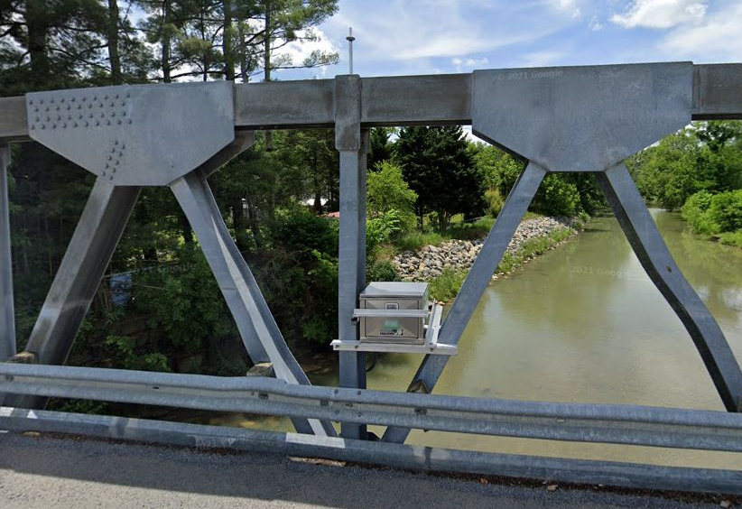
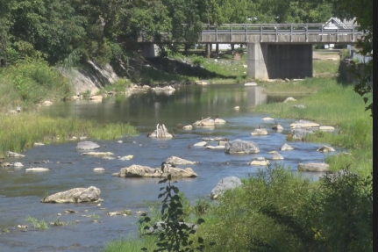
New Streamgages
in White Sulphur Springs

Slide 13
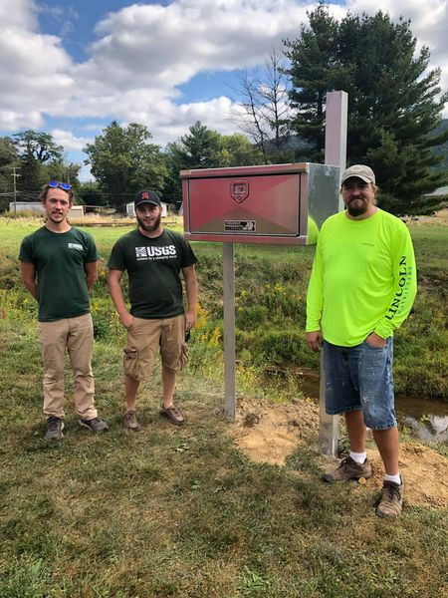
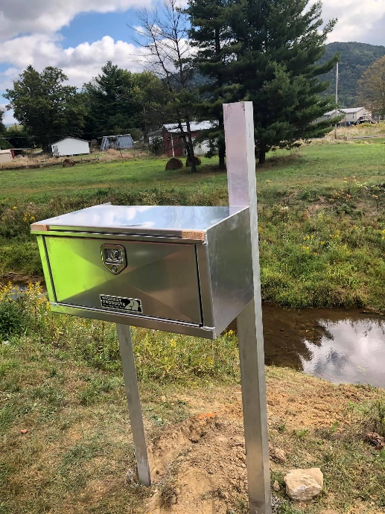
New Streamgages
in Rainelle

Slide 14
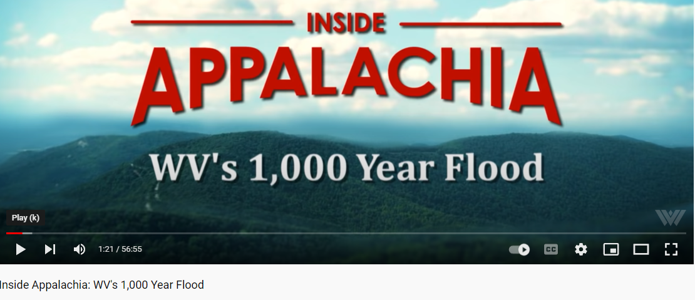
Thousand Year Flood?
WVNSTV 2021
WV Public Broadcasting 2016
WVNSTV 2022
Some websites like MH3WV clarify it as a 1,000-year rainfall event according to the NWS

Slide 15
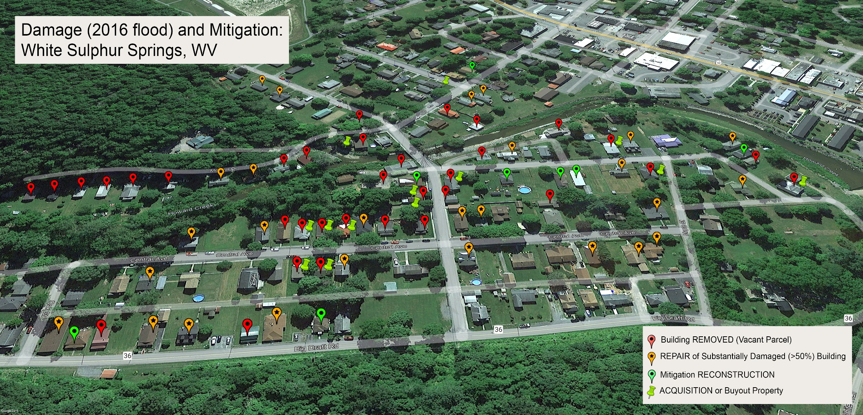
Damage (2016 Flood) and Mitigation
Central Ave., White Sulphur Springs

Slide 16
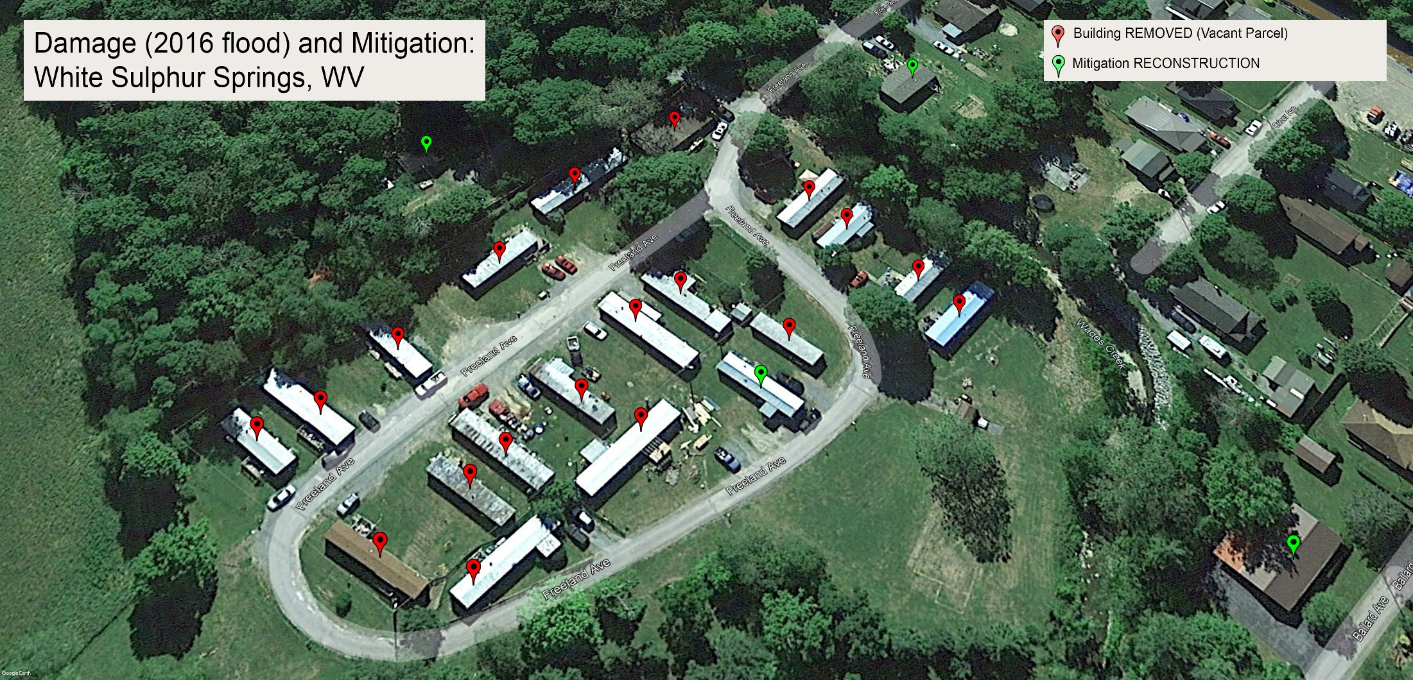
Damage (2016 Flood) and Mitigation
Freeland Ave., White Sulphur Springs

Slide 17
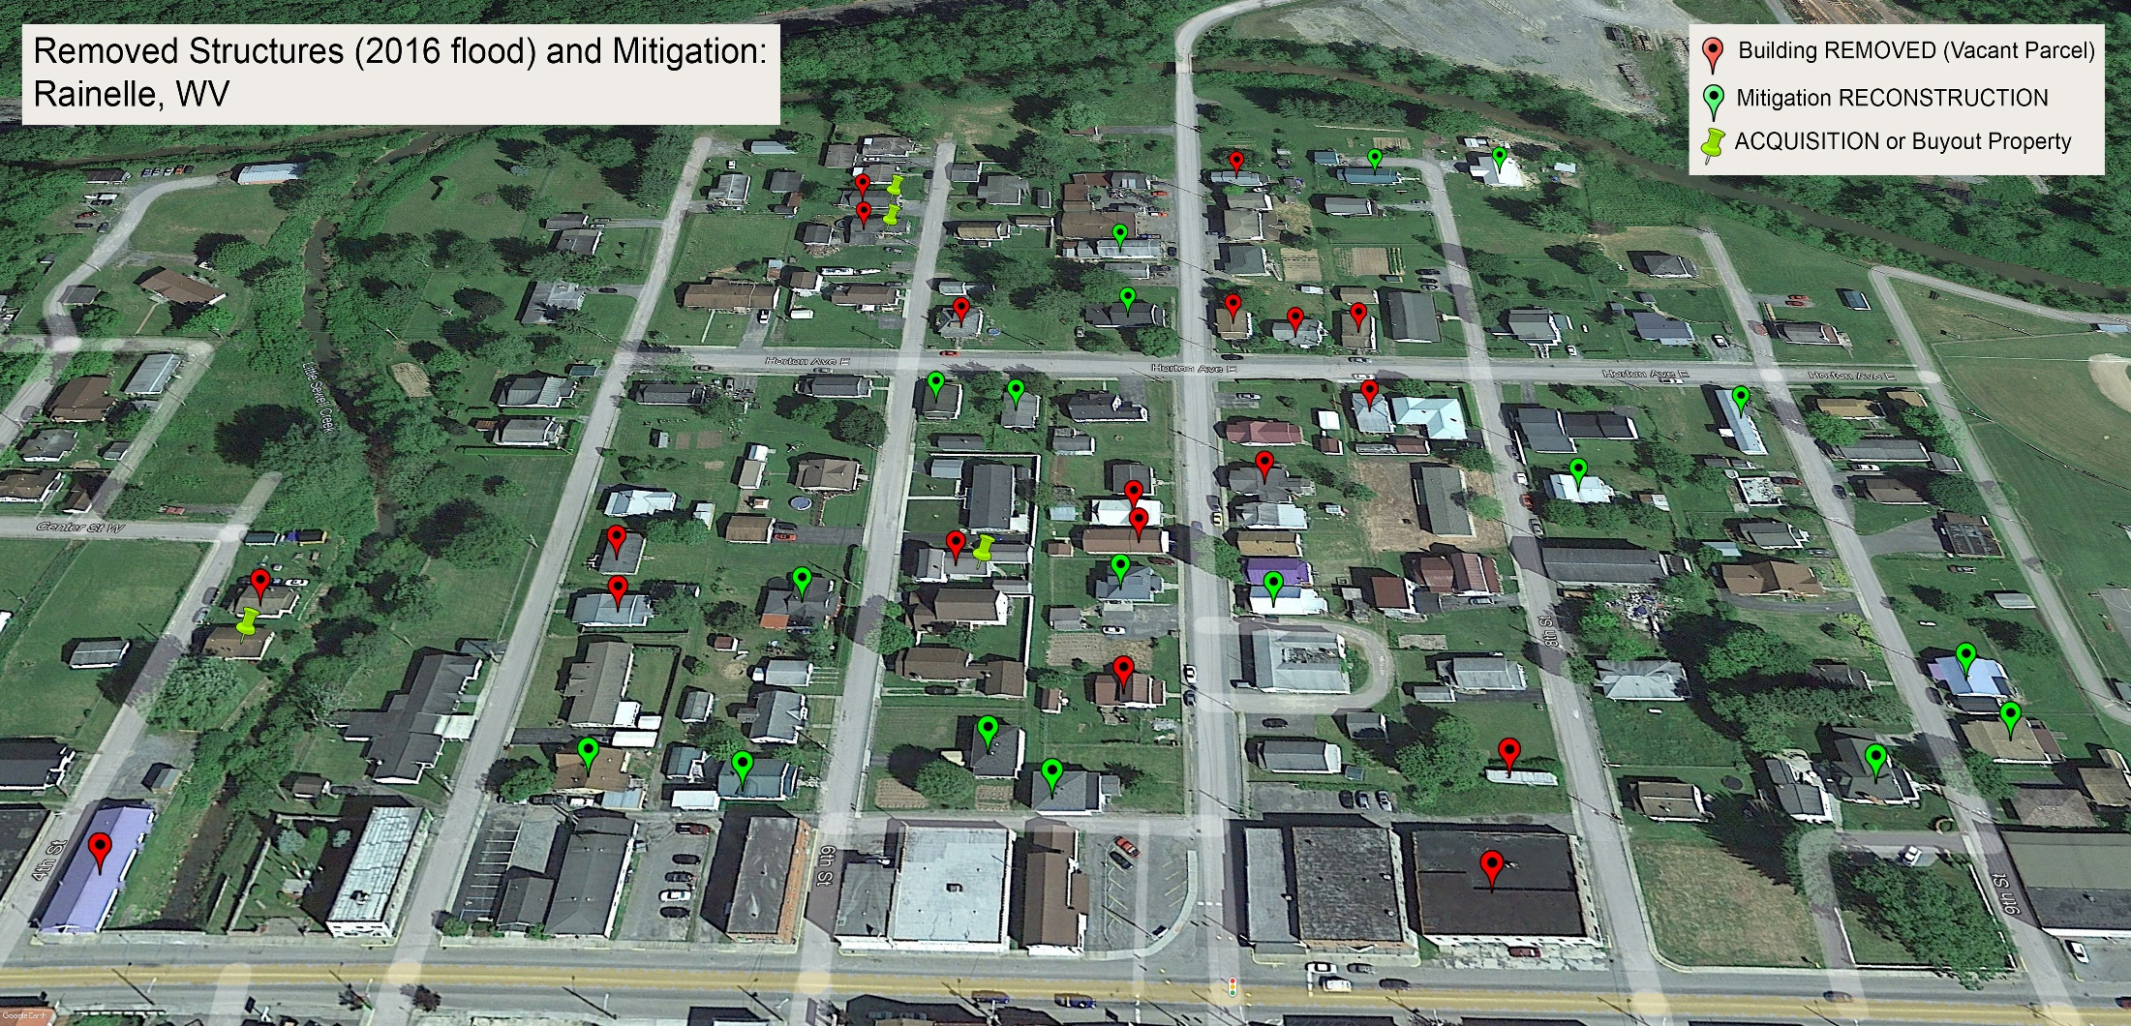
Removed Structures (2016 Flood) and Mitigation
7th St, Rainelle

Slide 18
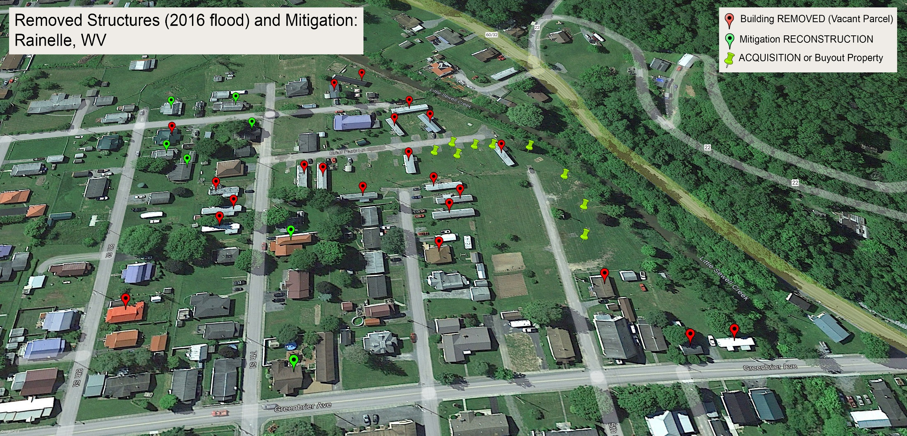
Removed Structures (2016 Flood) and Mitigation
Greenbrier Ave., Rainelle

Slide 19
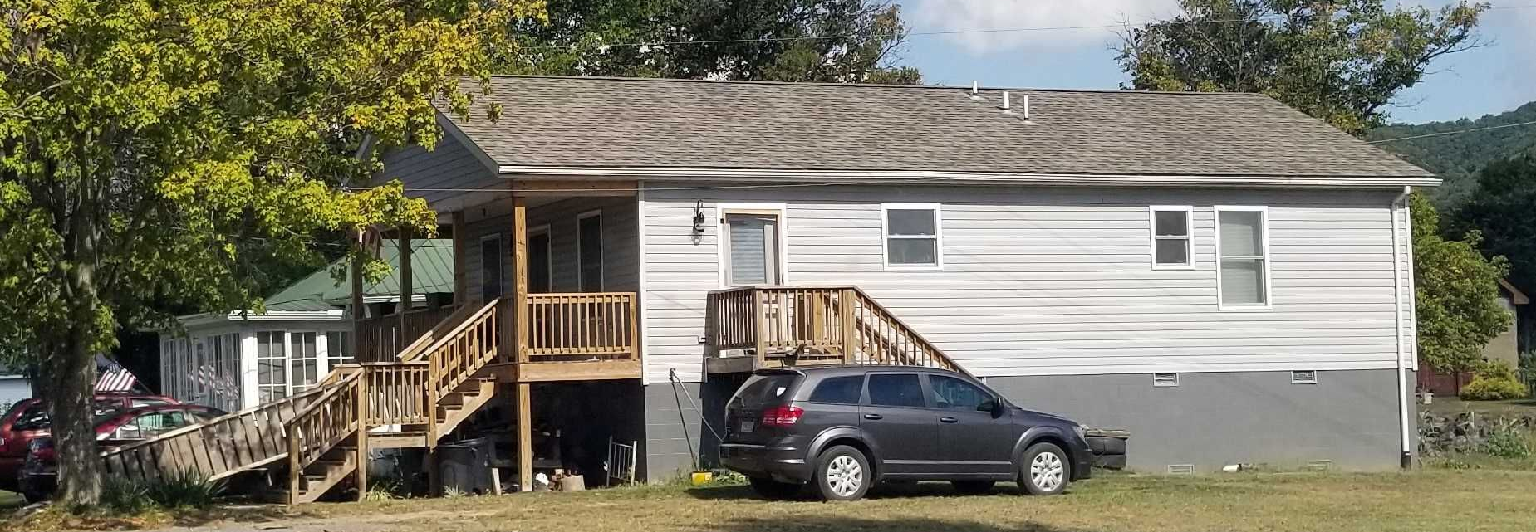
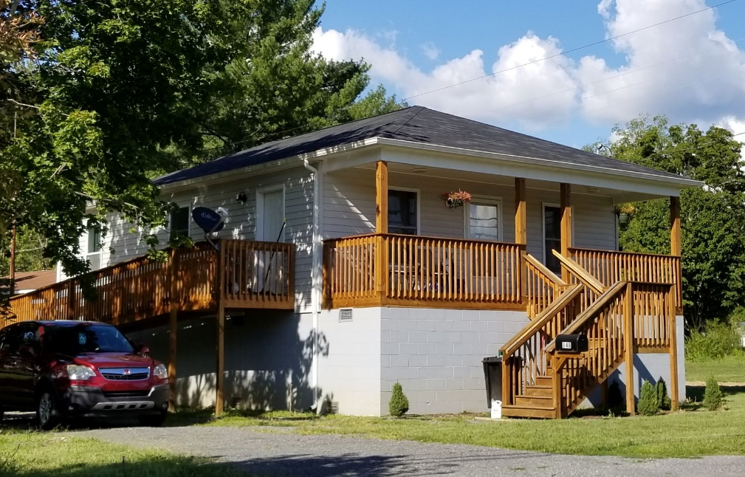
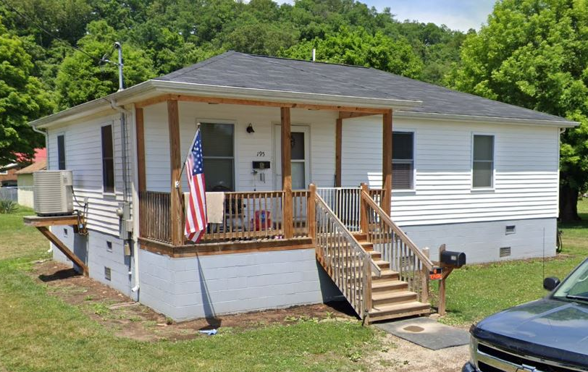
Examples of Mitigation Reconstruction
in White Sulphur Springs
Building ID: 13-17-0009-0009-0000_148
Flood Tool Link
Building ID: 13-17-0009-0009-0000_148
Flood Tool Link
Building ID: 13-17-0008-0152-0000_195
Flood Tool Link

Slide 20
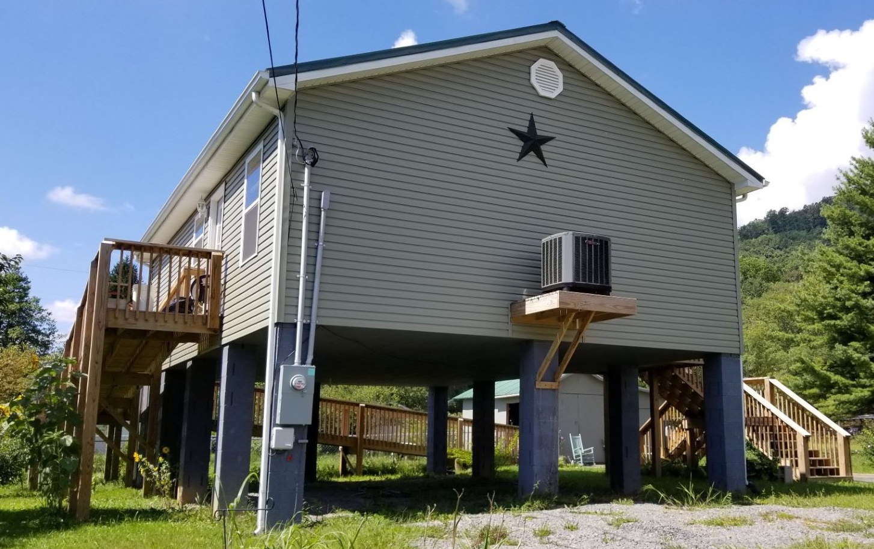
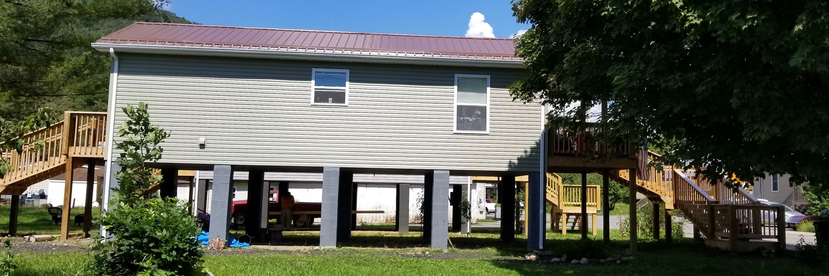
Example of Mitigation Reconstruction
in Rainelle
Building ID: 13-13-0005-0165-0000_256
Flood Tool Link
Building ID: 13-13-0001-0069-0000_108
Flood Tool Link
Building ID: 13-13-0001-0054-0000_182
Flood Tool Link

Slide 21
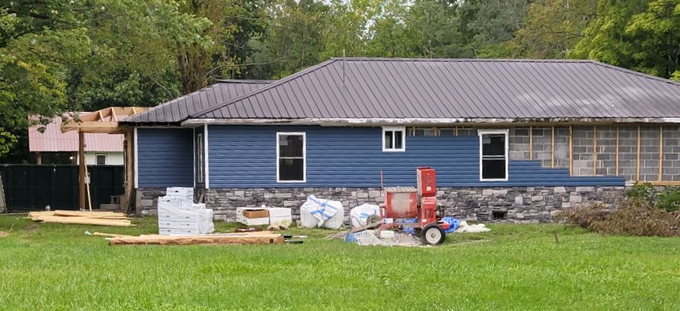
Unmitigated Example
in White Sulphur Springs
First Floor Height (FFH) BELOW FEMA 1-percent chance (100-yr) flood
First Floor BELOW 2016 HWM; 1%+,0.2-percent chance (500-yr) floods
 | HEIGHT (ft.)
BUILDING
First Floor Height | 2.0
Freeboard (FBD) | 2.0
FLOOD DEPTH
FSF 20% (5-Yr) | 0.0
FSF 1% (100-Yr) | 1.5
FSF 0.2% (500-Yr) | 3.4
FEMA 1% (100-Yr) | 4.0
2016 Flood HWM | 4.0
FEMA 1%+ (Climate) | 4.5
FEMA 0.2% (500-Yr) | 5.3
FEMA 100-Yr + FBD | 6.0
6.0’ (FEMA 1% / 100-Yr + 2’ FBD)
4.5’ (FEMA 1%+; Climate)
5.3’ (FEMA 0.2% / 500-Yr )
4.0’ (FEMA 1% / 100-Yr)
3.4’ (FSF 0.2% / 500-Yr)
4.0’ (2016 High Water)
1.5’ (FSF 1% / 100-Yr)
220 Central Avenue, White Sulphur Springs, WV, 24986
Building 13-17-0008-0139-0000_220
FLOOD DEPTHS:
FEMA
First Street Foundation (FSF)
USGS 2016 Flood High Water Mark

Slide 22
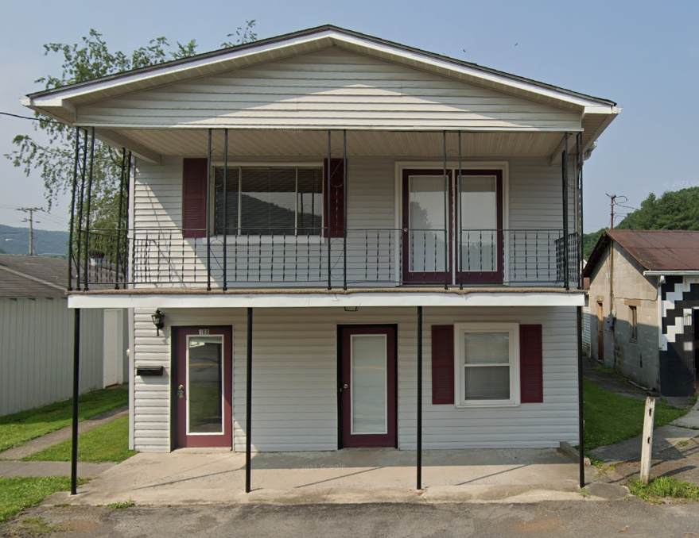
Unmitigated Example
in Rainelle
First Floor Height (FFH) BELOW FEMA 1-percent chance (100-yr) flood
First Floor BELOW 2016 HWM; 1%+,0.2-percent chance (500-yr) floods
 | HEIGHT (ft.)
BUILDING
First Floor Height | 0.0
Freeboard (FBD) | 2.0
FLOOD DEPTH
FSF 20% (5-Yr) | 2.1
FEMA 1% (100-Yr) | 4.0
FEMA 100-Yr + FBD | 6.0
FSF 1% (100-Yr) | 8.1
2016 Flood HWM | 8.3
FEMA 0.2% (500-Yr) | 9.9
FEMA 1%+ (Climate) | 10.1
FSF 0.2% (500-Yr) | 12.1
12.1’ (FSF 0.2% / 500-Yr)
9.9’ (FEMA 0.2% / 500-Yr )
10.1’ (FEMA 1%+; Climate)
8.1’ (FSF 1% / 100-Yr)
8.3’ (2016 High Water)
6.0’ (FEMA 1% / 100-Yr + 2’ FBD)
4.0’ (FEMA 1% / 100-Yr)
2.1’ (FSF 1% / 100-Yr)
166 7th Street, Rainelle, WV, 25962
Building 13-13-0001-0047-0000_166
FLOOD DEPTHS:
FEMA
First Street Foundation (FSF)
USGS 2016 Flood High Water Mark

Slide 23
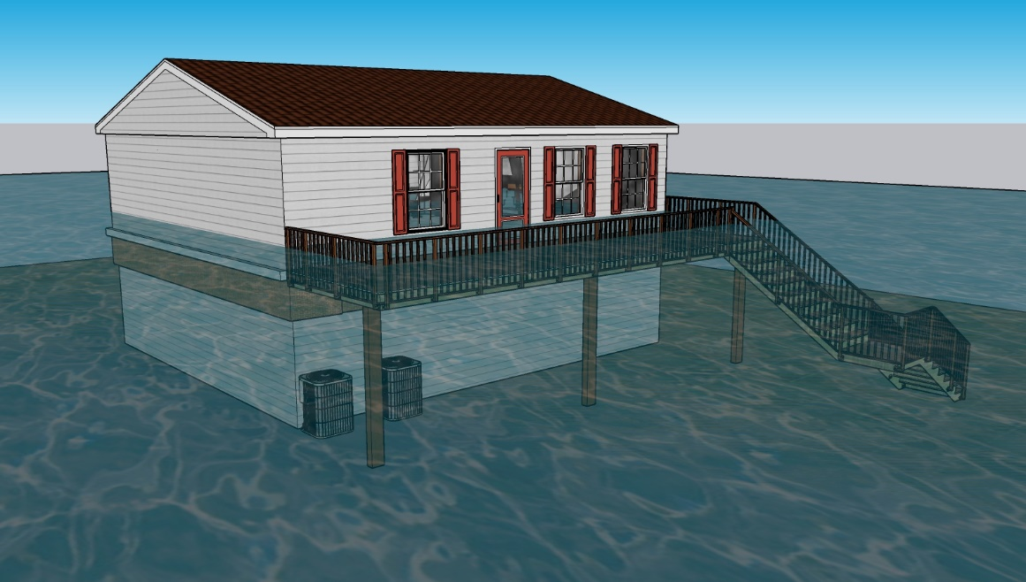
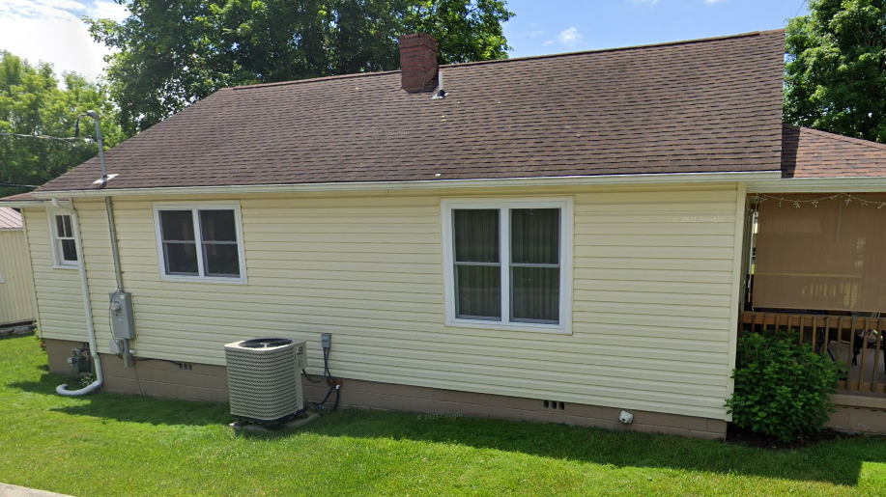
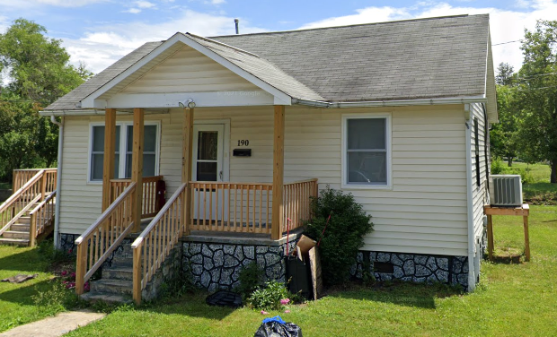
Partial Mitigation Examples
Elevated
No flood vents
Mechanicals at ground level
Flood vents < 1ft from ground
Elevated (potentially to BFE), but not to DFE (highest depth for structure = 2.5 ft)
Mechanicals at ground level
354 Horton Ave. E, Rainelle, WV, 25962
Some flood vents < 1 ft from ground
Some vents > 1ft from ground; Elevated but not to BFE (3.4 ft)
Mechanicals at ground level
Flood vents < 1 ft from ground
Mechanicals elevated
Elevated, but not to BFE (3.9 ft)
184 Central Venue, White Sulphur Springs, WV, 24986
190 Crescent Avenue, White Sulphur Springs, WV, 24986

Slide 24
Criteria, Rationale, and Data Sources
Mitigation Indicator | Criteria | Rationale | Data Source
Total Elevated Structures, Reconstruction to Design Flood Elevation (DFE) | Number of newly Constructed or remodeled structures elevated to Design Flood Elevation (DFE) (2 ft above the BFE) on open or closed foundations | A comprehensive inventory of mitigated structures results in more accurate building level risk assessments and shows how communities have applied flood adaptive measures in response to major flood events. | Elevation certificates, building pictures (step 7” rise, cinder block 8”), and major post-disaster mitigation reconstruction projects (1977 and 2016 floods)
Percent Structures Elevated to DFE in Total Residential Buildings | Percentage of the elevated structures in the total residential buildings in SFHA
Loss Avoidance by Elevating Structures | Difference between loss estimates in communities using the Hazus model with the first floor height of 1 ft (not elevated) and elevated to DFE (2 ft above BFE) | With significant investment being made in mitigation by elevating, demonstrating cost-effectiveness is crucial for continued support. Loss Avoidance Studies (LAS) quantify the losses avoided (also known as damage prevented or benefits) due to the implementation of the projects. | BLRA of 10/19/2022 (based on 2022 tax assessment), Total Exposure in Floodplain (TEIF), Building percent damage estimate values, Depth grids
Buyout Parcels | Number of verified buyout land parcels located within floodplains that experience frequent flooding and damage due to flood events altered, purchased, or have deed restrictions placed upon them by FEMA or other agencies | Buyout properties can prevent loss of life and property damage. Property owners/communities with public lands in floodplains are compensated for their land, and the land usually becomes public green space or restored to its natural floodplain function. | Data of Natural Resources Conservation Service (NRCS) to identify the verified buyout parcels with floodplain easements

Slide 25
Criteria, Rationale, and Data Sources
Mitigation Indicator | Criteria | Rationale | Data Source
Area of Open Space Preservation (OSP) | Area of preserved open spaces with no existing buildings or structures, filling, large pavement, or other encroachment to flood flows located in the community’s regulatory floodplains including the SFHA as shown on the community’s Flood Insurance Rate Map (FIRM) attached with a signed statement by a public or creditable private owner or some regulations on the parcel preventing from construction, fillings, or other encroachments on flood flows in the future. | Open Space Preservation restores the floodplain to its natural function and provides opportunities for credits from FEMA’s Community Rating System (CRS). | Data of Natural Resources Conservation Service (NRCS) for buyout properties & FEMA FIRM (2012 & 2022)
Ratio of Open Space Preservation (OSP to SFHA) | Ratio of the preserved open spaces in the impact adjusted Special Flood Hazard Area (SFHA) (after removing waterbodies larger than 10 acres in addition to the federally owned lands).
Number of Policies | Number of flood insurance policies in force in the community | Although higher number of policies in force can equate to a riskier area, it can show more mitigation policies in force. | Community Information System (CIS) 2019

