Slide 1
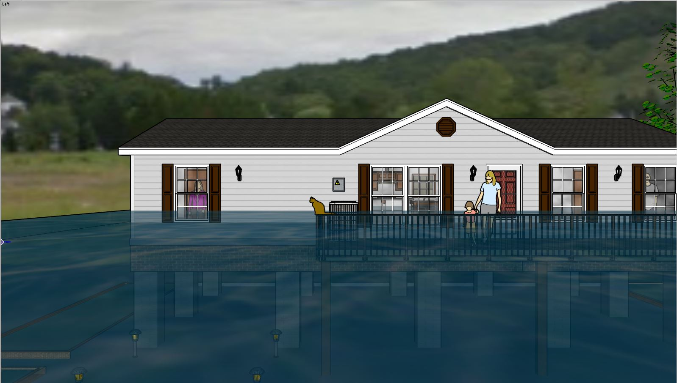
NEW RECONSTRUCTION
12.0’ (FSF 0.2%/500-Yr)
10.0’ (FEMA 1%/100-Yr)
8.0’ (FSF 1%/100-Yr)
6.0’ (FEMA 1%+2’FBD)
4.00’ (FEMA 1%/100-Yr)
2.00’ (FSF 20%/5-Yr)
GROUND LEVEL

Slide 2
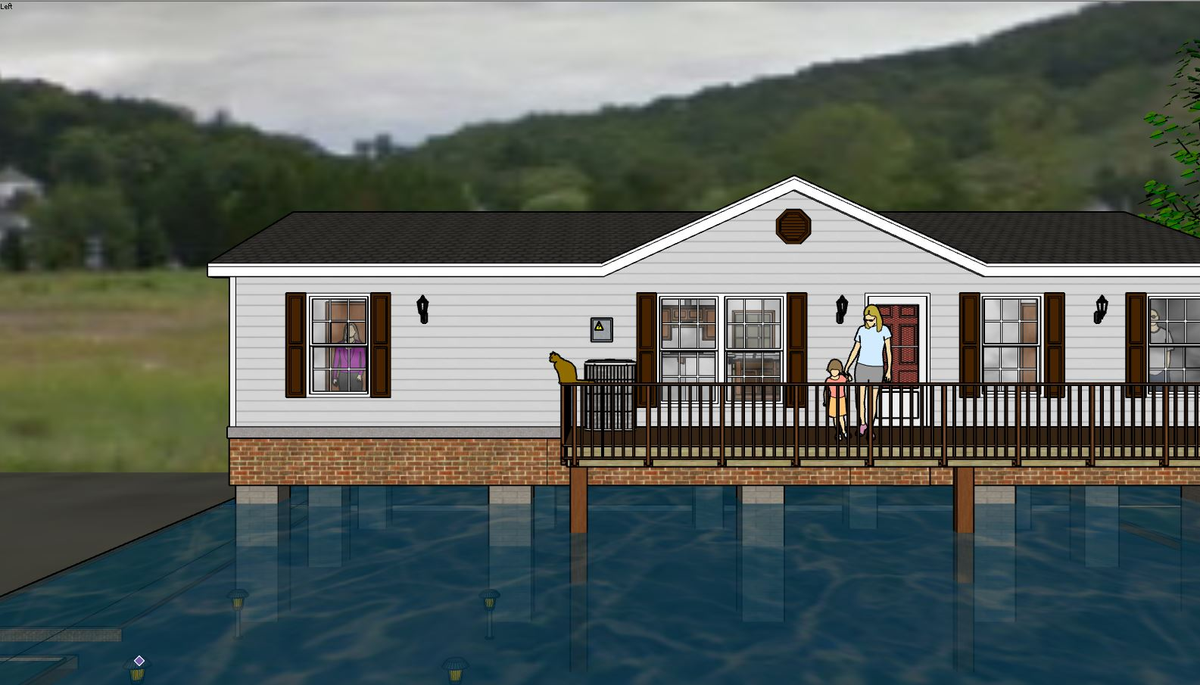
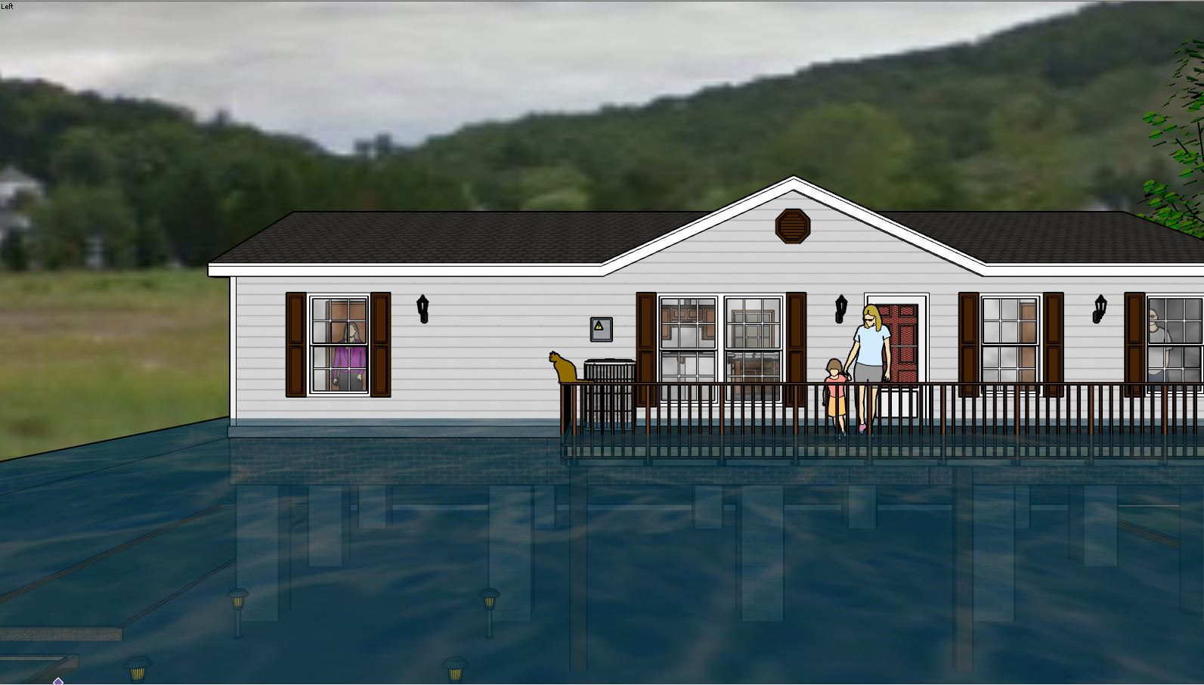
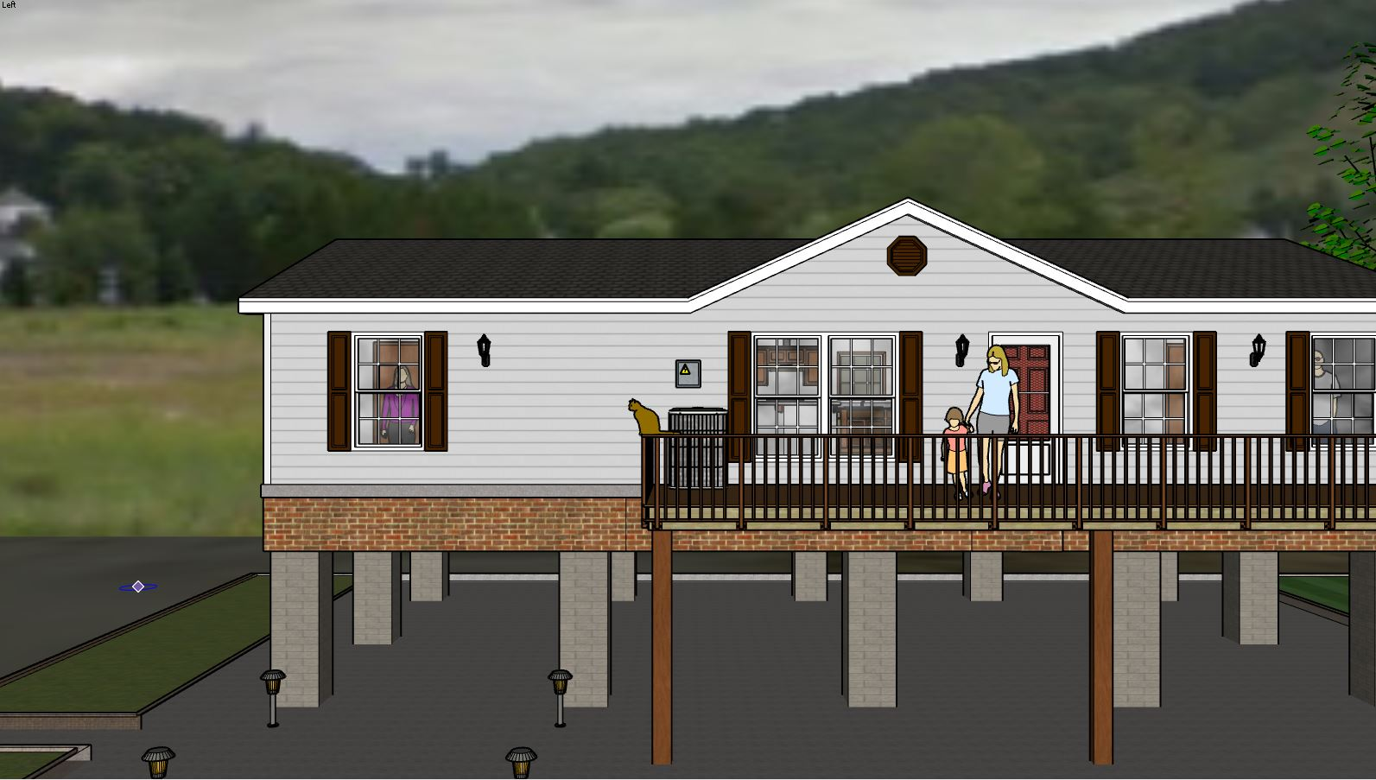
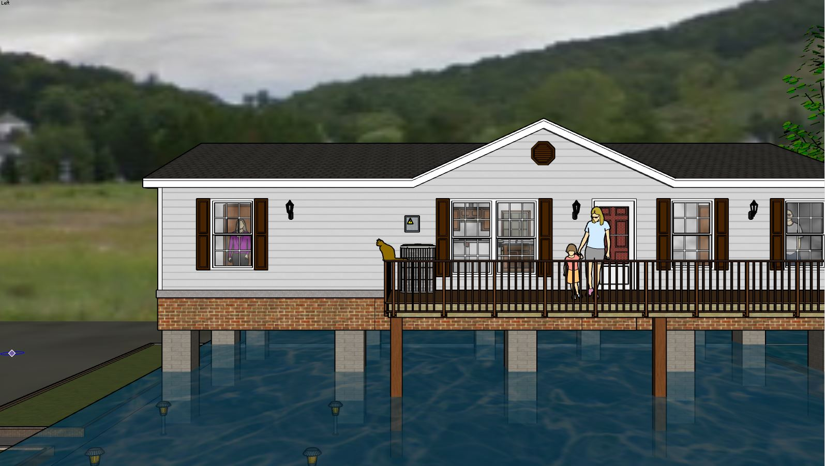
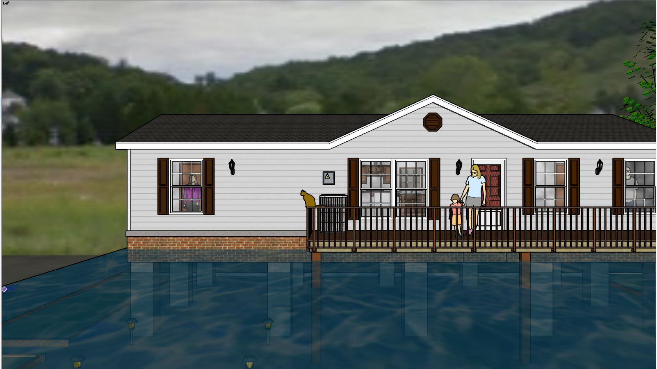
2 Feet Water Depth
4 Feet Water Depth
6 Feet Water Depth
8 Feet Water Depth
10 Feet Water Depth

