Slide 1
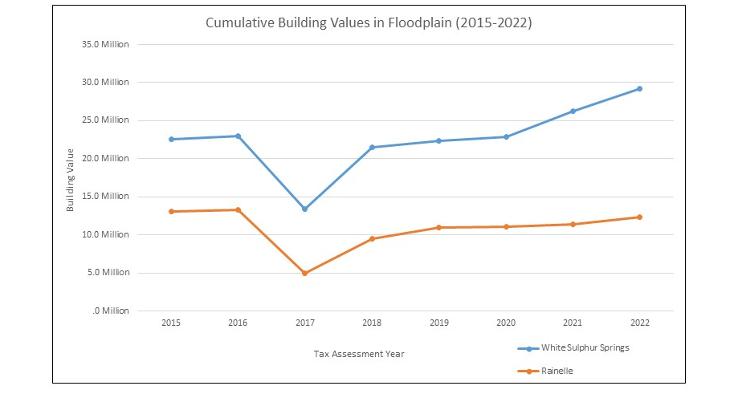
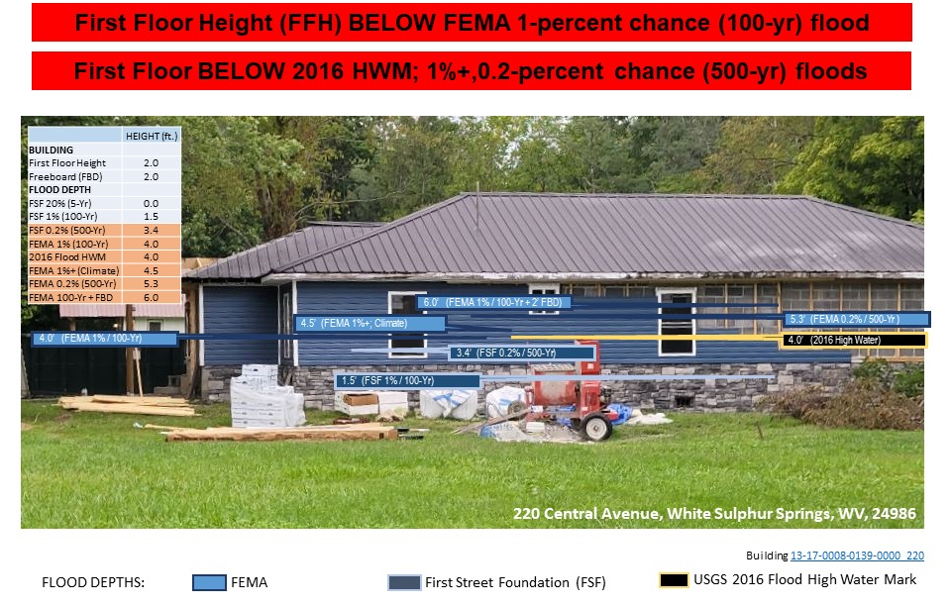
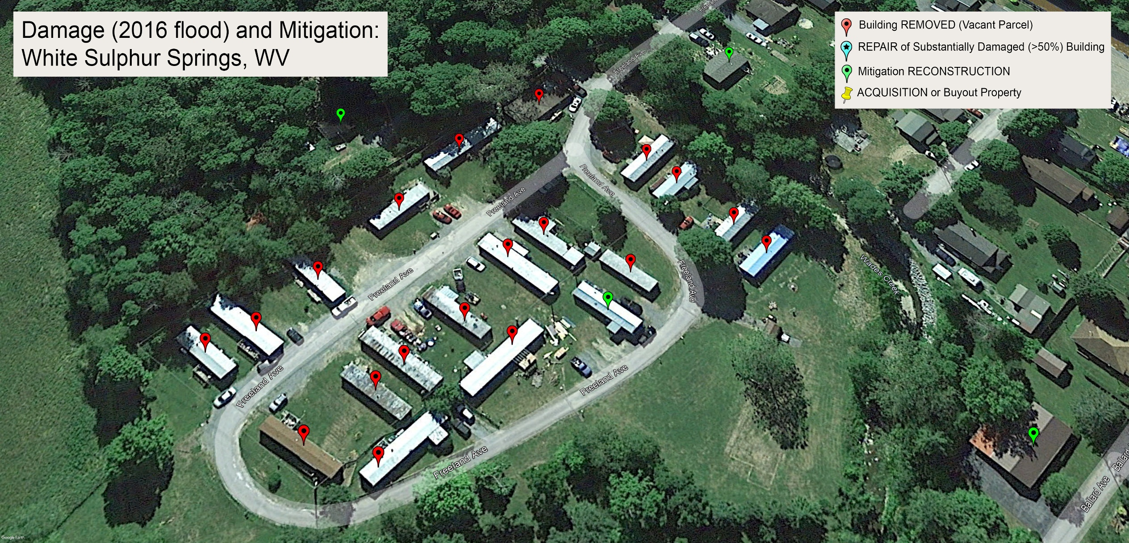
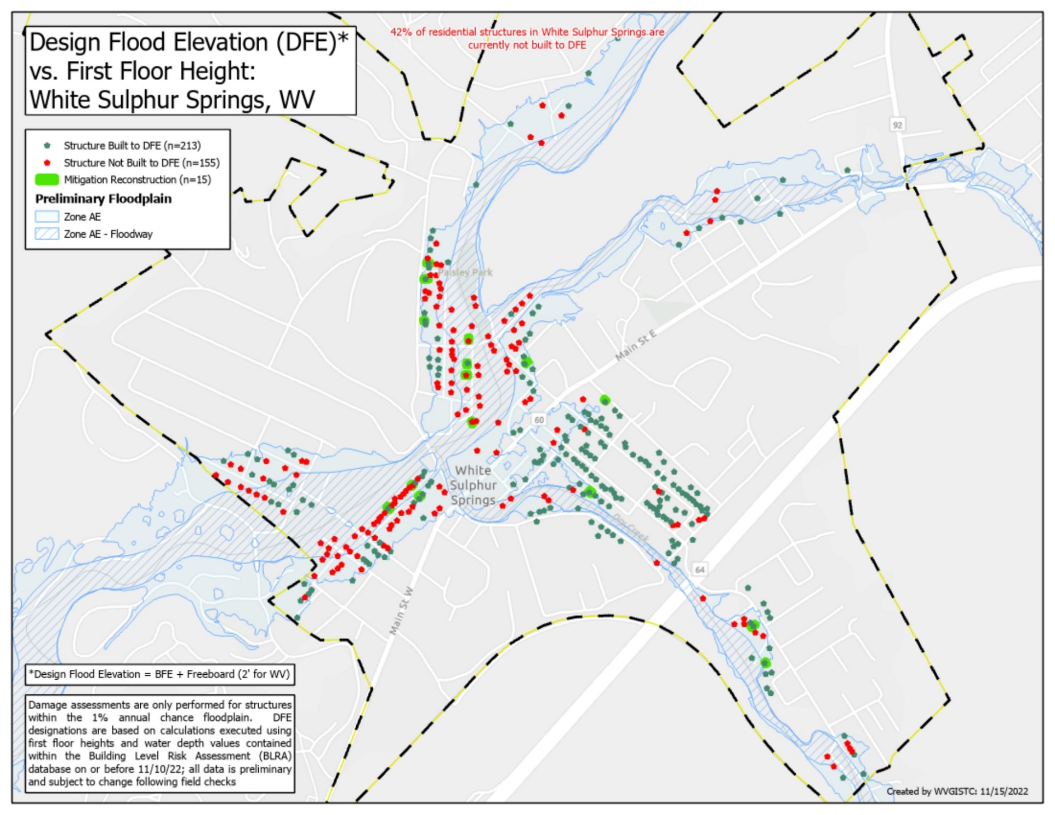
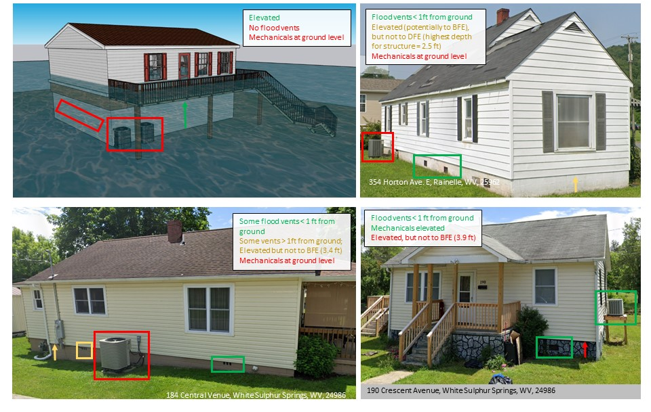
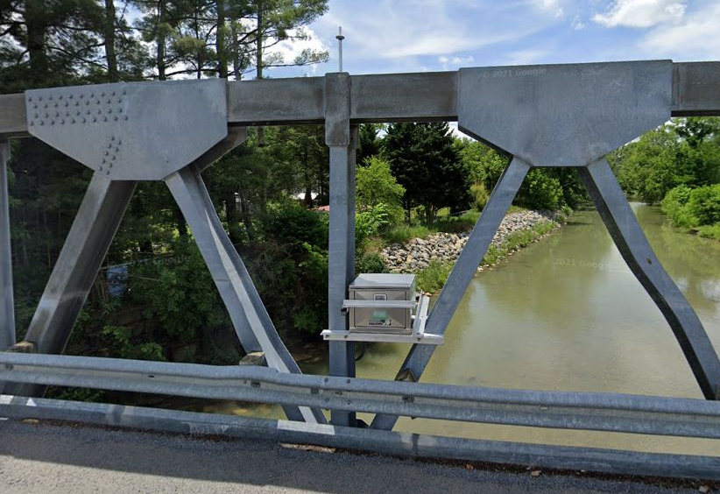
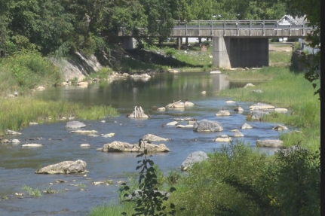
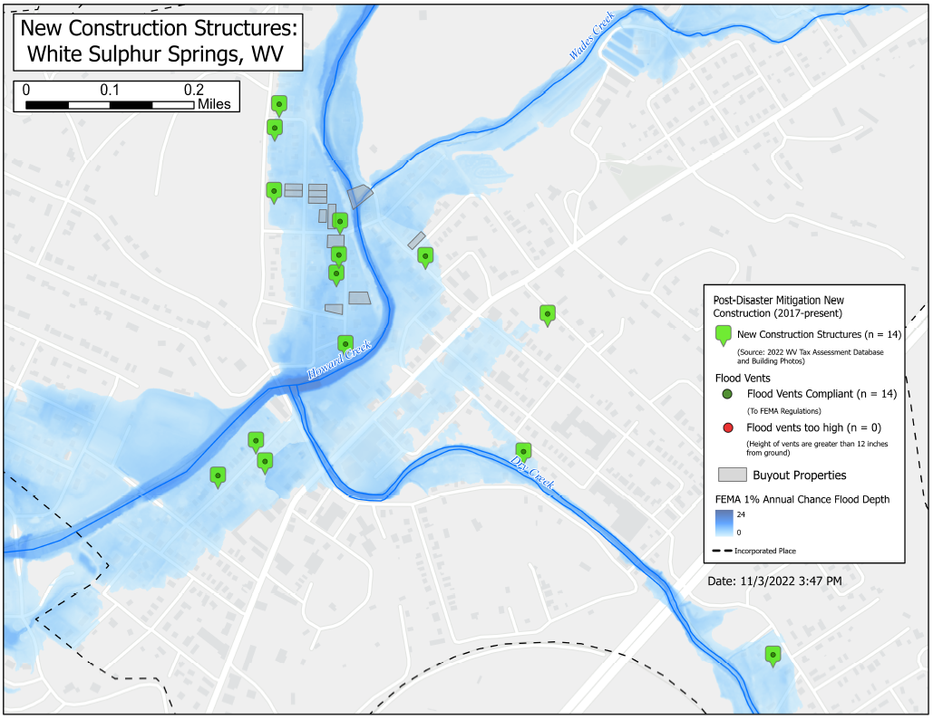
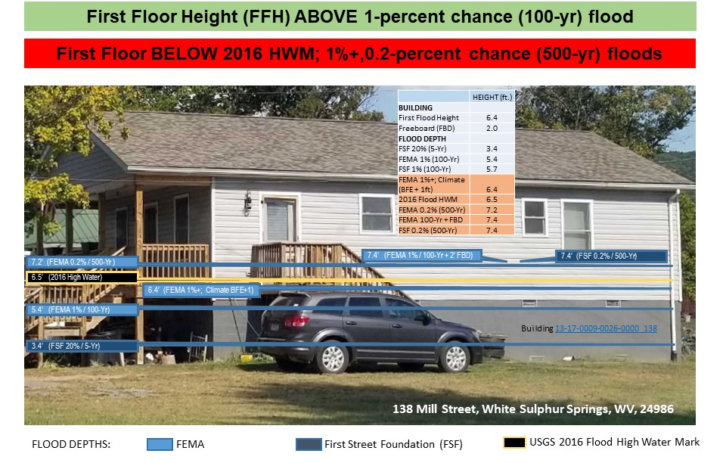

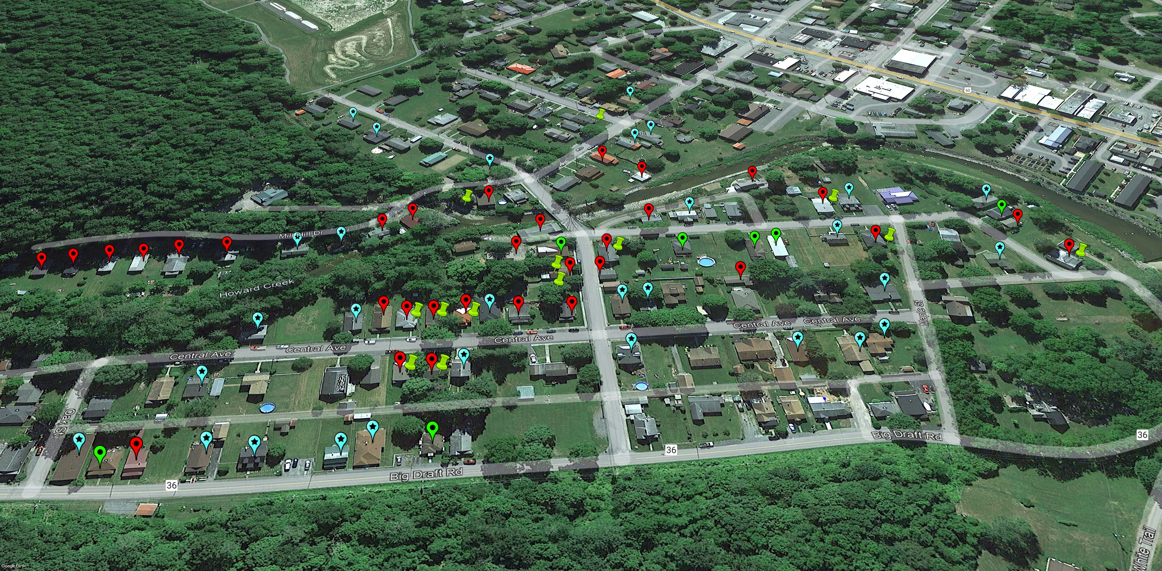
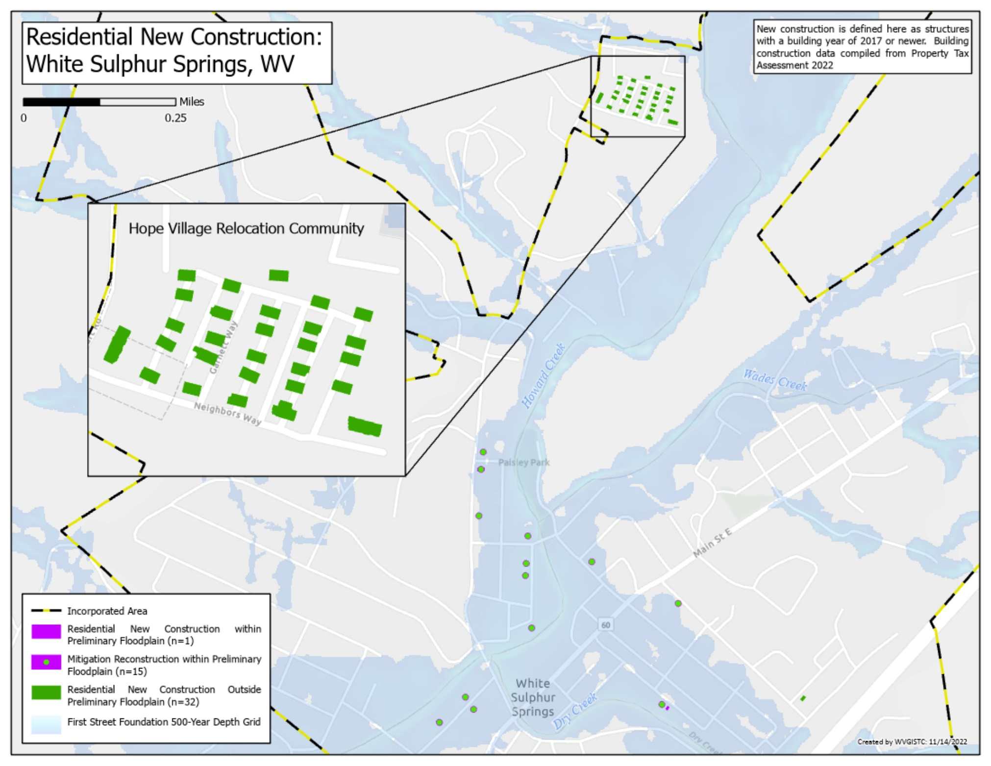
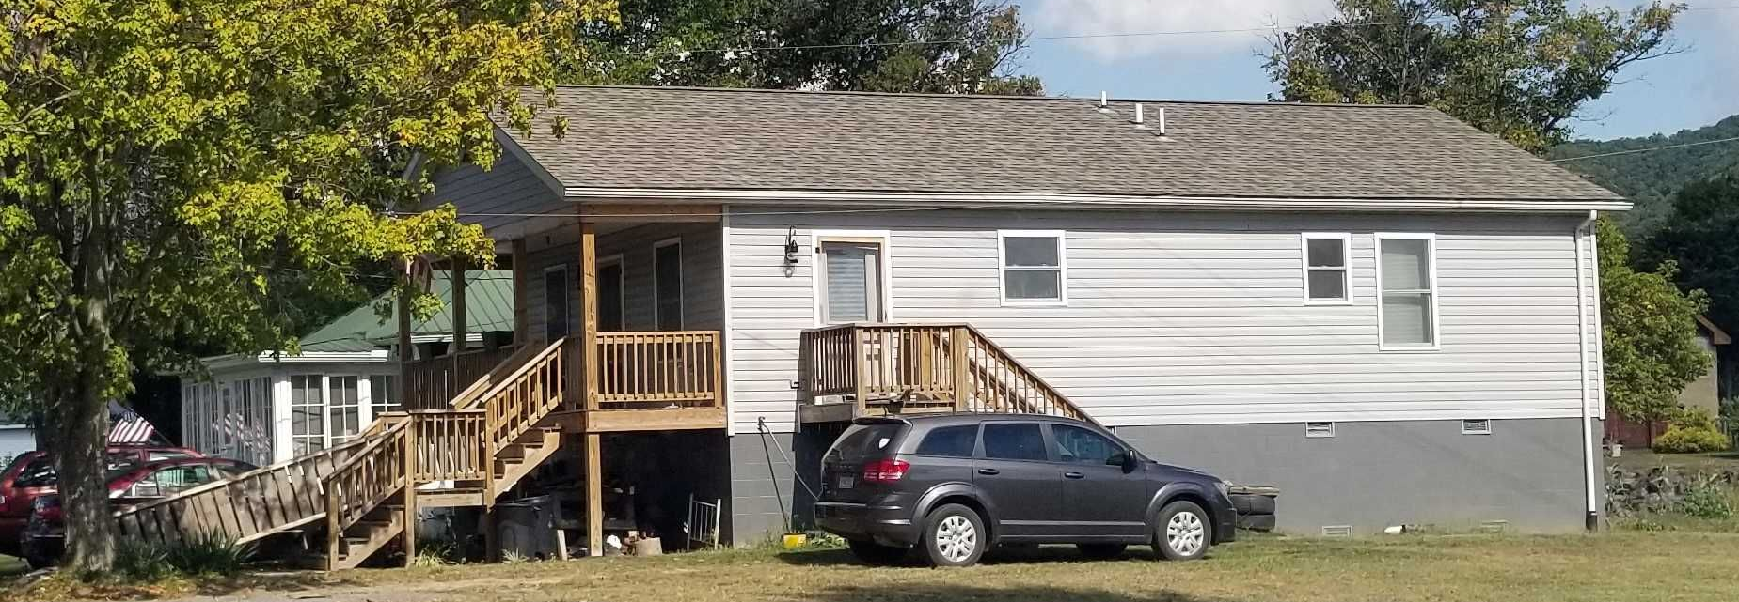
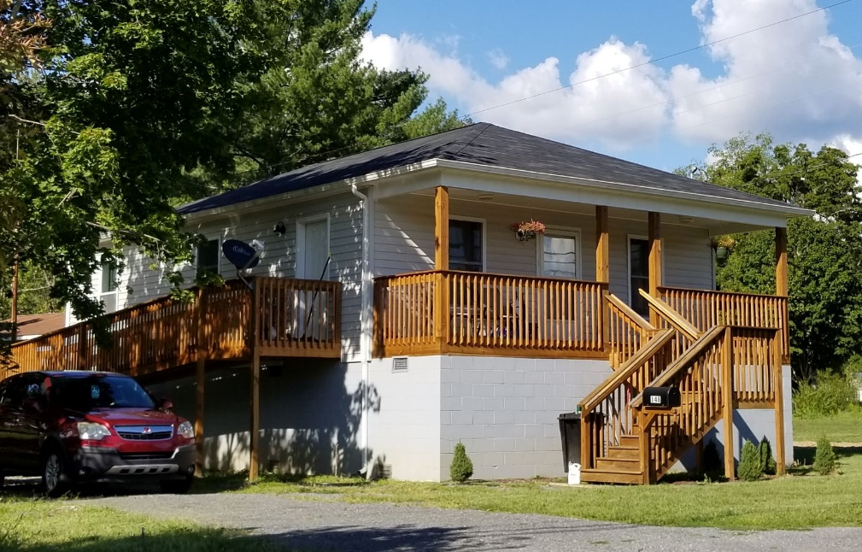
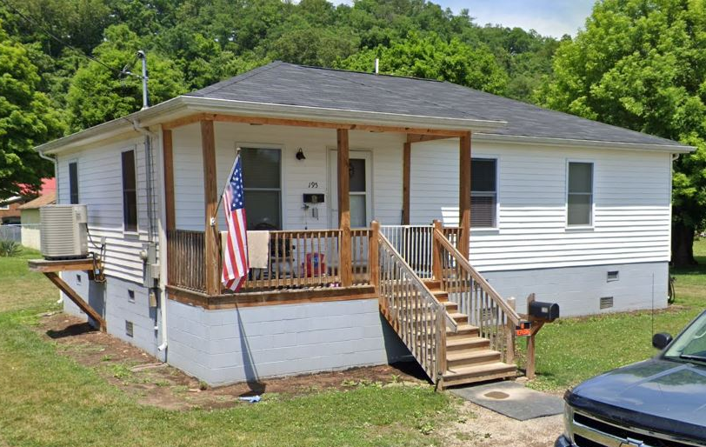
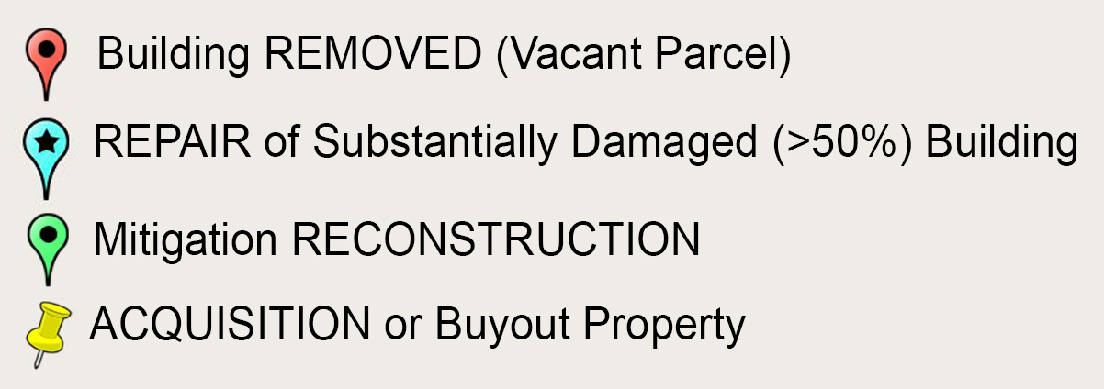
Mitigation Measures
White Sulphur Springs and Rainelle
Floodplain Building Value Recovery
White Sulphur Springs and Rainelle
Flood Risk Mitigation
In White Sulphur Springs
Unmitigated Example
in White Sulphur Springs
Category | Mitigation Indicator | White Sulphur Springs | Rainelle
Mitigated Structures | Mitigation Reconstruction or Elevated Structures to Design Flood Elevation (DFE) | 14 | 39
 | Rehabilitated/Repaired Structures | 394 | 278
 | Unmitigated Low Value Structures | 14 | 47
 | Structures Removed (vacant parcel) | 49 | 41
Open Space Preservation | Buyout Parcels (Deed Restricted) | 16 | 18
 | Community-Owned Vacant Parcels | 66 | 88
 | Area of Open Space Preservation (OSP) | 5 Acres | 3 Acres
 | Ratio of Open Space Preservation (OSP to SFHA) | 2.6% | 4.5%
Building Value Recovery | Net Value 2016-2022 Tax Assessment Value | + $6.1 Million | - $1.0 Million
Loss Avoidance 100-year Flood | Loss Avoidance by Elevating or Removing Structures (preliminary results) | $2.6 million | $2.3 million
WV GIS Technical Center
November 2022
COMMUNITY | 2015 | 2016 | 2017 | 2018 | 2019 | 2020 | 2021 | 2022
Rainelle (n=326) | 13.1 Million | 13.3 Million | 5.0 Million | 9.4 Million | 11.0 Million | 11.1 Million | 11.3 Million | 12.3 Million
White Sulphur Springs (n=409) | 22.6 Million | 23.0 Million | 13.4 Million | 21.5 Million | 22.4 Million | 22.9 Million | 26.2 Million | 29.2 Million
Source: Tax assessment database. May not include values for tax exempt properties.
Mitigation Measures (Continued)
White Sulphur Springs and Rainelle
Building Design Flood Elevation
White Sulphur Springs
New Streamgages
White Sulphur Springs
Partial Mitigation Examples
Category | Mitigation Indicator | White Sulphur Springs | Rainelle
Resiliency to Future Floods | Percent Residential Structures in 100-year floodplain elevated to Design Flood Elevation (DFE) | 58% | 30%
Higher Standards | Freeboard (safety elevation factor above BFE) | 2 ft. | 2 ft.
 | Community Rating System (above min. requirements) | No | No
Floodplain Management | Incorporated Place a compacted floodplain management area to enforce floodplain ordinance | Yes | Yes
 | Continuity of operations and immediate response to disasters | ? | ?
 | Record keeping (permits, EC’s, substantial damage) | ? | ?
Flood Insurance | Number of Policies 2019 | 133 | 44
Risk Communications | Flood Risk Disclosure Laws in West Virginia | F grade | F grade
 | Outreach to property owners about changes to flood maps (mapped in/mapped out of SFHA) | ? | ?
Mitigated Properties
White Sulphur Springs
Mitigation Reconstruction Example
in White Sulphur Springs
Damage (2016 Flood) and Mitigation
Central Ave., White Sulphur Springs
Relocation Community
White Sulphur Springs
Examples of Properly Elevated Structures
in White Sulphur Springs
Building ID: 13-17-0009-0009-0000_148
Building ID: 13-17-0009-0009-0000_148
Building ID: 13-17-0008-0152-0000_195

