Slide 1
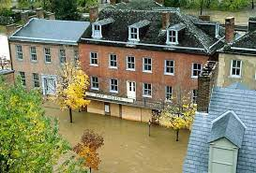
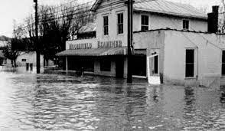
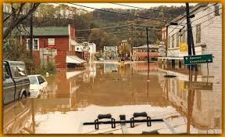
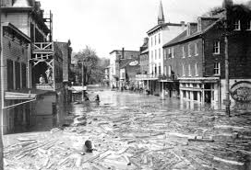
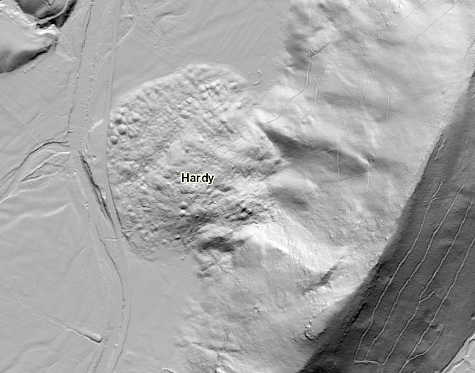
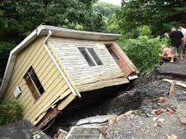
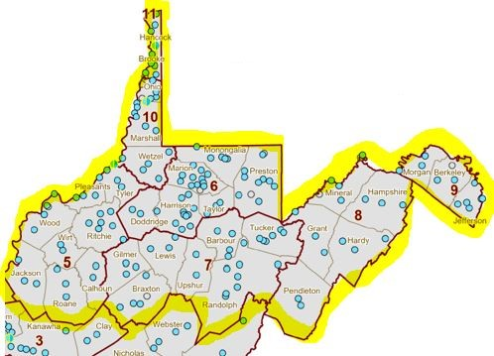
Risk Assessment Kick-Off Meeting Regions 5 through 11
RISK ASSESSMENT DATA VERIFICATION
WV GIS Technical Center West Virginia University April 14, 2021

Slide 2
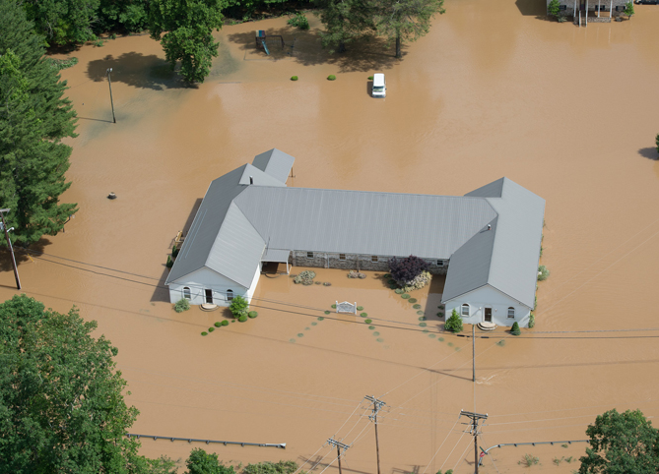
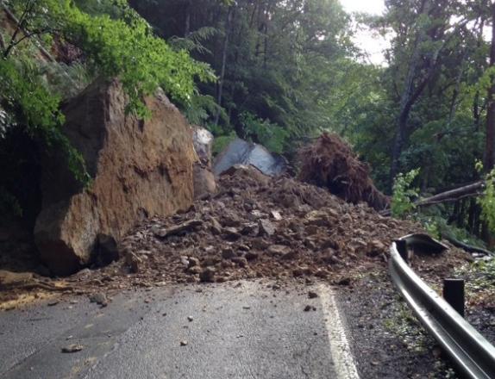
Multi-Hazard Risk Assessments
Funded from the Hazard Mitigation Grant Program (HMGP) by FEMA Region III and the State Hazard Mitigation Office, WVU and its partners are providing technical support to the communities for the following programs:
Flood Risk #1 WV Hazard
Landslide Risk #2 WV Hazard
FEMA-approved hazard mitigation plans legally required under provisions of the Stafford Act
Risk Mapping, Assessment and Planning (Risk MAP)
National Flood Insurance Program (NFIP) / Community Rating System (CRS)
No single agency has all the answers but leveraging multiple programs and perspectives can provide a cohesive solution

Slide 3
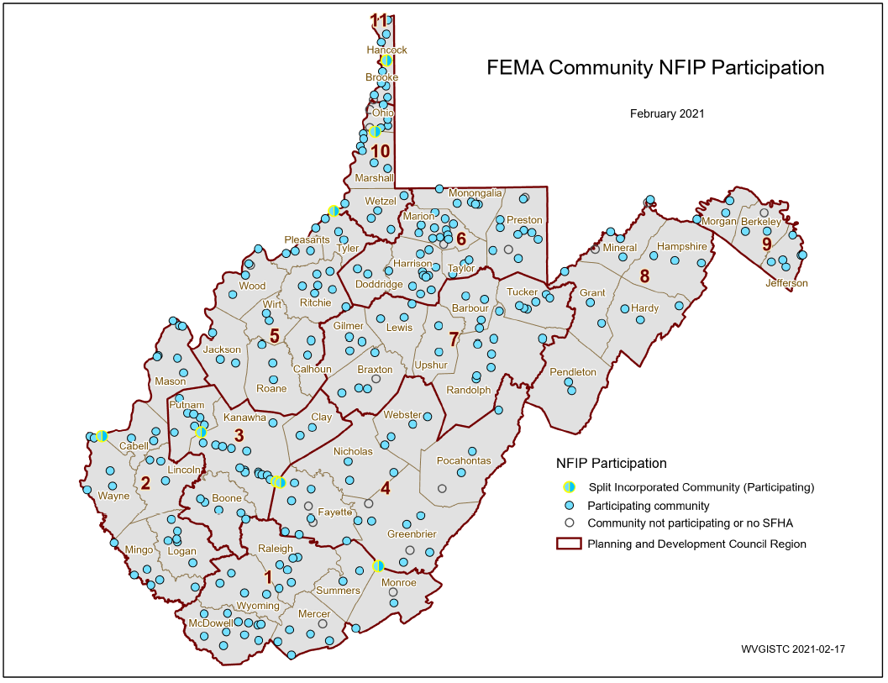
Statewide Hazard Assessment
294 Statistical Geographies form 286 Communities which form
55 Counties which form
11 PDC Regions which form
1 Statewide Flood Risk Assessment
94% of WV Municipalities have Special Flood Hazard Areas (SFHA)
SPLIT COMMUNITY | COUNTY 1 | COUNTY 2
Alderson | Greenbrier | Monroe
Huntington | Cabell | Wayne
Montgomery | Fayette | Kanawha
Nitro | Kanawha | Putnam
Paden City | Tyler | Wetzel
Smithers | Fayette | Kanawha
Wheeling | Marshall | Ohio
Weirton | Brooke | Hancock
PDF Map

Slide 4
152 Flood-Prone Communities
7 Regional Planning & Development Councils (34 Counties)
Region | # Counties | # Communities | Split Communities across County Boundary | Communities not participating in NFIP or no SFHA | # NFIP Communities¹
Region 1² | 6 | 32 |  | Athens, Union | 30
Region 2 | 6 | 31 | Huntington |  | 31
Region 3 | 4 | 29 | Nitro |  | 29
Region 4 | 5 | 31 | Alderson, Montgomery, Smithers | Fayetteville³, Hillsboro, Lewisburg, Quinwood³, Thurmond | 26
Region 5 | 8 | 30 | Paden City | North Hills | 29
Region 6 | 6 | 45 |  | Brandonville, Tunnelton, White Hall | 42
Region 7 | 7 | 31 |  | Flatwoods | 30
Region 8 | 5 | 17 |  | Carpendale, Elk Garden | 15
Region 9 | 3 | 12 |  | Hedgesville | 11
Region 10 | 3 | 18 | Wheeling | Bethlehem, Clearview | 16
Region 11 | 2 | 10 | Weirton | Windsor Heights | 9
total | 55 | 286 | 8 | 18 | 268
¹ Source: FEMA's Community Status Source Book ² Region 1 dissolved community of Rhodell (Raleigh County) included in NFIP count. Town of Matoaka (Mercer County) is not included. ³ Communities include SFHA or non-regulatory floodplain
Split Communities Alderson, Montgomery and Smithers are members of Region 4
Split Community Paden City is a member of Region 5

Slide 5
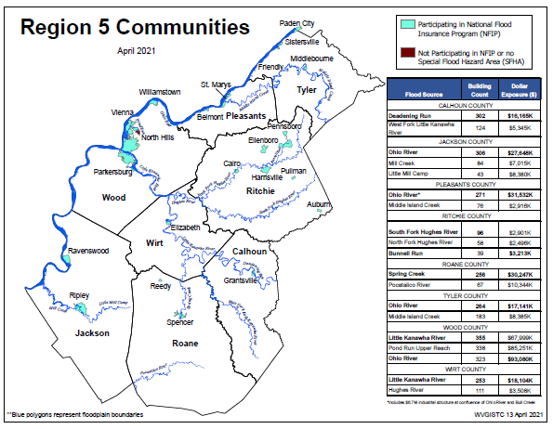
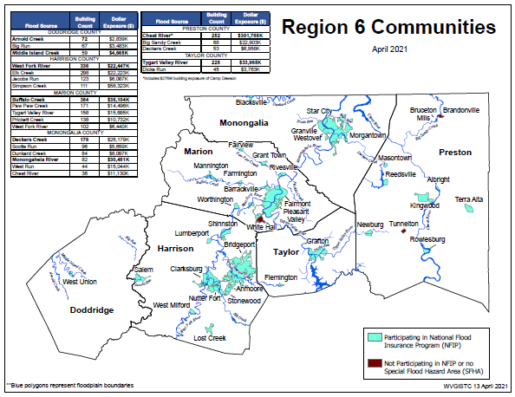
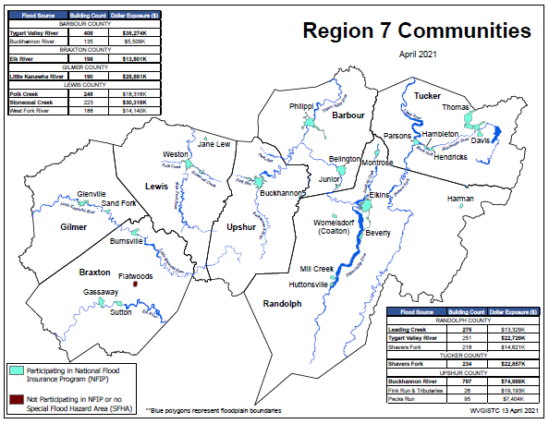
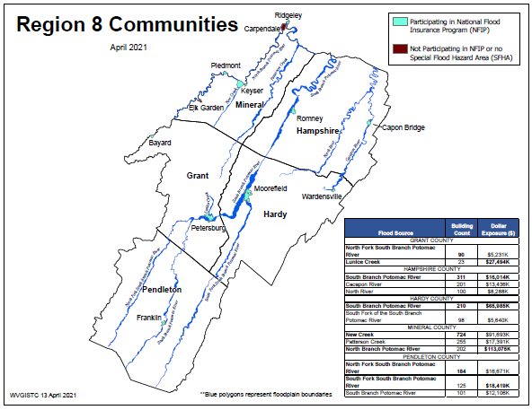
Regions 5-8: 116 Flood-Prone Communities
29
42
Region 5
Region 6
30
Region 7
15
Region 8

Slide 6
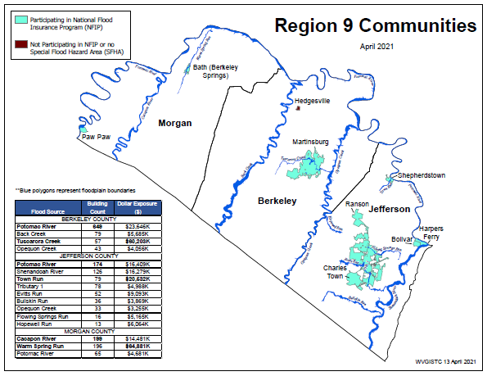
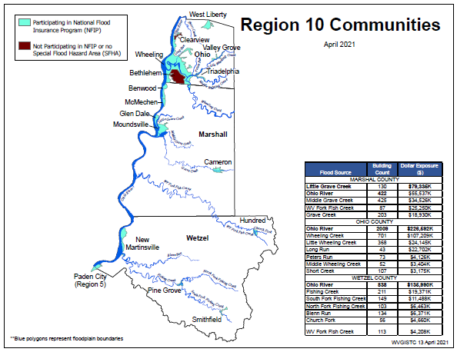
Regions 9-11: 36 Flood-Prone Communities
16
11
Region 9
Region 10
9
Region 11

Slide 7
Building Exposure by Region
County Subdivision of Rivers/Streams with "Highest" Building Count and Dollar Exposure
 | BUILDING COUNT |  |  |  | BUILDING DOLLAR ($) EXPOSURE
Region | County | Flood Source | Bldg. Count | Bldg. $ Value | County | Flood Source | Bldg. Count | Bldg. $ Value
1 | McDowell | Tug Fork | 810 | $41,337K | Mercer | Brush Creek | 248 | $47,440K
4 | Greenbrier | Greenbrier River | 533 | $34,028K | Greenbrier | Howard Creek | 368 | $80,905K
5 | Wood | Little Kanawha River | 355 | $67,999K | Wood | Ohio River | 323 | $93,080K
6 | Marion | Buffalo Creek | 354 | $35,104K | Preston | Cheat River* | 252 | $301,768K
7 | Upshur | Buckhannon River | 797 | $74,988K | Upshur | Buckhannon River | 797 | $74,988K
8 | Mineral | New Creek | 724 | $91,693K | Mineral | North Branch Potomac | 202 | $113,075K
9 | Berkeley | Potomac River | 649 | $23,646K | Morgan | Warm Spring Run | 196 | $64,881K
10 | Ohio | Ohio River | 2,009 | $226,592K | Ohio | Ohio River | 2,009 | $226,592K
11 | Brooke | Ohio River | 881 | $81,329K | Brooke | Ohio River | 881 | $81,329K
* Includes $276 million building exposure of Camp Dawson

Slide 8
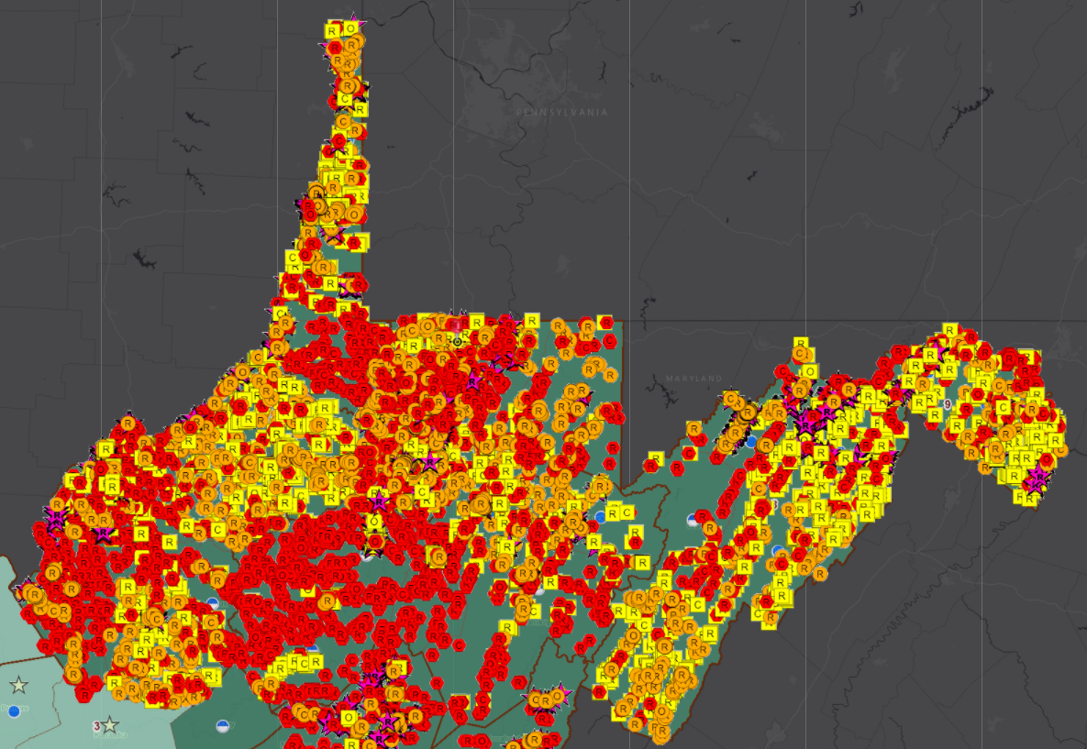
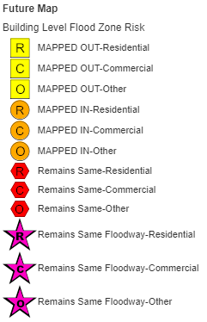
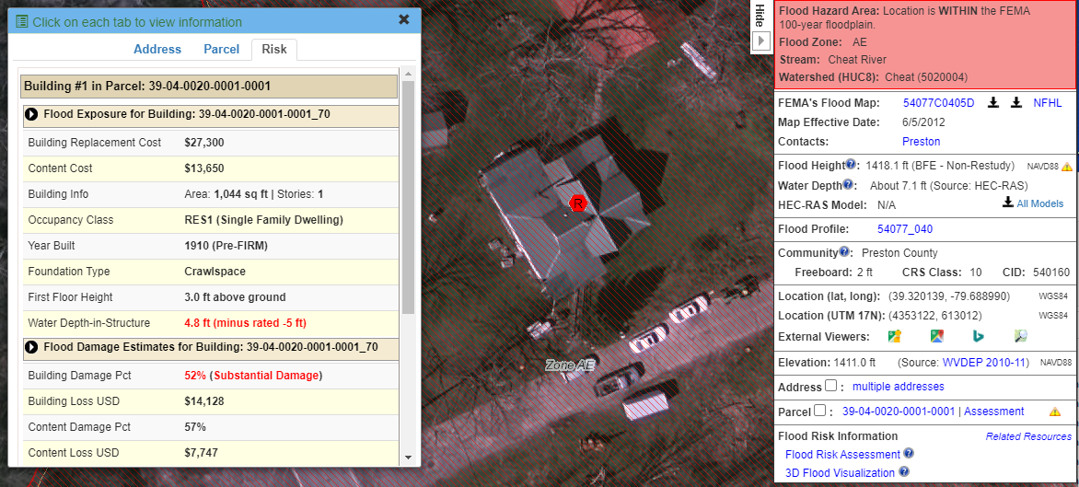
Building Exposure and Damage Estimates
More than 36,0000 structures in high-risk flood zones inventoried for Regions 5-11 (North Half of WV)
County Subdivision of Rivers/Streams with "Highest" Building Count and Dollar Exposure
Building
39-04-0020-0001-0001_70
Bldg. 39-04-0020-0001-0001_70
39-04-0020-0001-0001_70

Slide 9
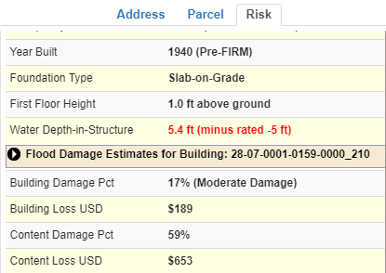
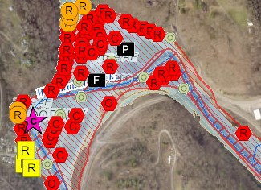
Building-Level Flood Risk Assessments
DATA INPUTS
Flood Zones Depth Grids Building Stock
GIS Reference & Elevation Data
BUILDING INVENTORY & ACCURACY IMPROVEMENTS Building Location
Building Attributes
COMMUNITY ENGAGEMENT & FIELD ACCURACY CHECKS
Floodplain Managers
Local Govt. Officials
Building-Level Flood Risk Assessments support:
Hazard Mitigation Plans
Floodplain Management
Community Assisted Visits
Community Rating System
1
Benefits
More detailed and accurate assessments
Automated scripts generate outputs quickly
Cost savings through efficiencies
Helps multiple stakeholders
Comprehensive Building Risk Database
4
2
Building-Level Assessment Cycle (Flood-Risk Assessment GIS)
3
DATA OUTPUTS
Building Level Community Level
3D Visualizations
Published to WV Flood Tool
Map Output
Methodology
Consistent methodology statewide
Semi-automated workflows
Continuous cycle to improve and update assessments
Tabular Output

Slide 10
Timeline for Community-Engagement Process
Kick Off Meeting
April 14, 2021
Q & A Meeting
April 21 & 28, 2021
Assessment Meeting
June-July
Data Submission
To answer any BLRA review related questions
Community deadline to Tech Center with updated inventory
To provide building-level risk assessment (BLRA) to communities for data verification
To review risk assessment information for hazard mitigation planning and risk reduction activities
May 26, 2021
RISK DATA
VERIFICATION
RISK DATA ANALYSIS
Communications and Management
Emails, conference calls
Online tracking survey
Log and manage communications

Slide 11
Statewide Hazard Assessment
Expectations
Floodplain managers and community officials verify at-risk structures in floodplain
Provide Elevation Certificates and Building Pictures of floodproofed structures
Provide shared links of significant flood map errors or unmapped landslides
Benefits to Communities
Validation of essential facilities and primary structures in flood hazard zones
Expand on base level information for further hazard reduction and planning efforts
Use risk assessment information for Community Rating System insurance discounts

Slide 12
Risk Assessment Data Verification
Verification¹ | Flood | Landslide | Description
Identified Hazards | X | X | Flood Zone Map Errors, High-Water Marks Landslide Incidents
Essential Facilities² | X |  | School, Police, Fire, Hospital, Nursing Home, E-911 Office
Primary Structures Missing in High-Risk Flood Zones² | X |  | Missing any Noteworthy Structures Future Map Conditions Base Flood Depth
Building Dollar Exposure³ | X |  | High-Value Buildings
Building Damage Estimates^{3, 4} (1%-Annual-Chance Flood) | X |  | Building Substantial Damage Estimates
Post-FIRM Construction^{3, 4} (Minus Rated) | X |  | Post-FIRM Construction (new development)
Mitigated/Elevated Structures⁴ | X |  | Residential Structures > 5 ft. Non-Residential
Buyout Properties (Deed Restricted) | X | X | Flood Buyout Parcel Landslide Buyout Parcel
¹ Use the Risk MAP View of the WV Flood Tool for map verification of hazards and structures ² Inventoried primary structures in the effective or advisory 1%-annual-chance (100-year) floodplain. Essential facilities are mapped to the 0.2 percent (500-year) floodplain
³ Targeted record verification. Data extract from Building-Level Risk Assessment (BLRA) inventory
⁴ Provide Elevation Certificates and Building Pictures for mitigated/elevated structures

Slide 13
What does it mean?
Addendum Slides and other reference documents provide more details
Verification | Flood | Land-slide | What does it mean?
Identified Hazards | X | X | Improves the accuracy and information about identified flood and landslide hazards Additional hazard information (e.g., high water marks, landslide locations) from communities
Essential Facilities | X |  | Identifies essential facilities that should be built to a higher level of flood protection Essential facilities (police and fire stations, E-911 dispatch offices, schools, hospitals, and nursing homes) that provide services to the community and should be functional after a flood
Primary Structures Missing in High-Risk Flood Zones | X |  | Answers the question “What is at HIGH RISK to riverine flooding?” Use for Floodplain Management Records: Building characteristics and flood depth exposure (occupancy class, replacement value, grade, building year, foundation type, ownership, flood zone type, water depth-in-structure, etc.). CRS program variable: Building Count in SFHA (bSFHA) Identifies proximity to flood source (floodway), a Risk Rating 2.0 insurance rating factor Can prepopulate structures in FEMA’s damage estimating software to save time during a crisis Reveals Future Map Conditions in which non-regulatory zones likely will become effective from future FEMA Risk MAP studies. Consider “Mapped out SFHA” structures for LOMAs.
Building Dollar Exposure | X |  | Identifies high-valued buildings exposed in 1%-annual-chance floodplain Cost to rebuild a home or non-residential structure is a significant insurance rating factor
Building Damage Estimates | X |  | Answers the question “What is the DEGREE of HIGH RISK to riverine flooding?” Identifies most vulnerable structures to damage for a 1%-annual-chance or 100-yr. flood event Provides substantial damage estimates (insurance rating factor) in dollars and percent Verify: foundation types, first floor heights; compare with Repetitive Loss and claims data
Post-FIRM Construction (Minus Rated) | X |  | Answers question “Are post-FIRM structures compliant with NFIP regulations and Ordinance?” Post-FIRM structures shouldn’t be minus rated if built to code at the time Minus-rated insurance policies don’t receive CRS community discounts Residential buildings must elevate to finished first floors and wet floodproof enclosed areas Commercial buildings have the option to wet floodproof, dry floodproof, or do a combination Verify: foundation types and first floor heights for Post-FIRM construction
Mitigated/Elevated Structures | X |  | Identifies floodproofed mitigated structures (e.g., elevation of structure/utilities, proper flood openings) to increase insurance discounts and reduce flood risk vulnerability.
Buyout Properties | X | X | Identifies open space preserved from mitigation of flood and landslide buyout parcels CRS community credit eligibility

Slide 14
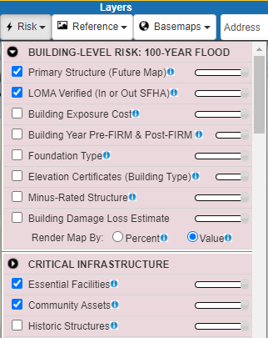
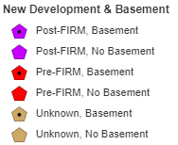
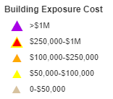
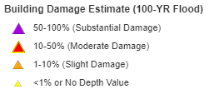
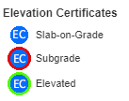
Map Verification – WV Flood Tool
WV Flood Tool (Risk MAP View) for Community Verification

Slide 15
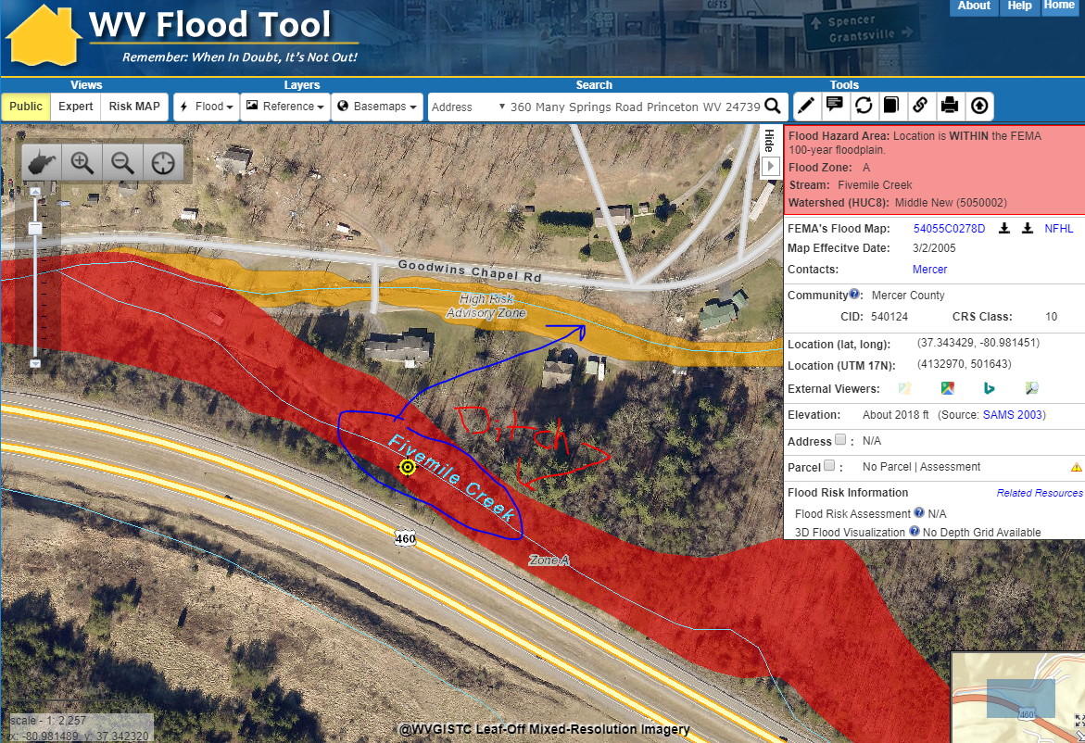
(1A) Identified Hazards - Flood
Shared Link Tool
Submit Shared Link and Error Description
https://www.mapwv.gov/flood/map/?wkid=102100&x=-9014532&y=4486968&l=10&v=1
Map Error Description: Drainage stream along U.S. 460 is misnamed Fivemile Creek. The main channel for Fivemile Creek (red zone) should follow the newly mapped Advisory A Zone (orange zone) along Goodwyns Chapel Road
Location: Near Oakvale, WV
(Mercer County)

Slide 16
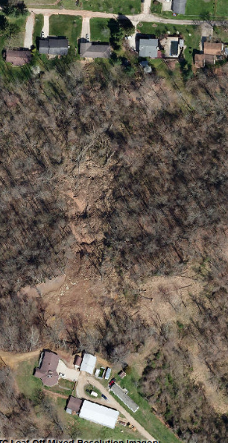
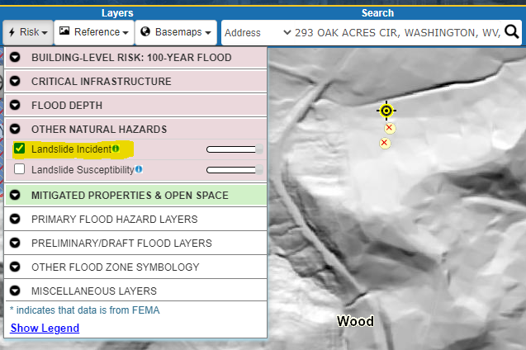
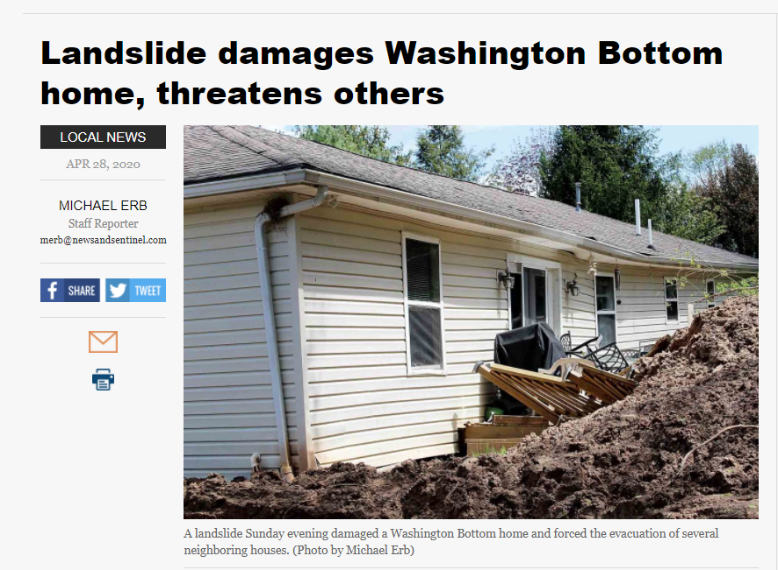
(1B) Identified Hazard - Landslide
WV Flood Tool
Impacted Home
Landslide Incident
April 2020 Landslide
April 2020 Landslide
Wood County Impacted home moved from foundation
Spring 2020 Aerial Imagery
Landslide Shared Link: https://www.mapwv.gov/flood/map/?wkid=102100&x=-9034072&y=4480092&l=10&v=2

Slide 17
Tabular Verification – Download BL Tables
Downloadable Building-Level (BL) Tabular Reports for Community Verification
Verification | Flood | Landslide | Download Table Web Link | Other Resource Documents
Identified Hazards | X | X | (1) Identified Hazards Folder (no table) | << Reference Tables >> Occupancy Classes | Foundation Types ___________________________________ << Report Tables >> Building Level | Community Level ____________________________________ << Instructional Resources >> Instructions | Teaching Videos Recorded Presentations WV Flood Tool Resource Page ____________________________________ << Data Verification Form >> Online Survey Check Sheet
Essential Facilities | X |  | (2) Essential Facilities Folder R5|R6|R7|R8|R9|R10|R11
Primary Structures Missing in High-Risk Flood Zones (BLRA)¹ | X |  | (3) BLRA Full List Folder (available if want to review all buildings inventoried) R5|R6|R7|R8|R9|R10|R11
Building Dollar Exposure² | X |  | (4) BLRA Data Extract Folder R5|R6|R7|R8|R9|R10|R11
Building Damage Estimates² | X |  | (5) BLRA Data Extract Folder R5|R6|R7|R8|R9|R10|R11
Post-FIRM Construction² | X |  | (6) BLRA Data Extract Folder R5|R6|R7|R8|R9|R10|R11
Mitigated/Elevated Structures | X |  | (7) Mitigated Structures R5|R6|R7|R8|R9|R10|R11
Buyout Properties | X | X | (8) Buyout Properties R5|R6|R7|R8|R9|R10|R11
¹ Building-Level Risk Assessment (BLRA) full table with 84 data fields
² Targeted record verification. Table data extract from BLRA inventory in 1%-annual-chance flood zone

Slide 18
(2) Essential Facilities – Table Verify
Community Name | Reg. | Facility Name | Building ID | Full Address | Facility Type | Building Appraisal | Flood Tool Link | 1% Flood Depth Grid
Wheeling** | 10 | Wheeling Middle School | 35-10-0W78-0041-0000_3500 | 3500 Chapline Street, Wheeling, WV 26003 | School | $10,300,000 | FT | 9.3
Wheeling** | 10 | Wheeling Fire Department Station 5 | 35-10-0W42-0044-0000_11 | 11 North Wabash Street, Wheeling, WV 26003 | Fire Department | $693,140 | FT | 9.1
Benwood | 10 | Benwood Police Department | 25-01-0007-0119-0000_430 | 430 Main Street, Benwood, WV 26031 | Police Department | $306,800 | FT | 9
Benwood | 10 | Benwood Volunteer Fire Department Incorporated | 25-01-0007-0122-0000_434 | 434 Main Street, Benwood, WV 26031 | Fire Department | $230,800 | FT | 8.1
New Martinsville | 10 | Wetzel County Sheriff's Office | 52-09-0020-0058-0000_210 | 200 Main Street, New Martinsville, WV 26155 | Police Department | $529,150 | FT | 7.8
New Martinsville | 10 | Magnolia High School | 52-09-0018-0009-0000_601 | 601 Maple Avenue, New Martinsville, WV 26155 | School | $10,843,500 | FT | 7.8
New Cumberland | 11 | New Cumberland Fire Department | 15-05-N26F-0001-0000_303 | 303 North Chester Street, New Cumberland, WV 26047 | Fire Department | $230,100 | FT | 7.5

Slide 19
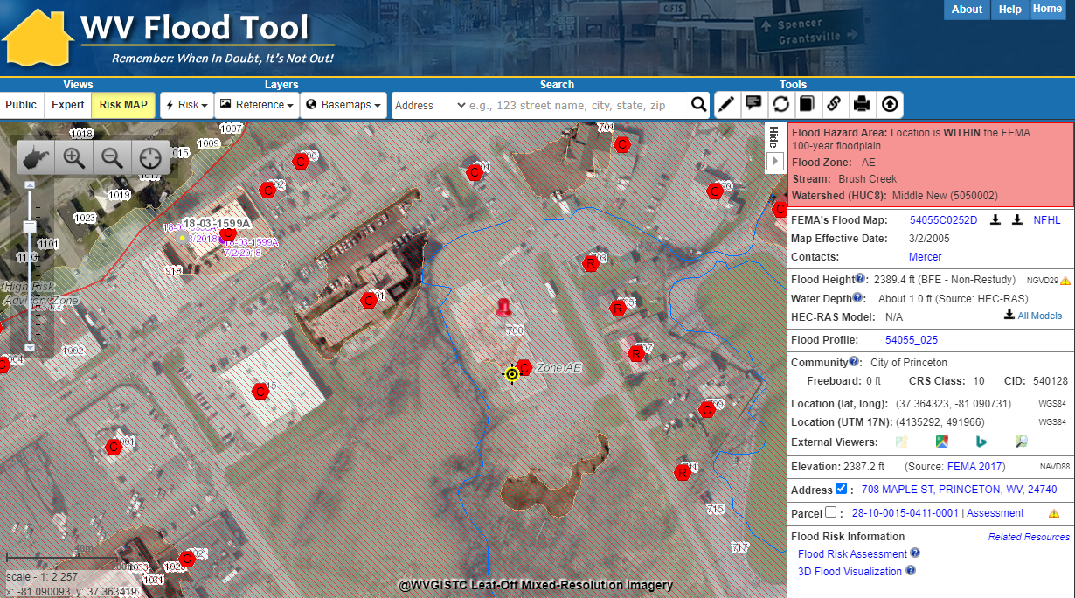
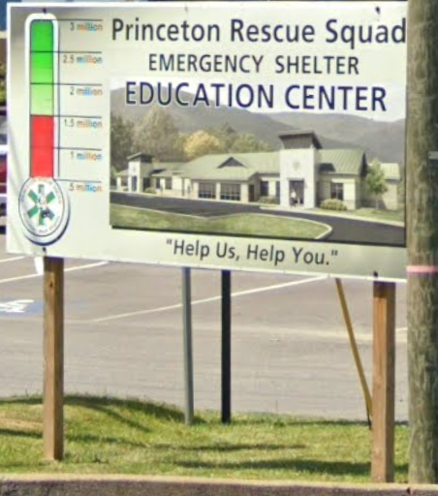
(3) Missing Structure – Map Verification
New $3 Million Princeton Rescue Squad Training Center and Emergency Shelter | 708 Maple Street | 28-10-0015-0411-0001 | Shared Link of Missing Structure https://www.mapwv.gov/flood/map/?wkid=102100&x=-9026984&y=4490043&l=11&v=2

Slide 20
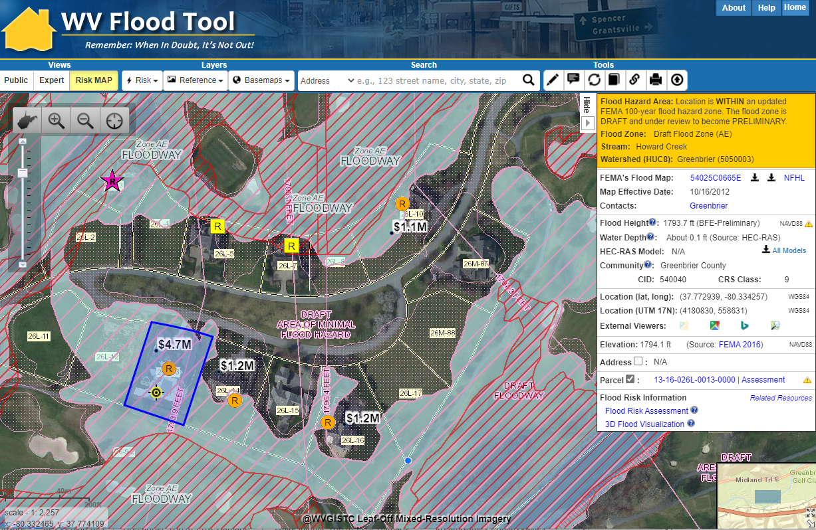
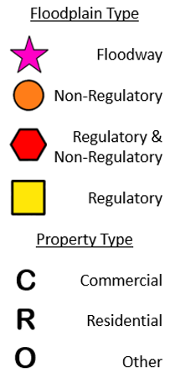
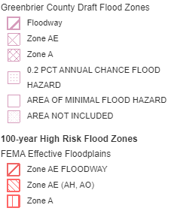
(4) Building $ Exposure – Map Verification
Four Homes along Howard Creek with Total Building Value of $8.2 million mapped into new Draft Floodplain
White Sulphur Springs
Mapped-In Draft Floodplain (Future SFHA)
https://www.mapwv.gov/flood/map/?wkid=102100&x=-8942775&y=4547402&l=11&v=2

Slide 21
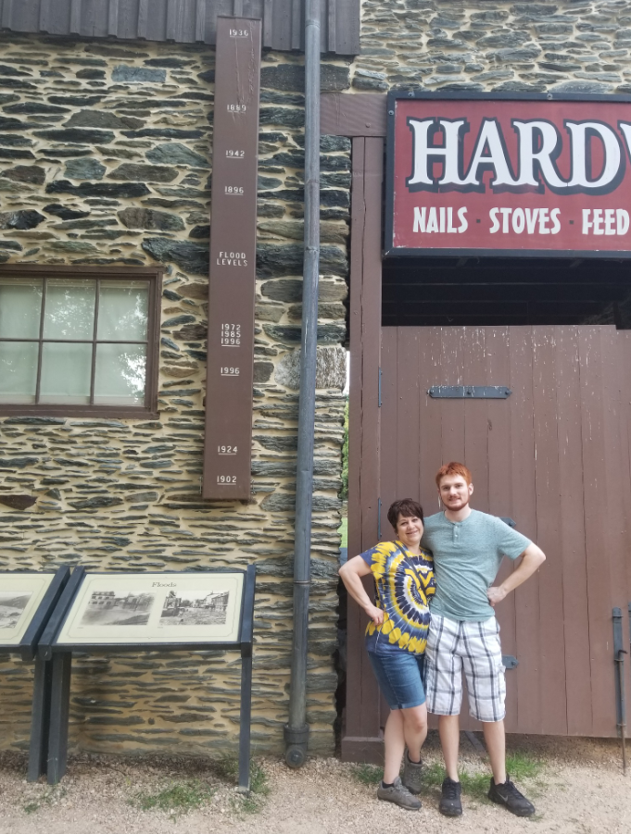
(5) Building Substantial Damaged
Bldg. 19-05-0004-0025-0000
1936 HWM
3D Flood Visualization Movie
Historical high-water marks and 1% flood model depths for structures along Shenandoah Street exceed 33 feet.
1936 Flood. (March 18-19). 36½ feet – record crest at Harpers Ferry
https://www.nps.gov/hafe/learn/historyculture/memorable-floods-at-harpers-ferry.htm
19-05-0004-0025-0000

Slide 22
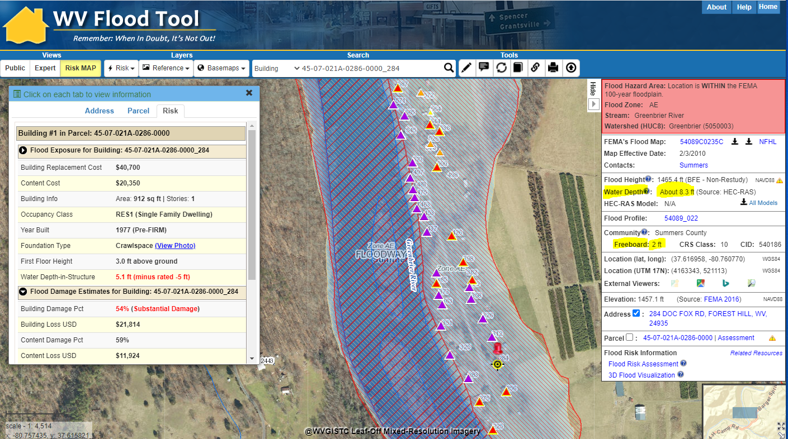
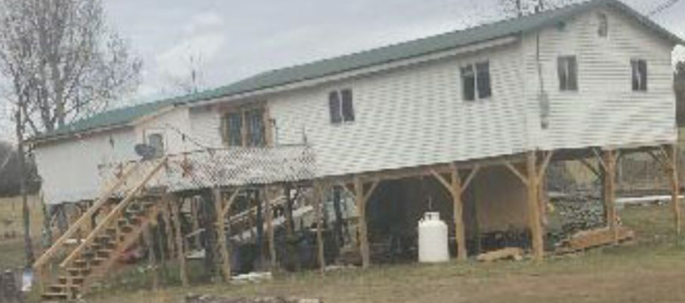
(5) Building Substantial Damaged
https://www.mapwv.gov/flood/map/?wkid=102100&x=-8990248&y=4525455&l=11&v=2
Foundation and First Floor Height from Assessment Record are not correct. Needs to be modified.
ADDENDUM INFORMATION
Substantial Damage of structure not adjusted for 9 ft. elevated First Floor
16 steps x 7” rise = 9 ft.
Large number of substantial damaged structures along Greenbrier River, Summers County

Slide 23
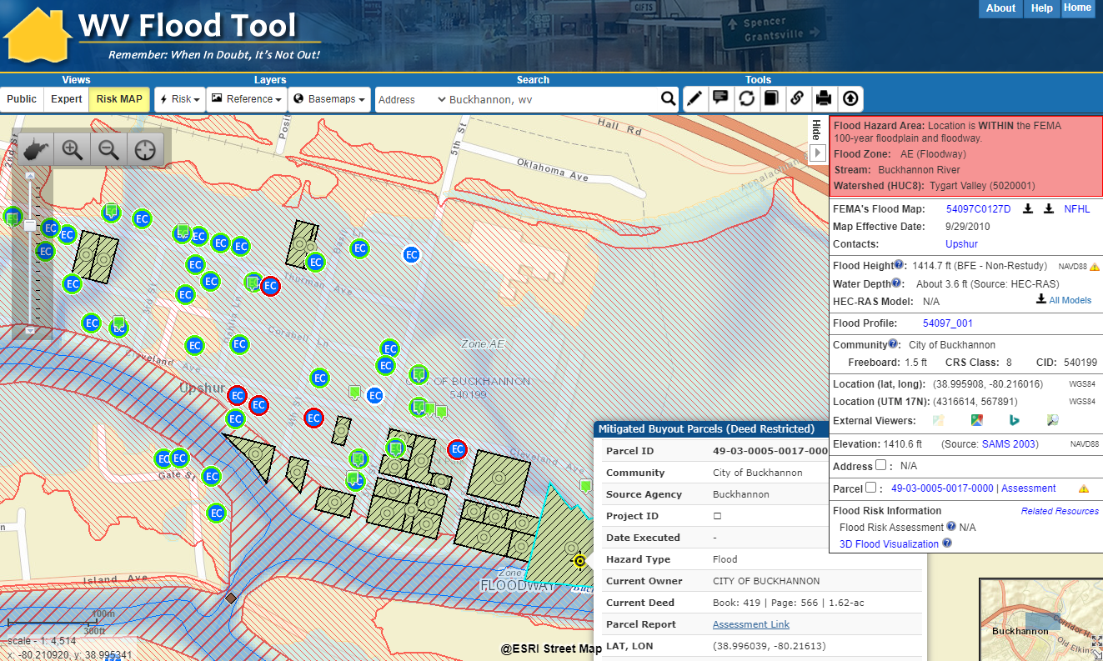
(7 & 8) Mitigated Properties - Verification
Buckhannon, WV
Elevation Certificate
of Elevated Structure (Bldg. Diagrams 5-8)
Verify MITIGATED STRUCTURE
Verify BUYOUT PROPERTY Parcel
https://mapwv.gov/flood/map/?wkid=102100&x=-8929946&y=4721378&l=10&v=2

Slide 24
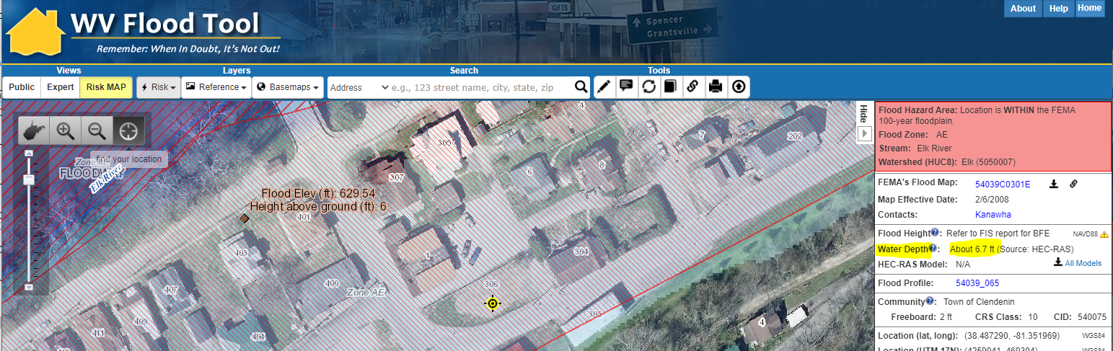
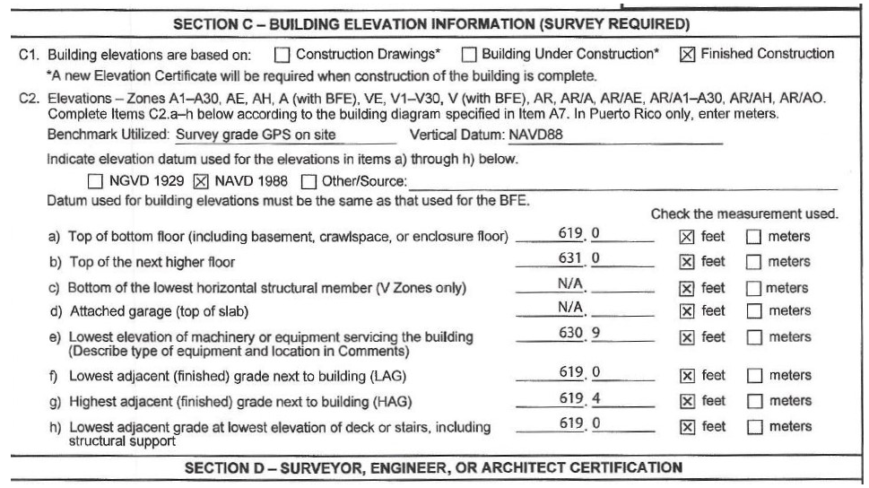
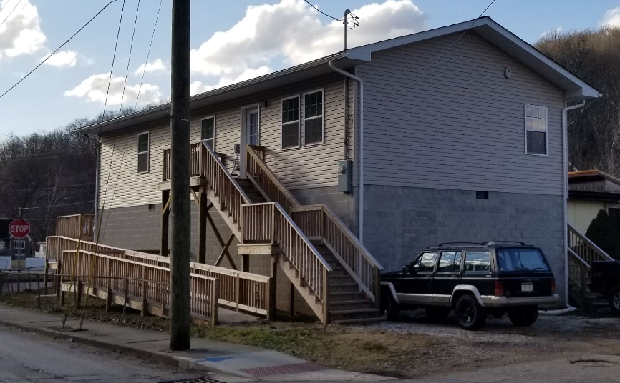
(7) Mitigated Structure – First Floor Height
Use Elevation Certificates and Building Pictures to identify Residential Elevated Structures > 5 ft.
Base Flood Depth
is 6.7 ft.
Newly built Elevated Structure not shown on aerial imagery
Elevation Certificate (Diagram 7)
631.0 ft. (C2b) – 619.0 ft. (C2f) = 12 ft.
19 steps x 7” rise = 11 ft.
16 blocks x 8” = 11 ft.
Building Picture
https://www.mapwv.gov/flood/map/?wkid=102100&x=-9056061&y=4648497&l=12&v=1

Slide 25
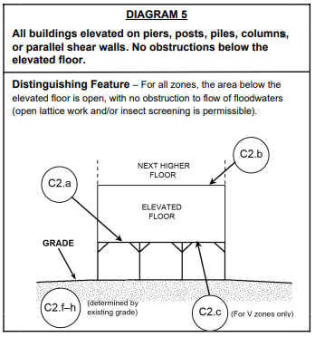
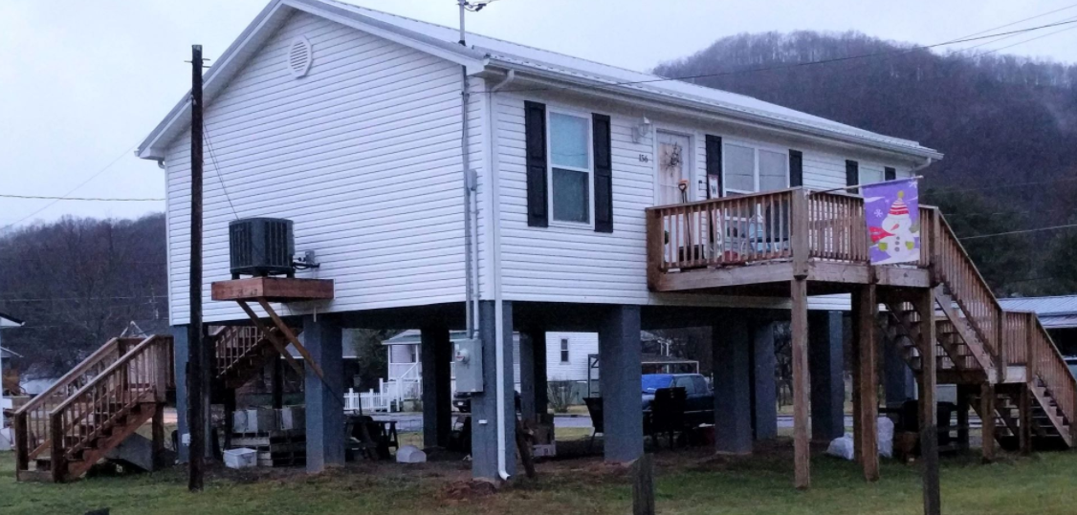
(7) Mitigated Structure – EC Bldg. #5
Building Diagram 5: Elevated Building with no Enclosure

Slide 26
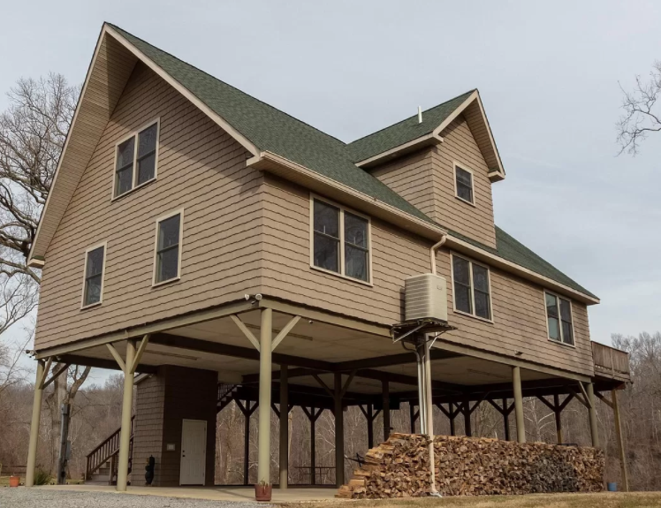
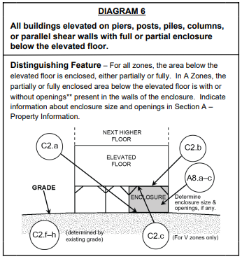
(7) Mitigated Structure – EC Bldg. #6
Building Diagram 6: Elevated Building with Enclosure (using piers, piles, posts)
Partial Enclosure

Slide 27
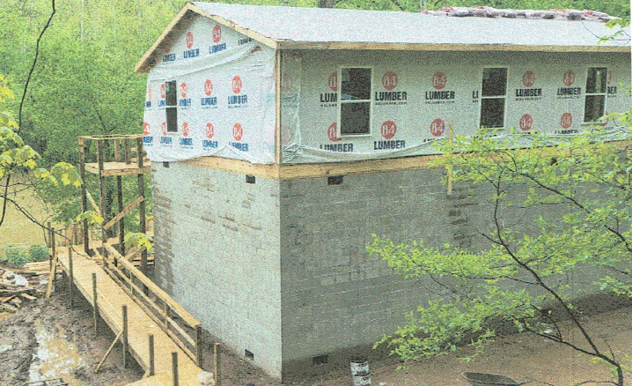
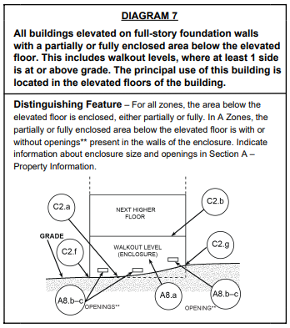
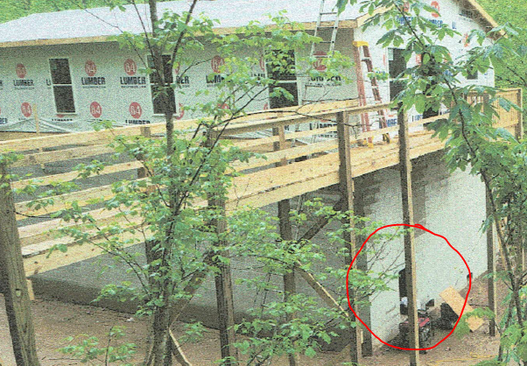
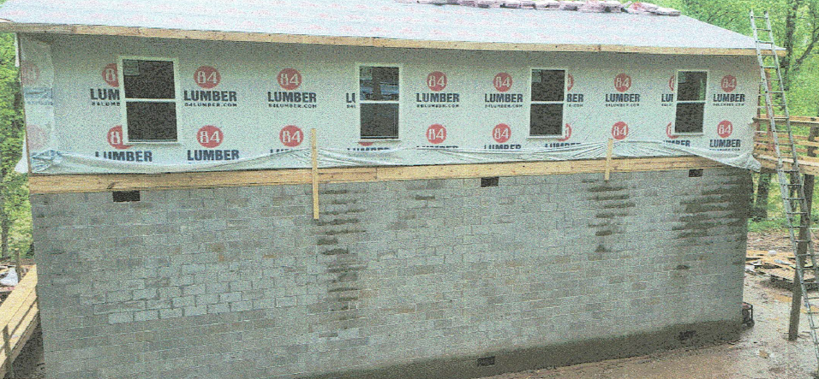
(7) Mitigated Structure – EC Bldg. #7
Building Diagram 7: Elevated Building on Solid Foundation Walls (Full-Story)
Building Diagram 5
Walkout Opening
Full-Story Enclosure
Building Picture

Slide 28
(7) Mitigated Structure – EC Bldg. #8
Building Diagram 8: Elevated Building with Crawlspace (Enclosure)
Crawlspace Enclosure

Slide 29
Quick Verification Guide and Survey
Complete Online Survey Form when Finished

Slide 30
RESPONSIBILITIES
ORGANIZATION(S) | DESCRIPTION | RESPONSIBILITIES
FEDERAL FEMA (Region III) FEMA contractors | Support for FEMA Programs including: State/Local Hazard Mitigation Plans, NFIP Compliance and Visits, CRS Community Eligibility, Grant Sponsorship, Risk MAP Studies, Technical Resources, Training | Hi-Level Support
STATE State NFIP, SHMO, CTP WV Floodplain Management Association | Support for FEMA Programs: NFIP/CRS Risk MAP Studies Hazard Mitigation Plans | Hi-Level Support Community Engagement
REGIONS 11 Regional Planning & Development Councils | Local Hazard Mitigation Planning Risk Assessment Verification Community Vulnerability Analysis | Administrative Support and Coordination Community Engagement
UNIVERSITY WV GIS Technical Center, West Virginia University | WV Flood Tool WV Landslide Tool Multi-Hazard Risk Assessments | Technical Support Community Engagement
LOCAL COMMUNITIES 268 NFIP Participating Communities. Floodplain Managers, Building Code Officials, GIS Specialists, Community Officials, etc. | Hazard Identification, Assessment, Disaster Response and Planning Risk Assessment Verification | Floodplain Management Support Hazard Mitigation Planning and Risk Reduction Activities

Slide 31
Major Take Away Point
Be Engaged! Participate!
ASK FOR HELP!
Hazard risk assessments and mitigation planning benefit from community-level input

Slide 32
Contacts
Local Floodplain Managers
https://www.mapwv.gov/flood/content/wvCountyFloodplainManagersList.htm
Regional Planning and Development Councils https://www.wvregionalcouncils.org/
Jason Roberts, Executive Director jasonroberts@regiononepdc.org | John Tuggle, Executive Director jtuggle@reg4wv.org
WV Offices of the Insurance Commissioner (OIC) | WV Emergency Management Division (WVEMD)
Chuck Grishaber, CFM State NFIP Director WV Offices of the Insurance Commissioner (OIC) 900 Pennsylvania Avenue Charleston, WV 25305-0540 Phone: (304) 414-8462 Charles.C.Grishaber@wv.gov | Kevin L. Sneed, CFM CTP Mapping Grants Coordinator WV Emergency Management Division 2403 Fairlawn Ave. Dunbar, WV 25064 Office: (304) 957-2571 | Mobile: (304) 545-2864 Kevin.L.Sneed@wv.gov
West Virginia University (Technical Support and Data Submission)
Kurt Donaldson, CFM, GISP GIS Manager West Virginia University West Virginia GIS Technical Center 98 Beechurst Avenue 330 Brooks Hall, PO Box 6300 Morgantown, WV 26505-6300 Phone: (304) 293-9467 kdonalds@wvu.edu | Maneesh Sharma, PhD, CFM, GISP Project Lead West Virginia University West Virginia GIS Technical Center 98 Beechurst Avenue 330 Brooks Hall, PO Box 6300 Morgantown, WV 26505-6300 Phone: (304) 293-6694 maneesh.sharma@mail.wvu.edu

Slide 33
More Contacts
FEMA Region III
Matthew McCullough Community Planner FEMA Region III 615 Chestnut St. Philadelphia, PA 19106 Mobile: (215) 268-2144 Matthew.McCullough@fema.dhs.gov | Robert Pierson, COTR III, PMP Mitigation Division, Risk Analysis Branch Civil Engineer Federal Emergency Management Agency Address: 615 Chestnut Street, 6th Floor One Independence Mall, Philadelphia, PA 19106 Office (215) 931-5650 | Mobile: (267) 319-6340 robert.pierson@dhs.gov
Betsy Ranson Floodplain Specialist FEMA Region III Office: (304) 532-2089 | Mobile: (215) 347-0686 Elizabeth.Ranson@fema.dhs.gov | Will Melville Operations Research Analyst, Mitigation Division FEMA Region III 202-679-1575 William.melvilleiii@fema.dhs.gov
ISO/CRS | WV Floodplain Management Association
Christina Groves, CFM ISO/CRS Specialist | ISO Solutions Verisk Insurance Solutions Phone: (270) 754-3646 | Cell: (270) 820-7817 Christina.Groves@verisk.com | Ray Perry, CFM President, WVFMA Code Enforcement Officer Logan County Commission, Logan County, WV 304-687-2847 rperry@lccwv.us
WV Emergency Management Division (WVEMD)
Kelli Batch State Hazard Mitigation Officer WV Emergency Management Division 2403 Fairlawn Avenue, Dunbar, WV 25064 Phone: (304) 957-2572 WVHMGP@wv.gov Kelli.R.Batch@wv.gov | Brian Penix State Hazard Mitigation Project Officer WV Emergency Management Division 2403 Fairlawn Avenue, Dunbar, WV 25064 Phone: (304) 558-5380 Brian.M.Penix@wv.gov | Nuvia E. Villamizar GIS Manager Integrity and Infrastructure Protection WV Emergency Management Division 2403 Fairlawn Avenue, Dunbar, WV 25064 Phone: (304) 558-5380 nuvia.e.villamizar@wv.gov

