Slide 1
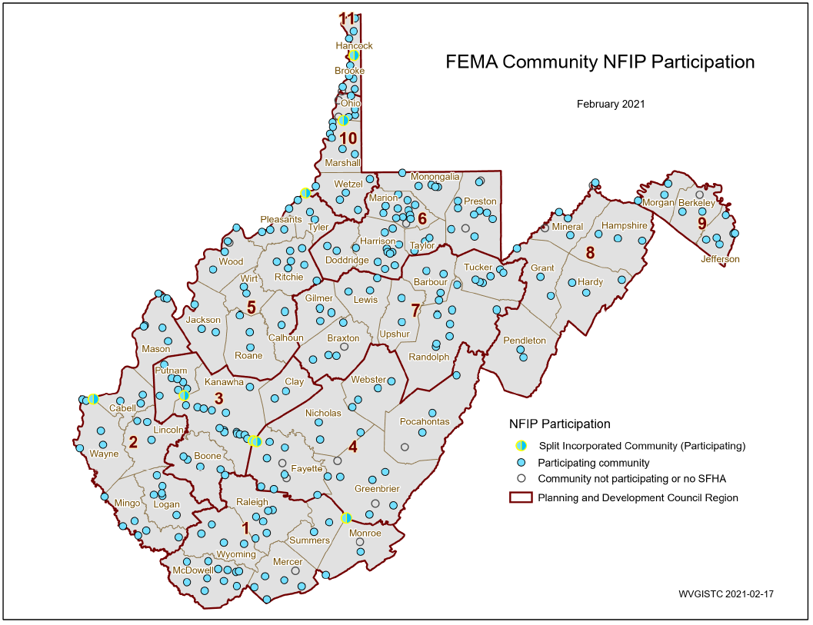
268 Floodprone Communities
12/12/2024
213 incorporated areas
+55 unincorporated areas
268 NFIP Communities
+18 no SFHA communities
286 WV Communities
+ 8 split communities
294 Statistical Geographies
294 Statistical Geographies form
286 Communities which form
55 Counties which form
11 PDC Regions which form
1 Statewide Flood Risk Assessment
94% of WV Communities have Special Flood Hazard Areas (SFHA)
SPLIT COMMUNITY | COUNTY 1 | COUNTY 2
Alderson | Greenbrier | Monroe
Huntington | Cabell | Wayne
Montgomery | Fayette | Kanawha
Nitro | Kanawha | Putnam
Paden City | Tyler | Wetzel
Smithers | Fayette | Kanawha
Wheeling | Marshall | Ohio
Weirton | Brooke | Hancock
PDF Map

Slide 2
268 Floodprone Communities
11 Regional Planning & Development Councils (55 Counties)
Region | # Counties | # Communities | Split Communities across County Boundary | Communities not participating in NFIP or no SFHA | # NFIP Communities¹
Region 1² | 6 | 32 |  | Athens, Union⁴ | 30
Region 2 | 6 | 31 | Huntington |  | 31
Region 3 | 4 | 29 | Nitro |  | 29
Region 4 | 5 | 31 | Alderson, Montgomery, Smithers | Fayetteville³, Hillsboro, Lewisburg, Quinwood³, Thurmond | 26
Region 5 | 8 | 30 | Paden City | North Hills | 29
Region 6 | 6 | 45 |  | Brandonville, Tunnelton, White Hall | 42
Region 7 | 7 | 31 |  | Flatwoods | 30
Region 8 | 5 | 17 |  | Carpendale, Elk Garden | 15
Region 9 | 3 | 12 |  | Hedgesville | 11
Region 10 | 3 | 18 | Wheeling | Bethlehem, Clearview | 16
Region 11 | 2 | 10 | Weirton | Windsor Heights | 9
total | 55 | 286 | 8 | 18 | 268
¹ Source: FEMA's Community Status Source Book. The communities of Rhodell (Fayette County) and Henderson (Mason County) have dissolved. ² Five communities in italics do not participate in National Flood Program according to Community Status Book. ³ Communities include SFHA or non-regulatory floodplain ⁴ Communities may not have any SFHA but still participate in the NFIP.
Split Communities Alderson, Montgomery and Smithers are members of Region 4
Split Community Paden City is a member of Region 5
Source: FEMA Community Status Book

