Slide 1
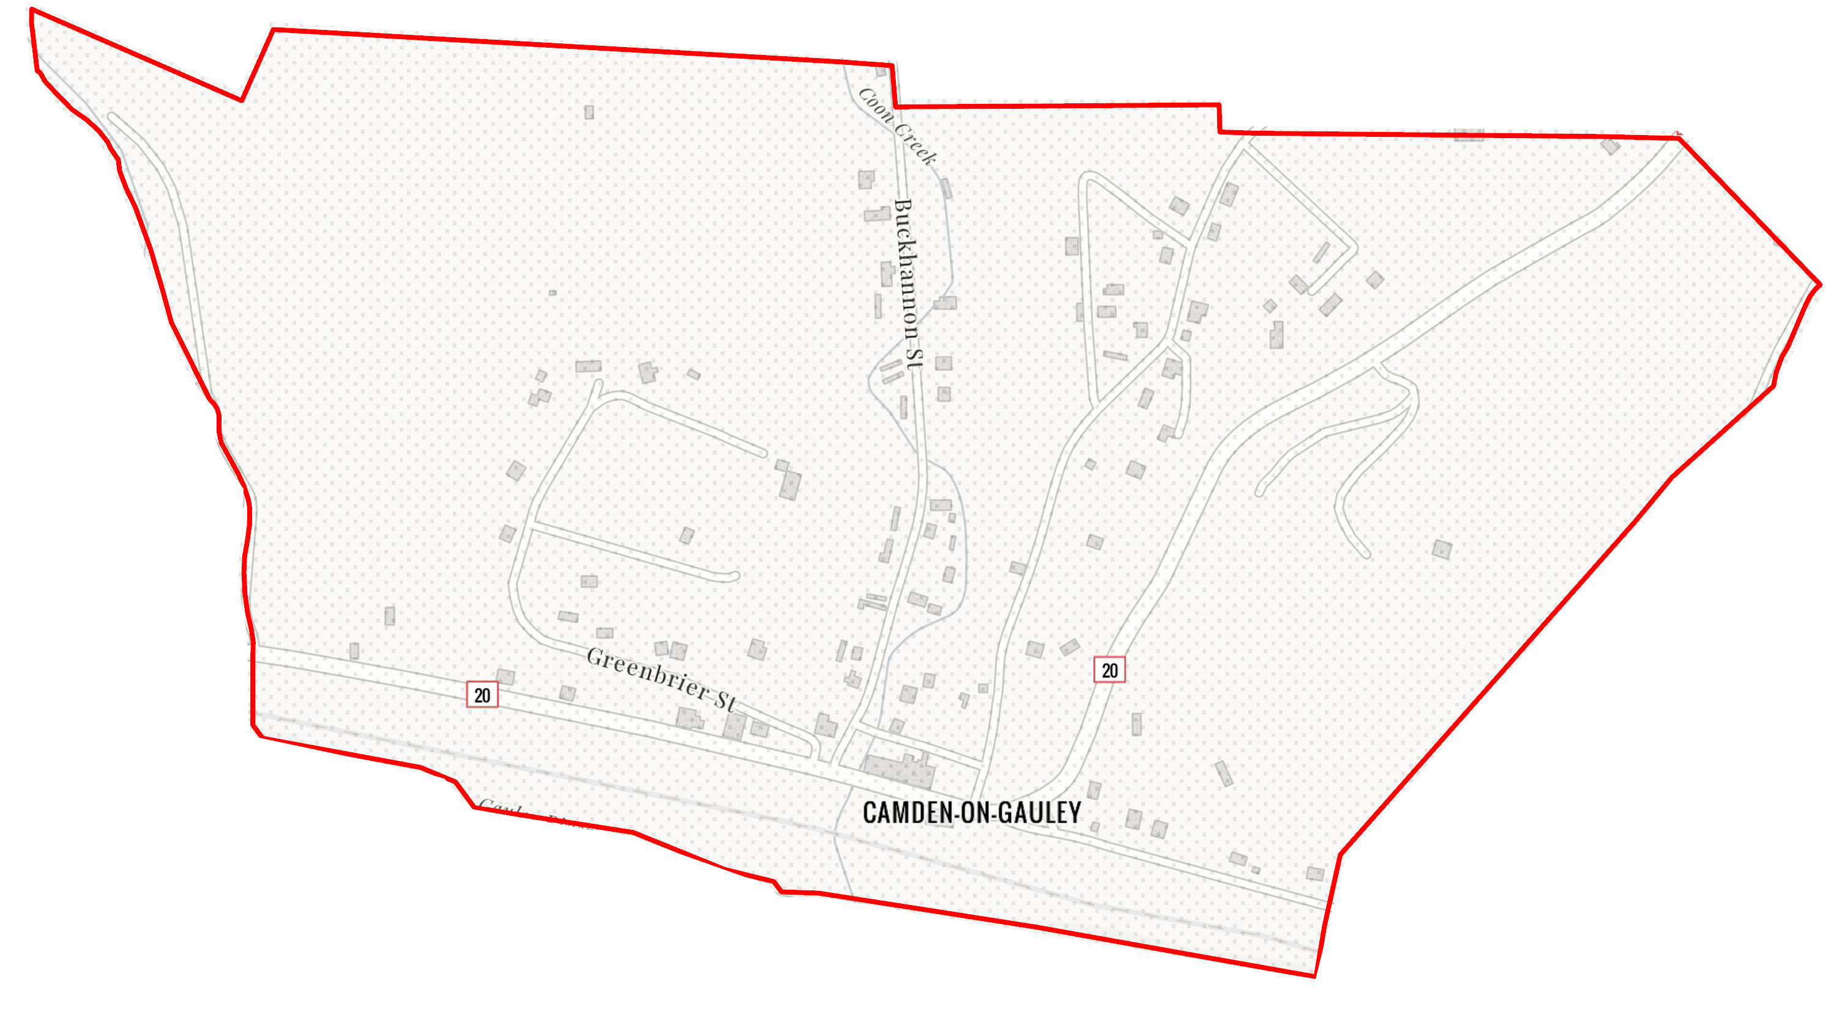
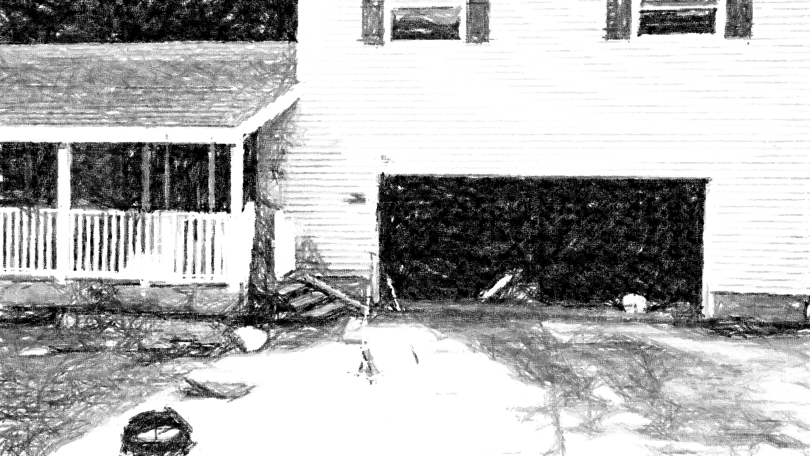
Camden on Gauley
51-04-0003-0006-0000_81
81 RIVERSIDE DR, Camden On Gauley, WV, 26208
Building Flood Profile
Building: 51-04-0003-0006-0000_81
91 RIVERSIDE DR, Camden On Gauley, WV, 26208

Slide 2
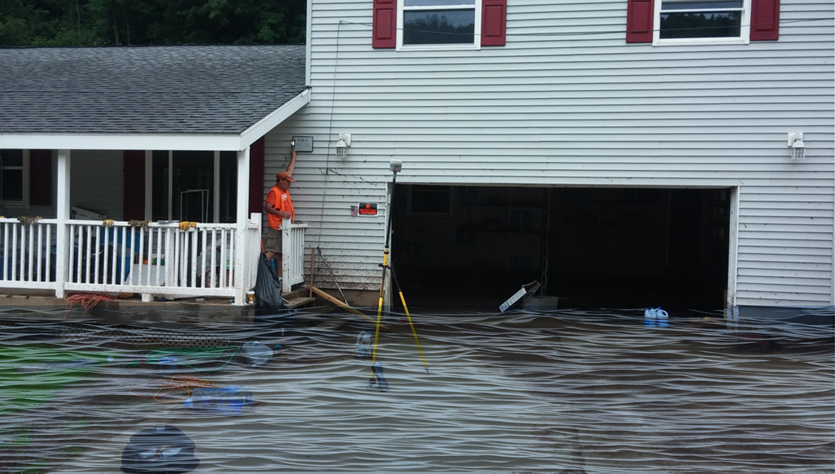
 | HEIGHT (ft.)
BUILDING
First Floor Height | 4
Freeboard (FBD) | 2
FLOOD DEPTH
FEMA 10% (10-Yr) | 1.9
FEMA 4% (25-Yr)
FEMA 2% (50-Yr)
2016 Flood HWM
FEMA 1% (100-Yr)
FEMA 100-Yr + FBD
FEMA 1%+ (84% CL)
FEMA 0.2% (500-Yr)
FSF 0.2% (500-Yr)
51-04-0003-0006-0000_81
81 RIVERSIDE DR, Camden On Gauley, WV, 26208
1.9’ (FEMA 10% / 10-Yr)
Building: 51-04-0003-0006-0000_81
FLOOD DEPTHS:
FEMA, Effective 2022
First Street Foundation (FSF, 2022)
USGS 2016 Flood High Water Mark

Slide 3
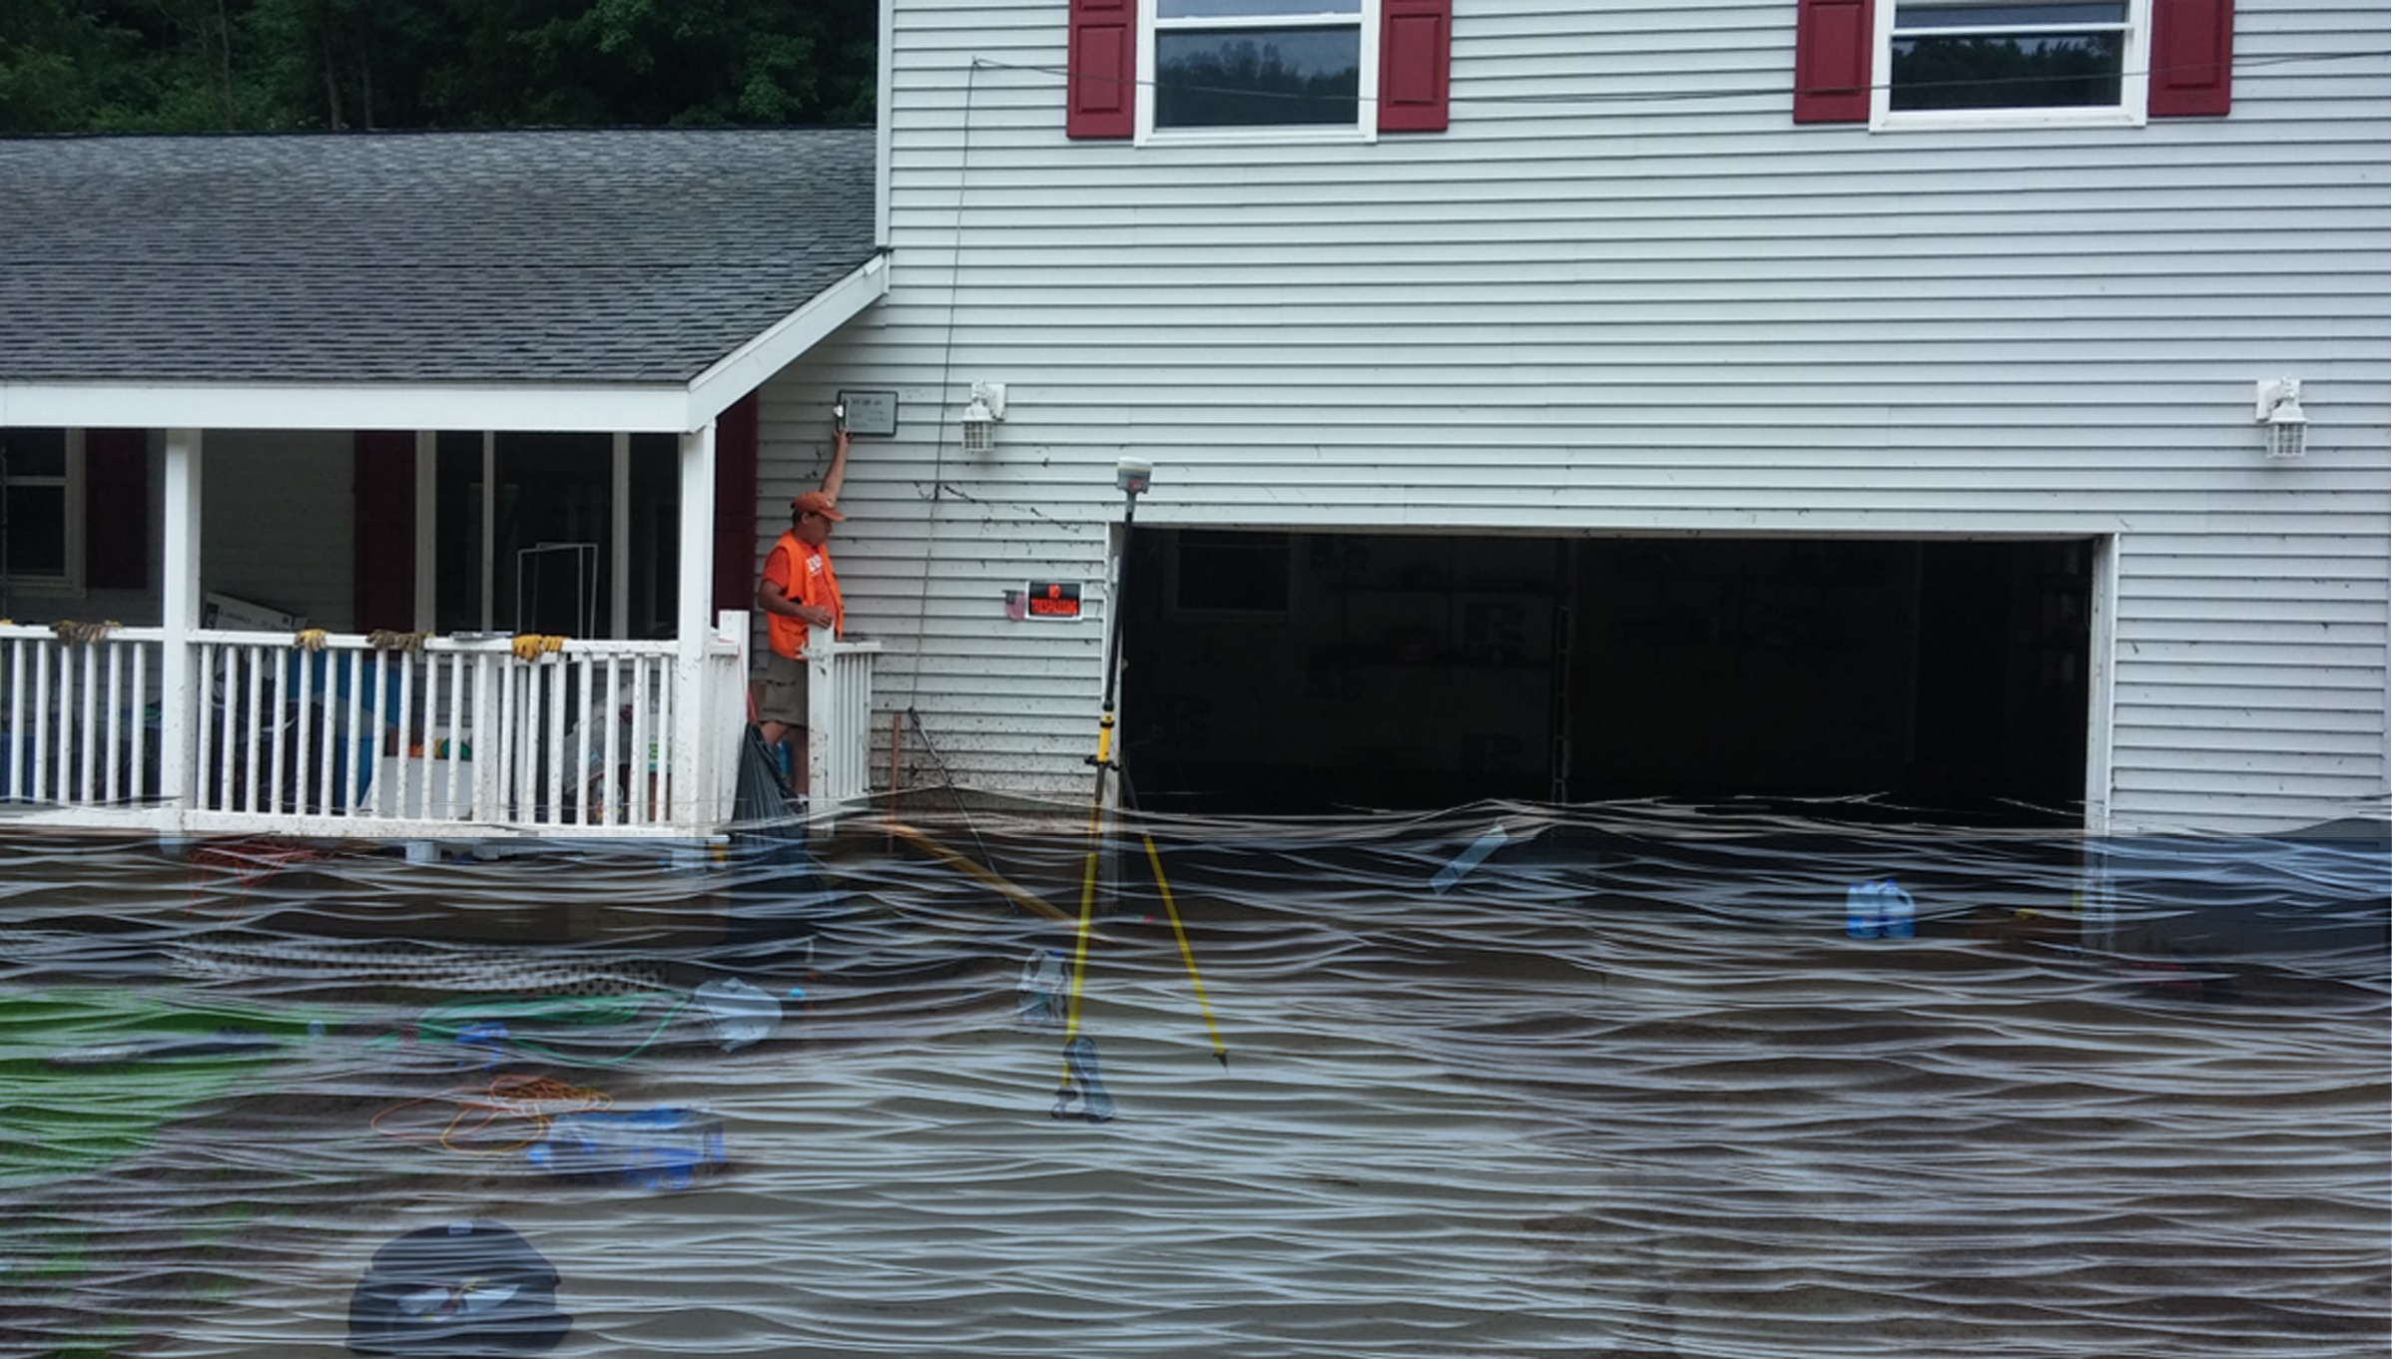
 | HEIGHT (ft.)
BUILDING
First Floor Height | 4
Freeboard (FBD) | 2
FLOOD DEPTH
FEMA 10% (10-Yr) | 1.9
FEMA 4% (25-Yr) | 4.4
FEMA 2% (50-Yr)
2016 Flood HWM
FEMA 1% (100-Yr)
FEMA 100-Yr + FBD
FEMA 1%+ (84% CL)
FEMA 0.2% (500-Yr)
FSF 0.2% (500-Yr)
51-04-0003-0006-0000_81
81 RIVERSIDE DR, Camden On Gauley, WV, 26208
4.4’ (FEMA 4% / 25-Yr)
1.9’ (FEMA 10% / 10-Yr)
Building: 51-04-0003-0006-0000_81
FLOOD DEPTHS:
FEMA, Effective 2022
First Street Foundation (FSF, 2022)
USGS 2016 Flood High Water Mark

Slide 4
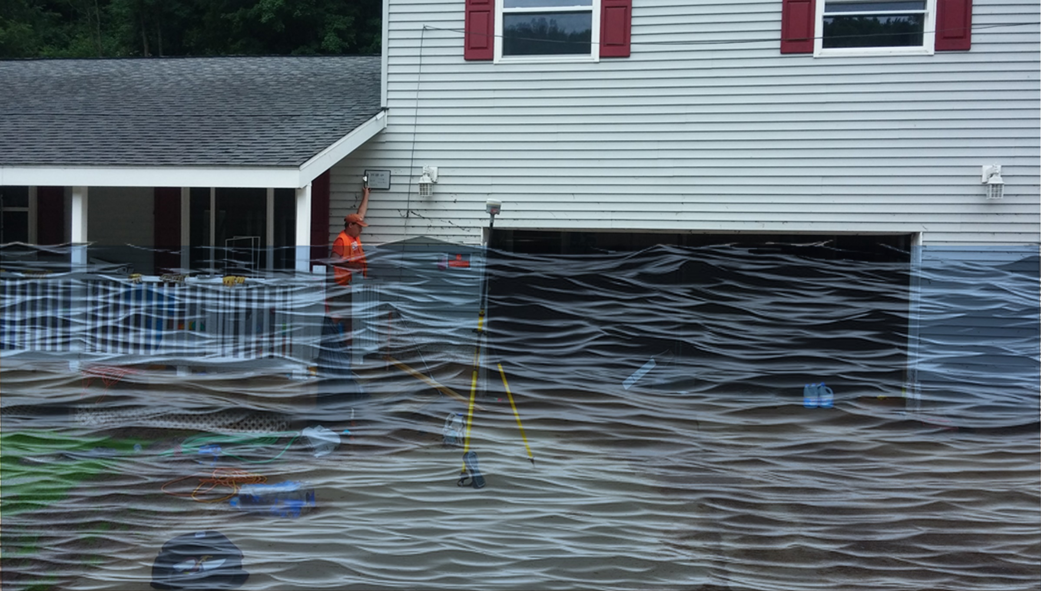
 | HEIGHT (ft.)
BUILDING
First Floor Height | 4
Freeboard (FBD) | 2
FLOOD DEPTH
FEMA 10% (10-Yr) | 1.9
FEMA 4% (25-Yr) | 4.4
FEMA 2% (50-Yr) | 6.7
2016 Flood HWM
FEMA 1% (100-Yr)
FEMA 100-Yr + FBD
FEMA 1%+ (84% CL)
FEMA 0.2% (500-Yr)
FSF 0.2% (500-Yr)
51-04-0003-0006-0000_81
81 RIVERSIDE DR, Camden On Gauley, WV, 26208
6.7’ (FEMA 2% / 50-Yr)
4.4’ (FEMA 4% / 25-Yr)
1.9’ (FEMA 10% / 10-Yr)
Building: 51-04-0003-0006-0000_81
FLOOD DEPTHS:
FEMA, Effective 2022
First Street Foundation (FSF, 2022)
USGS 2016 Flood High Water Mark

Slide 5
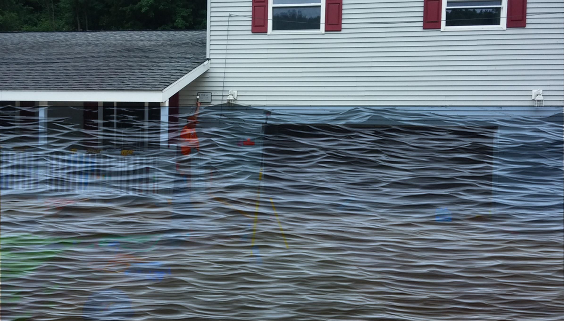
 | HEIGHT (ft.)
BUILDING
First Floor Height | 4
Freeboard (FBD) | 2
FLOOD DEPTH
FEMA 10% (10-Yr) | 1.9
FEMA 4% (25-Yr) | 4.4
FEMA 2% (50-Yr) | 6.7
2016 Flood HWM
FEMA 1% (100-Yr) | 8.3
FEMA 100-Yr + FBD | 10.3
FEMA 1%+ (84% CL)
FEMA 0.2% (500-Yr)
FSF 0.2% (500-Yr)
51-04-0003-0006-0000_81
81 RIVERSIDE DR, Camden On Gauley, WV, 26208
8.3’ (FEMA 1% / 100-Yr)
6.7’ (FEMA 2% / 50-Yr)
4.4’ (FEMA 4% / 25-Yr)
1.9’ (FEMA 10% / 10-Yr)
Building: 51-04-0003-0006-0000_81
FLOOD DEPTHS:
FEMA, Effective 2022
First Street Foundation (FSF, 2022)
USGS 2016 Flood High Water Mark

Slide 6
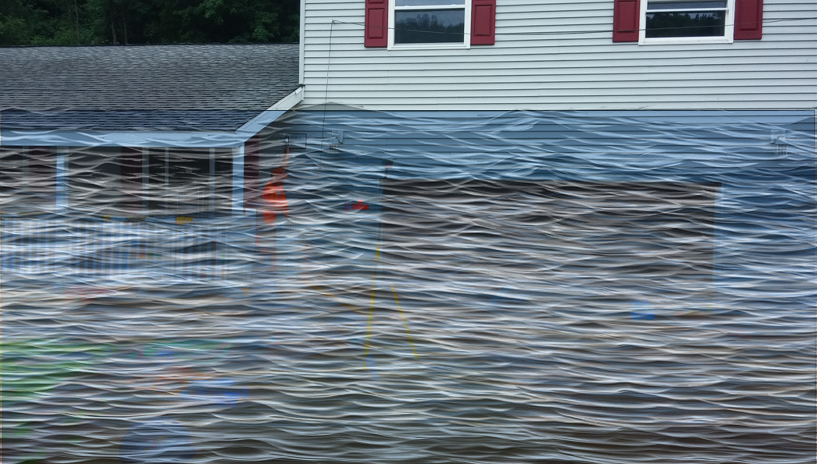
 | HEIGHT (ft.)
BUILDING
First Floor Height | 4
Freeboard (FBD) | 2
FLOOD DEPTH
FEMA 10% (10-Yr) | 1.9
FEMA 4% (25-Yr) | 4.4
FEMA 2% (50-Yr) | 6.7
2016 Flood HWM
FEMA 1% (100-Yr) | 8.3
FEMA 100-Yr + FBD | 10.3
FEMA 1%+ (84% CL) | 10.7
FEMA 0.2% (500-Yr)
FSF 0.2% (500-Yr)
51-04-0003-0006-0000_81
81 RIVERSIDE DR, Camden On Gauley, WV, 26208
10.7’ FEMA 1%+ (84% CL)
8.3’ (FEMA 1% / 100-Yr)
6.7’ (FEMA 2% / 50-Yr)
4.4’ (FEMA 4% / 25-Yr)
1.9’ (FEMA 10% / 10-Yr)
Building: 51-04-0003-0006-0000_81
FLOOD DEPTHS:
FEMA, Effective 2022
First Street Foundation (FSF, 2022)
USGS 2016 Flood High Water Mark

Slide 7
 | HEIGHT (ft.)
BUILDING
First Floor Height | 4
Freeboard (FBD) | 2
FLOOD DEPTH
FEMA 10% (10-Yr) | 1.9
FEMA 4% (25-Yr) | 4.4
FEMA 2% (50-Yr) | 6.7
2016 Flood HWM | 9.1
FEMA 1% (100-Yr) | 8.3
FEMA 100-Yr + FBD | 10.3
FEMA 1%+ (84% CL) | 10.7
FEMA 0.2% (500-Yr)
FSF 0.2% (500-Yr)
51-04-0003-0006-0000_81
81 RIVERSIDE DR, Camden On Gauley, WV, 26208
10.7’ FEMA 1%+ (84% CL)
9.1’ (2016 High Water)
8.3’ (FEMA 1% / 100-Yr)
6.7’ (FEMA 2% / 50-Yr)
4.4’ (FEMA 4% / 25-Yr)
1.9’ (FEMA 10% / 10-Yr)
Building: 51-04-0003-0006-0000_81
FLOOD DEPTHS:
FEMA, Effective 2022
First Street Foundation (FSF, 2022)
USGS 2016 Flood High Water Mark

Slide 8
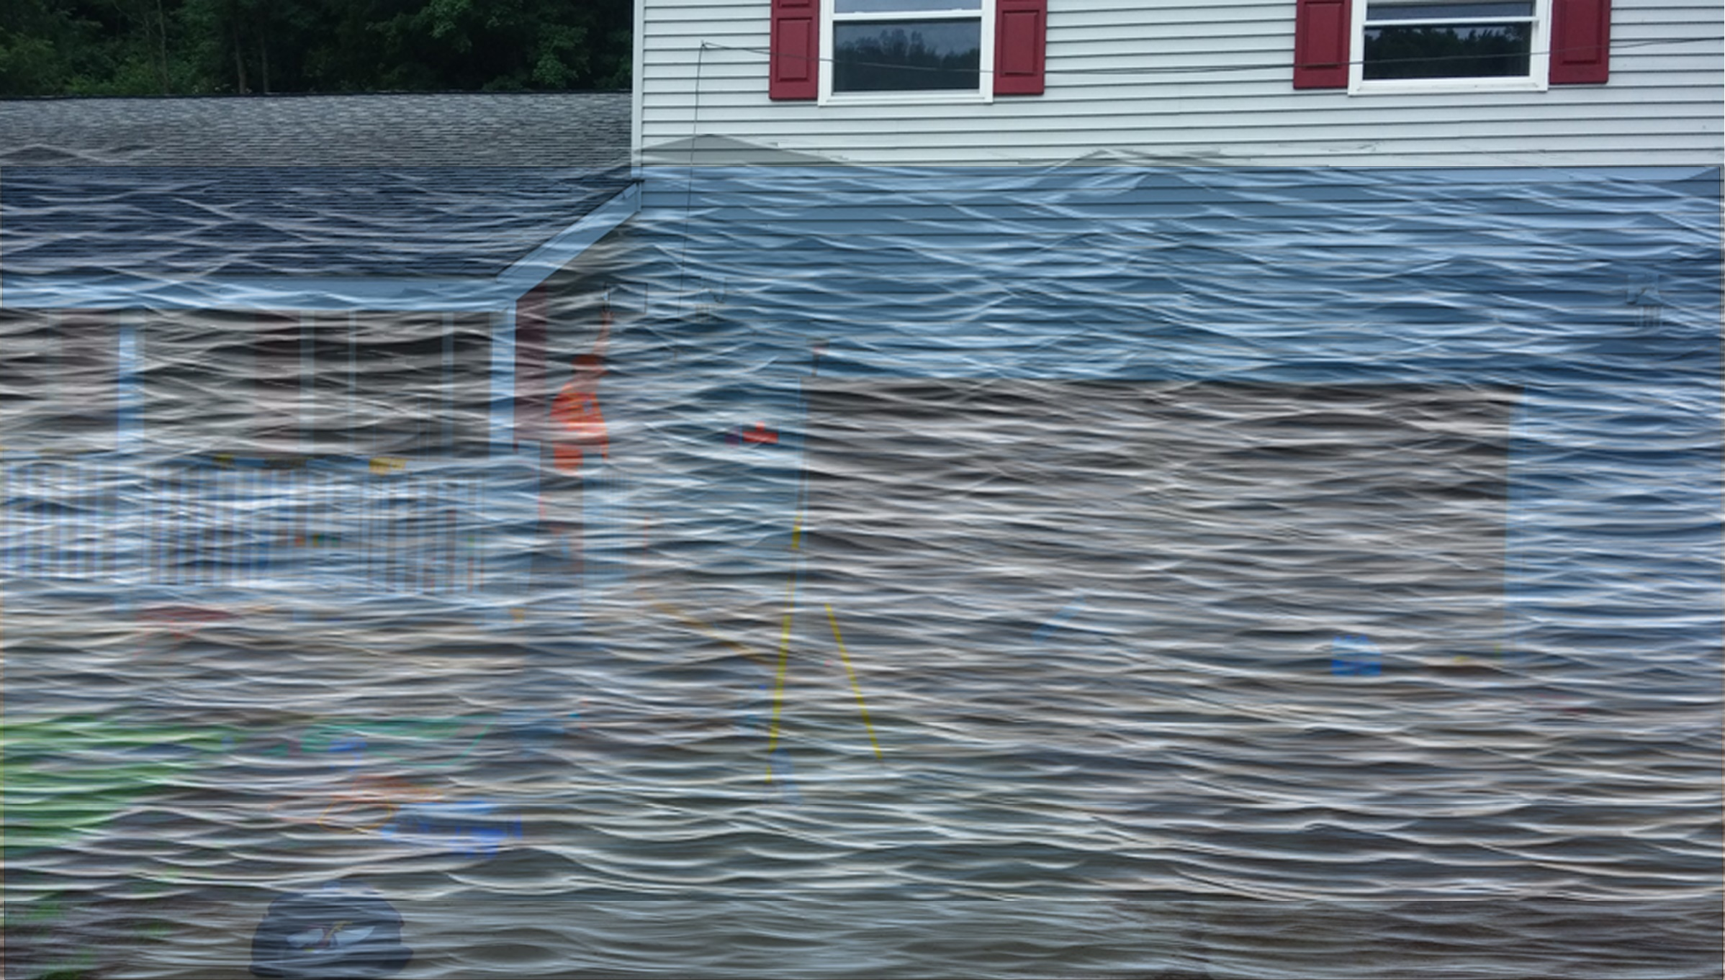
 | HEIGHT (ft.)
BUILDING
First Floor Height | 4
Freeboard (FBD) | 2
FLOOD DEPTH
FEMA 10% (10-Yr) | 1.9
FEMA 4% (25-Yr) | 4.4
FEMA 2% (50-Yr) | 6.7
2016 Flood HWM | 9.1
FEMA 1% (100-Yr) | 8.3
FEMA 100-Yr + FBD | 10.3
FEMA 1%+ (84% CL) | 10.7
FEMA 0.2% (500-Yr) | 12.7
FSF 0.2% (500-Yr)
51-04-0003-0006-0000_81
12.7’ (FEMA 0.2% / 500-Yr )
81 RIVERSIDE DR, Camden On Gauley, WV, 26208
10.7’ FEMA 1%+ (84% CL)
9.1’ (2016 High Water)
8.3’ (FEMA 1% / 100-Yr)
6.7’ (FEMA 2% / 50-Yr)
4.4’ (FEMA 4% / 25-Yr)
1.9’ (FEMA 10% / 10-Yr)
Building: 51-04-0003-0006-0000_81
FLOOD DEPTHS:
FEMA, Effective 2022
First Street Foundation (FSF, 2022)
USGS 2016 Flood High Water Mark

Slide 9
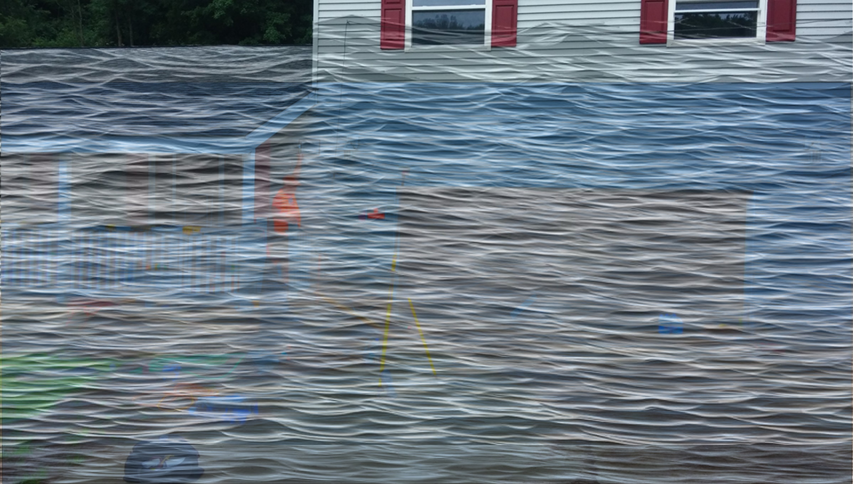
 | HEIGHT (ft.)
BUILDING
First Floor Height | 4
Freeboard (FBD) | 2
FLOOD DEPTH
FEMA 10% (10-Yr) | 1.9
FEMA 4% (25-Yr) | 4.4
FEMA 2% (50-Yr) | 6.7
2016 Flood HWM | 9.1
FEMA 1% (100-Yr) | 8.3
FEMA 100-Yr + FBD | 10.3
FEMA 1%+ (84% CL) | 10.7
FEMA 0.2% (500-Yr) | 12.7
FSF 0.2% (500-Yr) | 14.8
51-04-0003-0006-0000_81
14.8’ (FSF 0.2% / 500-Yr)
12.7’ (FEMA 0.2% / 500-Yr )
81 RIVERSIDE DR, Camden On Gauley, WV, 26208
10.7’ FEMA 1%+ (84% CL)
9.1’ (2016 High Water)
8.3’ (FEMA 1% / 100-Yr)
6.7’ (FEMA 2% / 50-Yr)
4.4’ (FEMA 4% / 25-Yr)
1.9’ (FEMA 10% / 10-Yr)
Building: 51-04-0003-0006-0000_81
FLOOD DEPTHS:
FEMA, Effective 2022
First Street Foundation (FSF, 2022)
USGS 2016 Flood High Water Mark

