Slide 1
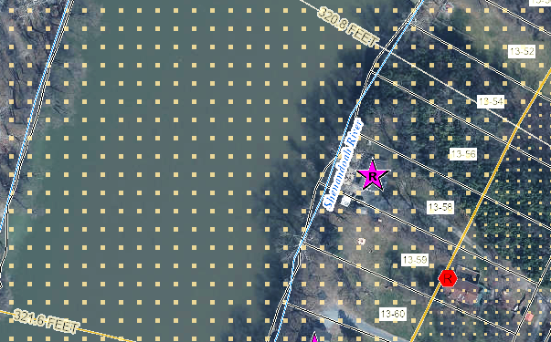
Building Flood Profile - Unmitigated
Single Family Dwelling in Jefferson County*
Appraised Value: $217K
(Building ID: 19-04-0013-0059-0000_89)
Rivermist Lane, Harpers Ferry
Repetitive Loss Area / Area of Mitigation Interest
 | HEIGHT (ft.)
BUILDING
Freeboard (FBD) | 3
FLOOD DEPTH
FEMA 1% (100-Yr) | 13.6
FEMA 100-Yr + | 16.6
FEMA 0.2% (500-Yr) | 19.6
Flood Source: Shenandoah River
Post-FIRM
19.6’ (FEMA 0.2% / 500-Yr)
16.6’ (FEMA 1% + / 100-Yr +)
13.6’ (FEMA 1% / 100-Yr)
Ground Level

Slide 2
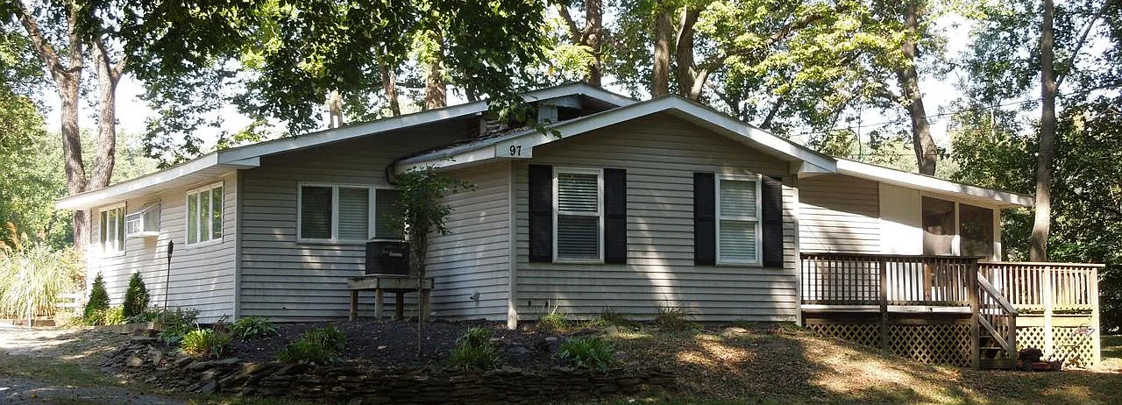
Building Flood Profile - Unmitigated
Single Family Dwelling in Jefferson County*
in Floodway
Appraised Value: $95K
(Building ID: 19-04-0013-0058-0000_97)
Rivermist Lane, Harpers Ferry
Repetitive Loss Area / Area of Mitigation Interest
Flood Source: Shenandoah River
 | HEIGHT (ft.)
BUILDING
Freeboard (FBD) | 3
FLOOD DEPTH
FEMA 1% (100-Yr) | 13.7
FEMA 100-Yr + | 16.7
FEMA 0.2% (500-Yr) | 19.7
Pre-FIRM
19.7’ (FEMA 0.2% / 500-Yr)
16.7’ (FEMA 1% + / 100-Yr +)
13.7’ (FEMA 1% / 100-Yr)
Ground Level

Slide 3
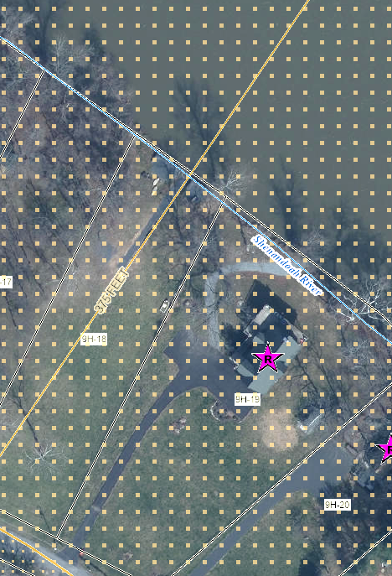
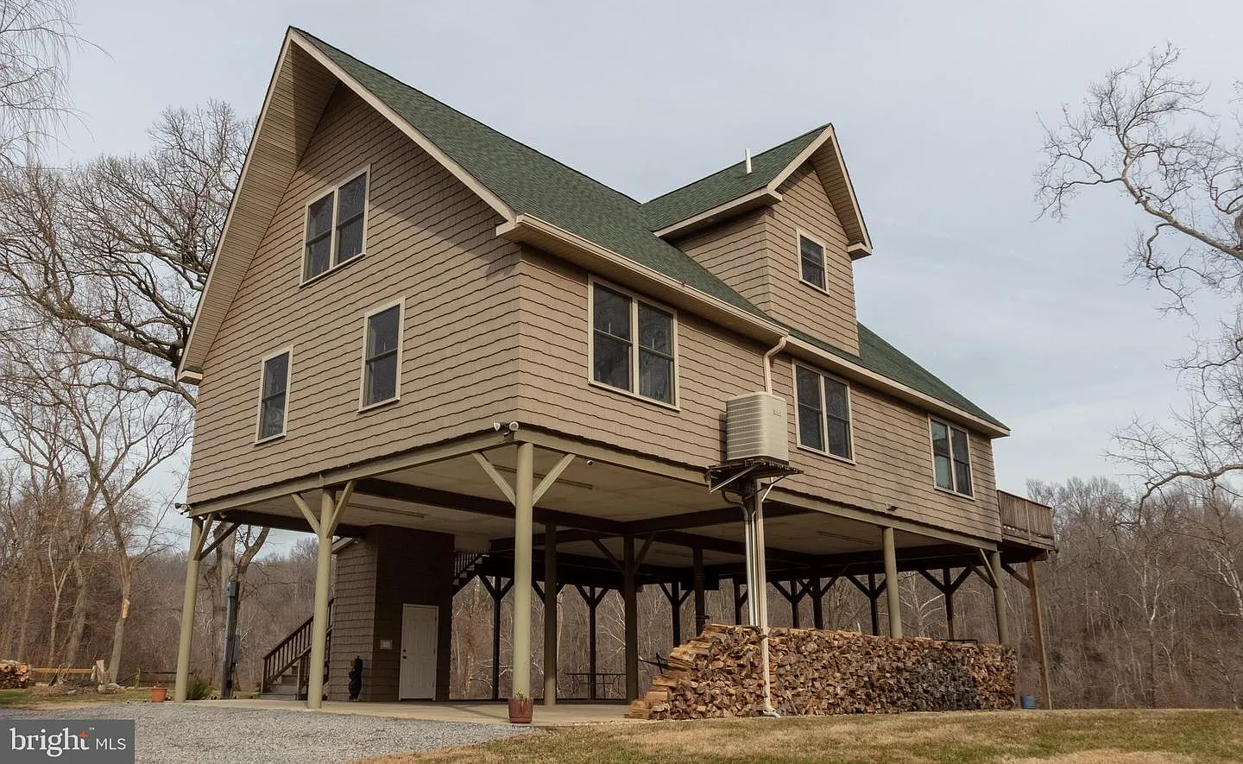
Building Flood Profile– Mitigated to DFE
Flood Profile
 | HEIGHT (ft.)
BUILDING
Freeboard (FBD) | 3
FLOOD DEPTH
FEMA 1% (100-Yr) | 9.9
FEMA 100-Yr + | 12.9
FEMA 0.2% (500-Yr) | 18.9
Flood Source: Shenandoah River
Post-FIRM
18.9’ (FEMA 0.2% / 500-Yr)
14.9’ (FEMA 1% + / 100-Yr +)
Single Family Dwelling in Jefferson County*
Elevated in Floodway
Appraised Value: $265K
(Building ID: 19-06-009H-0019-0000_781)
9.9’ (FEMA 1% / 100-Yr)
Ground Level

