Slide 1
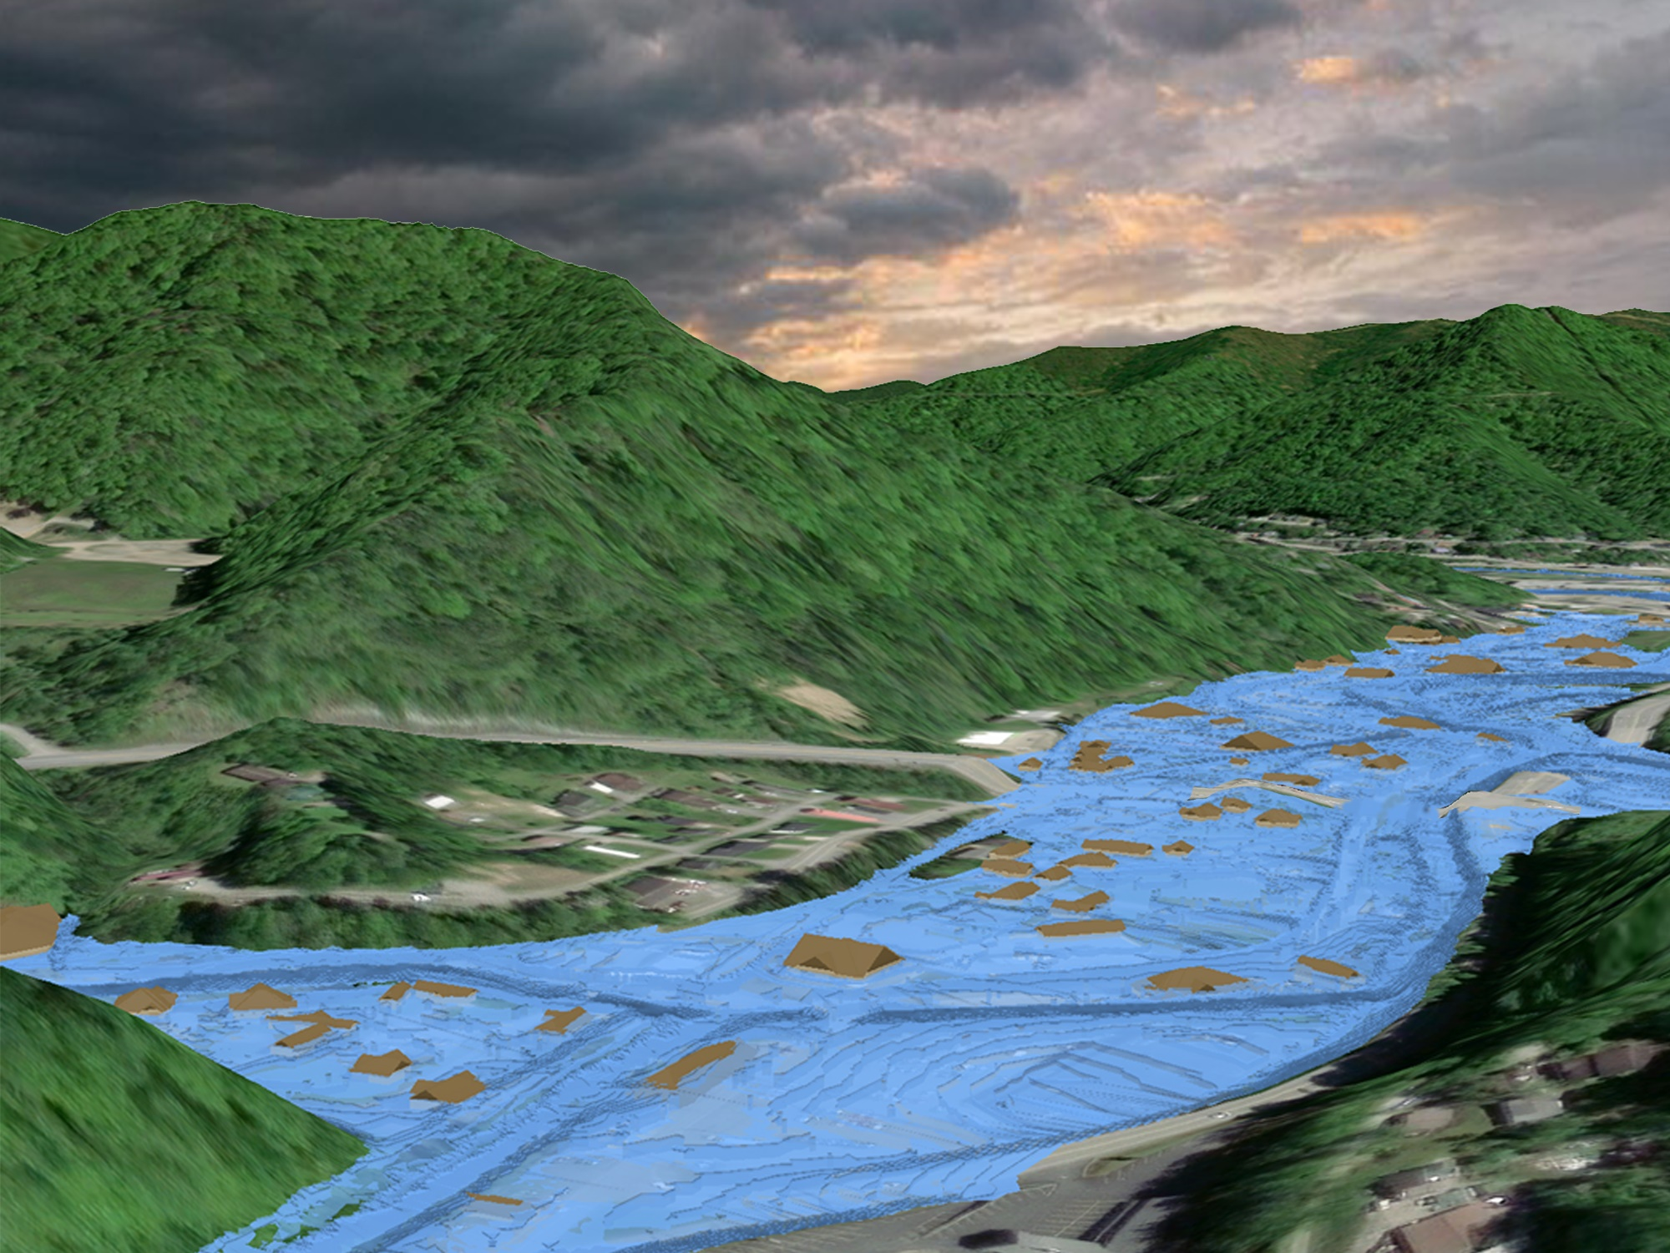

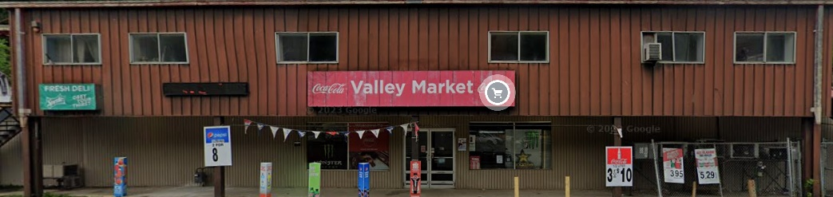
Inundated Area in one-hundred-year flood
Flood Source: Copperas Mine Fork
Watershed: Upper Guyandotte
Mud Fork
Copperas Mud Fork

Slide 2
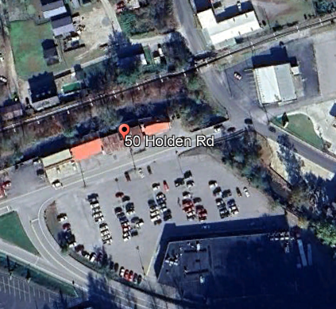
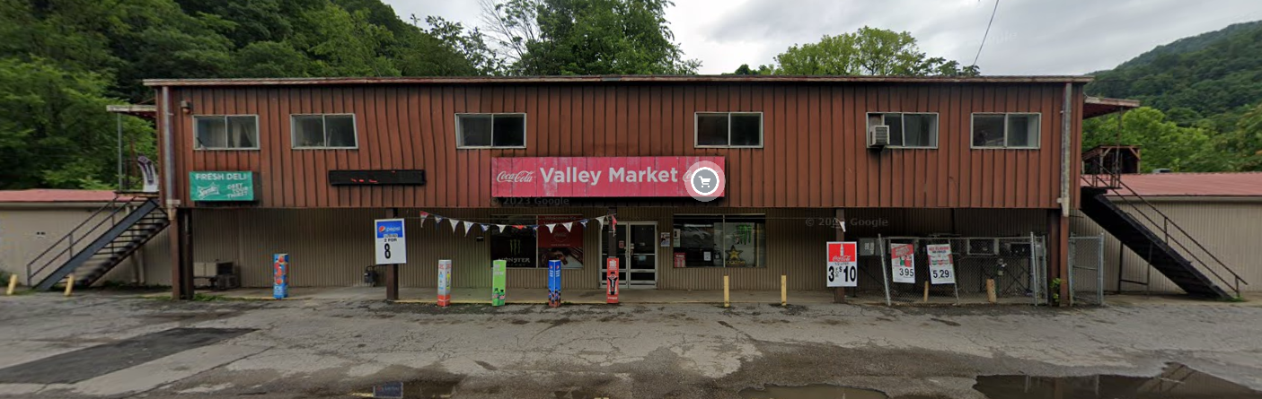
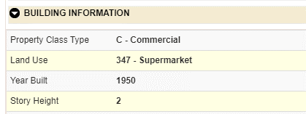
Building General Identification
23-03-0066-0074-0000_50
50 HOLDEN RD, MOUNT GAY, WV, 25637
Pre-FIRM

Slide 3

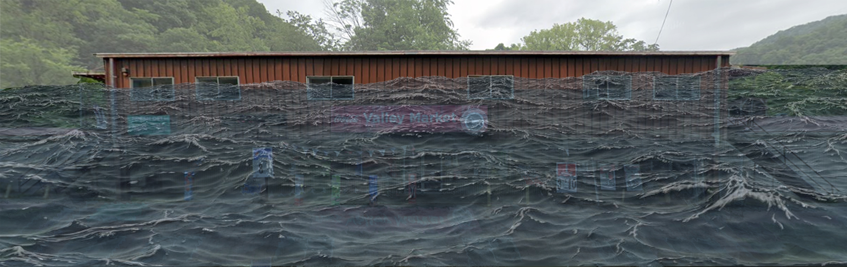
Flood Profile
 | HEIGHT (ft.)
BUILDING
Freeboard (FBD) | 2
FLOOD DEPTH
FEMA 1% (100-Yr) | 12.6
FEMA 100-Yr + FBD | 14.6
FEMA 0.2% (500-Yr)
Flood Profile
12.6’ (FEMA 1% / 100-Yr)
FLOOD DEPTHS:
FEMA, Effective 2008

Slide 4
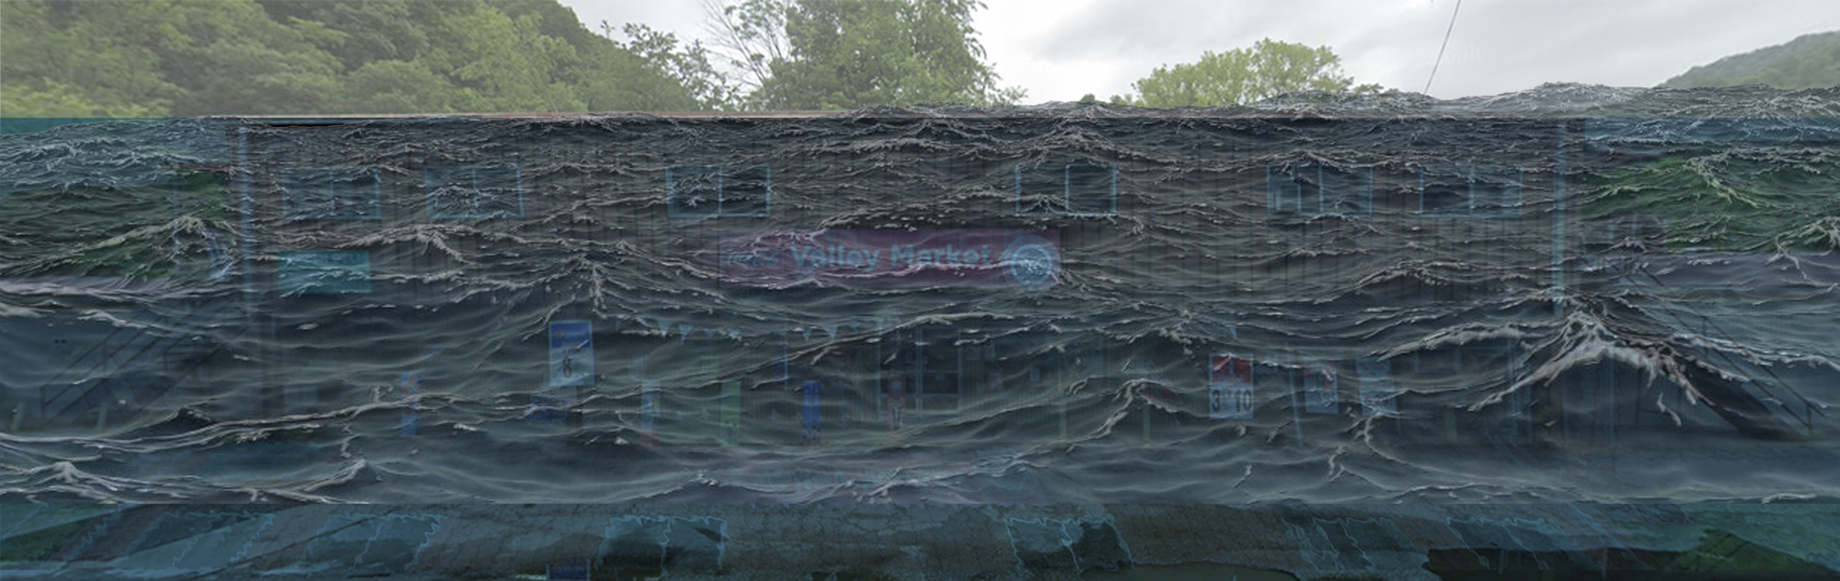
Flood Profile
 | HEIGHT (ft.)
BUILDING
Freeboard (FBD) | 2
FLOOD DEPTH
FEMA 1% (100-Yr) | 12.6
FEMA 100-Yr + FBD | 14.6
FEMA 0.2% (500-Yr) | 15.6
Flood Profile
15.6’ (FEMA 0.2% / 500-Yr)
12.6’ (FEMA 1% / 100-Yr)
FLOOD DEPTHS:
FEMA, Effective 2008

Slide 5
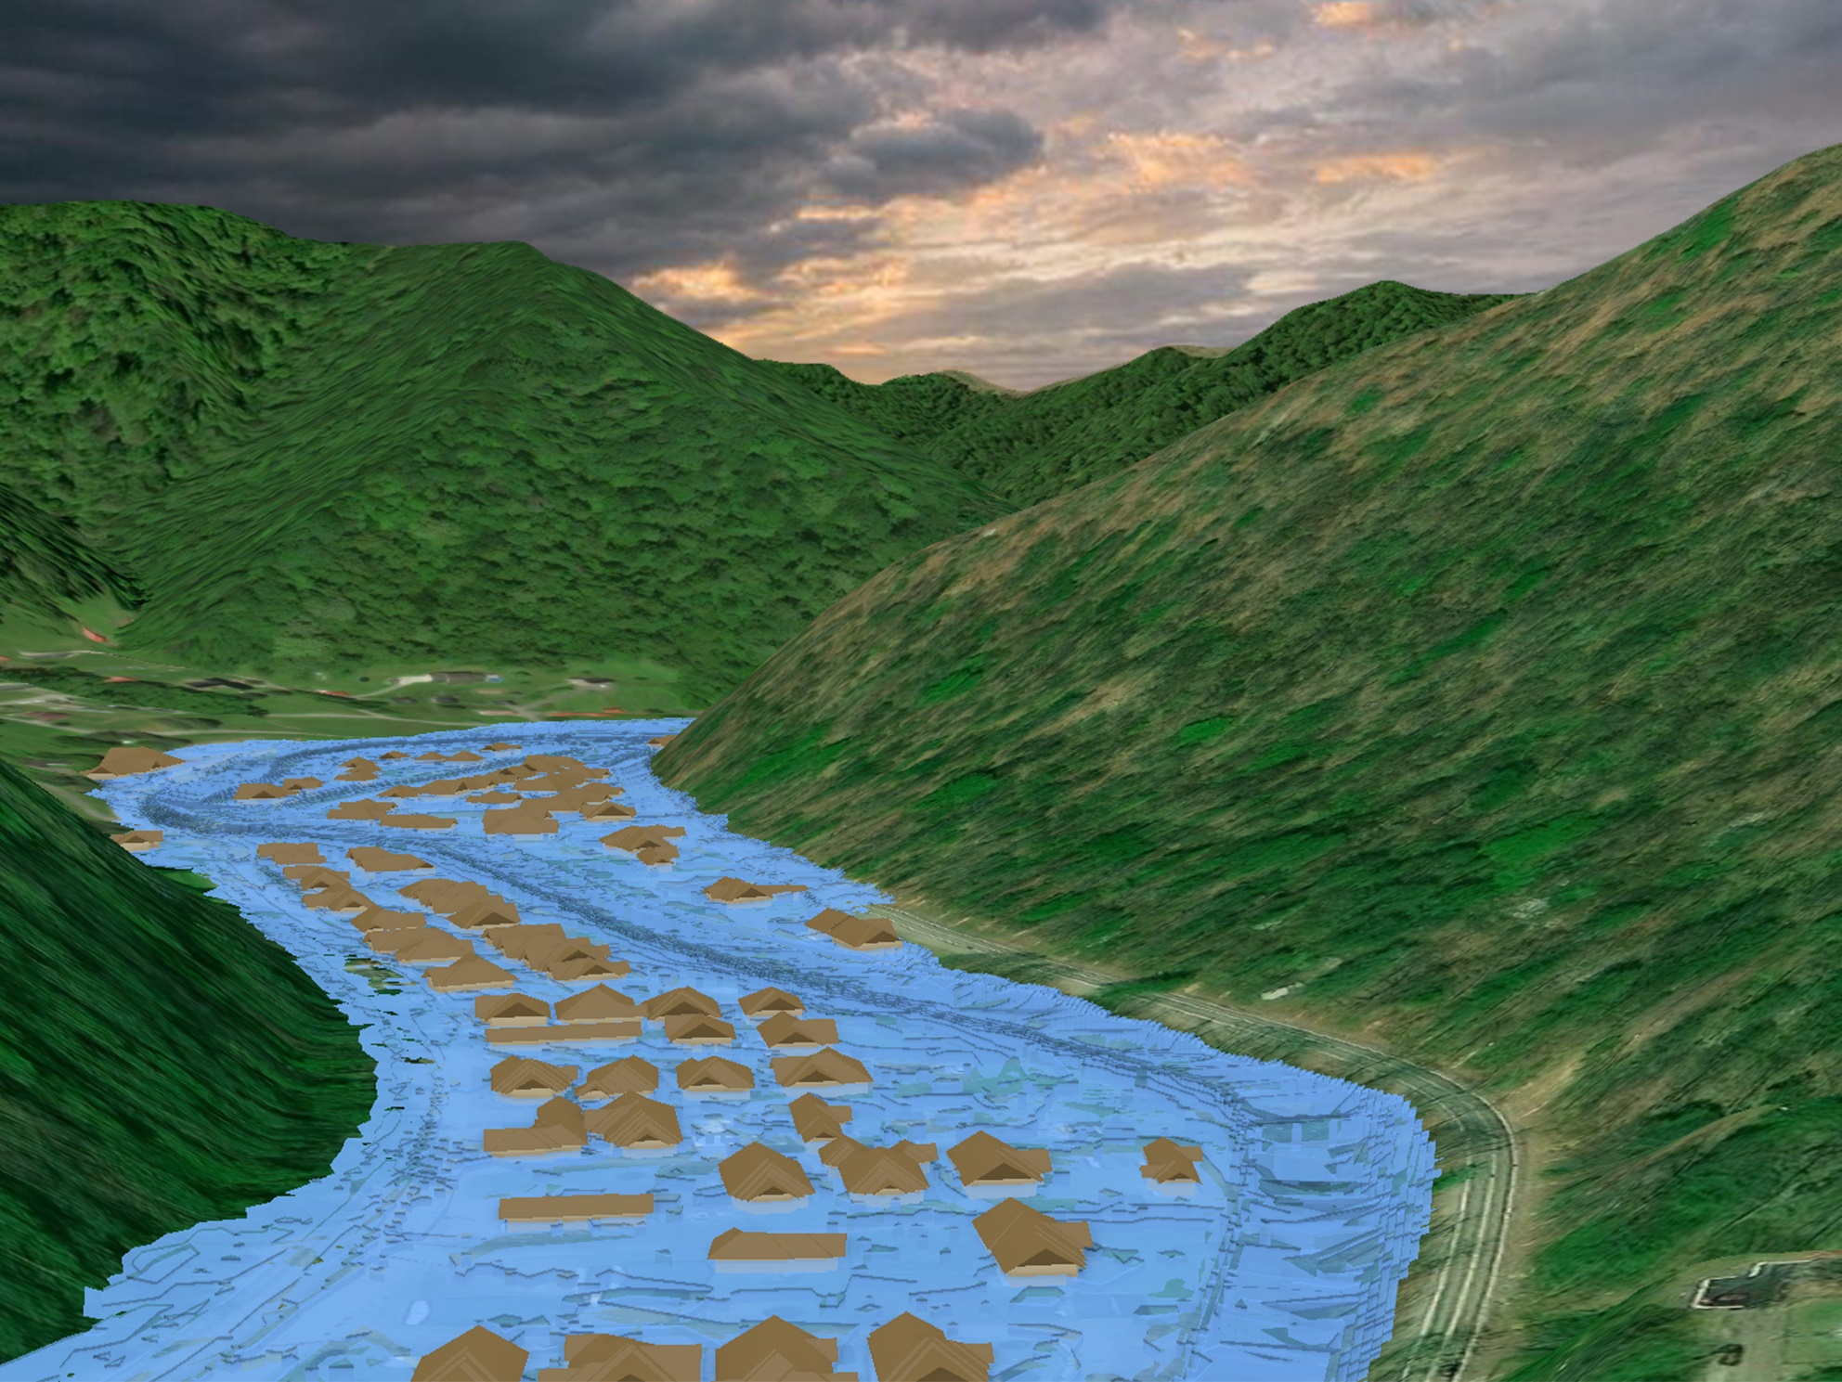
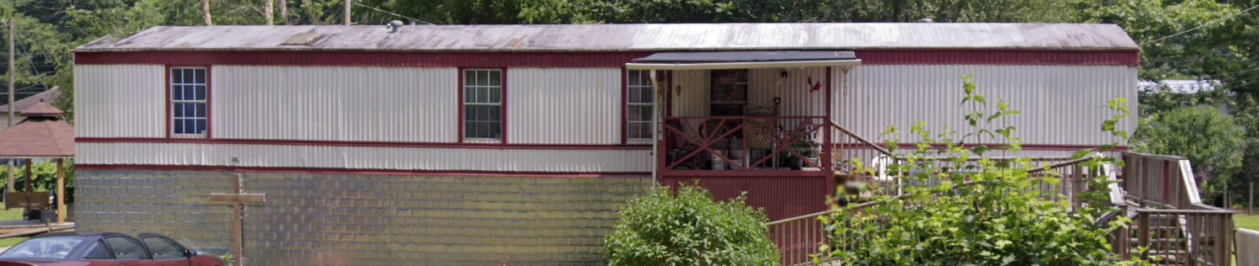

Inundated Area in one-hundred-year flood
Flood Source: Island Creek
Watershed: Upper Guyandotte
Island Creek
Island Creek

Slide 6
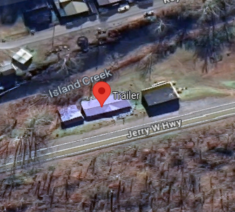
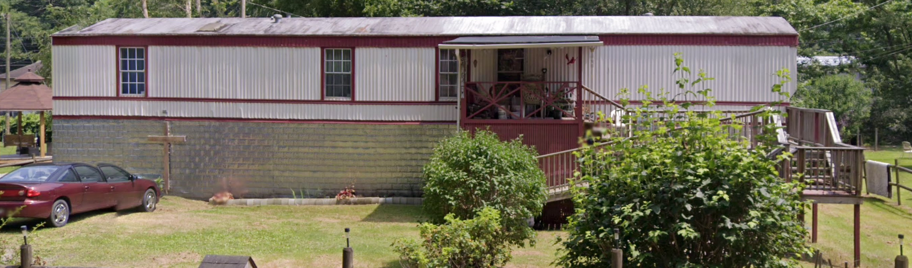
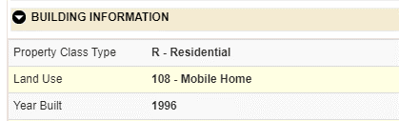
Building General Identification
23-03-0029-0029-0000_3456
3456 JERRY WEST HWY TRLR, ROSSMORE, WV, 25636
Post-FIRM

Slide 7
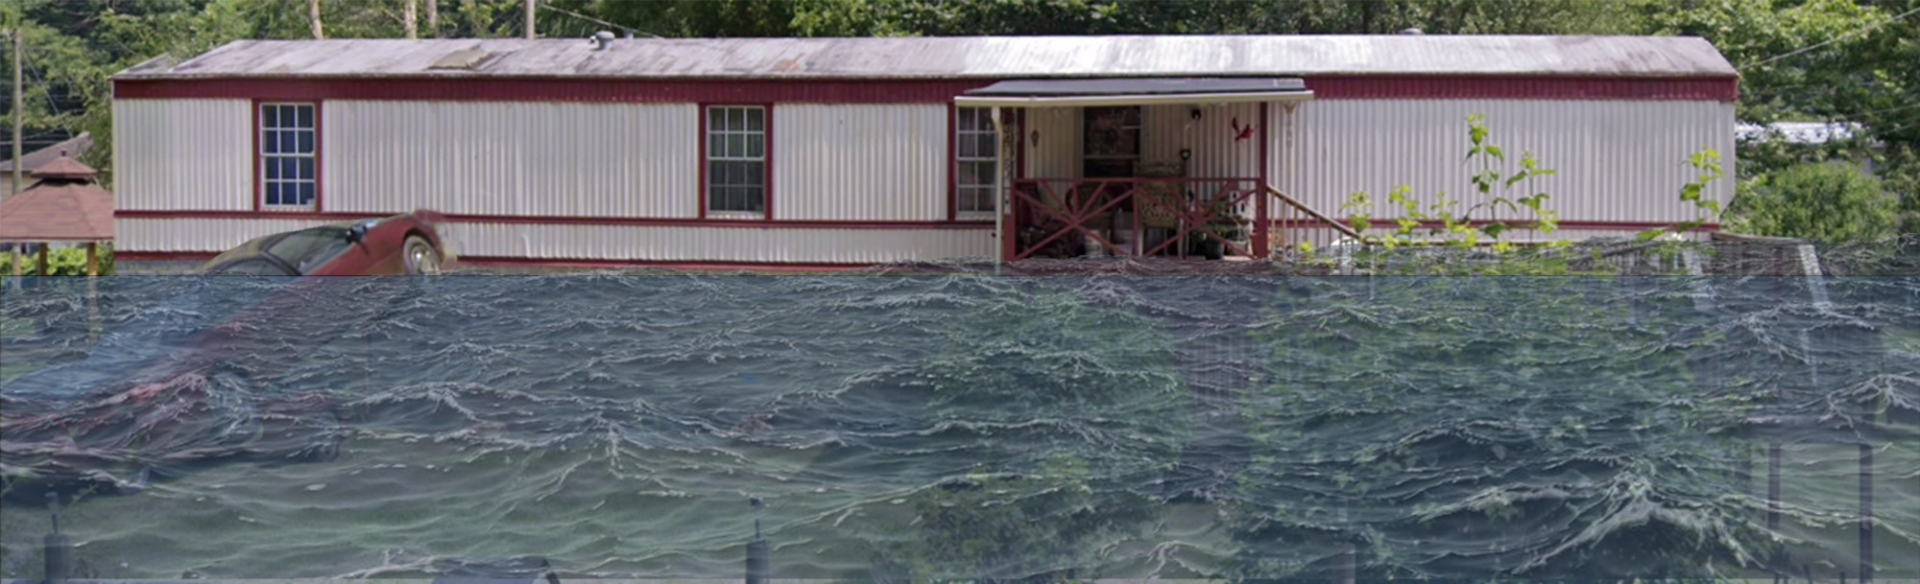
Flood Profile
 | HEIGHT (ft.)
BUILDING
Freeboard (FBD) | 2
FLOOD DEPTH
FEMA 1% (100-Yr) | 7.2
FEMA 100-Yr + FBD | 9.2
FEMA 0.2% (500-Yr)
Flood Profile
7.2’ (FEMA 1% / 100-Yr)
FLOOD DEPTHS:
FEMA, Effective 2008

Slide 8
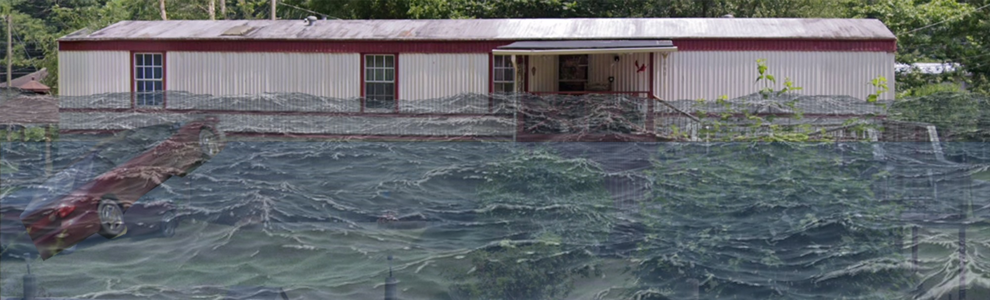
Flood Profile
 | HEIGHT (ft.)
BUILDING
Freeboard (FBD) | 2
FLOOD DEPTH
FEMA 1% (100-Yr) | 7.2
FEMA 100-Yr + FBD | 9.2
FEMA 0.2% (500-Yr) | 9.2
Flood Profile
9.2’ (FEMA 0.2% / 500-Yr)
7.2’ (FEMA 1% / 100-Yr)
FLOOD DEPTHS:
FEMA, Effective 2008

Slide 9
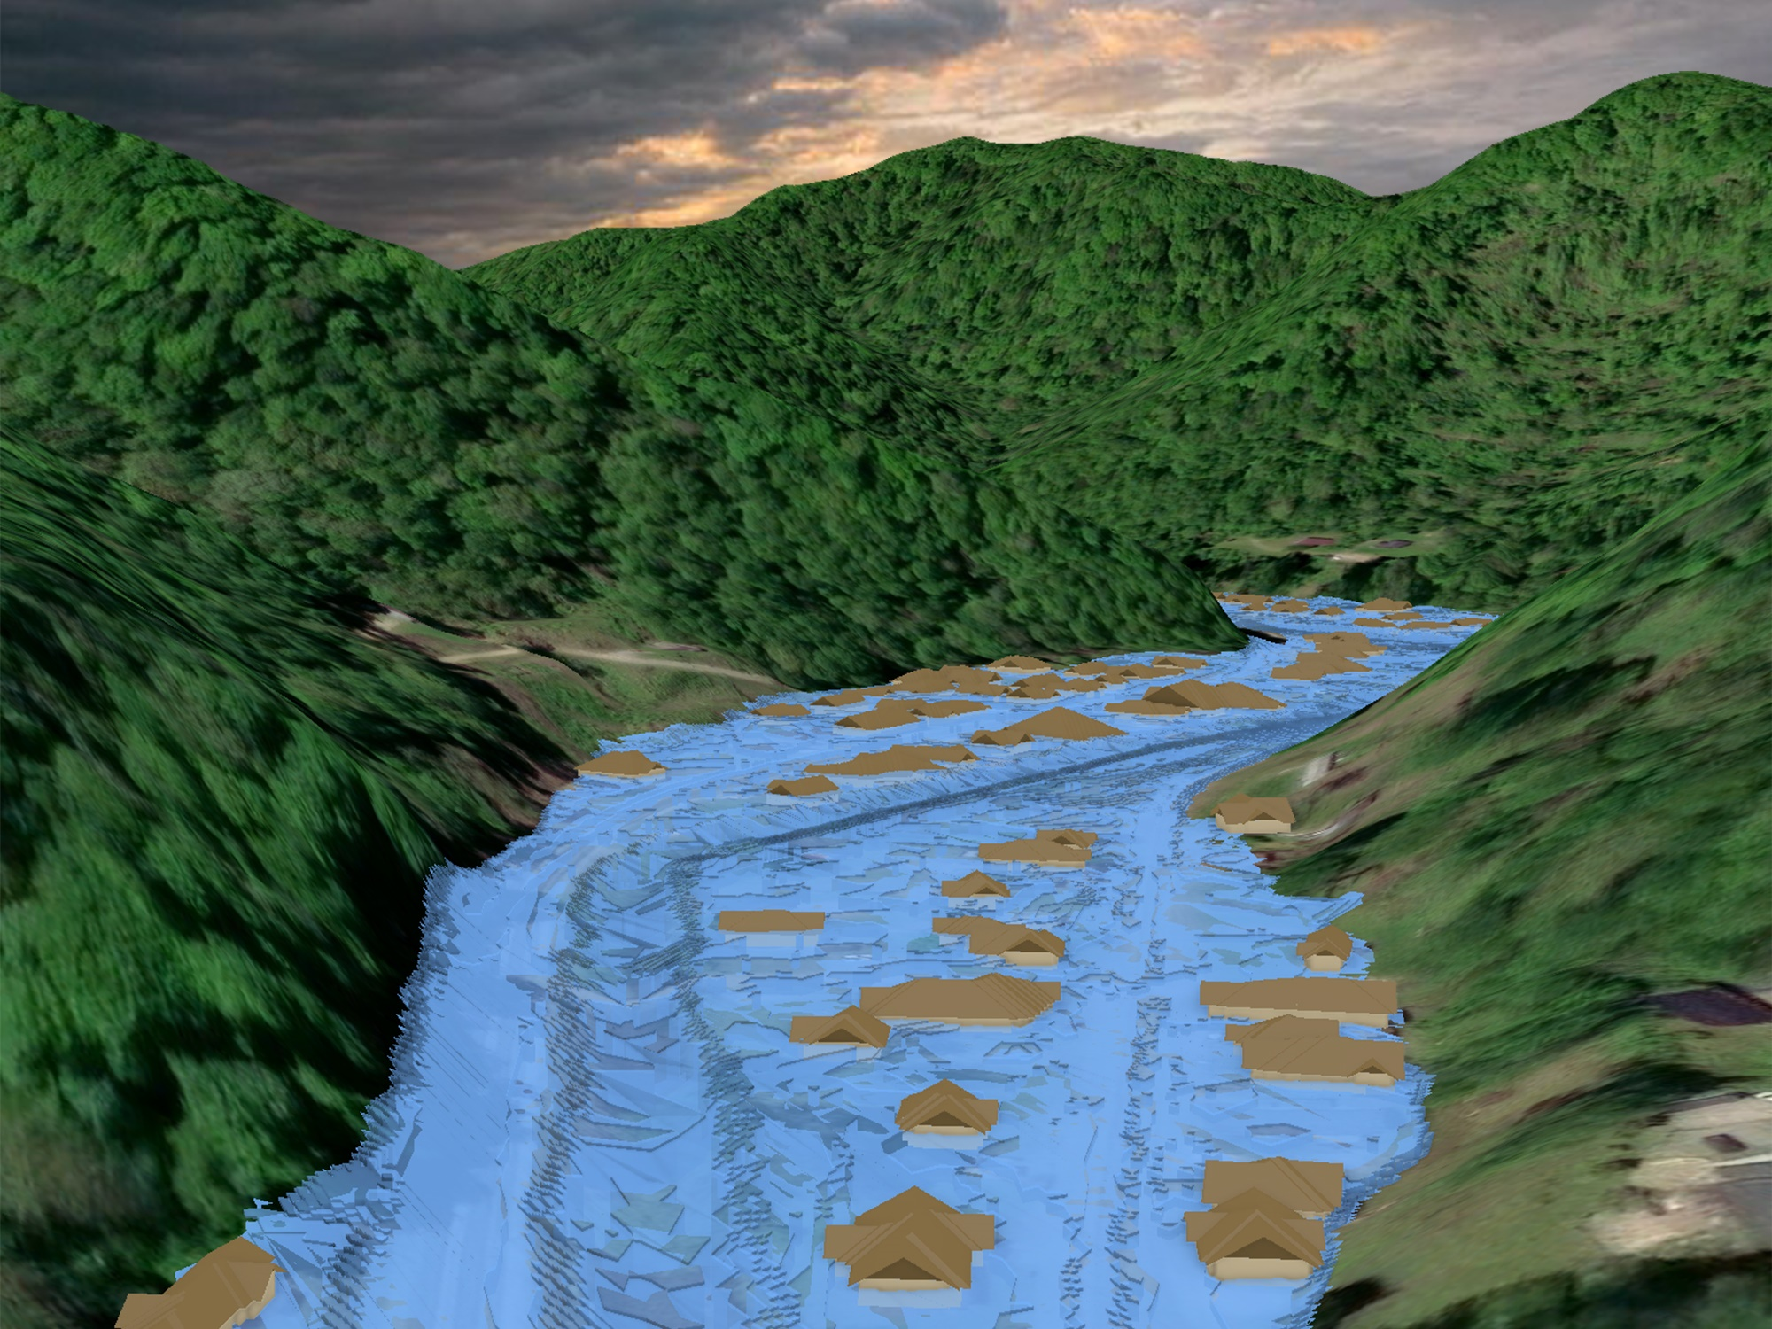
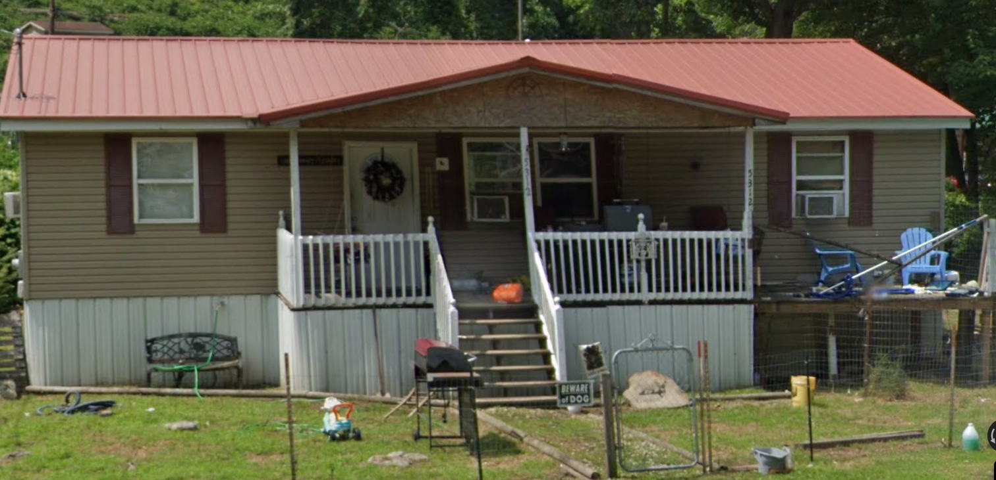
Inundated Area in one-hundred-year flood
Flood Source: Island Creek
Watershed: Upper Guyandotte
Island Creek
Island Creek

Slide 10
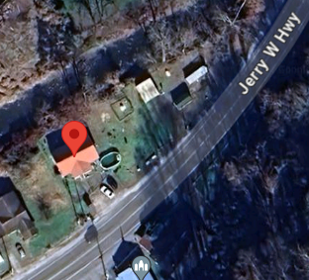
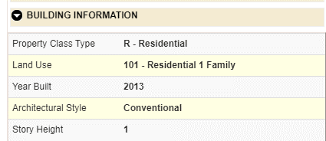
Building General Identification
23-03-0048-0113-0000_5312
5312 JERRY WEST HWY, SWITZER, WV, 25647
Post-FIRM

Slide 11
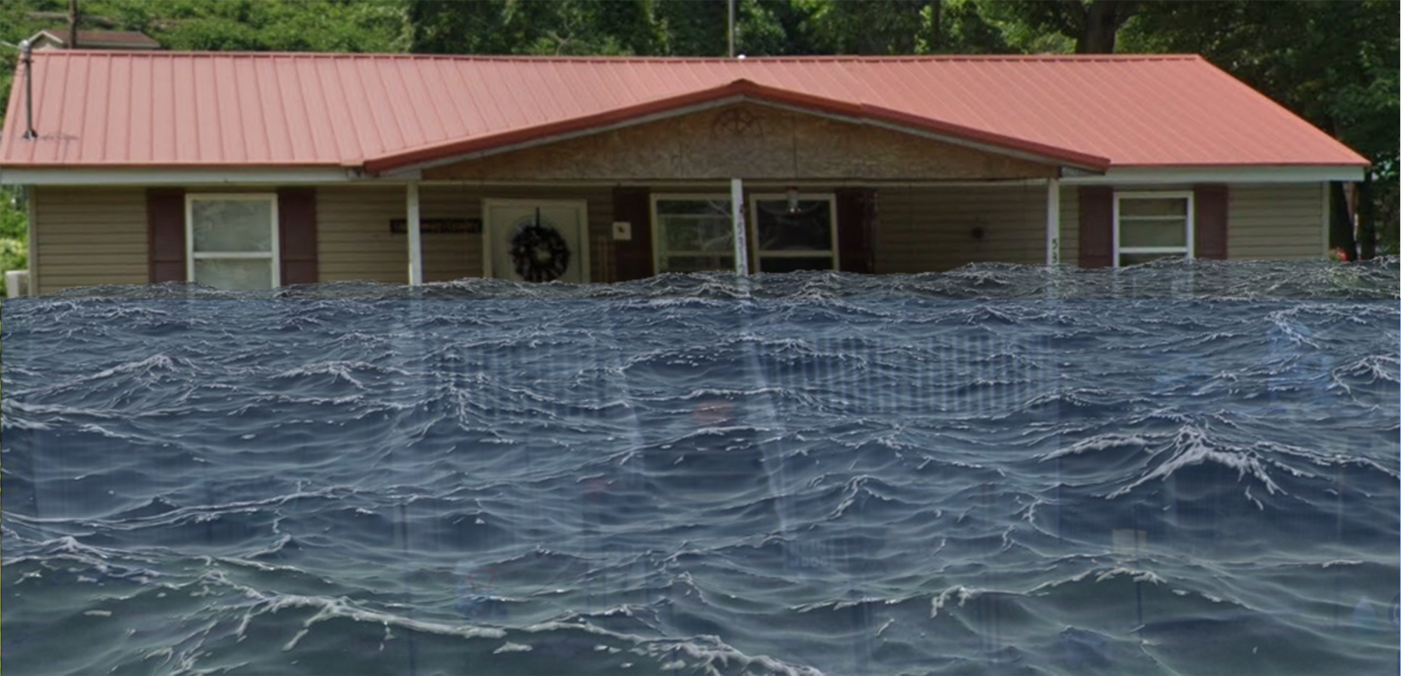
Flood Profile
 | HEIGHT (ft.)
BUILDING
Freeboard (FBD) | 2
FLOOD DEPTH
FEMA 1% (100-Yr) | 9.4
FEMA 100-Yr + FBD | 11.4
FEMA 0.2% (500-Yr)
Flood Profile
9.4’ (FEMA 1% / 100-Yr)
FLOOD DEPTHS:
FEMA, Effective 2008

Slide 12
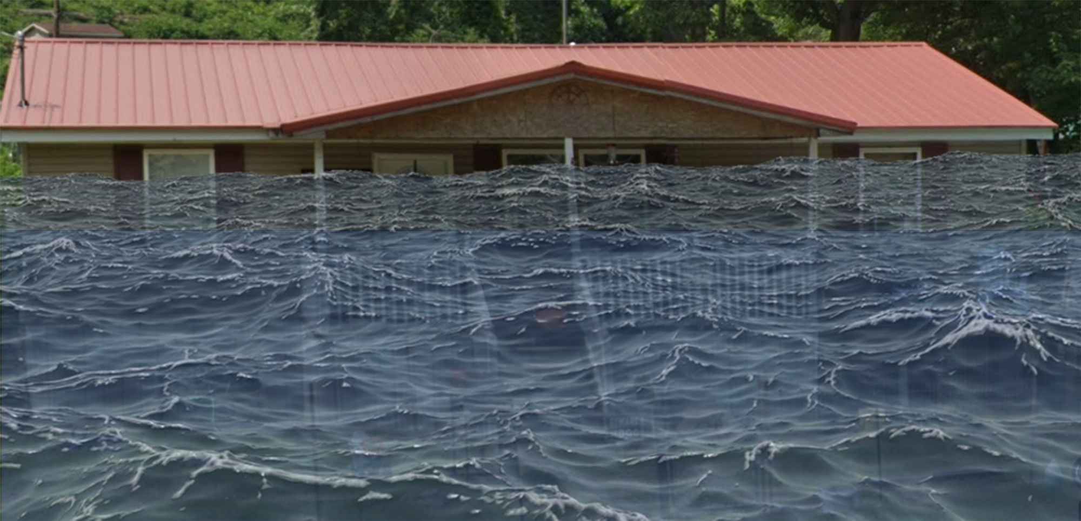
Flood Profile
 | HEIGHT (ft.)
BUILDING
Freeboard (FBD) | 2
FLOOD DEPTH
FEMA 1% (100-Yr) | 9.4
FEMA 100-Yr + FBD | 11.4
FEMA 0.2% (500-Yr) | 12.7
Flood Profile
12.2’ (FEMA 0.2% / 500-Yr)
9.4’ (FEMA 1% / 100-Yr)
FLOOD DEPTHS:
FEMA, Effective 2008

Slide 13
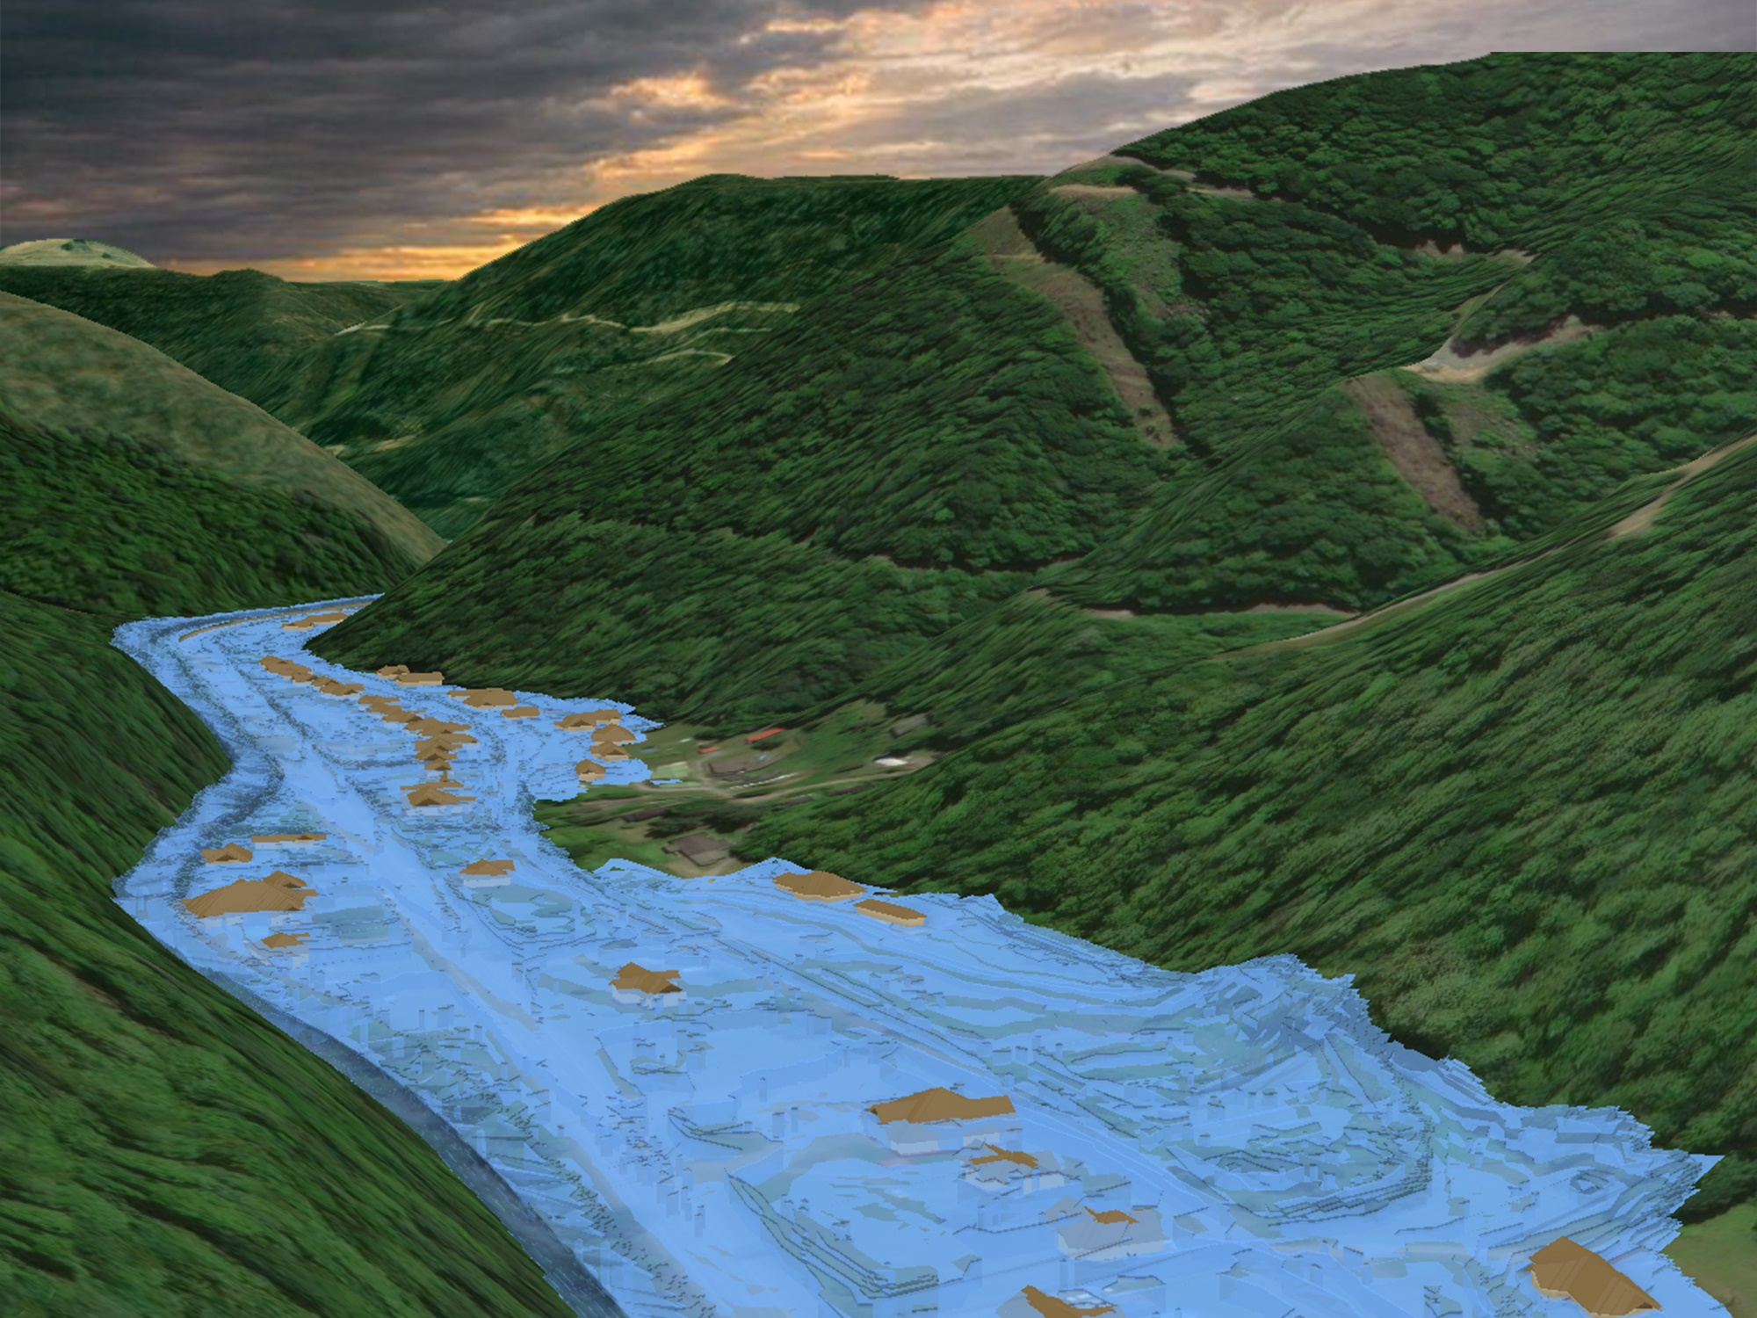

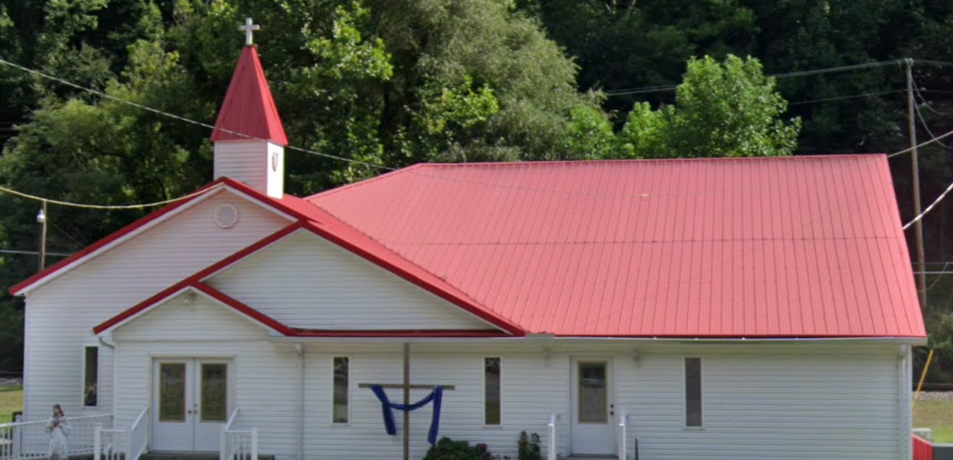
Inundated Area in one-hundred-year flood
Flood Source: Buffalo Creek
Watershed: Upper Guyandotte
Buffalo Creek
Buffalo Creek

Slide 14
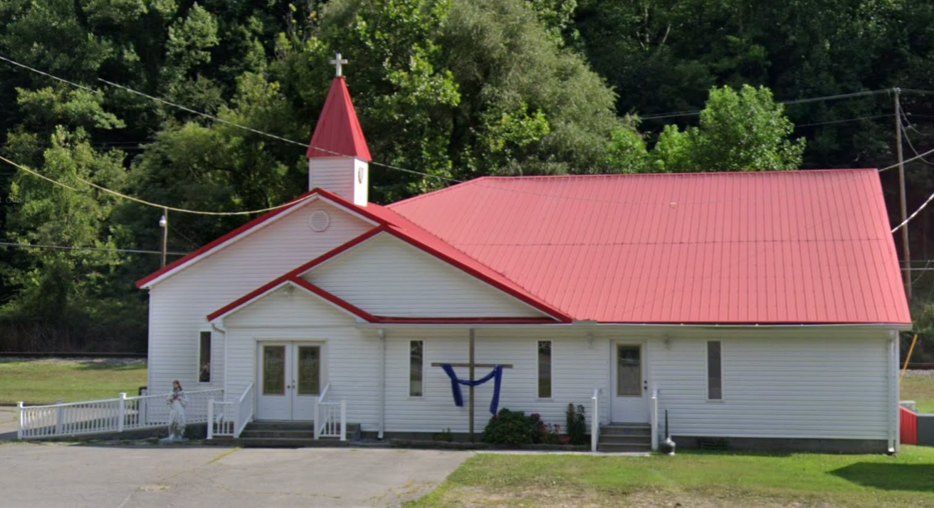
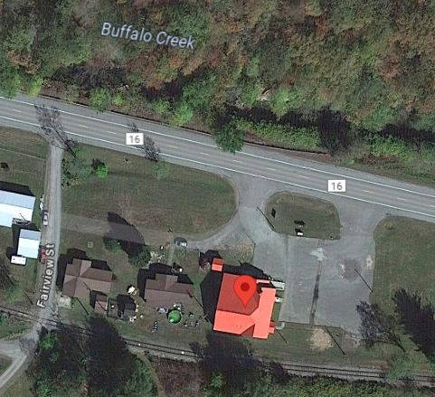
Building General Identification
Building: 23-08-0009-0051-0000_8968
8968 BUFFALO CREEK RD, LORADO, WV, 25630

Slide 15
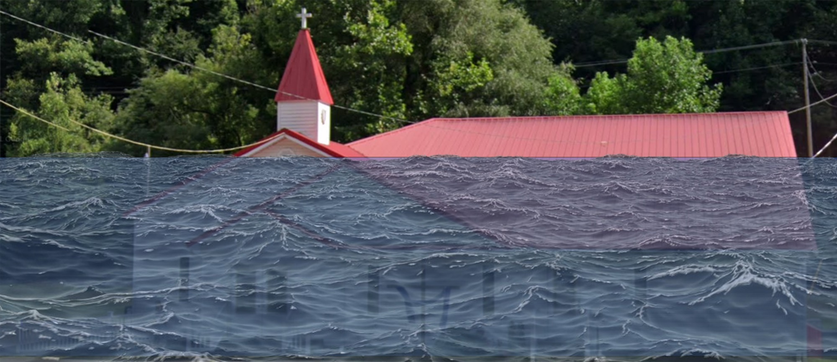
Flood Profile
 | HEIGHT (ft.)
BUILDING
Freeboard (FBD) | 2
FLOOD DEPTH
FEMA 1% (100-Yr) | 13.1
FEMA 100-Yr + FBD | 15.1
FEMA 0.2% (500-Yr)
13.1’ (FEMA 1% / 100-Yr)
FLOOD DEPTHS:
FEMA, Effective 2008

Slide 16
Flood Profile
 | HEIGHT (ft.)
BUILDING
Freeboard (FBD) | 2
FLOOD DEPTH
FEMA 1% (100-Yr) | 13.1
FEMA 100-Yr + FBD | 15.1
FEMA 0.2% (500-Yr) | 16.1
16.1’ (FEMA 0.2% / 500-Yr)
13.1’ (FEMA 1% / 100-Yr)
FLOOD DEPTHS:
FEMA, Effective 2008

Slide 17
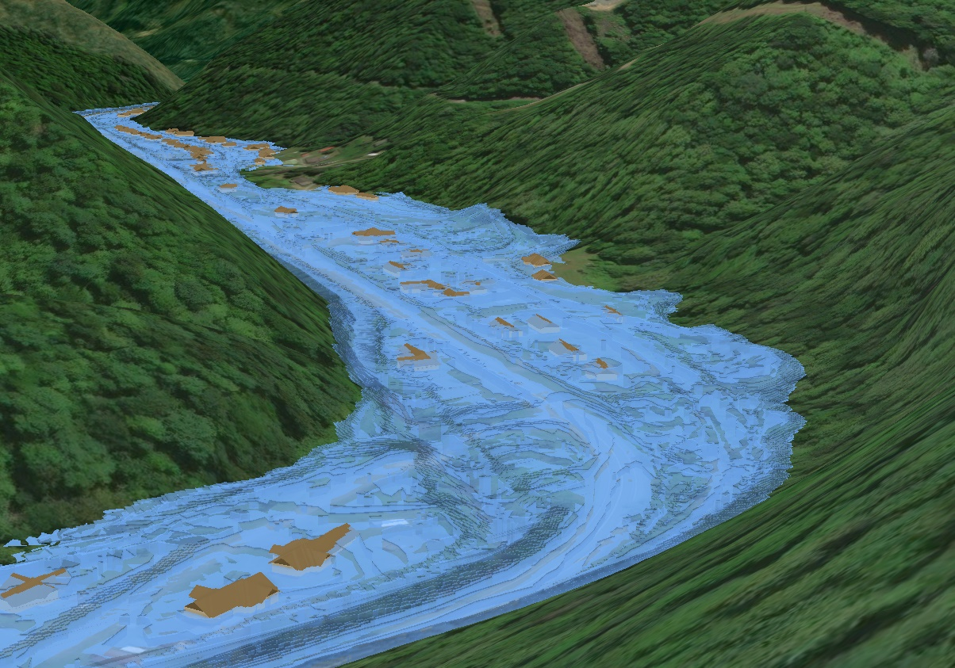
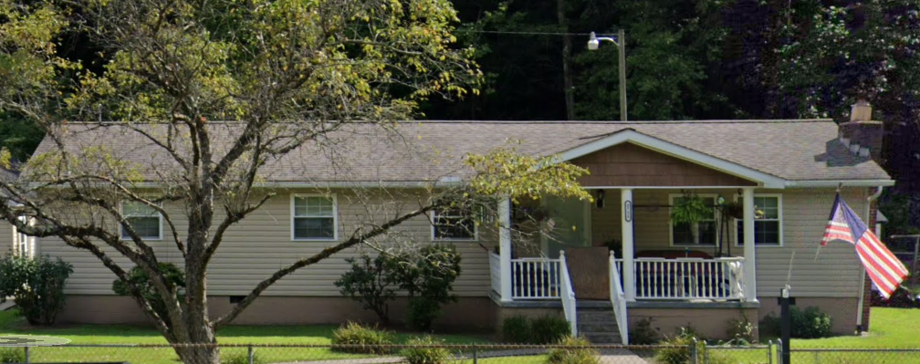
Inundated Area in one-hundred-year flood
Flood Source: Buffalo Creek
Watershed: Upper Guyandotte
Buffalo Creek

Slide 18
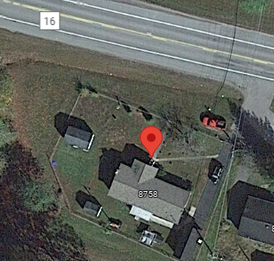
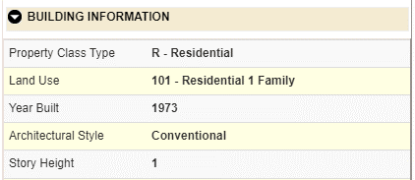
Building General Identification
Building: 23-08-0009-0028-0000_8758
8758 BUFFALO CREEK RD, LORADO, WV, 25630
Pre-FIRM

Slide 19
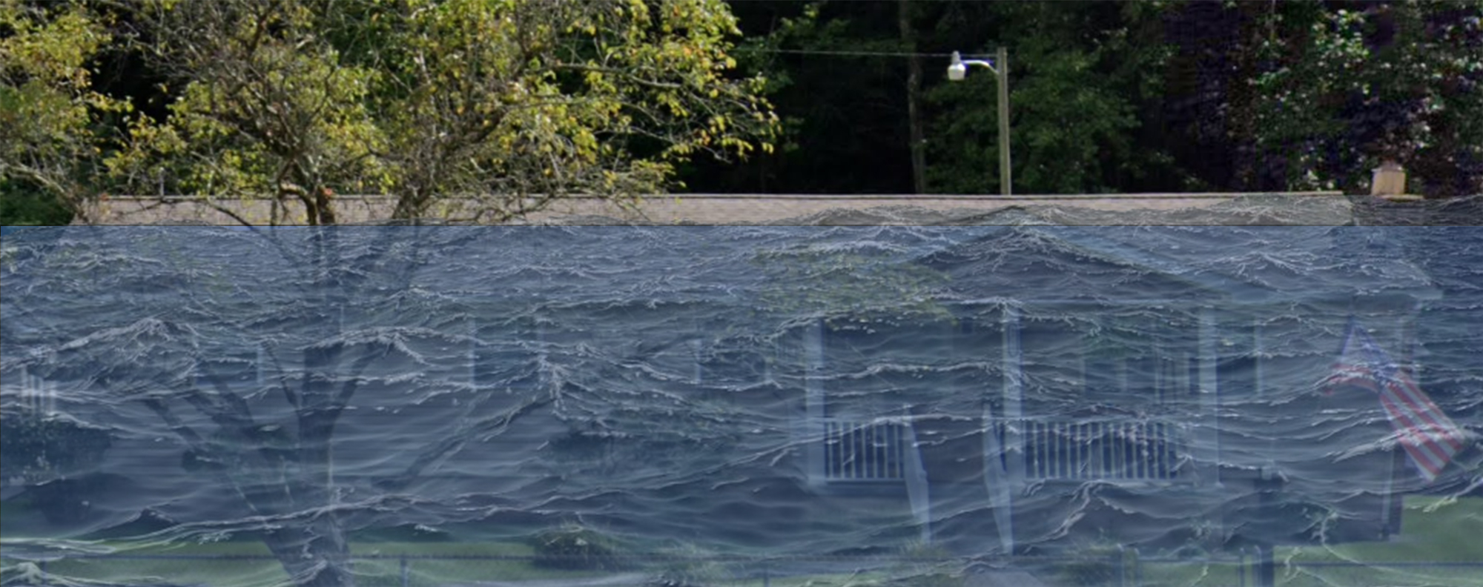
Flood Profile
 | HEIGHT (ft.)
BUILDING
Freeboard (FBD) | 2
FLOOD DEPTH
FEMA 1% (100-Yr) | 13.9
FEMA 100-Yr + FBD | 15.9
FEMA 0.2% (500-Yr)
Flood Profile
13.9’ (FEMA 1% / 100-Yr)
Island Creek
FLOOD DEPTHS:
FEMA, Effective 2008

Slide 20
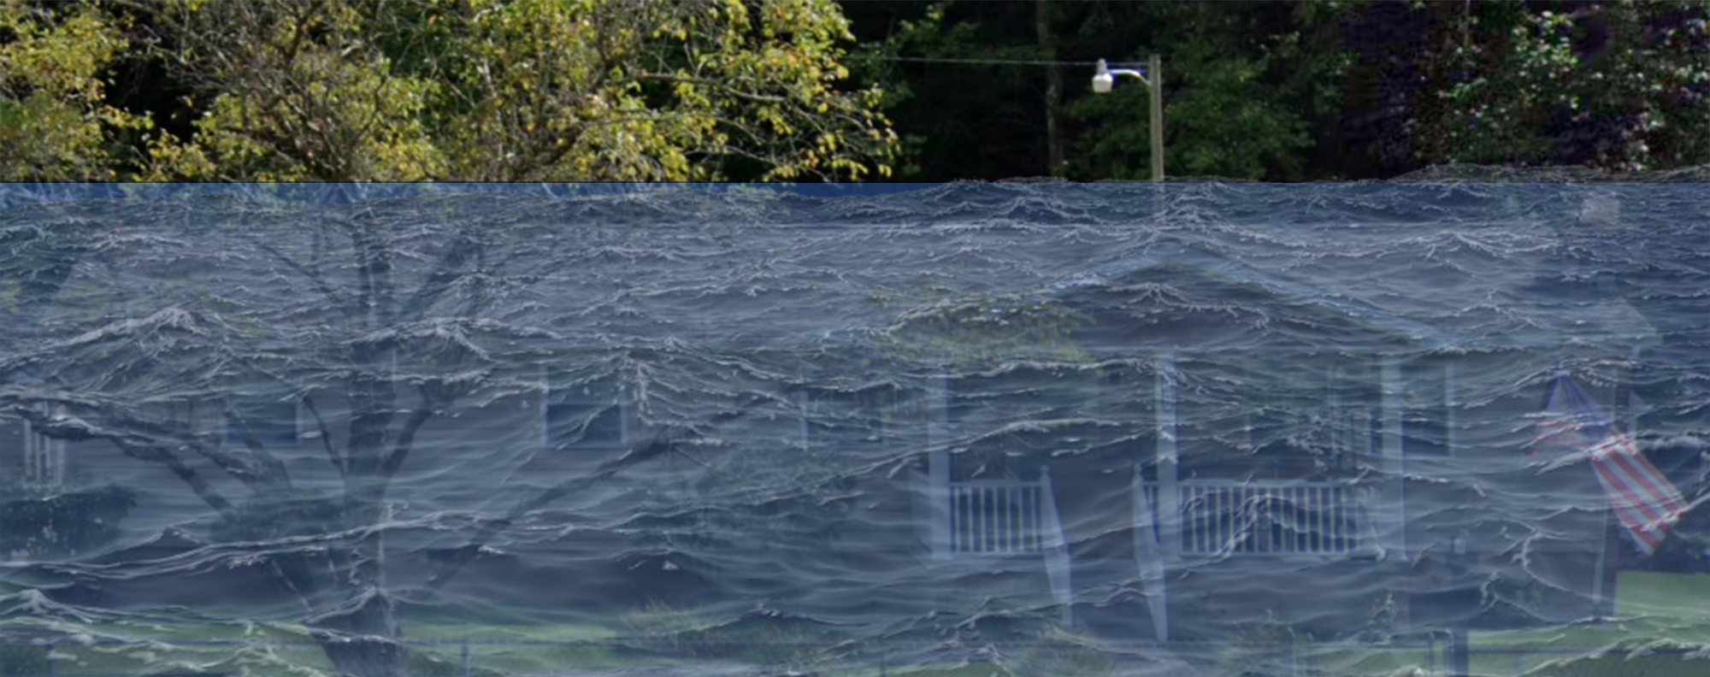
Flood Profile
 | HEIGHT (ft.)
BUILDING
Freeboard (FBD) | 2
FLOOD DEPTH
FEMA 1% (100-Yr) | 13.9
FEMA 100-Yr + FBD | 15.9
FEMA 0.2% (500-Yr) | 16.7
Flood Profile
16.7’ (FEMA 0.2% / 500-Yr)
13.9’ (FEMA 1% / 100-Yr)
Island Creek
FLOOD DEPTHS:
FEMA, Effective 2008

