Slide 1
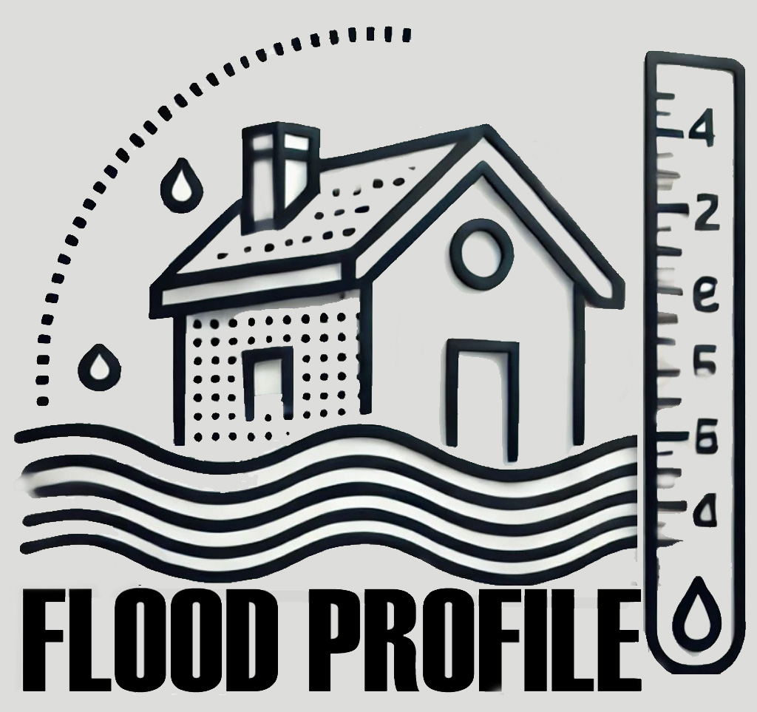
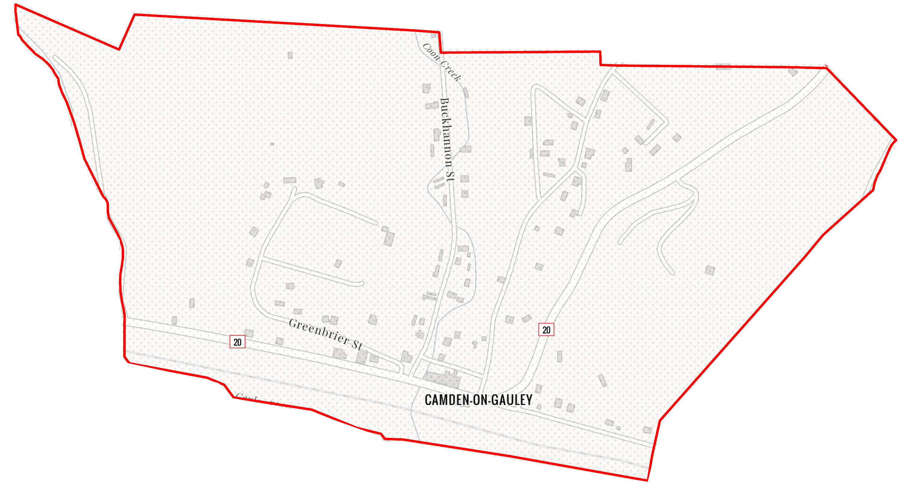
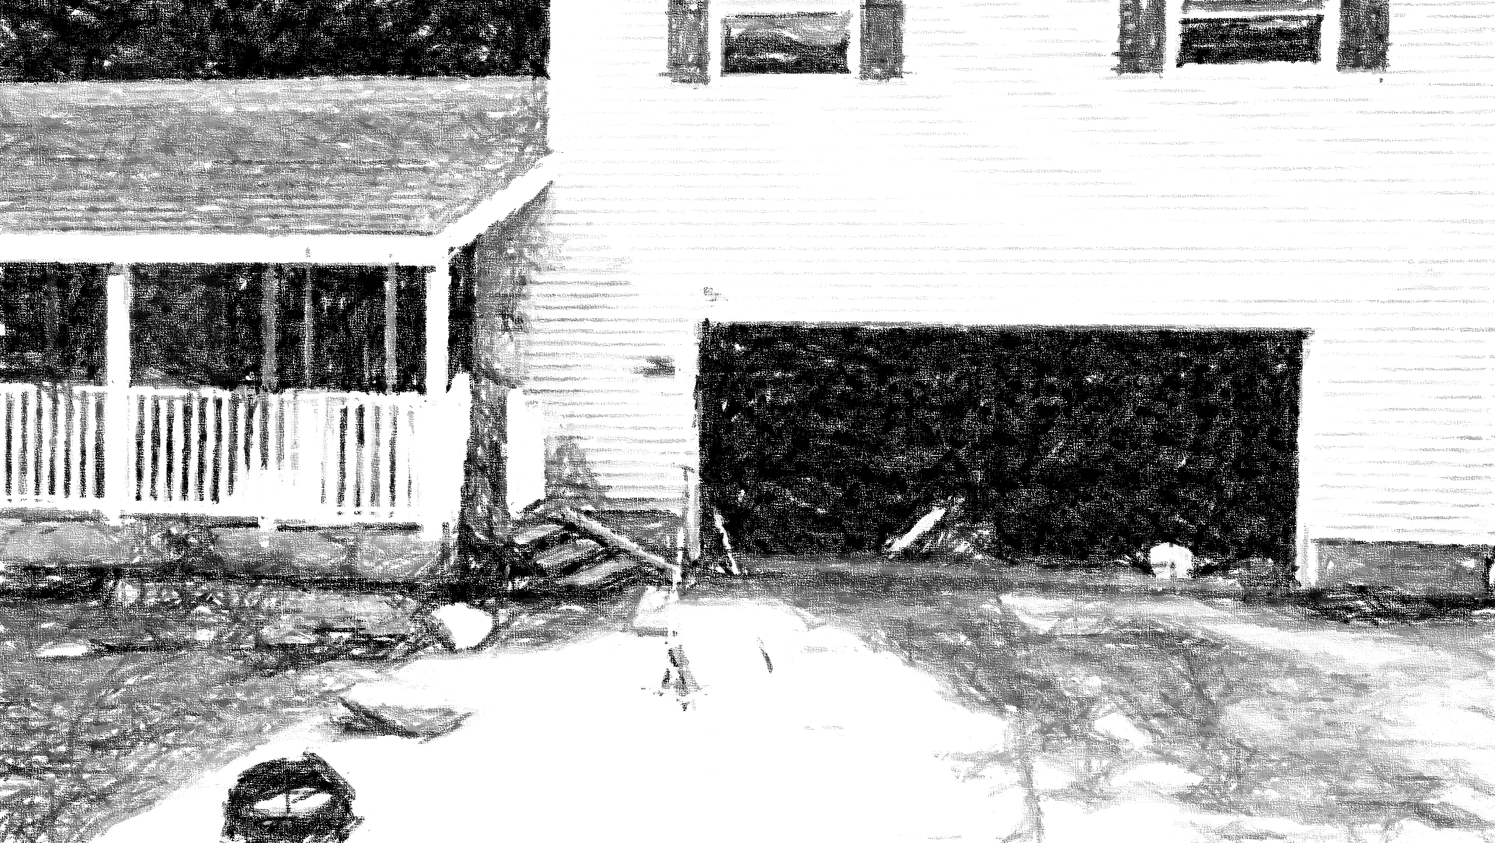
Camden on Gauley
51-04-0003-0006-0000_81
81 RIVERSIDE DR, Camden On Gauley, WV, 26208
Building Flood Profile
Building: 51-04-0003-0006-0000_81
91 RIVERSIDE DR, Camden On Gauley, WV, 26208

Slide 2
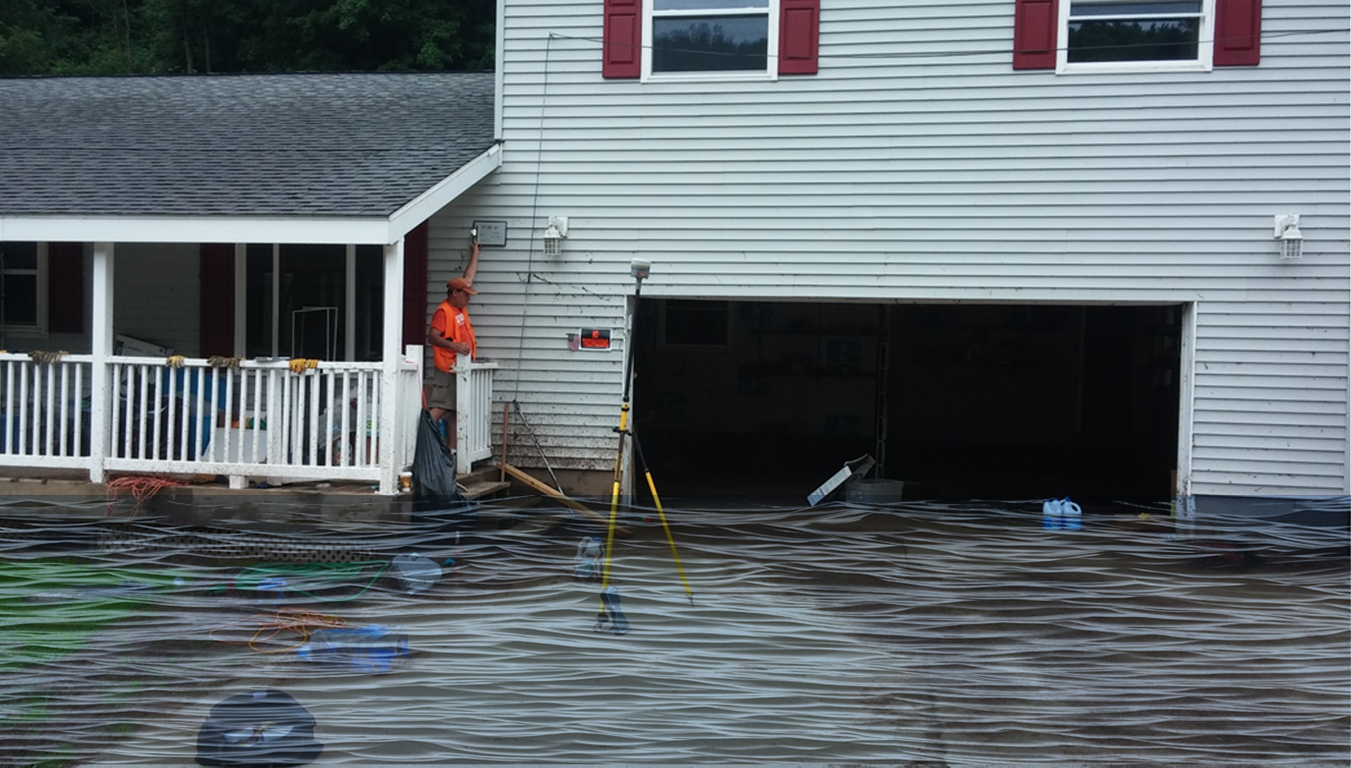
 | HEIGHT (ft.)
BUILDING
First Floor Height | 4
Freeboard (FBD) | 2
FLOOD DEPTH
FEMA 10% (10-Yr) | 1.9
FEMA 4% (25-Yr)
FEMA 2% (50-Yr)
2016 Flood HWM
FEMA 1% (100-Yr)
FEMA 100-Yr + FBD
FEMA 1%+ (84% CL)
FEMA 0.2% (500-Yr)
FSF 0.2% (500-Yr)
51-04-0003-0006-0000_81
81 RIVERSIDE DR, Camden On Gauley, WV, 26208
1.9’ (FEMA 10% / 10-Yr)
Building: 51-04-0003-0006-0000_81
FLOOD DEPTHS:
FEMA, Effective 2022
First Street Foundation (FSF, 2022)
USGS 2016 Flood High Water Mark

Slide 3
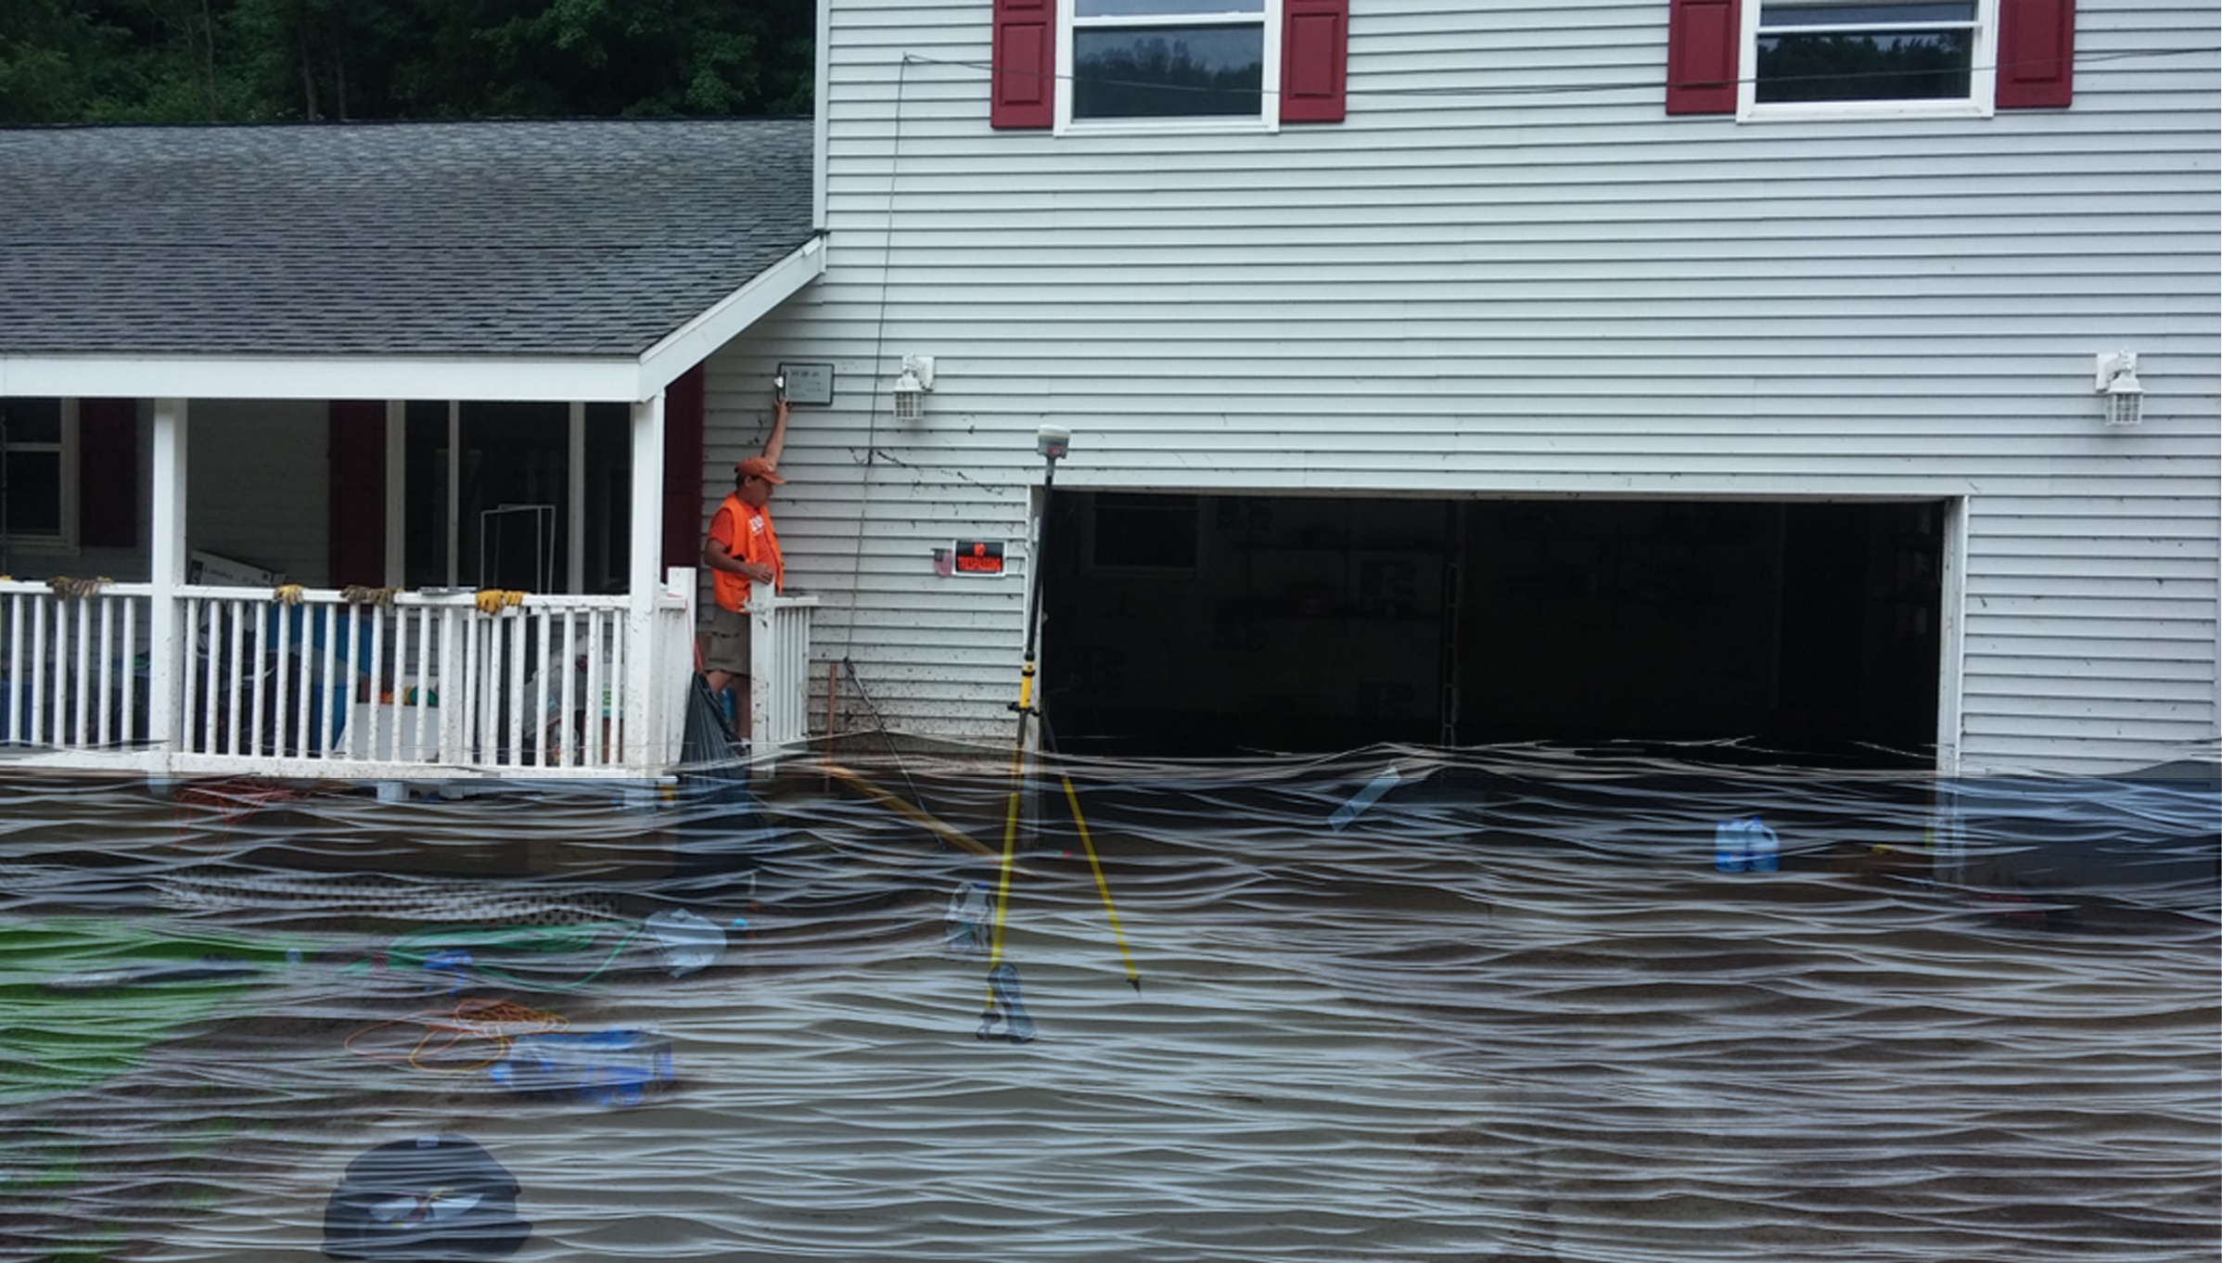
 | HEIGHT (ft.)
BUILDING
First Floor Height | 4
Freeboard (FBD) | 2
FLOOD DEPTH
FEMA 10% (10-Yr) | 1.9
FEMA 4% (25-Yr) | 4.4
FEMA 2% (50-Yr)
2016 Flood HWM
FEMA 1% (100-Yr)
FEMA 100-Yr + FBD
FEMA 1%+ (84% CL)
FEMA 0.2% (500-Yr)
FSF 0.2% (500-Yr)
51-04-0003-0006-0000_81
81 RIVERSIDE DR, Camden On Gauley, WV, 26208
4.4’ (FEMA 4% / 25-Yr)
1.9’ (FEMA 10% / 10-Yr)
Building: 51-04-0003-0006-0000_81
FLOOD DEPTHS:
FEMA, Effective 2022
First Street Foundation (FSF, 2022)
USGS 2016 Flood High Water Mark

Slide 4
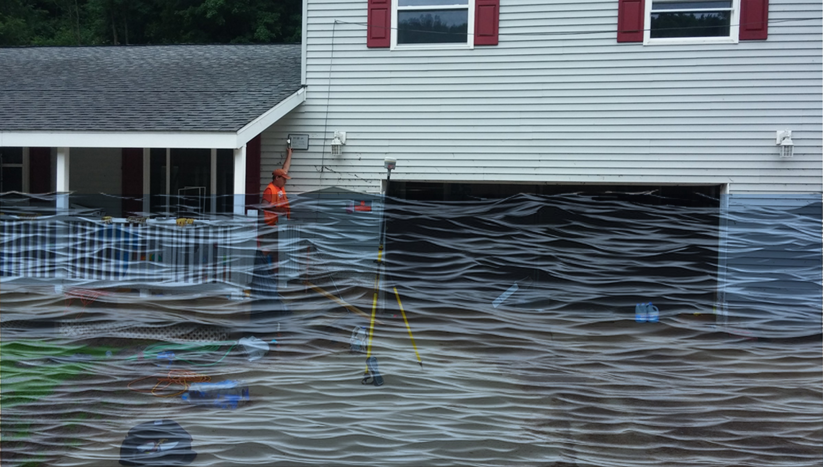
 | HEIGHT (ft.)
BUILDING
First Floor Height | 4
Freeboard (FBD) | 2
FLOOD DEPTH
FEMA 10% (10-Yr) | 1.9
FEMA 4% (25-Yr) | 4.4
FEMA 2% (50-Yr) | 6.7
2016 Flood HWM
FEMA 1% (100-Yr)
FEMA 100-Yr + FBD
FEMA 1%+ (84% CL)
FEMA 0.2% (500-Yr)
FSF 0.2% (500-Yr)
51-04-0003-0006-0000_81
81 RIVERSIDE DR, Camden On Gauley, WV, 26208
6.7’ (FEMA 2% / 50-Yr)
4.4’ (FEMA 4% / 25-Yr)
1.9’ (FEMA 10% / 10-Yr)
Building: 51-04-0003-0006-0000_81
FLOOD DEPTHS:
FEMA, Effective 2022
First Street Foundation (FSF, 2022)
USGS 2016 Flood High Water Mark

Slide 5
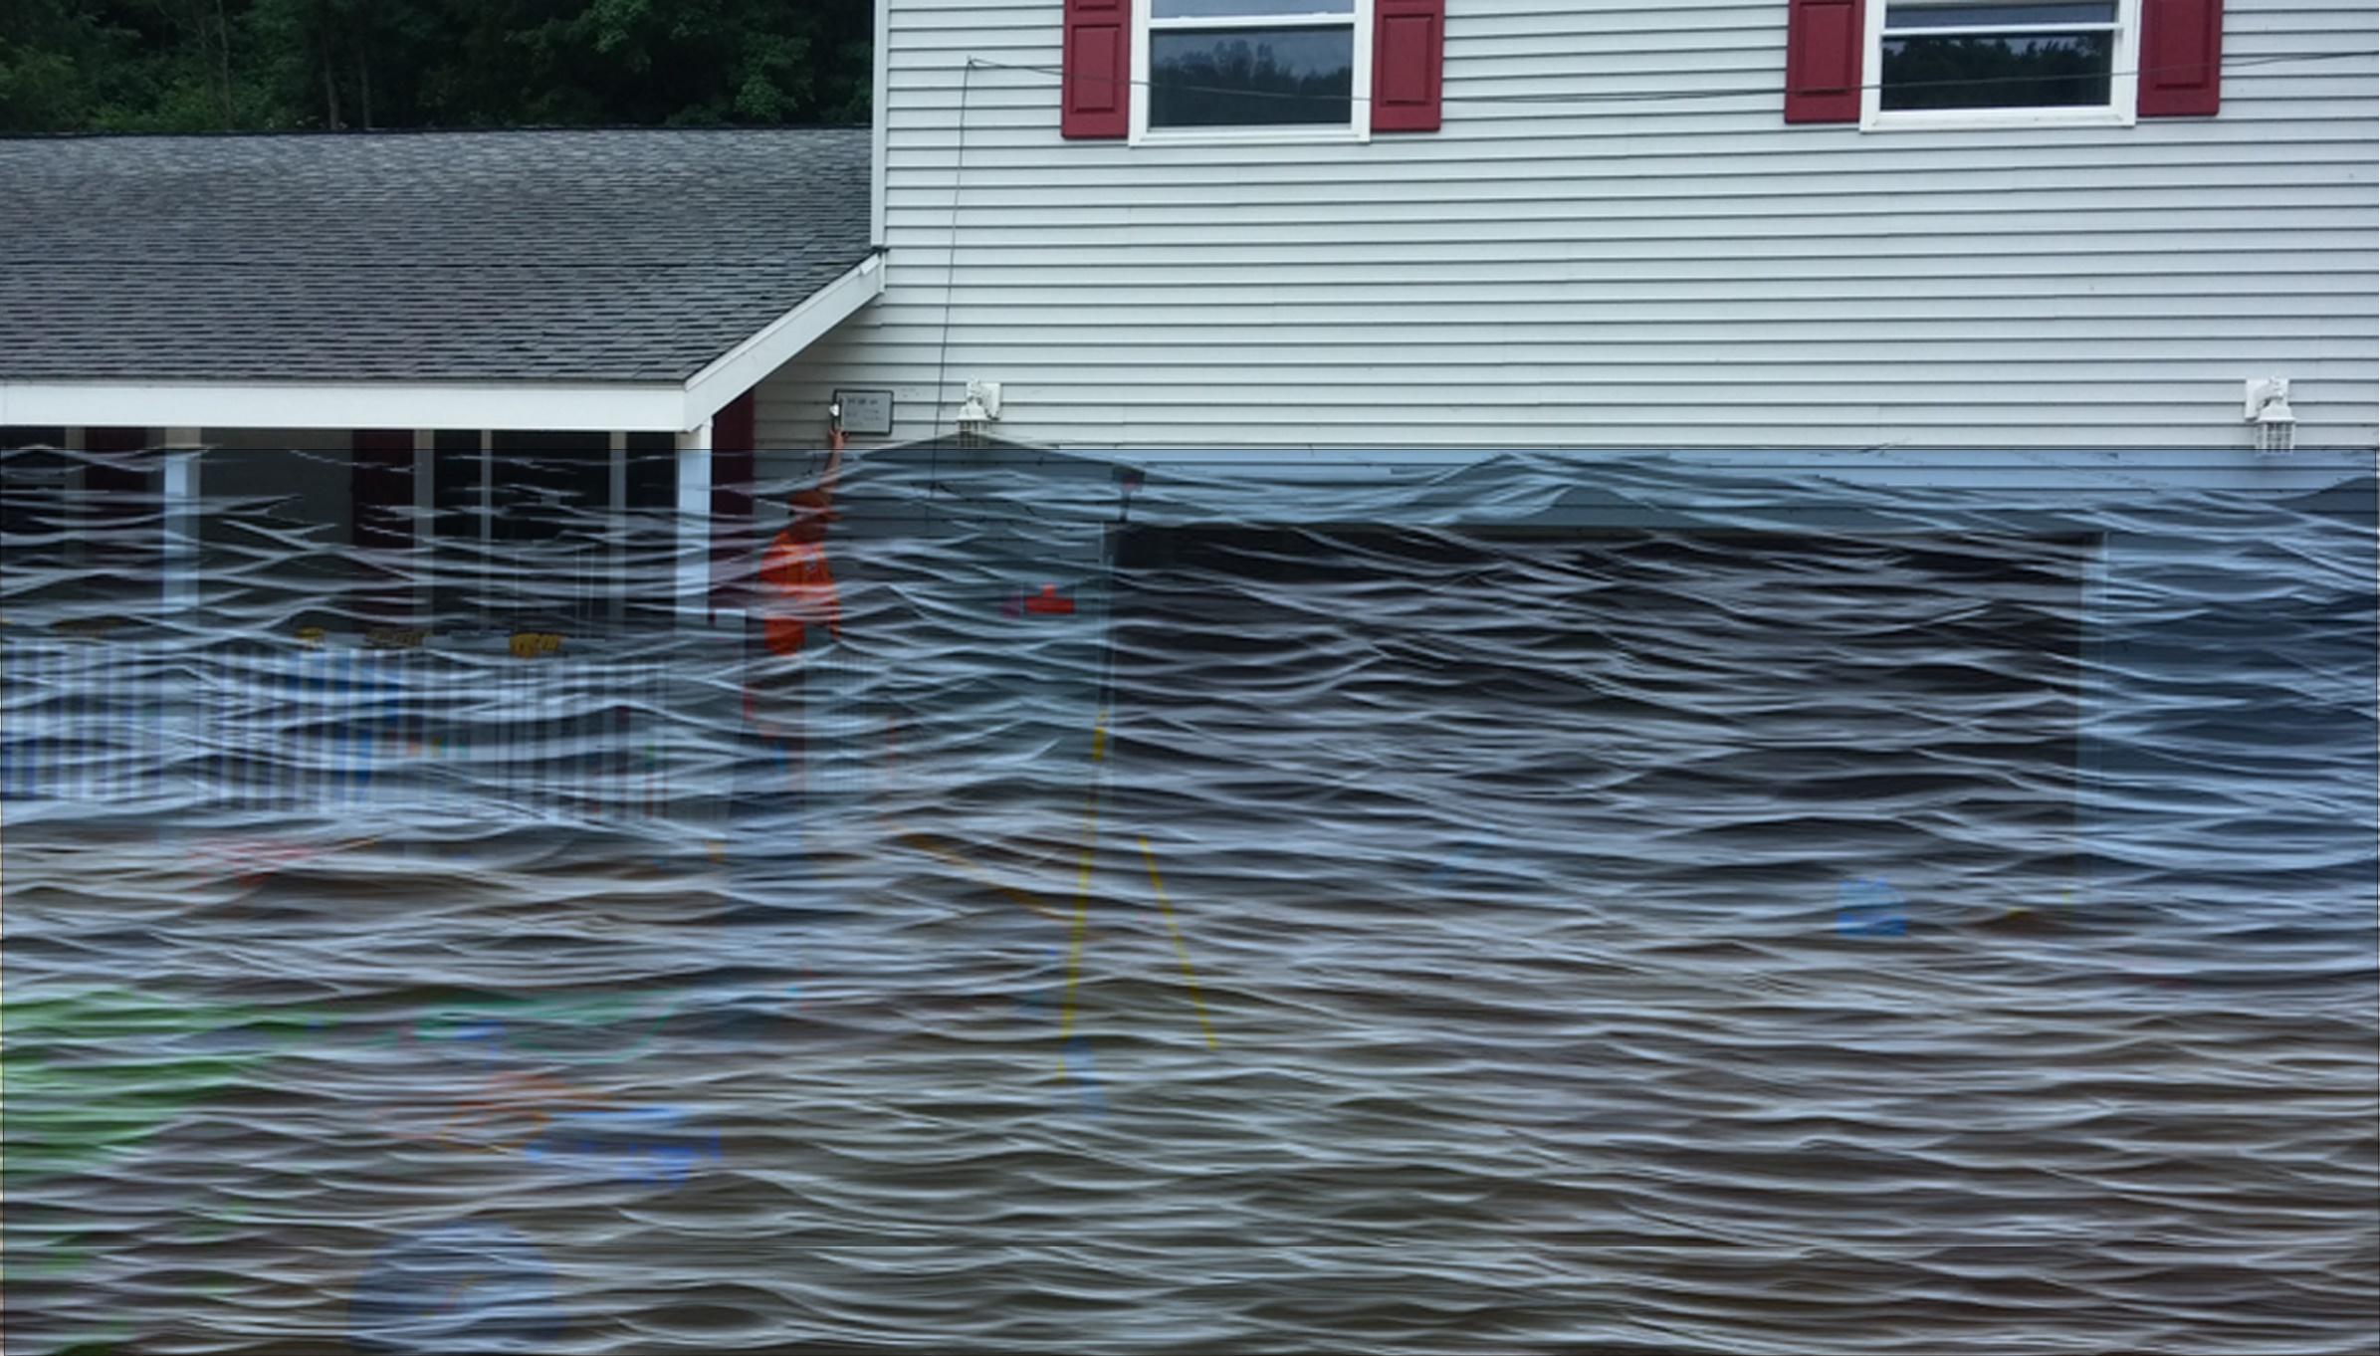
 | HEIGHT (ft.)
BUILDING
First Floor Height | 4
Freeboard (FBD) | 2
FLOOD DEPTH
FEMA 10% (10-Yr) | 1.9
FEMA 4% (25-Yr) | 4.4
FEMA 2% (50-Yr) | 6.7
2016 Flood HWM
FEMA 1% (100-Yr) | 8.3
FEMA 100-Yr + FBD | 10.3
FEMA 1%+ (84% CL)
FEMA 0.2% (500-Yr)
FSF 0.2% (500-Yr)
51-04-0003-0006-0000_81
81 RIVERSIDE DR, Camden On Gauley, WV, 26208
8.3’ (FEMA 1% / 100-Yr)
6.7’ (FEMA 2% / 50-Yr)
4.4’ (FEMA 4% / 25-Yr)
1.9’ (FEMA 10% / 10-Yr)
Building: 51-04-0003-0006-0000_81
FLOOD DEPTHS:
FEMA, Effective 2022
First Street Foundation (FSF, 2022)
USGS 2016 Flood High Water Mark

Slide 6
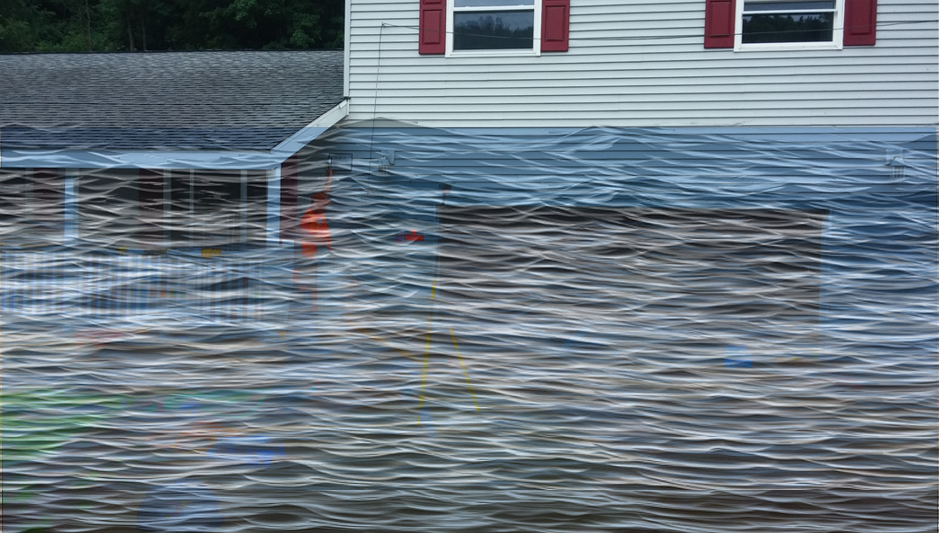
 | HEIGHT (ft.)
BUILDING
First Floor Height | 4
Freeboard (FBD) | 2
FLOOD DEPTH
FEMA 10% (10-Yr) | 1.9
FEMA 4% (25-Yr) | 4.4
FEMA 2% (50-Yr) | 6.7
2016 Flood HWM
FEMA 1% (100-Yr) | 8.3
FEMA 100-Yr + FBD | 10.3
FEMA 1%+ (84% CL) | 10.7
FEMA 0.2% (500-Yr)
FSF 0.2% (500-Yr)
51-04-0003-0006-0000_81
81 RIVERSIDE DR, Camden On Gauley, WV, 26208
10.7’ FEMA 1%+ (84% CL)
8.3’ (FEMA 1% / 100-Yr)
6.7’ (FEMA 2% / 50-Yr)
4.4’ (FEMA 4% / 25-Yr)
1.9’ (FEMA 10% / 10-Yr)
Building: 51-04-0003-0006-0000_81
FLOOD DEPTHS:
FEMA, Effective 2022
First Street Foundation (FSF, 2022)
USGS 2016 Flood High Water Mark

Slide 7
 | HEIGHT (ft.)
BUILDING
First Floor Height | 4
Freeboard (FBD) | 2
FLOOD DEPTH
FEMA 10% (10-Yr) | 1.9
FEMA 4% (25-Yr) | 4.4
FEMA 2% (50-Yr) | 6.7
2016 Flood HWM | 9.1
FEMA 1% (100-Yr) | 8.3
FEMA 100-Yr + FBD | 10.3
FEMA 1%+ (84% CL) | 10.7
FEMA 0.2% (500-Yr)
FSF 0.2% (500-Yr)
51-04-0003-0006-0000_81
81 RIVERSIDE DR, Camden On Gauley, WV, 26208
10.7’ FEMA 1%+ (84% CL)
9.1’ (2016 High Water)
8.3’ (FEMA 1% / 100-Yr)
6.7’ (FEMA 2% / 50-Yr)
4.4’ (FEMA 4% / 25-Yr)
1.9’ (FEMA 10% / 10-Yr)
Building: 51-04-0003-0006-0000_81
FLOOD DEPTHS:
FEMA, Effective 2022
First Street Foundation (FSF, 2022)
USGS 2016 Flood High Water Mark

Slide 8
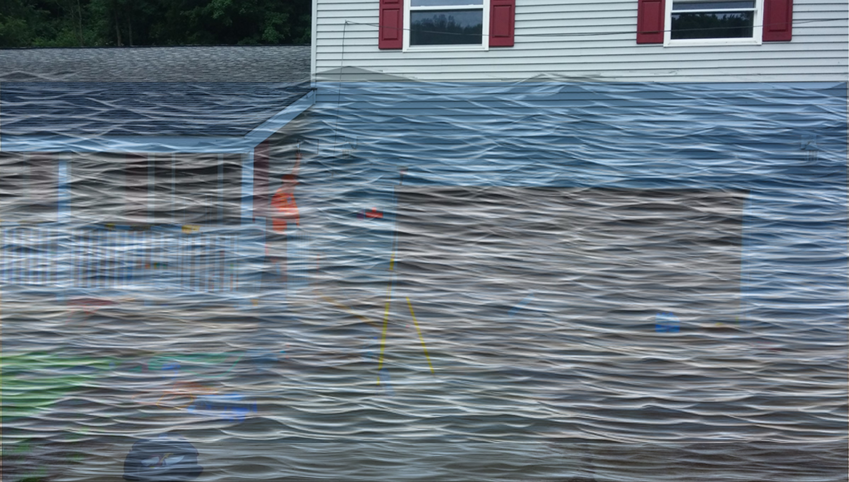
 | HEIGHT (ft.)
BUILDING
First Floor Height | 4
Freeboard (FBD) | 2
FLOOD DEPTH
FEMA 10% (10-Yr) | 1.9
FEMA 4% (25-Yr) | 4.4
FEMA 2% (50-Yr) | 6.7
2016 Flood HWM | 9.1
FEMA 1% (100-Yr) | 8.3
FEMA 100-Yr + FBD | 10.3
FEMA 1%+ (84% CL) | 10.7
FEMA 0.2% (500-Yr) | 12.7
FSF 0.2% (500-Yr)
51-04-0003-0006-0000_81
12.7’ (FEMA 0.2% / 500-Yr )
81 RIVERSIDE DR, Camden On Gauley, WV, 26208
10.7’ FEMA 1%+ (84% CL)
9.1’ (2016 High Water)
8.3’ (FEMA 1% / 100-Yr)
6.7’ (FEMA 2% / 50-Yr)
4.4’ (FEMA 4% / 25-Yr)
1.9’ (FEMA 10% / 10-Yr)
Building: 51-04-0003-0006-0000_81
FLOOD DEPTHS:
FEMA, Effective 2022
First Street Foundation (FSF, 2022)
USGS 2016 Flood High Water Mark

Slide 9
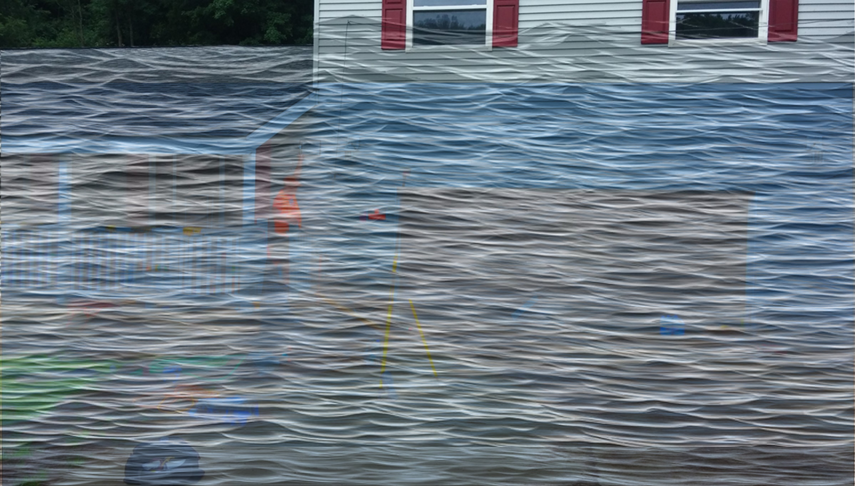
 | HEIGHT (ft.)
BUILDING
First Floor Height | 4
Freeboard (FBD) | 2
FLOOD DEPTH
FEMA 10% (10-Yr) | 1.9
FEMA 4% (25-Yr) | 4.4
FEMA 2% (50-Yr) | 6.7
2016 Flood HWM | 9.1
FEMA 1% (100-Yr) | 8.3
FEMA 100-Yr + FBD | 10.3
FEMA 1%+ (84% CL) | 10.7
FEMA 0.2% (500-Yr) | 12.7
FSF 0.2% (500-Yr) | 14.8
51-04-0003-0006-0000_81
14.8’ (FSF 0.2% / 500-Yr)
12.7’ (FEMA 0.2% / 500-Yr )
81 RIVERSIDE DR, Camden On Gauley, WV, 26208
10.7’ FEMA 1%+ (84% CL)
9.1’ (2016 High Water)
8.3’ (FEMA 1% / 100-Yr)
6.7’ (FEMA 2% / 50-Yr)
4.4’ (FEMA 4% / 25-Yr)
1.9’ (FEMA 10% / 10-Yr)
Building: 51-04-0003-0006-0000_81
FLOOD DEPTHS:
FEMA, Effective 2022
First Street Foundation (FSF, 2022)
USGS 2016 Flood High Water Mark

Slide 10
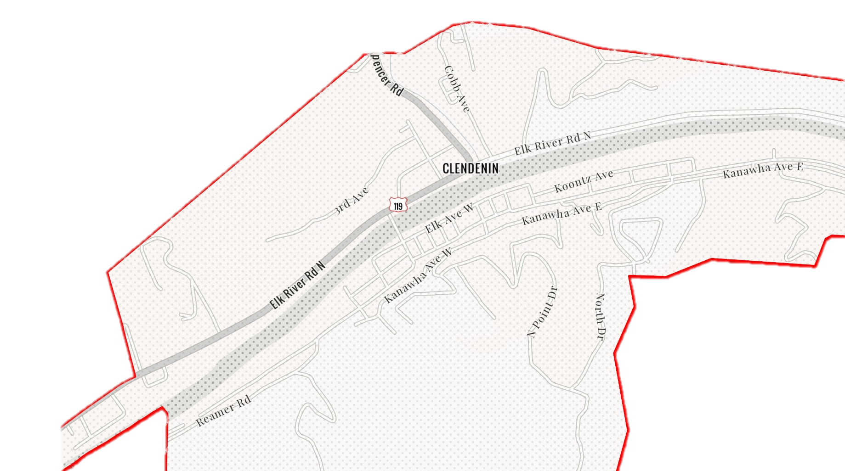
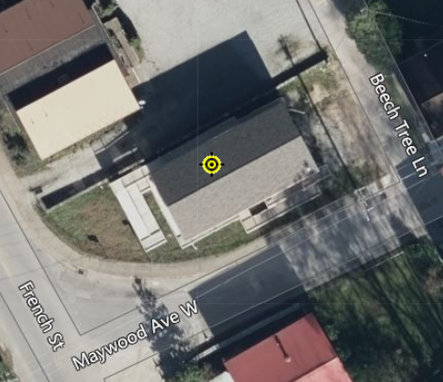
Clendenin
20-02-0006-0044-0000_306
306 Maywood Ave., Clendenin, WV, 25045
Building Flood Profile
Building-scale flood visualizations of different flood frequencies and magnitudes

Slide 11
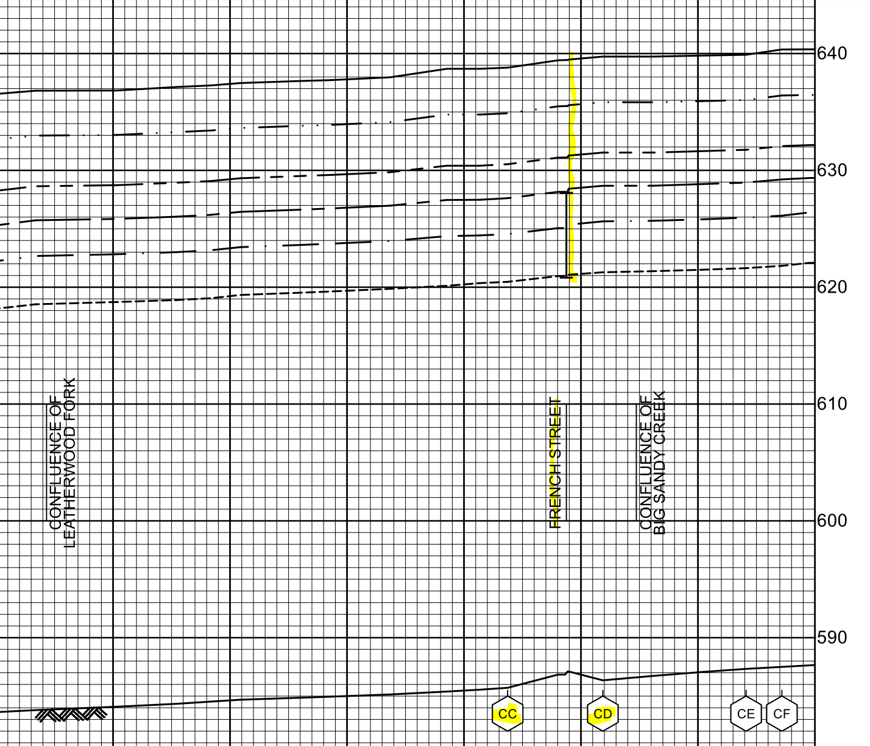
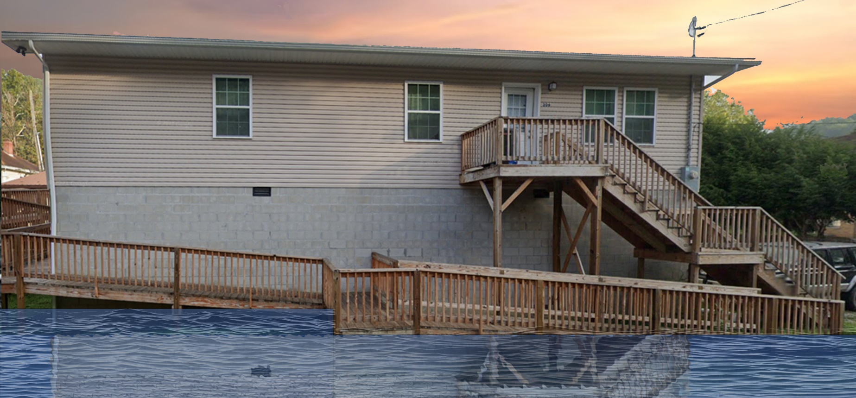
10% Probability of Flood in a year (10-year flood)
2.0’ (FEMA 10% / 10-Yr)
Building’s Ground Elevation

Slide 12
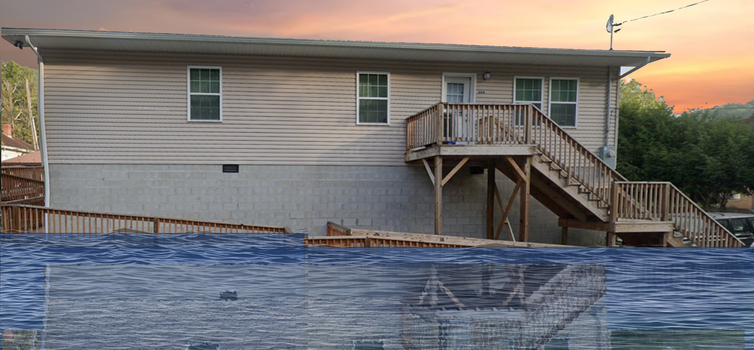
4% Probability of Flood in a year (25-year flood)
6.0’ (FEMA 4% / 25-Yr)

Slide 13
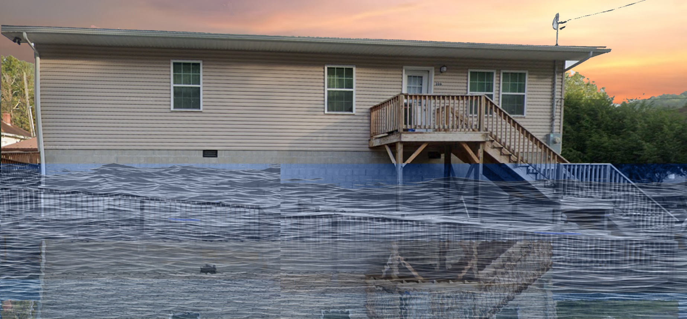
2% Probability of Flood in a year (50-year flood)
9.5’ (FEMA 2% / 50-Yr)

Slide 14
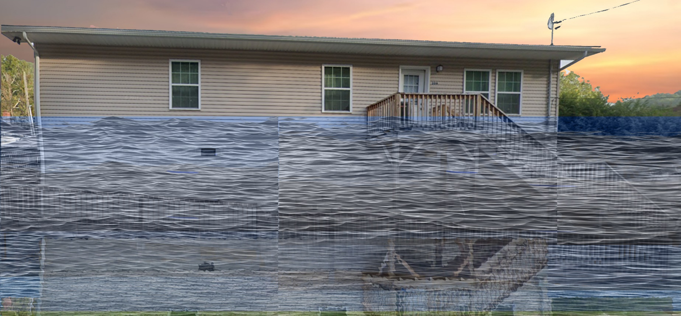
1% Probability of Flood in a year (100-year flood)
12.3’ (FEMA 2% / 50-Yr)

Slide 15
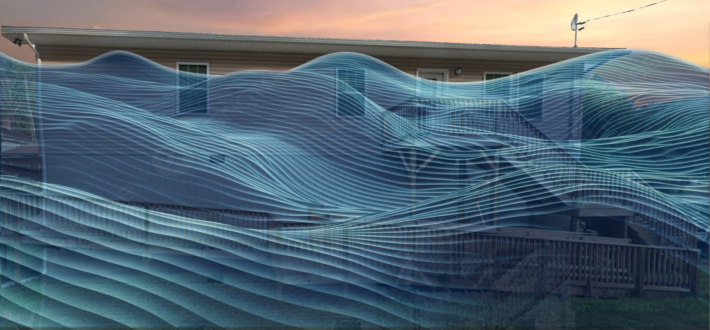
0.2% Probability of Flood in a year (500-year flood)
20.5’ (FEMA 0.2% / 500-Yr)

Slide 16
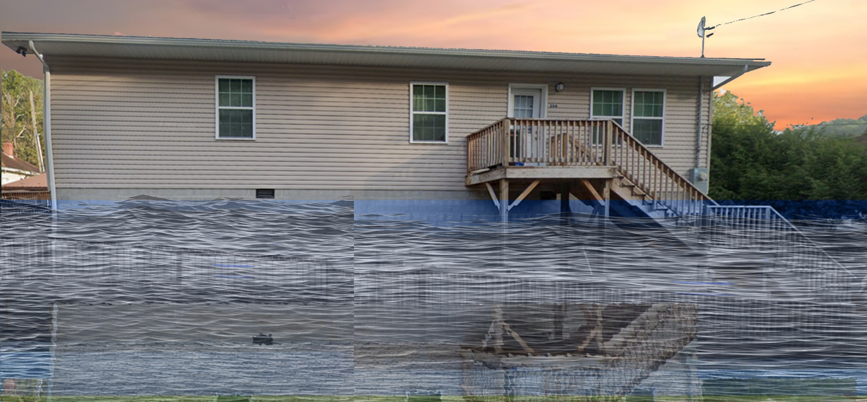
2016 High Watermark
High Watermark
9.5’ (FEMA 2% / 50-Yr)
10.5’ (2016 High Water)

Slide 17
The Design Flood Elevation (DFE) should be the BFE plus 2 feet of freeboard. The DFE should also be above the high-water marks of the 2016 flood plus freeboard.
 | HEIGHT (ft.)
BUILDING
First Floor Height | 12.0
Freeboard (FBD) | 2.0
FLOOD DEPTH
FEMA 10% (10-Yr) | 2.0
FEMA 4% (25-Yr)
FEMA 2% (50-Yr)
2016 Flood HWM
FEMA 1% (100-Yr)
FEMA 100-Yr + FBD
FEMA 1%+ (84% CL)
FEMA 0.2% (500-Yr)
FSF 0.2% (500-Yr)
306 Maywood Ave., Clendenin, WV, 25045
2.0’ (FEMA 10% / 10-Yr)
Building 20-02-0006-0044-0000_306
FLOOD DEPTHS:
FEMA, Effective 2023
First Street Foundation (FSF, 2022)
USGS 2016 Flood High Water Mark

Slide 18
The Design Flood Elevation (DFE) should be the BFE plus 2 feet of freeboard. The DFE should also be above the high-water marks of the 2016 flood plus freeboard.
 | HEIGHT (ft.)
BUILDING
First Floor Height | 12.0
Freeboard (FBD) | 2.0
FLOOD DEPTH
FEMA 10% (10-Yr) | 2.0
FEMA 4% (25-Yr) | 6.0
FEMA 2% (50-Yr)
2016 Flood HWM
FEMA 1% (100-Yr)
FEMA 100-Yr + FBD
FEMA 1%+ (84% CL)
FEMA 0.2% (500-Yr)
FSF 0.2% (500-Yr)
306 Maywood Ave., Clendenin, WV, 25045
6.0’ (FEMA 4% / 25-Yr)
2.0’ (FEMA 10% / 10-Yr)
Building 20-02-0006-0044-0000_306
FLOOD DEPTHS:
FEMA, Effective 2023
First Street Foundation (FSF, 2022)
USGS 2016 Flood High Water Mark

Slide 19
The Design Flood Elevation (DFE) should be the BFE plus 2 feet of freeboard. The DFE should also be above the high-water marks of the 2016 flood plus freeboard.
 | HEIGHT (ft.)
BUILDING
First Floor Height | 12.0
Freeboard (FBD) | 2.0
FLOOD DEPTH
FEMA 10% (10-Yr) | 2.0
FEMA 4% (25-Yr) | 6.0
FEMA 2% (50-Yr) | 9.5
2016 Flood HWM
FEMA 1% (100-Yr)
FEMA 100-Yr + FBD
FEMA 1%+ (84% CL)
FEMA 0.2% (500-Yr)
FSF 0.2% (500-Yr)
306 Maywood Ave., Clendenin, WV, 25045
9.5’ (FEMA 2% / 50-Yr)
6.0’ (FEMA 4% / 25-Yr)
2.0’ (FEMA 10% / 10-Yr)
Building 20-02-0006-0044-0000_306
FLOOD DEPTHS:
FEMA
First Street Foundation (FSF)
USGS 2016 Flood High Water Mark

Slide 20
The Design Flood Elevation (DFE) should be the BFE plus 2 feet of freeboard. The DFE should also be above the high-water marks of the 2016 flood plus freeboard.
 | HEIGHT (ft.)
BUILDING
First Floor Height | 12.0
Freeboard (FBD) | 2.0
FLOOD DEPTH
FEMA 10% (10-Yr) | 2.0
FEMA 4% (25-Yr) | 6.0
FEMA 2% (50-Yr) | 9.5
2016 Flood HWM | 10.5
FEMA 1% (100-Yr)
FEMA 100-Yr + FBD
FEMA 1%+ (84% CL)
FEMA 0.2% (500-Yr)
FSF 0.2% (500-Yr)
306 Maywood Ave., Clendenin, WV, 25045
10.5’ (2016 High Water)
9.5’ (FEMA 2% / 50-Yr)
6.0’ (FEMA 4% / 25-Yr)
2.0’ (FEMA 10% / 10-Yr)
Building 20-02-0006-0044-0000_306
FLOOD DEPTHS:
FEMA, Effective 2023
First Street Foundation (FSF, 2022)
USGS 2016 Flood High Water Mark

Slide 21
The Design Flood Elevation (DFE) should be the BFE plus 2 feet of freeboard. The DFE should also be above the high-water marks of the 2016 flood plus freeboard.
 | HEIGHT (ft.)
BUILDING
First Floor Height | 12.0
Freeboard (FBD) | 2.0
FLOOD DEPTH
FEMA 10% (10-Yr) | 2.0
FEMA 4% (25-Yr) | 6.0
FEMA 2% (50-Yr) | 9.5
2016 Flood HWM | 10.5
FEMA 1% (100-Yr) | 12.3
FEMA 100-Yr + FBD | 14.3
FEMA 1%+ (84% CL) | 16.5
FEMA 0.2% (500-Yr)
FSF 0.2% (500-Yr)
306 Maywood Ave., Clendenin, WV, 25045
16.5’ FEMA1%+ (84% CL)
12.3’ (FEMA 1% / 100-Yr)
10.5’ (2016 High Water)
9.5’ (FEMA 2% / 50-Yr)
6.0’ (FEMA 4% / 25-Yr)
2.0’ (FEMA 10% / 10-Yr)
Building 20-02-0006-0044-0000_306
FLOOD DEPTHS:
FEMA, Effective 2023
First Street Foundation (FSF, 2022)
USGS 2016 Flood High Water Mark

Slide 22
The Design Flood Elevation (DFE) should be the BFE plus 2 feet of freeboard. The DFE should also be above the high-water marks of the 2016 flood plus freeboard.
 | HEIGHT (ft.)
BUILDING
First Floor Height | 12.0
Freeboard (FBD) | 2.0
FLOOD DEPTH
FEMA 10% (10-Yr) | 2.0
FEMA 4% (25-Yr) | 6.0
FEMA 2% (50-Yr) | 9.5
2016 Flood HWM | 10.5
FEMA 1% (100-Yr) | 12.3
FEMA 100-Yr + FBD | 14.3
FEMA 1%+ (84% CL) | 16.5
FEMA 0.2% (500-Yr) | 20.5
FSF 0.2% (500-Yr)
306 Maywood Ave., Clendenin, WV, 25045
20.5’ (FEMA 0.2% / 500-Yr)
16.5’ FEMA1%+ (84% CL)
12.3’ (FEMA 1% / 100-Yr)
10.5’ (2016 High Water)
9.5’ (FEMA 2% / 50-Yr)
6.0’ (FEMA 4% / 25-Yr)
2.0’ (FEMA 10% / 10-Yr)
Building 20-02-0006-0044-0000_306
FLOOD DEPTHS:
FEMA, Effective 2023
First Street Foundation (FSF, 2022)
USGS 2016 Flood High Water Mark

Slide 23
The Design Flood Elevation (DFE) should be the BFE plus 2 feet of freeboard. The DFE should also be above the high-water marks of the 2016 flood plus freeboard.
 | HEIGHT (ft.)
BUILDING
First Floor Height | 12.0
Freeboard (FBD) | 2.0
FLOOD DEPTH
FEMA 10% (10-Yr) | 2.0
FEMA 4% (25-Yr) | 6.0
FEMA 2% (50-Yr) | 9.5
2016 Flood HWM | 10.5
FEMA 1% (100-Yr) | 12.3
FEMA 100-Yr + FBD | 14.3
FEMA 1%+ (84% CL) | 16.5
FEMA 0.2% (500-Yr) | 20.5
FSF 0.2% (500-Yr) | 24.6
306 Maywood Ave., Clendenin, WV, 25045
24.6’ (FSF 0.2% / 500-Yr)
20.5’ (FEMA 0.2% / 500-Yr)
16.5’ FEMA1%+ (84% CL)
12.3’ (FEMA 1% / 100-Yr)
10.5’ (2016 High Water)
9.5’ (FEMA 2% / 50-Yr)
6.0’ (FEMA 4% / 25-Yr)
2.0’ (FEMA 10% / 10-Yr)
Building 20-02-0006-0044-0000_306
FLOOD DEPTHS:
FEMA, Effective 2023
First Street Foundation (FSF, 2022)
USGS 2016 Flood High Water Mark

Slide 24
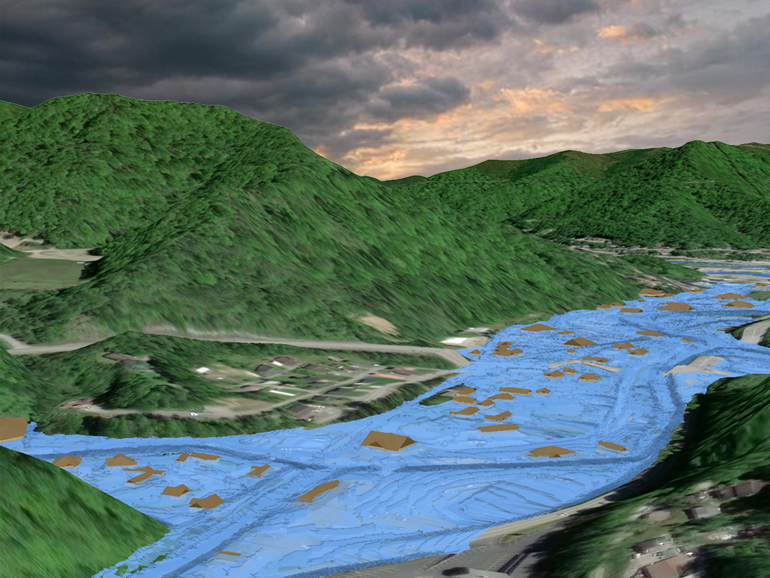
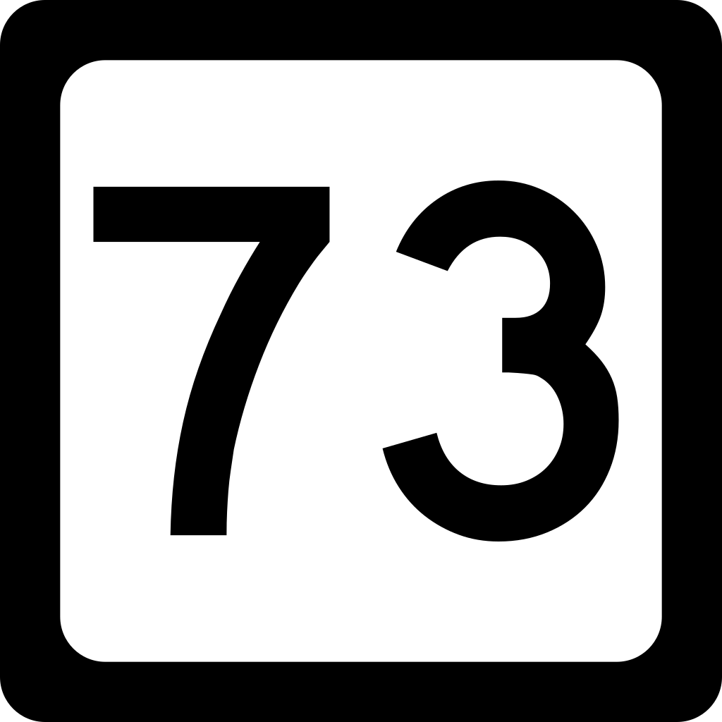
Inundated Area in one-hundred-year flood
Flood Source: Copperas Mine Fork
Watershed: Upper Guyandotte
Mud Fork
Copperas Mud Fork

Slide 25
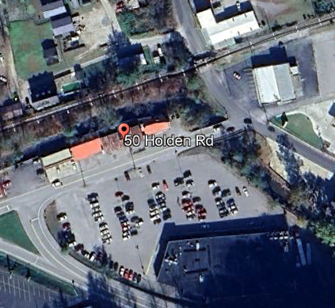
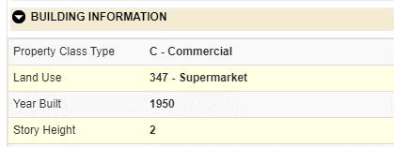
Building General Identification
23-03-0066-0074-0000_50
50 HOLDEN RD, MOUNT GAY, WV, 25637
Pre-FIRM

Slide 26
Flood Profile
 | HEIGHT (ft.)
BUILDING
Freeboard (FBD) | 2
FLOOD DEPTH
FEMA 1% (100-Yr) | 12.6
FEMA 100-Yr + FBD | 14.6
FEMA 0.2% (500-Yr)
Flood Profile
12.6’ (FEMA 1% / 100-Yr)
FLOOD DEPTHS:
FEMA, Effective 2008

Slide 27
Flood Profile
 | HEIGHT (ft.)
BUILDING
Freeboard (FBD) | 2
FLOOD DEPTH
FEMA 1% (100-Yr) | 12.6
FEMA 100-Yr + FBD | 14.6
FEMA 0.2% (500-Yr) | 15.6
Flood Profile
15.6’ (FEMA 0.2% / 500-Yr)
12.6’ (FEMA 1% / 100-Yr)
FLOOD DEPTHS:
FEMA, Effective 2008

Slide 28
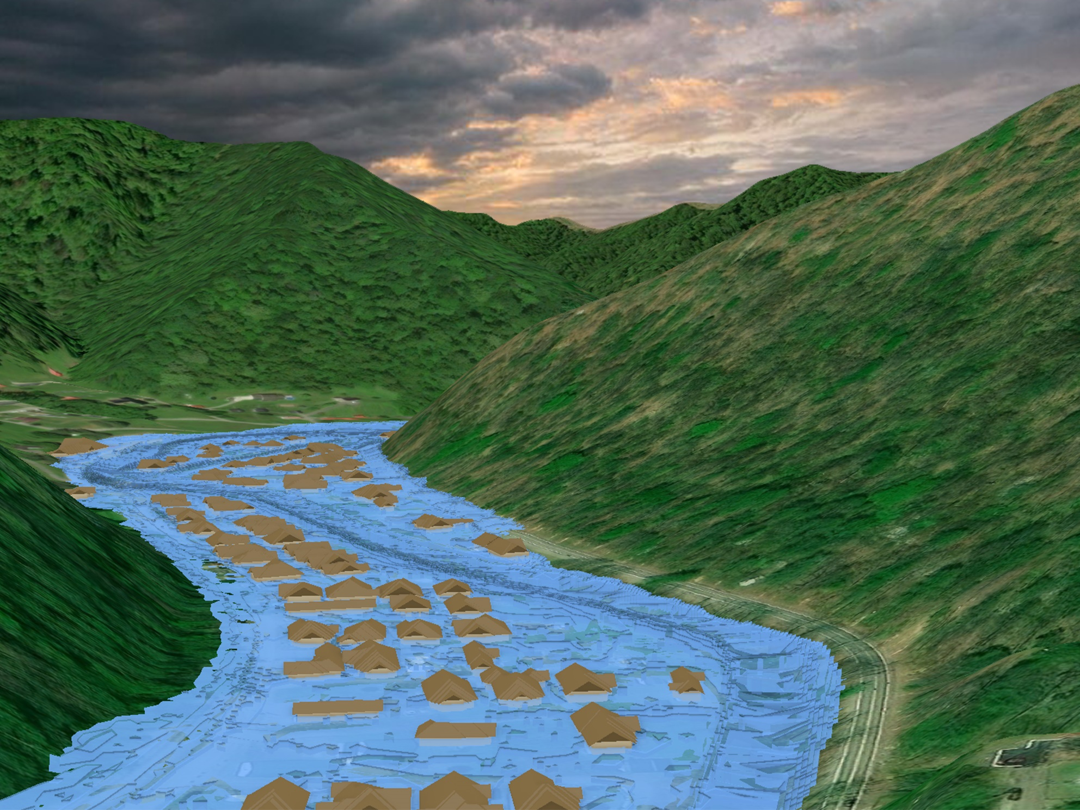
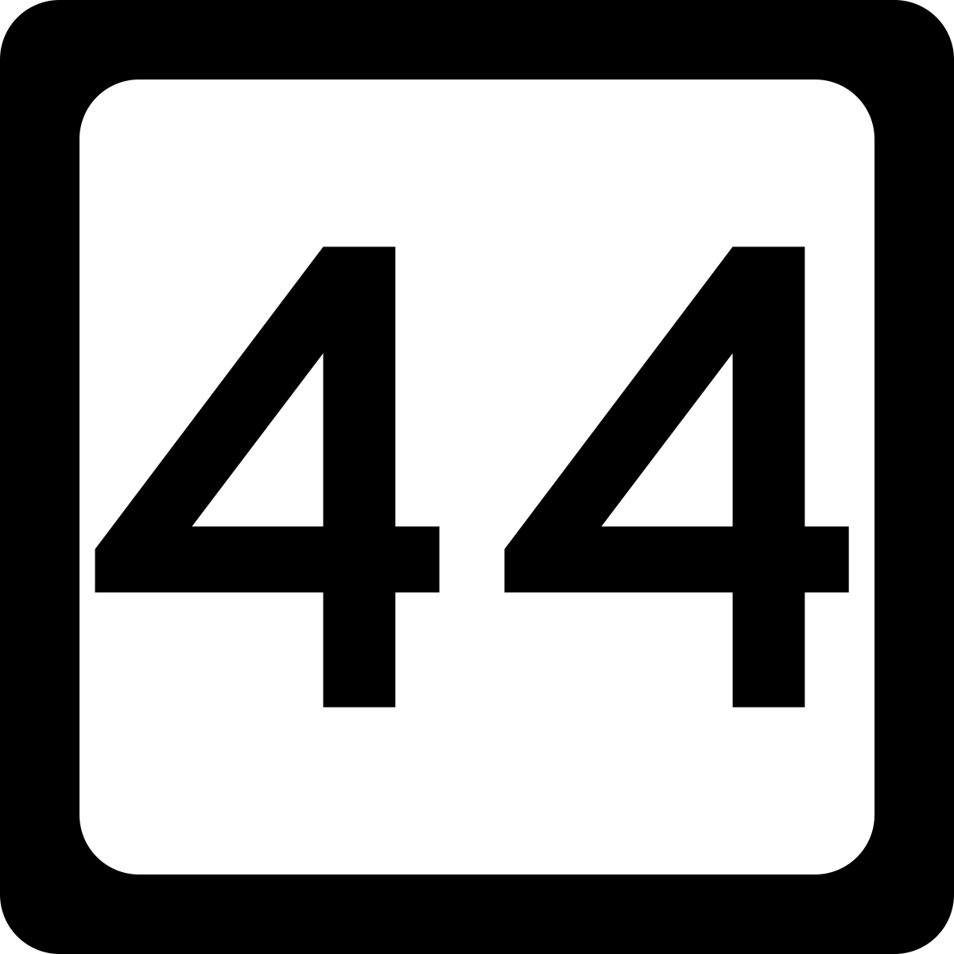
Inundated Area in one-hundred-year flood
Flood Source: Island Creek
Watershed: Upper Guyandotte
Island Creek
Island Creek

Slide 29
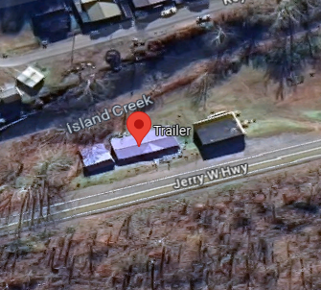
Building General Identification
23-03-0029-0029-0000_3456
3456 JERRY WEST HWY TRLR, ROSSMORE, WV, 25636
Post-FIRM

Slide 30
Flood Profile
 | HEIGHT (ft.)
BUILDING
Freeboard (FBD) | 2
FLOOD DEPTH
FEMA 1% (100-Yr) | 7.2
FEMA 100-Yr + FBD | 9.2
FEMA 0.2% (500-Yr)
Flood Profile
7.2’ (FEMA 1% / 100-Yr)
FLOOD DEPTHS:
FEMA, Effective 2008

Slide 31
Flood Profile
 | HEIGHT (ft.)
BUILDING
Freeboard (FBD) | 2
FLOOD DEPTH
FEMA 1% (100-Yr) | 7.2
FEMA 100-Yr + FBD | 9.2
FEMA 0.2% (500-Yr) | 9.2
Flood Profile
9.2’ (FEMA 0.2% / 500-Yr)
7.2’ (FEMA 1% / 100-Yr)
FLOOD DEPTHS:
FEMA, Effective 2008

Slide 32
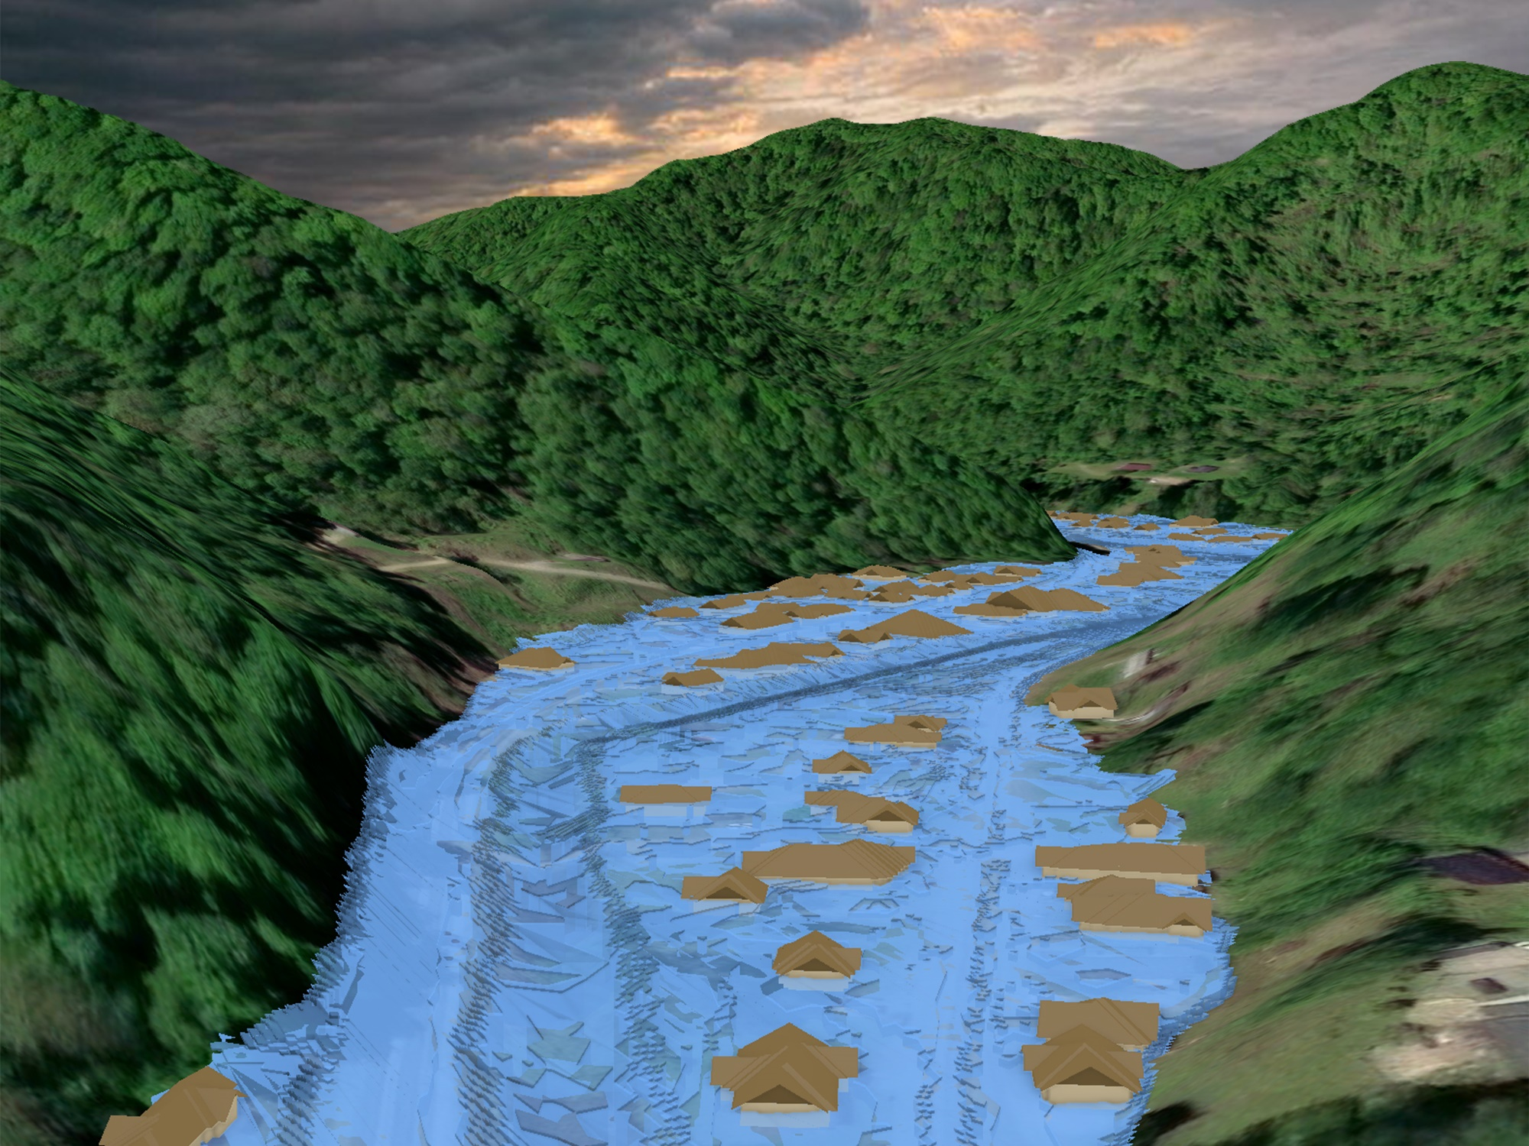
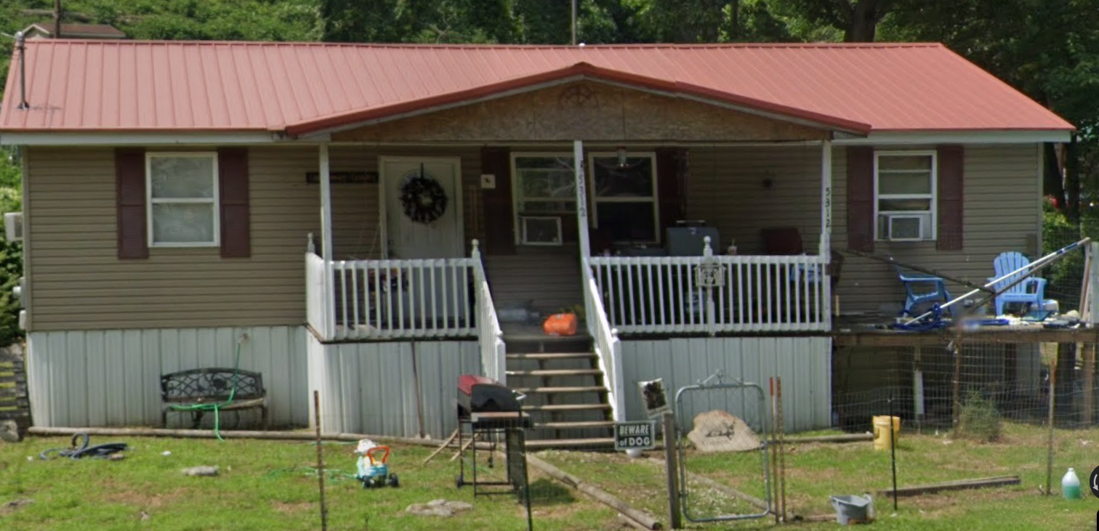
Inundated Area in one-hundred-year flood
Flood Source: Island Creek
Watershed: Upper Guyandotte
Island Creek
Island Creek

Slide 33
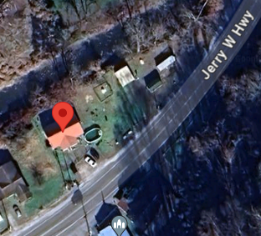
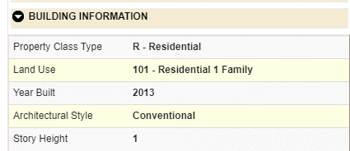
Building General Identification
23-03-0048-0113-0000_5312
5312 JERRY WEST HWY, SWITZER, WV, 25647
Post-FIRM

Slide 34
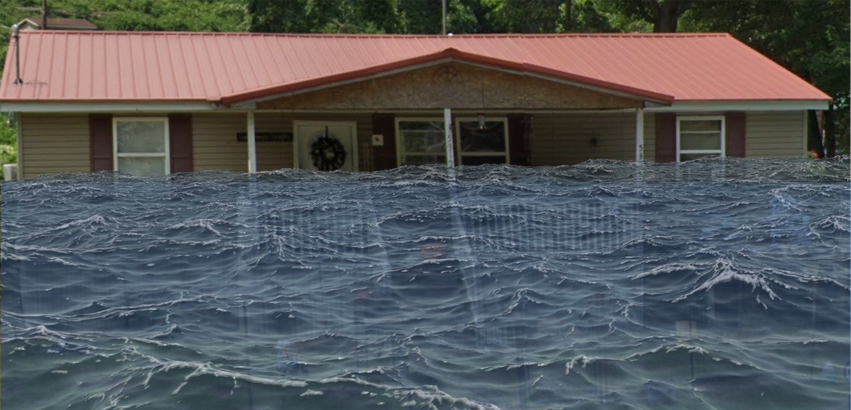
Flood Profile
 | HEIGHT (ft.)
BUILDING
Freeboard (FBD) | 2
FLOOD DEPTH
FEMA 1% (100-Yr) | 9.4
FEMA 100-Yr + FBD | 11.4
FEMA 0.2% (500-Yr)
Flood Profile
9.4’ (FEMA 1% / 100-Yr)
FLOOD DEPTHS:
FEMA, Effective 2008

Slide 35
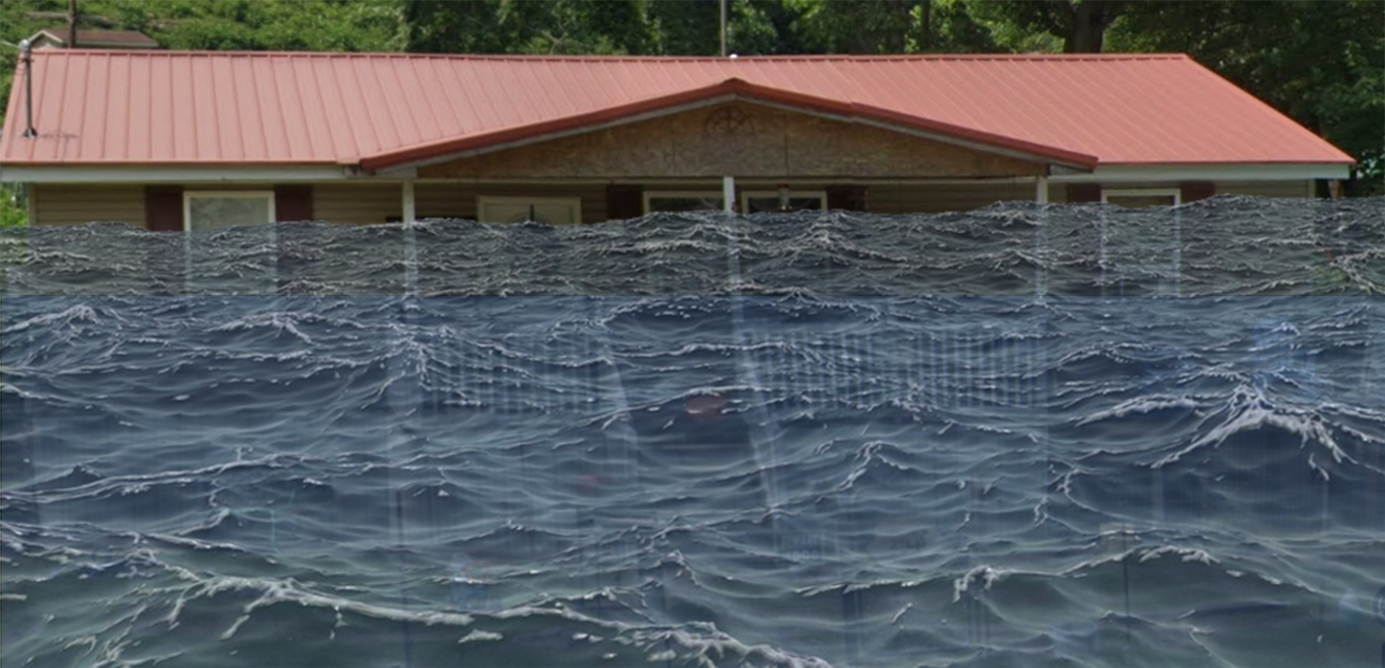
Flood Profile
 | HEIGHT (ft.)
BUILDING
Freeboard (FBD) | 2
FLOOD DEPTH
FEMA 1% (100-Yr) | 9.4
FEMA 100-Yr + FBD | 11.4
FEMA 0.2% (500-Yr) | 12.7
Flood Profile
12.2’ (FEMA 0.2% / 500-Yr)
9.4’ (FEMA 1% / 100-Yr)
FLOOD DEPTHS:
FEMA, Effective 2008

Slide 36
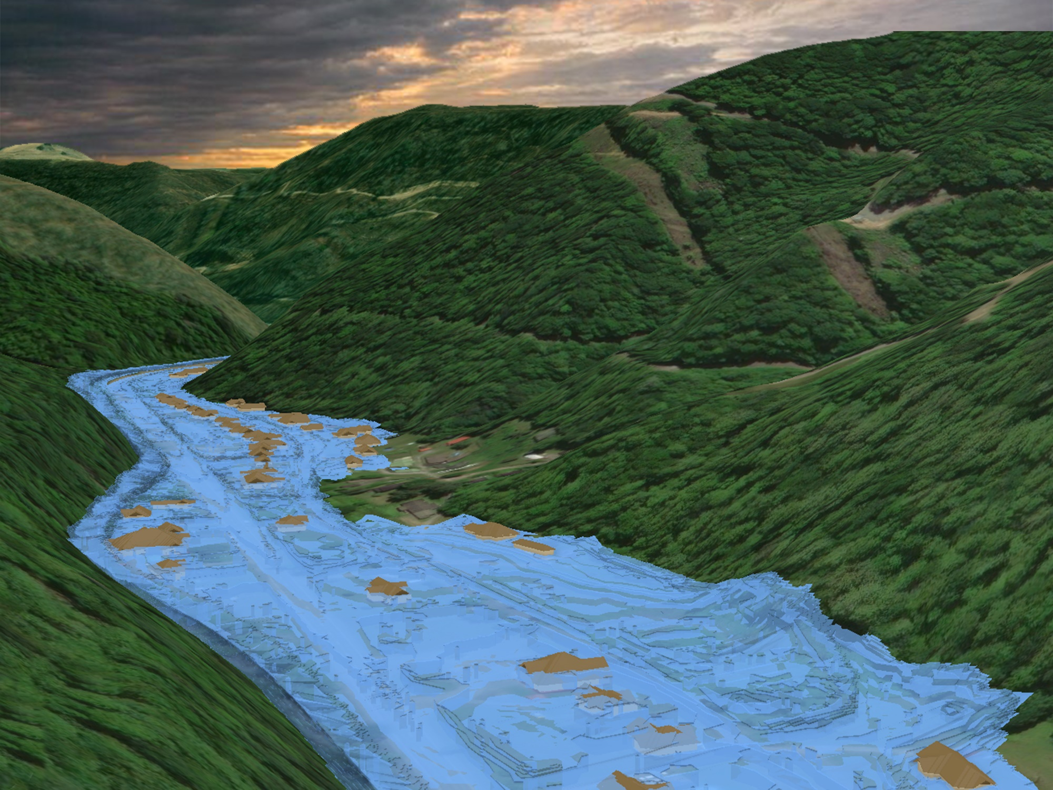
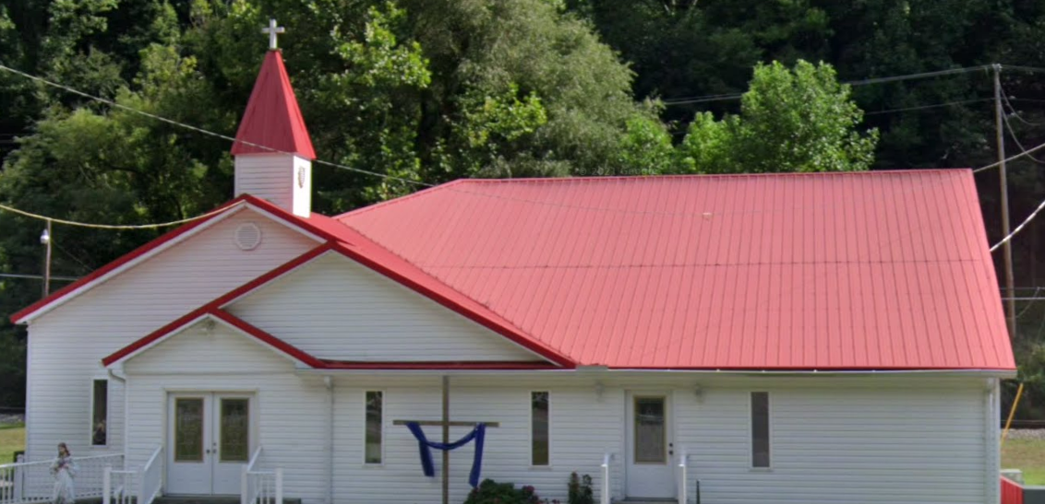
Inundated Area in one-hundred-year flood
Flood Source: Buffalo Creek
Watershed: Upper Guyandotte
Buffalo Creek
Buffalo Creek

Slide 37
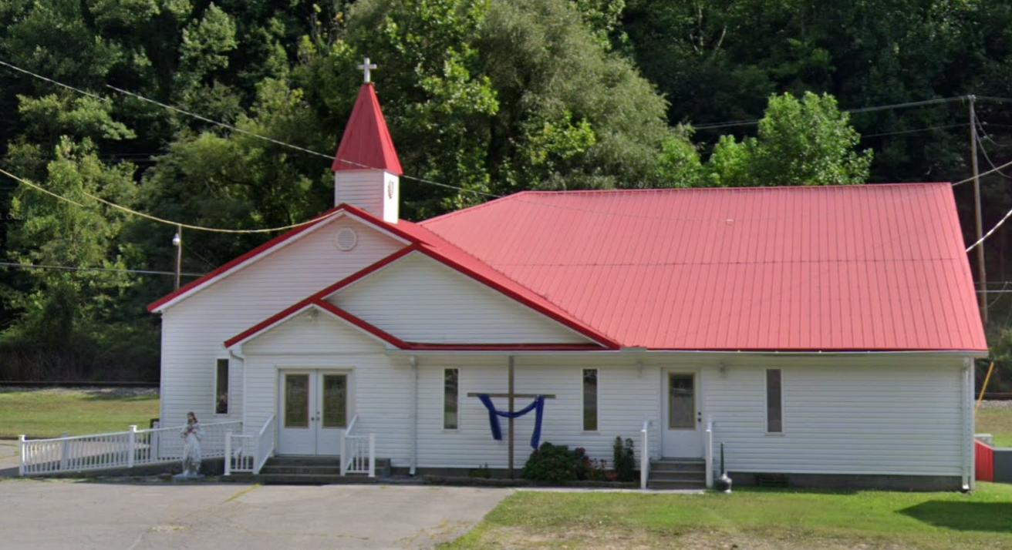
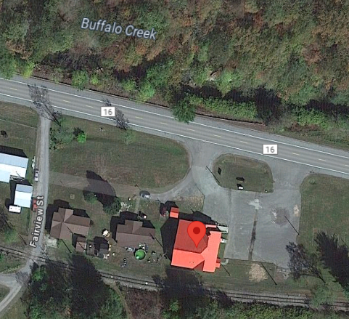
Building General Identification
Building: 23-08-0009-0051-0000_8968
8968 BUFFALO CREEK RD, LORADO, WV, 25630

Slide 38
Flood Profile
 | HEIGHT (ft.)
BUILDING
Freeboard (FBD) | 2
FLOOD DEPTH
FEMA 1% (100-Yr) | 13.1
FEMA 100-Yr + FBD | 15.1
FEMA 0.2% (500-Yr)
13.1’ (FEMA 1% / 100-Yr)
FLOOD DEPTHS:
FEMA, Effective 2008

Slide 39
Flood Profile
 | HEIGHT (ft.)
BUILDING
Freeboard (FBD) | 2
FLOOD DEPTH
FEMA 1% (100-Yr) | 13.1
FEMA 100-Yr + FBD | 15.1
FEMA 0.2% (500-Yr) | 16.1
16.1’ (FEMA 0.2% / 500-Yr)
13.1’ (FEMA 1% / 100-Yr)
FLOOD DEPTHS:
FEMA, Effective 2008

Slide 40
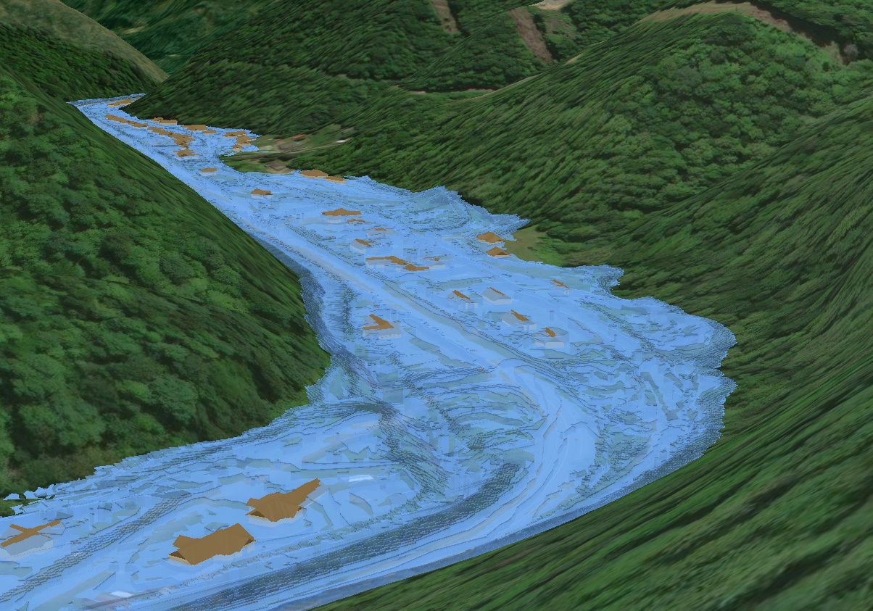
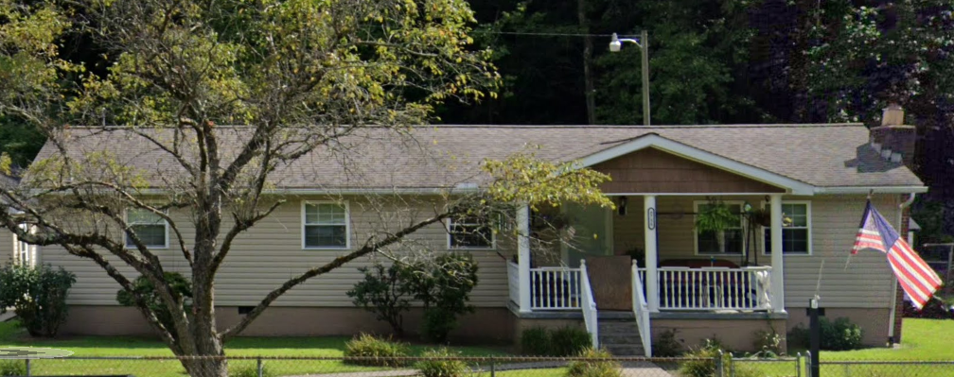
Inundated Area in one-hundred-year flood
Flood Source: Buffalo Creek
Watershed: Upper Guyandotte
Buffalo Creek

Slide 41
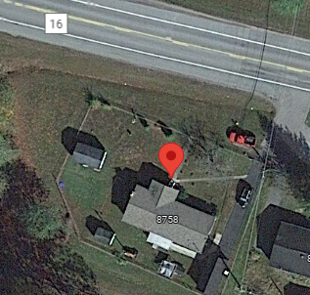
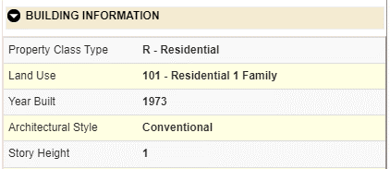
Building General Identification
Building: 23-08-0009-0028-0000_8758
8758 BUFFALO CREEK RD, LORADO, WV, 25630
Pre-FIRM

Slide 42
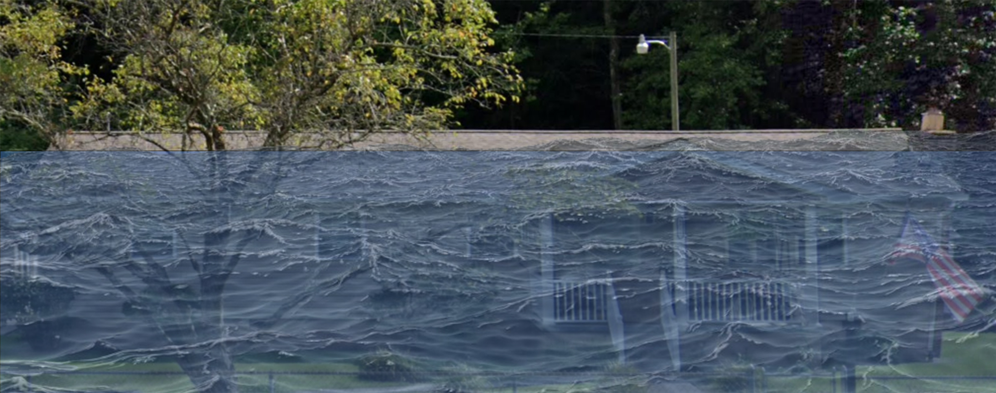
Flood Profile
 | HEIGHT (ft.)
BUILDING
Freeboard (FBD) | 2
FLOOD DEPTH
FEMA 1% (100-Yr) | 13.9
FEMA 100-Yr + FBD | 15.9
FEMA 0.2% (500-Yr)
Flood Profile
13.9’ (FEMA 1% / 100-Yr)
Island Creek
FLOOD DEPTHS:
FEMA, Effective 2008

Slide 43
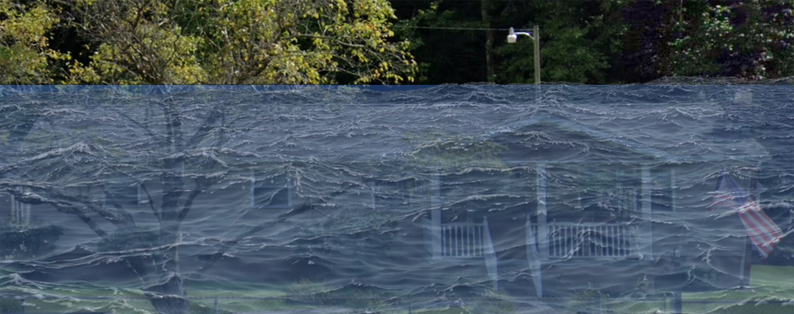
Flood Profile
 | HEIGHT (ft.)
BUILDING
Freeboard (FBD) | 2
FLOOD DEPTH
FEMA 1% (100-Yr) | 13.9
FEMA 100-Yr + FBD | 15.9
FEMA 0.2% (500-Yr) | 16.7
Flood Profile
16.7’ (FEMA 0.2% / 500-Yr)
13.9’ (FEMA 1% / 100-Yr)
Island Creek
FLOOD DEPTHS:
FEMA, Effective 2008

Slide 44
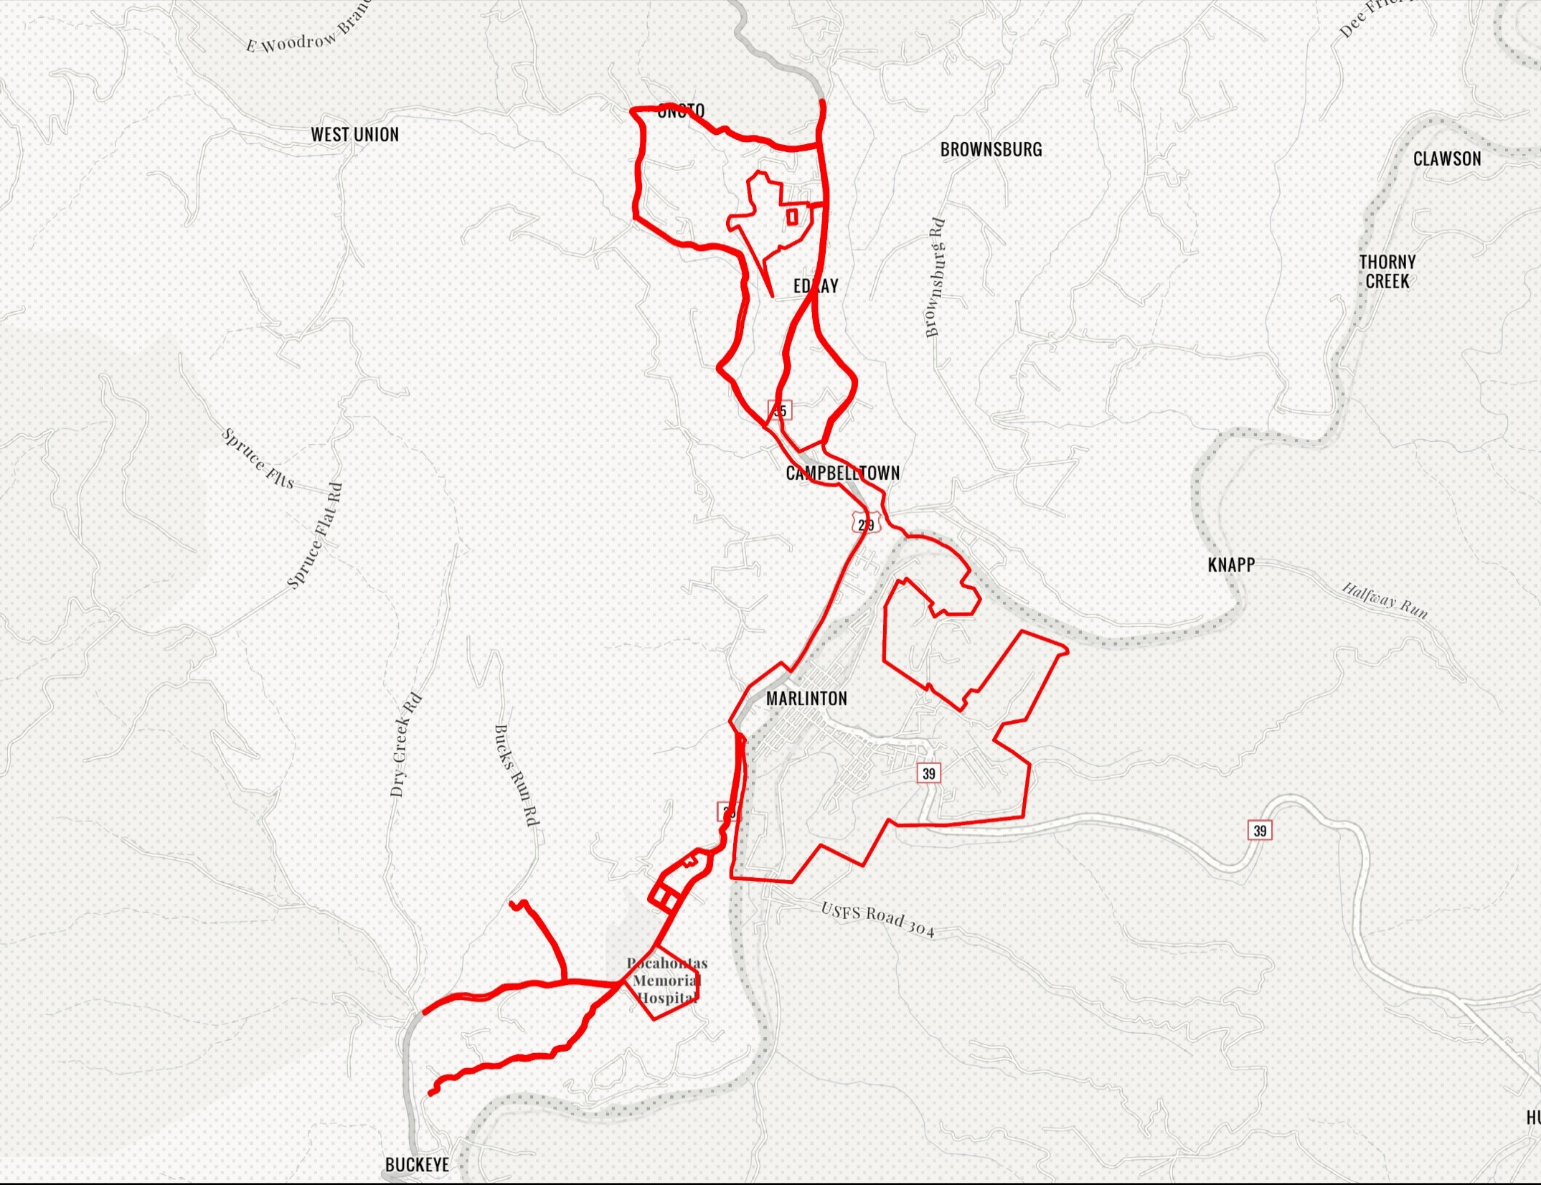
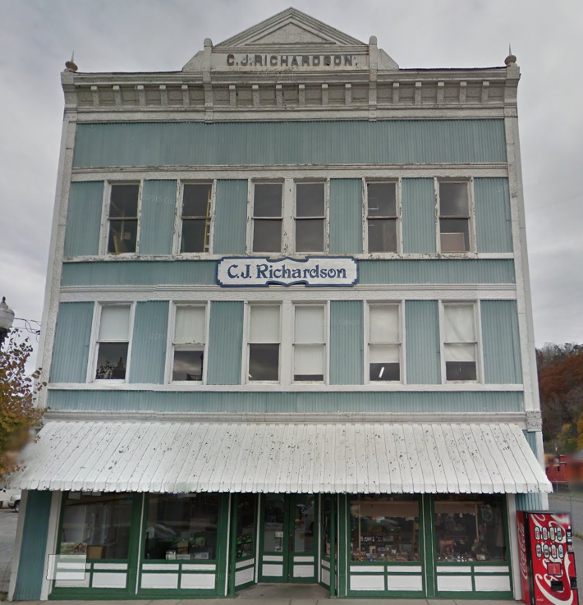
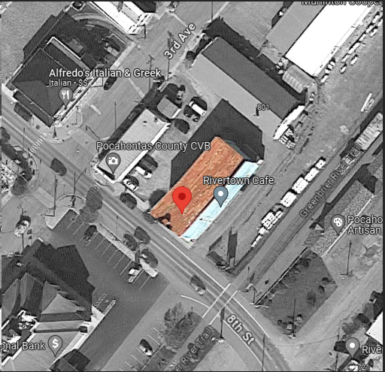
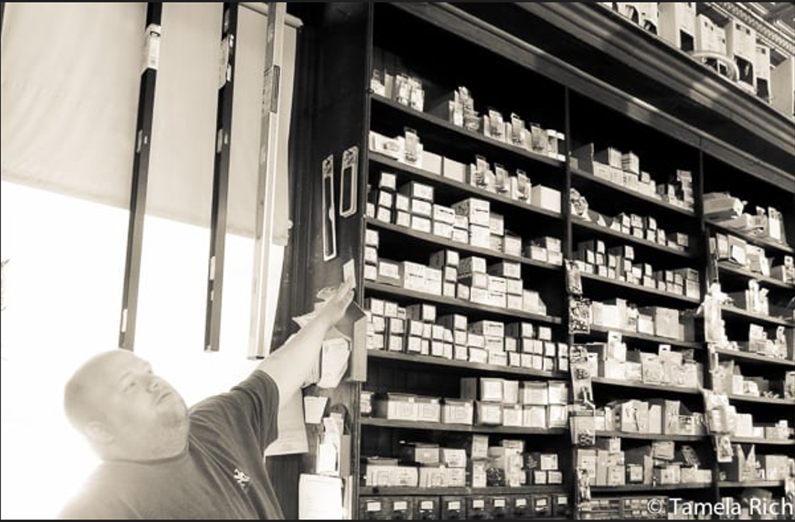
Marlinton
Ideally, the Design Flood Elevation (DFE) should be the BFE plus 2 feet of freeboard. The DFE should also be above the high-water marks of the 1985 flood plus freeboard.
Building: 38-08-0003-0023-0000
1900 Commercial Structure
Flood Intervals | Height (ft.) | Source
FEMA 10% / 10-Yr | 0.4 | Flood Profile (Effective 2010)
FEMA 2% / 50-yr | 2.7 | Flood Profile (Effective 2010)
FEMA 1% / 100-yr | 3.6 | Flood Profile (Effective 2010)
FEMA 100-yr + 2.0 Ft. Freeboard (DFE) | 5.6 | Design flood elevation (DFE)
High Water Mark (1985 Flood) | 7.0 | Picture
FEMA Draft NFHL 100-yr | 4.8 | WV Flood Tool (Draft 2023)
FEMA 500-yr | 8.8 | WV Flood Tool (Draft 2023)
FSF 500-yr | 9.4 | FSF Flood Depth (2022)
Building Flood Profile
309 8th St, Marlinton, WV, 24954
9.4’ (FSF 0.2% / 500-Yr)
8.8’ (FEMA DRAFT NFHL 0.2% / 500-Yr )
7’ (1985 High Water Mark)
4.8’ (FEMA DRAFT NFHL 1% / 100-Yr)
3.6’ (FEMA 1% / 100-Yr)
2.7’ (FEMA 2% / 50-Yr)
1985 Flood High Water Mark
0.4’ (FEMA 10% / 10-Yr)
FLOOD DEPTHS:
FEMA Effective (2010)
FEMA Draft NFHL (2023)
First Street Foundation (FSF, 2022)
1985 Flood High Water Mark

Slide 45
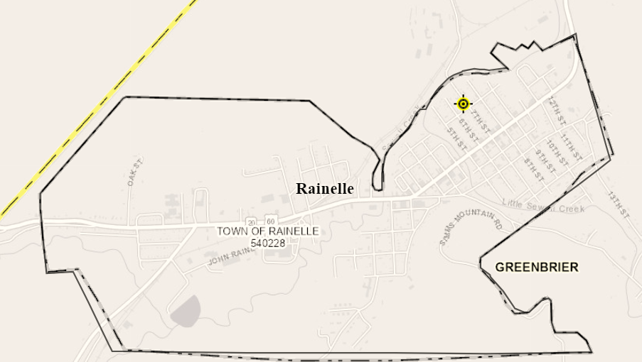
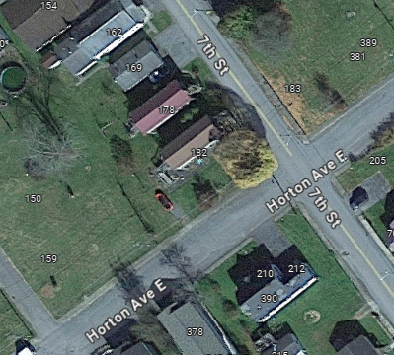
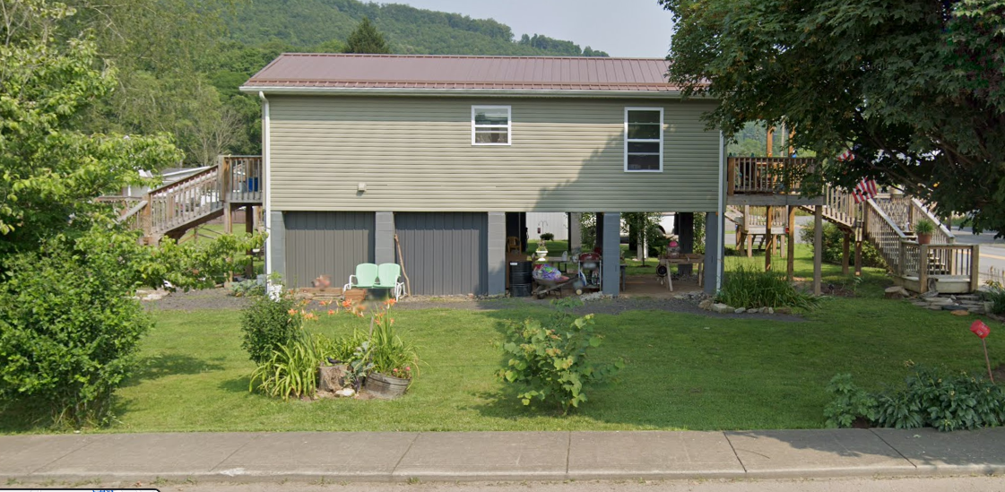
Rainelle
182 SEVENTH ST, Rainelle, WV, 25962
Building Flood Profile
13-13-0001-0054-0000_182

Slide 46
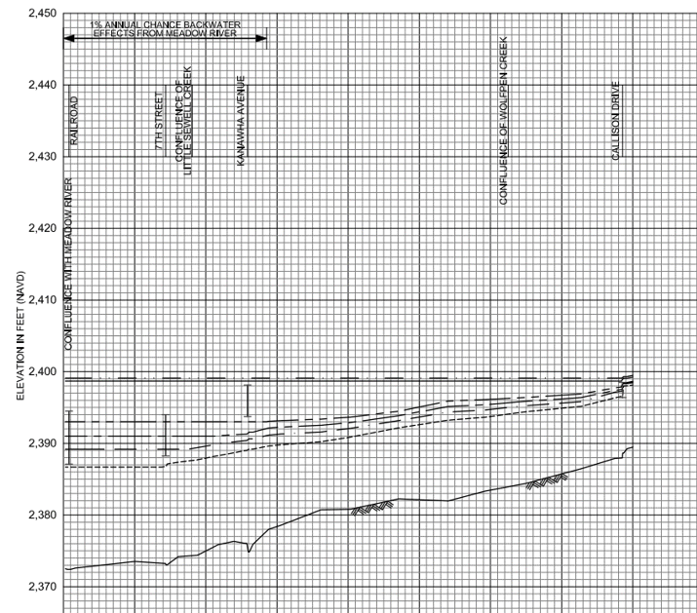
10% Probability of Flood in a year (10-year flood)
Building’s Ground Elevation
No Inundation

Slide 47
4% Probability of Flood in a year (25-year flood)
0’ (FEMA 4% / 25-Yr)

Slide 48
2% Probability of Flood in a year (50-year flood)
1.9’ (FEMA 2% / 50-Yr)

Slide 49
1% Probability of Flood in a year (100-year flood)
3.1’ (FEMA 1% /100-Yr)

Slide 50
0.2% Probability of Flood in a year (500-year flood)
9.9’ (FEMA 1% +/ 84% CL)
9.9’ (FEMA 0.2% /500-Yr)

Slide 51
2016 High Watermark
High Watermark
7.5’ (2016 High Water)

Slide 52
 | HEIGHT (ft.)
BUILDING
First Floor Height | 9
Freeboard (FBD) | 2
FLOOD DEPTH
FEMA 10% (10-Yr) | NA
FEMA 4% (25-Yr) | NA
FEMA 2% (50-Yr) | 1.9
2016 Flood HWM
FEMA 1% (100-Yr)
FEMA 100-Yr + FBD
FEMA 1%+ (84% CL)
FEMA 0.2% (500-Yr)
FSF 0.2% (500-Yr)
1.9’ (FEMA 10% / 10-Yr)
Building: 13-13-0001-0054-0000_182
182 Seventh Street, Rainelle, WV, 25962
FLOOD DEPTHS:
FEMA, Effective 2023
First Street Foundation (FSF, 2022)
USGS 2016 Flood High Water Mark

Slide 53
 | HEIGHT (ft.)
BUILDING
First Floor Height | 9
Freeboard (FBD) | 2
FLOOD DEPTH
FEMA 10% (10-Yr) | NA
FEMA 4% (25-Yr) | NA
FEMA 2% (50-Yr) | 1.9
2016 Flood HWM
FEMA 1% (100-Yr) | 3.1
FEMA 100-Yr + FBD
FEMA 1%+ (84% CL)
FEMA 0.2% (500-Yr)
FSF 0.2% (500-Yr) Climate
3.1’ (FEMA 1% / 100-Yr)
1.9’ (FEMA 10% / 10-Yr)
Building: 13-13-0001-0054-0000_182
182 Seventh Street, Rainelle, WV, 25962
FLOOD DEPTHS:
FEMA, Effective 2023
First Street Foundation (FSF, 2022)
USGS 2016 Flood High Water Mark

Slide 54
 | HEIGHT (ft.)
BUILDING
First Floor Height | 9
Freeboard (FBD) | 2
FLOOD DEPTH
FEMA 10% (10-Yr) | NA
FEMA 4% (25-Yr) | NA
FEMA 2% (50-Yr) | 1.9
2016 Flood HWM
FEMA 1% (100-Yr) | 3.1
FEMA 100-Yr + FBD | 5.1
FEMA 1%+ (84% CL) | 9.9
FEMA 0.2% (500-Yr)
FSF 0.2% (500-Yr) Climate
9.9’ FEMA 1%+ (84% CL)
3.1’ (FEMA 1% / 100-Yr)
1.9’ (FEMA 10% / 10-Yr)
Building: 13-13-0001-0054-0000_182
182 Seventh Street, Rainelle, WV, 25962
FLOOD DEPTHS:
FEMA, Effective 2023
First Street Foundation (FSF, 2022)
USGS 2016 Flood High Water Mark

Slide 55
 | HEIGHT (ft.)
BUILDING
First Floor Height | 9
Freeboard (FBD) | 2
FLOOD DEPTH
FEMA 10% (10-Yr) | NA
FEMA 4% (25-Yr) | NA
FEMA 2% (50-Yr) | 1.9
2016 Flood HWM | 7.5
FEMA 1% (100-Yr) | 3.1
FEMA 100-Yr + FBD | 5.1
FEMA 1%+ (84% CL) | 9.9
FEMA 0.2% (500-Yr)
FSF 0.2% (500-Yr) Climate
9.9’ FEMA 1%+ (84% CL)
7.5’ (2016 High Water)
3.1’ (FEMA 1% / 100-Yr)
1.9’ (FEMA 10% / 10-Yr)
Building: 13-13-0001-0054-0000_182
182 Seventh Street, Rainelle, WV, 25962
FLOOD DEPTHS:
FEMA, Effective 2023
First Street Foundation (FSF, 2022)
USGS 2016 Flood High Water Mark

Slide 56
 | HEIGHT (ft.)
BUILDING
First Floor Height | 9
Freeboard (FBD) | 2
FLOOD DEPTH
FEMA 10% (10-Yr) | NA
FEMA 4% (25-Yr) | NA
FEMA 2% (50-Yr) | 1.9
2016 Flood HWM | 7.5
FEMA 1% (100-Yr) | 3.1
FEMA 100-Yr + FBD | 5.1
FEMA 1%+ (84% CL) | 9.9
FEMA 0.2% (500-Yr) | 9.9
FSF 0.2% (500-Yr) Climate
9.9’ (FEMA 0.2% / 500-Yr )
9.9’ FEMA 1%+ (84% CL)
7.5’ (2016 High Water)
3.1’ (FEMA 1% / 100-Yr)
1.9’ (FEMA 10% / 10-Yr)
Building: 13-13-0001-0054-0000_182
182 Seventh Street, Rainelle, WV, 25962
FLOOD DEPTHS:
FEMA, Effective 2023
First Street Foundation (FSF, 2022)
USGS 2016 Flood High Water Mark

Slide 57
 | HEIGHT (ft.)
BUILDING
First Floor Height | 9
Freeboard (FBD) | 2
FLOOD DEPTH
FEMA 10% (10-Yr) | NA
FEMA 4% (25-Yr) | NA
FEMA 2% (50-Yr) | 1.9
2016 Flood HWM | 7.5
FEMA 1% (100-Yr) | 3.1
FEMA 100-Yr + FBD | 5.1
FEMA 1%+ (84% CL) | 9.9
FEMA 0.2% (500-Yr) | 9.9
FSF 0.2% (500-Yr) Climate | 12.2
12.2’ (FSF 0.2% / 500-Yr)
9.9’ (FEMA 0.2% / 500-Yr )
9.9’ FEMA 1%+ (84% CL)
7.5’ (2016 High Water)
3.1’ (FEMA 1% / 100-Yr)
1.9’ (FEMA 10% / 10-Yr)
Building: 13-13-0001-0054-0000_182
182 Seventh Street, Rainelle, WV, 25962
FLOOD DEPTHS:
FEMA, Effective 2023
First Street Foundation (FSF, 2022)
USGS 2016 Flood High Water Mark

Slide 58
Richwood
34-06-0011-0090-0000_113
113 Valley Ave, Richwood, WV
Building Flood Profile

Slide 59
2% Probability of Flood in a year (50-year flood)
2.8’ (FEMA 2% / 50-Yr)
Building’s Ground Elevation

Slide 60
1% Probability of Flood in a year (100-year flood)
3.5’ (FEMA 1% / 100-Yr)

Slide 61
0.2% Probability of Flood in a year (500-year flood)
8.3’ (FEMA 0.2% / 500-Yr)

Slide 62
2016 High Watermark
High Watermark
1.0’ (2016 High Water)
Building’s Ground Elevation

Slide 63
The Design Flood Elevation (DFE) should be the BFE plus 2 feet of freeboard. The DFE should also be above the high-water marks of the 2016 flood plus freeboard.
113 Valley Ave, Richwood, WV
 | HEIGHT (ft.)
BUILDING
First Floor Height | 8
Freeboard (FBD) | 2
FLOOD DEPTH
FEMA 10% (10-Yr) | NA
FEMA 4% (25-Yr) | NA
FEMA 2% (50-Yr)
2016 Flood HWM | 1.0
FEMA 1% (100-Yr)
FEMA 100-Yr + FBD
FEMA 1%+ (84% CL)
FEMA 0.2% (500-Yr)
FSF 0.2% (500-Yr)
1.0’ (2016 High Water)
Building 34-06-0011-0090-0000_113
Building 34-06-0011-0090-0000_113
FLOOD DEPTHS:
FEMA, Effective 2021
First Street Foundation (FSF, 2022)
USGS 2016 Flood High Water Mark

Slide 64
The Design Flood Elevation (DFE) should be the BFE plus 2 feet of freeboard. The DFE should also be above the high-water marks of the 2016 flood plus freeboard.
113 Valley Ave, Richwood, WV
 | HEIGHT (ft.)
BUILDING
First Floor Height | 8
Freeboard (FBD) | 2
FLOOD DEPTH
FEMA 10% (10-Yr) | NA
FEMA 4% (25-Yr) | NA
FEMA 2% (50-Yr) | 2.8
2016 Flood HWM | 1.0
FEMA 1% (100-Yr)
FEMA 100-Yr + FBD
FEMA 1%+ (84% CL)
FEMA 0.2% (500-Yr)
FSF 0.2% (500-Yr)
2.8’ (FEMA 2% / 50-Yr)
1.0’ (2016 High Water)
Building 34-06-0011-0090-0000_113
FLOOD DEPTHS:
FEMA, Effective 2021
First Street Foundation (FSF, 2022)
USGS 2016 Flood High Water Mark

Slide 65
The Design Flood Elevation (DFE) should be the BFE plus 2 feet of freeboard. The DFE should also be above the high-water marks of the 2016 flood plus freeboard.
113 Valley Ave, Richwood, WV
 | HEIGHT (ft.)
BUILDING
First Floor Height | 8
Freeboard (FBD) | 2
FLOOD DEPTH
FEMA 10% (10-Yr) | NA
FEMA 4% (25-Yr) | NA
FEMA 2% (50-Yr) | 2.8
2016 Flood HWM | 1.0
FEMA 1% (100-Yr) | 3.5
FEMA 100-Yr + FBD | 5.5
FEMA 1%+ (84% CL) | 9.0
FEMA 0.2% (500-Yr)
FSF 0.2% (500-Yr)
9.0’ FEMA1%+ (84% CL)
3.5’ (FEMA 1% / 100-Yr)
2.8’ (FEMA 2% / 50-Yr)
1.0’ (2016 High Water)
Building 34-06-0011-0090-0000_113
FLOOD DEPTHS:
FEMA, Effective 2021
First Street Foundation (FSF, 2022)
USGS 2016 Flood High Water Mark

Slide 66
The Design Flood Elevation (DFE) should be the BFE plus 2 feet of freeboard. The DFE should also be above the high-water marks of the 2016 flood plus freeboard.
113 Valley Ave, Richwood, WV
 | HEIGHT (ft.)
BUILDING
First Floor Height | 8
Freeboard (FBD) | 2
FLOOD DEPTH
FEMA 10% (10-Yr) | NA
FEMA 4% (25-Yr) | NA
FEMA 2% (50-Yr) | 2.8
2016 Flood HWM | 1.0
FEMA 1% (100-Yr) | 3.5
FEMA 100-Yr + FBD | 5.5
FEMA 1%+ (84% CL) | 9.0
FEMA 0.2% (500-Yr) | 8.3
FSF 0.2% (500-Yr)
9.0’ FEMA1%+ (84% CL)
8.3’ (FEMA 0.2% / 500-Yr)
3.5’ (FEMA 1% / 100-Yr)
2.8’ (FEMA 2% / 50-Yr)
1.0’ (2016 High Water)
Building 34-06-0011-0090-0000_113
FLOOD DEPTHS:
FEMA, Effective 2021
First Street Foundation (FSF, 2022)
USGS 2016 Flood High Water Mark

Slide 67
The Design Flood Elevation (DFE) should be the BFE plus 2 feet of freeboard. The DFE should also be above the high-water marks of the 2016 flood plus freeboard.
113 Valley Ave, Richwood, WV
 | HEIGHT (ft.)
BUILDING
First Floor Height | 8
Freeboard (FBD) | 2
FLOOD DEPTH
FEMA 10% (10-Yr) | NA
FEMA 4% (25-Yr) | NA
FEMA 2% (50-Yr) | 2.8
2016 Flood HWM | 1.0
FEMA 1% (100-Yr) | 3.5
FEMA 100-Yr + FBD | 5.5
FEMA 1%+ (84% CL) | 9.0
FEMA 0.2% (500-Yr) | 8.3
FSF 0.2% (500-Yr) | 6.7
9.0’ FEMA1%+ (84% CL)
8.3’ (FEMA 0.2% / 500-Yr)
6.7’ (FSG 0.2% / 500-Yr)
3.5’ (FEMA 1% / 100-Yr)
2.8’ (FEMA 2% / 50-Yr)
1.0’ (2016 High Water)
Building 34-06-0011-0090-0000_113
FLOOD DEPTHS:
FEMA, Effective 2021
First Street Foundation (FSF, 2022)
USGS 2016 Flood High Water Mark

Slide 68
Wheeling
35.7’ (FSF 2% / 500 yr)
40 VIRGINIA ST, Wheeling, WV, 26003
Building: 35-10-0W43-0134-0000_40
Flood Intervals | HEIGHT (ft.) | Source
FEMA 10% / 10-Yr | NA | Not in by FEMA 10yr flood boundary
FEMA 4% / 25 yr | NA | Not in by FEMA 25yr flood boundary
FEMA 2% / 50 yr | 4.1 | Flood Profile
FEMA 1% / 100 yr (2023 BFE) | 7.1 | Flood Profile
FEMA 100 yr + 2.0 Ft. Freeboard (DFE) | 9.1 | Design flood elevation (DFE)
FEMA 0.2% / 500 yr | 10.1 | Flood Profile
FSF 500 yr | 35.7
Building Flood Profile
10.1’ (FEMA 0.2% / 500 yr)
7.1’ (FEMA 1% / 100 yr)
4.1’ (FEMA 2% / 50 yr)
Flood Depth (ft)
FEMA |  |  |  |  |  |  |  | FSF
Flood Depth in Ft (Current Study) |  |  |  |  | Flood Depth in Ft (Previous Study)
Draft/Effective Date | 50 year (2%) | 100 year (1%) | 100 year Plus(1%+) | 500 year (0.2%) | Effective Date | 100 year (1%) | 500 year (0.2%) | 100 year (1%) | 500 year (0.2%)
2006 | 4.1 | 7.1 | - | 10.1 | 1992 | BFE: 659 (5.9 ft) |  | 22.3 | 35.7
FLOOD DEPTHS:
FEMA, Effective 2006
First Street Foundation (FSF, 2022)

Slide 69
Wheeling
High Water Mark from 1936 Flood
Lowest Adjacent Grade (LAG) = 649.5 feet (estimate from WV Flood Tool). Estimate first floor height to be about 9 feet based on steps and blocks.
1936 HWM = 607.3 ft (gauge height = 0) + 55.2 ft = 662.5 ft.
1936 Flood Depth = LAG 662.5 feet – 649.5 = 13 feet. Estimate four feet of water in structure for 1936 flood.

Slide 70
White Sulphur Springs
Building Flood Profile

Slide 71
Building Flood Profile

Slide 72
Building Flood Profile
138 Mill Street, White Sulphur Springs, WV, 24986
13-17-0009-0026-0000_138

Slide 73
10% Probability of Flood in a year (10-year flood)
1.7’ (FEMA 10% / 10-Yr)
Building’s Ground Elevation

Slide 74
4% Probability of Flood in a year (25-year flood)
2.0’ (FEMA 4% / 25-Yr)

Slide 75
2% Probability of Flood in a year (50-year flood)
3.4’ (FEMA 2% / 50-Yr)

Slide 76
1% Probability of Flood in a year (100-year flood)
5.4’ (FEMA 1% / 100-Yr)

Slide 77
0.2% Probability of Flood in a year (500-year flood)
7.2’ (FEMA 0.2% / 500-Yr)

Slide 78
2016 High Watermark
High Watermark
6.5’ (2016 High Water)

Slide 79
The Design Flood Elevation (DFE) should be the BFE plus 2 feet of freeboard. The DFE should also be above the high-water marks of the 2016 flood plus freeboard.
 | HEIGHT (ft.)
BUILDING
First Floor Height | 6.4
Freeboard (FBD) | 2.0
FLOOD DEPTH
FEMA 10% (10-Yr) | 0.7
FEMA 4% (25-Yr)
FEMA 2% (50-Yr)
2016 Flood HWM
FEMA 1% (100-Yr)
FEMA 100-Yr + FBD
FEMA 1%+ (84% CL)
FEMA 0.2% (500-Yr)
FSF 0.2% (500-Yr)
0.7’ (FEMA 10% / 10-Yr)
Building: 13-13-0001-0054-0000_182
182 Seventh Street, Rainelle, WV, 25962
Building 13-17-0009-0026-0000_138
FLOOD DEPTHS:
FEMA, Effective 2023
First Street Foundation (FSF, 2022)
USGS 2016 Flood High Water Mark

Slide 80
The Design Flood Elevation (DFE) should be the BFE plus 2 feet of freeboard. The DFE should also be above the high-water marks of the 2016 flood plus freeboard.
 | HEIGHT (ft.)
BUILDING
First Floor Height | 6.4
Freeboard (FBD) | 2.0
FLOOD DEPTH
FEMA 10% (10-Yr) | 0.7
FEMA 4% (25-Yr) | 2.0
FEMA 2% (50-Yr)
2016 Flood HWM
FEMA 1% (100-Yr)
FEMA 100-Yr + FBD
FEMA 1%+ (84% CL)
FEMA 0.2% (500-Yr)
FSF 0.2% (500-Yr)
2.0’ (FEMA 4% / 25-Yr)
0.7’ (FEMA 10% / 10-Yr)
Building: 13-13-0001-0054-0000_182
182 Seventh Street, Rainelle, WV, 25962
Building 13-17-0009-0026-0000_138
FLOOD DEPTHS:
FEMA, Effective 2023
First Street Foundation (FSF, 2022)
USGS 2016 Flood High Water Mark

Slide 81
The Design Flood Elevation (DFE) should be the BFE plus 2 feet of freeboard. The DFE should also be above the high-water marks of the 2016 flood plus freeboard.
 | HEIGHT (ft.)
BUILDING
First Floor Height | 6.4
Freeboard (FBD) | 2.0
FLOOD DEPTH
FEMA 10% (10-Yr) | 0.7
FEMA 4% (25-Yr) | 2.0
FEMA 2% (50-Yr) | 3.4
2016 Flood HWM
FEMA 1% (100-Yr)
FEMA 100-Yr + FBD
FEMA 1%+ (84% CL)
FEMA 0.2% (500-Yr)
FSF 0.2% (500-Yr)
3.4’ (FEMA 2% / 50-Yr)
2.0’ (FEMA 4% / 25-Yr)
0.7’ (FEMA 10% / 10-Yr)
Building: 13-13-0001-0054-0000_182
182 Seventh Street, Rainelle, WV, 25962
Building 13-17-0009-0026-0000_138
FLOOD DEPTHS:
FEMA, Effective 2023
First Street Foundation (FSF, 2022)
USGS 2016 Flood High Water Mark

Slide 82
The Design Flood Elevation (DFE) should be the BFE plus 2 feet of freeboard. The DFE should also be above the high-water marks of the 2016 flood plus freeboard.
 | HEIGHT (ft.)
BUILDING
First Floor Height | 6.4
Freeboard (FBD) | 2.0
FLOOD DEPTH
FEMA 10% (10-Yr) | 0.7
FEMA 4% (25-Yr) | 2.0
FEMA 2% (50-Yr) | 3.4
2016 Flood HWM
FEMA 1% (100-Yr) | 5.4
FEMA 100-Yr + FBD | 7.4
FEMA 1%+ (84% CL) | 6.4
FEMA 0.2% (500-Yr)
FSF 0.2% (500-Yr)
6.4’ FEMA 1%+ (84% CL)
5.4’ (FEMA 1% / 100-Yr)
3.4’ (FEMA 2% / 50-Yr)
2.0’ (FEMA 4% / 25-Yr)
0.7’ (FEMA 10% / 10-Yr)
Building: 13-13-0001-0054-0000_182
182 Seventh Street, Rainelle, WV, 25962
Building 13-17-0009-0026-0000_138
FLOOD DEPTHS:
FEMA, Effective 2023
First Street Foundation (FSF, 2022)
USGS 2016 Flood High Water Mark

Slide 83
The Design Flood Elevation (DFE) should be the BFE plus 2 feet of freeboard. The DFE should also be above the high-water marks of the 2016 flood plus freeboard.
 | HEIGHT (ft.)
BUILDING
First Floor Height | 6.4
Freeboard (FBD) | 2.0
FLOOD DEPTH
FEMA 10% (10-Yr) | 0.7
FEMA 4% (25-Yr) | 2.0
FEMA 2% (50-Yr) | 3.4
2016 Flood HWM | 6.5
FEMA 1% (100-Yr) | 5.4
FEMA 100-Yr + FBD | 7.4
FEMA 1%+ (84% CL) | 6.4
FEMA 0.2% (500-Yr)
FSF 0.2% (500-Yr)
6.5’ (2016 High Water)
6.4’ FEMA 1%+ (84% CL)
5.4’ (FEMA 1% / 100-Yr)
3.4’ (FEMA 2% / 50-Yr)
2.0’ (FEMA 4% / 25-Yr)
0.7’ (FEMA 10% / 10-Yr)
Building: 13-13-0001-0054-0000_182
182 Seventh Street, Rainelle, WV, 25962
Building 13-17-0009-0026-0000_138
FLOOD DEPTHS:
FEMA, Effective 2023
First Street Foundation (FSF, 2022)
USGS 2016 Flood High Water Mark

Slide 84
The Design Flood Elevation (DFE) should be the BFE plus 2 feet of freeboard. The DFE should also be above the high-water marks of the 2016 flood plus freeboard.
 | HEIGHT (ft.)
BUILDING
First Floor Height | 6.4
Freeboard (FBD) | 2.0
FLOOD DEPTH
FEMA 10% (10-Yr) | 0.7
FEMA 4% (25-Yr) | 2.0
FEMA 2% (50-Yr) | 3.4
2016 Flood HWM | 6.5
FEMA 1% (100-Yr) | 5.4
FEMA 100-Yr + FBD | 7.4
FEMA 1%+ (84% CL) | 6.4
FEMA 0.2% (500-Yr) | 7.2
FSF 0.2% (500-Yr)
7.2’ (FEMA 0.2% / 500-Yr )
6.5’ (2016 High Water)
6.4’ FEMA 1%+ (84% CL)
5.4’ (FEMA 1% / 100-Yr)
3.4’ (FEMA 2% / 50-Yr)
2.0’ (FEMA 4% / 25-Yr)
0.7’ (FEMA 10% / 10-Yr)
Building: 13-13-0001-0054-0000_182
182 Seventh Street, Rainelle, WV, 25962
Building 13-17-0009-0026-0000_138
FLOOD DEPTHS:
FEMA, Effective 2023
First Street Foundation (FSF, 2022)
USGS 2016 Flood High Water Mark

Slide 85
The Design Flood Elevation (DFE) should be the BFE plus 2 feet of freeboard. The DFE should also be above the high-water marks of the 2016 flood plus freeboard.
 | HEIGHT (ft.)
BUILDING
First Floor Height | 6.4
Freeboard (FBD) | 2.0
FLOOD DEPTH
FEMA 10% (10-Yr) | 0.7
FEMA 4% (25-Yr) | 2.0
FEMA 2% (50-Yr) | 3.4
2016 Flood HWM | 6.5
FEMA 1% (100-Yr) | 5.4
FEMA 100-Yr + FBD | 7.4
FEMA 1%+ (84% CL) | 6.4
FEMA 0.2% (500-Yr) | 7.2
FSF 0.2% (500-Yr) | 7.4
7.4’ (FSF 0.2% / 500-Yr)
7.2’ (FEMA 0.2% / 500-Yr )
6.5’ (2016 High Water)
6.4’ FEMA 1%+ (84% CL)
5.4’ (FEMA 1% / 100-Yr)
3.4’ (FEMA 2% / 50-Yr)
2.0’ (FEMA 4% / 25-Yr)
0.7’ (FEMA 10% / 10-Yr)
Building: 13-13-0001-0054-0000_182
182 Seventh Street, Rainelle, WV, 25962
Building 13-17-0009-0026-0000_138
FLOOD DEPTHS:
FEMA, Effective 2023
First Street Foundation (FSF, 2022)
USGS 2016 Flood High Water Mark

