Slide 1
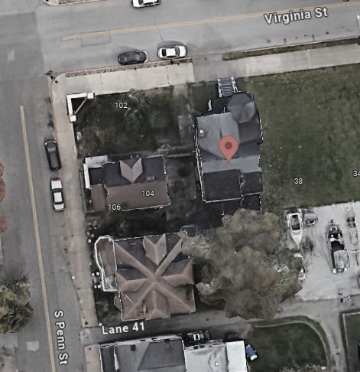
Wheeling
35.7’ (FSF 2% / 500 yr)
40 VIRGINIA ST, Wheeling, WV, 26003
Building: 35-10-0W43-0134-0000_40
Flood Intervals | HEIGHT (ft.) | Source
FEMA 10% / 10-Yr | NA | Not in by FEMA 10yr flood boundary
FEMA 4% / 25 yr | NA | Not in by FEMA 25yr flood boundary
FEMA 2% / 50 yr | 4.1 | Flood Profile
FEMA 1% / 100 yr (2023 BFE) | 7.1 | Flood Profile
FEMA 100 yr + 2.0 Ft. Freeboard (DFE) | 9.1 | Design flood elevation (DFE)
FEMA 0.2% / 500 yr | 10.1 | Flood Profile
FSF 500 yr | 35.7
Building Flood Profile
10.1’ (FEMA 0.2% / 500 yr)
7.1’ (FEMA 1% / 100 yr)
4.1’ (FEMA 2% / 50 yr)
Flood Depth (ft)
FEMA |  |  |  |  |  |  |  | FSF
Flood Depth in Ft (Current Study) |  |  |  |  | Flood Depth in Ft (Previous Study)
Draft/Effective Date | 50 year (2%) | 100 year (1%) | 100 year Plus(1%+) | 500 year (0.2%) | Effective Date | 100 year (1%) | 500 year (0.2%) | 100 year (1%) | 500 year (0.2%)
2006 | 4.1 | 7.1 | - | 10.1 | 1992 | BFE: 659 (5.9 ft) |  | 22.3 | 35.7
FLOOD DEPTHS:
FEMA, Effective 2006
First Street Foundation (FSF, 2022)

Slide 2
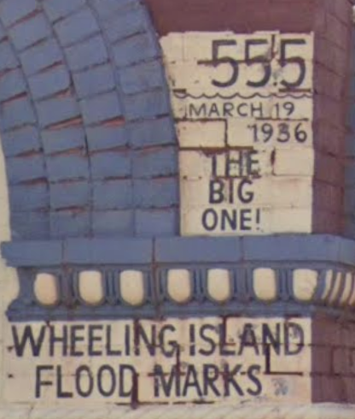
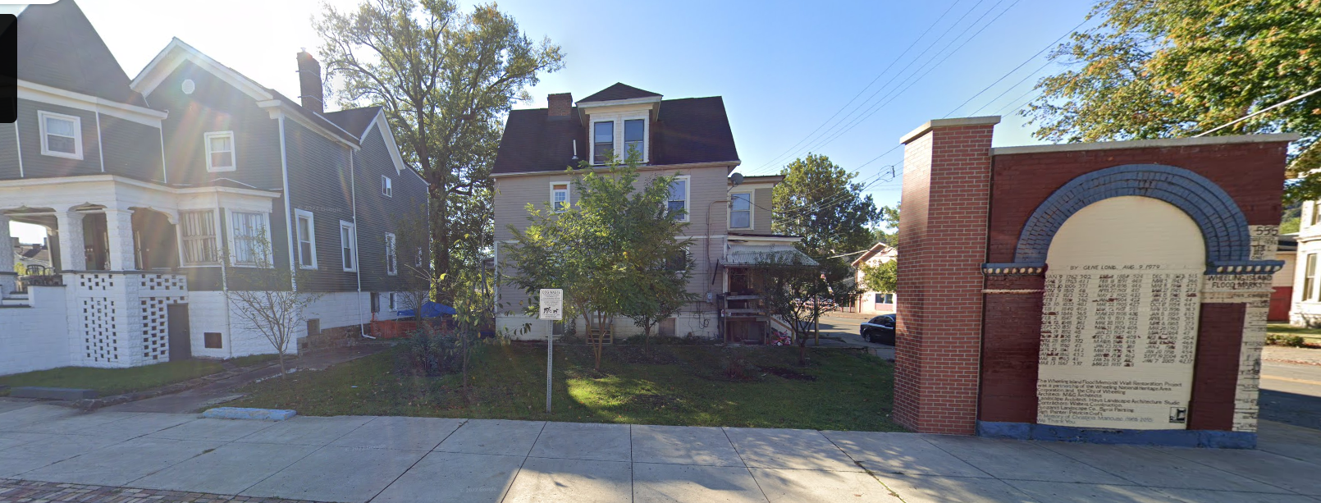
Wheeling
High Water Mark from 1936 Flood
Lowest Adjacent Grade (LAG) = 649.5 feet (estimate from WV Flood Tool). Estimate first floor height to be about 9 feet based on steps and blocks.
1936 HWM = 607.3 ft (gauge height = 0) + 55.2 ft = 662.5 ft.
1936 Flood Depth = LAG 662.5 feet – 649.5 = 13 feet. Estimate four feet of water in structure for 1936 flood.

