Slide 1
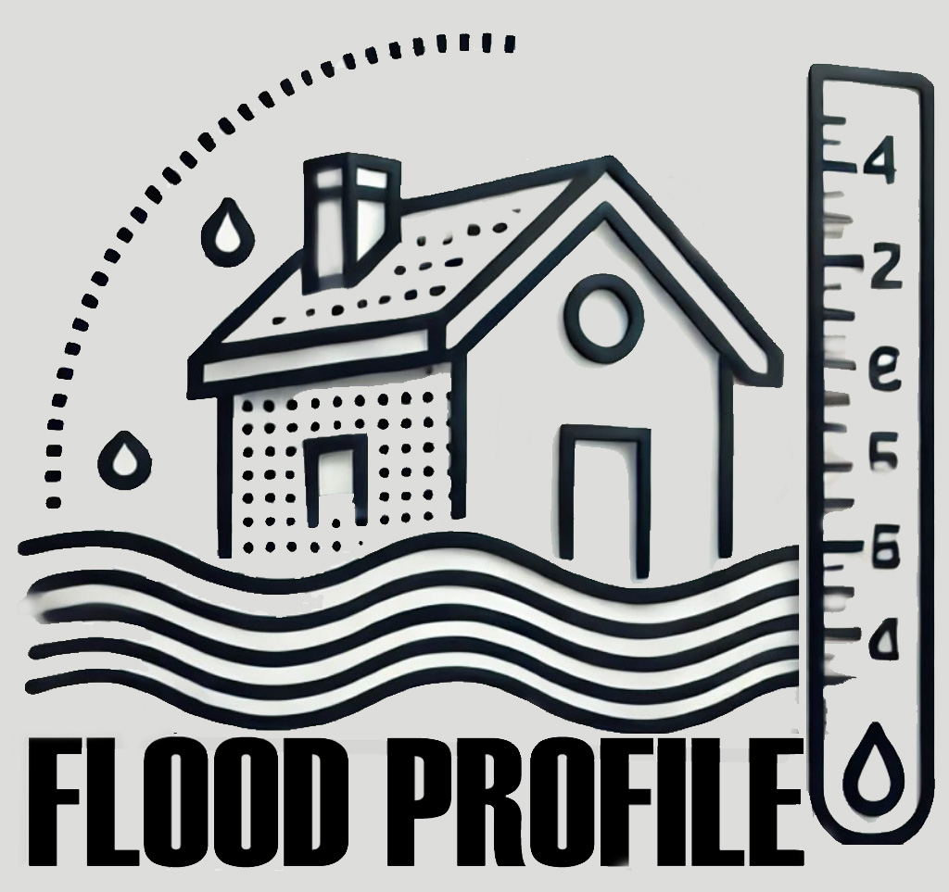
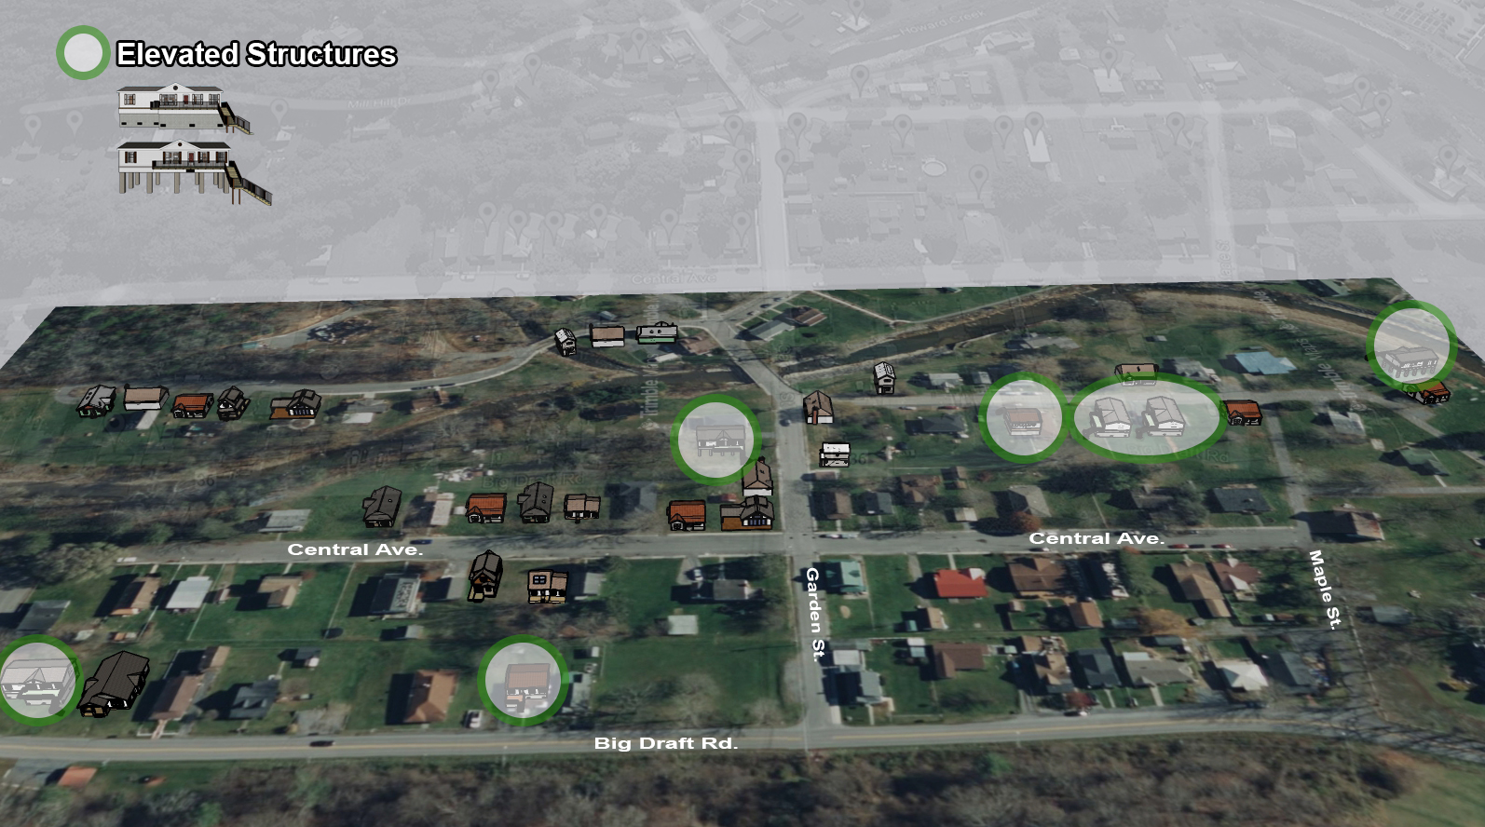
White Sulphur Springs
Building Flood Profile

Slide 2
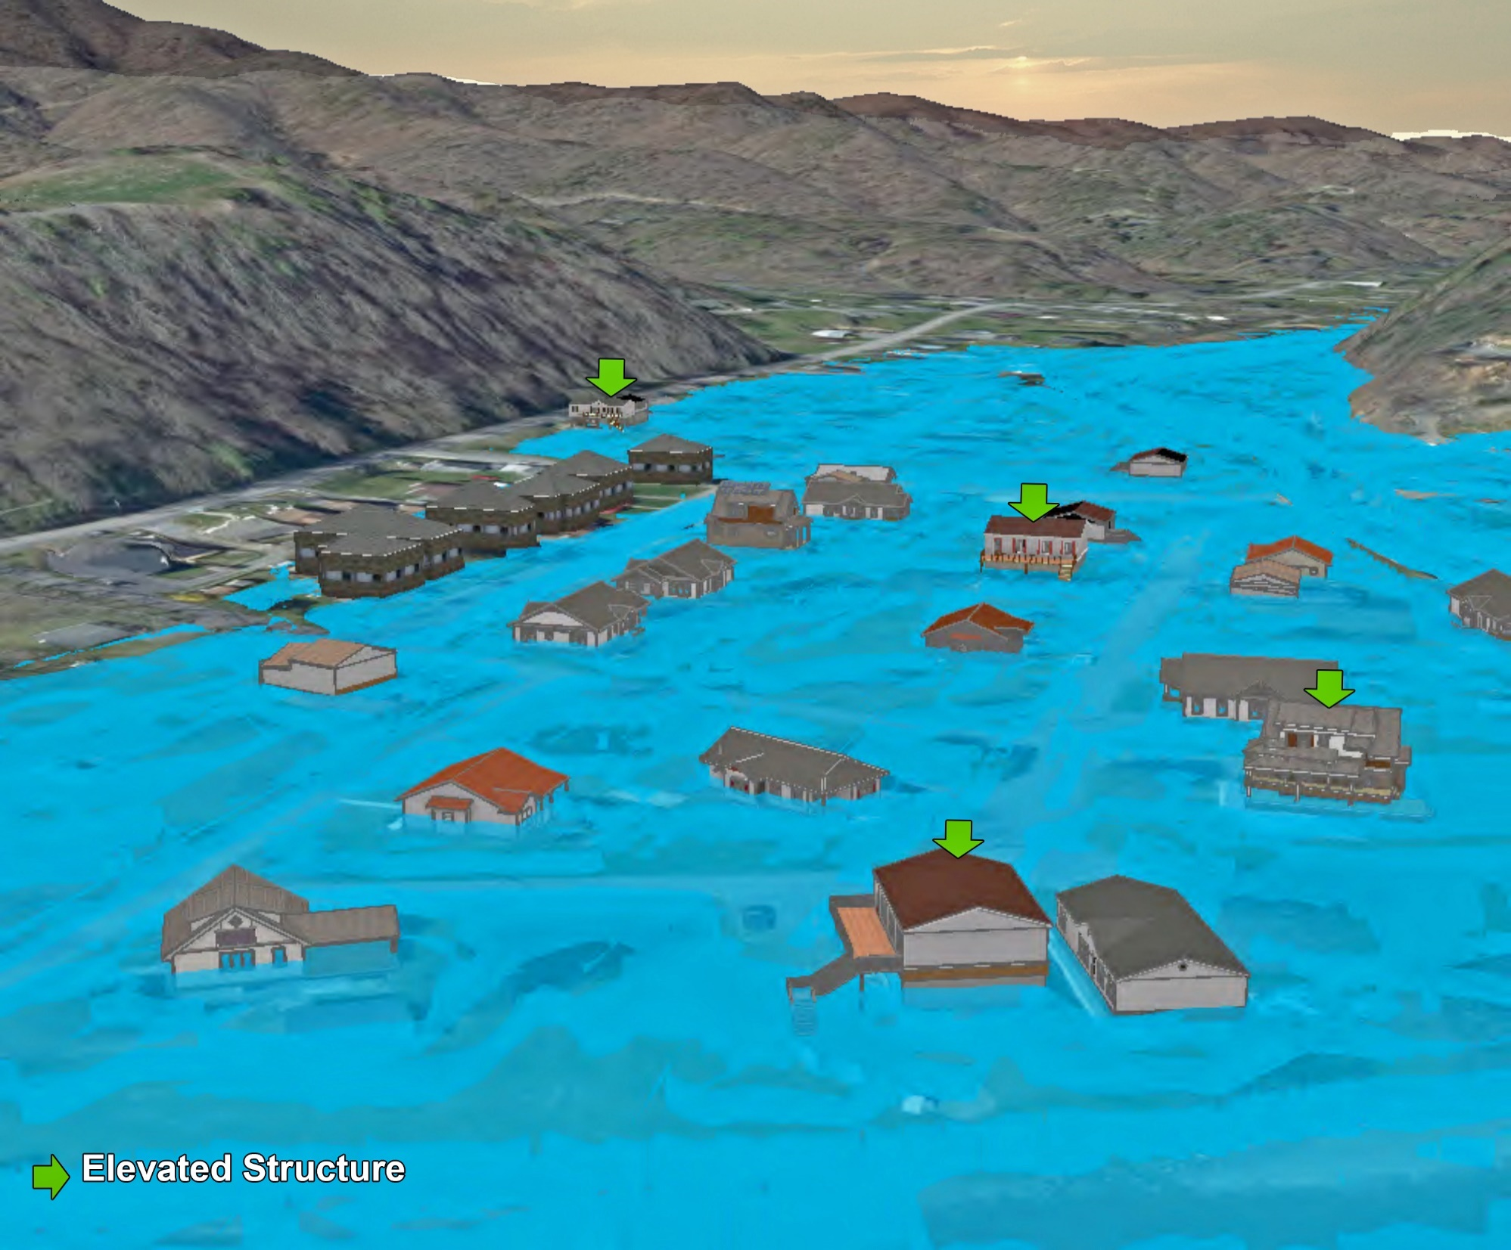
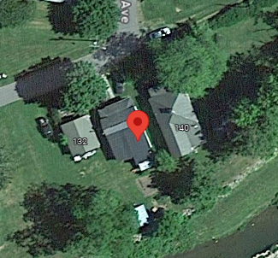
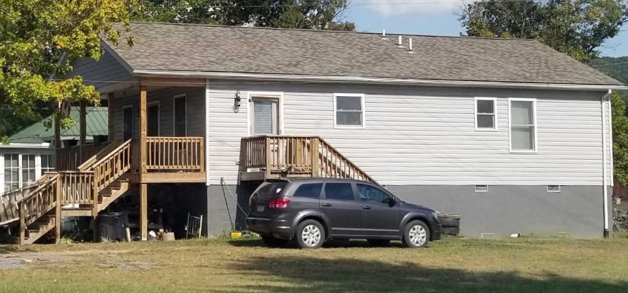
Building Flood Profile

Slide 3
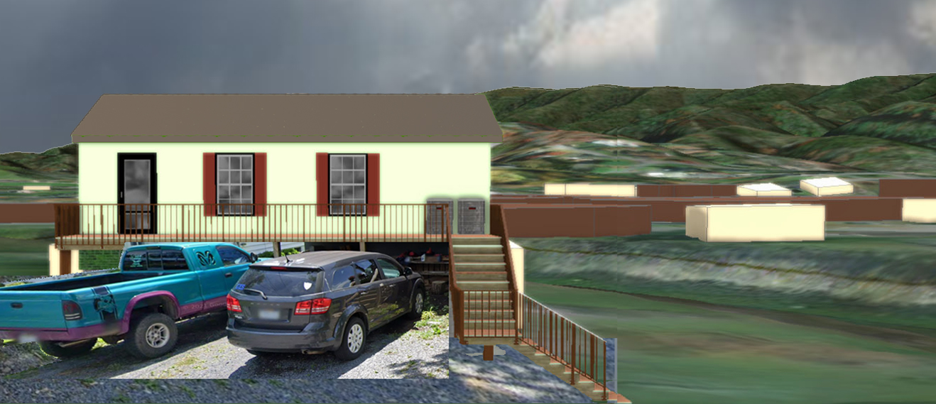
Building Flood Profile
138 Mill Street, White Sulphur Springs, WV, 24986
13-17-0009-0026-0000_138

Slide 4
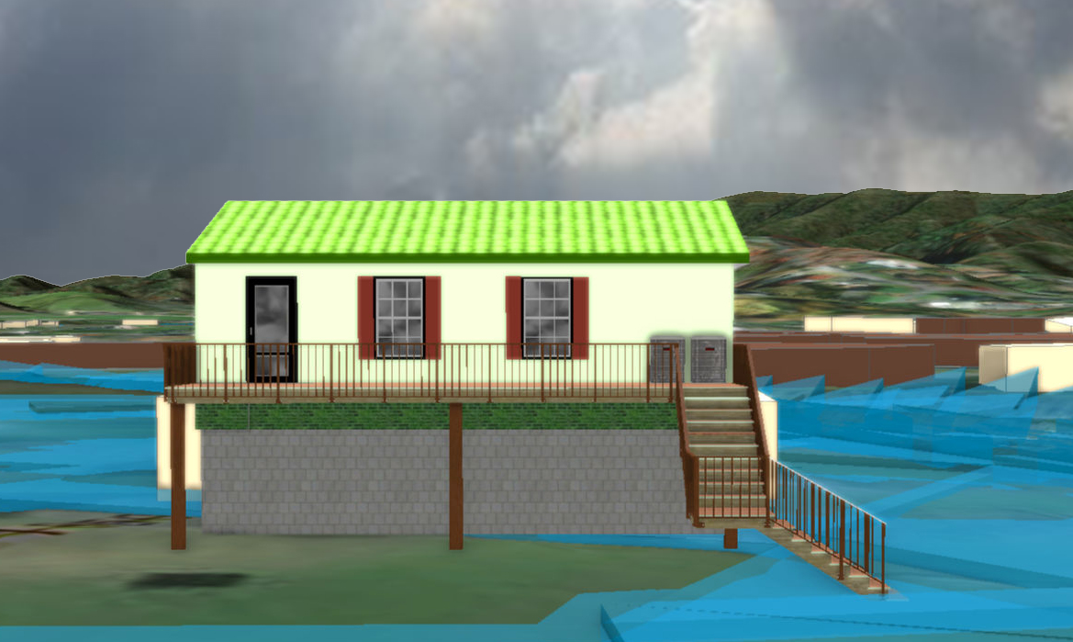
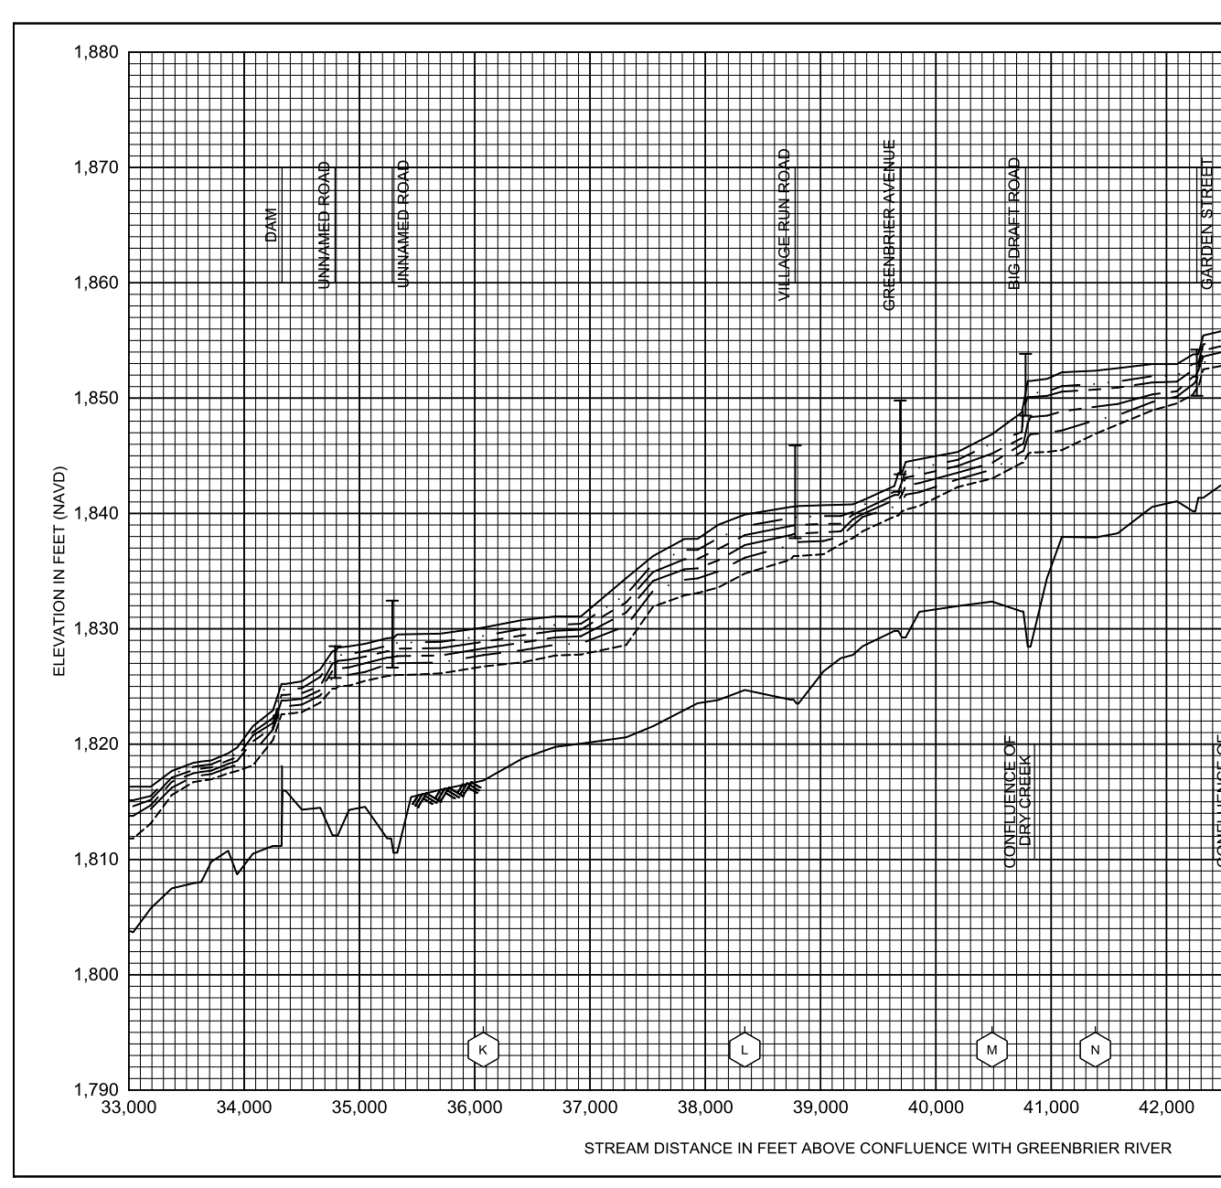
10% Probability of Flood in a year (10-year flood)
1.7’ (FEMA 10% / 10-Yr)
Building’s Ground Elevation

Slide 5
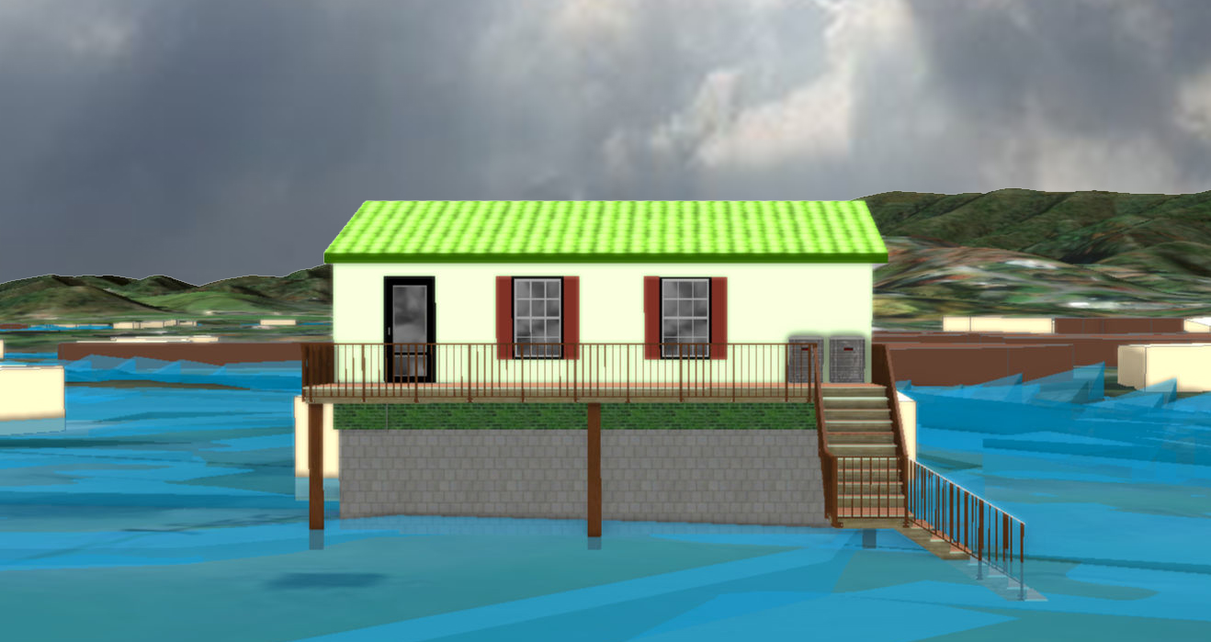
4% Probability of Flood in a year (25-year flood)
2.0’ (FEMA 4% / 25-Yr)

Slide 6
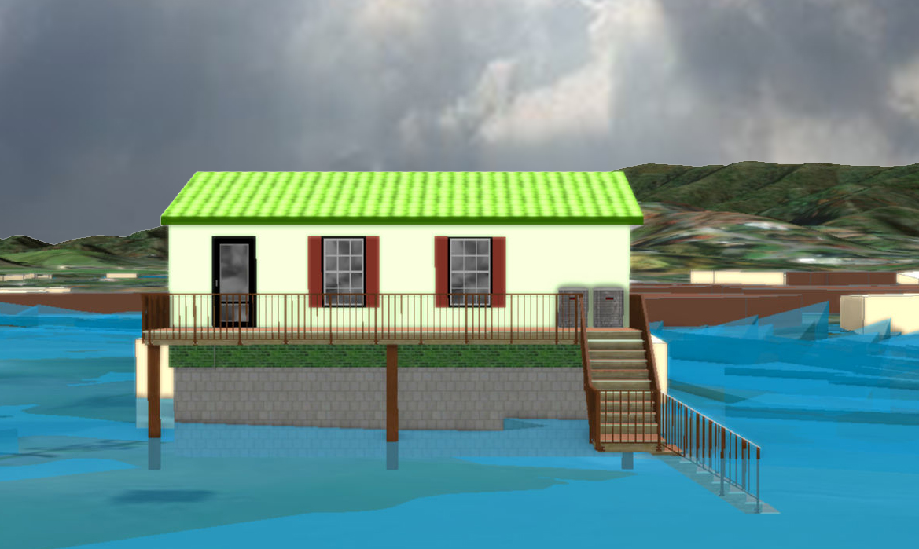
2% Probability of Flood in a year (50-year flood)
3.4’ (FEMA 2% / 50-Yr)

Slide 7
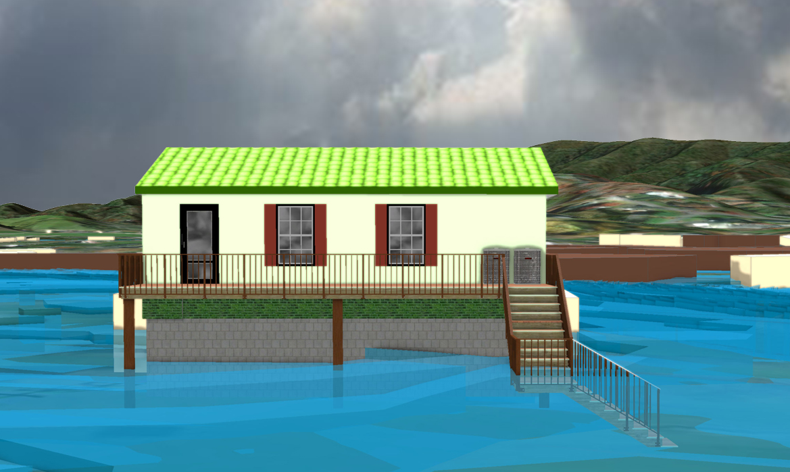
1% Probability of Flood in a year (100-year flood)
5.4’ (FEMA 1% / 100-Yr)

Slide 8
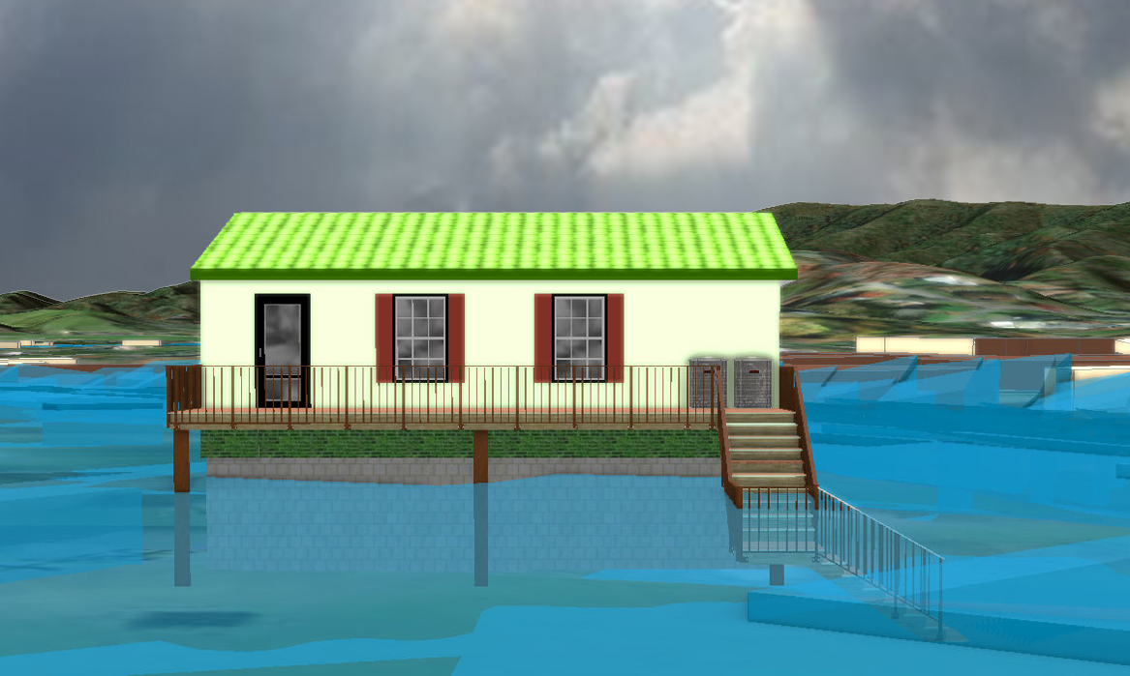
0.2% Probability of Flood in a year (500-year flood)
7.2’ (FEMA 0.2% / 500-Yr)

Slide 9
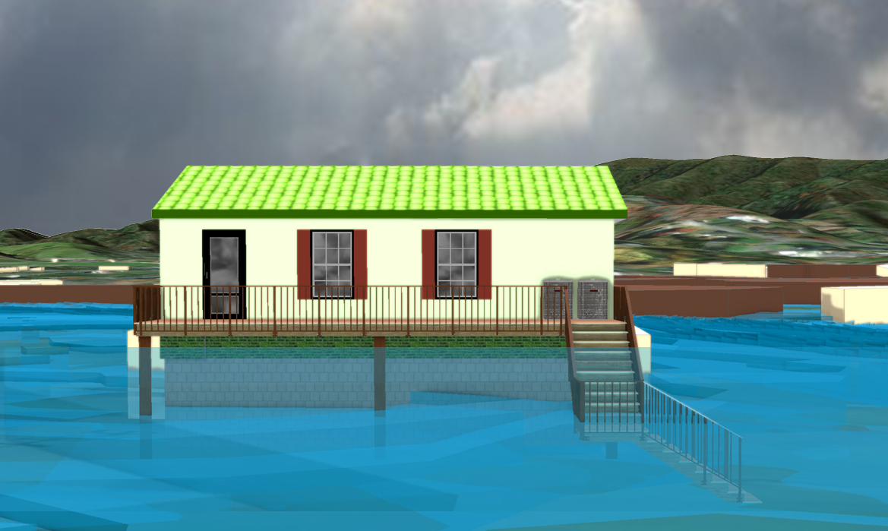
2016 High Watermark
High Watermark
6.5’ (2016 High Water)

Slide 10
The Design Flood Elevation (DFE) should be the BFE plus 2 feet of freeboard. The DFE should also be above the high-water marks of the 2016 flood plus freeboard.
 | HEIGHT (ft.)
BUILDING
First Floor Height | 6.4
Freeboard (FBD) | 2.0
FLOOD DEPTH
FEMA 10% (10-Yr) | 0.7
FEMA 4% (25-Yr)
FEMA 2% (50-Yr)
2016 Flood HWM
FEMA 1% (100-Yr)
FEMA 100-Yr + FBD
FEMA 1%+ (84% CL)
FEMA 0.2% (500-Yr)
FSF 0.2% (500-Yr)
0.7’ (FEMA 10% / 10-Yr)
Building: 13-13-0001-0054-0000_182
182 Seventh Street, Rainelle, WV, 25962
Building 13-17-0009-0026-0000_138
FLOOD DEPTHS:
FEMA, Effective 2023
First Street Foundation (FSF, 2022)
USGS 2016 Flood High Water Mark

Slide 11
The Design Flood Elevation (DFE) should be the BFE plus 2 feet of freeboard. The DFE should also be above the high-water marks of the 2016 flood plus freeboard.
 | HEIGHT (ft.)
BUILDING
First Floor Height | 6.4
Freeboard (FBD) | 2.0
FLOOD DEPTH
FEMA 10% (10-Yr) | 0.7
FEMA 4% (25-Yr) | 2.0
FEMA 2% (50-Yr)
2016 Flood HWM
FEMA 1% (100-Yr)
FEMA 100-Yr + FBD
FEMA 1%+ (84% CL)
FEMA 0.2% (500-Yr)
FSF 0.2% (500-Yr)
2.0’ (FEMA 4% / 25-Yr)
0.7’ (FEMA 10% / 10-Yr)
Building: 13-13-0001-0054-0000_182
182 Seventh Street, Rainelle, WV, 25962
Building 13-17-0009-0026-0000_138
FLOOD DEPTHS:
FEMA, Effective 2023
First Street Foundation (FSF, 2022)
USGS 2016 Flood High Water Mark

Slide 12
The Design Flood Elevation (DFE) should be the BFE plus 2 feet of freeboard. The DFE should also be above the high-water marks of the 2016 flood plus freeboard.
 | HEIGHT (ft.)
BUILDING
First Floor Height | 6.4
Freeboard (FBD) | 2.0
FLOOD DEPTH
FEMA 10% (10-Yr) | 0.7
FEMA 4% (25-Yr) | 2.0
FEMA 2% (50-Yr) | 3.4
2016 Flood HWM
FEMA 1% (100-Yr)
FEMA 100-Yr + FBD
FEMA 1%+ (84% CL)
FEMA 0.2% (500-Yr)
FSF 0.2% (500-Yr)
3.4’ (FEMA 2% / 50-Yr)
2.0’ (FEMA 4% / 25-Yr)
0.7’ (FEMA 10% / 10-Yr)
Building: 13-13-0001-0054-0000_182
182 Seventh Street, Rainelle, WV, 25962
Building 13-17-0009-0026-0000_138
FLOOD DEPTHS:
FEMA, Effective 2023
First Street Foundation (FSF, 2022)
USGS 2016 Flood High Water Mark

Slide 13
The Design Flood Elevation (DFE) should be the BFE plus 2 feet of freeboard. The DFE should also be above the high-water marks of the 2016 flood plus freeboard.
 | HEIGHT (ft.)
BUILDING
First Floor Height | 6.4
Freeboard (FBD) | 2.0
FLOOD DEPTH
FEMA 10% (10-Yr) | 0.7
FEMA 4% (25-Yr) | 2.0
FEMA 2% (50-Yr) | 3.4
2016 Flood HWM
FEMA 1% (100-Yr) | 5.4
FEMA 100-Yr + FBD | 7.4
FEMA 1%+ (84% CL) | 6.4
FEMA 0.2% (500-Yr)
FSF 0.2% (500-Yr)
6.4’ FEMA 1%+ (84% CL)
5.4’ (FEMA 1% / 100-Yr)
3.4’ (FEMA 2% / 50-Yr)
2.0’ (FEMA 4% / 25-Yr)
0.7’ (FEMA 10% / 10-Yr)
Building: 13-13-0001-0054-0000_182
182 Seventh Street, Rainelle, WV, 25962
Building 13-17-0009-0026-0000_138
FLOOD DEPTHS:
FEMA, Effective 2023
First Street Foundation (FSF, 2022)
USGS 2016 Flood High Water Mark

Slide 14
The Design Flood Elevation (DFE) should be the BFE plus 2 feet of freeboard. The DFE should also be above the high-water marks of the 2016 flood plus freeboard.
 | HEIGHT (ft.)
BUILDING
First Floor Height | 6.4
Freeboard (FBD) | 2.0
FLOOD DEPTH
FEMA 10% (10-Yr) | 0.7
FEMA 4% (25-Yr) | 2.0
FEMA 2% (50-Yr) | 3.4
2016 Flood HWM | 6.5
FEMA 1% (100-Yr) | 5.4
FEMA 100-Yr + FBD | 7.4
FEMA 1%+ (84% CL) | 6.4
FEMA 0.2% (500-Yr)
FSF 0.2% (500-Yr)
6.5’ (2016 High Water)
6.4’ FEMA 1%+ (84% CL)
5.4’ (FEMA 1% / 100-Yr)
3.4’ (FEMA 2% / 50-Yr)
2.0’ (FEMA 4% / 25-Yr)
0.7’ (FEMA 10% / 10-Yr)
Building: 13-13-0001-0054-0000_182
182 Seventh Street, Rainelle, WV, 25962
Building 13-17-0009-0026-0000_138
FLOOD DEPTHS:
FEMA, Effective 2023
First Street Foundation (FSF, 2022)
USGS 2016 Flood High Water Mark

Slide 15
The Design Flood Elevation (DFE) should be the BFE plus 2 feet of freeboard. The DFE should also be above the high-water marks of the 2016 flood plus freeboard.
 | HEIGHT (ft.)
BUILDING
First Floor Height | 6.4
Freeboard (FBD) | 2.0
FLOOD DEPTH
FEMA 10% (10-Yr) | 0.7
FEMA 4% (25-Yr) | 2.0
FEMA 2% (50-Yr) | 3.4
2016 Flood HWM | 6.5
FEMA 1% (100-Yr) | 5.4
FEMA 100-Yr + FBD | 7.4
FEMA 1%+ (84% CL) | 6.4
FEMA 0.2% (500-Yr) | 7.2
FSF 0.2% (500-Yr)
7.2’ (FEMA 0.2% / 500-Yr )
6.5’ (2016 High Water)
6.4’ FEMA 1%+ (84% CL)
5.4’ (FEMA 1% / 100-Yr)
3.4’ (FEMA 2% / 50-Yr)
2.0’ (FEMA 4% / 25-Yr)
0.7’ (FEMA 10% / 10-Yr)
Building: 13-13-0001-0054-0000_182
182 Seventh Street, Rainelle, WV, 25962
Building 13-17-0009-0026-0000_138
FLOOD DEPTHS:
FEMA, Effective 2023
First Street Foundation (FSF, 2022)
USGS 2016 Flood High Water Mark

Slide 16
The Design Flood Elevation (DFE) should be the BFE plus 2 feet of freeboard. The DFE should also be above the high-water marks of the 2016 flood plus freeboard.
 | HEIGHT (ft.)
BUILDING
First Floor Height | 6.4
Freeboard (FBD) | 2.0
FLOOD DEPTH
FEMA 10% (10-Yr) | 0.7
FEMA 4% (25-Yr) | 2.0
FEMA 2% (50-Yr) | 3.4
2016 Flood HWM | 6.5
FEMA 1% (100-Yr) | 5.4
FEMA 100-Yr + FBD | 7.4
FEMA 1%+ (84% CL) | 6.4
FEMA 0.2% (500-Yr) | 7.2
FSF 0.2% (500-Yr) | 7.4
7.4’ (FSF 0.2% / 500-Yr)
7.2’ (FEMA 0.2% / 500-Yr )
6.5’ (2016 High Water)
6.4’ FEMA 1%+ (84% CL)
5.4’ (FEMA 1% / 100-Yr)
3.4’ (FEMA 2% / 50-Yr)
2.0’ (FEMA 4% / 25-Yr)
0.7’ (FEMA 10% / 10-Yr)
Building: 13-13-0001-0054-0000_182
182 Seventh Street, Rainelle, WV, 25962
Building 13-17-0009-0026-0000_138
FLOOD DEPTHS:
FEMA, Effective 2023
First Street Foundation (FSF, 2022)
USGS 2016 Flood High Water Mark

