Slide 1
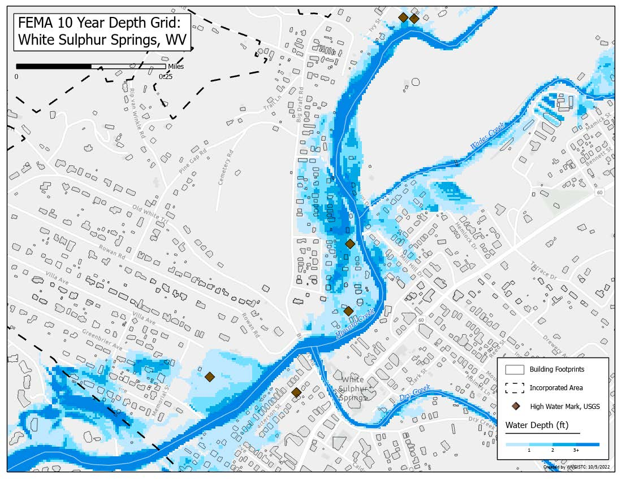
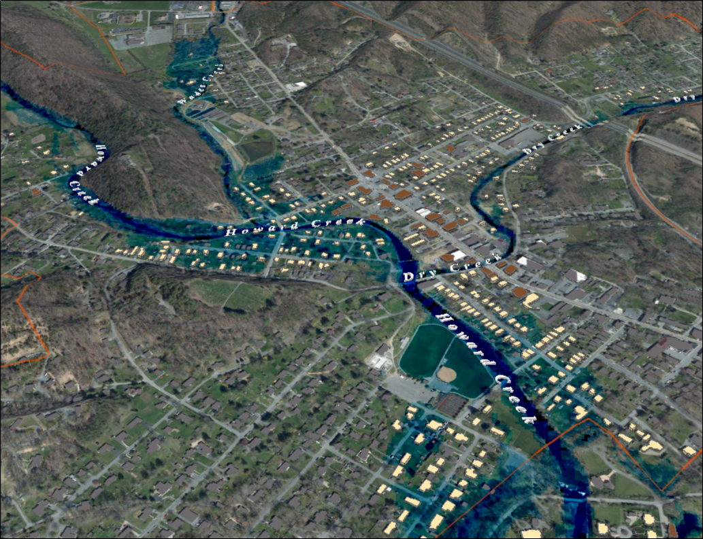
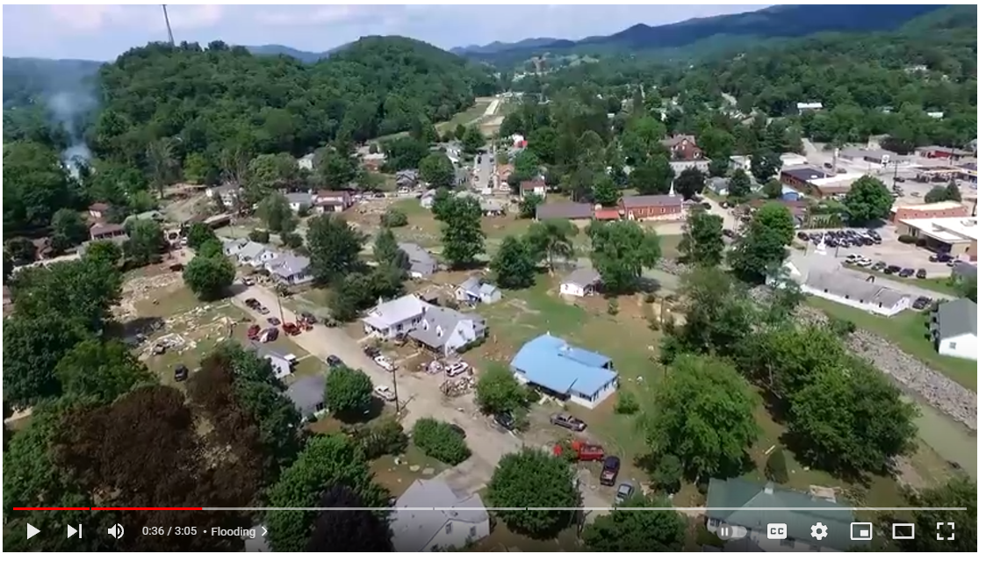
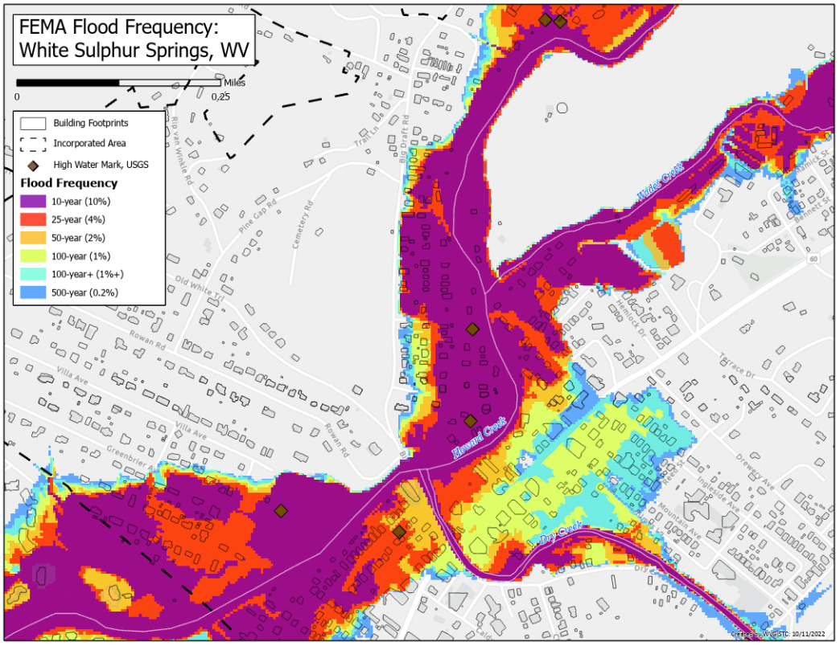
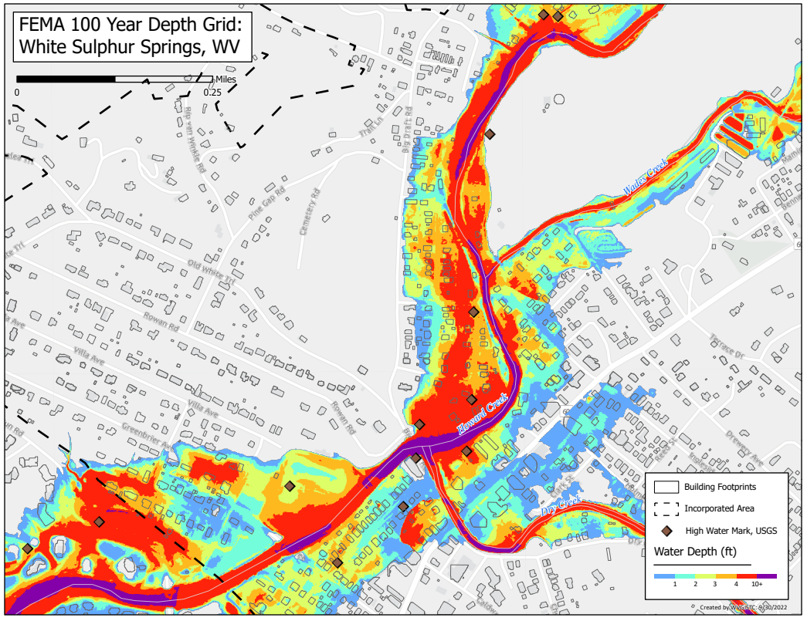
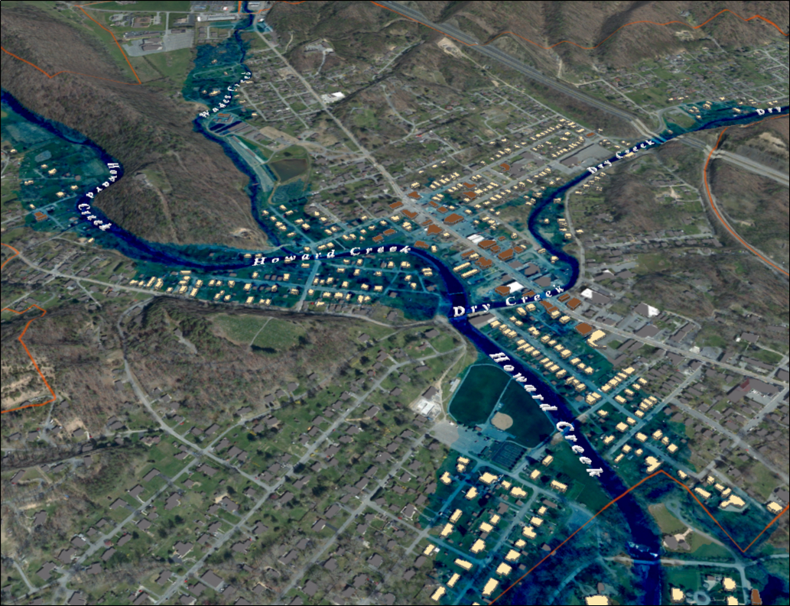
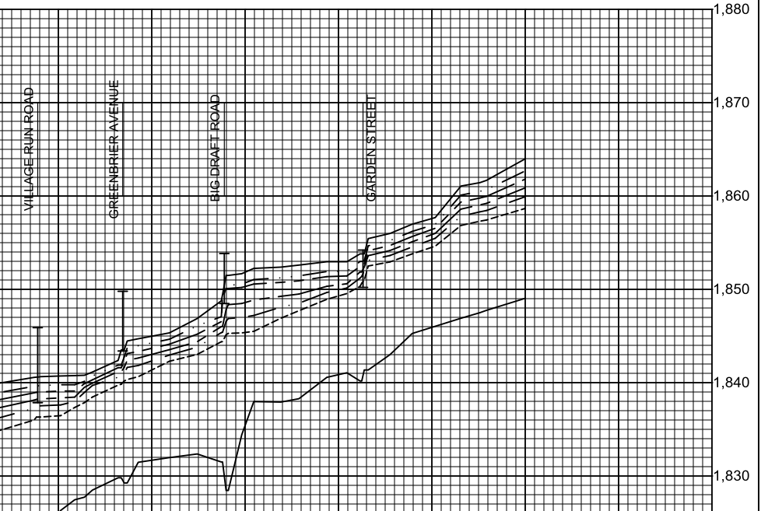
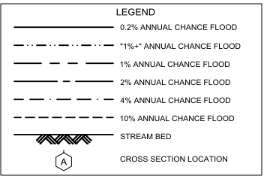
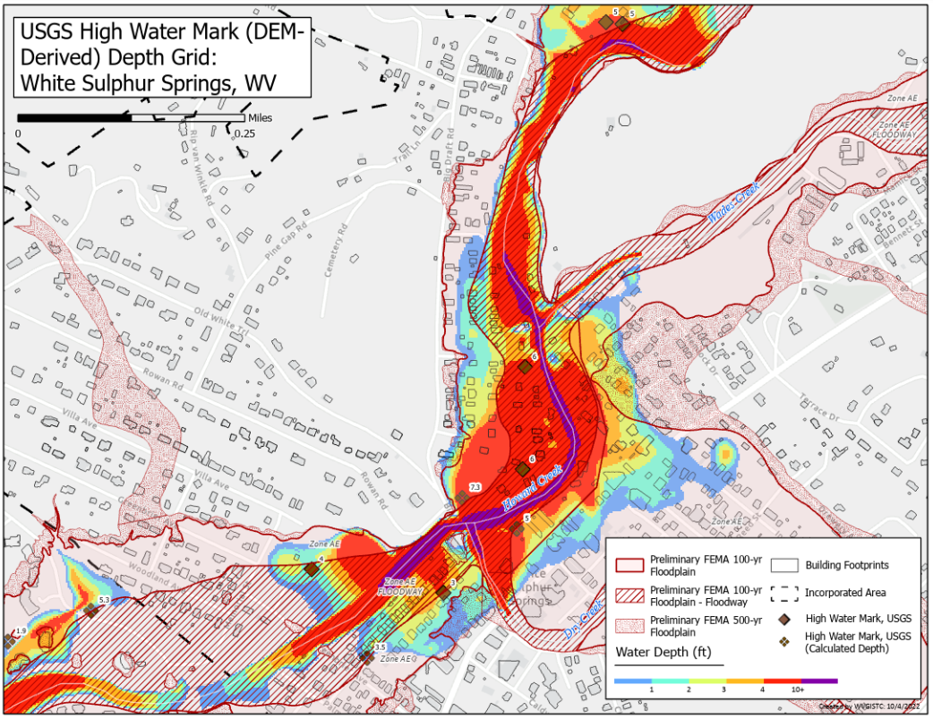
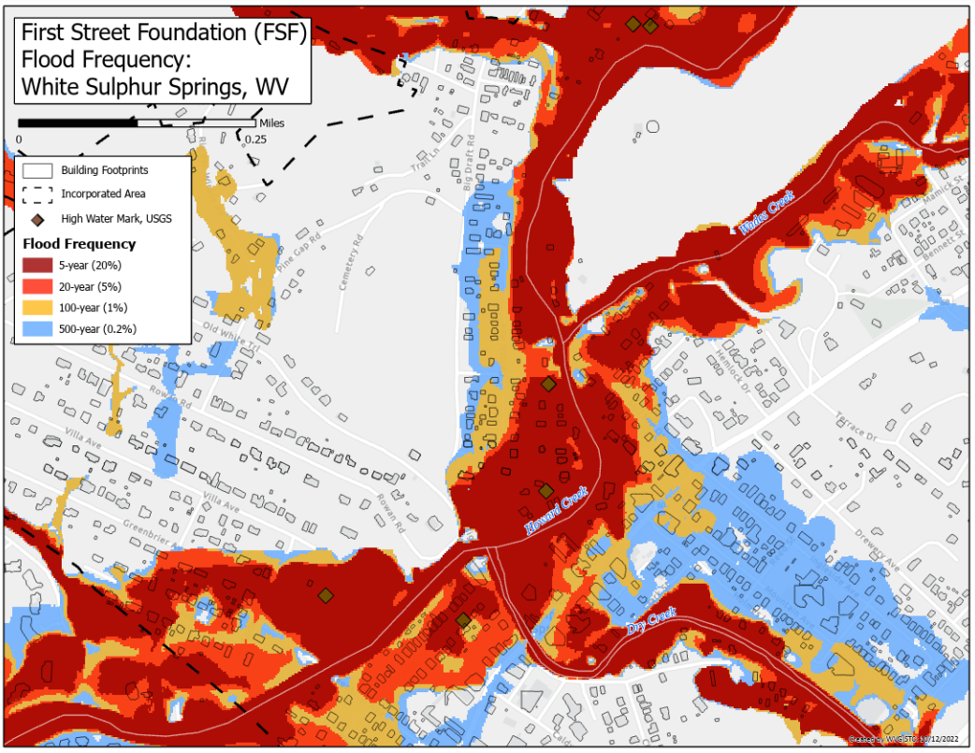
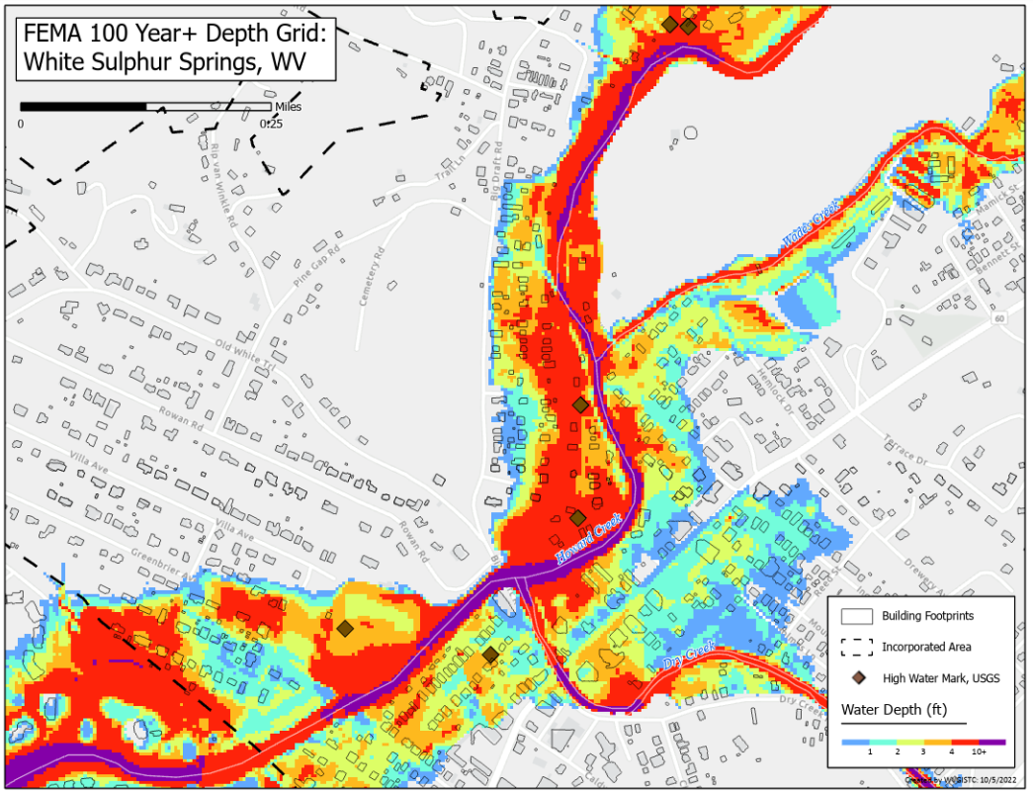
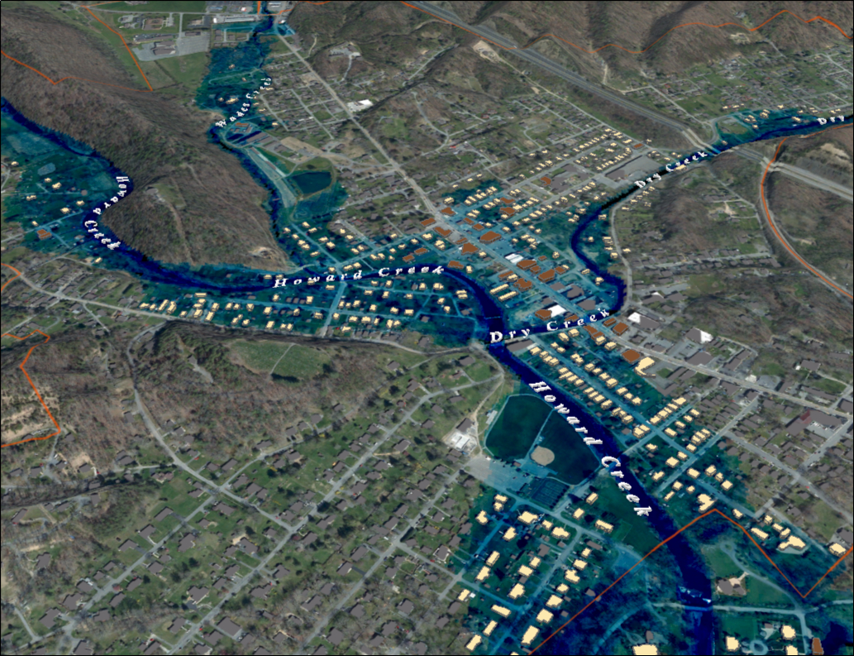
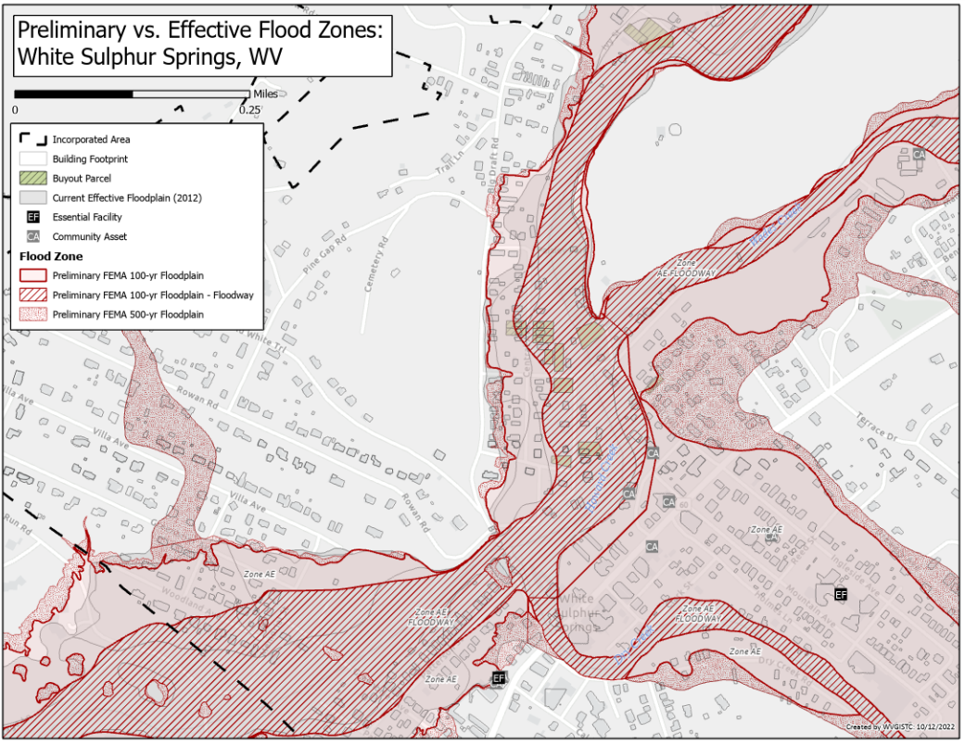
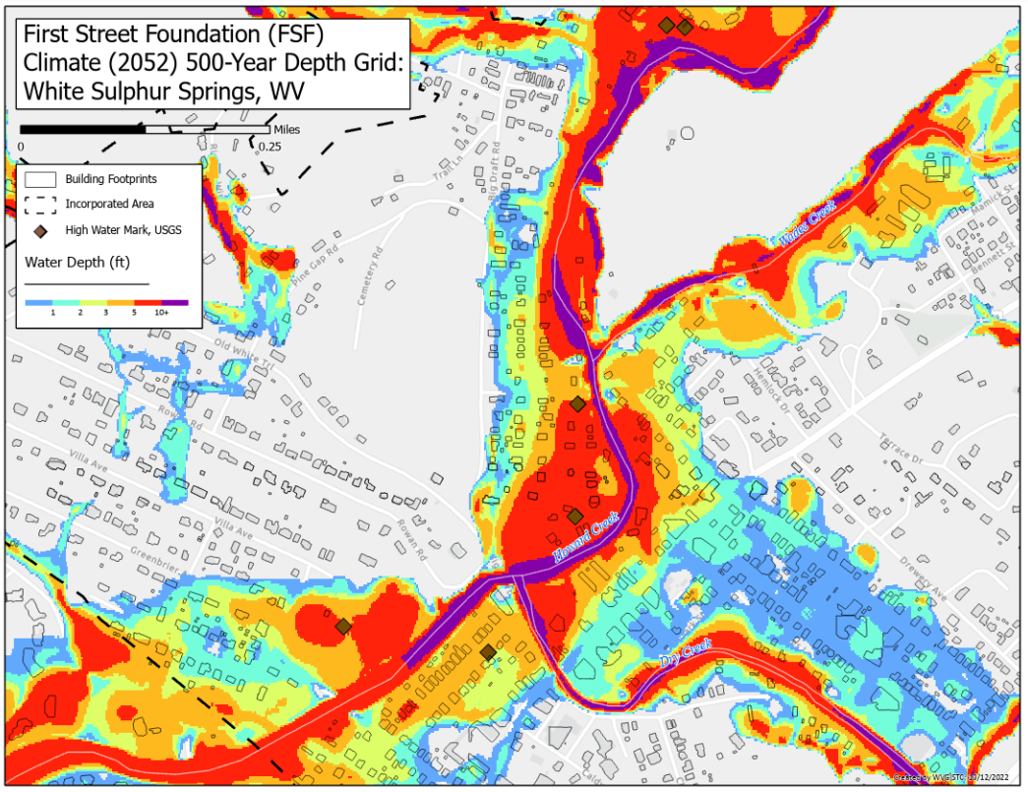
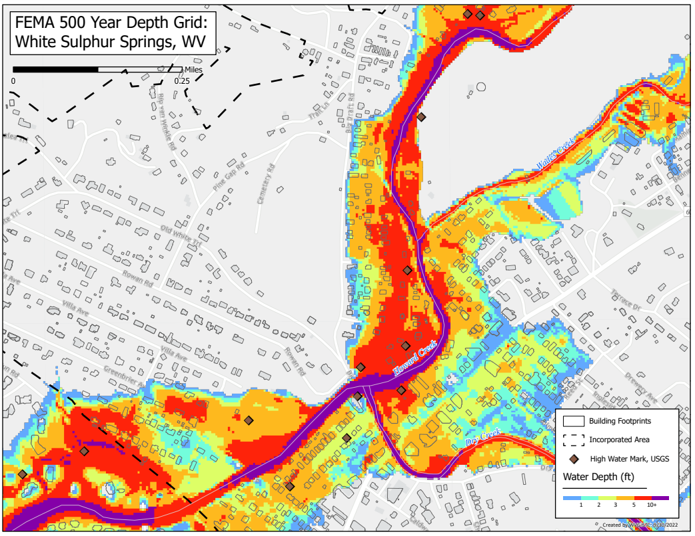
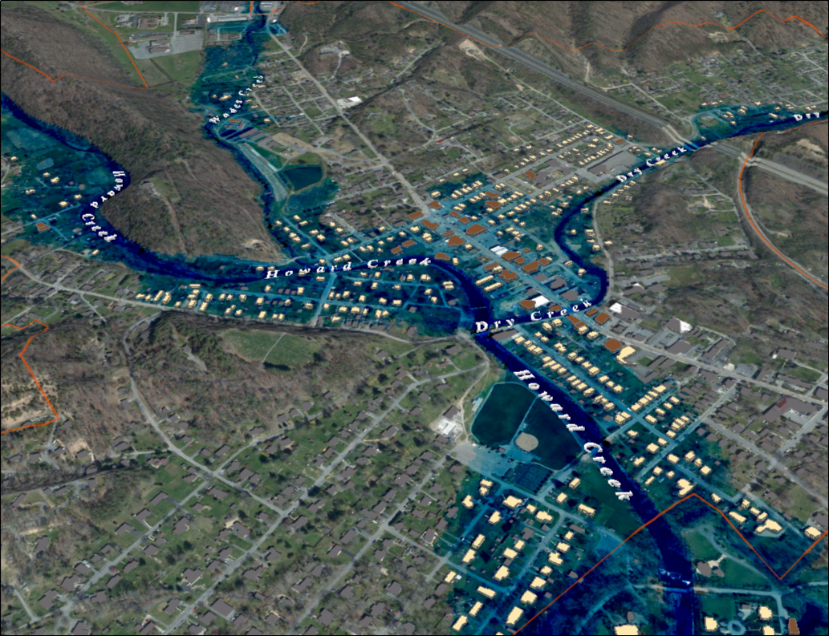
Flood Characteristics
2016 Damage Video (White Sulphur Springs)
FEMA Flood Model: 10-Year Flood Depth
FEMA 10% Annual Chance (10-year) White Sulphur Springs, WV
Category | Flood Characteristic | White Sulphur Springs | Rainelle
Frequency (new flood maps) | Probability that a flood of a specific size will be equaled or exceeded in any given year
 | FEMA Flood Models: 10-, 25-, 50-, 100-, 100+, and 500-year flood elevations. FEMA’s 1%+ flood elevations measure how high the 100-year flood could be given the statistical uncertainties in flood modeling (upper 84-percent confidence limit). | See models | See models
 | First Street Foundation Flood Models: 5-, 20-, 100-, and 500-year flood elevations. Climate models based on 2052 or 30 years in the future. | See models | See models
Depth | Flood depth or water surface elevation above the ground surface. Source USGS high-water marks. | 6 feet | 8 feet
Velocity | Speed at which the floodwaters are flowing | High | Moderate
Duration | Measure of how long water remains above normal levels | 24 hours | 72 hours
Rise and Fall | Floodwater that rises very quickly with little or no warning | Quick Rise | Quick Rise
96% probability of flooding at least once over 30 years
Video Link
0 ft.
FLOOD DEPTH
35 ft.
Notes: Flood characteristics are based on the 2016 flood and FEMA’s new flood studies
Howard Creek Flood Study Profile
FEMA Flood Models: Likelihood and Magnitude
FEMA Flood Model: 100-Year Flood Depth
FEMA 1% Annual Chance (100-year) White Sulphur Springs, WV
2022 Preliminary 1% Base Flood (100-Yr) Elevation 1850.7 ft for Building 13-17-0009-0026-0000_138
26% probability of flooding at least once over 30 years
Video Link
Confluence of Dry Creek
Confluence of Wades Creek
Preliminary 2022 FEMA Maps
2022 Base Flood Elevation increased 1 to 1.5 feet from the 2012 FEMA Map between Dry Creek Bridge (Big Draft Rd) and Wades Creek Bridge (Garden St)
Bldg. 13-17-0009-0026-0000_138 1% WSEL 1850.7 ft.
For bridges shown on the flood profile, the structure is represented by an “I” symbol. The top of the bridge symbol represents the top of road and the bottom of the symbol represents the low chord (or low steel) of the bridge.
3.5’ ponding upslope
of Big Draft Bridge
1.5’ ponding upslope
of Garden Street Bridge
2016 Flood
1,852.5 ft. (BFE + 1.8 ft. to reach HWM)
0 ft.
FLOOD DEPTH
35 ft.
https://data.wvgis.wvu.edu/pub/NSF/FloodProfiles/54025CV002B.pdf#page=43
FEMA FIS Technical Reference 2019
USGS High Water Marks: 2016 Flood Depths
FSF Flood Models: Likelihood and Magnitude
FEMA Flood Model: 100-Year Plus Flood Depth
FEMA 1%+ Annual Chance (100-year) White Sulphur Springs, WV
26% probability of flooding at least once over 30 years
Climate
Change
Climate
Change
0 ft.
FLOOD DEPTH
35 ft.
Preliminary FEMA Flood Maps Effective 2023
FSF Flood Model: 500-Year Flood Depth 2052
FEMA Flood Model: 500-Year Flood Depth
FEMA 0.2% Annual Chance (500-year) White Sulphur Springs, WV
6% probability of flooding at least once over 30 years
Climate
Change
0 ft.
FLOOD DEPTH
35 ft.

