Slide 1
Flood Frequency
Frequency: Probability that a flood of a specific size will be equaled or exceeded in any given year.
5-, 10-, 20-, 25-, 50-, 100-, and 500-year flood elevations (above sea level) refer to expected water levels of the 20%, 10%, 5%, 4%, 2%, 1%, and 0.2% annual chance flood events.
FEMA |  |  |  |  |  | First Street Foundation (FSF)
Return Period (Likelihood) and Flood Size (Magnitude) | Annual Probability | Cumulative Probability - Flooding at least once over 30 years | FEMA Risk Description | Climate Model |  | Return Period and Flood Size (2022, 2037, 2052)* | Annual Probability (flooding at least 1 cm) | Cumulative Probability - Flooding at least once over 30 years | First Street Risk Description | Climate Model
 |  |  |  |  |  | 5 yr (1 in 5) | 20% | >99% | Almost Certain Risk | Yes (2052)
10 yr (1 in 10) | 10% | 96% | High Risk
 |  |  |  |  |  | 20 yr (1 in 20) | 5% | >85% | High Risk | Yes (2052)
25 yr (1 in 25) | 4% | 71% | High Risk
50 yr (1 in 50) | 2% | 45% | High Risk
100 yr (1 in 100) | 1% | 26% | High Risk |  |  | 100 yr (1 in 100) | 1% | >26% | Substantial Risk | Yes (2052)
100 yr (1 in 100) Plus | 1%+ | 26% | High Risk | Yes
500 yr (1 in 500) | 0.2% | 6% | Moderate Risk |  |  | 500 yr (1 in 500) | 0.2% | >0% | Any Risk | Yes (2052)
Climate scenario based on 100-yr plus upper confidence limit |  |  |  |  |  | Climate scenario based on 2052 or 30 years in the future
2022 Flood Study Sources: FEMA and First Street Foundation (FSF)

Slide 2
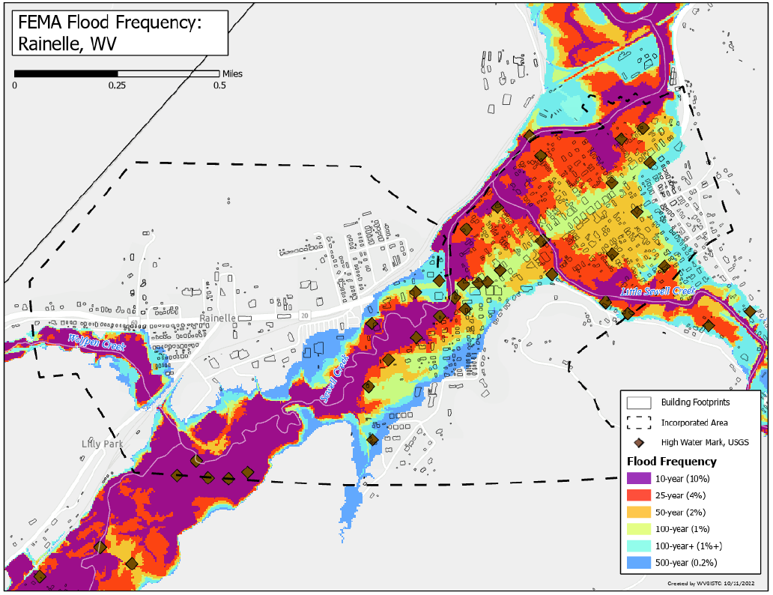
FEMA Flood Frequency Levels

Slide 3
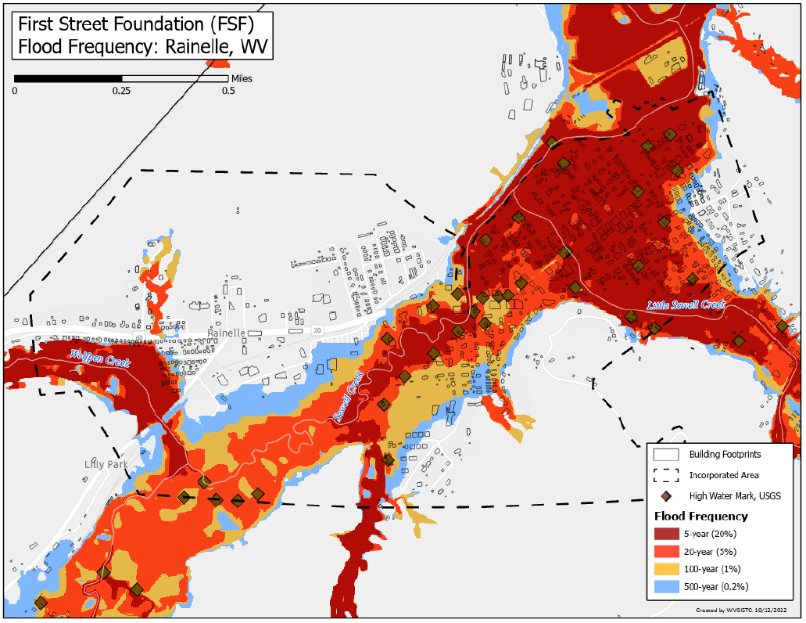
FSF Flood Frequency Levels

Slide 4
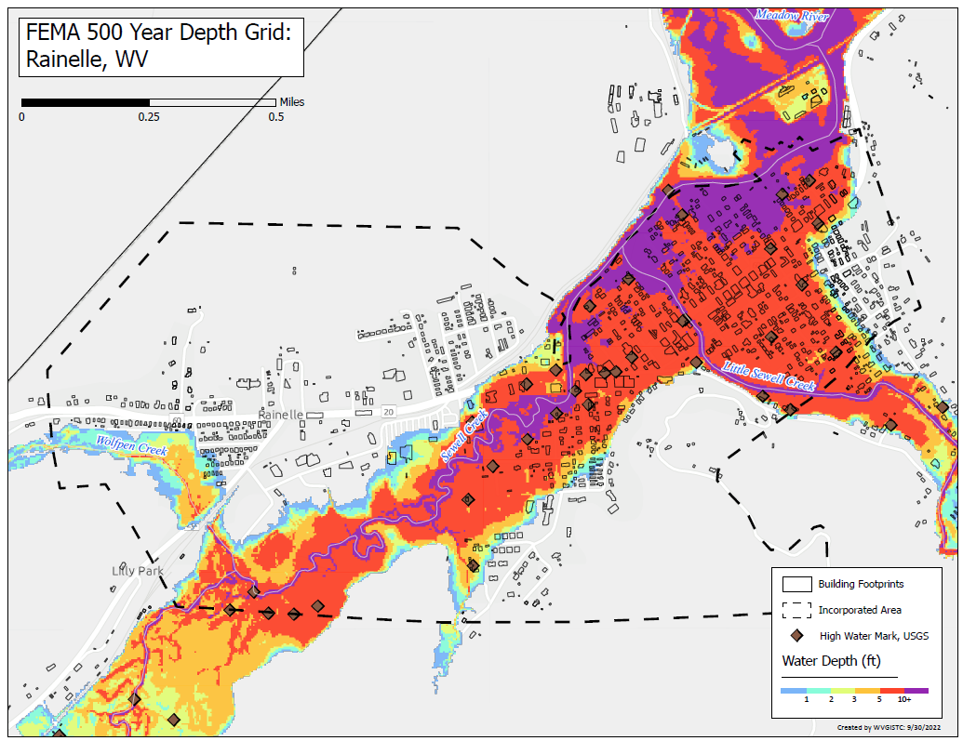
FEMA 500-YR (0.2%)

Slide 5
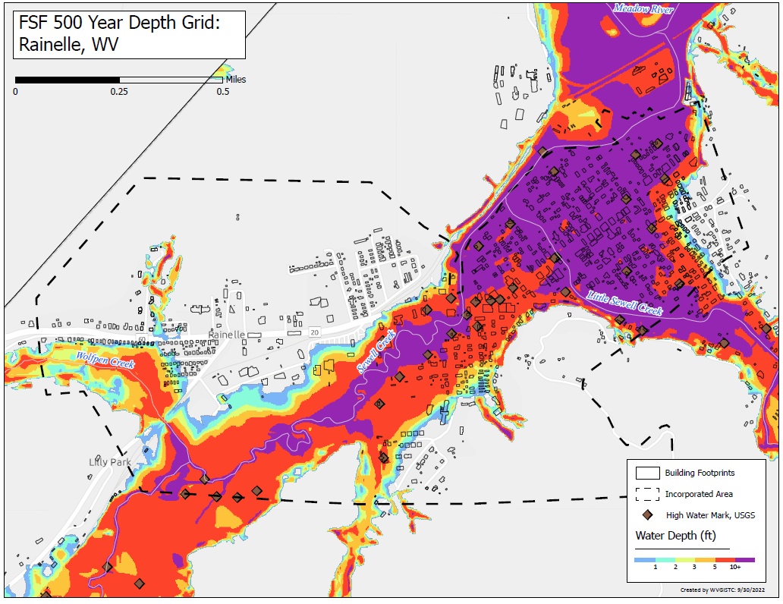
FSF 500-YR (0.2%)

Slide 6
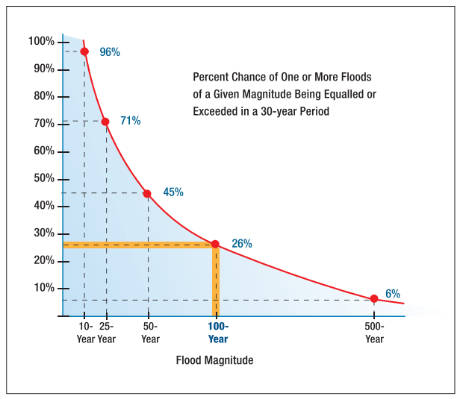
Flood Models and Studies
Source: FEMA
Relationship between flood recurrence intervals and the probability of an event occurring within a given period

Slide 7
Flood Characteristics
Flood Characteristics Impacting Community
Frequency: Probability that a flood of a specific size will be equaled or exceeded in any given year
5-, 10-, 20-, 25-, 50-, 100-, and 500-year flood elevations (above sea level) refer to expected water levels of the 20%, 10%, 5%, 4%, 2%, 1%, and 0.2% annual chance flood events. A 1000-yr flood has a 0.1% chance of happening in any given year.
FEMA’s 1%+ flood elevations measures how high the 100-year flood could be given the statistical uncertainties in flood modeling. It represents the upper 84-percent confidence limit of the statistical error for calculating the 1-percent annual chance event.
The relative frequency of any given flood (e.g., 5-year or 10-year) serves as a useful reference point when selecting a mitigation options and evaluating cost effectiveness.
Depth: Flood depth or water surface elevation above the ground surface
Critical during design considerations, as it is often the primary factor in evaluating the potential for flood damage
Flood depth sources include flood models and high water marks which measure the degree of flooding
Velocity: Speed at which the floodwaters are flowing
Flowing water often causes erosion and scour, as well as debris impacts and hydrodynamic forces.
FEMA’s detailed engineering studies provide river/stream flows
Duration: Measure of how long water remains above normal levels.
Prolonged contact with floodwaters may make some mitigation measures, including dry flood-proofing, inappropriate because of the increased chance of seepage and potential structural failure.
Long periods of inundation are more likely to cause greater damage to structural members and finishes than short periods of flooding.
Rate of Floodwater Rise and Fall: Floodwater that rises very quickly with little or no warning
Steep topography and locations with small drainage areas may experience flash flooding in which floodwater can rise very quickly with little or no warning.
High-velocity water flows usually accompany flash floods and preclude certain types of flood mitigation measures, especially those requiring human intervention
Rapid rates of the rise and fall of floodwater can also lead to unequal hydrostatic pressures on a building. The probability of unequal hydrostatic pressures increases when building exteriors are designed to be watertight
Historical Information: Use past information like the high-water marks of the 2016 Flood as an indication of the nature and severity of effects likely to occur during future events.
Source: FEMA 2013

Slide 8
Rainelle New Reconstruction
First Floor Height ABOVE 2016 Flood HWM; 1-percent chance (100-yr) flood
First Floor Height BELOW 1%+, 0.2-percent chance (500-yr) floods
 | HEIGHT (ft.)
BUILDING
First Flood Height | 9
Freeboard (FBD) | 2
FLOOD DEPTH
FSF 20% (5-Yr) | 2.3
FEMA 1% (100-Yr) | 3.9
FEMA 100-Yr + 2.0 Ft. Freeboard | 5.9
2016 Flood HWM | 6.5
FSF 1% (100-Yr) | 8.2
FEMA 1%+, 0.2% | 9.9
FSF 0.2% (500-Yr) | 12.2
Building 13-13-0001-0054-0000_182
12.2’ (FSF 0.2% / 500-Yr )
9.9’ (FEMA 1%+ / 100-Yr; 0.2%)
8.2’ (FSF 1% / 100-Yr)
6.5’ (2016 High Water)
5.9’ (FEMA 1% + 2’ FBD)
3.9’ (FEMA 1% / 100-Yr)
2.3’ (FSF 20% / 5-Yr)
The Design Flood Elevation (DFE) should be the BFE plus 2 feet of freeboard. The DFE should also be above the high-water marks of the 2016 flood plus freeboard.
182 Seventh Street, Rainelle, WV, 25962
FLOOD DEPTHS:
FEMA
First Street Foundation (FSF)
USGS 2016 Flood High Water Mark

Slide 9
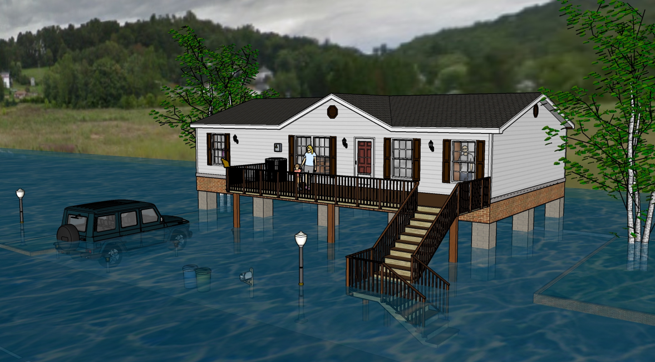
Flood Visualization 4 feet

Slide 10
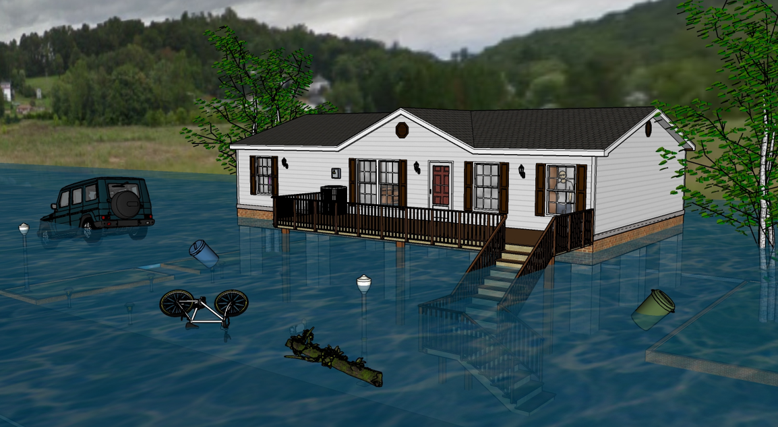
Flood Visualization 8 feet

Slide 11
Building 13-13-0001-0054-0000_182

Slide 12
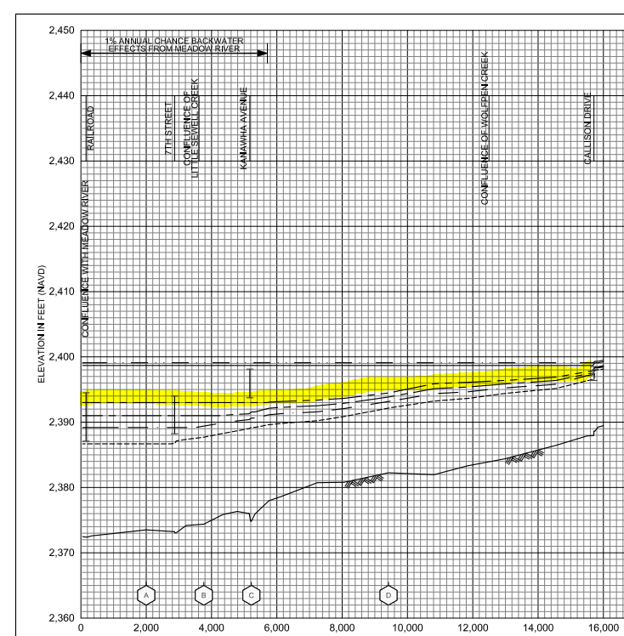
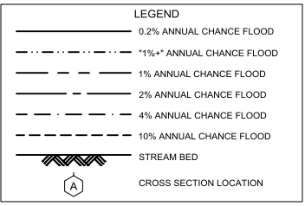
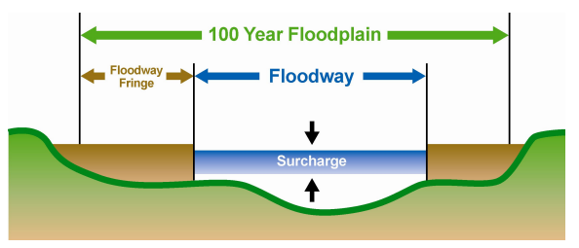
Sewell Creek Flood Study Profile
2022 Preliminary 1% Base Flood (100-Yr) Elevation 1850.7 ft for Building 13-17-0009-0026-0000_138
New 2022 FEMA Maps
The 2012 FEMA flood maps were incomplete in that the high risk flood areas were not fully mapped. The floodplain narrowed significantly and most of the town was no longer in the Special Flood Hazard Area (SFHA).
The 2022 base flood elevation (100-yr) for a majority of Rainelle between 1st and 14th Streets is 2,393 feet. A similar base flood elevation was mapped for the 1987 flood maps for structures northwest of Main Street (U.S. 60).
The “1-percent plus” is a measure of how high the 1% flood could be given the statistical uncertainties in flood modeling. The backwater flooding from Meadow River results in more uncertainty of the flood model and thus a wider confidence level. The 1%+ flood elevation is six feet higher than 1% elevation and same as the 02%.
Confluence of Little Sewell Creek
Confluence of Wolfren Creek
182 7th Street (Bldg.13-13-0001-0054-0000_182
2016 Flood
2,396.4 ft. (BFE + 3.4 ft. to reach HWM)
The "Regulatory Floodway" is the channel of a river or other watercourse and the adjacent land areas that must be reserved in order to discharge the base flood without cumulatively increasing the water surface elevation more than a designated height. Source: FEMA
Sewell Creek 2022 Flood Study Profile

Slide 13
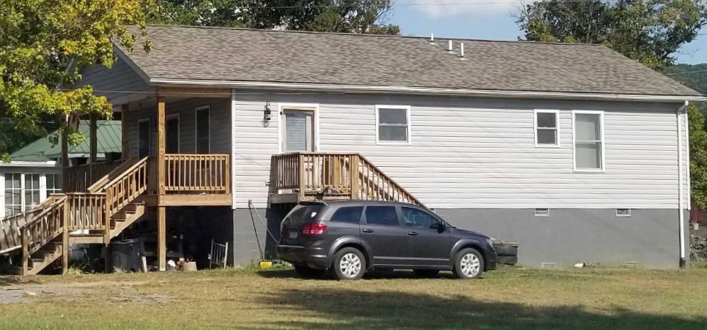
WSS New Reconstruction
First Floor Height (FFH) ABOVE 1-percent chance (100-yr) flood
First Floor BELOW 2016 HWM; 1%+,0.2-percent chance (500-yr) floods
 | HEIGHT (ft.)
BUILDING
First Flood Height | 6.4
Freeboard (FBD) | 2.0
FLOOD DEPTH
FSF 20% (5-Yr) | 3.4
FEMA 1% (100-Yr) | 5.4
FSF 1% (100-Yr) | 5.7
FEMA 1%+; Climate (BFE + 1ft) | 6.4
2016 Flood HWM | 6.5
FEMA 0.2% (500-Yr) | 7.2
FEMA 100-Yr + FBD | 7.4
FSF 0.2% (500-Yr) | 7.4
7.2’ (FEMA 0.2% / 500-Yr )
7.4’ (FEMA 1% / 100-Yr + 2’ FBD)
7.4’ (FSF 0.2% / 500-Yr)
6.5’ (2016 High Water)
6.4’ (FEMA 1%+; Climate BFE+1)
5.4’ (FEMA 1% / 100-Yr)
Building 13-17-0009-0026-0000_138
3.4’ (FSF 20% / 5-Yr)
138 Mill Street, White Sulphur Springs, WV, 24986
FLOOD DEPTHS:
FEMA
First Street Foundation (FSF)
USGS 2016 Flood High Water Mark

Slide 14
Building 13-17-0009-0026-0000_138

Slide 15
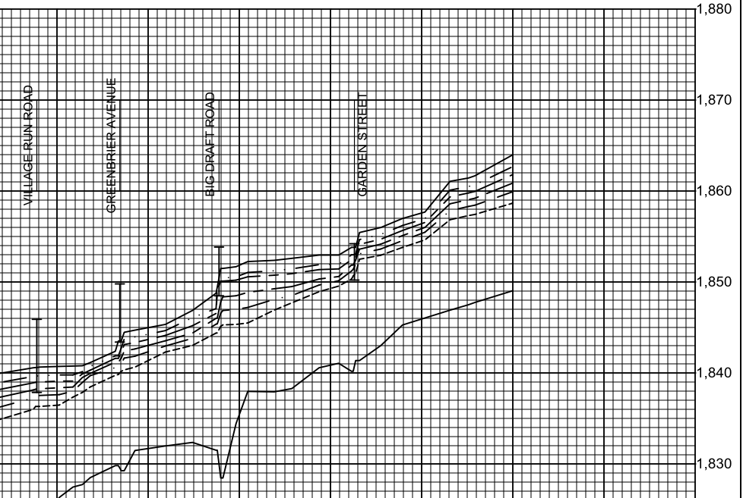
Howard Creek Flood Study Profile
2022 Preliminary 1% Base Flood (100-Yr) Elevation 1850.7 ft for Building 13-17-0009-0026-0000_138
Preliminary 2022 FEMA Maps
2022 Base Flood Elevation increased 1 to 1.5 feet from the 2012 FEMA Map between Dry Creek Bridge (Big Draft Rd) and Wades Creek Bridge (Garden St)
Confluence of Dry Creek
Confluence of Wades Creek
For bridges shown on the flood profile, the structure is represented by an “I” symbol. The top of the bridge symbol represents the top of road and the bottom of the symbol represents the low chord (or low steel) of the bridge.
Bldg. 13-17-0009-0026-0000_138 1% WSEL 1850.7 ft.
3.5’ ponding upslope
of Big Draft Bridge
1.5’ ponding upslope
of Garden Street Bridge
2016 Flood
1,852.5 ft. (BFE + 1.8 ft. to reach HWM)
https://data.wvgis.wvu.edu/pub/NSF/FloodProfiles/54025CV002B.pdf#page=43
FEMA FIS Technical Reference 2019

Slide 16
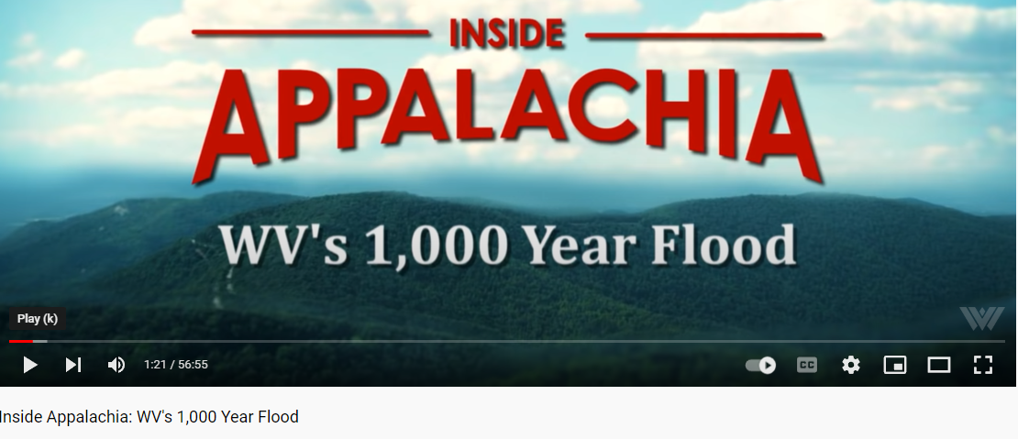
Thousand Year Flood?
WVNSTV 2021
WV Public Broadcasting 2016
WVNSTV 2022
Some websites like MH3WV clarify it as a 1,000-year rainfall event according to the NWS

Slide 17
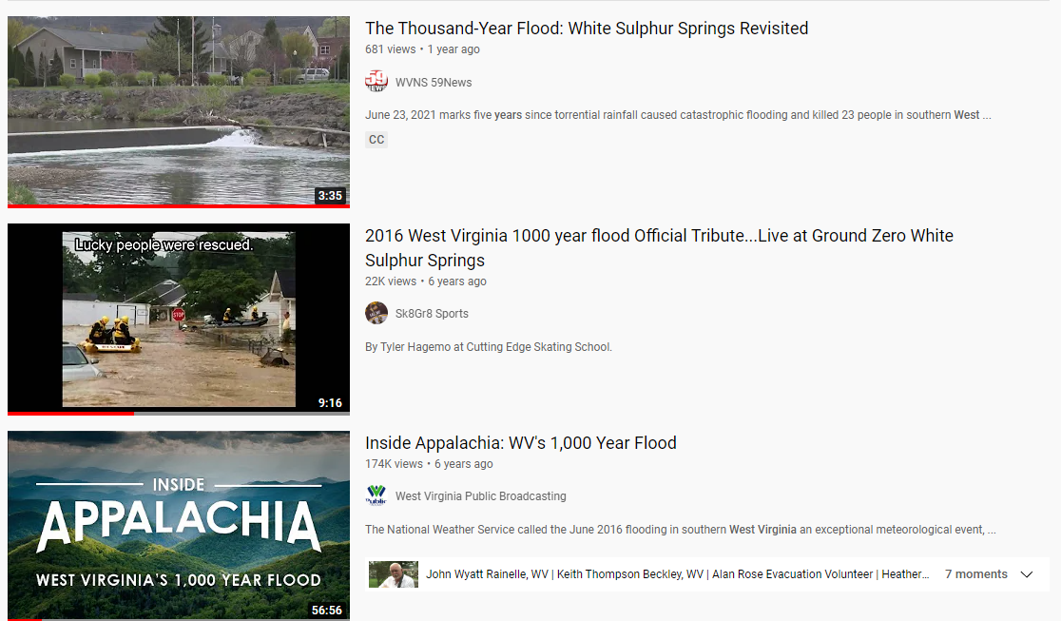
Thousand Year Flood?

Slide 18
1,000-Year Flood?
A Thousand-year Downpour or Rainfall is different than a Thousand-year Flood
What is a 1,000-year flood?
The term “1,000-year flood” means that, statistically speaking, a flood of that magnitude (or greater) has a 1 in 1,000 chance of occurring in any given year. In terms of probability, the 1,000-year flood has a 0.1% chance of happening in any given year. These statistical values are based on observed data.
How can a 1,000-year rainfall not result in a 1,000-year flood?
It comes down to a number of factors, including the pattern of movement of the rainstorm in each particular watershed, the conditions of the soil and plant matter in the watershed, and the timing of the rainstorm in one watershed versus other watersheds. For example, if the ground is already saturated before a rainstorm, much of the rain will run off into streams, but if the ground is dry, it will soak up more of the rain and the runoff will be less significant.
Source: USGS | NOAA Climate.gov | NWS Blacksburg
In the immediate aftermath of the June 2016 flood, USGS and the Federal Emergency Management Agency (FEMA) initiated a cooperative study to evaluate the flood’s magnitude, extent, and probability of occurrence.

Slide 19
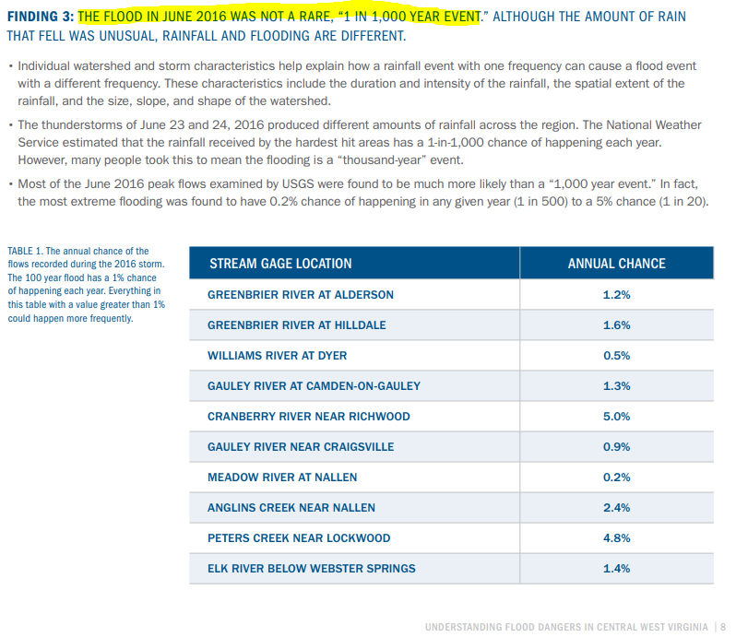
1,000-Year Flood?
THE FLOOD IN JUNE 2016 WAS NOT A RARE, “1 IN 1,000 YEAR EVENT.” ALTHOUGH THE AMOUNT OF RAIN THAT FELL WAS UNUSUAL, RAINFALL AND FLOODING ARE DIFFERENT.
Most of the June 2016 peak flows examined by USGS were found to be much more likely than a “1,000 year event.” In fact, the most extreme flooding was found to have 0.2% chance of happening in any given year (1 in 500) to a 5% chance (1 in 20).
Source: FEMA

Slide 20
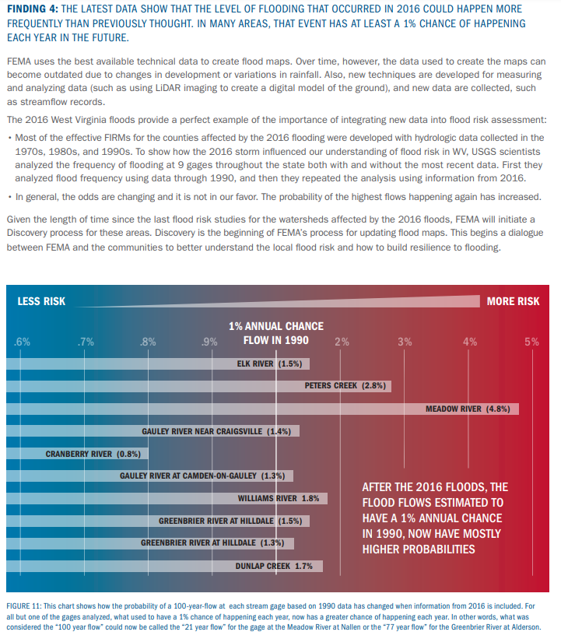
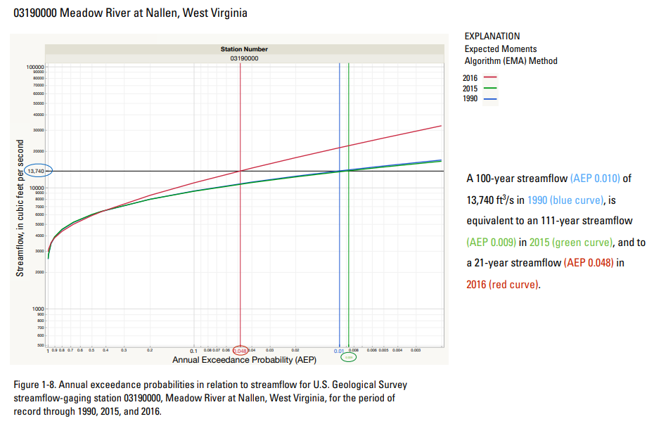
1,000-Year Flood?
THE LATEST DATA SHOW THAT THE LEVEL OF FLOODING THAT OCCURRED IN 2016 COULD HAPPEN MORE FREQUENTLY THAN PREVIOUSLY THOUGHT. IN MANY AREAS, THAT EVENT HAS AT LEAST A 1% CHANCE OF HAPPENING EACH YEAR IN THE FUTURE.
For all but one of the gages analyzed, what used to have a 1% chance of happening each year, now has a greater chance of happening each year. In other words, what was considered the “100 year flow (1%)” could now be called the “21 year flow (4.8%)” for the gage at the Meadow River (watershed for Rainelle) at Nallen or the “77 year flow (1.3%)” for the Greenbrier River at Alderson (watershed for White Sulphur Springs).
USGS Study: Three annual exceedance probability (AEP) curves calculated using the Expected Moments Algorithm (EMA) method were used to compare 100-year (AEP 0.0100) annual peak stream flows at 12 streamflow-gaging stations, measured from initiation of the period of record (POR) at each streamflow-gaging station through 1990, 2015, and 2016.
Greenbrier River at Alderson
Source: FEMA
Source: USGS Report |AEP Meadow River | Pubs Site

