Slide 1
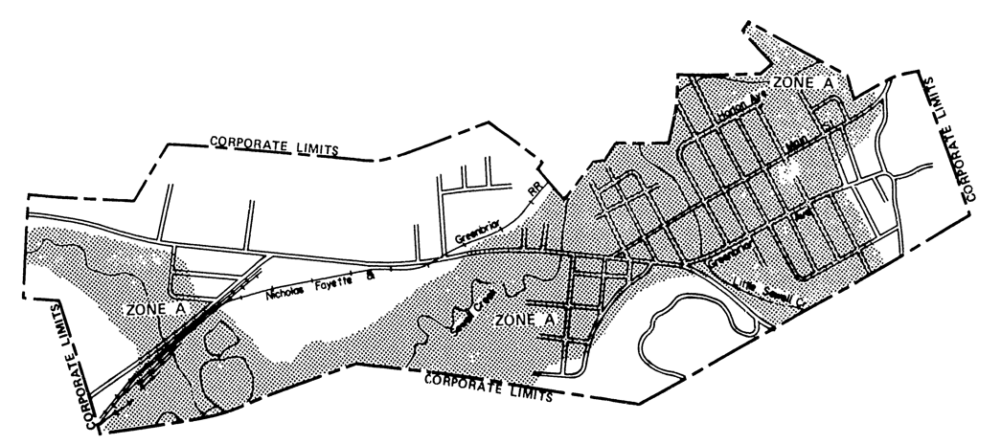
Rainelle 1977 FHBM
https://map1.msc.fema.gov/firm?id=540228

Slide 2
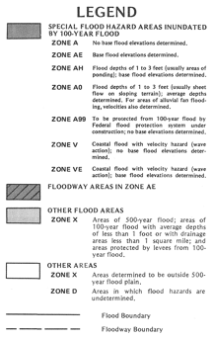
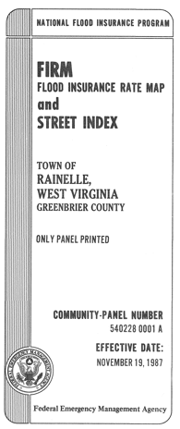
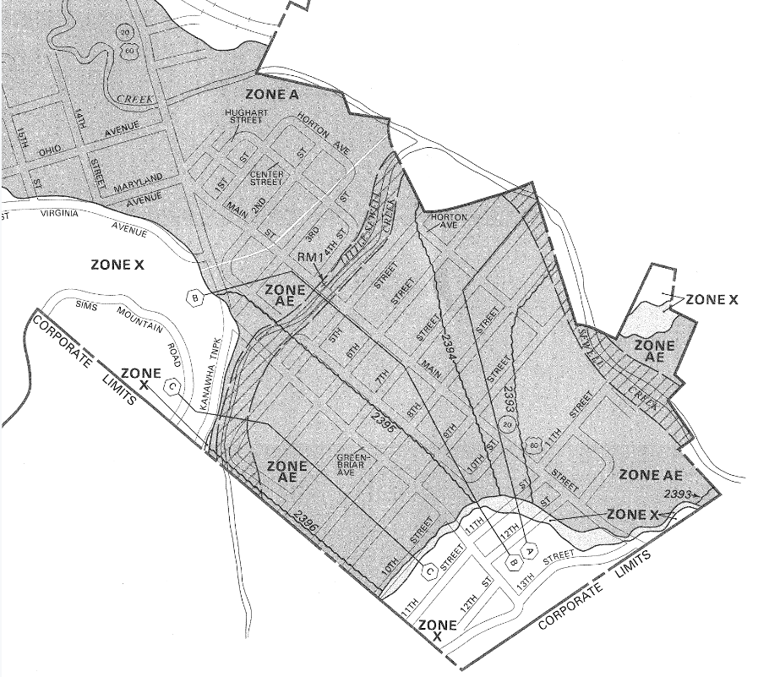
Rainelle 1987 FIRM
https://map1.msc.fema.gov/firm?id=5402280001A

Slide 3
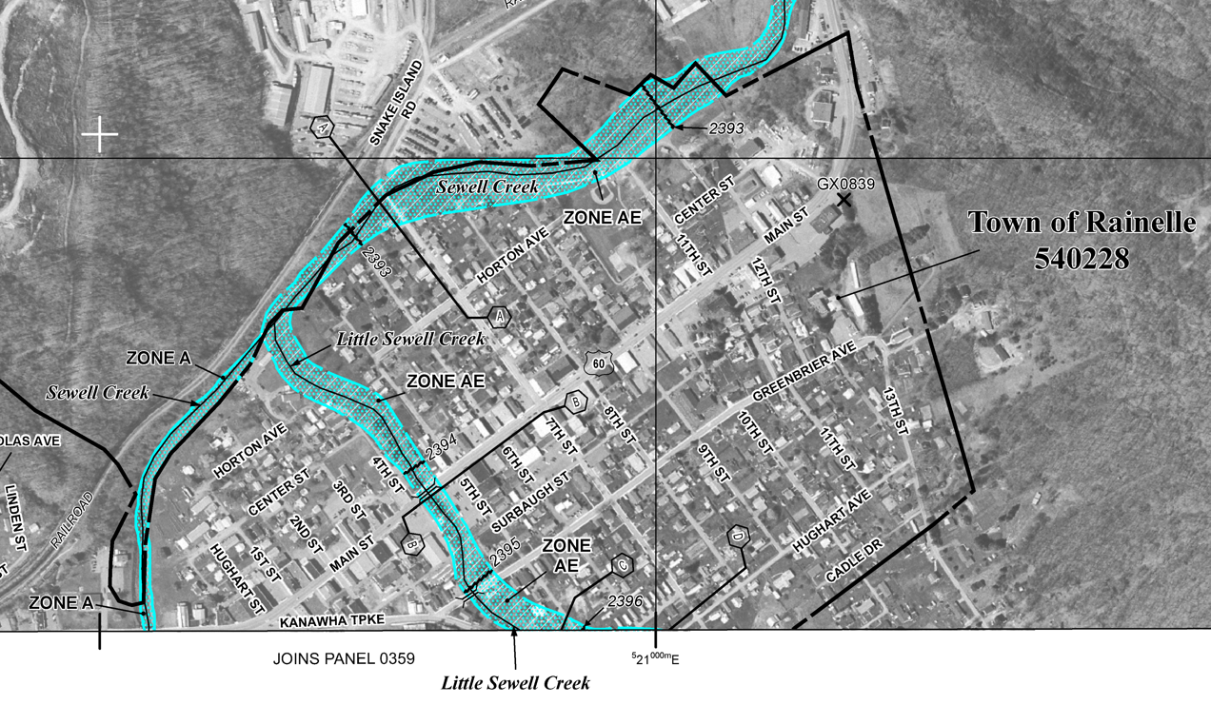
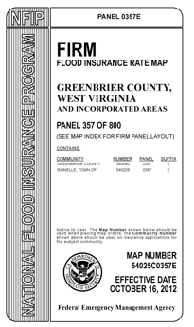
Rainelle 2012 FIRM
https://map1.msc.fema.gov/firm?id=54025C0357E
Only the floodway was shown on the 2012 FIRM. The floodway fringe, a major portion of the Special Flood Hazard Area that previously covered Rainelle, was not included in the 2012 FIRM.

Slide 4
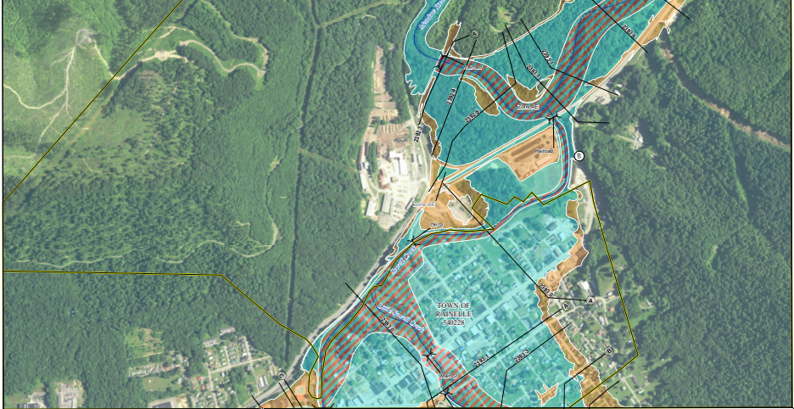
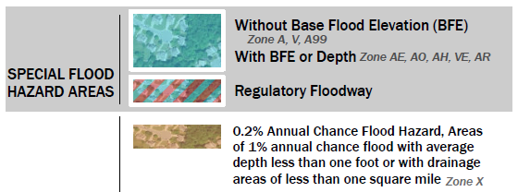
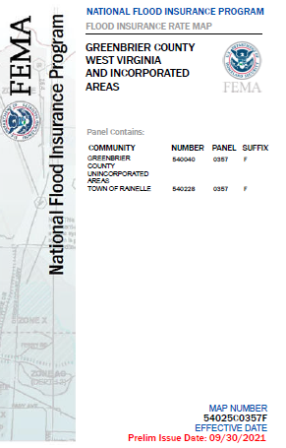
Rainelle 2022 Preliminary FIRM
Panels FIRM Index and Panels

Slide 5
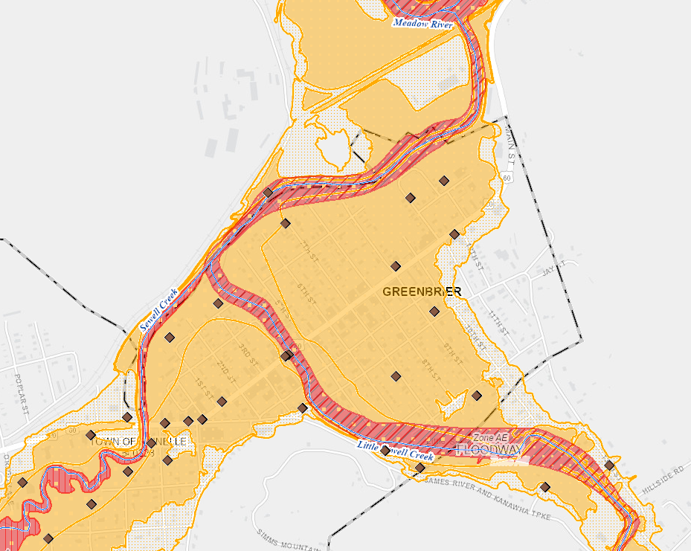
Rainelle 2022 Preliminary FIRM
2012 FIRM (floodway only mapped)
The Special Flood Hazard Area (SFHA) is the land in the floodplain subject to a one percent (100-year) or greater chance of flooding in any given year
2022 FIRM (floodway and fringe)
High Risk Flood Zones for 1%-chance (100-yr) flood
Rainelle
WV Flood Tool

Slide 6
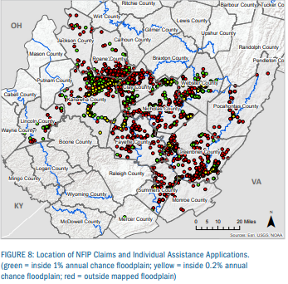
2016 Flood Claims Outside SFHA
Homeowners also need to know that there’s really no such thing as a flood-free zone. In fact, FEMA makes a regular point of noting that 25 percent of flood claims come from areas outside the Special Flood Hazard Area with low-to-moderate risk.
Source: https://www.kin.com/blog/fema-flood-maps/
2016 Flood Insurance Claims. Of the nearly 1,000 flood insurance claims in the declared counties, 77% were in the 1% annual-chance floodplain and approximately 23% of the insurance claims were outside. On average, in floods across the country, about 25% of claims are outside the Special Flood Hazard Area, so this is consistent with the national trend.
Source: https://www.fema.gov/sites/default/files/documents/Region_III_WV_FloodReport.pdf#page=9
23% of the 2016 Flood Insurance Claims were outside the SFHA or 1% annual chance (100-year) floodplain

Slide 7
Impact of Flood Map Issues
The outcome of having incomplete flood maps is that people don’t know the risks they face. This could create a false sense of security for property owners outside of FEMA-designated high-risk flood areas that aren’t required to have flood insurance. As a result, they may:
Unknowingly move to areas with a high risk for flood.
End up underinsured when a flood hits.
Build homes that can’t withstand flooding.
Source: https://www.kin.com/blog/fema-flood-maps/
Incomplete flood maps increase the danger to the public health, safety, and welfare of the community. It also increases financial burdens imposed on the communities, its governmental units, and its residents, by not preventing the unwise design and construction of development in areas subject to flooding.
Source: https://www.whitesulphurspringswv.org/documents/floodplain-ordinance/

Slide 8
Uninformed Homeowners
The outcome of having incomplete flood maps is that people don’t know the risks they face. This could create a false sense of security for property owners outside of FEMA-designated high-risk flood areas that aren’t required to have flood insurance. As a result, they may:
Unknowingly move to areas with a high risk for flood.
End up underinsured when a flood hits.
Build homes that can’t withstand flooding.
Video of new homeowners
Real Estate Disclosure Laws
“Lack of flood disclosure laws is putting home buyers at risk as extreme storms become more frequent” CNN
https://www.cnn.com/2022/10/01/us/flood-disclosure-laws-home-buyers-climate
“Lack of flood insurance in hard-hit Central Florida leaves families struggling after Hurrican Ian” CNN

Slide 9
Economy vs. Floodplain Mgmt.
2012 Flood Zone Map Error: “2012 FEMA map goof not caught during evaluation period when maps went digital and the Town [Rainelle] wished to leave the wrong maps AS-IS versus prove FEMA wrong. They said it would save people money not having to buy flood insurance. We argued...requested Town Hall meetings, etc. [Previous] Mayor refused. Everyone in Rainelle knew that they were in the floodplain. Rent to own is [also] a huge problem in the Greenbrier County flood-prone areas.”
Source: Paula Brown, Deputy Director of Homeland Security & Emergency Management Agency, Greenbrier County, personal communications 10/2022.
Economy versus Floodplain Management in the Community: Smaller communities are under constant pressure to allow development that preserves the community’s tax base and economic stability, perpetuating the existence of repetitively flooded communities. Earth Economics 2017
This includes the justification by community leaders that by not mapping the full extent of the high-risk flood zones, property owners will not be mandated to buy flood insurance for federally-backed loans, and thereby increasing the community’s economic vitality and stability.

