Slide 1
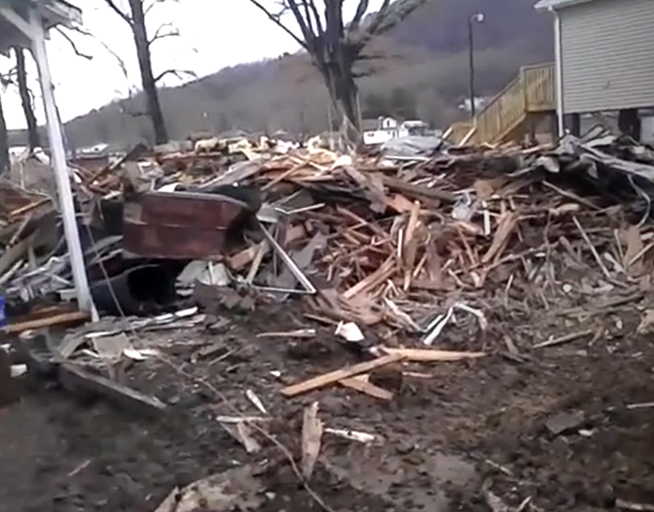
Relocation
A “prior owner” search query of the WV Property Assessment data shows that John Hutsenpiller moved from 212 11th St. to 202 Chestnut Street in Grace Village, Rainelle. Eight new homes were built for flood survivors at Grace Village on two acres of land donated by a local dentist.
Video testimony by John Hutsenpiller Jr. of home destroyed on 11th Street in Rainelle. He relocated to a new home in Grace Village.
Media Links
WV Press
Metro News Grace Village 5 new homes
Local Dentist Donates Land for Flood Victims

