Slide 1
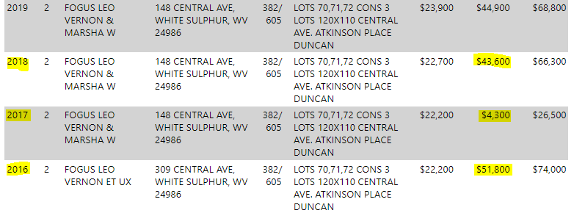
Structure located within SFHA recently sold according to Zillow
White Sulphur Springs
148 Central Ave, White Sulphur Springs, WV, 24986:
Building ID: 13-17-0008-0154-0000_148
FIRM Status: Pre-FIRM (1929)
Water Depth in Structure: 2.7 ft
Mitigation Type: Repaired not to DFE
Flood Tool Link

Slide 2
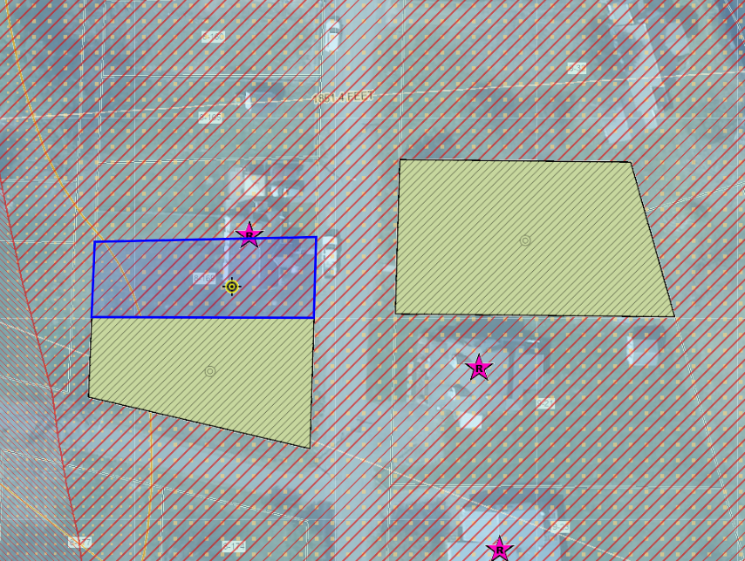
Structure located within SFHA recently sold according to Zillow
White Sulphur Springs
147 Crescent Ave, White Sulphur Springs, WV, 24986:
Building ID: 13-17-0008-0169-0000_147
FIRM Status: Pre-FIRM (1930)
Water Depth in Structure: 4.3 ft
Mitigation Type: Repaired not to DFE
Flood Tool Link

Slide 3
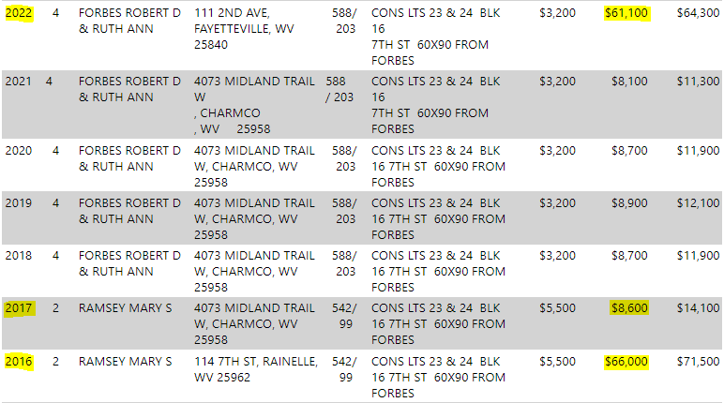
Structure located within SFHA recently sold according to Zillow Rainelle
166 7th Street, Rainelle, WV, 25962:
Building ID: 13-13-0001-0047-0000_166
FIRM Status: Pre-FIRM (1965)
Water Depth in Structure: 3.9 ft
Mitigation Type: Repaired Rental not to DFE
Flood Tool Link

Slide 4
Structure located within SFHA recently sold according to Zillow
White Sulphur Springs
116 8th Street, Rainelle, WV, 24986:
Building ID: 13-13-0001-0070-0000_116
FIRM Status: Pre-FIRM (2004)
Water Depth in Structure: 4.3 ft
Mitigation Type: Repaired not to DFE
Flood Tool Link

