Slide 1
Jefferson County, WV
CCO Meeting
December 2024

Slide 2
Risk MAP (Jefferson Co. Preliminary Flood Maps)
Risk Mapping (Review New Flood Risk Maps)
Map Changes BFE’s (e.g., 24’ BFE change at Harpers Ferry) Floodplain Width (e.g., Shepherdstown)
SFHA Building Changes Mapped-in/Mapped Out Bldgs. LOMAs (SFHA bldgs. mapped out)
Risk Communications Outreach Letters for building changes in SFHA/Floodway
Future Map Discovery Map Zone AE Upgrades for Potomac / Shenandoah Rivers?
Risk Assessment (Quantify Flood Risk)
Statewide Risk Assessment (aggregate level or summary reports) River/Stream Scale County Scale Unincorporated Area Scale Incorporated Area Scale Shepherdstown Harpers Ferry
Building Level Risk Assessments Unmitigated Structures Mitigated Structure
Risk Planning (Build Flood Resiliency)
Pre-Disaster Planning Preload WV Flood Tool Structures into FEMA’s SDE Software Update Emergency Response & Hazard Mitigation Plans using risk assessments for major storm event
Higher Standards - Municipalities Apply for CRS status Adopt higher Freeboard value of 3 ft. in floodplain mgmt. ordinance
Verify Risk Layers on WV Flood Tool Building-level assessments Open space properties Repetitive Loss Areas
WV Flood Resiliency Framework
Risk MAP: Reduce Loss of Life and Property
Web link to Slide Deck

Slide 3
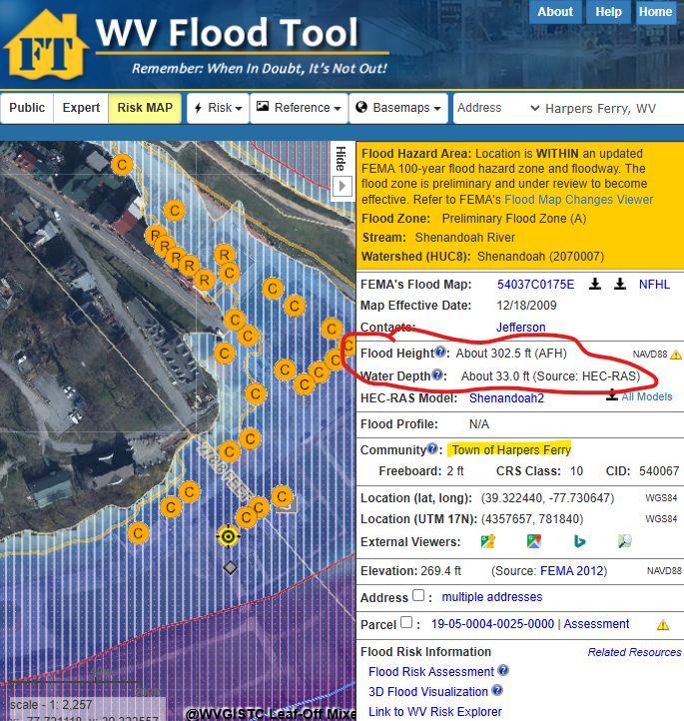
Map Changes – Harpers Ferry
Harpers Ferry: BFE change minus 24 ft.

Slide 4
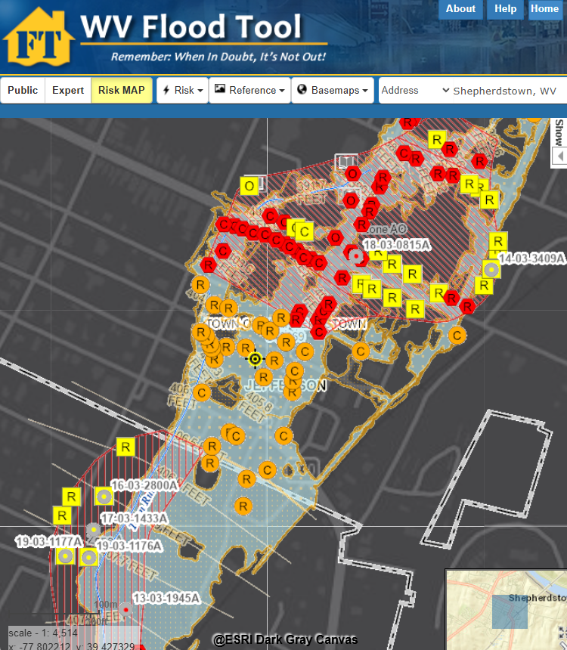
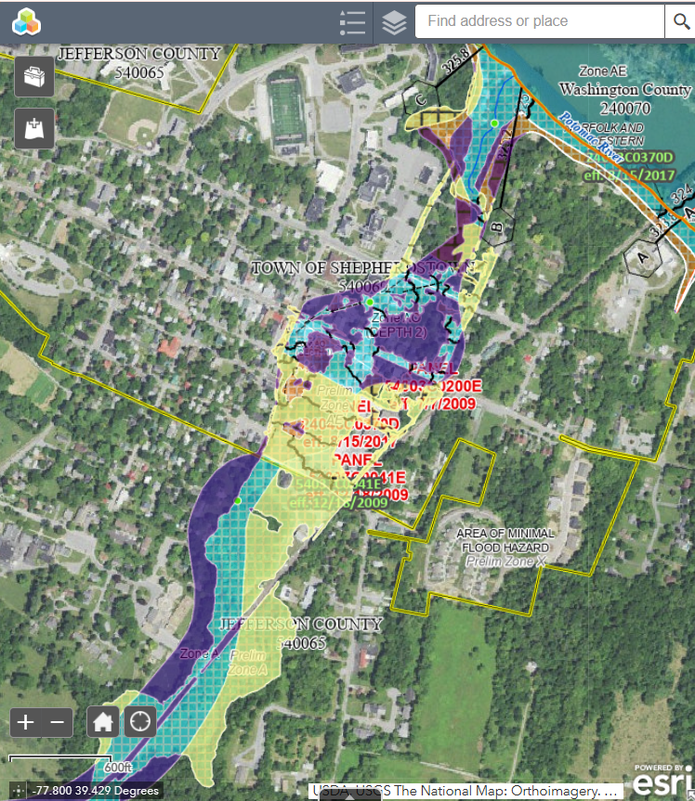
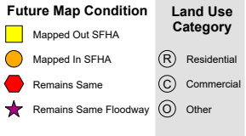
Map Changes - Shepherdstown
Harpers Ferry: BFE change minus 24 ft.
Shepherdstown: WV Flood Tool
Shepherdstown: FEMA Change Viewer

Slide 5
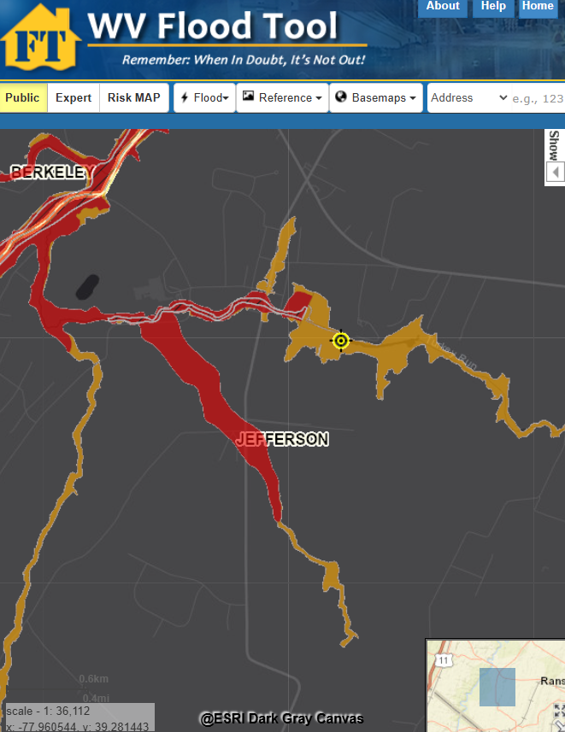
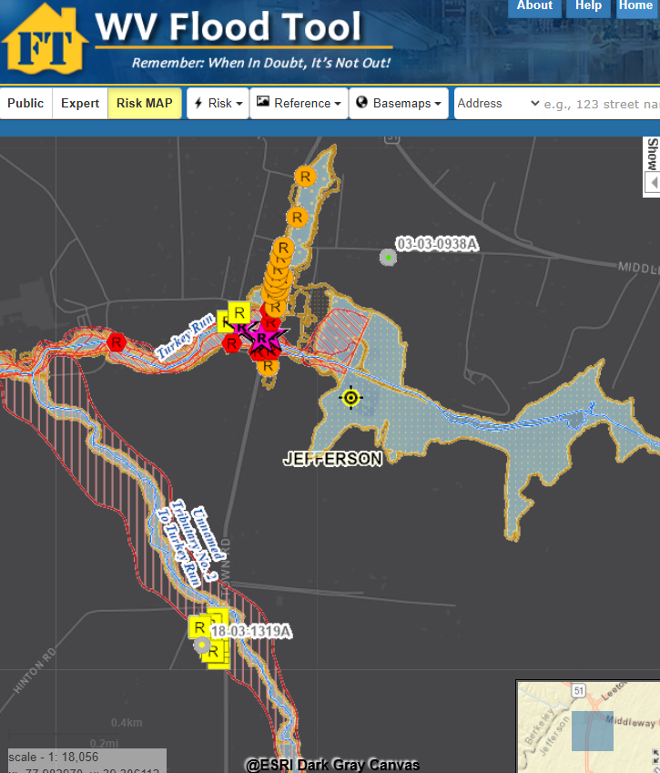
Map Changes – Jefferson County
Floodway
WV Flood Tool Public View
WV Flood Tool (Risk MAP View)

Slide 6
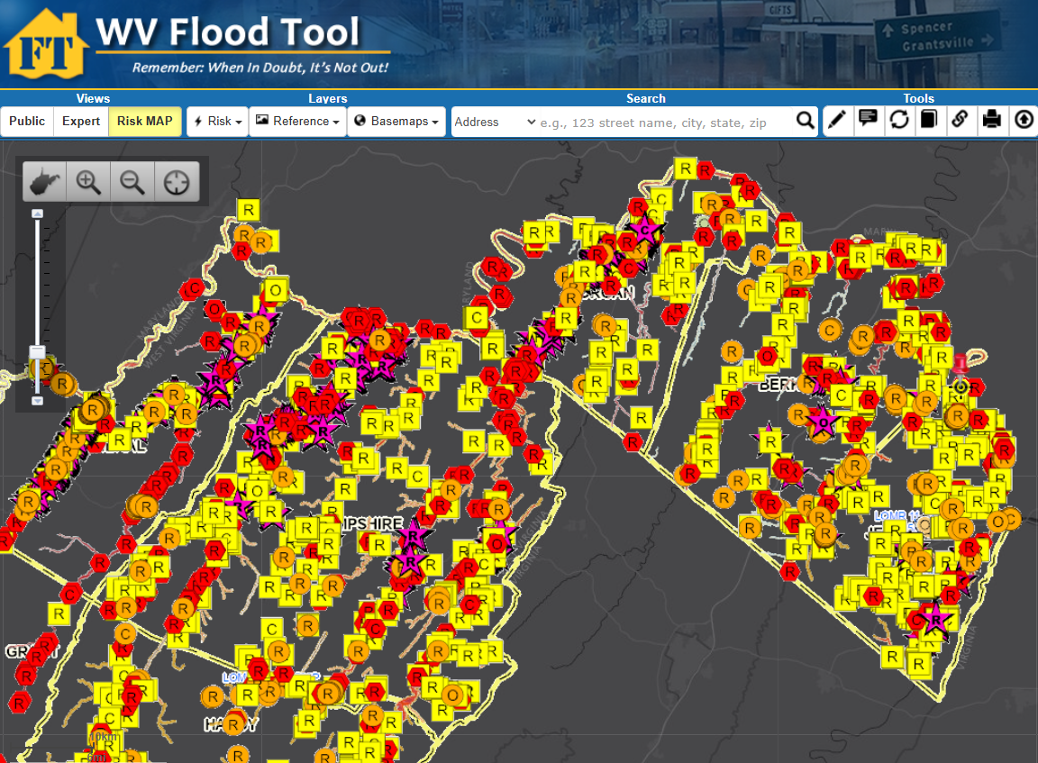
Buildings Mapped-In / Out of Preliminary SFHA
Floodway
Difference between FEMA’s 2009 and 2024 flood studies

Slide 7
SFHA Building Changes: Mapped-In/Out
COMMUNITY IDENTIFICATION |  | Estimated structures in the Community | Estimated structures in the preliminary flood high hazard area | Estimated structures newly mapped in | Estimated structures newly mapped out
Community Name | Community Type
Jefferson County* | Unincorporated | 20,397 | 317 | 55 | 220
Bolivar | Incorporated | 616 | 4 | 4 | 0
Charles Town | Incorporated | 3,670 | 21 | 4 | 8
Harpers Ferry | Incorporated | 276 | 31 | 30 | 0
Ranson | Incorporated | 2,918 | 50 | 1 | 28
Shepherdstown | Incorporated | 735 | 76 | 29 | 20
JEFFERSON | County | 28,612 | 499 | 123 | 276
* Unincorporated Area
County Net Change in structures: - 153
County Net Change in floodway structures: - 14

Slide 8
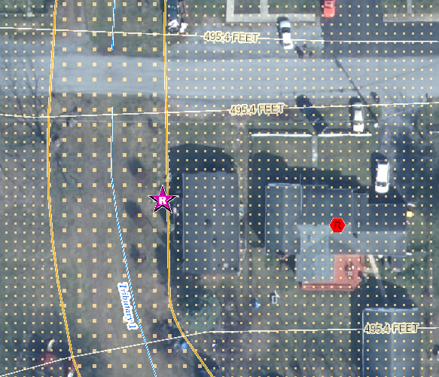
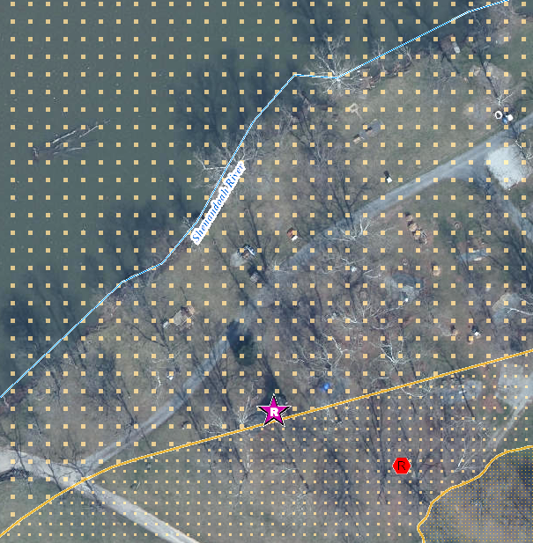
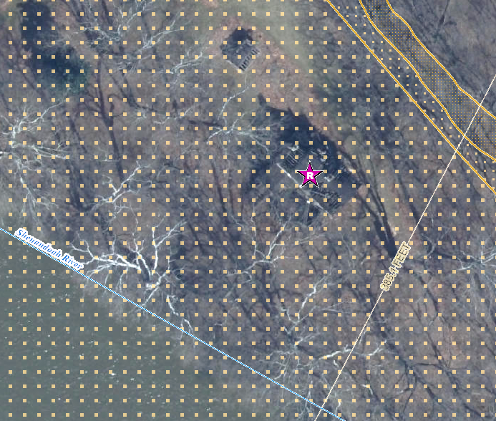
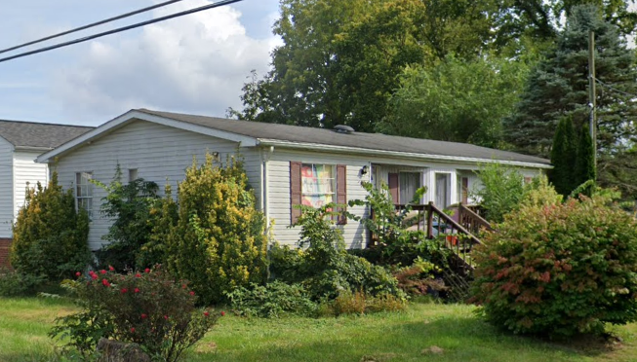
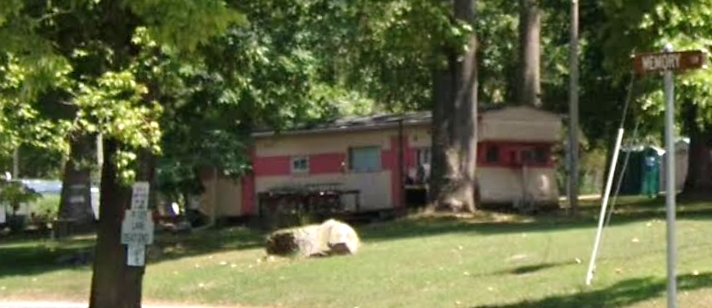
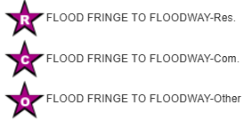
Buildings Mapped into Floodway
Single Family Dwelling in Jefferson County* (FD: 14.0 ft)
$8K; Minus Rated: 10.3 ft; Year Built: 1979 (Pre-FIRM)
(Building ID: 19-06-008F-0007-0000_457)
Structures mapped from Floodplain Fringe into Floodway
Double-wide Mobile Home in Ranson (FD: 2.2 ft)
$33K; Year Built: 1993 (Post-FIRM)
(Building ID: 19-08-0006-0019-0001_407)
Single-wide Mobile Home in Jefferson County* (FD: 7.0 ft)
$25K; Minus Rated: 3.5 ft; Year Built: Unknown
(Building ID: 19-02-0020-0031-0000_30)

Slide 9
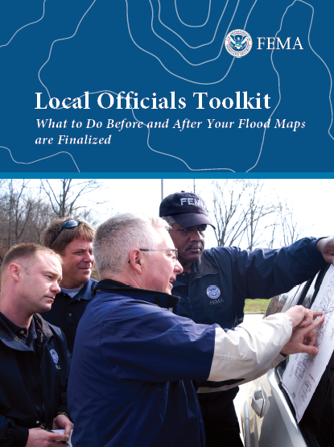
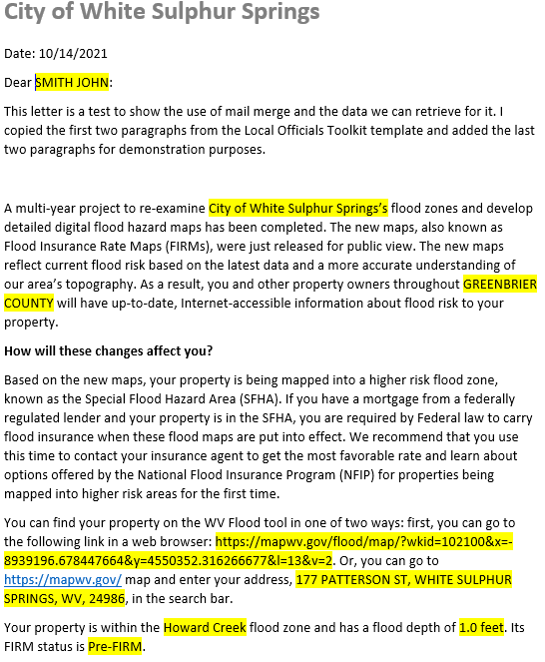
Risk Communications: SFHA Map Change Letters
Incorporate 1% Floodplain Building Risk Assessment Inventory into Mitigation and NFIP/CRS Management Activities
Counties which recently sent outreach letters to homeowners:
Hardy County Risk MAP
Kanawha County - Elk River PMR
Greenbrier County Risk MAP
Jefferson County and Shepherdstown have 55 and 29 buildings, respectfully, mapped into the SFHA
FEMA Region 3 Toolkit for New Flood Studies
Mail Merge Template for SFHA Mapped-in Structures

Slide 10
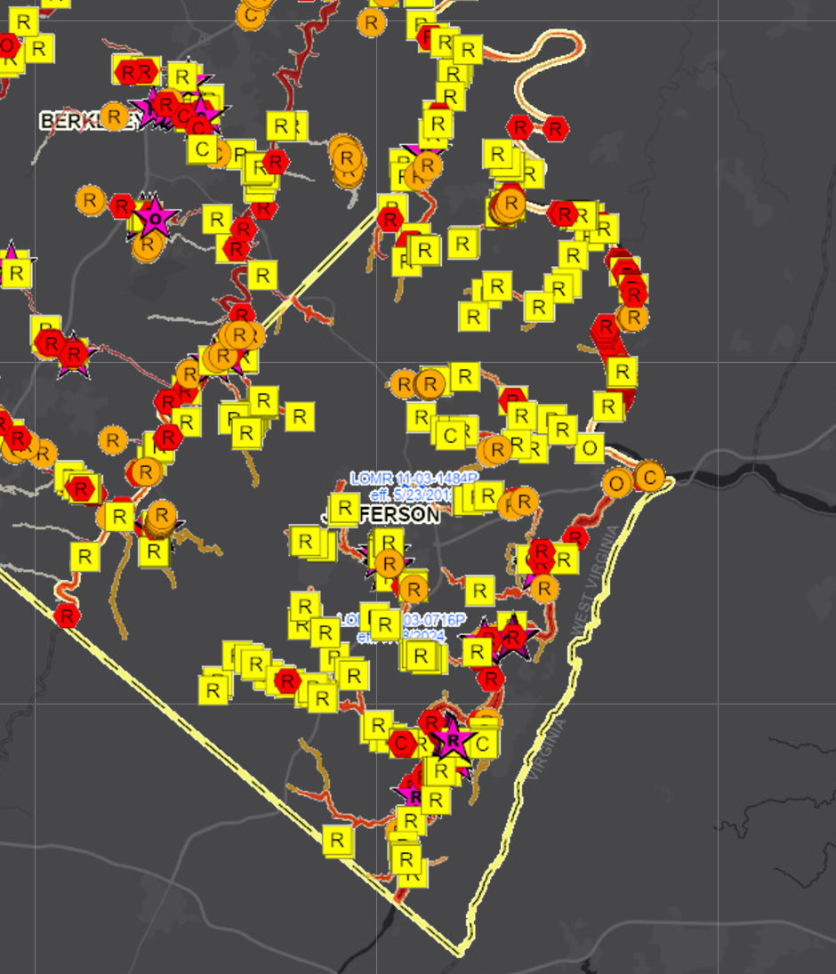
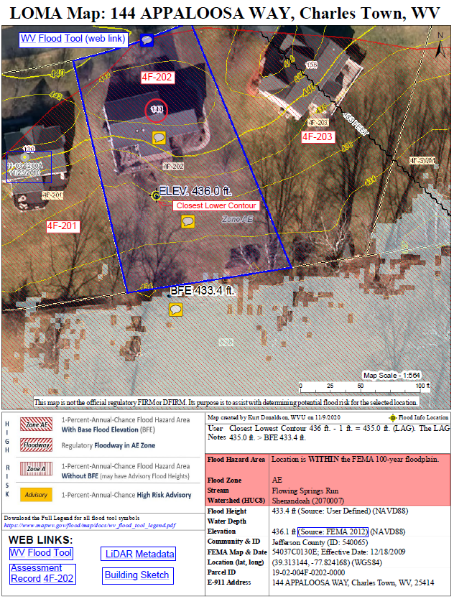
SFHA Buildings Changes: LOMAs for Mapped Out
Jefferson County
Mapped-out structures of the SFHA may qualify for LOMAs
Floodway
276
Mapped Out SFHA
WV Flood Tool LiDAR LOMA: Instructions | Guide
All building symbols in the floodplain fringe will become “red color” once flood maps are effective

Slide 11
River/Stream Building Risk Assessment
MEDIAN BUILDING VALUE: Town Run and Shenandoah River rank first and fourth, respectively, of 156 major rivers/streams in the state with the highest median value of structures in high-risk flood areas.
# | STATE CATEGORY RANK | River/Stream Floodplain | Building Characteristics | CATEGORY SCORE
 |  |  | Building Median Value
1 | 1 | Town Run | $247,700 | 100.0%
2 | 4 | Shenandoah River | $95,100 | 98.0%
3 | 24 | Potomac River | $57,300 | 85.1%
FLOOD DEPTH MEDIAN: Floodplain structures along the Shenandoah River have high flood depths compared to 156 other major rivers/streams in the state.
# | STATE CATEGORY RANK | River/Stream Floodplain | Floodplain Characteristics |  | CATEGORY SCORE
 |  |  | Floodplain Length | Flood Depth Median
1 | 12 | Shenandoah River | 30.2 Miles | 7.4 Ft | 92.9%
2 | 2 | Potomac River | 143.8 Miles | 4.5 Ft | 99.3%
3 | 147 | Town Run | 2.1 Miles | 0.2 Ft | 5.8%
WV Risk Explorer: Stream Risk Comparison Report

Slide 12
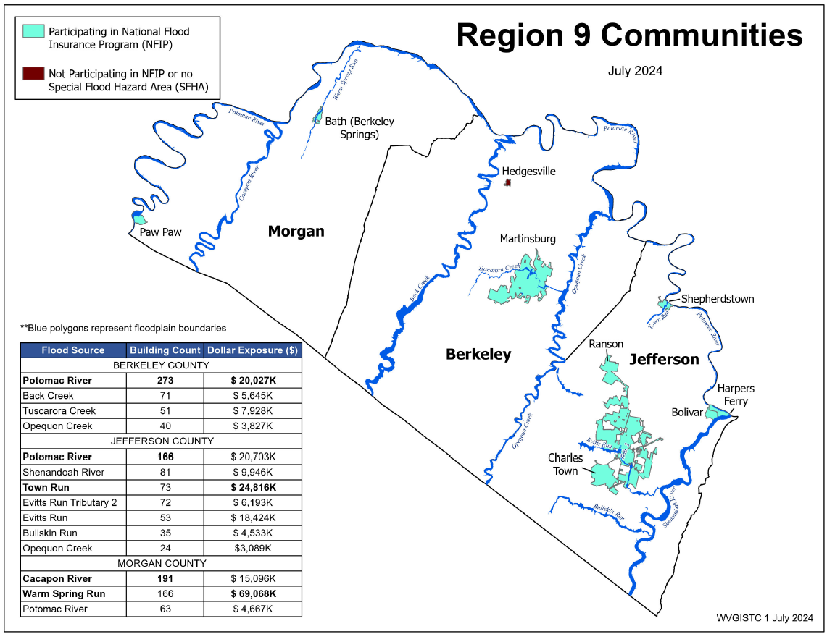
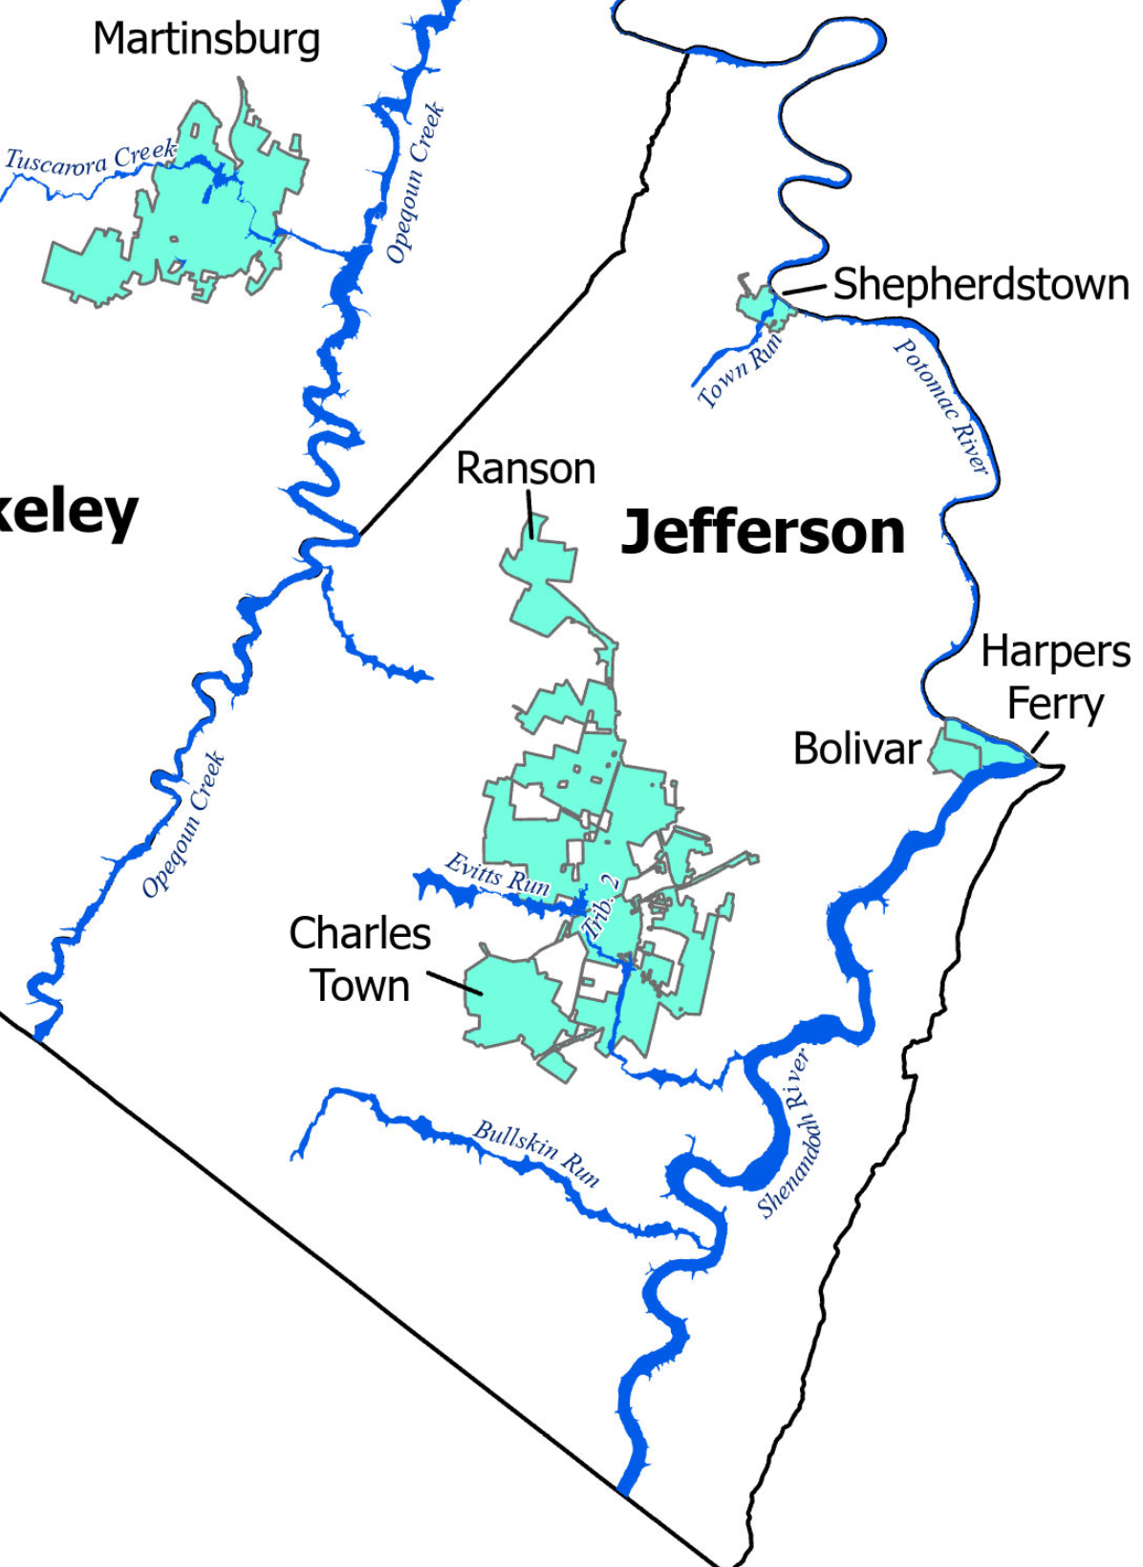
River/Stream Building Risk Assessment
Shepherdstown
Top rivers with high building counts in SFHA are Potomac River (166), Shenandoah River (81) and Town Run (73). Town Run has highest building dollar exposure.
Region 9 Rivers/Streams

Slide 13
Jefferson County Risk Assessment
Statewide Rank
among the Top 5
#
JEFFERSON COUNTY ranks “very high” or in the top 20% of all 55 counties in the state for the five risk indicators below. View Top 20% Risk Indicators Report for county. Click on Risk Factor links for rationales/recommendations.
Category | Flood Risk Indicator | Value for Jefferson | Indicator Score (0 - 100%) | Indicator Rating
Building Characteristics | Building Median Value | $97,450 (Median $42,200) | 100.0% | VERY HIGH
 | Bldg. Subgrade Basements Ratio | 49.5% | 94.4% | VERY HIGH
 | Bldg. Year Minus Rated Post-FIRM Ratio | 9.4% | 81.4% | Very High
Community Assets | Community Assets Historical | 120 | 94.4% | VERY HIGH
Building Damage Loss | Bldg. Substantial Damage Ratio | 24.0% | 90.7% | VERY HIGH
1
4
4
JEFFERSON COUNTY UNINCORPORATED* ranks “very high” or in the top 20% of all 55 unincorporated areas in the state for the six risk indicators below. View Top 20% Risk Indicators Report for incorporated area.
Category | Flood Risk Indicator | Value for Jefferson County* - Unincorporated | Indicator Score (0 - 100%) | Indicator Rating
Floodplain Characteristics | Flood Depth Median | 4.7 Ft | 94.4% | VERY HIGH
Building Characteristics | Building Median Value | $93,150 (Median $37,350) | 100.0% | VERY HIGH
 | Bldg. Subgrade Basements Ratio | 48.9% | 98.1% | VERY HIGH
 | Bldg. Year Minus Rated Post-FIRM Ratio | 14.5% | 90.7% | VERY HIGH
Community Assets | Community Assets Historical | 26 | 100.0% | VERY HIGH
Building Damage Loss | Bldg. Substantial Damage Ratio | 29.7% | 90.7% | VERY HIGH
4
1
2
1

Slide 14
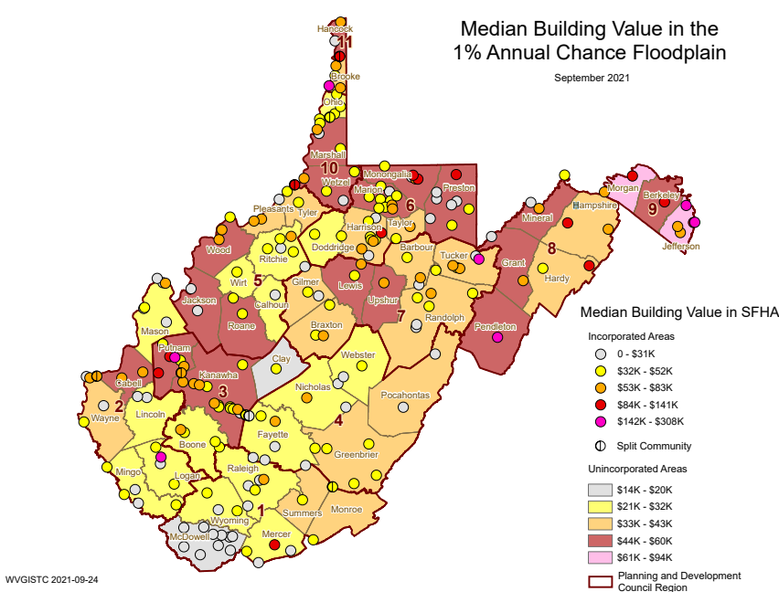
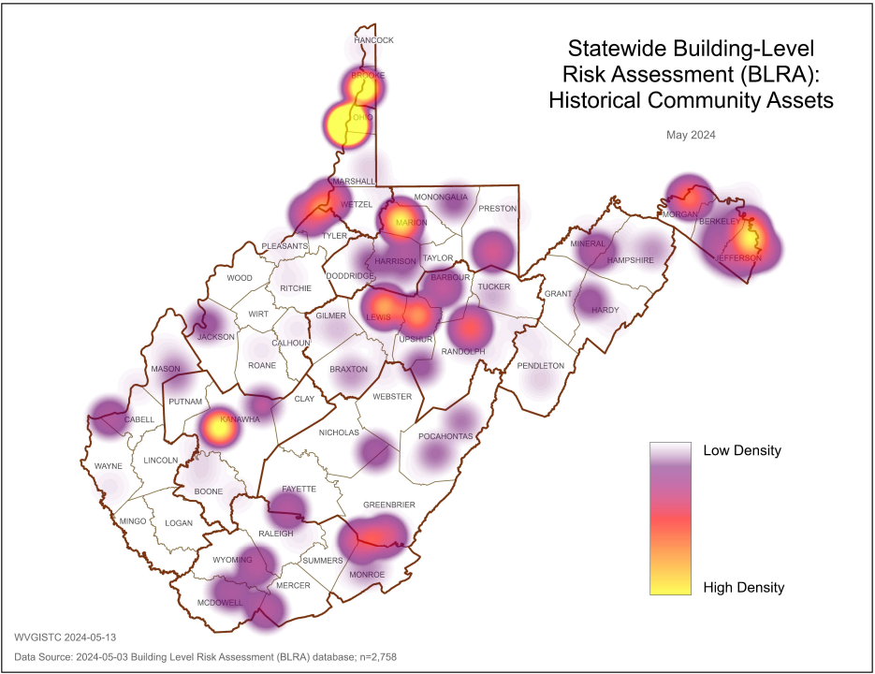
Jefferson County Building Risk Assessment
High Building Values
High Historical Buildings
Jefferson County has very high Building Values, or more than double the statewide median value.
Jefferson County has a high number of Historical Community Assets on the National Register.
Source: Statewide Building-Level Risk Assessment

Slide 15
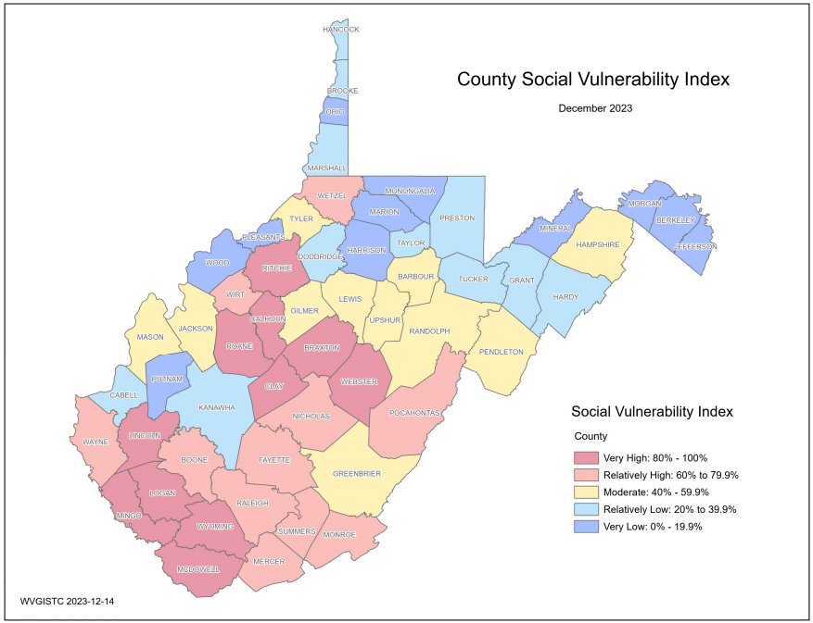
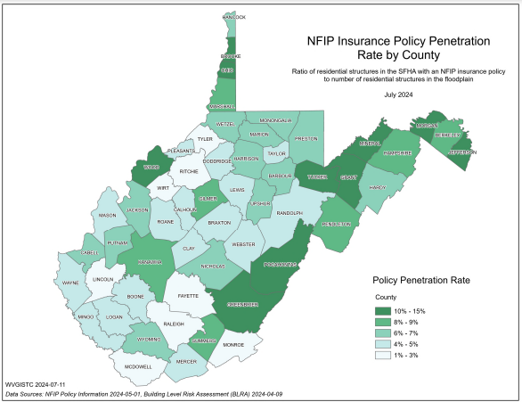
Jefferson County Resiliency
(1) Jefferson County has no Essential Facilities in the high or moderate risk floodplains
(2) Jefferson County has the lowest Social Vulnerability Index in the State
(3) Jefferson County has higher NFIP Insurance Penetration Rate than other counties

Slide 16
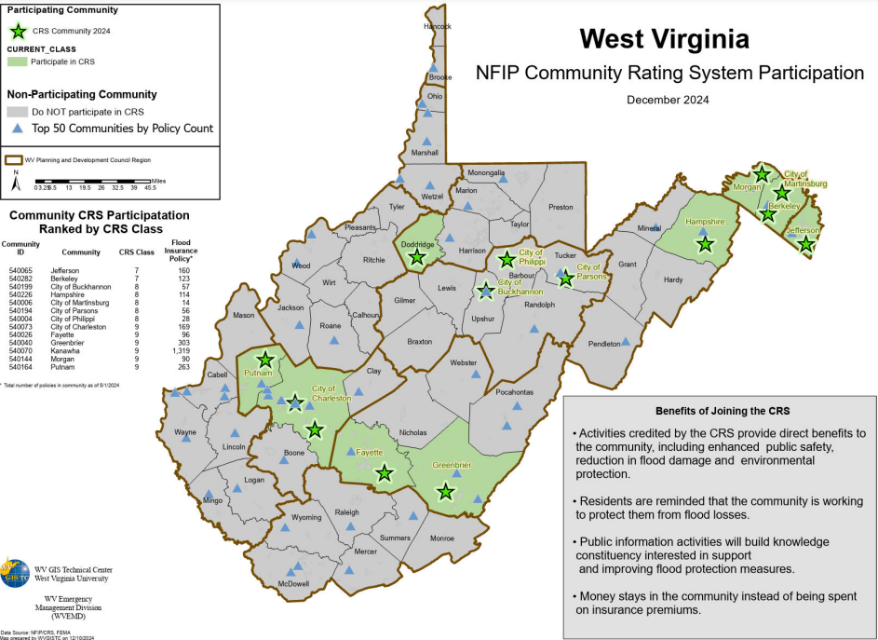
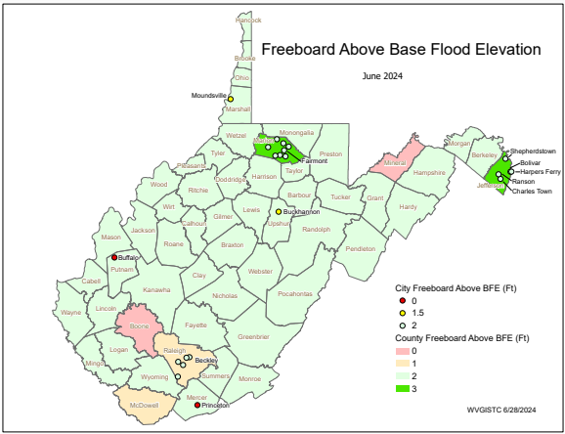
Jefferson County Unincorporated* Resiliency
Jefferson County Unincorporated has a high CRS Rating of Class 7
Jefferson County Unincorporated has a high Freeboard safety factor of 3 feet

Slide 17
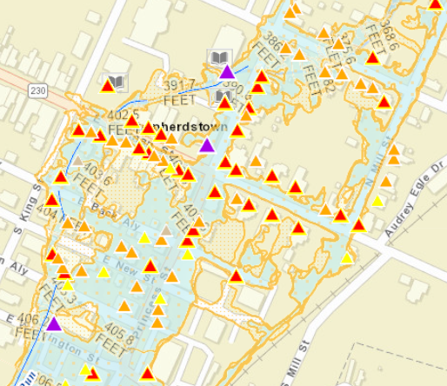
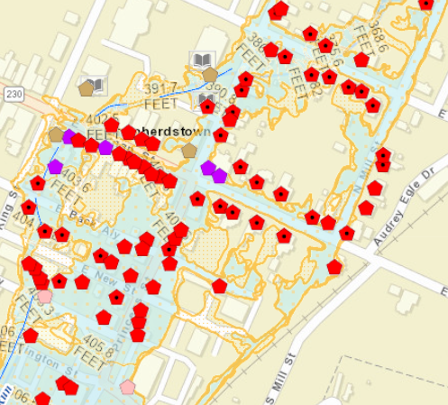
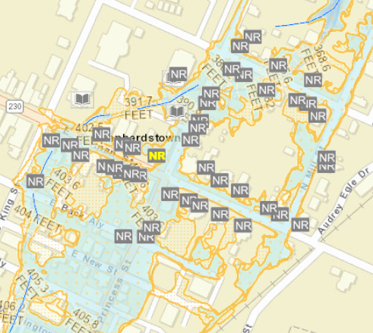
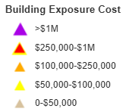
Shepherdstown Risk Assessment
Building Value and Density.
Median Building Value ranks first of 229 incorporated places in the state. High density of buildings in small area.
Pre-FIRM and Basements.
Nearly 90% of structures are Pre-FIRM and nearly half have basements.
Historical Buildings.
Most building are in the National Historic District.
Refer to online All Risk Indicators Report
Sources: WV Flood Tool’s Risk Map View & Statewide Building-Level Risk Assessment

Slide 18
Shepherdstown 3D Flood Movie
Click here to view 3D Flood Movie of Shepherdstown

Slide 19
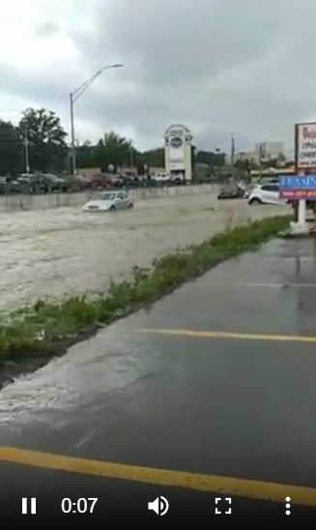
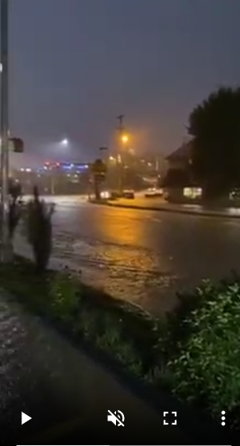
Example Urban Flooding
View Videos of 2021 Morgantown Flooding along Popenoe Run on Patteson Drive near WVU stadium that may occur similarly on Town Run in Shepherdstown
Courtesy of WV Hazard Library

Slide 20
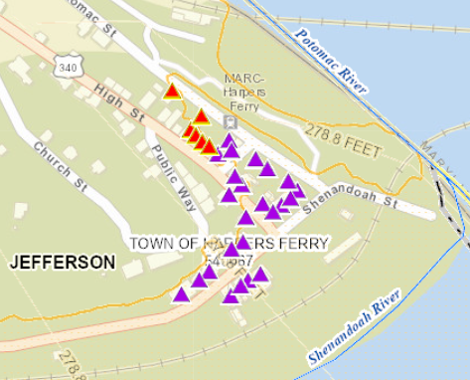
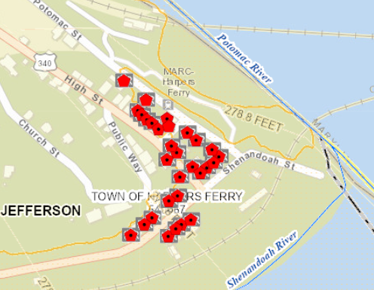
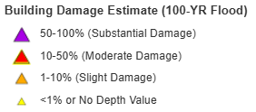
Harpers Ferry Risk Assessment
Building Substantial Damage Ratio highest of all 229 incorporated places in the state
Pre-FIRM Building Ratio highest of all 229 incorporated places in the state
Refer to online All Risk Indicators Report
Sources: WV Flood Tool’s Risk Map View & Statewide Building-Level Risk Assessment

Slide 21
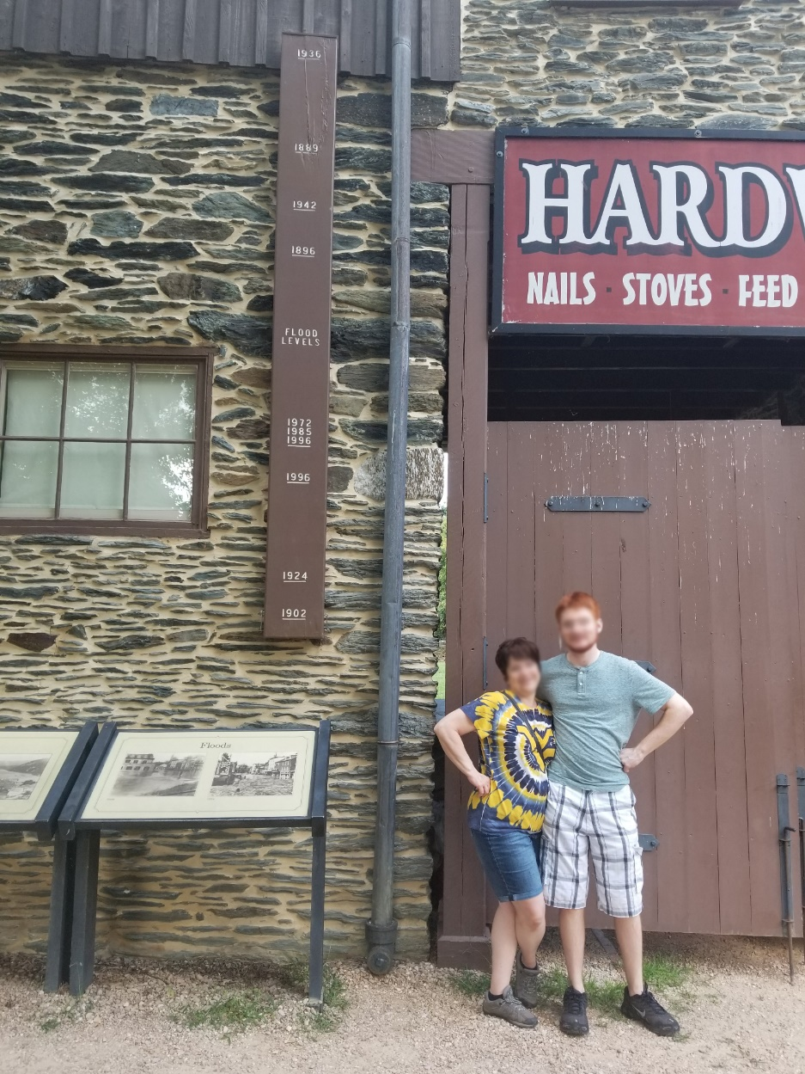
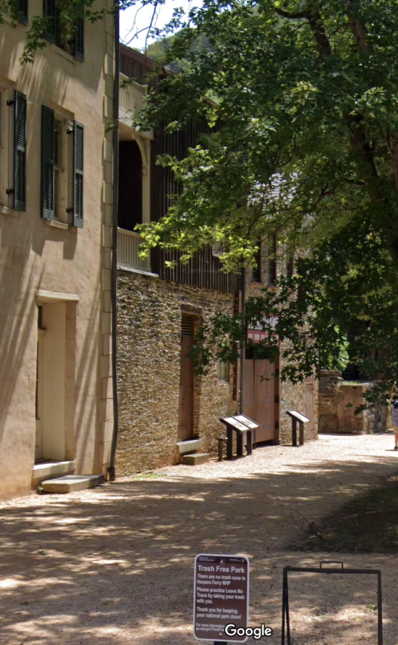
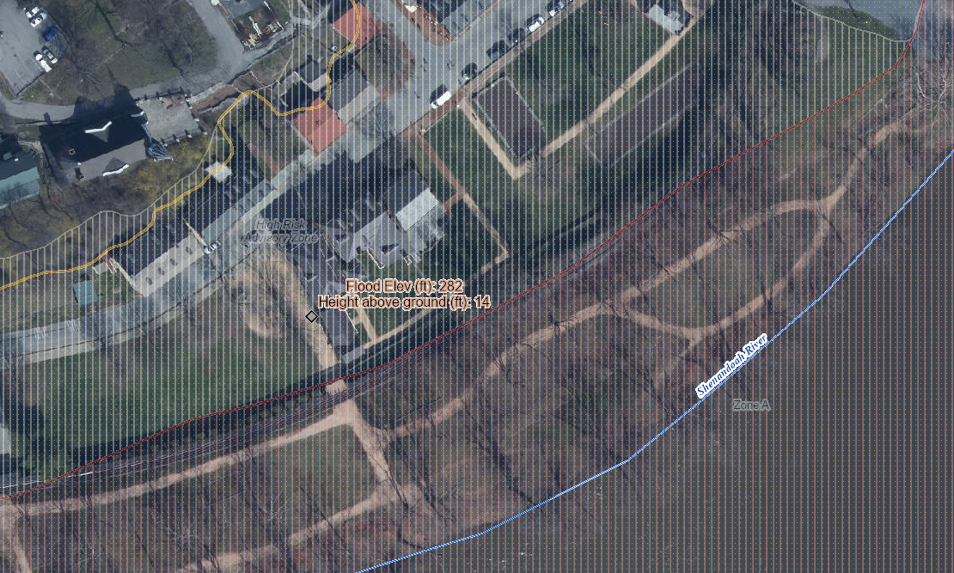
Harpers Ferry Risk Assessment
744 Shenandoah St, Harpers Ferry, WV, 25425
Building ID: 19-05-0004-0025-0000_801A
Historical structure built in 1845
14’ (1936 High Water Mark)
1936 Flood of Record
8’ (1996 High Water Mark)
Knapp Creek
Greenbrier River
High Water Mark

Slide 22
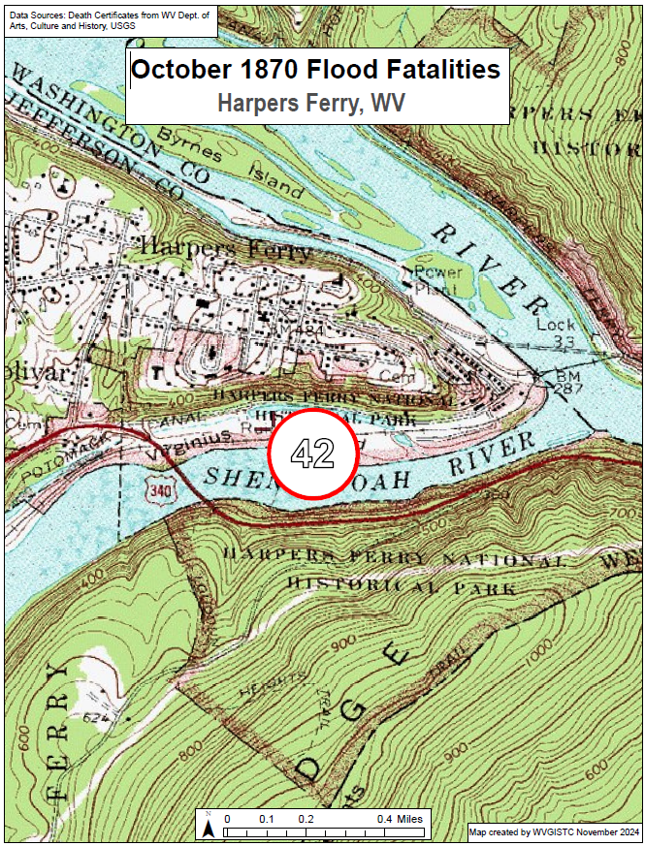
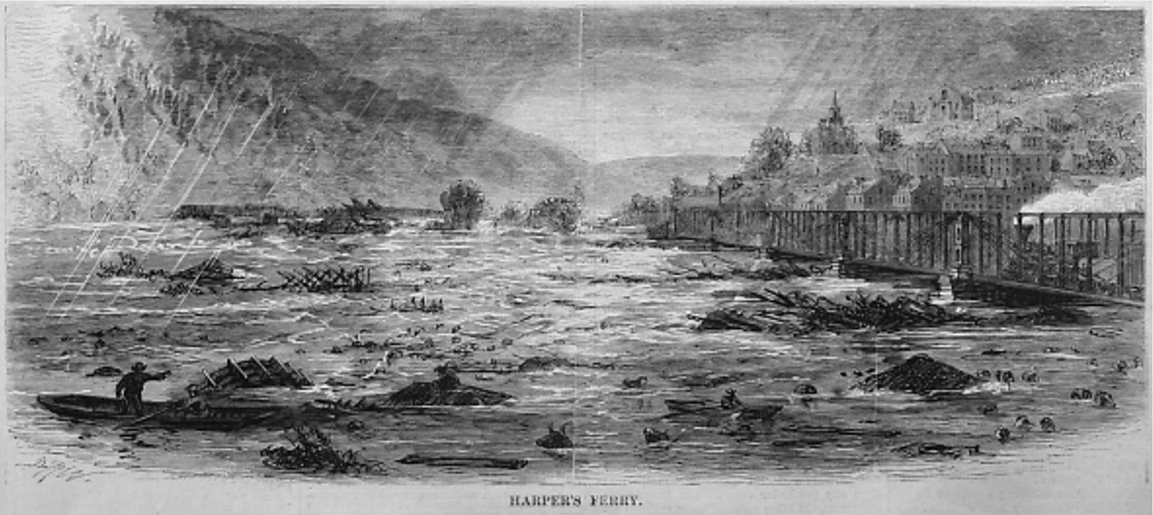
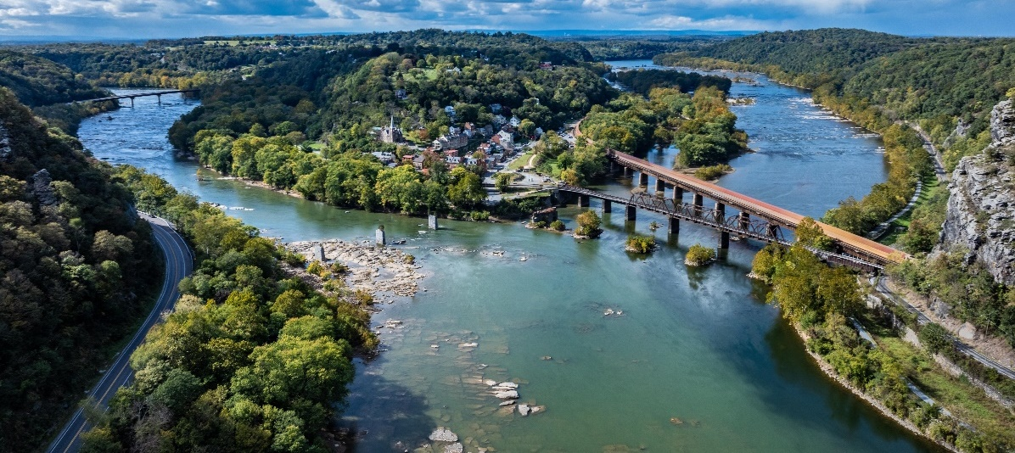
Historical Flood Research (Harpers Ferry, WV)
Engraving of the flood in Harpers Ferry, from Harper’s Weekly, October 20, 1870
(Image courtesy of Yesterday’s America)
October 1870 Flood
(42 fatalities)
Link to WV Flood Fatality Dashboard

Slide 23
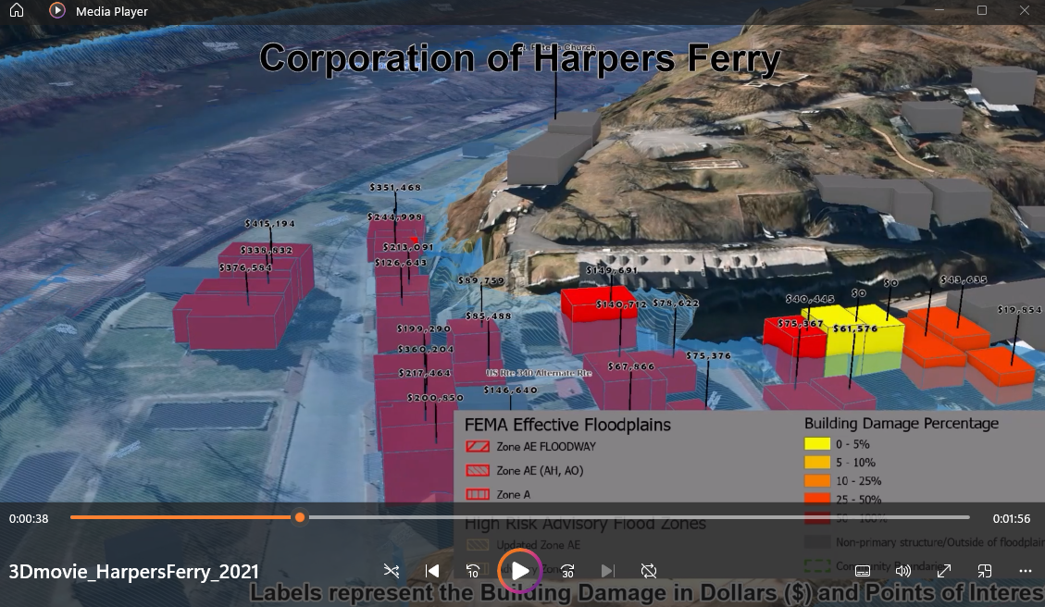
Harpers Ferry 3D Flood Movie
Click here to view 3D Flood Movie of Harpers Ferry

Slide 24
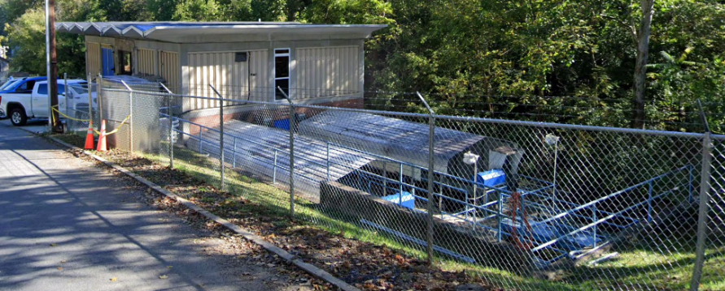
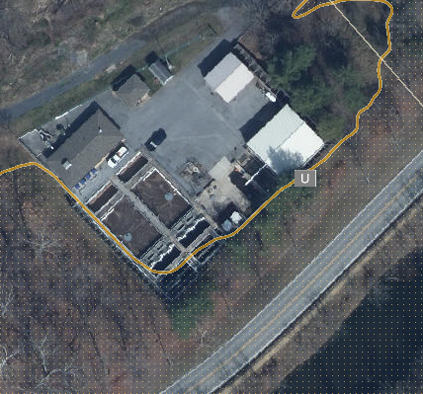
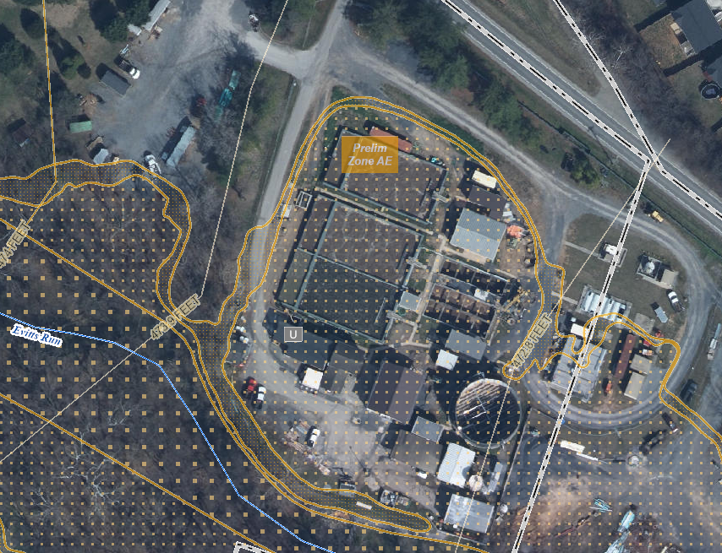
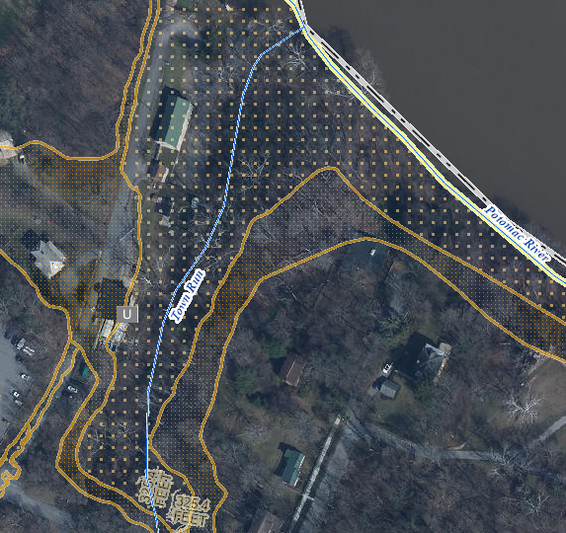
Utilities in Floodplain (High $ Exposure)
Backwater
Harpers Ferry Bolivar PSD Wastewater
Treatment Plant (FD: 1 ft)
(Building ID: 19-05-0004-0025-0000_192) ($462K)
Value source inflation adjusted to 2021
City of Charles Town Wastewater Treatment Plant (FD: 1 ft)
Highest CA Value ($6.8M) in Jefferson County
(Building ID: 19-03-0008-0001-0000_842)
Value source inflation adjusted to 2021
Shepherdstown Water Works Water Treatment Plant (FD: ? ft)
(Building ID: 19-10-0001-0052-0000_309) ($3.1M)
Value source inflation adjusted to 2021

Slide 25
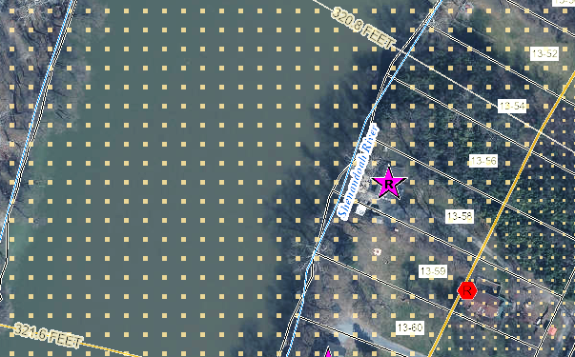
Building Flood Profile - Unmitigated
Single Family Dwelling in Jefferson County*
Appraised Value: $217K
(Building ID: 19-04-0013-0059-0000_89)
Rivermist Lane, Harpers Ferry
Repetitive Loss Area / Area of Mitigation Interest
 | HEIGHT (ft.)
BUILDING
Freeboard (FBD) | 3
FLOOD DEPTH
FEMA 1% (100-Yr) | 13.6
FEMA 100-Yr + FBD | 16.6
FEMA 0.2% (500-Yr) | 19.6
Flood Source: Shenandoah River
Post-FIRM
19.6’ (FEMA 0.2% / 500-Yr)
16.6’ (FEMA 1% + / 100-Yr +)
13.6’ (FEMA 1% / 100-Yr)
Ground Level

Slide 26
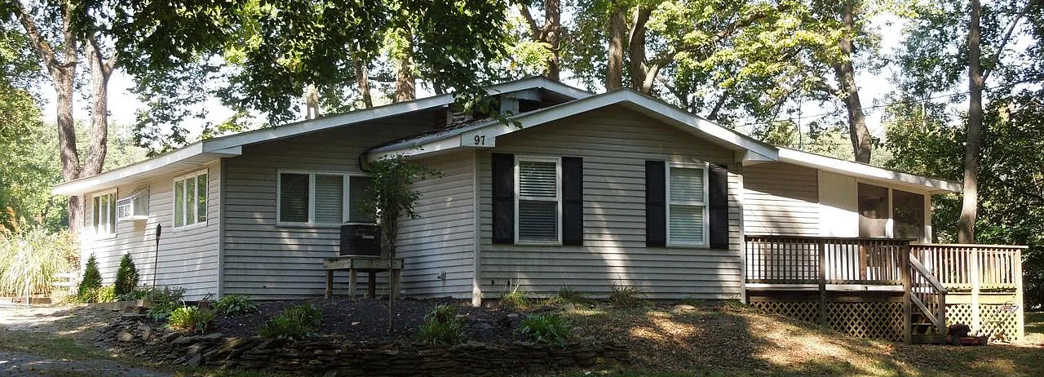
Building Flood Profile - Unmitigated
Single Family Dwelling in Jefferson County*
in Floodway
Appraised Value: $95K
(Building ID: 19-04-0013-0058-0000_97)
Rivermist Lane, Harpers Ferry
Repetitive Loss Area / Area of Mitigation Interest
Flood Source: Shenandoah River
 | HEIGHT (ft.)
BUILDING
Freeboard (FBD) | 3
FLOOD DEPTH
FEMA 1% (100-Yr) | 13.7
FEMA 100-Yr + FBD | 16.7
FEMA 0.2% (500-Yr) | 19.7
Pre-FIRM
19.7’ (FEMA 0.2% / 500-Yr)
16.7’ (FEMA 1% + / 100-Yr +)
13.7’ (FEMA 1% / 100-Yr)
Ground Level

Slide 27
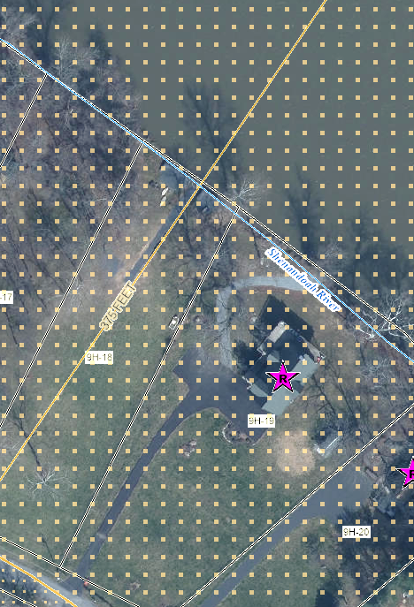
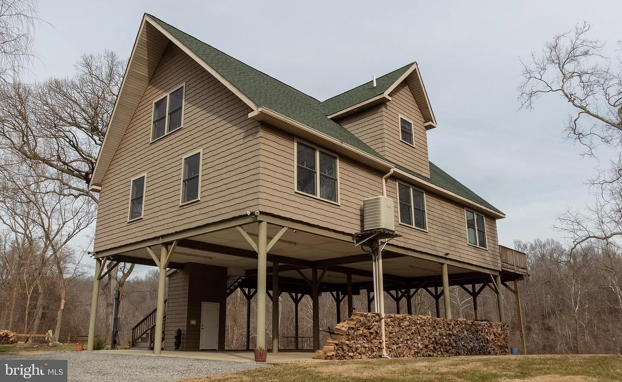
Building Flood Profile – Mitigated to DFE
Flood Profile
 | HEIGHT (ft.)
BUILDING
Freeboard (FBD) | 3
FLOOD DEPTH
FEMA 1% (100-Yr) | 9.9
FEMA 100-Yr + FBD | 12.9
FEMA 0.2% (500-Yr) | 18.9
Flood Source: Shenandoah River
Post-FIRM
18.9’ (FEMA 0.2% / 500-Yr)
14.9’ (FEMA 1% + / 100-Yr +)
Single Family Dwelling in Jefferson County*
Elevated in Floodway
Appraised Value: $265K
(Building ID: 19-06-009H-0019-0000_781)
9.9’ (FEMA 1% / 100-Yr)
Ground Level

Slide 28
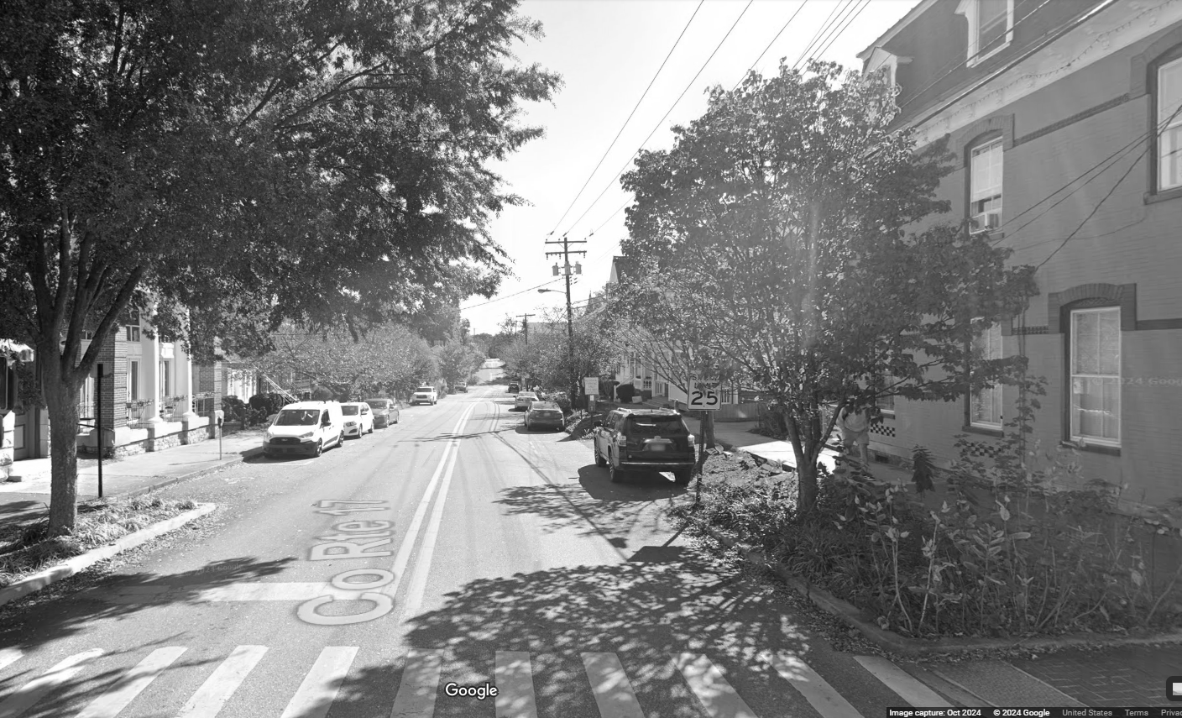
Contact Persons:
Kurt Donaldson
kurt.donaldson@mail.wvu.edu
Behrang Bidadian
behrang.bidadian@mail.wvu.edu
Annie Mahmoudi
anm0050@mail.wvu.edu
West Virginia GIS
Technical Center

