Slide 1
Jefferson County, WV
CCO Meeting
December 2024

Slide 2
Risk MAP (Jefferson Co. Preliminary Flood Maps)
Risk Mapping (Review New Flood Risk Maps)
Map Changes BFE’s (e.g., 24’ BFE change at Harpers Ferry) Floodplain Width (e.g., Shepherdstown)
SFHA Building Changes Mapped-in/Mapped Out Bldgs. LOMAs (SFHA bldgs. mapped out)
Risk Communications Outreach Letters for building changes in SFHA/Floodway
Future Map Discovery Map Zone AE Upgrades for Potomac / Shenandoah Rivers?
Risk Assessment (Quantify Flood Risk)
Statewide Risk Assessment (aggregate level or summary reports) River/Stream Scale County Scale Unincorporated Area Scale Incorporated Area Scale Shepherdstown Harpers Ferry
Building Level Risk Assessments Unmitigated Structures Mitigated Structure
Risk Planning (Build Flood Resiliency)
Pre-Disaster Planning Preload WV Flood Tool Structures into FEMA’s SDE Software Update Emergency Response & Hazard Mitigation Plans using risk assessments for major storm event
Higher Standards - Municipalities Apply for CRS status Adopt higher Freeboard value of 3 ft. in floodplain mgmt. ordinance
Verify Risk Layers on WV Flood Tool Building-level assessments Open space properties Repetitive Loss Areas
WV Flood Resiliency Framework
Risk MAP: Reduce Loss of Life and Property
Web link to Slide Deck
Notes:
Risk MAP (Mapping, Assessment, Supplemental) Slides prepared by the WV GIS Technical Center for the Community Coordination and Outreach (CCO) meeting to discuss the new preliminary Flood Insurance Study (FIS) and Flood Insurance Rate Maps (FIRMs) for Jefferson County, WV, issued on September 24, 2024. This CCO meeting is an opportunity for local government representatives to work with FEMA Region 3, state government representatives, and members of the project team on strategies and resources for public outreach, how to provide comments/appeals to the preliminary information, the ordinance update and adoption process, and other questions/answers related to the National Flood Insurance Program (NFIP) and getting the new FIRMs to effective status.
This CCO meeting is organized by the National Flood Insurance Program (NFIP), a voluntary program that works to reduce future flood losses by guiding development away from hazardous areas, and by encouraging communities to:
• Know Your Risk: Identify flood hazards through mapping.
• Insure Your Risk: Provide insurance and outreach measures.
• Reduce Your Risk: Manage floodplains through ordinances, mitigation practice and resiliency efforts.
Community To-Do List
• Review the preliminary FIRM. Make corrections, share comments and submit appeals to FEMA through the community Chief Executive Officer (CEO), when appropriate.
• Reach out to notify residents, businesses and property owners affected by the changes on the FIRM.

Slide 3
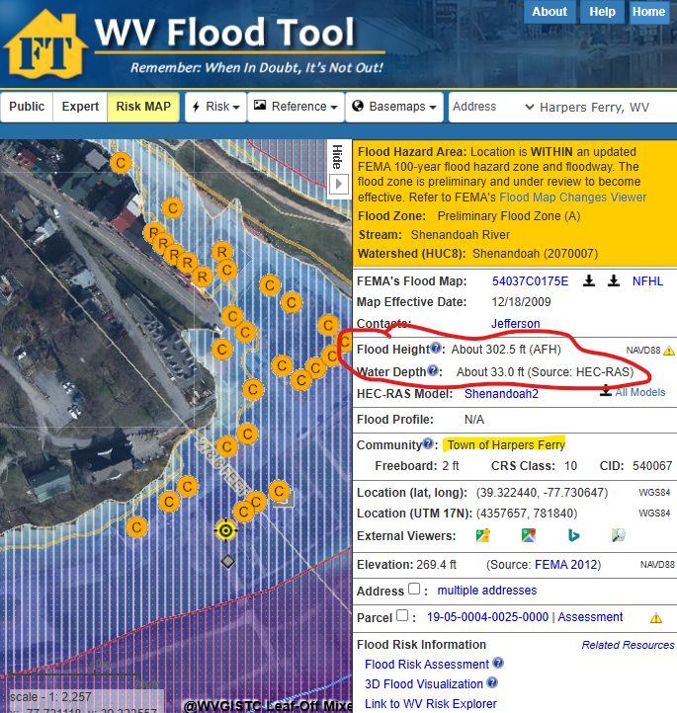
Map Changes – Harpers Ferry
Harpers Ferry: BFE change minus 24 ft.
Notes:
Communities like Harpers Ferry should review the preliminary Flood Insurance Rate Map (FIRM) where structures are being mapped into the high-risk Special Flood Hazard Area, and the base flood elevation is decreasing 24 feet. The preliminary FIRM shows flood risk zones in a community, including Special Flood Hazard Areas (SFHAs), areas subject to inundation by the base (1%-percent-annual-chance) flood. The 1%-annual-chance flood is also referred to as the 100-year flood.

Slide 4
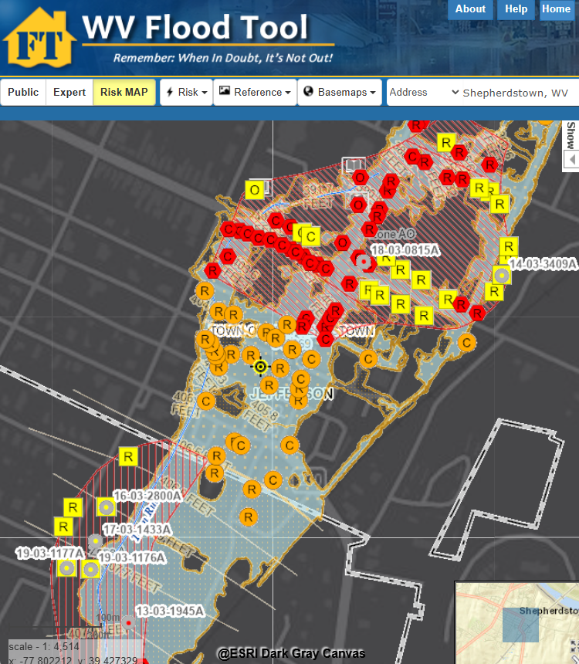
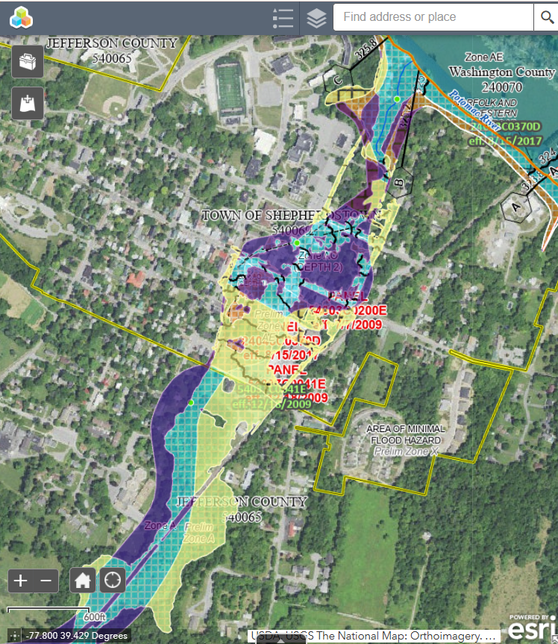
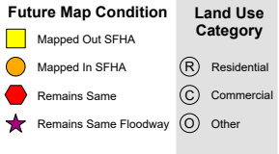
Map Changes - Shepherdstown
Harpers Ferry: BFE change minus 24 ft.
Shepherdstown: WV Flood Tool
Shepherdstown: FEMA Change Viewer
Notes:
Preliminary maps show the high-risk floodplain of Shepherdstown is changing dramatically, and consequently these floodplain boundary changes between the current 2009 effective and 2024 preliminary flood maps should be viewed using the WV Flood Tool’s Risk MAP View (SFHA Building Changes - Building Changes Since Last FIRM) and FEMA’s Changes Since Last FIRM (CSLF) Viewer. Jefferson County has nearly 30 structures being mapped into the updated Special Flood Hazard Area, and so it is the community’s responsibility to notify property owners and other stakeholders that they will be affected by the map changes.

Slide 5
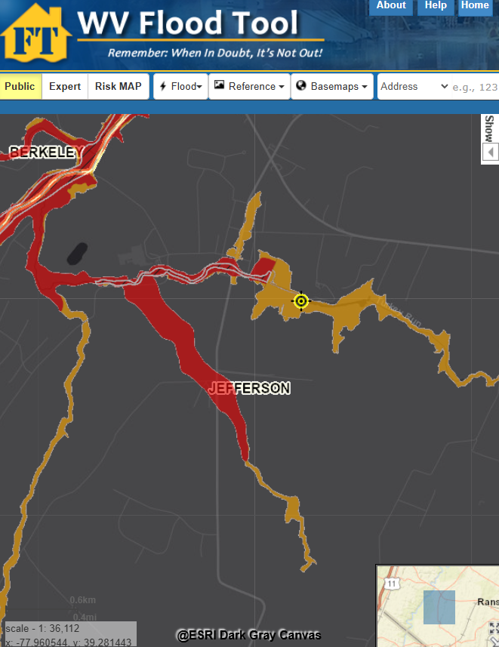
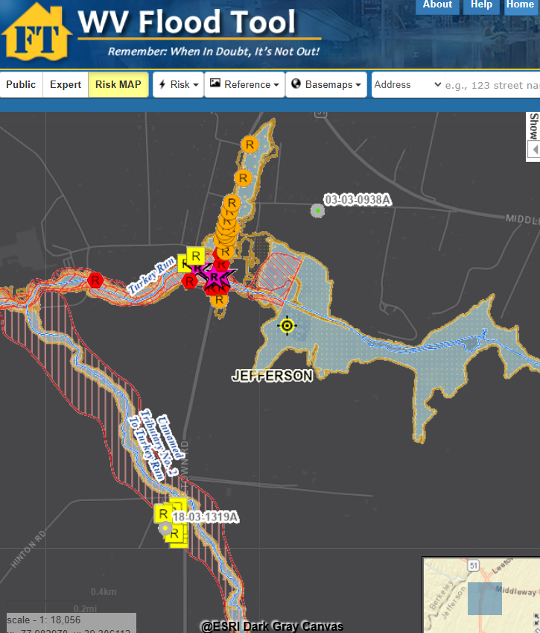
Map Changes – Jefferson County
Floodway
WV Flood Tool Public View
WV Flood Tool (Risk MAP View)
Notes:
Preliminary map changes for Jefferson County Unincorporated show “mapped-in structures” (orange symbol color) along streams where studies have been extended; or “mapped-out” structures (yellow symbol color) along existing streams due to more accurate topographic and hydrologic/hydraulic flood studies.

Slide 6
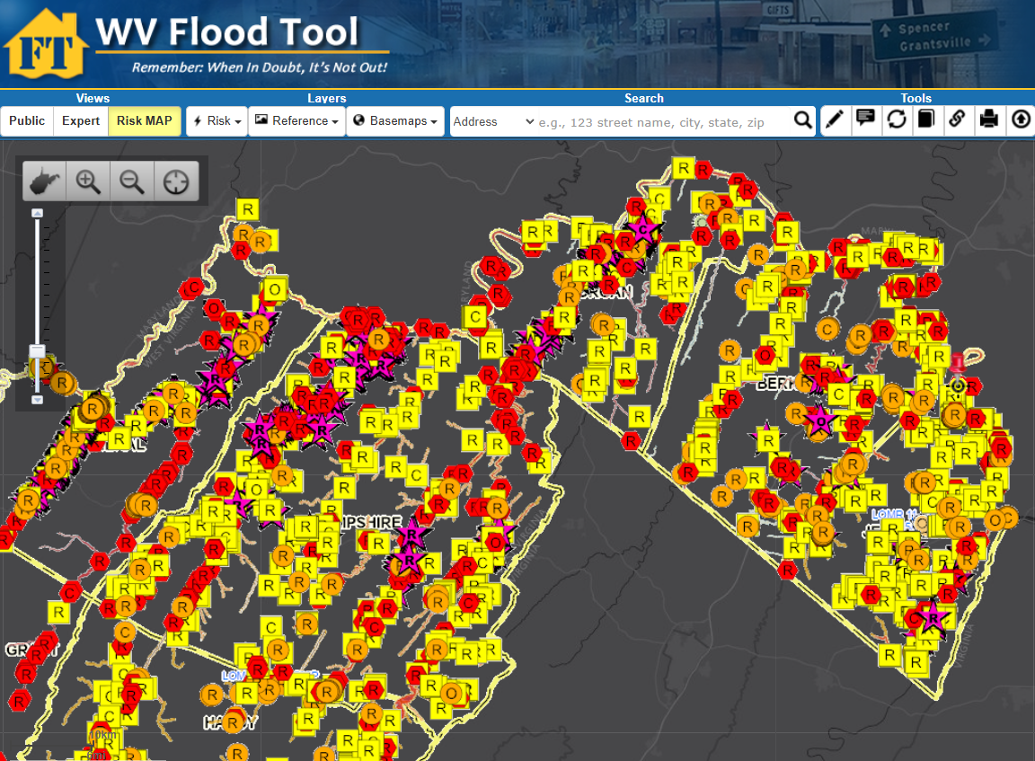
Buildings Mapped-In / Out of Preliminary SFHA
Floodway
Difference between FEMA’s 2009 and 2024 flood studies
Notes:
The WV Flood Tool’s Risk MAP View shows the future building status change according to the new flood maps:
Mapped Out SFHA (yellow square symbol). Candidates for LiDAR LOMAS. Communities should notify property owners of map change.
Mapped In SFHA (orange circle symbol). Communities should notify property owners of map change.
No Change - Remains Same (red hexagon symbol).
Floodway (star symbol)

Slide 7
SFHA Building Changes: Mapped-In/Out
COMMUNITY IDENTIFICATION |  | Estimated structures in the Community | Estimated structures in the preliminary flood high hazard area | Estimated structures newly mapped in | Estimated structures newly mapped out
Community Name | Community Type
Jefferson County* | Unincorporated | 20,397 | 317 | 55 | 220
Bolivar | Incorporated | 616 | 4 | 4 | 0
Charles Town | Incorporated | 3,670 | 21 | 4 | 8
Harpers Ferry | Incorporated | 276 | 31 | 30 | 0
Ranson | Incorporated | 2,918 | 50 | 1 | 28
Shepherdstown | Incorporated | 735 | 76 | 29 | 20
JEFFERSON | County | 28,612 | 499 | 123 | 276
* Unincorporated Area
County Net Change in structures: - 153
County Net Change in floodway structures: - 14
Notes:
Tax assessment records and aerial imagery allow for a more detailed inventory of primary buildings within the Special Flood Hazard Area and Regulatory Floodway. The preliminary flood maps reveal a net total of 499 structures in the preliminary SFHA, with 123 structures mapped-in the SFHA and 276 structures (more than double) mapped out. The countywide building net change is minus 153 and minus 14 structures in the preliminary SFHA and Floodway, respectively. Communities should contact the State NFIP Office for technical assistance in mailing notification letters to property owners that will be affected by the map changes.

Slide 8
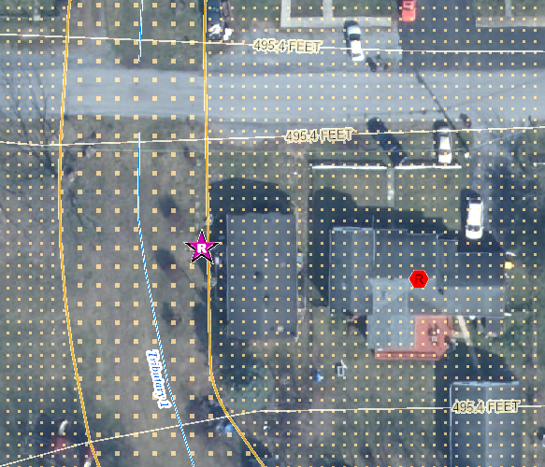
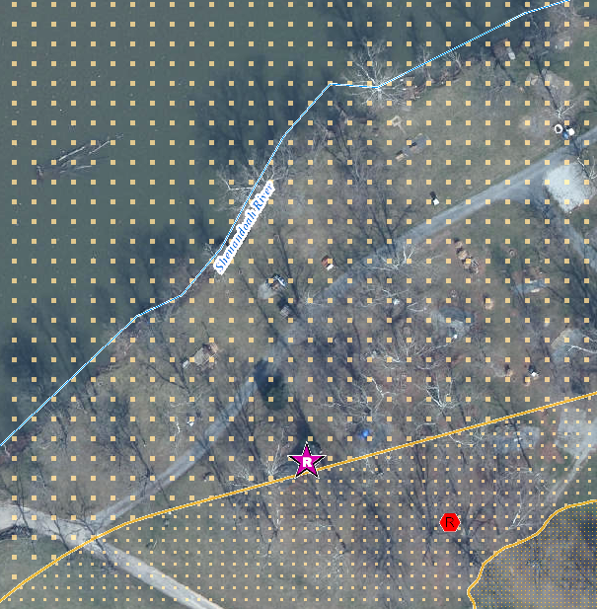
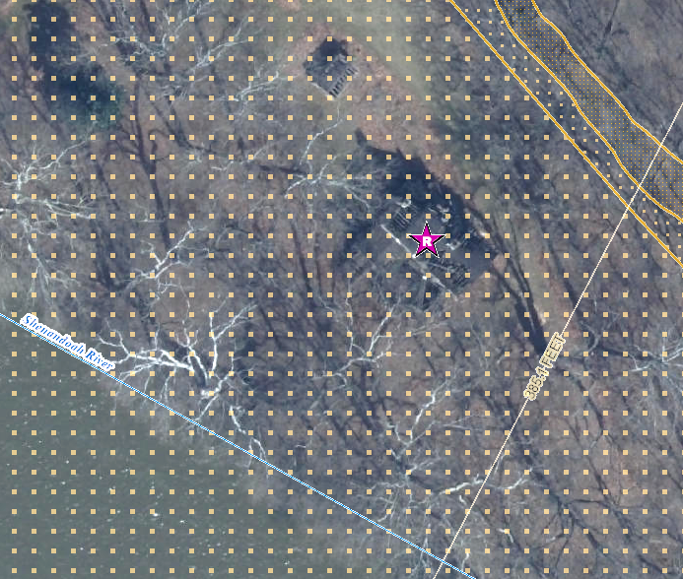
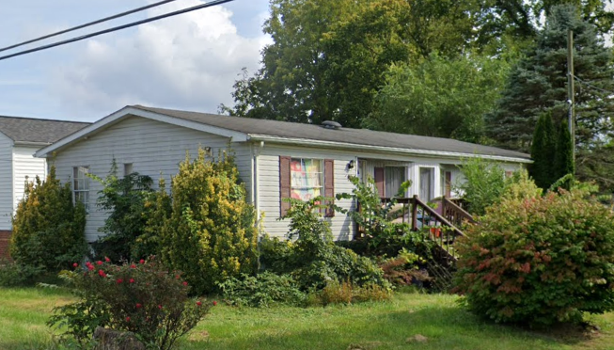
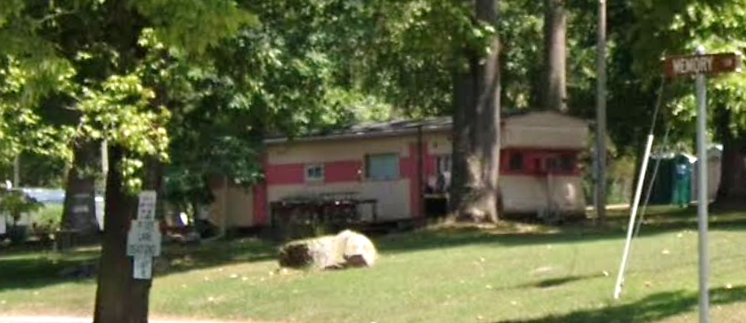
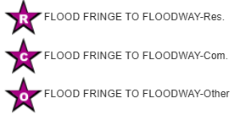
Buildings Mapped into Floodway
Single Family Dwelling in Jefferson County* (FD: 14.0 ft)
$8K; Minus Rated: 10.3 ft; Year Built: 1979 (Pre-FIRM)
(Building ID: 19-06-008F-0007-0000_457)
Structures mapped from Floodplain Fringe into Floodway
Double-wide Mobile Home in Ranson (FD: 2.2 ft)
$33K; Year Built: 1993 (Post-FIRM)
(Building ID: 19-08-0006-0019-0001_407)
Single-wide Mobile Home in Jefferson County* (FD: 7.0 ft)
$25K; Minus Rated: 3.5 ft; Year Built: Unknown
(Building ID: 19-02-0020-0031-0000_30)
Notes:
Communities should also notify property owners being mapped into a much higher risk flood zone of the Special Flood Hazard Area (SFHA), known as the Regulatory Floodway, or the main channel of the river or stream where floodwaters are likely the deepest and with the highest velocities. Before a local permit can be issued for proposed development in the floodway, a “No-Rise/No Impact” certification must be submitted by a professional engineer licensed in West Virginia to ensure your proposed project won’t increase flood levels.

Slide 9
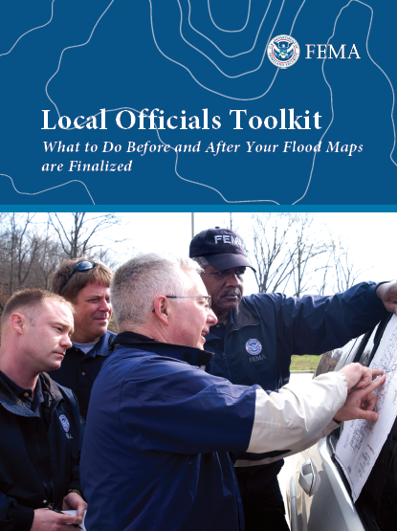
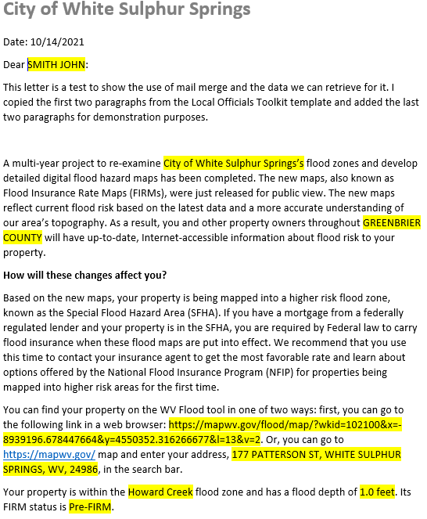
Risk Communications: SFHA Map Change Letters
Incorporate 1% Floodplain Building Risk Assessment Inventory into Mitigation and NFIP/CRS Management Activities
Counties which recently sent outreach letters to homeowners:
Hardy County Risk MAP
Kanawha County - Elk River PMR
Greenbrier County Risk MAP
Jefferson County and Shepherdstown have 55 and 29 buildings, respectfully, mapped into the SFHA
FEMA Region 3 Toolkit for New Flood Studies
Mail Merge Template for SFHA Mapped-in Structures
Notes:
Communities should contact the State NFIP Office for technical support in creating outreach letters for property owners affected by the map changes. Based on mail merge templates, outreach letters on community letterhead can be generated for all (1) SFHA Mapped-In, (2) Mapped-In Floodway, and (3) SFHA Mapped-Out structures shown on the WV Flood Tool’s RiskMAP View (www.mapwv.gov/Flood). All the communities must do is download the files, then print, validate, and mail the letters. CRS communities like Jefferson County Unincorporated should be eligible for credit points for this outreach activity.
For the SFHA mapped-out letters, it is important to have this text included in the letter template: "If you do currently have flood insurance, you should not cancel your flood insurance before the new flood maps are officially adopted by the community. Moreover, if you have a federally-backed mortgage, NEVER cancel your flood insurance before consulting your mortgage lender!“
Another useful resource about the Regulatory Update is FEMA’s Risk Communication Guidebook for Local Officials. https://www.fema.gov/sites/default/files/documents/fema_region-6_risk-communications-guidebook_112023.pdf#page=25

Slide 10
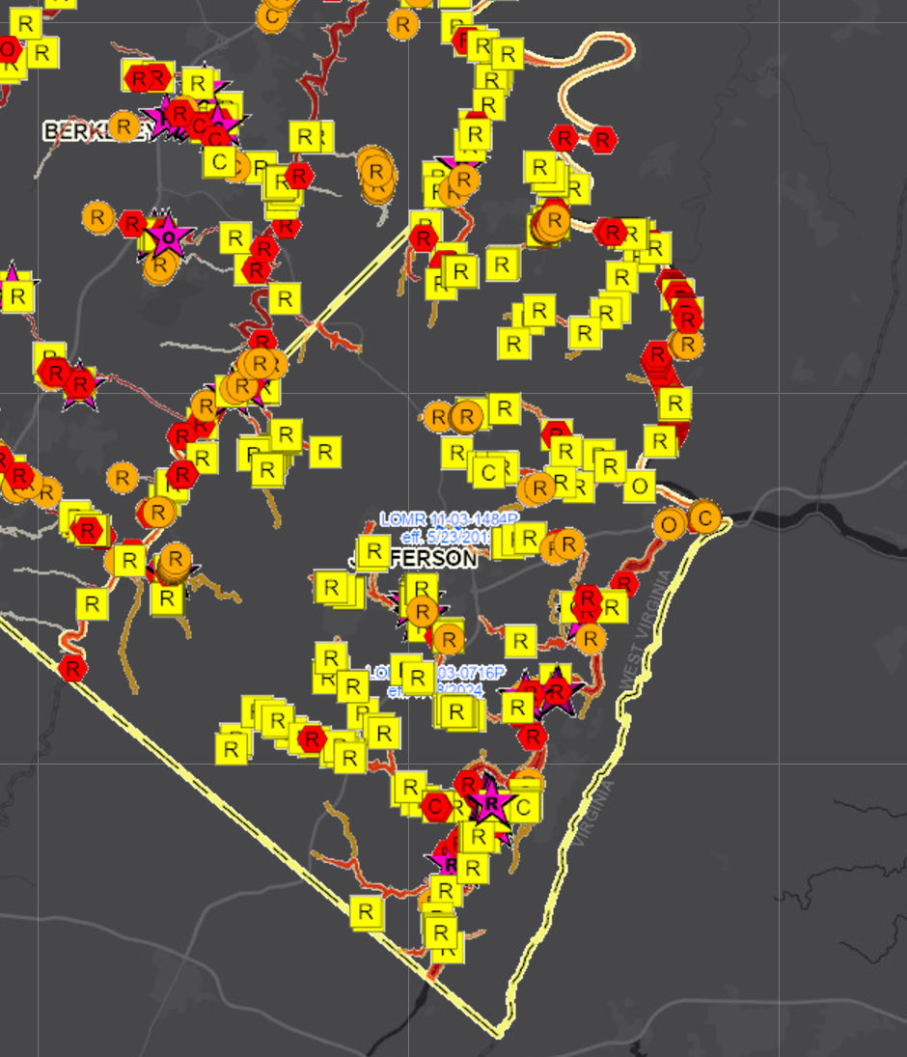
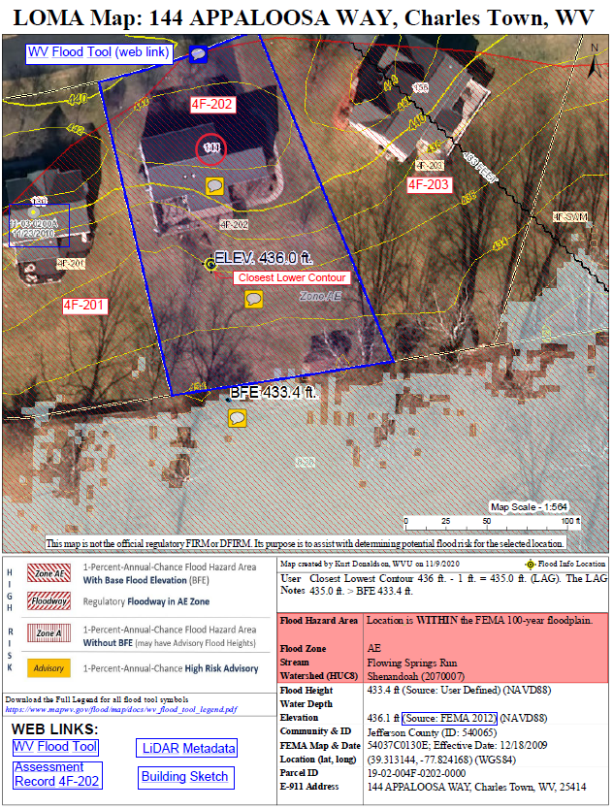
SFHA Buildings Changes: LOMAs for Mapped Out
Jefferson County
Mapped-out structures of the SFHA may qualify for LOMAs
Floodway
276
Mapped Out SFHA
WV Flood Tool LiDAR LOMA: Instructions | Guide
All building symbols in the floodplain fringe will become “red color” once flood maps are effective
Notes:
Property owners with structures that are mapped out of the SFHA (yellow square symbols on WV Flood Tool’s RiskMAP View) may be eligible for LiDAR Letter of Map Amendment (LOMA) if they want to expedite their removal from the SFHA until the preliminary FIRMS become effective. See the information links for more guidance. It is estimated that 276 structures are mapped out of the SFHA for the entire county. If applicable, LiDAR data can replace the requirement to submit certified elevation information which can create a cost savings for property owners.

Slide 11
River/Stream Building Risk Assessment
MEDIAN BUILDING VALUE: Town Run and Shenandoah River rank first and fourth, respectively, of 156 major rivers/streams in the state with the highest median value of structures in high-risk flood areas.
# | STATE CATEGORY RANK | River/Stream Floodplain | Building Characteristics | CATEGORY SCORE
 |  |  | Building Median Value
1 | 1 | Town Run | $247,700 | 100.0%
2 | 4 | Shenandoah River | $95,100 | 98.0%
3 | 24 | Potomac River | $57,300 | 85.1%
FLOOD DEPTH MEDIAN: Floodplain structures along the Shenandoah River have high flood depths compared to 156 other major rivers/streams in the state.
# | STATE CATEGORY RANK | River/Stream Floodplain | Floodplain Characteristics |  | CATEGORY SCORE
 |  |  | Floodplain Length | Flood Depth Median
1 | 12 | Shenandoah River | 30.2 Miles | 7.4 Ft | 92.9%
2 | 2 | Potomac River | 143.8 Miles | 4.5 Ft | 99.3%
3 | 147 | Town Run | 2.1 Miles | 0.2 Ft | 5.8%
WV Risk Explorer: Stream Risk Comparison Report
Notes:
Risk assessment results of 156 major rivers/streams in the state reveal that Town Run and Shenandoah River have high building values and thus more dollar exposure to flood damage. Both the Shenandoah and Potomac Rivers have high flood depth medians values (> 4.5 feet) for a 1%-annual-chance (100-yr) flood which translates to a potential for higher damage losses.

Slide 12
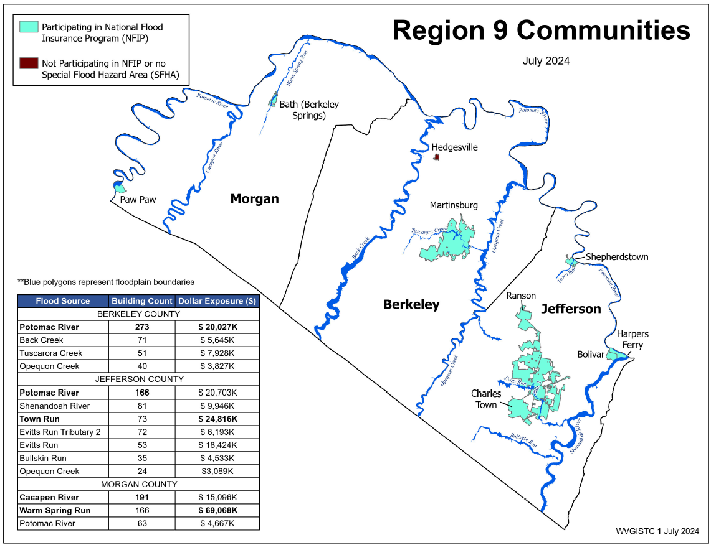
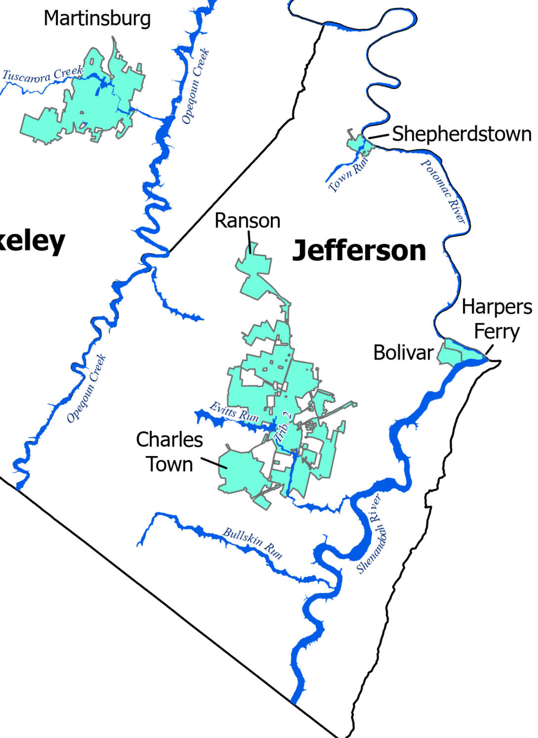
River/Stream Building Risk Assessment
Shepherdstown
Top rivers with high building counts in SFHA are Potomac River (166), Shenandoah River (81) and Town Run (73). Town Run has highest building dollar exposure.
Region 9 Rivers/Streams
Notes:
A river/stream building risk assessment for Region 9 and Jefferson County reveals that Potomac River has the most structures mapped in the SFHA while Town Run has the largest cumulative building value.

Slide 13
Jefferson County Risk Assessment
Statewide Rank
among the Top 5
#
JEFFERSON COUNTY ranks “very high” or in the top 20% of all 55 counties in the state for the five risk indicators below. View Top 20% Risk Indicators Report for county. Click on Risk Factor links for rationales/recommendations.
Category | Flood Risk Indicator | Value for Jefferson | Indicator Score (0 - 100%) | Indicator Rating
Building Characteristics | Building Median Value | $97,450 (Median $42,200) | 100.0% | VERY HIGH
 | Bldg. Subgrade Basements Ratio | 49.5% | 94.4% | VERY HIGH
 | Bldg. Year Minus Rated Post-FIRM Ratio | 9.4% | 81.4% | Very High
Community Assets | Community Assets Historical | 120 | 94.4% | VERY HIGH
Building Damage Loss | Bldg. Substantial Damage Ratio | 24.0% | 90.7% | VERY HIGH
1
4
4
JEFFERSON COUNTY UNINCORPORATED* ranks “very high” or in the top 20% of all 55 unincorporated areas in the state for the six risk indicators below. View Top 20% Risk Indicators Report for incorporated area.
Category | Flood Risk Indicator | Value for Jefferson County* - Unincorporated | Indicator Score (0 - 100%) | Indicator Rating
Floodplain Characteristics | Flood Depth Median | 4.7 Ft | 94.4% | VERY HIGH
Building Characteristics | Building Median Value | $93,150 (Median $37,350) | 100.0% | VERY HIGH
 | Bldg. Subgrade Basements Ratio | 48.9% | 98.1% | VERY HIGH
 | Bldg. Year Minus Rated Post-FIRM Ratio | 14.5% | 90.7% | VERY HIGH
Community Assets | Community Assets Historical | 26 | 100.0% | VERY HIGH
Building Damage Loss | Bldg. Substantial Damage Ratio | 29.7% | 90.7% | VERY HIGH
4
1
2
1
Notes:
A Top 20% Risk Indicators Report reveals that Jefferson County and unincorporated areas have high building values and historical community assets that are exposed to a major flood like a 1%-annual chance (100-yr) flood. View the WV Risk Explorer report for more information about these risk factors specific to Jefferson County including rationales/recommendations.

Slide 14
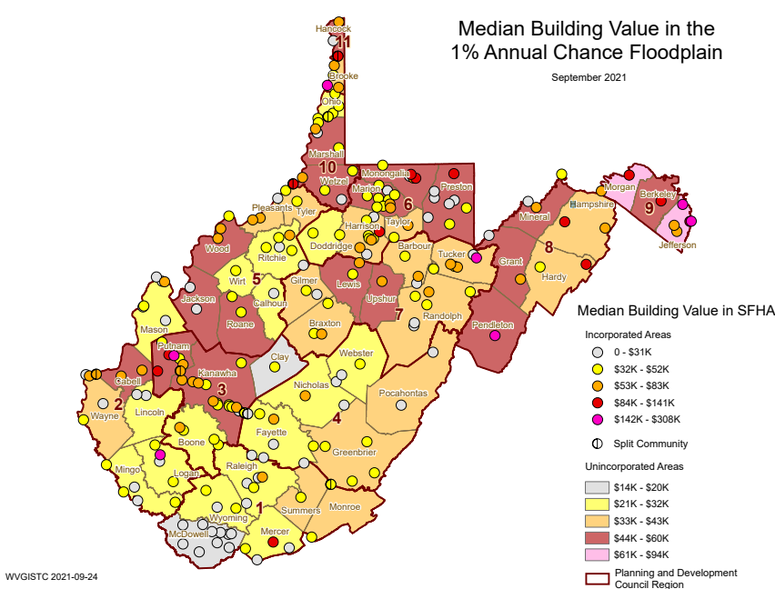
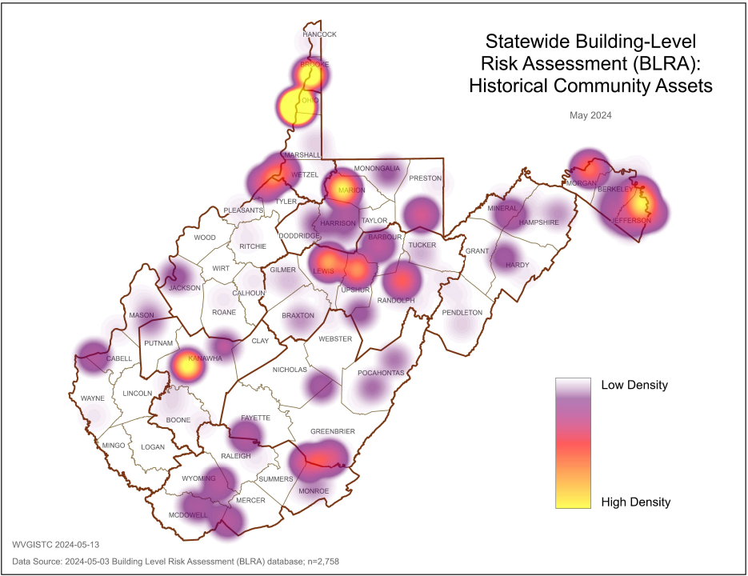
Jefferson County Building Risk Assessment
High Building Values
High Historical Buildings
Jefferson County has very high Building Values, or more than double the statewide median value.
Jefferson County has a high number of Historical Community Assets on the National Register.
Source: Statewide Building-Level Risk Assessment
Notes:
Jefferson County has very high building values and historical community assets of all 55 counties in the state. Graphics of these risk indicators affecting Jefferson County can be discovered from the WV Hazard Library.

Slide 15
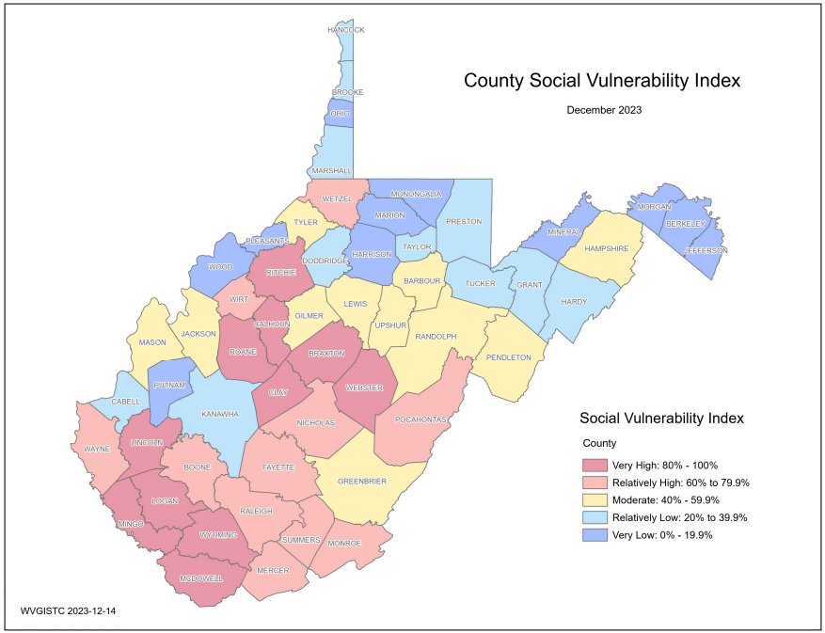
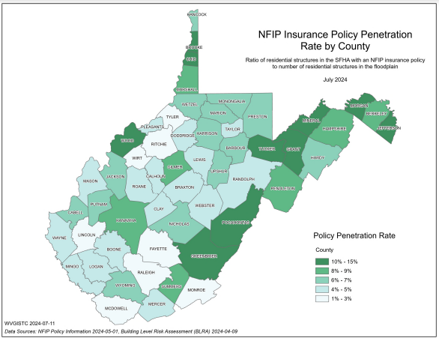
Jefferson County Resiliency
(1) Jefferson County has no Essential Facilities in the high or moderate risk floodplains
(2) Jefferson County has the lowest Social Vulnerability Index in the State
(3) Jefferson County has higher NFIP Insurance Penetration Rate than other counties
Notes:
Jefferson County is more resilient to flooding than most other counties in the state because the county has:
• No Essential Facilities in high (100-yr) or moderate (500-yr) risk floodplains.
• The lowest Social Vulnerability Index in the state.
• Higher NFIP Insurance Penetration Rate coverage than other counties.

Slide 16
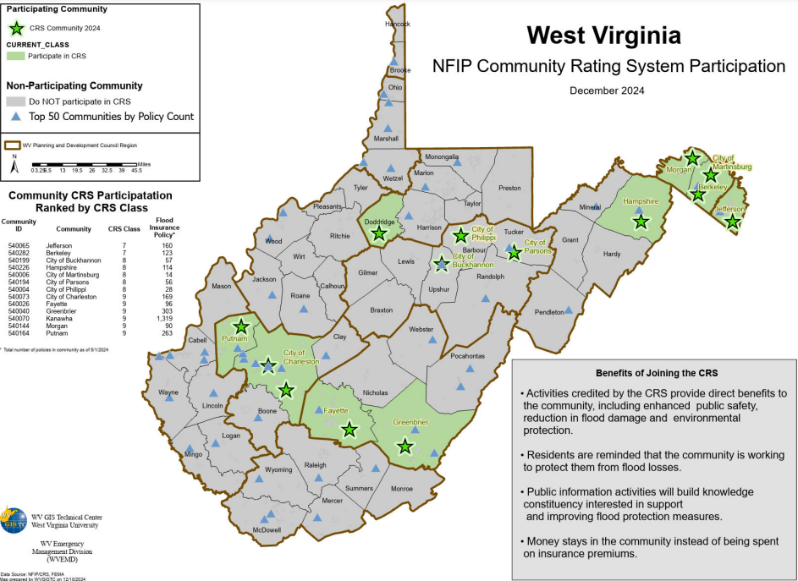
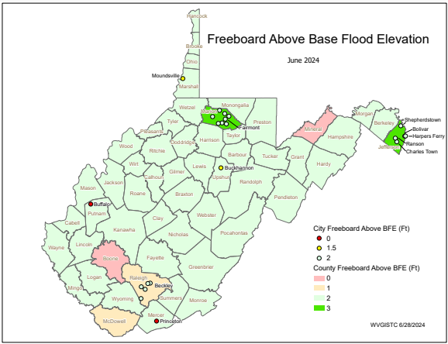
Jefferson County Unincorporated* Resiliency
Jefferson County Unincorporated has a high CRS Rating of Class 7
Jefferson County Unincorporated has a high Freeboard safety factor of 3 feet
Notes:
Jefferson County Unincorporated implements higher standards for floodplain management than all other 284 incorporated and unincorporated communities in the state

Slide 17
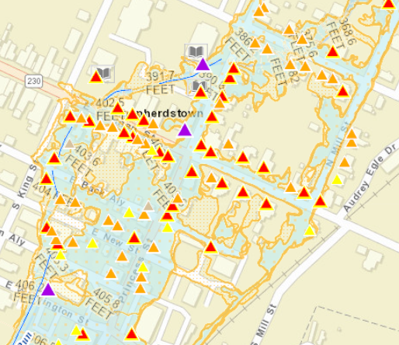
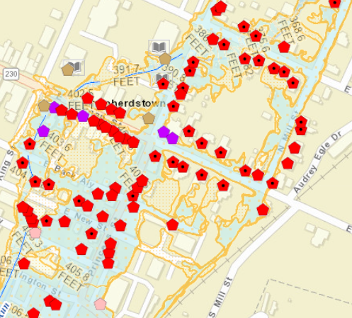
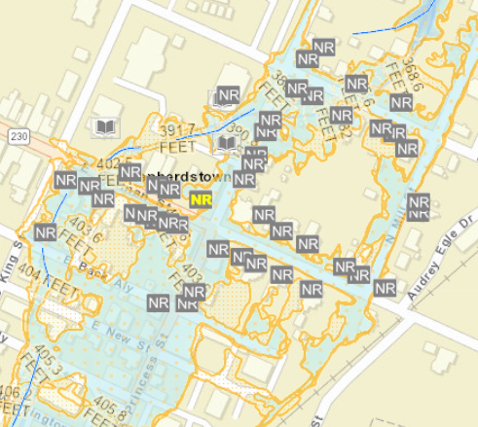
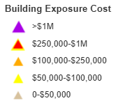
Shepherdstown Risk Assessment
Building Value and Density.
Median Building Value ranks first of 229 incorporated places in the state. High density of buildings in small area.
Pre-FIRM and Basements.
Nearly 90% of structures are Pre-FIRM and nearly half have basements.
Historical Buildings.
Most building are in the National Historic District.
Refer to online All Risk Indicators Report
Sources: WV Flood Tool’s Risk Map View & Statewide Building-Level Risk Assessment
Notes:
Shepherdstown has a high density of 76 buildings in the high-risk floodplain, nearly all of which are pre-FIRM and within the Shepherdstown Historic District. Shepherdstown ranks very high for the following building risk factors:
High Building Dollar Value and Density of Structures. A higher total building value in floodplains can lead to increased insurance costs. A higher ratio of buildings in the floodplain to total floodplain are signifies a greater physical and human exposure to flooding.
High number of Pre-FIRM Structures with Basements. Pre-FIRM structures are more vulnerable to flooding because they were constructed when a Flood Insurance Rate Map (FIRM) was not in effect and thus were not built according to the regulations and building codes for floodplain development. Subgrade basements can flood quickly, especially in the event of flash floods, leading to structural damage, property loss, and increased recovery costs. Additionally, electrical equipment in basements can increase the risk of electrocution while flooding.
Higher number of Historical Buildings. Historical assets often have significant cultural value, so it is crucial to know how many historical assets are in floodprone areas to aid in allocating resources for flood resilience and emergency response. A designated historic structure can obtain the benefit of subsidized flood insurance through the NFIP even if it has been substantially improved or substantially damaged so long as the building maintains its historic designation. Refer to FEMA’s Floodplain Management bulletin of Historic Structures for more information. https://data.wvgis.wvu.edu/pub/RA/_resources/Historic/FEMA_bulletin_historic_structures_2008.pdf

Slide 18
Shepherdstown 3D Flood Movie
Click here to view 3D Flood Movie of Shepherdstown
Notes:
View the narrated 3D flood visualization movie as an effective way of communicating flood risk and high building values for a major 1%-annual-chance (100-yr) flood event. Shepherdstown, the oldest town in West Virginia, faces flooding from two primary sources: Town Run and the backwater of the Potomac River. The Potomac River borders the eastern edge of the community, while Town Run flows through the town, winding under the historic district. The 1936 flood on Town Run caused maximum flood heights ranging from 1.5 to 2.0 feet in some areas of the town.

Slide 19
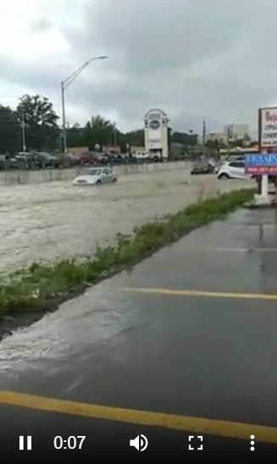
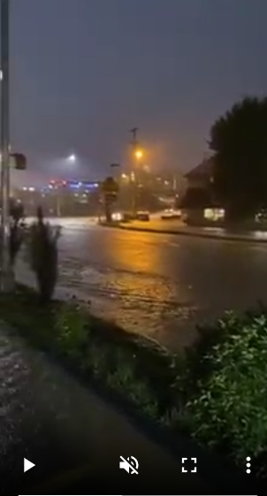
Example Urban Flooding
View Videos of 2021 Morgantown Flooding along Popenoe Run on Patteson Drive near WVU stadium that may occur similarly on Town Run in Shepherdstown
Courtesy of WV Hazard Library
Notes:
The 2021 Morgantown urban flooding along Popenoe Run on Patterson Driver may occur similarly on Town Run in Shepherdstown. According to FEMA’s FIS report, flooding from Town Run typically results in shallow overland flow depths of less than 3 feet. However, when the channel capacity is exceeded, floodwaters follow through streets and low-lying areas, and impact regions not directly adjacent to the stream channel. Like the 2021 urban flooding in Morgantown, primary roads in Shepherdstown will be flooded during a major storm event. Understanding the town's vulnerabilities, such as the impact of floods on primary roads and high-value structures, is essential for effective flood preparedness and resilience efforts.

Slide 20
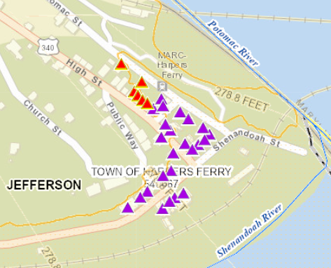
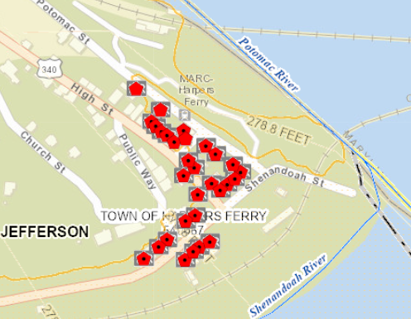
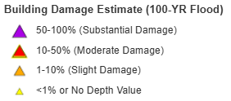
Harpers Ferry Risk Assessment
Building Substantial Damage Ratio highest of all 229 incorporated places in the state
Pre-FIRM Building Ratio highest of all 229 incorporated places in the state
Refer to online All Risk Indicators Report
Sources: WV Flood Tool’s Risk Map View & Statewide Building-Level Risk Assessment
Notes:
The historical buildings located in Harpers Ferry are subject to high flood depths (second floor flooding) and damage from a major flood storm. Fortunately, the historical masonry buildings are more durable and resistant to water damage than other construction materials.

Slide 21
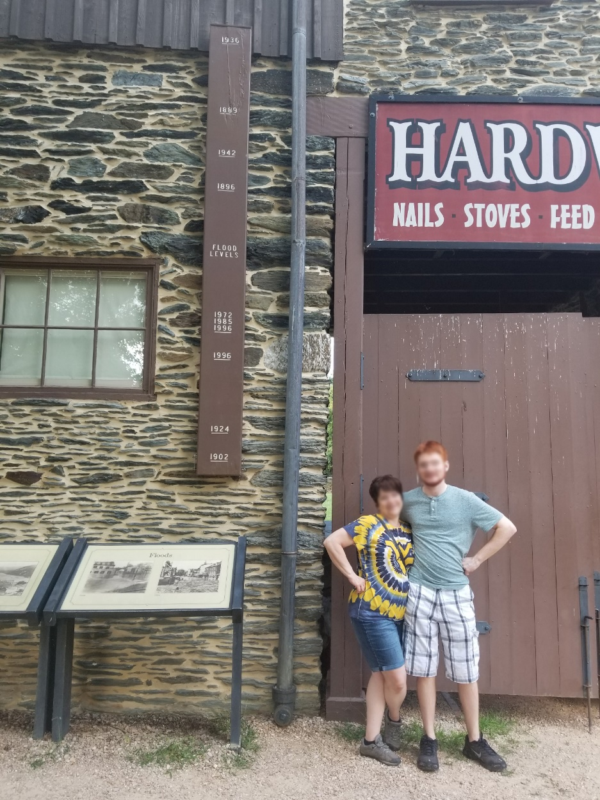
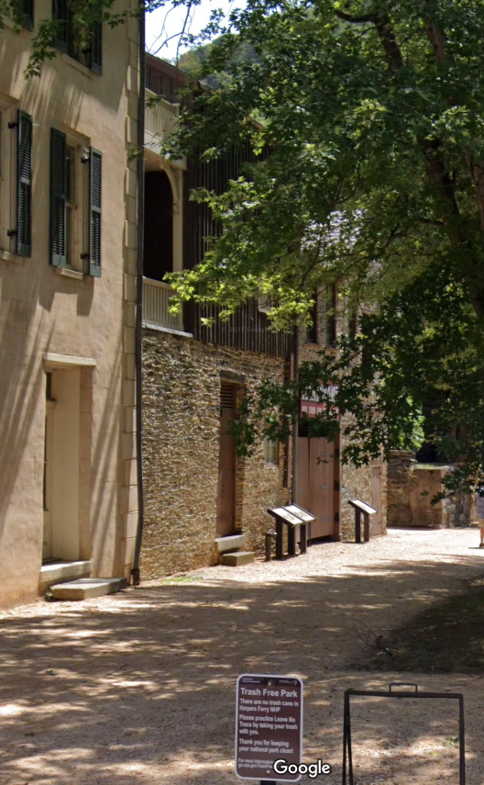
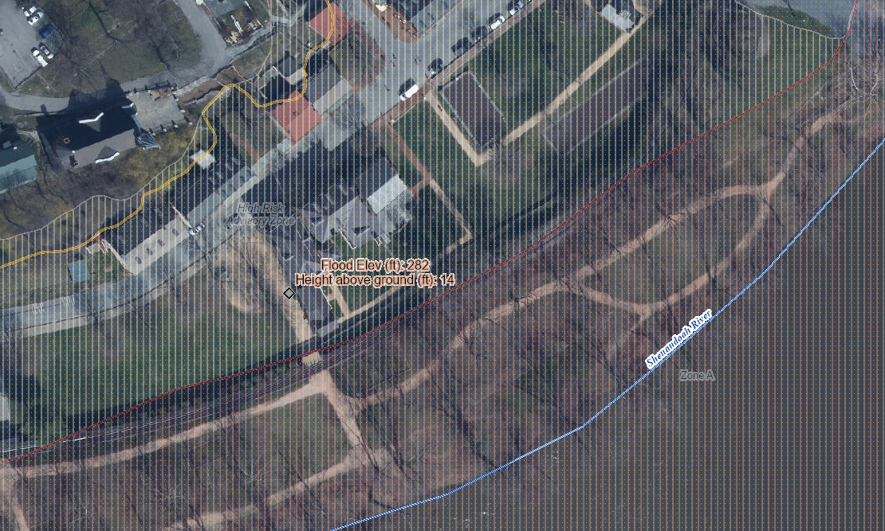
Harpers Ferry Risk Assessment
744 Shenandoah St, Harpers Ferry, WV, 25425
Building ID: 19-05-0004-0025-0000_801A
Historical structure built in 1845
14’ (1936 High Water Mark)
1936 Flood of Record
8’ (1996 High Water Mark)
Knapp Creek
Greenbrier River
High Water Mark
Notes:
Although the damage loss estimates for the structures in Harpers Ferry will decrease with the new flood models at the confluence of the Shenandoah and Potomac Rivers, Harpers Ferry is the lowest point in the state and repeatedly floods. The worst known flood was on March 19, 1936, when the Potomac crested at a record 36.5 feet, more than 18 feet above flood stage.

Slide 22
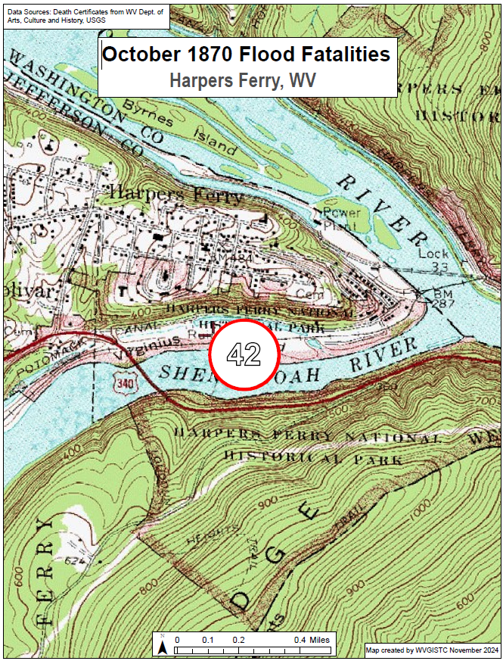
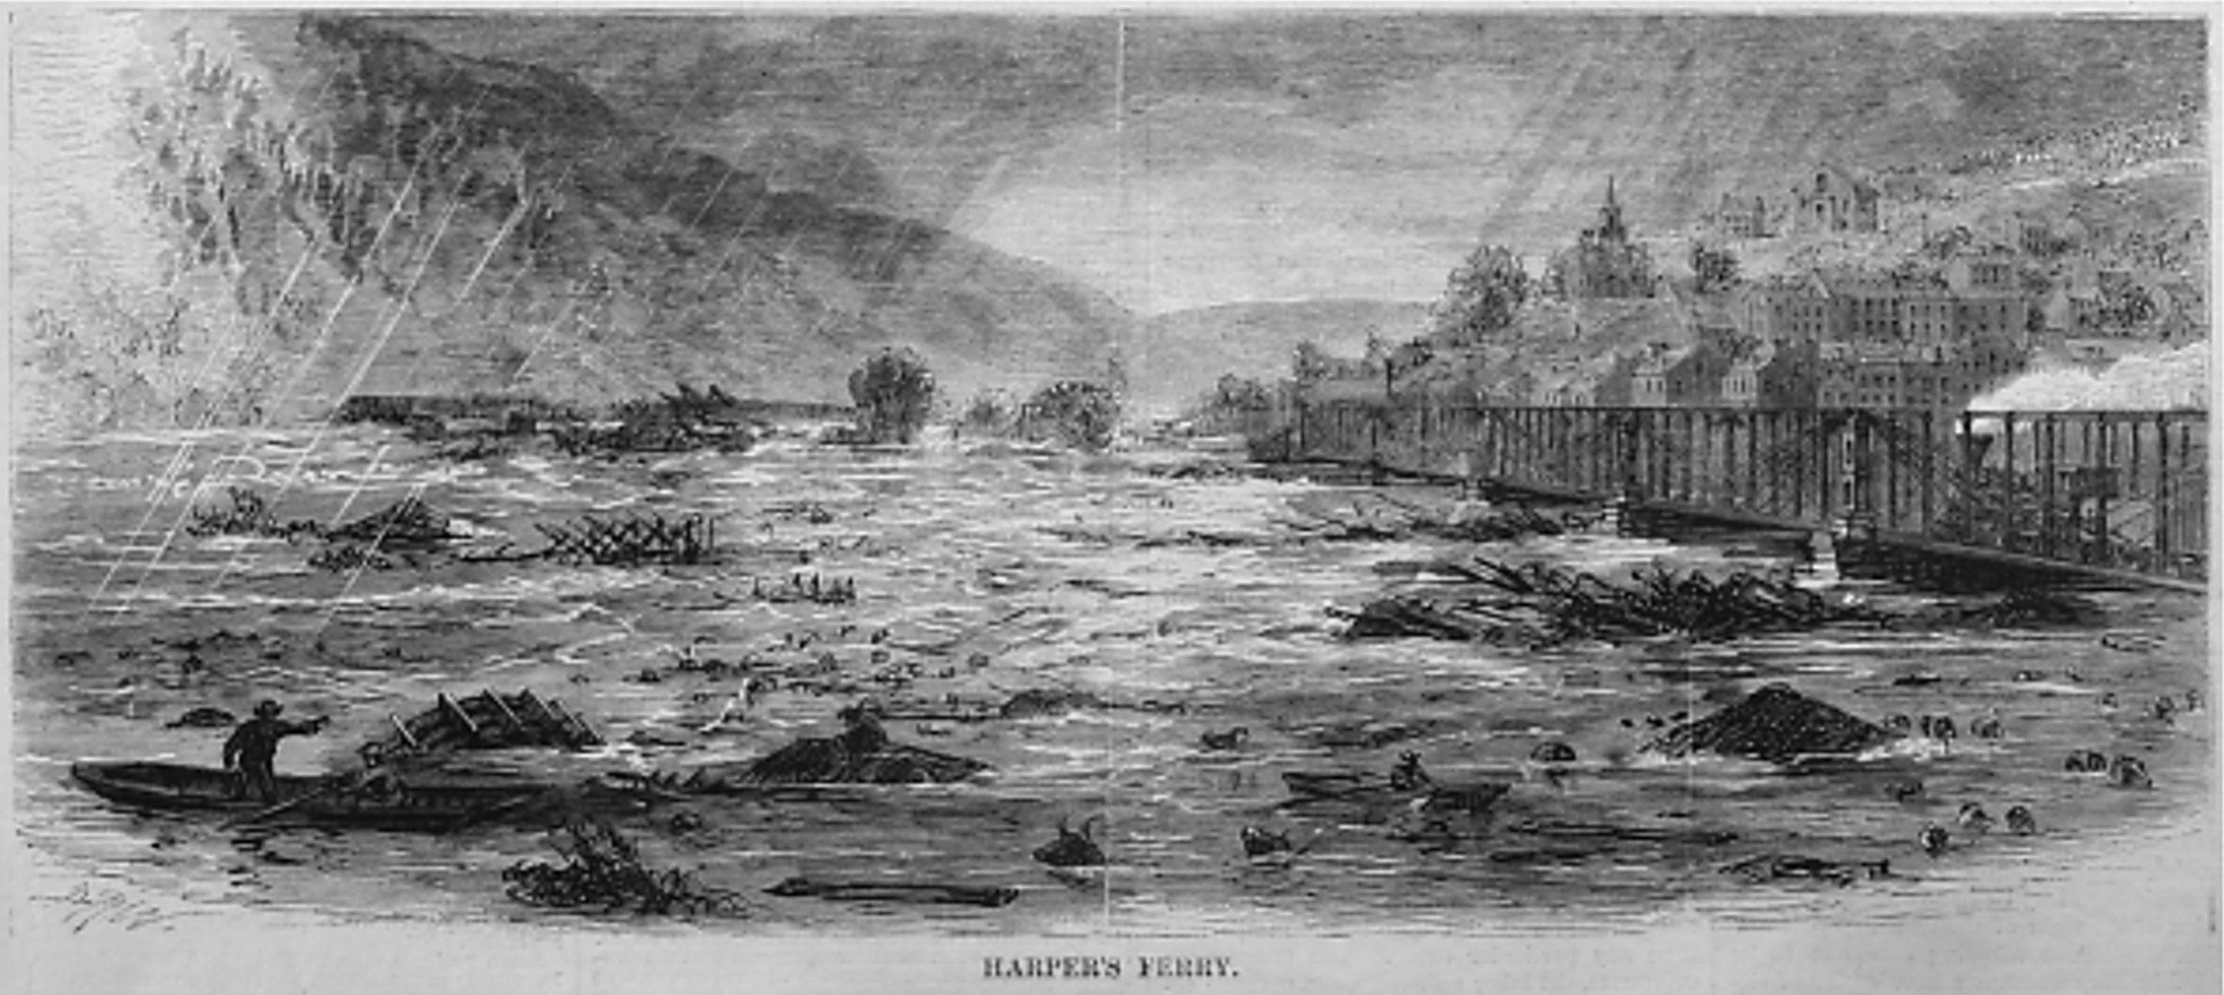
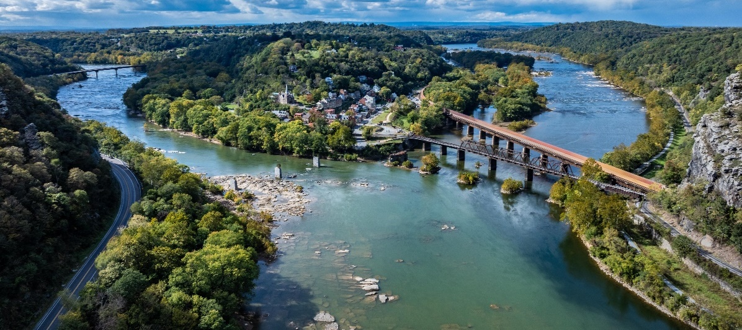
Historical Flood Research (Harpers Ferry, WV)
Engraving of the flood in Harpers Ferry, from Harper’s Weekly, October 20, 1870
(Image courtesy of Yesterday’s America)
October 1870 Flood
(42 fatalities)
Link to WV Flood Fatality Dashboard
Notes:
Since recorded history, severe floods have ravaged Harpers Ferry The flood of 1870 resulted in the Shenandoah River rising so rapidly that residents were trapped on Virginius Island. Floodwaters swept away much of the island's homes and industry and claimed 42 lives at Harpers Ferry.

Slide 23
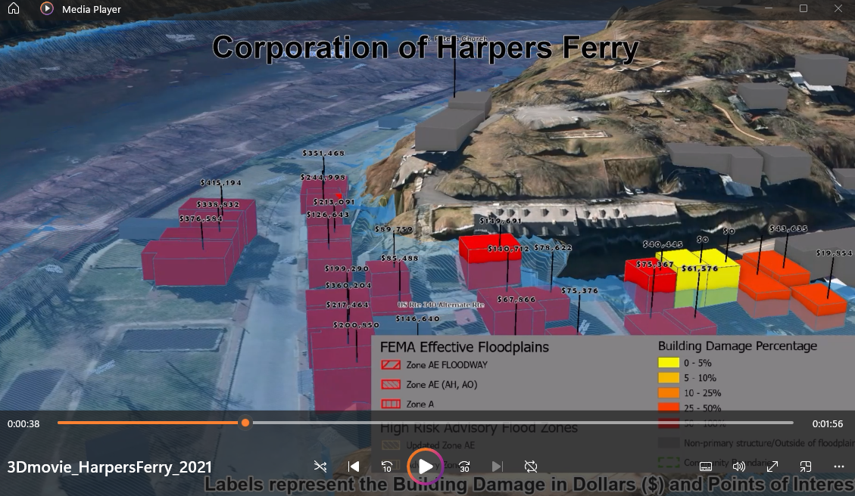
Harpers Ferry 3D Flood Movie
Click here to view 3D Flood Movie of Harpers Ferry
Notes:
View the narrated 3D flood visualization movie as an effective way of communicating flood risk and high building values for a major 1%-annual-chance (100-yr) flood event occurring at Harpers Ferry. The movies shows damage loss estimates for a 100-year flood event based on FEMA’s 2009 flood model.

Slide 24
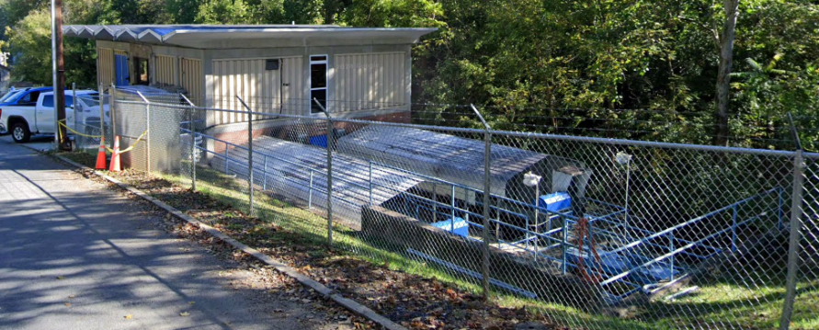
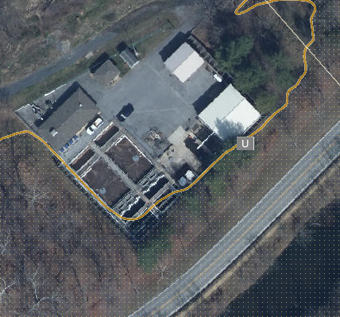
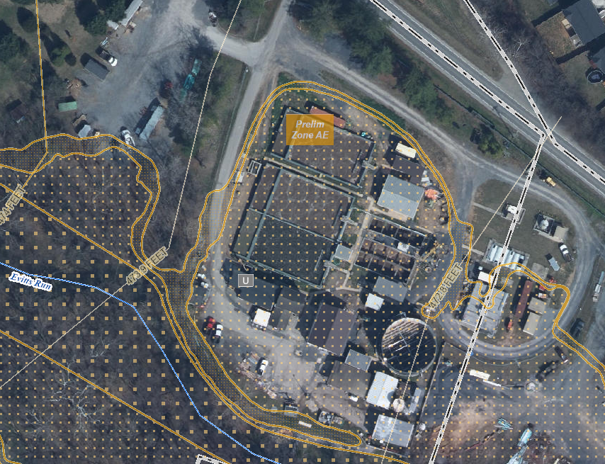
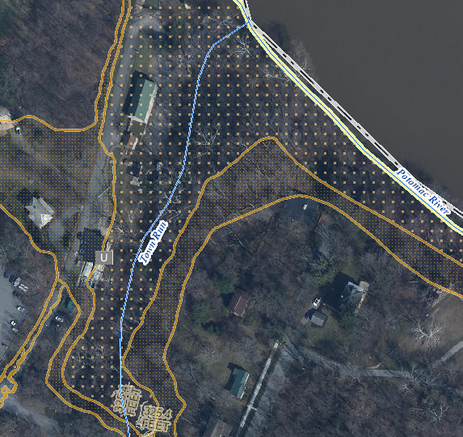
Utilities in Floodplain (High $ Exposure)
Backwater
Harpers Ferry Bolivar PSD Wastewater
Treatment Plant (FD: 1 ft)
(Building ID: 19-05-0004-0025-0000_192) ($462K)
Value source inflation adjusted to 2021
Online Mitigation Resources:
EPA FLOOD RESILIENCE: Guide for Water/Wastewater Utilities
Tips for Flood-Proofing Wastewater Treatment Plants
Flood-Resistant Wastewater Treatment Plant Upgrades
City of Charles Town Wastewater Treatment Plant (FD: 1 ft)
Highest CA Value ($6.8M) in Jefferson County
(Building ID: 19-03-0008-0001-0000_842)
Value source inflation adjusted to 2021
Shepherdstown Water Works Water Treatment Plant (FD: 3 ft)
(Building ID: 19-10-0001-0052-0000_309) ($3.1M)
Value source inflation adjusted to 2021
Notes:
Water and wastewater treatment utilities are high-value assets that provide vital services to nearby communities. These utilities are typically close to flood sources and thus communities should floodproof these structures to minimize damage from future floods. Examples of mitigation measures for utilities include:
Emergency response plan
Barriers around key assets
Elevated electrical equipment
Emergency generators
Bolted down chemical tanks

Slide 25
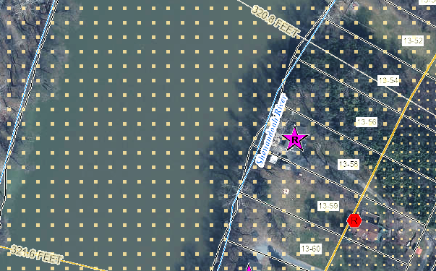
Building Flood Profile - Unmitigated
Single Family Dwelling in Jefferson County*
Appraised Value: $217K
(Building ID: 19-04-0013-0059-0000_89)
Rivermist Lane, Harpers Ferry
Repetitive Loss Area / Area of Mitigation Interest
 | HEIGHT (ft.)
BUILDING
Freeboard (FBD) | 3
FLOOD DEPTH
FEMA 1% (100-Yr) | 13.6
FEMA 100-Yr + FBD | 16.6
FEMA 0.2% (500-Yr) | 19.6
Flood Source: Shenandoah River
Post-FIRM
19.6’ (FEMA 0.2% / 500-Yr)
16.6’ (FEMA 1% + / 100-Yr +)
13.6’ (FEMA 1% / 100-Yr)
Ground Level

Slide 26
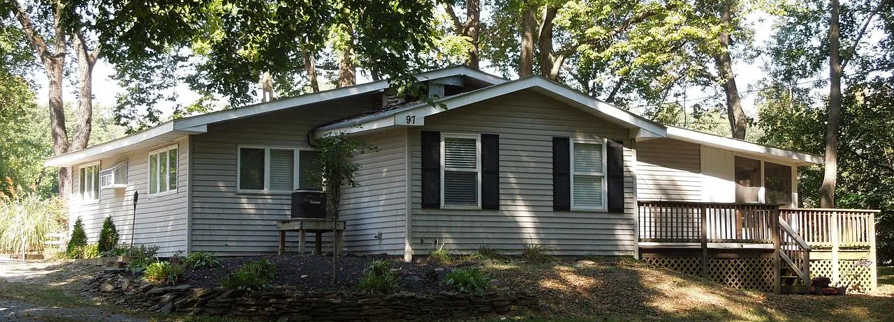
Building Flood Profile - Unmitigated
Single Family Dwelling in Jefferson County*
in Floodway
Appraised Value: $95K
(Building ID: 19-04-0013-0058-0000_97)
Rivermist Lane, Harpers Ferry
Repetitive Loss Area / Area of Mitigation Interest
Flood Source: Shenandoah River
 | HEIGHT (ft.)
BUILDING
Freeboard (FBD) | 3
FLOOD DEPTH
FEMA 1% (100-Yr) | 13.7
FEMA 100-Yr + FBD | 16.7
FEMA 0.2% (500-Yr) | 19.7
Pre-FIRM
19.7’ (FEMA 0.2% / 500-Yr)
16.7’ (FEMA 1% + / 100-Yr +)
13.7’ (FEMA 1% / 100-Yr)
Ground Level

Slide 27
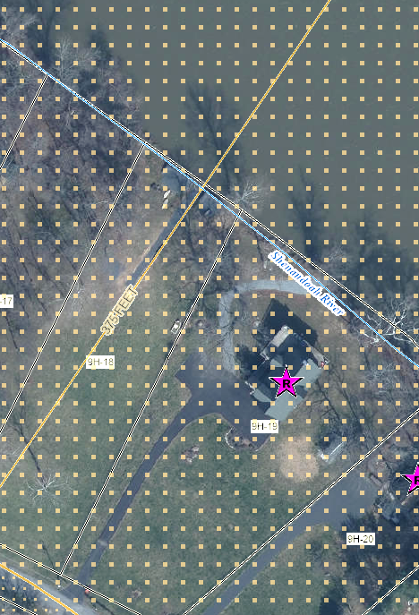
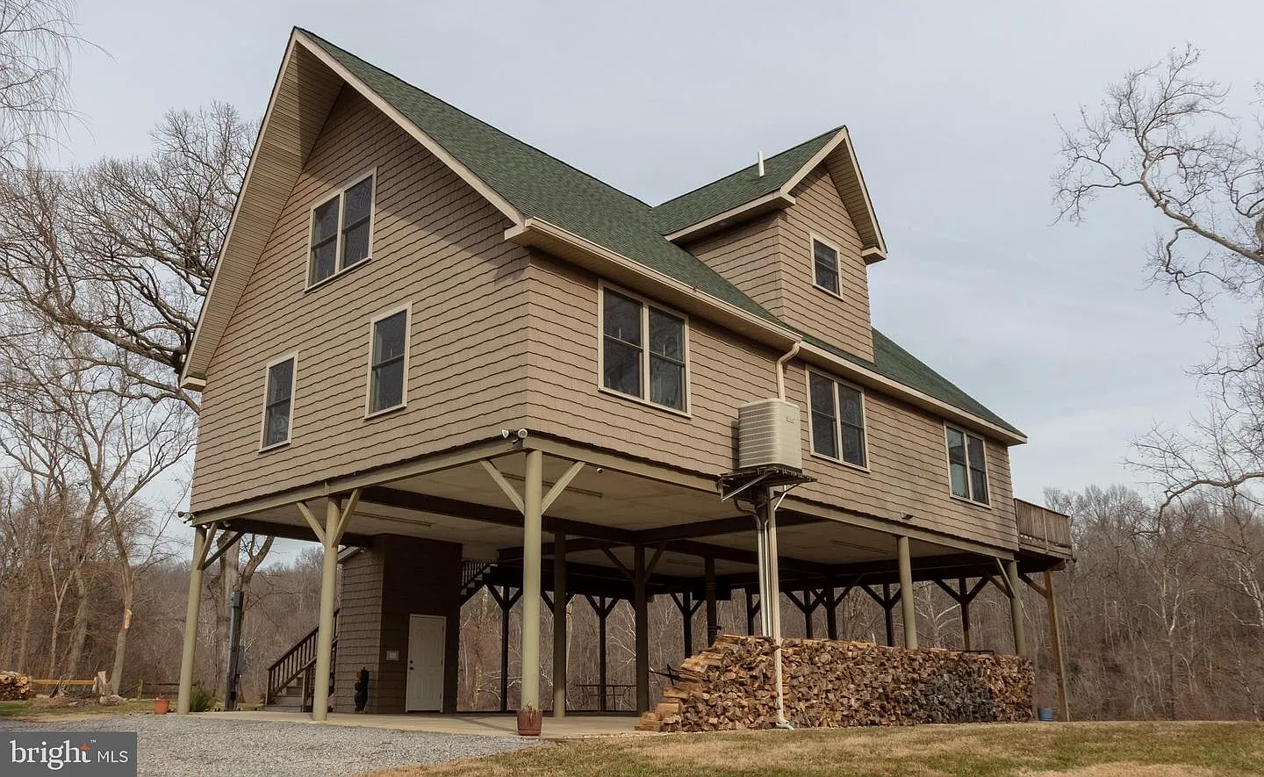
Building Flood Profile – Mitigated to DFE
Flood Profile
 | HEIGHT (ft.)
BUILDING
Freeboard (FBD) | 3
FLOOD DEPTH
FEMA 1% (100-Yr) | 9.9
FEMA 100-Yr + FBD | 12.9
FEMA 0.2% (500-Yr) | 18.9
Flood Source: Shenandoah River
Post-FIRM
18.9’ (FEMA 0.2% / 500-Yr)
14.9’ (FEMA 1% + / 100-Yr +)
Single Family Dwelling in Jefferson County*
Elevated in Floodway
Appraised Value: $265K
(Building ID: 19-06-009H-0019-0000_781)
9.9’ (FEMA 1% / 100-Yr)
Ground Level

Slide 28
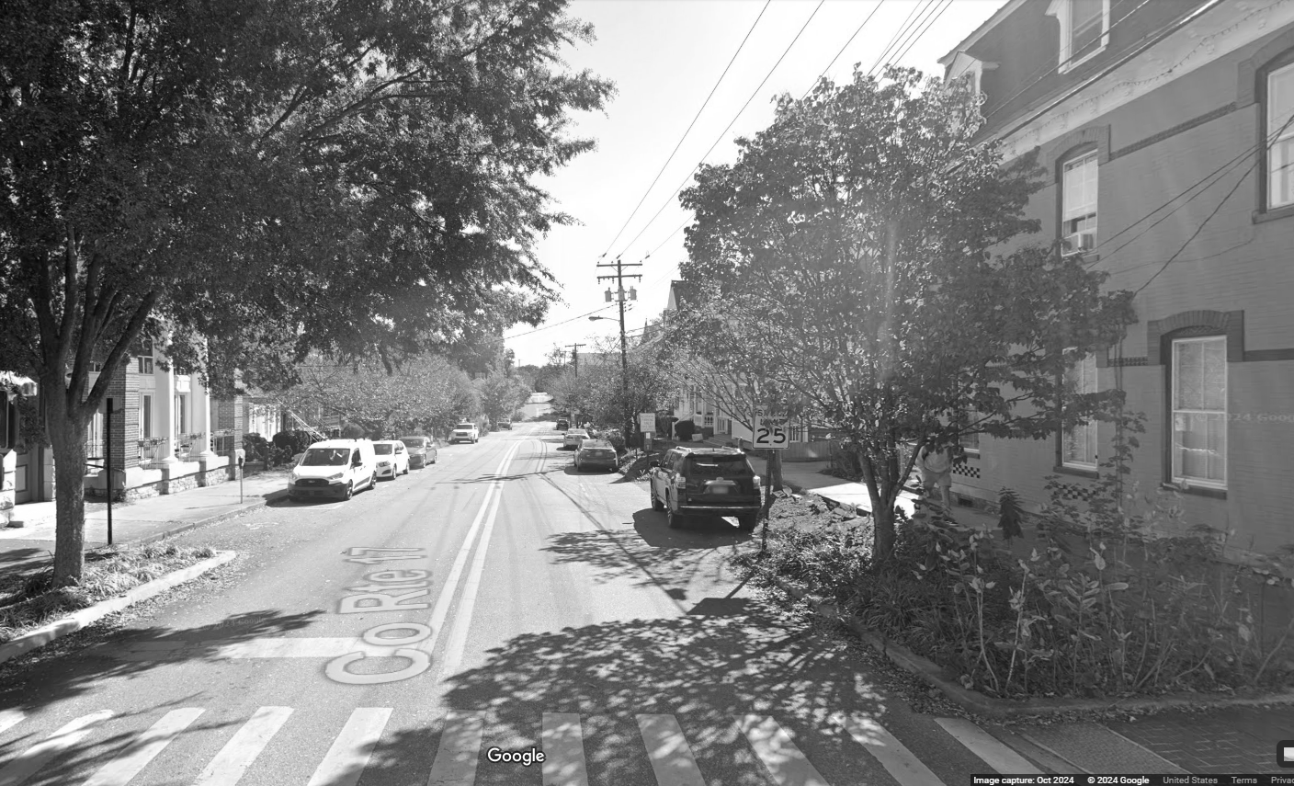
Contact Persons:
Kurt Donaldson
kurt.donaldson@mail.wvu.edu
Behrang Bidadian
behrang.bidadian@mail.wvu.edu
Annie Mahmoudi
anm0050@mail.wvu.edu
West Virginia GIS
Technical Center

