Slide 1
Jefferson County 2024
Overall Flood Risk
(1) FLOODPLAIN CHARACTERISTICS
(2) BUILDING EXPOSURE
(3) BUILDING CHARACTERISTICS
(4) CRITICAL INFRASTRUCTURE
(5) COMMUNITY ASSETS
(6) BUILDING DAMAGE LOSS
(7) PEOPLE / SOCIAL VULNERABILITIES
(8) OTHER HAZARDS
Floodplain Area
Building Floodplain Count¹ ²
Building Value¹ ²
Essential Facilities
Historical Assets
Substantial Damage Estimates*¹ ²
Population in Floodplain
Dam/Levee Failure
Floodplain Length¹ ²
Building Floodway Count¹ ²
Mobile Homes
Roads Inundated
Non-Historical Assets
Previous Claims
Population Displaced
Landslides
Floodplain Depth¹ ²
Building Floodplain Ratio²
Basement
Repetitive Losses
WV Social Vulnerability Index
Karst
Flood Disaster Frequency
Building Density¹ ²
One Story
Building Year*
Cumulative Flood Risk Index
1
2
WV Risk Explorer: https://wvfrf.org/wvre/
* Multiple Indicators
River/Stream Indicator
Watershed Indicator

Slide 2
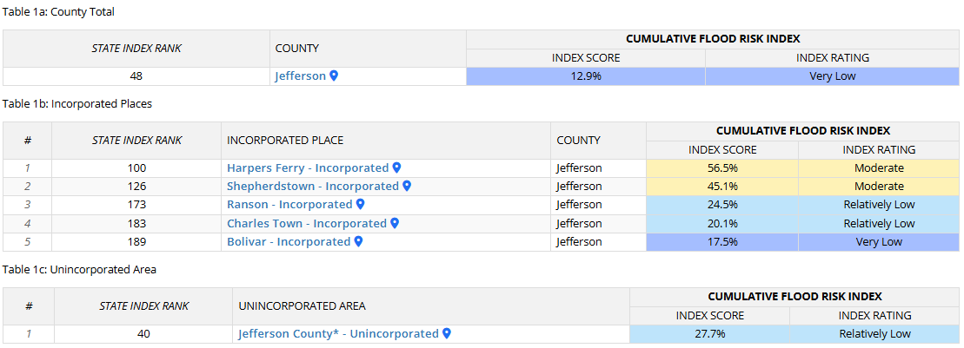
Flood Risk Assessment
Jefferson County
Link to Flood Risk Comparison Report on WVRE:
https://wvfrf.org/wvre/report/?scaleid=3&entityid=19&type=hierarchy
Cumulative Flood Risk Index:

Slide 3
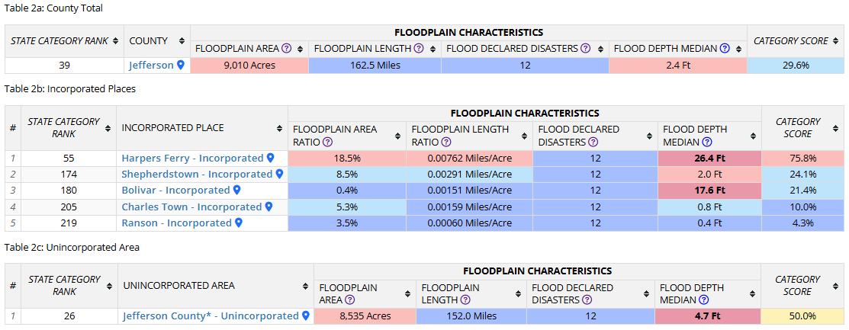
Flood Risk Assessment
Jefferson County
(1) Floodplain Characteristics:
Statewide Rank
among the Top 5
#
Rankings done separately for counties, unincorporated areas, and 229 incorporated places
1
2
State Median: 1.8 Ft
4
State Median: 2.0 Ft
Notes:
Floodplain Area: Modified Floodplain Area (mSFHA) = Total Special Flood Hazard Area (aSFHA) – [Open water lakes > 10 acres] – [Large rivers bank-to-bank > 500 ft] – [Federal lands > 10 acres]
Floodplain Length: Total length of the Effective and Advisory Special Flood Hazard floodplains in miles
Floodplain Length Breakdown:
Jefferson County → Detailed: 34.1%, Approximate: 52.3%, Advisory: 13.6%
Harpers Ferry → Detailed: 0%, Approximate: 68.5%, Advisory: 31.5%
Shepherdstown → Detailed: 50.7%, Approximate: 8.0%, Advisory: 41.3%
Bolivar → Detailed: 0%, Approximate: 100%, Advisory: 0%
Charles Town → Detailed: 54.9%, Approximate: 43.7%, Advisory: 1.3%
Ranson → Detailed: 93.6%, Approximate: 5.8%, Advisory: 0.6%
Jefferson Unincorporated Area → Detailed: 34.2%, Approximate: 54.6%, Advisory: 11.2%
Floodplain Area Ratio: Ratio of the Modified Special Flood Hazard Area (mSFHA) to total incorporated place area
Floodplain Length Ratio: Ratio of Special Flood Hazard length (Effective and Advisory) to total incorporated place area
Flood Declared Disasters: Number of federally-declared flood disasters in the county since 1953
Flood Depth Median: Median value of flood depths of all primary structures inventoried in the High-Risk* flood zones from FEMA's models
* High-Risk 100-year floodplain may include both Effective or Advisory Floodplains

Slide 4
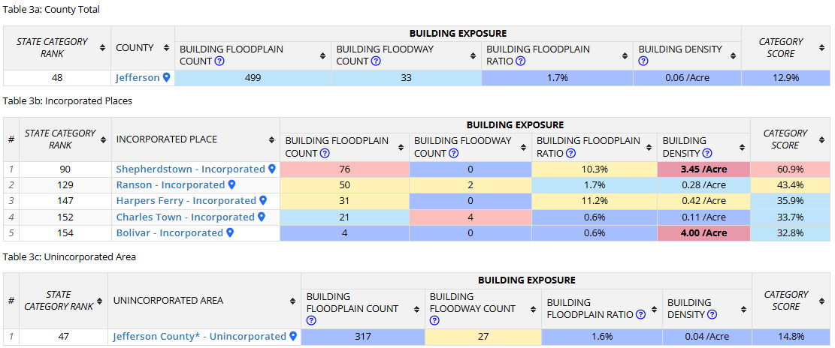
Flood Risk Assessment
Jefferson County
(2) Building Exposure:
Statewide Rank
among the Top 5
#
Rankings done separately for counties, unincorporated areas, and 229 incorporated places
3
2
State Median: 0.75 /Acre
Notes:
Building Floodplain Count: Building count in Special Flood Hazard Area including Effective, New Preliminary, and Draft floodplains (excluding mapped-out structures)
Buildings in Floodplain Breakdown:
Jefferson County → in Effective: 376, in Advisory: 123
Shepherdstown → in Effective: 47, in Advisory: 29
Ranson → in Effective: 49, in Advisory: 1
Harpers Ferry → in Effective: 1, in Advisory: 30
Charles Town → in Effective: 17, in Advisory: 4
Bolivar → in Effective: 0, in Advisory: 4
Jefferson Unincorporated Area → in Effective: 262, in Advisory: 55
Building Floodway Count: Building count in Regulatory Floodway
Building Floodplain Ratio: Percentage of floodplain buildings (in High-Risk* (100-yr) Effective or Advisory Floodplains) to total buildings
Building Density: Density of buildings in High-Risk* flood areas to total floodplain acres
* High-Risk 100-year floodplain may include both Effective or Advisory Floodplains

Slide 5
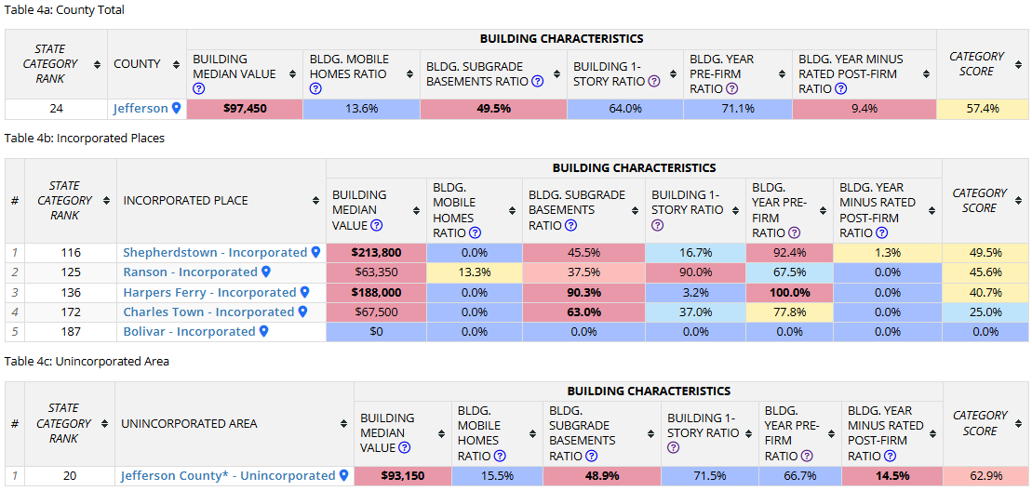
Flood Risk Assessment
Jefferson County
(3) Building Characteristics:
Statewide Rank
among the Top 5
#
Rankings done separately for counties, unincorporated areas, and 229 incorporated places
1
4
State Median: $42,200
State Median: 21.6%
1
2
1
1
State Median: $41,500
State Median: 25.5%
State Median: 86.6%
Notes:
1
2
State Median: $37,350
State Median: 19.5%
Building Median Value: Median of appraised values of all primary structures in the
High-Risk* 100-year floodplain from the most recent tax assessment data or other building value data sources for tax-exempt structures
Bldg. Mobile Homes Ratio: Percentage of manufactured buildings (occupancy class code RES2) among all single-family structures (RES1 & RES2) in the High-Risk* 100-year floodplain
Bldg. Subgrade Basements Ratio: Percentage of structures with subgrade basements among all primary structures in the High-Risk* 100-year floodplain (may also include walkout basement enclosures)
Building 1-Story Ratio: Percentage of one-story structures among all primary buildings in the High-Risk* 100-year floodplain
Bldg. Year Pre-FIRM Ratio: Percentage of buildings constructed or substantially improved on or before December 31, 1974, or before the effective date of the initial Flood Insurance Rate Map of the community, whichever is late (also including Post-FIRM construction regulated to Pre-FIRM and Unknown FIRM status) among all primary structures in the High-Risk* 100-year floodplain
Bldg. Year Minus Rated Post-FIRM Ratio: Percentage of structures constructed after the FIRM date of which their first floor is more than one foot below the Base Flood Elevation (BFE) among all primary structures in the High-Risk* 100-year floodplain

Slide 6
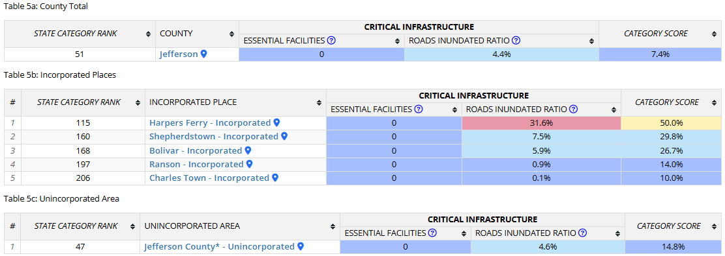
Flood Risk Assessment
Jefferson County
(4) Critical Infrastructure:
Notes:
Essential Facilities: Number of essential facilities (including schools, hospitals, nursing homes, police stations, fire department buildings, & E-911 emergency operations centers) which provide critical services to the community in the high (100-year), moderate (500-year), and reduced risk flood zones
Roads Inundated Ratio: Percentage of roads inundated by flood waters of 1 foot or more by a high-risk 1% annual chance (100-year) flood event

Slide 7
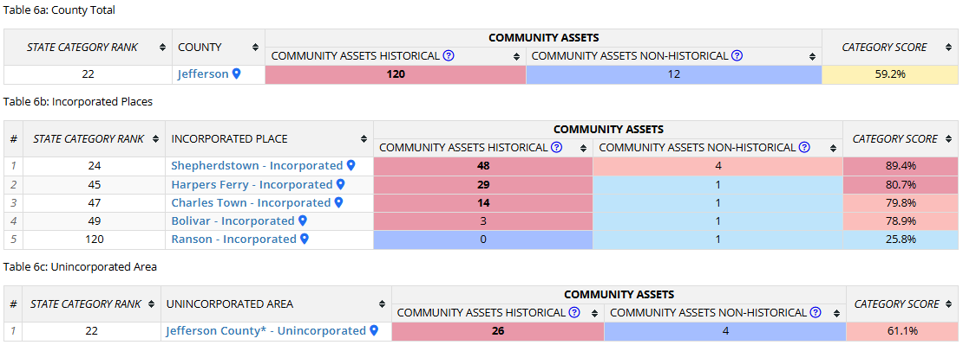
Flood Risk Assessment
Jefferson County
(5) Community Assets:
Statewide Rank
among the Top 5
#
Rankings done separately for counties, unincorporated areas, and 229 incorporated places
4
State Median: 7
1
State Median: 1
Notes:
Community Assets Historical: Number of historical community assets listed on the National Register of Historic Places or buildings within the Historic Districts constructed before 1930 in the High-Risk* 100-year floodplain
Community Assets Non-Historical: Number of non-historical community assets including utilities, post-secondary educational facilities, EMS, government buildings providing public services, and religious buildings in the High-Risk* 100-year floodplain
* High-Risk 100-year floodplain may include both Effective or Advisory Floodplains

Slide 8
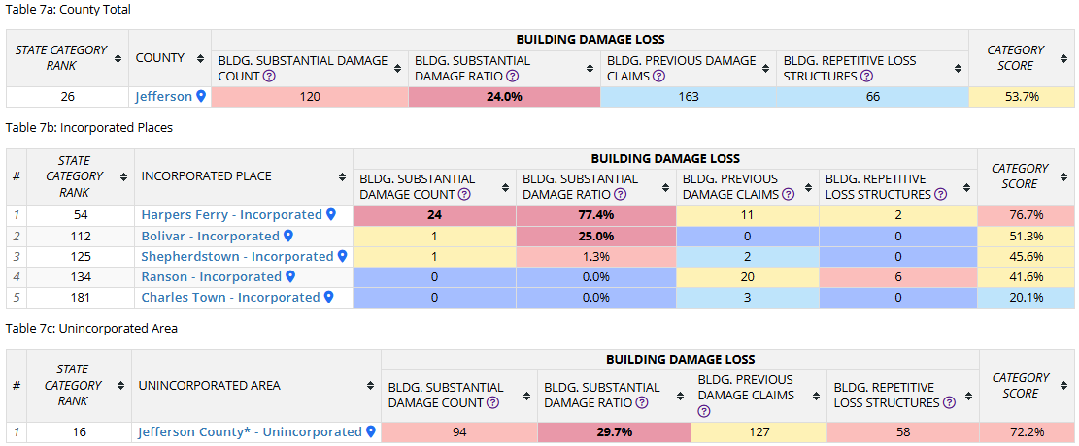
Flood Risk Assessment
Jefferson County
(6) Building Damage Loss:
Statewide Rank
among the Top 5
#
Rankings done separately for counties, unincorporated areas, and 229 incorporated places
1
State Median: 0.9%
Notes:
Bldg. Substantial Damage Count: Estimated number of primary structures substantially damaged from a 1% annual chance (100-year) flood for which the estimated flood loss is 50% or greater of the building appraised value
Bldg. Substantial Damage Ratio: Percentage of substantially damaged structures to total floodplain structures
Bldg. Previous Damage Claims: Number of previous flood-related insurance claims
Bldg. Repetitive Loss Structures: Number of NFIP-insured structures that have had at least 2 paid flood losses of more than $1,000 each in any 10-year period since 1978

Slide 9
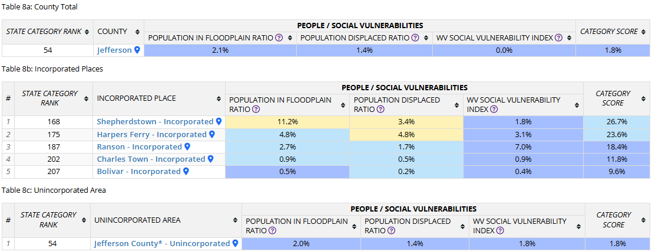
Flood Risk Assessment
Jefferson County
(7) People / Social Vulnerabilities:
Notes:
Population in Floodplain Ratio: Percentage of population residing in the High-Risk* Special Flood Hazard Area to total population
Population Displaced Ratio: Estimated percentage of population displaced by a major storm of a 1% annual chance (100-year) probability to total population
WV Social Vulnerability Index: Social vulnerability index developed for West Virginia based on the eight following socioeconomic and demographic indicators:
Poverty Rate, Unemployment Rate, No High School Diploma Ratio, Vulnerable Ages Ratio, Disability Ratio, Population Change Ratio, Median Housing Value, and Mobile Homes Ratio in Total Area
* High-Risk 100-year floodplain may include both Effective or Advisory Floodplains

