Slide 1
Supplemental Slides (Risk MAP Study)
Community Coordination and Outreach (CCO) Meeting, 12/11/2024 Jefferson County, WV and Incorporated Areas
Notes:
Risk MAP (Mapping, Assessment, Supplemental) Slides prepared by the WV GIS Technical Center at West Virginia University for the Community Coordination and Outreach (CCO) meeting to discuss the new preliminary Flood Insurance Study (FIS) and Flood Insurance Rate Maps (FIRMs) for Jefferson County, WV, issued on September 24, 2024. The CCO meeting was held on December 11, 2024, at the Jefferson County Office of Homeland Security and Emergency Management, 28 Industrial Boulevard, Kearneysville West Virginia, 25430.

Slide 2
Risk MAP (Jefferson Co. Preliminary Flood Maps)
Risk Mapping (Review New Flood Risk Maps)
Map Changes BFE’s (e.g., 24’ BFE change at Harpers Ferry) Floodplain Width (e.g., Shepherdstown)
SFHA Building Changes Mapped-in/Mapped Out Bldgs. LOMAs (SFHA bldgs. mapped out)
Risk Communications Outreach Letters for building changes in SFHA/Floodway
Future Map Discovery Map Zone AE Upgrades for Potomac / Shenandoah Rivers?
Risk Assessment (Quantify Flood Risk)
Statewide Risk Assessment (aggregate level or summary reports) River/Stream Scale County Scale Unincorporated Area Scale Incorporated Area Scale Shepherdstown Harpers Ferry
Building Level Risk Assessments Unmitigated Structures Mitigated Structure
Risk Planning (Build Flood Resiliency)
Pre-Disaster Planning Preload WV Flood Tool Structures into FEMA’s SDE Software Update Emergency Response & Hazard Mitigation Plans using risk assessments for major storm event
Higher Standards - Municipalities Apply for CRS status Adopt higher Freeboard value of 3 ft. in floodplain mgmt. ordinance
Verify Risk Layers on WV Flood Tool Building-level assessments Open space properties Repetitive Loss Areas
WV Flood Resiliency Framework
Risk MAP: Reduce Loss of Life and Property
Web link to Slide Deck
Notes:
This CCO meeting is an opportunity for local government representatives to work with FEMA Region 3, state government representatives, and members of the project team on strategies and resources for public outreach, how to provide comments/appeals to the preliminary information, the ordinance update and adoption process, and other questions/answers related to the National Flood Insurance Program (NFIP) and getting the new FIRMs to effective status.
This CCO meeting is organized by the National Flood Insurance Program (NFIP), a voluntary program that works to reduce future flood losses by guiding development away from hazardous areas, and by encouraging communities to:
• Know Your Risk: Identify flood hazards through mapping.
• Insure Your Risk: Provide insurance and outreach measures.
• Reduce Your Risk: Manage floodplains through ordinances, mitigation practice and resiliency efforts.
Community To-Do List
• Review the preliminary FIRM. Make corrections, share comments and submit appeals to FEMA through the community Chief Executive Officer (CEO), when appropriate.
• Reach out to notify residents, businesses and property owners affected by the changes on the FIRM.

Slide 3
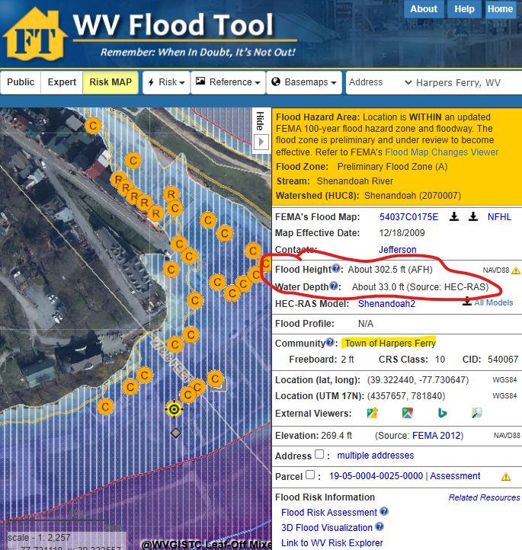
Map Changes – Harpers Ferry
Harpers Ferry: BFE change minus 24 ft.
Notes:
The preliminary FIRM shows flood risk zones in a community, including Special Flood Hazard Areas (SFHAs), subject to inundation by the base (1%-percent-annual-chance) flood. The 1%-annual-chance flood is also referred to as the 100-year flood.
Communities like Harpers Ferry should review its preliminary Flood Insurance Rate Map (FIRM) where structures are being mapped into a high-risk Special Flood Hazard Area, and where the base flood elevation is decreasing by 24 feet due to the revised 1%-annual-chance backwater effect where Shenandoah River meets the larger Potomac River.

Slide 4
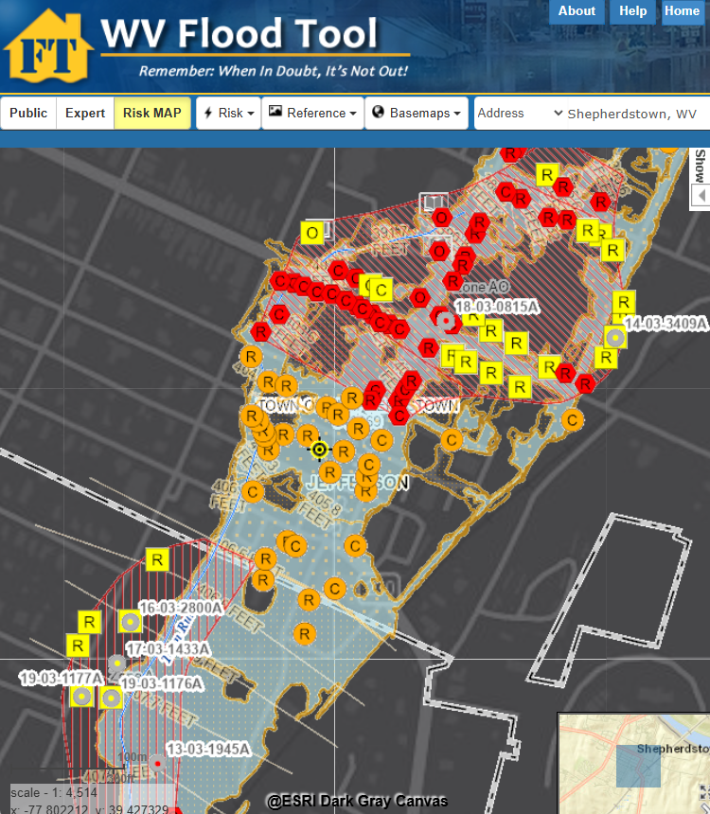
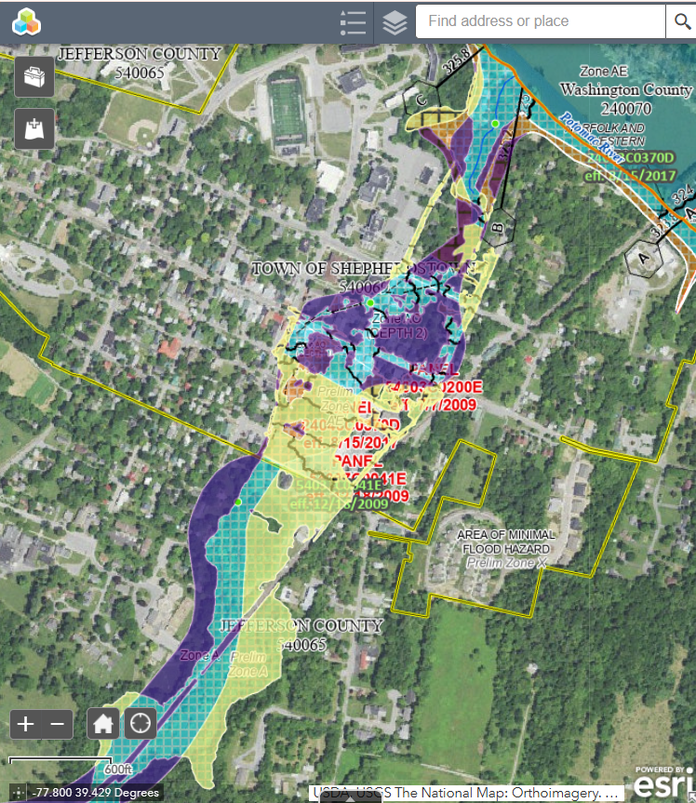
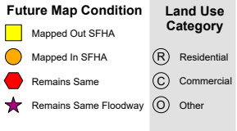
Map Changes - Shepherdstown
Harpers Ferry: BFE change minus 24 ft.
Shepherdstown: WV Flood Tool
Shepherdstown: FEMA Change Viewer
Notes:
Preliminary maps show the high-risk floodplain of Shepherdstown is changing dramatically, and consequently these floodplain boundary changes between the current 2009 effective and 2024 preliminary flood maps should be viewed using the WV Flood Tool’s Risk MAP View (SFHA Building Changes - Building Changes Since Last FIRM) and FEMA’s Changes Since Last FIRM (CSLF) Viewer. Shepherdstown has nearly 30 structures being mapped into the updated Special Flood Hazard Area, and so it is the community’s responsibility to notify property owners and other stakeholders that they will be affected by the map changes.

Slide 5
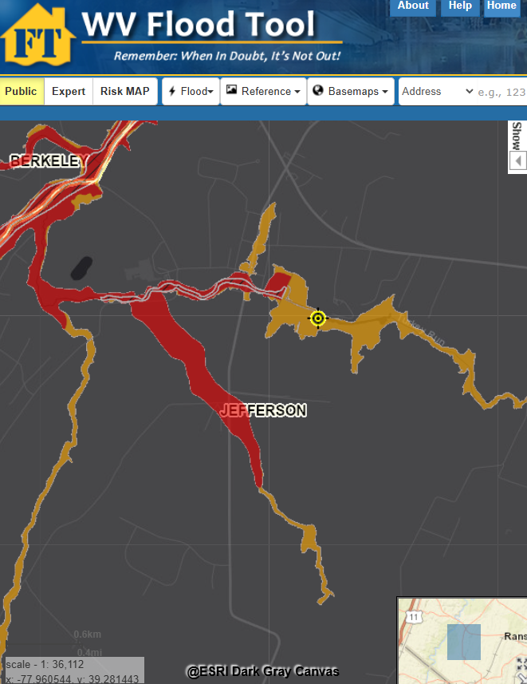
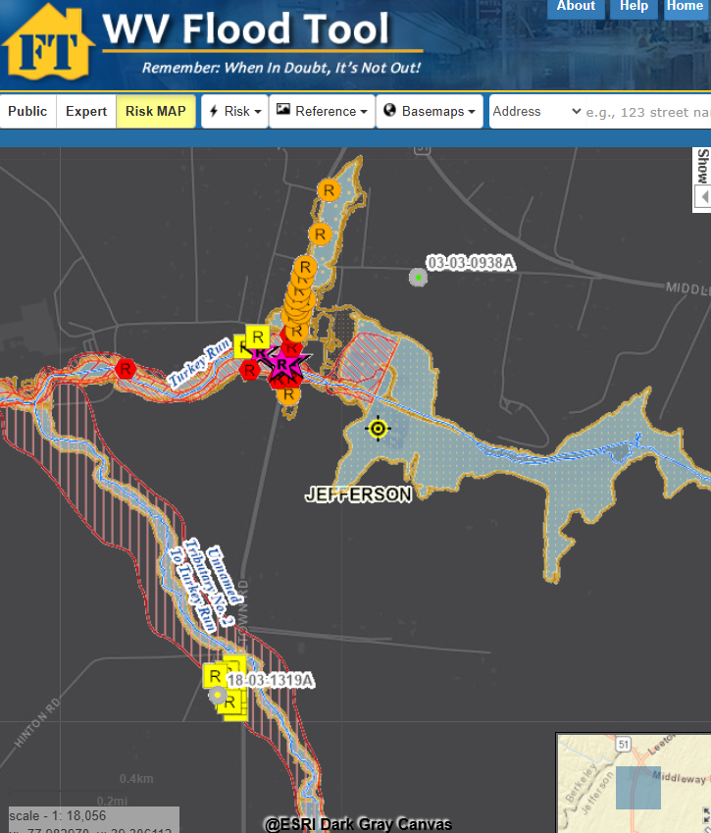
Map Changes – Jefferson County
Floodway
WV Flood Tool Public View
WV Flood Tool (Risk MAP View)
Notes:
Preliminary map changes for Jefferson County Unincorporated show “mapped-in structures” (orange symbol color) along streams where studies have been extended; or “mapped-out” structures (yellow symbol color) along existing streams due to more accurate topographic data and updated hydrologic/hydraulic flood studies.

Slide 6
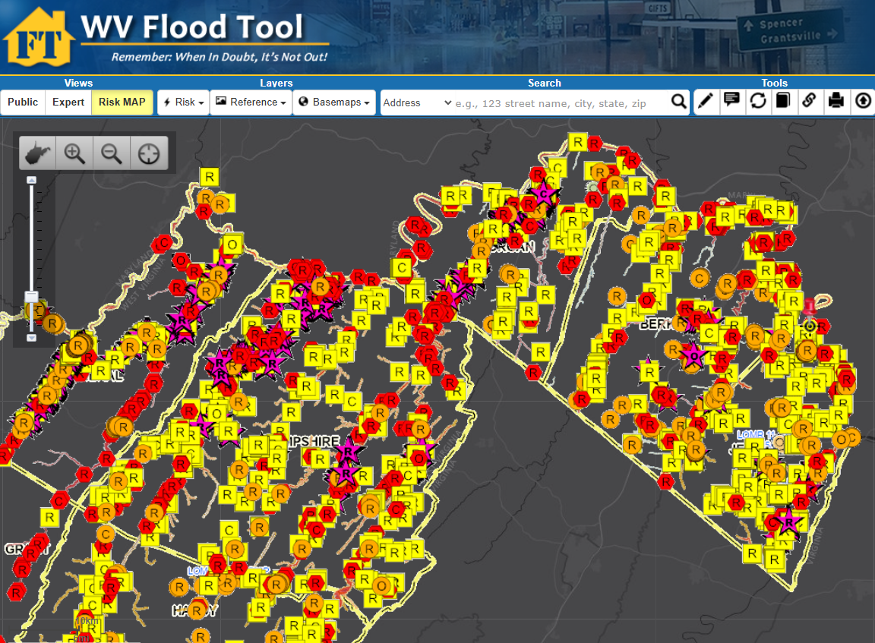
Buildings Mapped-In / Out of Preliminary SFHA
Floodway
Difference between FEMA’s 2009 and 2024 flood studies
Notes:
The WV Flood Tool’s Risk MAP View shows the future building status change according to the new flood maps:
• Mapped Out SFHA (yellow square symbol). Communities should notify property owners of map-in SFHA changes. Additionally, these structures may be candidates for LiDAR LOMAS.
• Mapped In SFHA (orange circle symbol). Communities should notify property owners of map-out SFHA changes.
• No Change - Remains Same in SFHA (red hexagon symbol).
• Floodway (star symbol)

Slide 7
SFHA Building Changes: Mapped-In/Out
COMMUNITY IDENTIFICATION |  | Estimated structures in the Community | Estimated structures in the preliminary flood high hazard area | Estimated structures newly mapped in | Estimated structures newly mapped out
Community Name | Community Type
Jefferson County* | Unincorporated | 20,397 | 317 | 55 | 220
Bolivar | Incorporated | 616 | 4 | 4 | 0
Charles Town | Incorporated | 3,670 | 21 | 4 | 8
Harpers Ferry | Incorporated | 276 | 31 | 30 | 0
Ranson | Incorporated | 2,918 | 50 | 1 | 28
Shepherdstown | Incorporated | 735 | 76 | 29 | 20
JEFFERSON | County | 28,612 | 499 | 123 | 276
* Unincorporated Area
County Net Change in structures: - 153
County Net Change in floodway structures: - 14
Notes:
Tax assessment records and aerial imagery allow for a more detailed inventory of primary buildings within the Special Flood Hazard Area and Regulatory Floodway. For Jefferson county, the preliminary flood maps reveal a net total of 499 structures in the preliminary SFHA, with 123 structures mapped-in the SFHA and 276 structures (more than double) mapped out. The countywide building net change is minus 153 and minus 14 structures in the preliminary SFHA and Floodway, respectively. Communities should contact the State NFIP Office for technical assistance in mailing notification letters to property owners that will be affected by these map changes.

Slide 8
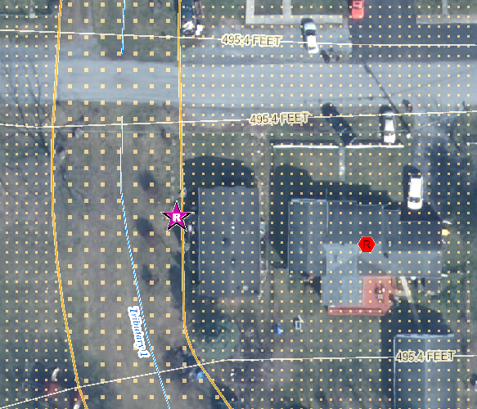
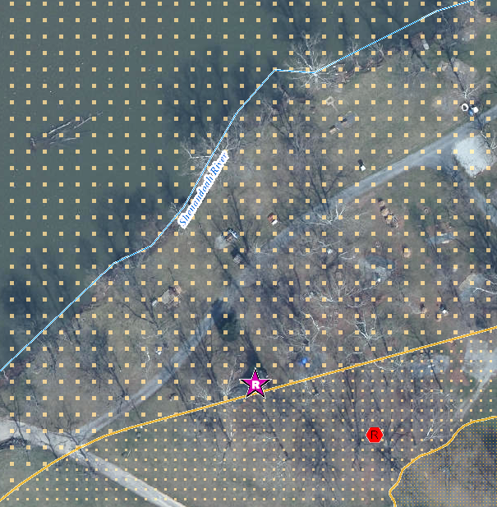
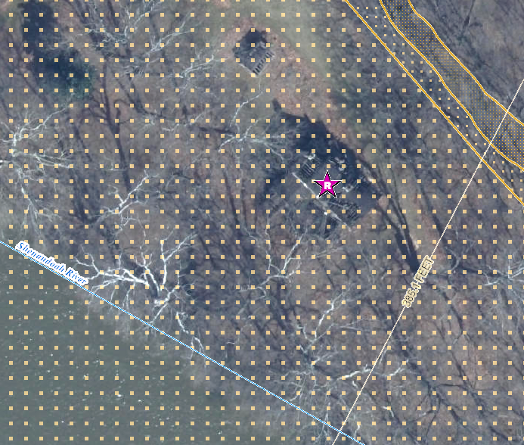
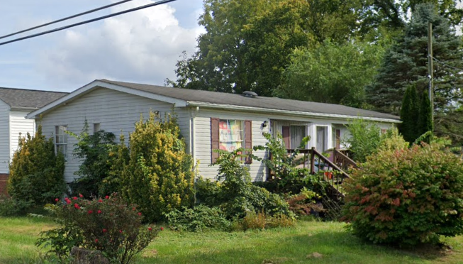
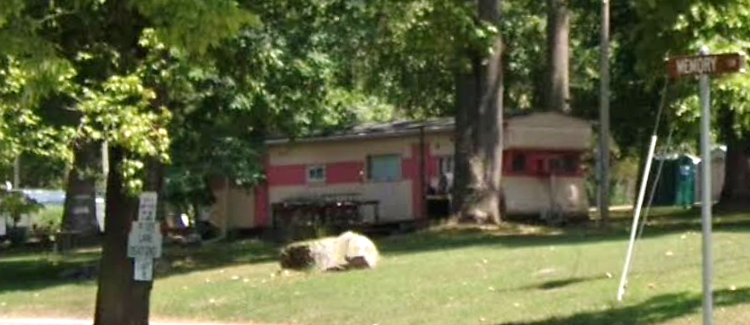
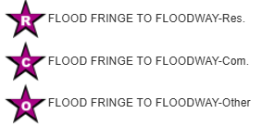
Buildings Mapped into Floodway
Single Family Dwelling in Jefferson County* (FD: 14.0 ft)
$8K; Minus Rated: 10.3 ft; Year Built: 1979 (Pre-FIRM)
(Building ID: 19-06-008F-0007-0000_457)
Structures mapped from Floodplain Fringe into Floodway
Double-wide Mobile Home in Ranson (FD: 2.2 ft)
$33K; Year Built: 1993 (Post-FIRM)
(Building ID: 19-08-0006-0019-0001_407)
Single-wide Mobile Home in Jefferson County* (FD: 7.0 ft)
$25K; Minus Rated: 3.5 ft; Year Built: Unknown
(Building ID: 19-02-0020-0031-0000_30)
Notes:
Communities should also notify property owners being mapped into a much higher risk flood zone of the Special Flood Hazard Area (SFHA), known as the Regulatory Floodway, or the main channel of the river/stream where floodwaters are likely the deepest and with the highest velocities. Before a local permit can be issued for proposed development in the floodway, a “No-Rise/No Impact” certification must be submitted by a professional engineer licensed in West Virginia to ensure a proposed project won’t increase flood levels.

Slide 9
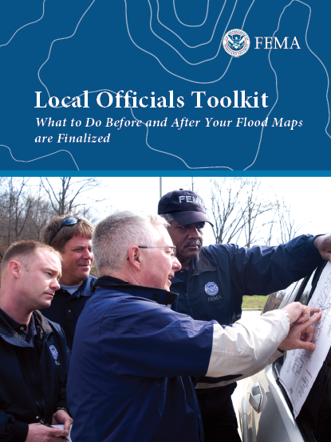
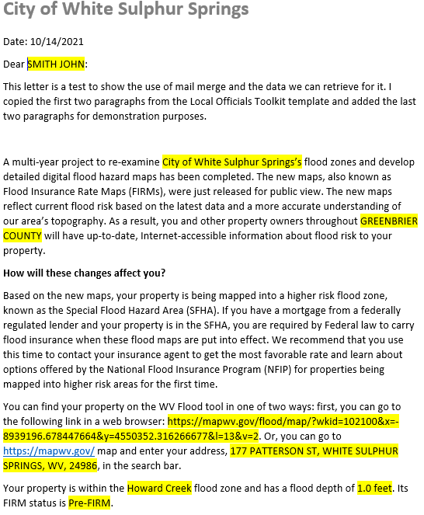
Risk Communications: SFHA Map Change Letters
Incorporate 1% Floodplain Building Risk Assessment Inventory into Mitigation and NFIP/CRS Management Activities
Counties which recently sent outreach letters to homeowners:
Hardy County Risk MAP
Kanawha County - Elk River PMR
Greenbrier County Risk MAP
Jefferson County and Shepherdstown have 55 and 29 buildings, respectfully, mapped into the SFHA
FEMA Region 3 Toolkit for New Flood Studies
Mail Merge Template for SFHA Mapped-in Structures
Notes:
Communities should contact the State NFIP Office for technical support in creating outreach letters for property owners affected by the map changes. Based on mail merge templates, outreach letters on community letterhead can be generated for all (1) SFHA Mapped-In, (2) Mapped-In Floodway, and (3) SFHA Mapped-Out structures shown on the WV Flood Tool’s RiskMAP View (www.mapwv.gov/Flood). All the communities must do is download the files, then print, validate, and mail the letters. CRS communities like Jefferson County Unincorporated should be eligible for credit points for this outreach activity.
For the SFHA mapped-out letters, it is important to have this text included in the letter template: "If you do currently have flood insurance, you should not cancel your flood insurance before the new flood maps are officially adopted by the community. Moreover, if you have a federally-backed mortgage, NEVER cancel your flood insurance before consulting your mortgage lender!“
Another useful resource about the Regulatory Update is FEMA’s Risk Communication Guidebook for Local Officials. https://www.fema.gov/sites/default/files/documents/fema_region-6_risk-communications-guidebook_112023.pdf#page=25

Slide 10
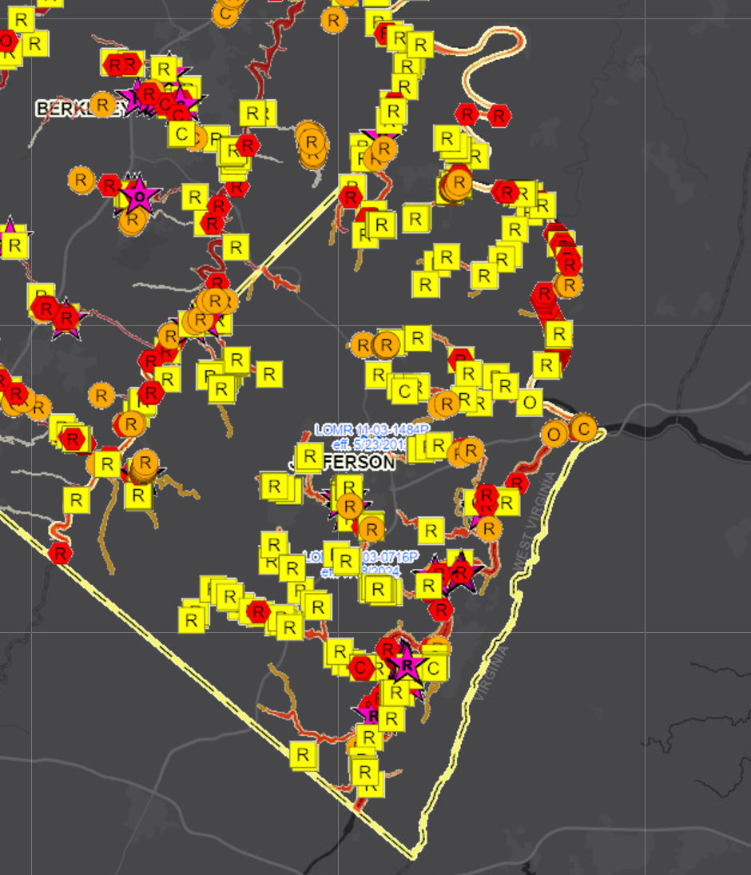
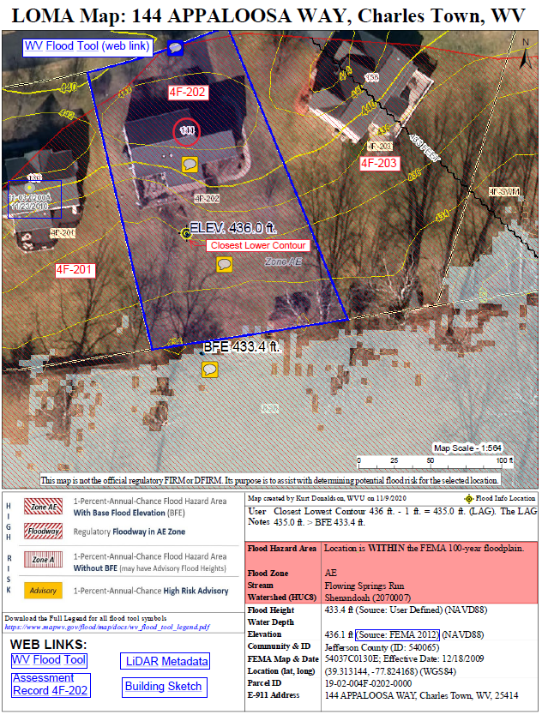
SFHA Buildings Changes: LOMAs for Mapped Out
Jefferson County
Mapped-out structures of the SFHA may qualify for LOMAs
Floodway
276
Mapped Out SFHA
WV Flood Tool LiDAR LOMA: Instructions | Guide
All building symbols in the floodplain fringe will become “red color” once flood maps are effective
Notes:
Before the preliminary FIRMS become effective, property owners with structures that are mapped out of the SFHA (yellow square symbols on WV Flood Tool’s RiskMAP View) may be eligible for a LiDAR Letter of Map Amendment (LOMA).
It is estimated that 276 structures are mapped out of the SFHA for the entire county. If applicable, LiDAR data can replace the requirement to submit certified elevation information for LOMAs, which can create a cost savings for property owners requiring mandatory flood insurance. If property owners want to expedite the removal of their structure from the SFHA, then refer to the information links regarding LiDAR LOMAs for more guidance.

Slide 11
River/Stream Building Risk Assessment
MEDIAN BUILDING VALUE: Town Run and Shenandoah River rank first and fourth, respectively, of 156 major rivers/streams in the state with the highest median value of structures in high-risk flood areas.
# | STATE CATEGORY RANK | River/Stream Floodplain | Building Characteristics | CATEGORY SCORE
 |  |  | Building Median Value
1 | 1 | Town Run | $247,700 | 100.0%
2 | 4 | Shenandoah River | $95,100 | 98.0%
3 | 24 | Potomac River | $57,300 | 85.1%
FLOOD DEPTH MEDIAN: Floodplain structures along the Shenandoah River have high flood depths compared to 156 other major rivers/streams in the state.
# | STATE CATEGORY RANK | River/Stream Floodplain | Floodplain Characteristics |  | CATEGORY SCORE
 |  |  | Floodplain Length | Flood Depth Median
1 | 12 | Shenandoah River | 30.2 Miles | 7.4 Ft | 92.9%
2 | 2 | Potomac River | 143.8 Miles | 4.5 Ft | 99.3%
3 | 147 | Town Run | 2.1 Miles | 0.2 Ft | 5.8%
WV Risk Explorer: Stream Risk Comparison Report
Notes:
Risk assessment results of 156 major rivers/streams in the state reveal that Town Run and Shenandoah River have high building values and thus more dollar exposure to flood damage. Both the Shenandoah and Potomac Rivers have high flood depth medians values (> 4.5 feet) for a 1%-annual-chance (100-yr) flood which translates to a potential for higher damage losses and loss of life.

Slide 12
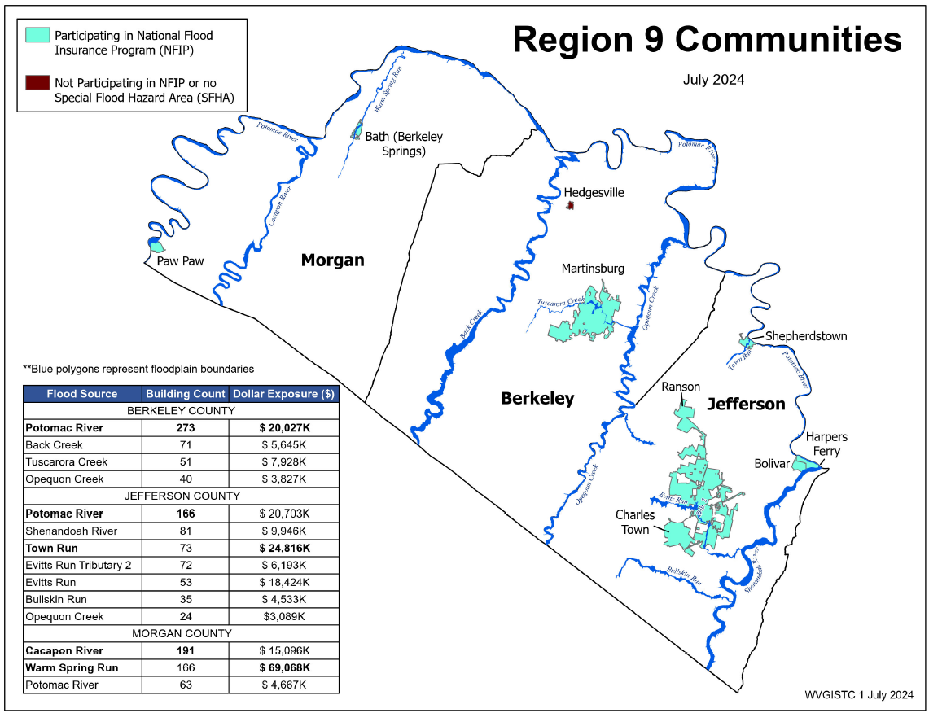
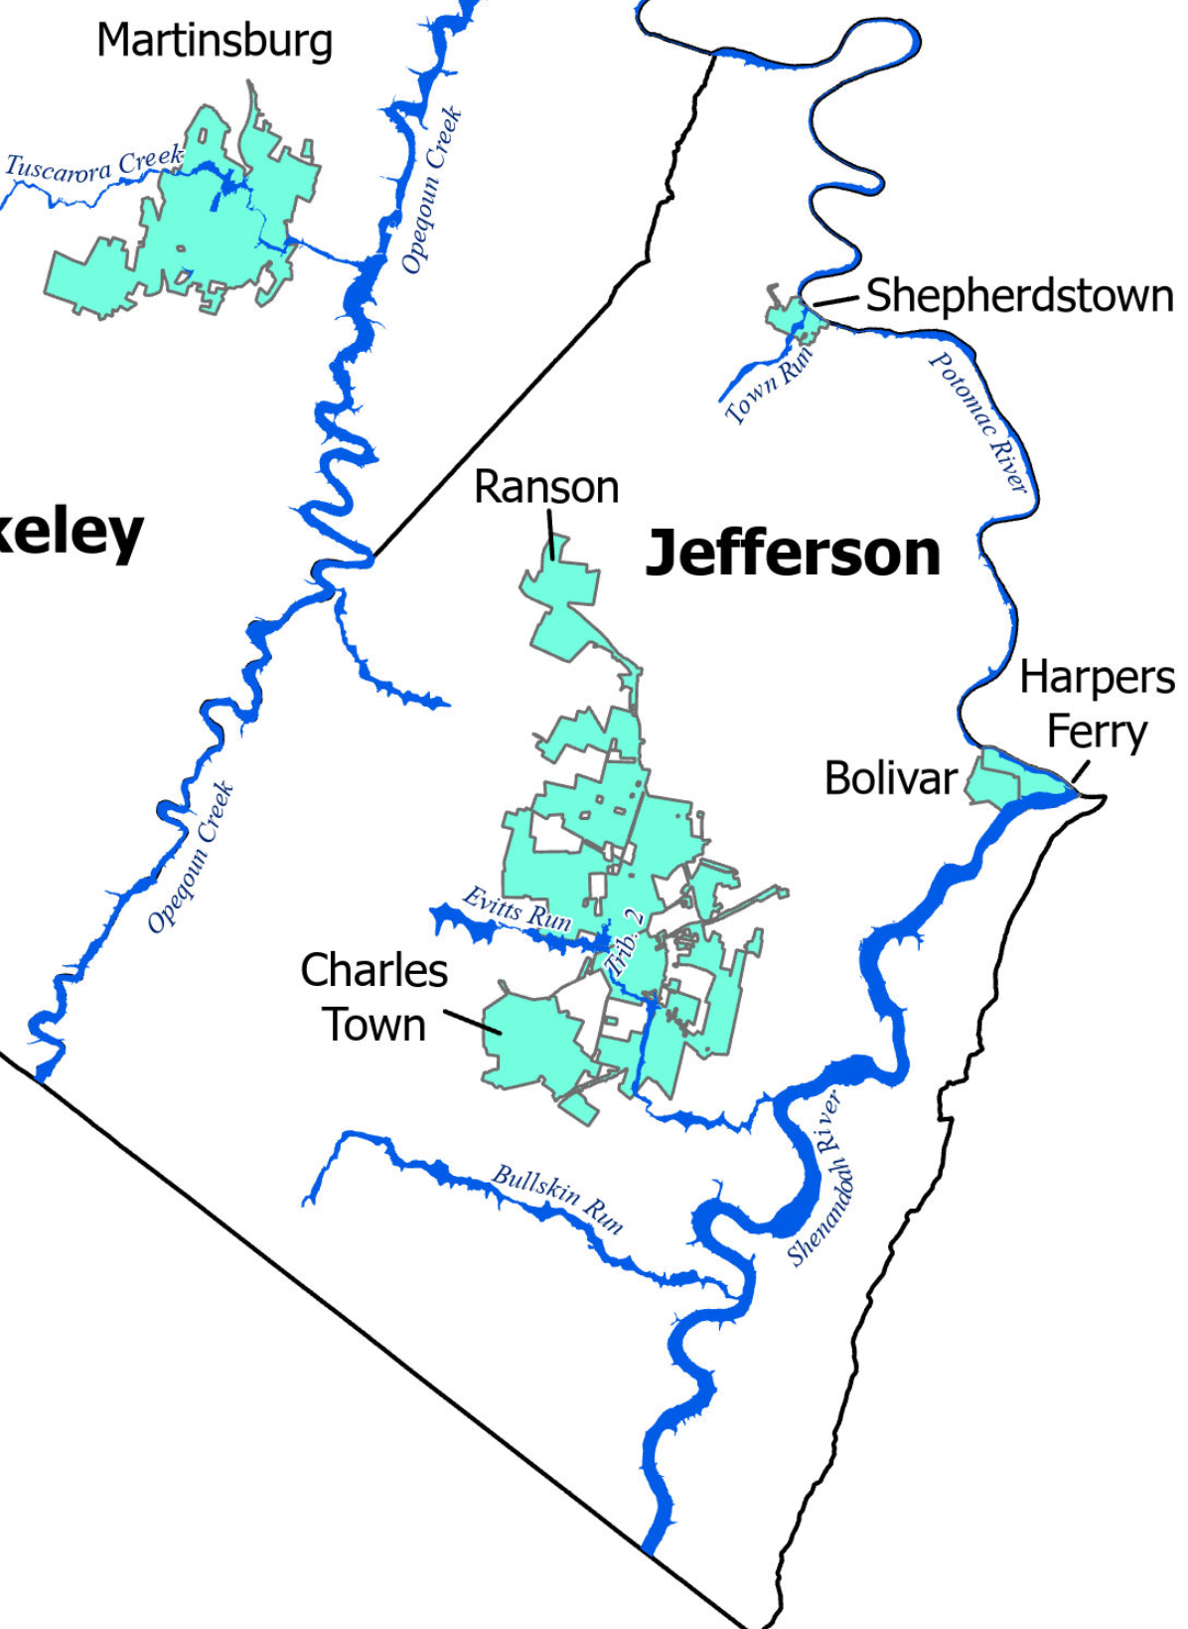
River/Stream Building Risk Assessment
Shepherdstown
Top rivers with high building counts in SFHA are Potomac River (166), Shenandoah River (81) and Town Run (73). Town Run has highest building dollar exposure.
Region 9 Rivers/Streams
Notes:
A river/stream building risk assessment for Region 9 and Jefferson County reveals that the Potomac River has the most structures mapped in the SFHA while Town Run has fewer structures but the largest cumulative building value.

Slide 13
Jefferson County Risk Assessment
Statewide Rank
among the Top 5
#
JEFFERSON COUNTY ranks “very high” or in the top 20% of all 55 counties in the state for the five risk indicators below. View Top 20% Risk Indicators Report for county. Click on Risk Factor links for rationales/recommendations.
Category | Flood Risk Indicator | Value for Jefferson | Indicator Score (0 - 100%) | Indicator Rating
Building Characteristics | Building Median Value | $97,450 (Median $42,200) | 100.0% | VERY HIGH
 | Bldg. Subgrade Basements Ratio | 49.5% | 94.4% | VERY HIGH
 | Bldg. Year Minus Rated Post-FIRM Ratio | 9.4% | 81.4% | Very High
Community Assets | Community Assets Historical | 120 | 94.4% | VERY HIGH
Building Damage Loss | Bldg. Substantial Damage Ratio | 24.0% | 90.7% | VERY HIGH
1
4
4
JEFFERSON COUNTY UNINCORPORATED* ranks “very high” or in the top 20% of all 55 unincorporated areas in the state for the six risk indicators below. View Top 20% Risk Indicators Report for incorporated area.
Category | Flood Risk Indicator | Value for Jefferson County* - Unincorporated | Indicator Score (0 - 100%) | Indicator Rating
Floodplain Characteristics | Flood Depth Median | 4.7 Ft | 94.4% | VERY HIGH
Building Characteristics | Building Median Value | $93,150 (Median $37,350) | 100.0% | VERY HIGH
 | Bldg. Subgrade Basements Ratio | 48.9% | 98.1% | VERY HIGH
 | Bldg. Year Minus Rated Post-FIRM Ratio | 14.5% | 90.7% | VERY HIGH
Community Assets | Community Assets Historical | 26 | 100.0% | VERY HIGH
Building Damage Loss | Bldg. Substantial Damage Ratio | 29.7% | 90.7% | VERY HIGH
4
1
2
1
Notes:
A Top 20% Risk Indicators Report reveals that Jefferson County and Jefferson County Unincorporated have structures in the high-risk flood zones that are of high appraisal value and which reside in historical districts. View the WV Risk Explorer report for more information about these risk factors specific to Jefferson County including rationales and recommendations.

Slide 14
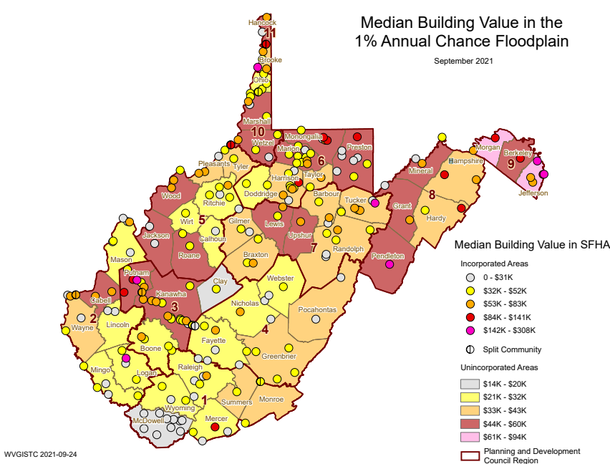
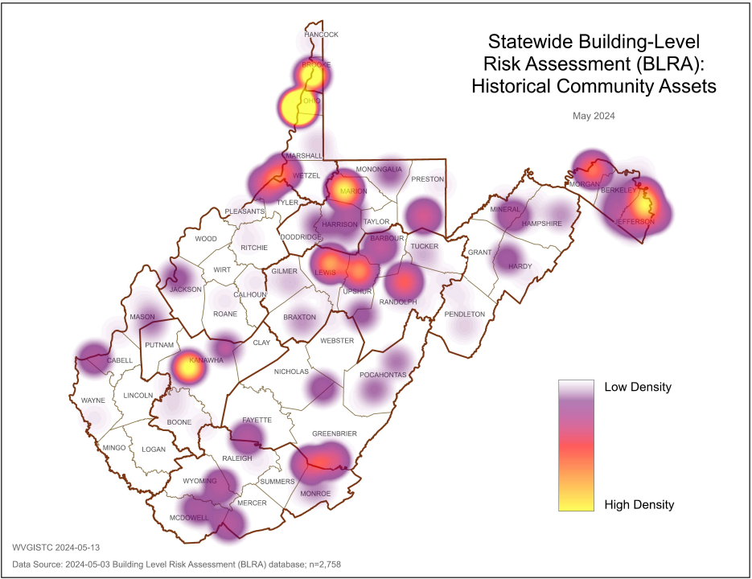
Jefferson County Building Risk Assessment
High Building Values
High Historical Buildings
Jefferson County has very high Building Values, or more than double the statewide median value.
Jefferson County has a high number of Historical Community Assets on the National Register.
Source: Statewide Building-Level Risk Assessment
Notes:
When compared to all 55 counties in the state, for the Jefferson County structures located in the Special Flood Hazard Area, these inventoried buildings have high appraisal values, and a large number are designated by the National Register of Historic Places. Graphics of these risk indicators affecting Jefferson County can be discovered from the WV Hazard Library.

Slide 15
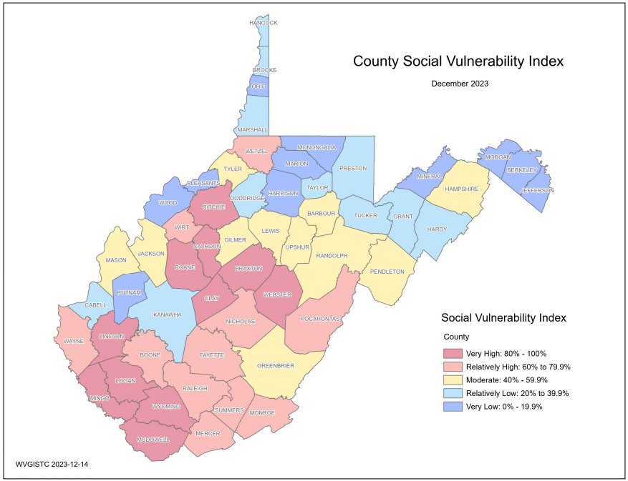
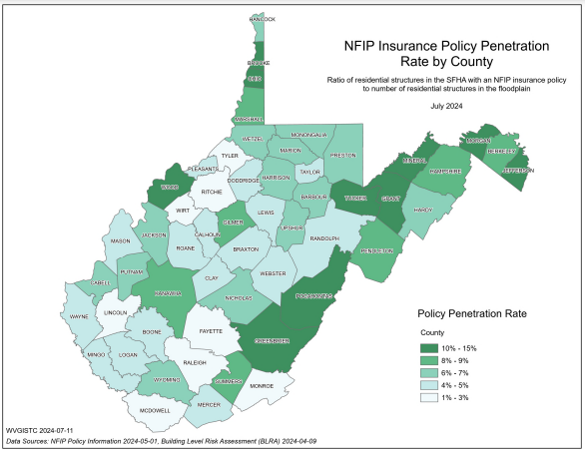
Jefferson County Resiliency
(1) Jefferson County has no Essential Facilities in the high or moderate risk floodplains
(2) Jefferson County has the lowest Social Vulnerability Index in the State
(3) Jefferson County has higher NFIP Insurance Penetration Rate than other counties
Notes:
Jefferson County is more resilient to flooding than most other counties in the state because the county has:
• No Essential Facilities in high (100-yr) or moderate (500-yr) risk floodplains.
• The lowest Social Vulnerability Index in the state.
• Higher NFIP Insurance Penetration Rate coverage than other counties.

Slide 16
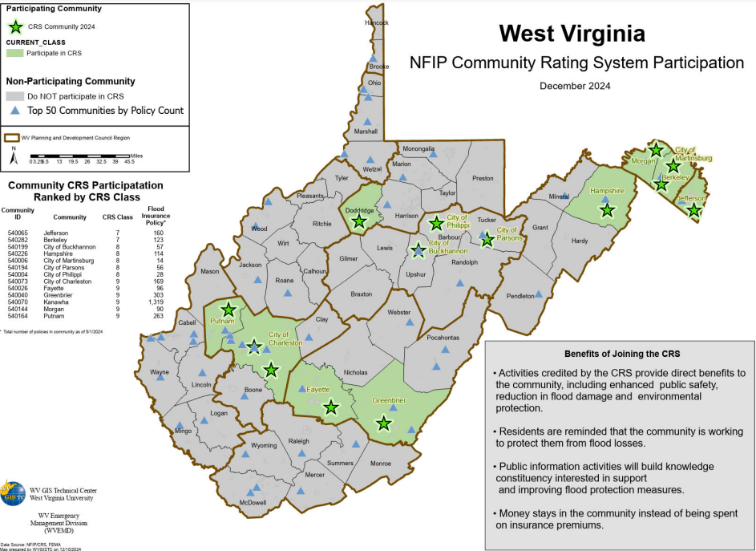
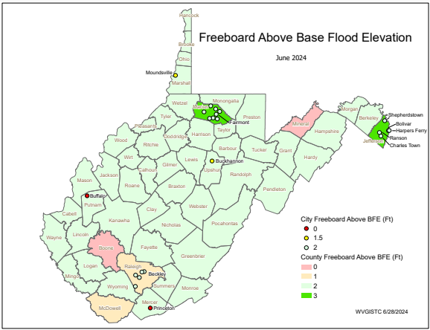
Jefferson County Unincorporated* Resiliency
Jefferson County Unincorporated has a high CRS Rating of Class 7
Jefferson County Unincorporated has a high Freeboard safety factor of 3 feet
Notes:
Jefferson County Unincorporated implements higher standards for floodplain management than all the other 284 incorporated and unincorporated communities in the state

Slide 17
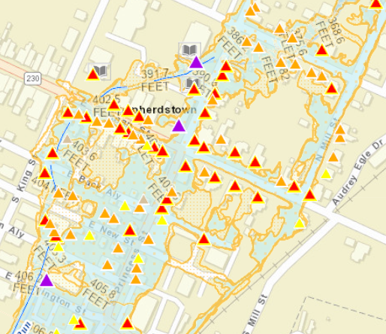
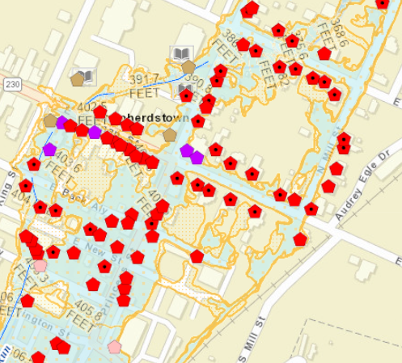
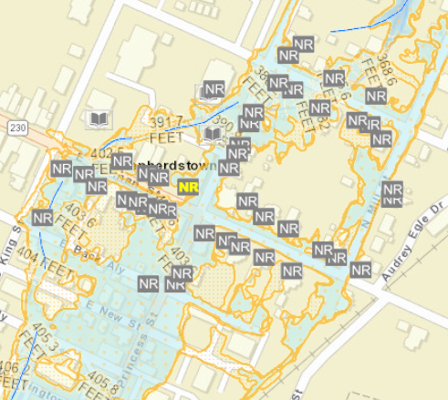
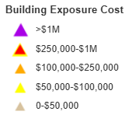
Shepherdstown Risk Assessment
Building Value and Density.
Median Building Value ranks first of 229 incorporated places in the state. High density of buildings in small area.
Pre-FIRM and Basements.
Nearly 90% of structures are Pre-FIRM and nearly half have basements.
Historical Buildings.
Most building are in the National Historic District.
Refer to online All Risk Indicators Report
Sources: WV Flood Tool’s Risk Map View & Statewide Building-Level Risk Assessment
Notes:
Shepherdstown has a high density of 76 buildings in the high-risk floodplain, nearly all of which are pre-FIRM and within the Shepherdstown Historic District. Shepherdstown ranks very high for the following building risk factors:
High Building Dollar Value and Density of Structures. A higher total building value in floodplains can lead to increased insurance costs, while a higher density of buildings per acre in the floodplain signifies a greater physical and human exposure to flooding.
High number of Pre-FIRM Structures with Basements. Pre-FIRM structures are more vulnerable to flooding because they were constructed when a Flood Insurance Rate Map (FIRM) was not in effect and thus were not built according to the regulations and building codes for floodplain development. Subgrade basements can flood quickly, especially in the event of flash floods, leading to structural damage, property loss, and increased recovery costs. Additionally, electrical equipment in basements can increase the risk of electrocution while flooding.
Higher number of Historical Buildings. Historical assets often have significant cultural value, so it is crucial to know how many historical assets are in floodprone areas to aid in allocating resources for flood resilience and emergency response. A designated historic structure can obtain the benefit of subsidized flood insurance through the NFIP even if it has been substantially improved or substantially damaged so long as the building maintains its historic designation. Refer to FEMA’s Floodplain Management bulletin of Historic Structures for more information. https://data.wvgis.wvu.edu/pub/RA/_resources/Historic/FEMA_bulletin_historic_structures_2008.pdf

Slide 18
Shepherdstown 3D Flood Movie
Click here to view 3D Flood Movie of Shepherdstown
Notes:
View the narrated 3D flood visualization movie of Shepherdstown as an effective way of communicating flood risk and high building values for a major 1%-annual-chance (100-yr) flood event. Shepherdstown, the oldest town in West Virginia, faces flooding from two primary sources: Town Run and the backwater of the Potomac River. The Potomac River borders the eastern edge of the community, while Town Run flows through the town, winding under the historic district. The 1936 flood on Town Run caused maximum flood heights ranging from 1.5 to 2.0 feet in some areas of the town.

Slide 19
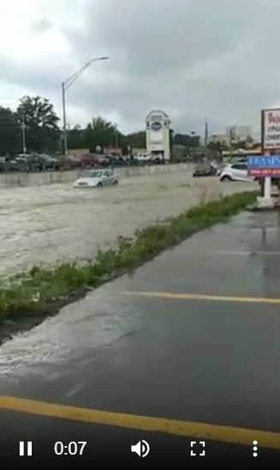
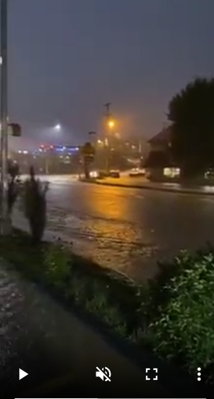
Example Urban Flooding
View Videos of 2021 Morgantown Flooding along Popenoe Run on Patteson Drive near WVU stadium that may occur similarly on Town Run in Shepherdstown
Courtesy of WV Hazard Library
Notes:
The 2021 Morgantown urban flooding along Popenoe Run on Patterson Driver may occur similarly on Town Run in Shepherdstown. According to FEMA’s FIS report, flooding from Town Run typically results in shallow overland flow depths of less than 3 feet. However, when the channel capacity is exceeded, floodwaters follow through streets and low-lying areas, and impact regions not directly adjacent to the stream channel. Like the 2021 urban flooding in Morgantown, primary roads in Shepherdstown will likely be flooded during a major storm event. Understanding the town's vulnerabilities, such as the impact of floods on primary roads and high-value structures, is essential for effective flood preparedness and resiliency efforts.

Slide 20
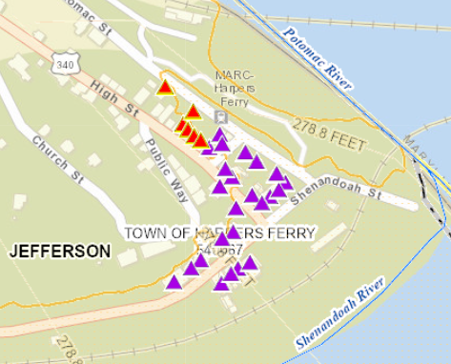
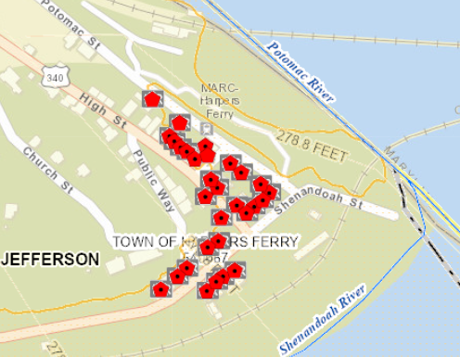
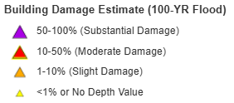
Harpers Ferry Risk Assessment
Building Substantial Damage Ratio highest of all 229 incorporated places in the state
Pre-FIRM Building Ratio highest of all 229 incorporated places in the state
Refer to online All Risk Indicators Report
Sources: WV Flood Tool’s Risk Map View & Statewide Building-Level Risk Assessment
Notes:
The historical buildings located in Harpers Ferry are subject to very high flood depths (second floor flooding) and damage from a major flood storm. Fortunately, the historical masonry buildings of Harpers Ferry are more durable and resistant to water damage than other construction materials.

Slide 21
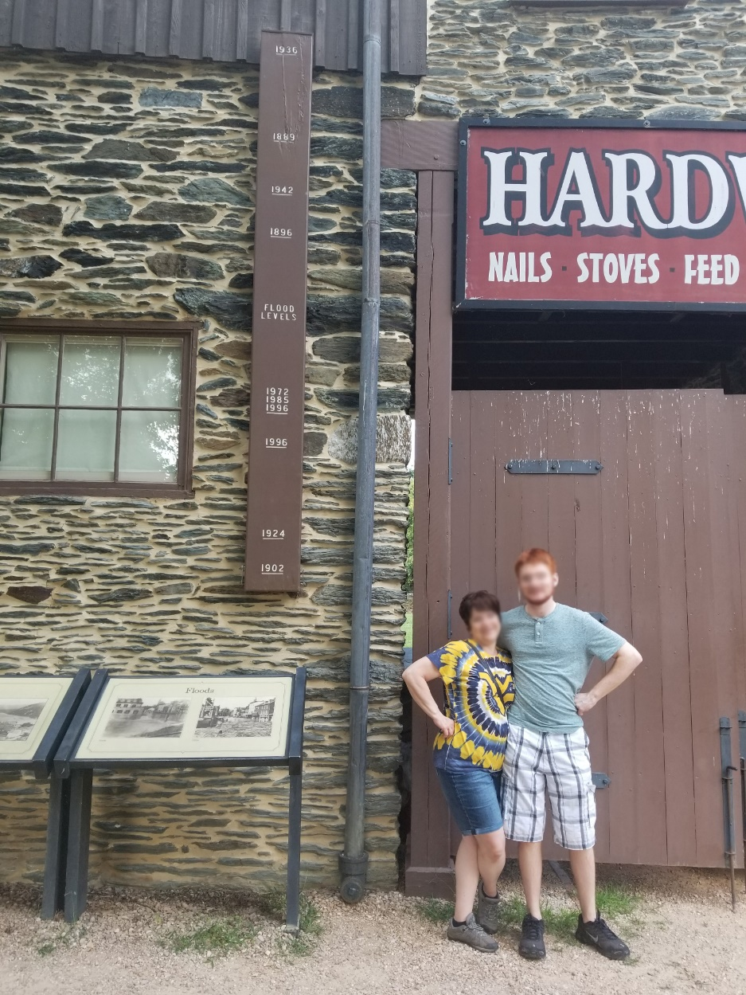
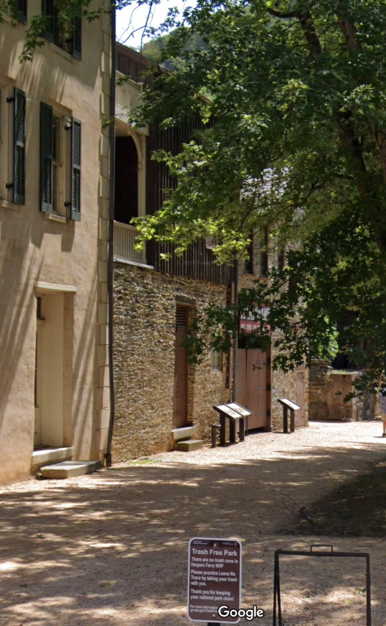
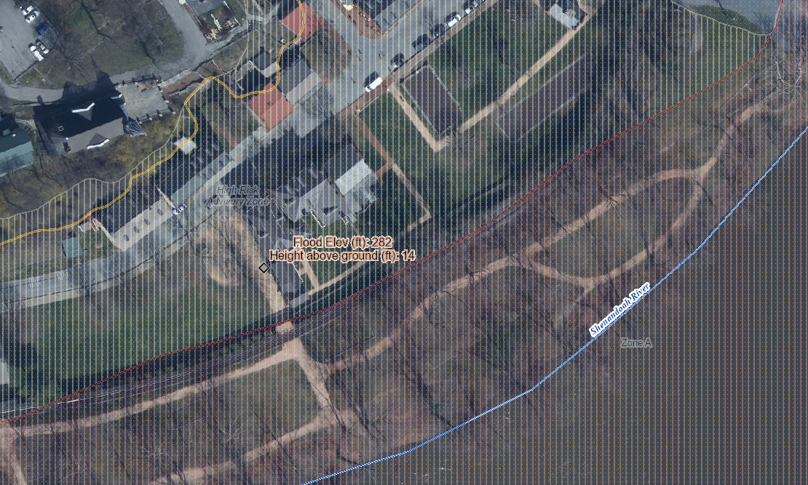
Harpers Ferry Risk Assessment
744 Shenandoah St, Harpers Ferry, WV, 25425
Building ID: 19-05-0004-0025-0000_801A
Historical structure built in 1845
14’ (1936 High Water Mark)
1936 Flood of Record
8’ (1996 High Water Mark)
Knapp Creek
Greenbrier River
High Water Marks
Notes:
Although the damage loss estimates for the structures in Harpers Ferry will decrease with the new preliminary flood maps, Harpers Ferry is the lowest point in the state and the town repeatedly floods at the confluence of the Shenandoah and Potomac Rivers. The worst known flood was on March 19, 1936, when the Potomac crested at a record 36.5 feet, more than 18 feet above flood stage.

Slide 22
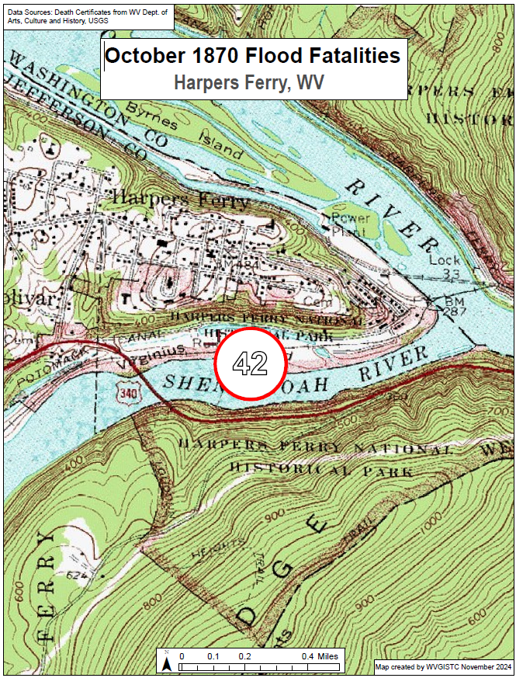
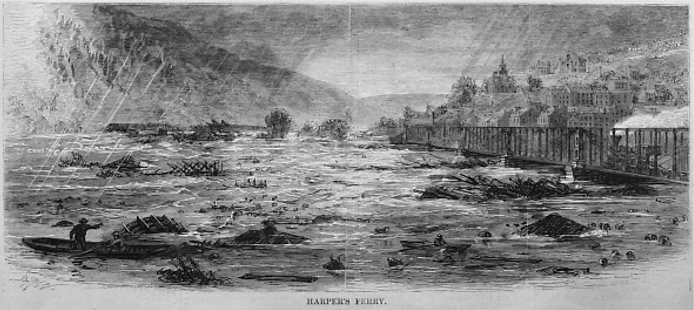
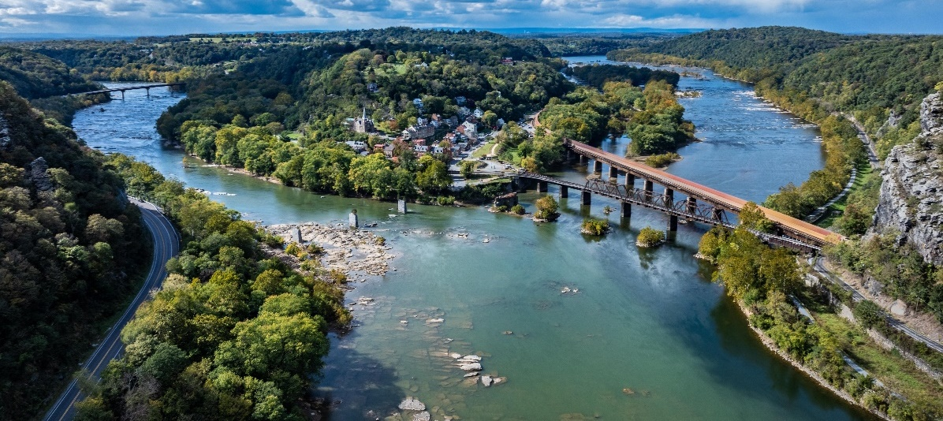
Historical Flood Research (Harpers Ferry, WV)
Engraving of the flood in Harpers Ferry, from Harper’s Weekly, October 20, 1870
(Image courtesy of Yesterday’s America)
October 1870 Flood
(42 fatalities)
Link to WV Flood Fatality Dashboard
Notes:
Since recorded history, severe floods have ravaged Harpers Ferry. The flood of 1870 resulted in the Shenandoah River rising so rapidly that residents were trapped on Virginius Island. Floodwaters swept away much of the island's homes and industry and claimed 42 lives at Harpers Ferry.

Slide 23
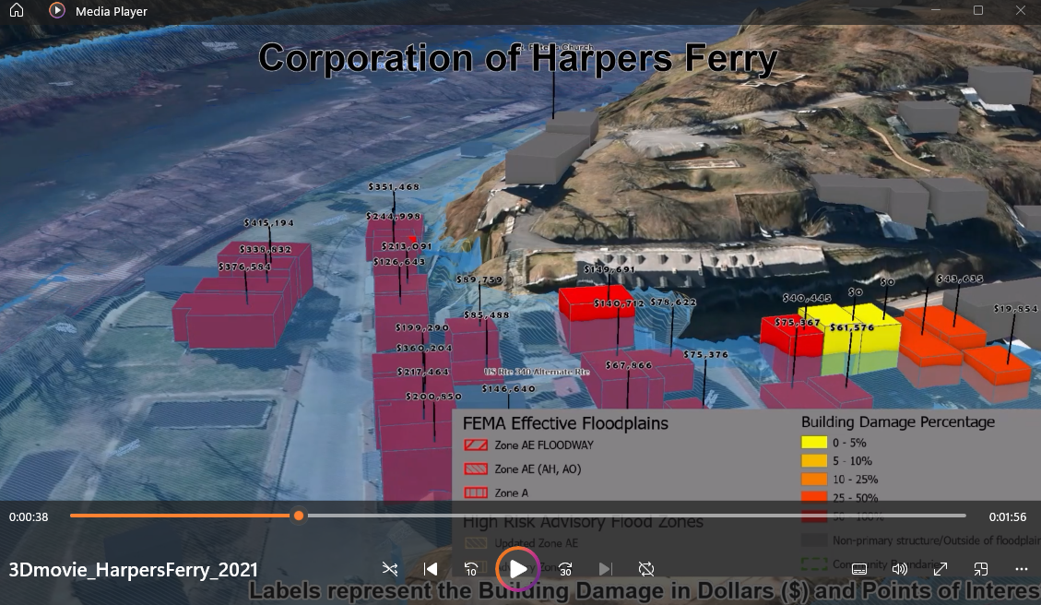
Harpers Ferry 3D Flood Movie
Click here to view 3D Flood Movie of Harpers Ferry
Notes:
View the narrated 3D flood visualization movie of Harpers Ferry as an effective way of communicating flood risk and high building values for a major 1%-annual-chance (100-yr) flood event occurring at Harpers Ferry. The movies shows damage loss estimates for a 100-year flood event based on FEMA’s 2009 flood model.

Slide 24
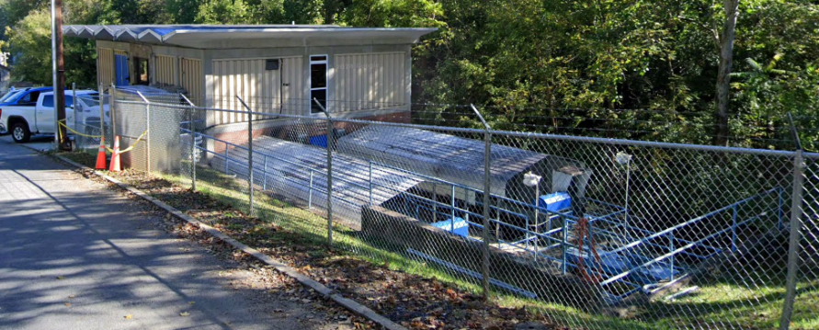
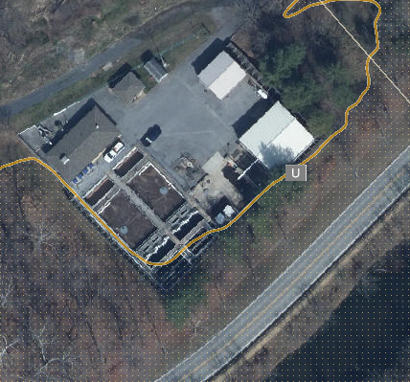
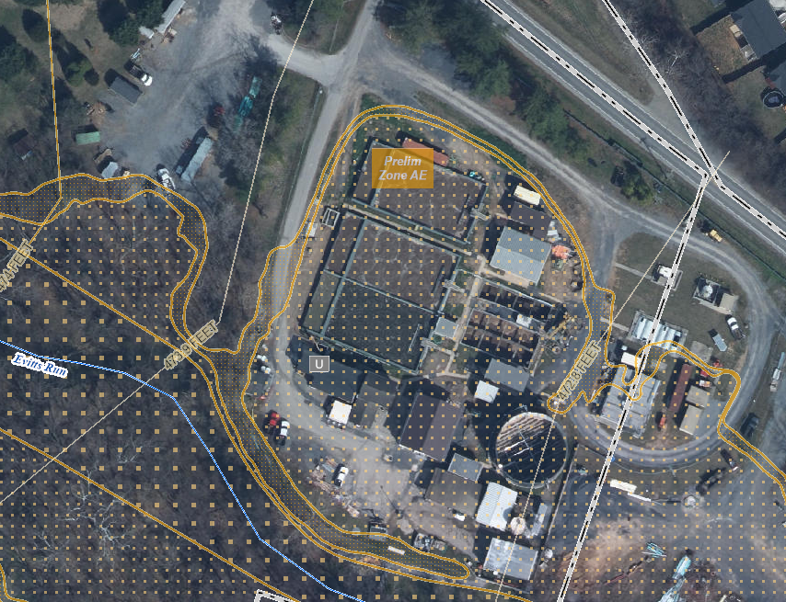
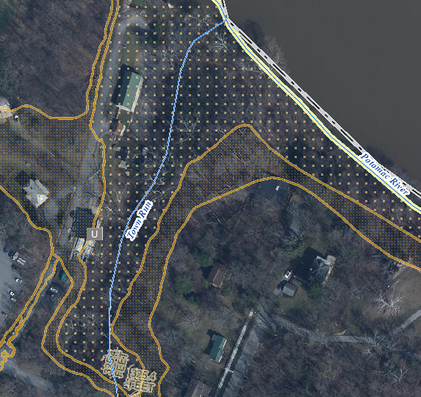
Utilities in Floodplain (High $ Exposure)
Backwater
Harpers Ferry Bolivar PSD Wastewater
Treatment Plant (FD: 1 ft)
(Building ID: 19-05-0004-0025-0000_192) ($462K)
Value source inflation adjusted to 2021
Online Mitigation Resources:
EPA FLOOD RESILIENCE: Guide for Water/Wastewater Utilities
Tips for Flood-Proofing Wastewater Treatment Plants
Flood-Resistant Wastewater Treatment Plant Upgrades
City of Charles Town Wastewater Treatment Plant (FD: 1 ft)
Highest CA Value ($6.8M) in Jefferson County
(Building ID: 19-03-0008-0001-0000_842)
Value source inflation adjusted to 2021
Shepherdstown Water Works Water Treatment Plant (FD: 3 ft)
(Building ID: 19-10-0001-0052-0000_309) ($3.1M)
Value source inflation adjusted to 2021
Notes:
Water and wastewater treatment utilities of Jefferson County are high-value assets that provide vital services to nearby communities. These utilities are typically close to flood sources and thus communities should floodproof these structures to minimize damage from future floods. Examples of mitigation measures for utilities include:
Emergency response plan
Barriers around key assets
Elevated electrical equipment
Emergency generators
Bolted down chemical tanks

Slide 25
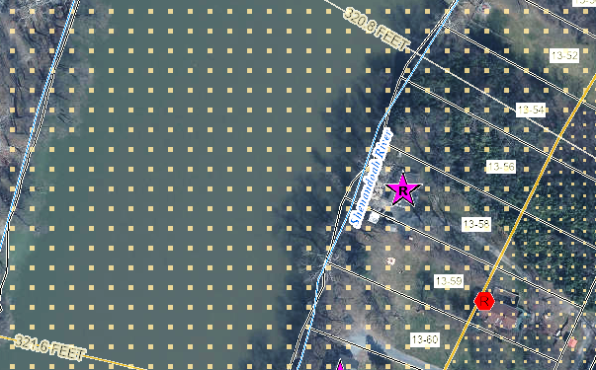
Building Flood Profile - Unmitigated
Single Family Dwelling in Jefferson County*
Appraised Value: $217K
(Building ID: 19-04-0013-0059-0000_89)
Rivermist Lane, Harpers Ferry
Repetitive Loss Area / Area of Mitigation Interest
 | HEIGHT (ft.)
BUILDING
Freeboard (FBD) | 3
FLOOD DEPTH
FEMA 1% (100-Yr) | 13.6
FEMA 1%+ (100-Yr+) | 16.6
FEMA 0.2% (500-Yr) | 19.6
Flood Source: Shenandoah River
Post-FIRM
19.6’ (FEMA 0.2% / 500-Yr)
16.6’ (FEMA 1% + / 100-Yr +)
13.6’ (FEMA 1% / 100-Yr)
Ground Level
Notes:
An unmitigated residential structure built in 1985 is located along Shenandoah River at 89 RIVERMIST LN, Harpers Ferry, WV, 25425. Based on the new flood study, the flood elevations range from 13.6 feet to 19.6 feet for the 1%-annual-chance(100-yr) and 0.2%-annual-chance (500-yr) flood events. The new Flood Study Profile reveals the following flood elevations for the 100-yr and 500-yr flood frequencies:
13.6 feet for a major 1% annual chance (100-yr) flood event.
16.6 feet for a 1-percent plus annual chance (100-yr) flood. The 1-percent plus flood elevation for a study utilizing rainfall-runoff methodology is defined as a flood elevation derived by using discharges at the upper 84-percent confidence limit for the 1-percent-annual-chance flood. FEMA captures this statistical uncertainty in its 1%+ flood elevations representing the higher 84-percent confidence limit of the statistical error for calculating the 1%-annual-chance event.
19.6 feet for a catastrophic 0.2%-annual-chance (500-yr) flood event.
This structure is a very vulnerable flood risk area along the Shenandoah River. This area has been mapped on the WV Flood Tool’s RiskMAP View as a REPETITIVE LOSS AREA / AREA OF MITIGATION INTEREST (AoMI) based on the following criteria:
Repetitive Loss Structures
Substantial Damage Estimates
Mitigated Properties
High Flood Depths
High Water Marks
Similar Topography

Slide 26
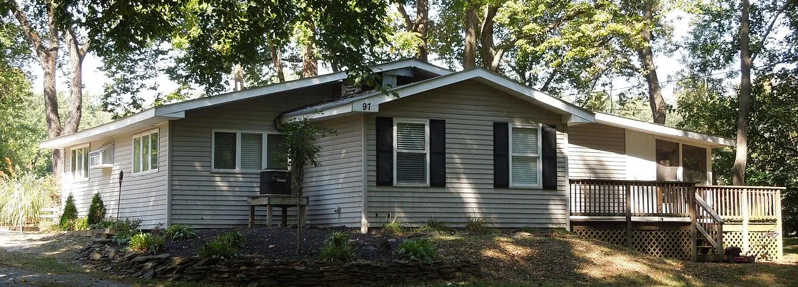
Building Flood Profile - Unmitigated
Single Family Dwelling in Jefferson County*
in Floodway
Appraised Value: $95K
(Building ID: 19-04-0013-0058-0000_97)
Rivermist Lane, Harpers Ferry
Repetitive Loss Area / Area of Mitigation Interest
Flood Source: Shenandoah River
 | HEIGHT (ft.)
BUILDING
Freeboard (FBD) | 3
FLOOD DEPTH
FEMA 1% (100-Yr) | 13.7
FEMA 1%+ (100-Yr +) | 16.7
FEMA 0.2% (500-Yr) | 19.7
Pre-FIRM
19.7’ (FEMA 0.2% / 500-Yr)
16.7’ (FEMA 1% + / 100-Yr +)
13.7’ (FEMA 1% / 100-Yr)
Ground Level
Notes:
This one-store residential Pre-FIRM structure located at 97 RIVERMIST LN, Harpers Ferry, WV, 25425 is in the Regulatory Floodway of the Shenandoah River and subject to extreme flood depths of 13.7 feet and 19.7 feet for the 1%-annual-chance event (100-yr) and 0.2%-annual-chance event (500-yr) flood events, respectively. To avoid loss of life during a major flood event, residents at this home must evacuate to higher ground away from the structure.

Slide 27
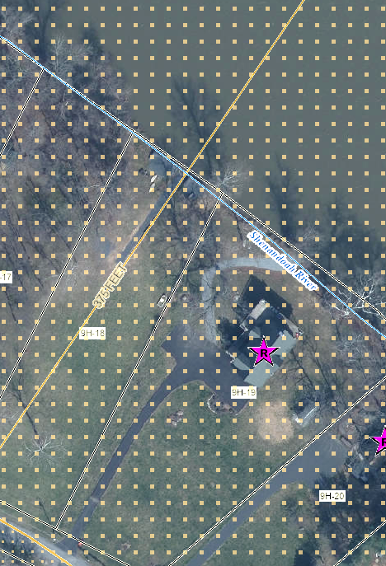
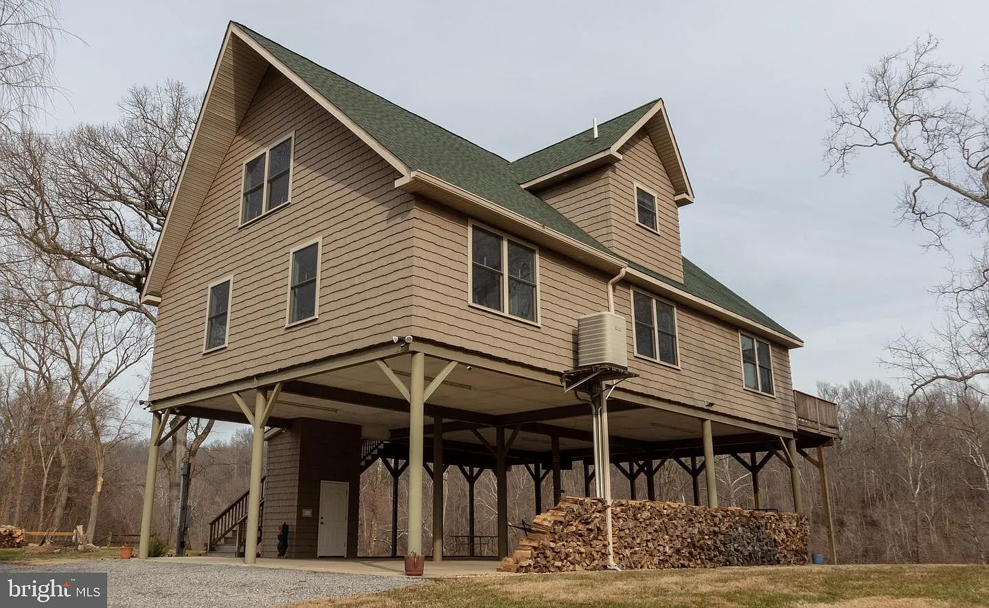
Building Flood Profile – Mitigated to DFE
Flood Profile
 | HEIGHT (ft.)
BUILDING
Freeboard (FBD) | 3
FLOOD DEPTH
FEMA 1% (100-Yr) | 9.9
FEMA 1%+ (100-Yr +) | 12.9
FEMA 0.2% (500-Yr) | 18.9
Flood Source: Shenandoah River
Post-FIRM
18.9’ (FEMA 0.2% / 500-Yr)
14.9’ (FEMA 1% + / 100-Yr +)
Single Family Dwelling in Jefferson County*
Elevated in Floodway
Appraised Value: $265K
(Building ID: 19-06-009H-0019-0000_781)
9.9’ (FEMA 1% / 100-Yr)
Ground Level
Notes:
Built in 2011, this mitigated residential structure at 781 AVON BEND RD, Charles Town, WV, 25414, is elevated to the Design Flood Elevation (DFE) of the FEMA 1%-annual-chance (100-yr) base flood elevation plus 3 feet of freeboard. However, this home is still vulnerable to extreme flooding from a rare, catastrophic 0.2%-annual-chance flood depth of 19 feet. The building appraisal value of this structure is $265,000 on the 2024 tax assessment database, while the total tax appraisal value (building and land) is $406,200 compared to $554,000 on Zillow.

Slide 28
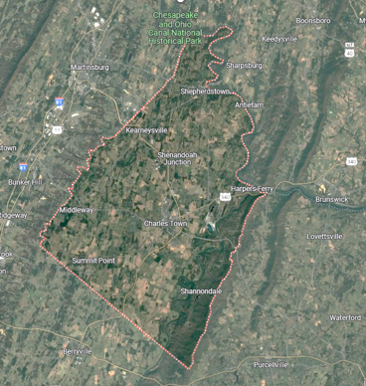
Contact Persons:
Kurt Donaldson
kurt.donaldson@mail.wvu.edu
Behrang Bidadian
behrang.bidadian@mail.wvu.edu
Annie Mahmoudi
anm0050@mail.wvu.edu
West Virginia GIS
Technical Center
Notes:
Contact information if one has questions about the risk assessment slides.

Slide 29
Jefferson County 2024
APPENDIX SLIDES
Jefferson County Risk Assessment
Study Source: WV Risk Explorer Tool
https://wvfrf.org/wvre/
Notes:
Jefferson County risk assessment using the WV Risk Explorer, a risk tool of the WV Flood Resiliency Framework (www.WVFRF.org)

Slide 30
Jefferson County 2024
Overall Flood Risk
(1) FLOODPLAIN CHARACTERISTICS
(2) BUILDING EXPOSURE
(3) BUILDING CHARACTERISTICS
(4) CRITICAL INFRASTRUCTURE
(5) COMMUNITY ASSETS
(6) BUILDING DAMAGE LOSS
(7) PEOPLE / SOCIAL VULNERABILITIES
(8) OTHER HAZARDS
Floodplain Area
Building Floodplain Count¹ ²
Building Value¹ ²
Essential Facilities
Historical Assets
Substantial Damage Estimates*¹ ²
Population in Floodplain
Dam/Levee Failure
Floodplain Length¹ ²
Building Floodway Count¹ ²
Mobile Homes
Roads Inundated
Non-Historical Assets
Previous Claims
Population Displaced
Landslides
Floodplain Depth¹ ²
Building Floodplain Ratio²
Basement
Repetitive Losses
WV Social Vulnerability Index
Karst
Flood Disaster Frequency
Building Density¹ ²
One Story
Building Year*
Cumulative Flood Risk Index
1
2
WV Risk Explorer: https://wvfrf.org/wvre/
* Multiple Indicators
River/Stream Indicator
Watershed Indicator
Notes:
25 Flood Risk Indicators quantify the overall cumulative risk index of each community. Refer to the WV Risk Explorer Tool for rationales and recommendations of each risk factor.

Slide 31
Flood Risk Assessment
Jefferson County
Link to Flood Risk Comparison Report on WVRE:
https://wvfrf.org/wvre/report/?scaleid=3&entityid=19&type=hierarchy
Cumulative Flood Risk Index:
Notes:
Cumulative Flood Risk Index report for Jefferson County, Jefferson County Unincorporated, and Incorporated Places. View online report using the WV Risk Explorer Tool.

Slide 32
Flood Risk Assessment
Jefferson County
(1) Floodplain Characteristics:
Statewide Rank
among the Top 5
#
Rankings done separately for counties, unincorporated areas, and 229 incorporated places
1
2
State Median: 1.8 Ft
4
State Median: 2.0 Ft
Notes:
Floodplain Area: Modified Floodplain Area (mSFHA) = Total Special Flood Hazard Area (aSFHA) – [Open water lakes > 10 acres] – [Large rivers bank-to-bank > 500 ft] – [Federal lands > 10 acres]
Floodplain Length: Total length of the Effective and Advisory Special Flood Hazard floodplains in miles
Floodplain Length Breakdown:
Jefferson County → Detailed: 34.1%, Approximate: 52.3%, Advisory: 13.6%
Harpers Ferry → Detailed: 0%, Approximate: 68.5%, Advisory: 31.5%
Shepherdstown → Detailed: 50.7%, Approximate: 8.0%, Advisory: 41.3%
Bolivar → Detailed: 0%, Approximate: 100%, Advisory: 0%
Charles Town → Detailed: 54.9%, Approximate: 43.7%, Advisory: 1.3%
Ranson → Detailed: 93.6%, Approximate: 5.8%, Advisory: 0.6%
Jefferson Unincorporated Area → Detailed: 34.2%, Approximate: 54.6%, Advisory: 11.2%
Floodplain Area Ratio: Ratio of the Modified Special Flood Hazard Area (mSFHA) to total incorporated place area
Floodplain Length Ratio: Ratio of Special Flood Hazard length (Effective and Advisory) to total incorporated place area
Flood Declared Disasters: Number of federally-declared flood disasters in the county since 1953
Flood Depth Median: Median value of flood depths of all primary structures inventoried in the High-Risk* flood zones from FEMA's models
* High-Risk 100-year floodplain may include both Effective or Advisory Floodplains
Notes:
Floodplain Characteristics Category. Harpers Ferry and Bolivar have high median flood depths for structures located in the Special Flood Hazard Area.

Slide 33
Flood Risk Assessment
Jefferson County
(2) Building Exposure:
Statewide Rank
among the Top 5
#
Rankings done separately for counties, unincorporated areas, and 229 incorporated places
3
2
State Median: 0.75 /Acre
Notes:
Building Floodplain Count: Building count in Special Flood Hazard Area including Effective, New Preliminary, and Draft floodplains (excluding mapped-out structures)
Buildings in Floodplain Breakdown:
Jefferson County → in Effective: 376, in Advisory: 123
Shepherdstown → in Effective: 47, in Advisory: 29
Ranson → in Effective: 49, in Advisory: 1
Harpers Ferry → in Effective: 1, in Advisory: 30
Charles Town → in Effective: 17, in Advisory: 4
Bolivar → in Effective: 0, in Advisory: 4
Jefferson Unincorporated Area → in Effective: 262, in Advisory: 55
Building Floodway Count: Building count in Regulatory Floodway
Building Floodplain Ratio: Percentage of floodplain buildings (in High-Risk* (100-yr) Effective or Advisory Floodplains) to total buildings
Building Density: Density of buildings in High-Risk* flood areas to total floodplain acres
* High-Risk 100-year floodplain may include both Effective or Advisory Floodplains
Notes:
Building Exposure Category. Bolivar and Shepherdstown have a high density of structures in the Special Flood Hazard Area.

Slide 34
Flood Risk Assessment
Jefferson County
(3) Building Characteristics:
Statewide Rank
among the Top 5
#
Rankings done separately for counties, unincorporated areas, and 229 incorporated places
1
4
State Median: $42,200
State Median: 21.6%
1
2
1
1
State Median: $41,500
State Median: 25.5%
State Median: 86.6%
Notes:
1
2
State Median: $37,350
State Median: 19.5%
Building Median Value: Median of appraised values of all primary structures in the
High-Risk* 100-year floodplain from the most recent tax assessment data or other building value data sources for tax-exempt structures
Bldg. Mobile Homes Ratio: Percentage of manufactured buildings (occupancy class code RES2) among all single-family structures (RES1 & RES2) in the High-Risk* 100-year floodplain
Bldg. Subgrade Basements Ratio: Percentage of structures with subgrade basements among all primary structures in the High-Risk* 100-year floodplain (may also include walkout basement enclosures)
Building 1-Story Ratio: Percentage of one-story structures among all primary buildings in the High-Risk* 100-year floodplain
Bldg. Year Pre-FIRM Ratio: Percentage of buildings constructed or substantially improved on or before December 31, 1974, or before the effective date of the initial Flood Insurance Rate Map of the community, whichever is late (also including Post-FIRM construction regulated to Pre-FIRM and Unknown FIRM status) among all primary structures in the High-Risk* 100-year floodplain
Bldg. Year Minus Rated Post-FIRM Ratio: Percentage of structures constructed after the FIRM date of which their first floor is more than one foot below the Base Flood Elevation (BFE) among all primary structures in the High-Risk* 100-year floodplain
Notes:
Building Characteristics Category. Although Bolivar was not ranked because it only has four structures in the high-risk flood zones, all communities in Jefferson County have high building values.
Since Shepherdstown and Harpers Ferry are designated historic districts, nearly all these structures are Pre-FIRM or built before there were effective Flood Insurance Rate Maps.
Based on the tax assessment data, Jefferson County has a percentage of structures with basements, but some of these structures are “walkout” basements instead of “subgrade” basements.

Slide 35
Flood Risk Assessment
Jefferson County
(4) Critical Infrastructure:
Notes:
Essential Facilities: Number of essential facilities (including schools, hospitals, nursing homes, police stations, fire department buildings, & E-911 emergency operations centers) which provide critical services to the community in the high (100-year), moderate (500-year), and reduced risk flood zones
Roads Inundated Ratio: Percentage of roads inundated by flood waters of 1 foot or more by a high-risk 1% annual chance (100-year) flood event
Notes:
Critical Infrastructure. Jefferson County has no essential facilities in the high and moderate flood risk zones.

Slide 36
Flood Risk Assessment
Jefferson County
(5) Community Assets:
Statewide Rank
among the Top 5
#
Rankings done separately for counties, unincorporated areas, and 229 incorporated places
4
State Median: 7
1
State Median: 1
Notes:
Community Assets Historical: Number of historical community assets listed on the National Register of Historic Places or buildings within the Historic Districts constructed before 1930 in the High-Risk* 100-year floodplain
Community Assets Non-Historical: Number of non-historical community assets including utilities, post-secondary educational facilities, EMS, government buildings providing public services, and religious buildings in the High-Risk* 100-year floodplain
* High-Risk 100-year floodplain may include both Effective or Advisory Floodplains
Notes:
Community Assets. Jefferson County has a high number of historical structures in the SFHA that are vulnerable to flooding. Jefferson County Unincorporated ranks 1st of all other 55 unincorporated areas in the state.

Slide 37
Flood Risk Assessment
Jefferson County
(6) Building Damage Loss:
Statewide Rank
among the Top 5
#
Rankings done separately for counties, unincorporated areas, and 229 incorporated places
1
State Median: 0.9%
Notes:
Bldg. Substantial Damage Count: Estimated number of primary structures substantially damaged from a 1% annual chance (100-year) flood for which the estimated flood loss is 50% or greater of the building appraised value
Bldg. Substantial Damage Ratio: Percentage of substantially damaged structures to total floodplain structures
Bldg. Previous Damage Claims: Number of previous flood-related insurance claims
Bldg. Repetitive Loss Structures: Number of NFIP-insured structures that have had at least 2 paid flood losses of more than $1,000 each in any 10-year period since 1978
Notes:
Building Damage Loss. Harpers Ferry has high substantial damage estimates (more than 50% damage to structure) because of high flood depths for a major 1%-annual-chance storm.

Slide 38
Flood Risk Assessment
Jefferson County
(7) People / Social Vulnerabilities:
Notes:
Population in Floodplain Ratio: Percentage of population residing in the High-Risk* Special Flood Hazard Area to total population
Population Displaced Ratio: Estimated percentage of population displaced by a major storm of a 1% annual chance (100-year) probability to total population
WV Social Vulnerability Index: Social vulnerability index developed for West Virginia based on the eight following socioeconomic and demographic indicators:
Poverty Rate, Unemployment Rate, No High School Diploma Ratio, Vulnerable Ages Ratio, Disability Ratio, Population Change Ratio, Median Housing Value, and Mobile Homes Ratio in Total Area
* High-Risk 100-year floodplain may include both Effective or Advisory Floodplains
Notes:
People / Social Vulnerabilities. Jefferson County has the lowest WV Social Vulnerability Index in the state and thus should be able to recover more quickly from a major flood disaster than most counties in the state.

