Slide 1
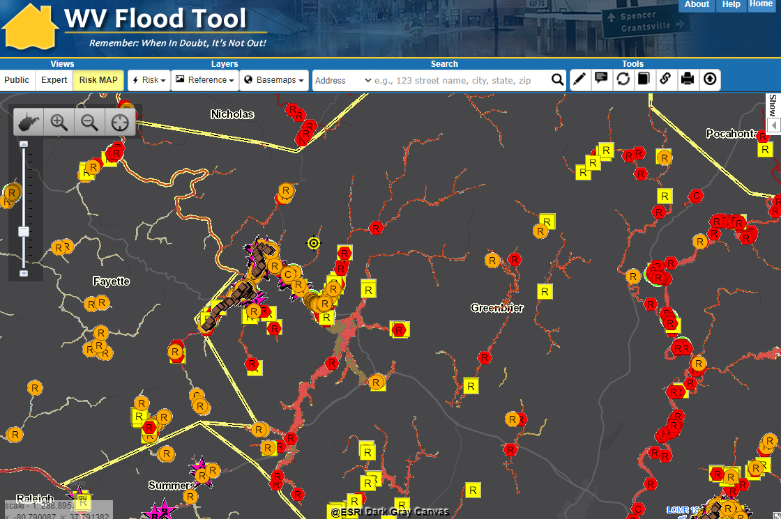
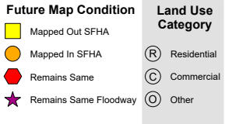
Region 4 Flood Risk Assessment
Region 4 Vulnerability Risk Assessment
Kurt Donaldson, WVU
2/10/2022

Slide 2
WV Statewide Risk Assessment
OVERVIEW

Slide 3

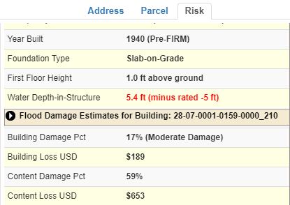
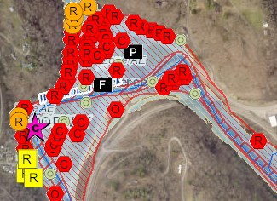
WV Building-Level Flood Risk Assessment
BUILDING INVENTORY
Primary Building
Identification &
Hazus Attributes
Essential Facilities & Community Assets
FLOOD LOSS MODELS
Open Hazus FAST
Flood Depths
Building Damage Estimates
COMMUNITY ENGAGEMENT
Risk Assessment
Data Verification
Mitigation Actions Identified
BLDG. LEVEL RISK ASSESSMENT (BLRA) DATABASE
Building Level & Community Level Outputs
Building-Level Flood Risk Assessments support:
Hazard Mitigation Plans
Floodplain Management
Community Assisted Visits
Community Rating System
BLRA Cycle and Methodology
1
Benefits
More detailed and accurate assessments
Automated scripts generate outputs quickly
Cost savings through efficiencies
Helps multiple stakeholders
Comprehensive Building Risk Spatial Database
4
Building-Level Risk Assessment (BLRA) Cycle
2
3
Methodology
Consistent methodology statewide
Semi-automated workflows
Continuous cycle to improve and update assessments
Tabular Output
Map Output
Published to WV Flood Tool

Slide 4
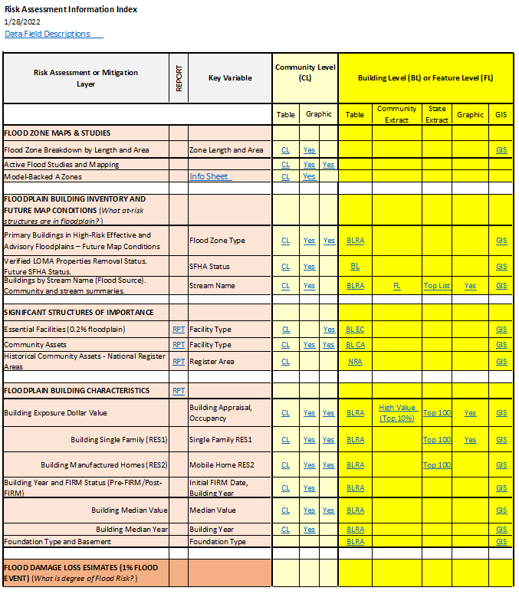
Access Risk Assessment Info
Use the Risk Information Index to access Data and Products
Building Level Risk Assessment (BLRA) Products
GIS Files
Tables (Excel)
  Community Level
  Building (and Feature) Levels with links to online maps
    Table Extracts
    Top Lists
Maps
  Interactive Web Maps
  Graphics and Maps
Reports (Word Docs)
3D Flood Visualizations
Most of the risk assessment data can be viewed on the RiskMAP View of the WV Flood Tool

Slide 5
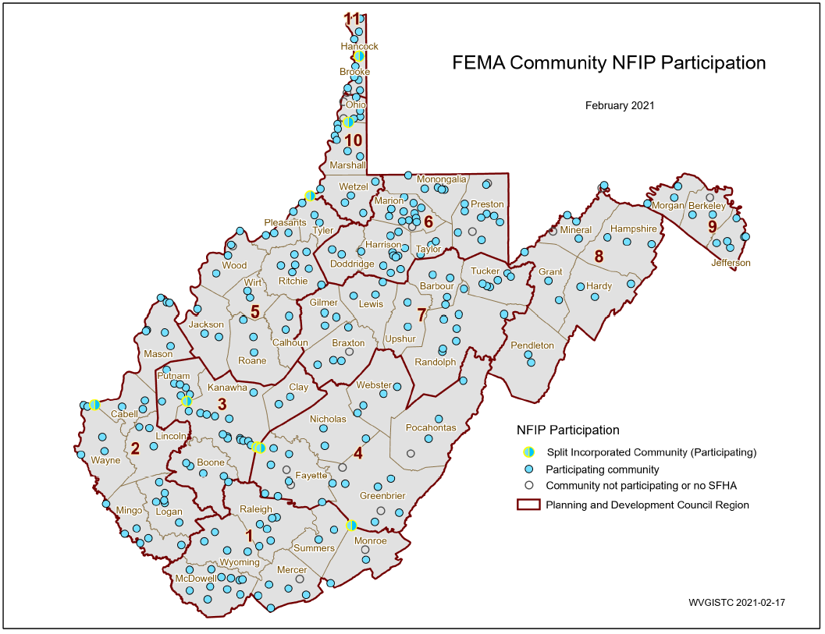
Statewide Hazard Assessment
213 incorporated areas
+55 unincorporated areas
268 NFIP Communities
+18 no SFHA communities
286 WV Communities
+ 8 split communities
294 Statistical Geographies
294 Statistical Geographies form
286 Communities which form
55 Counties which form
11 PDC Regions which form
1 Statewide Flood Risk Assessment
94% of WV Communities have Special Flood Hazard Areas (SFHA)
26 Flood-Prone Communities in
Region 4 (5 counties)
SPLIT COMMUNITY | COUNTY 1 | COUNTY 2
Alderson | Greenbrier | Monroe
Huntington | Cabell | Wayne
Montgomery | Fayette | Kanawha
Nitro | Kanawha | Putnam
Paden City | Tyler | Wetzel
Smithers | Fayette | Kanawha
Wheeling | Marshall | Ohio
Weirton | Brooke | Hancock
PDF Map

Slide 6
268 Flood-Prone Communities
Region 4 has 26 Flood-Prone Communities in the National Flood Insurance Program
11 Regional Planning & Development Councils (55 Counties)
Region | # Counties | # Communities | Split Communities across County Boundary | Communities not participating in NFIP or no SFHA | # NFIP Communities¹
Region 1² | 6 | 32 |  | Athens, Union | 30
Region 2 | 6 | 31 | Huntington |  | 31
Region 3 | 4 | 29 | Nitro |  | 29
Region 4 | 5 | 31 | Alderson, Montgomery, Smithers | Fayetteville³, Hillsboro, Lewisburg, Quinwood³, Thurmond | 26
Region 5 | 8 | 30 | Paden City | North Hills | 29
Region 6 | 6 | 45 |  | Brandonville, Tunnelton, White Hall | 42
Region 7 | 7 | 31 |  | Flatwoods | 30
Region 8 | 5 | 17 |  | Carpendale, Elk Garden | 15
Region 9 | 3 | 12 |  | Hedgesville | 11
Region 10 | 3 | 18 | Wheeling | Bethlehem, Clearview | 16
Region 11 | 2 | 10 | Weirton | Windsor Heights | 9
total | 55 | 286 | 8 | 18 | 268
¹ Source: FEMA's Community Status Source Book ² Region 1 dissolved community of Rhodell (Raleigh County) included in NFIP count. Town of Matoaka (Mercer County) is not included. ³ Communities include SFHA or non-regulatory floodplain
Split Communities Alderson, Montgomery and Smithers are members of Region 4
Split Community Paden City is a member of Region 5

Slide 7
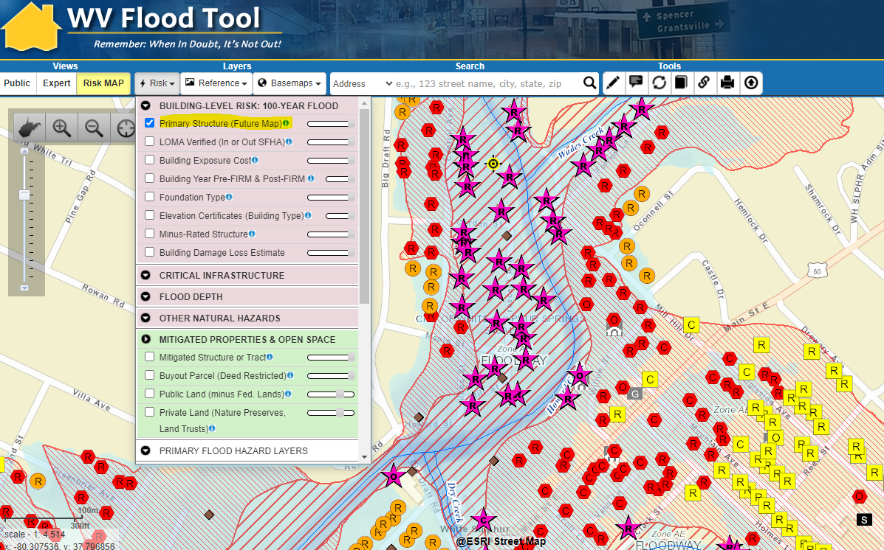
Floodplain Building-Level Risk
All Risk Assessment and Mitigation Layers are displayed on the RiskMAP View of the WV Flood Tool
High-Risk Effective & Advisory
1%-Annual-Chance (100-Yr) Floodplains

Slide 8
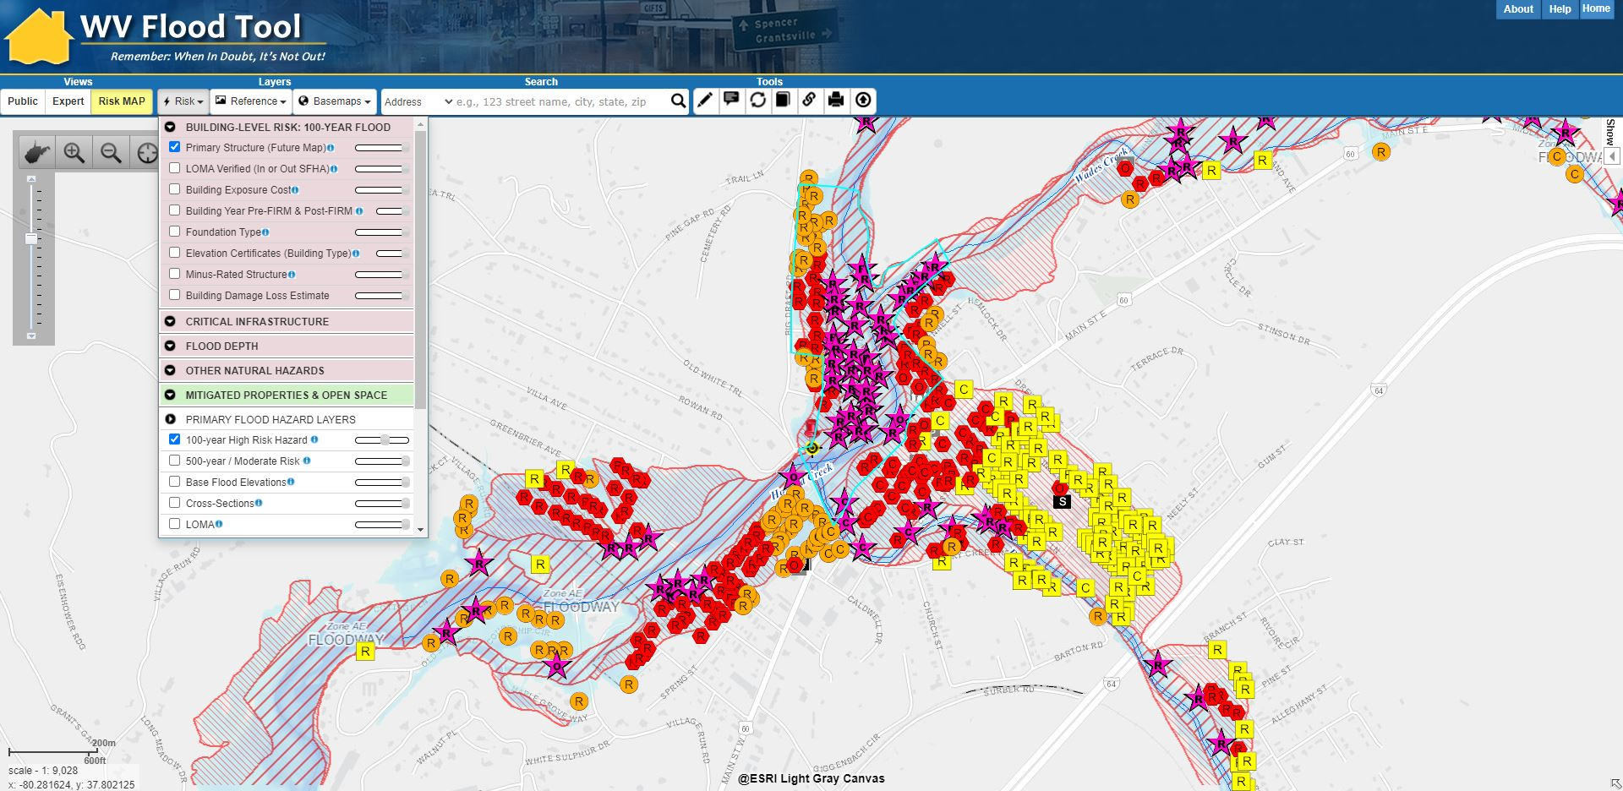
Building Level Risk Assessment
White Sulphur Springs’ primary structures viewable on the Risk MAP View of the WV Flood Tool. Symbol letters indicate general occupancy (Residential, Commercial, Other Non-Residential).

Slide 9
Risk Assessment
FLOOD ZONE MAP INFORMATOIN
What flood zone map information is available now or in the future?

Slide 10
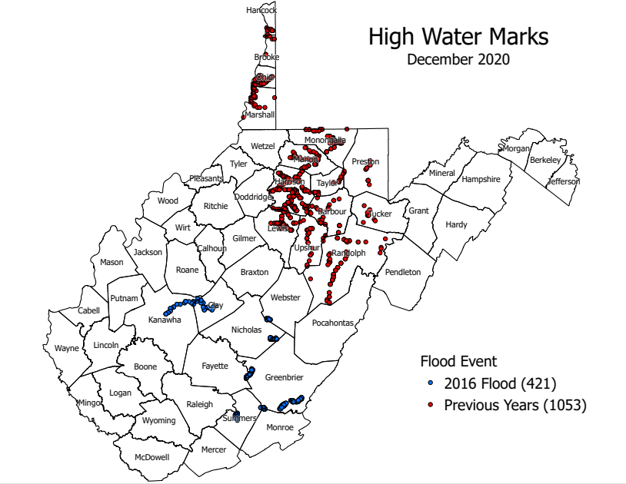
Historical Flood Information
STORY MAPS:
Flood Risk in West Virginia: What We Learned from the June 2016 Flood
WV Flooded Towns, June 2016. The Historic Flooding of Southern West Virginia on June 23, 2016
High-Water Marks Graphic
Historical flood information including high water marks of past flooding events should be reviewed.
FEMA Region 3 Report
Understanding Flood Dangers in Central West Virginia: LESSONS LEARNED FROM THE JUNE 2016 FLOOD

Slide 11
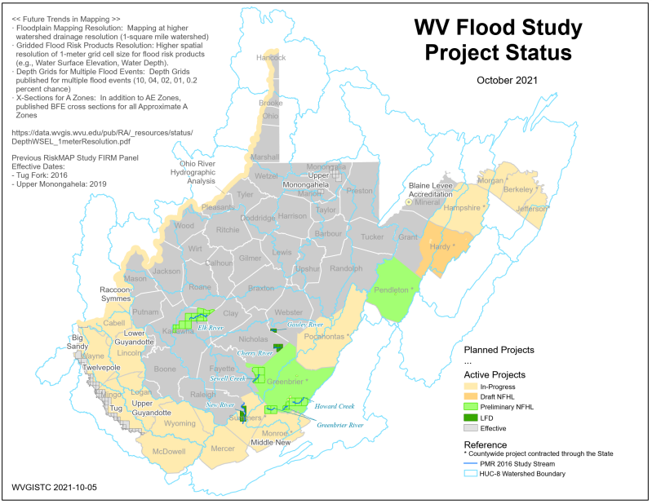
Active Flood Studies
FEMA is creating new flood maps for a number of counties and streams in Region 4 which will alter the floodplain boundaries and base flood elevations. The new flood maps will affect the at-risk building inventories as well.
Flood Study Project Status Map PDF

Slide 12
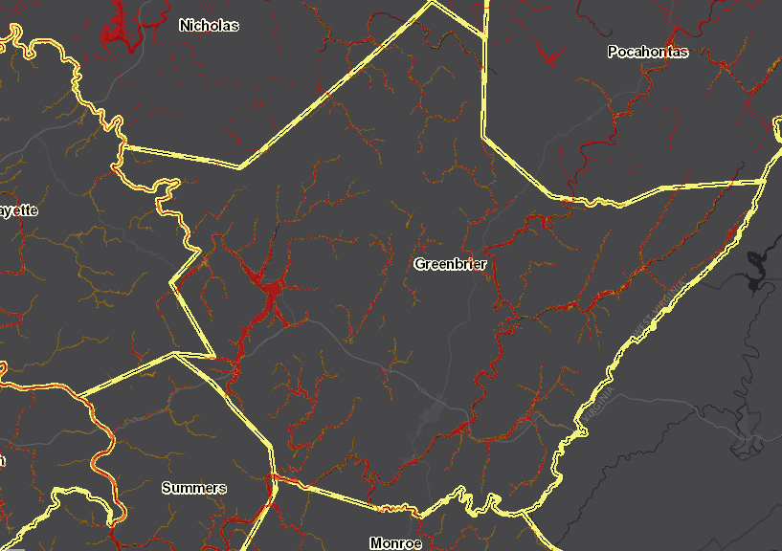
Floodplain Measurements (Area)
Region 4 Unincorporated Areas: Acreage in Effective SFHA
Unincorporated Area* | Total Community Area (acres) | Total SFHA Area (acres) | Modified Total SFHA Area (acres)¹ | Ratio of aSFHA to Community Area
GREENBRIER COUNTY* | 648,250 | 21,594 | 19,278 | 3%
NICHOLAS COUNTY* | 414,533 | 13,865 | 8,579 | 2%
WEBSTER COUNTY * | 354,803 | 8,905 | 6,759 | 2%
POCAHONTAS COUNTY * | 600,184 | 12,584 | 8,050 | 1%
FAYETTE COUNTY* | 412,491 | 5,757 | 3,393 | 1%
Areas excluded from Total aSFHA: Open water lakes > 10 acres; Large river bank-to-bank > 500 ft.; Federal lands > 10 acres Source Table: https://data.wvgis.wvu.edu/pub/RA/State/CL/Flood_Zone_Type-Length-aSFHA/
Risk Assessment: Greenbrier County (4th largest in the State) and Greenbrier Unincorporated (ranked 4th) have the largest acreage in the Special Flood Hazard Area (SFHA), the effective 1%-annual-chance floodplain
GREENBRIER COUNTY
Note: The SFHA (red) will increase for a number of communities in Greenbrier County when the Preliminary flood zones (orange) become effective. The town of Rainelle will have the largest SFHA increase. See Rainelle map link.

Slide 13
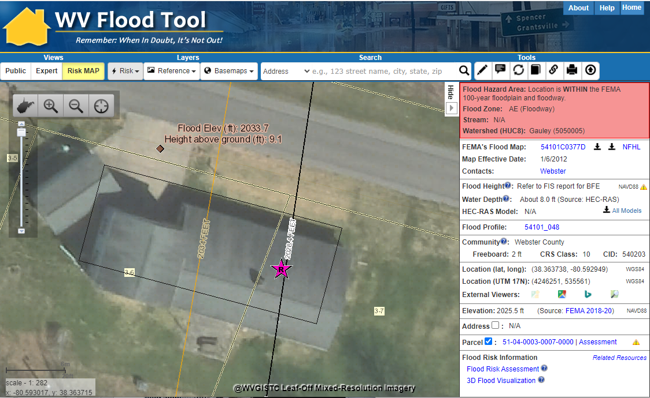
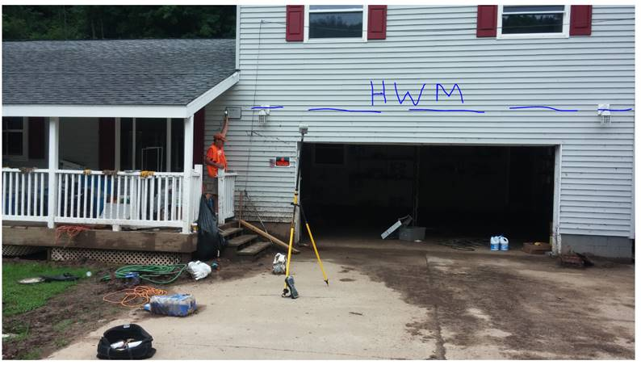
New Flood Maps
FEMA is creating new flood maps for select communities in Region 4 which will alter the floodplain boundaries and base flood elevations. The new flood maps will affect the at-risk building inventories as well. The BFE is increasing 6 feet at this location.
Gauley River
The June 2016 Flood High-Water Mark was 9.1 feet for Building 51-04-0003-0007-0000_91 located near the town Camden-On-Gauley (Webster County) on the Gauley River. The Base Flood Elevation is increasing by 6 feet on the new FEMA flood maps for this location.

Slide 14
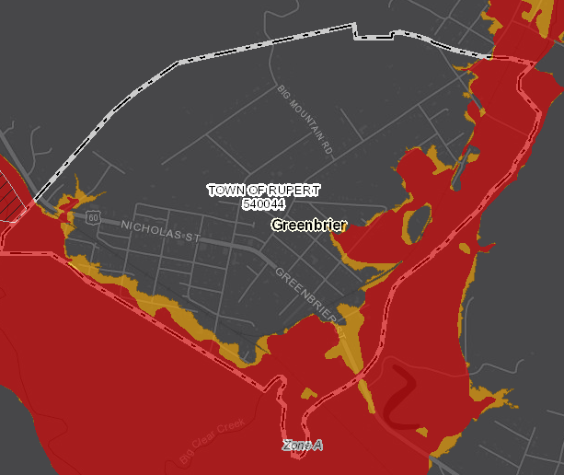
Floodplain Measurements (Area)
Region 4 Incorporated Areas: Acreage in Effective SFHA
Municipality Name | County | Total Community Area (acres) | Modified Total SFHA Area (acres)¹ | Ratio of aSFHA to Community Area
RUPERT, TOWN OF | GREENBRIER COUNTY | 501 | 114 | 23%
MARLINTON, TOWN OF | POCAHONTAS COUNTY | 1,566 | 330 | 21%
ALDERSON, TOWN OF | GREENBRIER COUNTY & MONROE COUNTY | 611 | 126 | 21%
MEADOW BRIDGE, TOWN OF | FAYETTE COUNTY | 260 | 50 | 19%
WHITE SULPHUR SPRINGS, CITY OF | GREENBRIER COUNTY | 1,214 | 189 | 16%
Areas excluded from Total aSFHA: Open water lakes > 10 acres; Large river bank-to-bank > 500 ft.; Federal lands > 10 acres Source Table: https://data.wvgis.wvu.edu/pub/RA/State/CL/Flood_Zone_Type-Length-aSFHA/
RUPERT
Risk Assessment: About 20% of the total incorporated land of Rupert, Marlinton, Alderson, and Meadow Bridge are in the Special Flood Hazard Area (SFHA) and thus have a higher 1%-annual-chance (100-yr) floodplain exposure than other communities.
Mitigation Note: The acreage in the SFHA (aSFHA) is an important programming variable for FEMA’s Community Rating System (CRS). Both Greenbrier and Fayette Unincorporated are West Virginia CRS Class 9 communities.
Rupert web map link

Slide 15
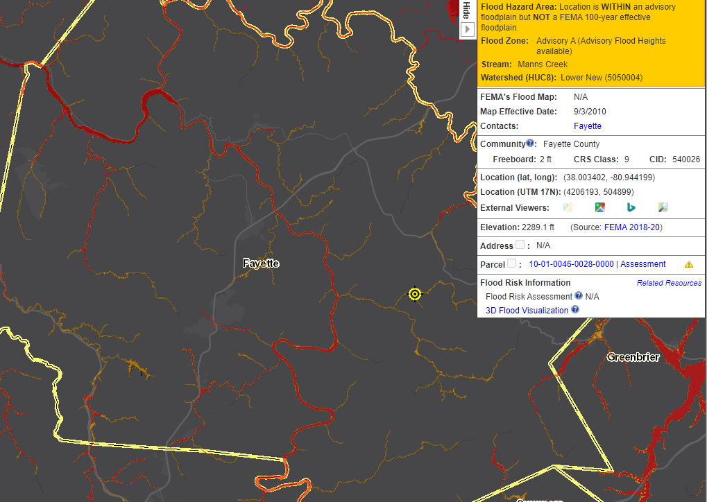
Floodplain Measurements (Length)
Floodplain Length (miles): High-Risk Effective & Advisory Flood Zones
Community Name | Stream Length(mi) -Zones: AE,AH,AO | Stream Length (mi) -Effective A | Stream Length (mi) – Advisory A | Total Length (mi) | Detailed Zone % | Approx. A Zone % | Advisory Zone % | Total Flood Zone Rank in State
GREENBRIER | 55 | 508 | 43 | 606 | 9% | 84% | 7% | 2
NICHOLAS | 26 | 371 | 2 | 399 | 7% | 93% | 0% | 9
POCAHONTAS | 87 | 290 | 6 | 382 | 23% | 76% | 2% | 12
FAYETTE | 29 | 124 | 187 | 340 | 8% | 37% | 55% | 16
WEBSTER | 131 | 183 | 2 | 316 | 41% | 58% | 1% | 22
FAYETTE COUNTY
Risk Assessment
Greenbrier County is ranked 2nd in the State in flood zone stream miles.
Note: If the Advisory Floodplains (orange color) for Fayette County become effective (red color) upon completion of new flood studies, then most likely the flood zone miles will more than double (55%) with an increase of 187 miles of effective A Zones. Refer to High-Risk Advisory Floodplains for more information.
New flood map for Fayette County will most likely double the effective flood zone stream miles
View web Map of Advisory Floodplains (orange colored zones)

Slide 16
R4 Risk Assessment
FLOODPLAIN BUIDLING INVENTORY & FUTURE MAP CONDITIONS
What buildings are at risk?

Slide 17
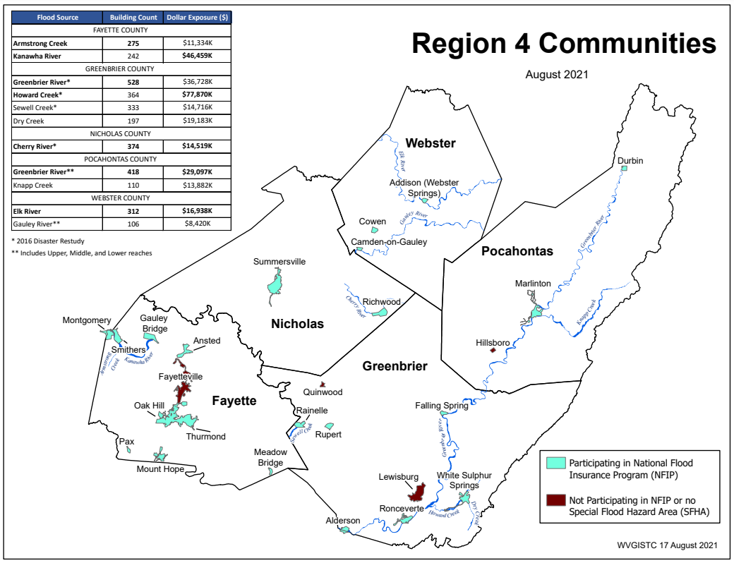
Building Risk by Flood Source
Building Counts and Building Exposure $ Values by Stream Name
Flood Sources | Building Count | Dollar Exposure ($)
FAYETTE COUNTY
Armstrong Creek | 275 | $13,334K
Kanawha River | 242 | $46,459K
GREENBRIER COUNTY
Greenbrier River* | 528 | $60,728K
Howard Creek* | 364 | $94,870K
Sewell Creek* | 333 | $14,716K
Dry Creek | 197 | $19,183K
NICHOLAS COUNTY
Cherry River* | 374 | $15,719K
POCAHONTAS COUNTY
Greenbrier River** | 418 | $29,097K
Knapp Creek | 110 | $13,882K
WEBSTER COUNTY
Elk River | 312 | $16,938K
Gauley River** | 106 | $8,420K
* 2016 Disaster Restudy
Greenbrier River totals for Greenbrier and Pocahontas counties: 946 buildings in 1% floodplain, $90M dollar exposure
Greenbrier River in Region 4 has the most structures in the 1%-annual-chance floodplain
Howard Creek in Greenbrier County has the highest building dollar exposure of all communities in Region 4
Computed for 1% (100-yr) floodplain
RA Tables: Buildings by River/Stream Name
Region 4 PDF Map Primary Flood Sources

Slide 18
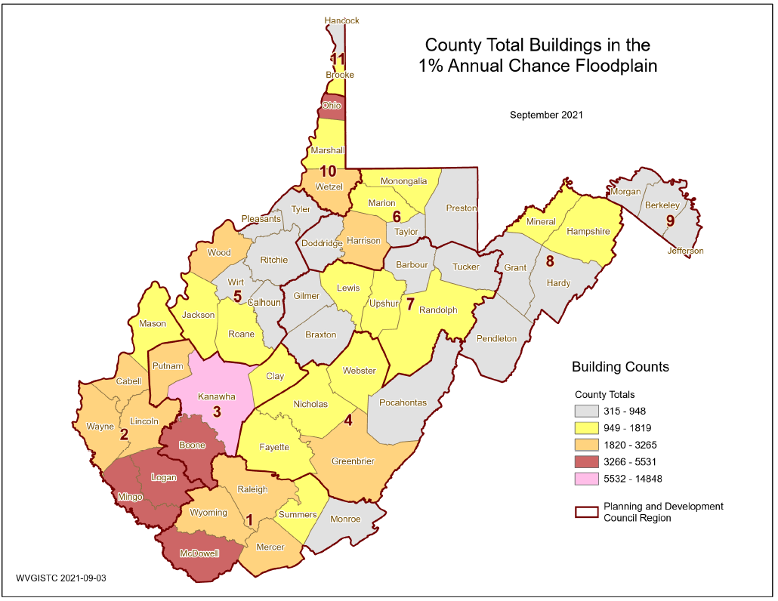
Buildings in 1% Floodplain
County-Wide
Primary structures located in high-risk effective and advisory 1%-annual-chance (100 year) floodplains
1,074
1,056
948
1,819
2,225
Greenbrier County (Region 4) has the most buildings in the 1% Annual Chance Floodplain

Slide 19
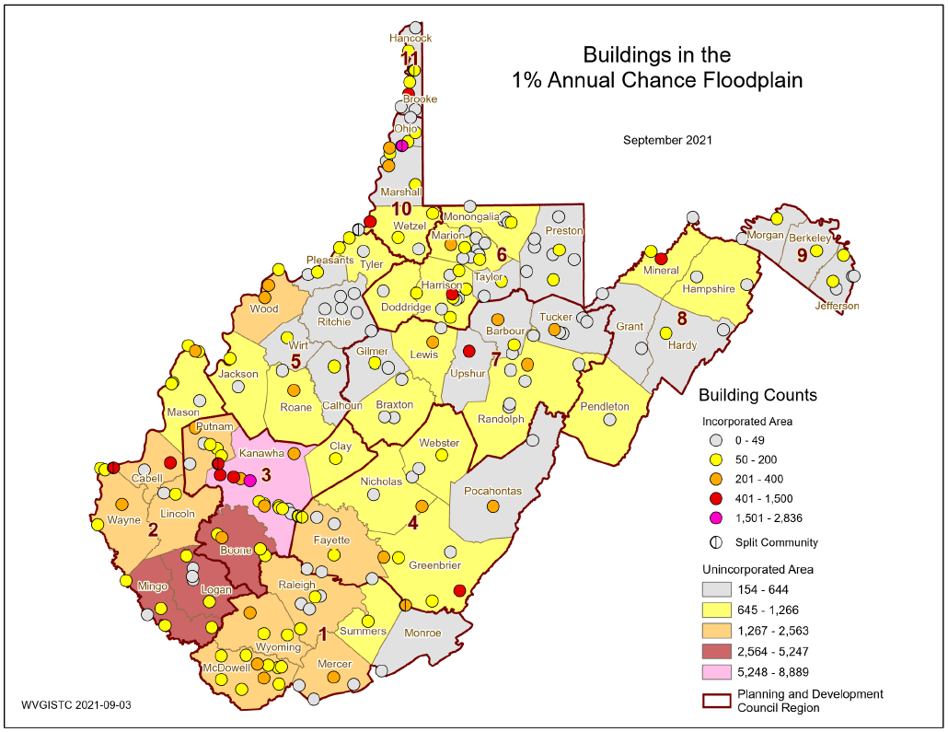
Buildings in 1% Floodplain
Community-Wide
Region 4 has a total of 7,123 structures in the high-risk effective and advisory 1%-annual-chance (100 yr.) floodplains valued at $525,285 million. Greenbrier County (ranked 15th in the State) has the highest countywide building count in the region.
Primary structures located in high-risk effective and advisory 1%-annual-chance (100 year) floodplains
White Sulphur Springs
White Sulphur Springs (Region 4) has the most buildings in the 1% Annual Chance Floodplain

Slide 20
Building Risk by Flood Zone
Region 4 Table
Community-Level Flood Zone Breakdown
Risk Assessment:
According to future flood maps, Fayette, Greenbrier, and Pocahontas counties have many structures being mapped into the higher risk 1%-annual-chance floodplain.
Webster Unincorporated and Richwood Incorporated have the most structures in the floodway. Buildings in the main channel of the river or stream, or close to the flood source, will be subject to the greatest flood depths, highest velocities, and greatest debris potential.

Slide 21
Region 4 Flood Zone Buildings Counts
High-Risk Effective and Advisory 1%-Annual Chance (100-Yr) Floodplains
High-Risk Effective Floodplains (Special Flood Hazard Areas)
SFHA (Effective only) | 5,486
Approximate A | 2,598
Detailed AE | 2,306
Detailed AE Floodway | 582
High-Risk Effective and Advisory Floodplains
SFHA | 5,486
Mapped in Advisory A / AE | 1,636
Total High-Risk (Effective & Advisory) 1% Floodplains | 7,122
Building counts from August 2021 Building Level Risk Assessment

Slide 22
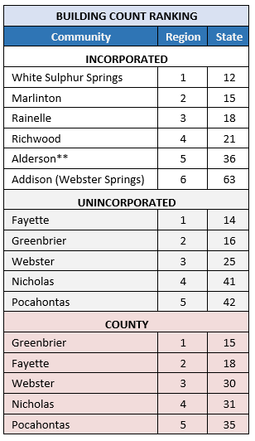
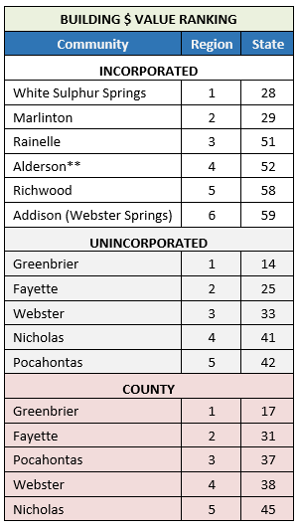
Building Risk by Community Type
Risk Assessment:
White Sulphur Springs INCORPORATED AREA has the highest 1% flood zone building counts and dollar exposure
Fayette and Greenbrier UNINCORPORATED AREAS have the highest building counts and dollar exposure, respectively.
Greenbrier COUNTY has the highest building counts and dollar exposure
Highest number of primary structures in the 1% floodplain:
White Sulphur Springs (incorporated)
Fayette County Unincorporated (unincorporated area)
Greenbrier County (countywide)
Highest building dollar exposure in the 1% floodplain:
White Sulphur Springs (incorporated)
Greenbrier County Unincorporated (unincorporated)
Greenbrier County (countywide)
** Split Community
Source: Region 4 Community-Level Building Exposure Table

Slide 23
Building Future Map Conditions
Residential Structure “remains same” in SFHA
High-Risk Effective & Advisory
1%-Annual-Chance (100-Yr) Floodplains
Residential Structure “mapped out” of SFHA
Flood Risk: According to future flood maps, Greenbrier (735), Fayette (590), and Pocahontas (167) counties have many structures being mapped in to future SFHA. The towns of Rainelle (331) and White Sulphur Springs (68) have many mapped in structures as well.
Commercial Structure “mapped in” of SFHA
(Higher Flood Risk)
Future Map Conditions for structures are inventoried for counties with mapped High-Risk Advisory Floodplains

Slide 24
Future Building Map Conditions
SFHA AND FUTURE MAP CONDITIONS | Select counties have non-regulatory, advisory flood zones (orange zones on WV Flood Tool) that indicate future map conditions of the Special Flood Hazard Area (SFHA).
Floodway | Floodways cans be dangerous because water may flow very fast. Development is not allowed unless there is "no rise" in flood elevations, floodway elevations, and floodway widths are certified. Structures in floodways may require special consideration for mitigation measures.
No Change SFHA | No Change in SFHA designation where High-Risk Effective and Advisory Floodplains overlap. When future map restudies are completed and new FIRMs become effective, it is predicted that structures with this designation are neither "mapped in" nor "mapped out" of the SFHA.
Mapped In SFHA | Risk Assessment: Structures potentially "mapped-in" the SFHA according to mapped High-Risk Advisory Floodplains based on more accurate topography and model-backed A Zones. The "mapped-in" structures most likely will be included in the SFHA when future FEMA Restudies are done and new FIRMS become effective. Communities should review all "mapped-in" structures. Homeowners are at higher risk to flooding and should be contacted about Flood Insurance Preferred Risk Policies and other potential mitigation measures.
Mapped Out SFHA | Structures potentially "mapped-out" the SFHA according to mapped Advisory Floodplains and most likely will NOT be included in the SFHA when the new FIRMs become effective from future Restudies. Communities should review all "mapped-out" structures for LiDAR LOMAs. Although these structures may be mapped to a lesser flood risk designation, property owners should be encouraged to purchase Flood Insurance Preferred Risk Policies at lower premiums. Fayette County example| Monroe County example

Slide 25
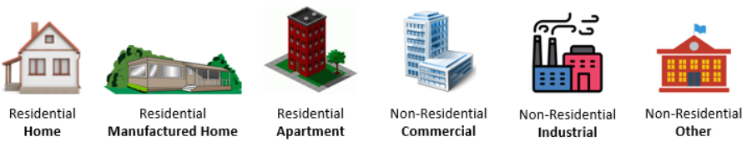


Building Risk Reports
Incorporate information from Risk Assessment Reports into local hazard mitigation planning
Region 4 Building Types & Exposure
Region 4 Essential Facilities Report
Region 4 Community Assets Report

Slide 26
Building Exposure and Type
Risk Assessment: What is at risk?
Floodplain Building Counts: Which communities have the most buildings in high-risk effective and advisory floodplains? Greenbrier County (ranked 15th in the State) has the highest countywide building counts in the region. Fayette County Unincorporated (ranked 14th for unincorporated areas) and the towns of White Sulphur Springs (ranked 12th for incorporated areas) and Marlinton (ranked 15th) also have high building counts.
Building Dollar Exposure: Greenbrier County (ranked 9th in the State) and the incorporated city of White Sulphur Springs (ranked 20th for incorporated areas) have the highest building dollar values exposed to a 1%-annual-chance flood event. Higher building values increase substantial damage thresholds and mitigation reconstruction costs.
Residential/Non-Residential Occupancy Type: Most of the primary buildings in the floodplain are residential: Webster County (92%), Fayette County (91%), Greenbrier County (87%), Nicholas County (86%), and Pocahontas County (85%). Municipalities typically have a higher percentage of non-residential structures, such as the towns of Gauley Bridge (53%) and Ronceverte (49%), in which half the structures are non-residential. The occupancy type (residential versus non-residential) impacts requirements for flood insurance, mitigation construction, substantial damage calculations, flood model estimates, etc.
Residential Structure Type: The majority of the residential structures (<= 4 units) valued at more than $1 million dollars for both Region 4 and the State are located along Howard Creek in Greenbrier County. In fact, 74% of million-dollar structures in State are located along Howard Creek. It is expected that some of these structures will be removed from the 1%-annual-chance floodplain when the preliminary study flood maps become effective.
Non-Residential Structure Type: The top non-residential structures in the 1%-annual-chance floodplain with the highest building value are the Ronceverte Wastewater Treatment Plant ($24M) and White Sulphur Springs (Caldwell) Wastewater Treatment Plant ($17M) in Greenbrier County, Summersville Wastewater Treatment Plant ($10M) in Nicholas County, and Hacker Valley School ($9M) in Webster County

Slide 27
Building Exposure and Type
Risk Assessment: What is at risk?
Median Building Replacement Value: Greenbrier ($43K) and Pocahontas ($34K) counties rank 32nd and 43rd, respectively, in the State for countywide median single-family dwelling (RES 1 Occupancy Class) replacement value. The value for Greenbrier County is close to the statewide median single family dwelling value of $44,000.
Owner Occupied: Of the residential buildings, most of the building stock is owner-occupied: Nicholas (82%), Fayette (79%), Pocahontas (72%), Webster (70%), and Greenbrier (66%). Renters may not have flood insurance and be at higher risk.
Manufactured Homes: Webster County Unincorporated (ranked 28th in the State) has the highest percentage (28%) of manufactured homes for single family dwelling building stock. The town of Cowen (ranked 10th for incorporated areas) also has a high percentage (54%). Lighter-weight manufactured homes are more vulnerable to flood damage.
Building Year and FIRM Status: Webster County ranks 27th in the State for the highest percentage of Post-FIRM structures or new development. The cities of Mount Hope and Ronceverte are two of the oldest communities in the region with building year median values of 1920.

Slide 28






Residential versus Non-Residential
Community | RESIDENTIAL |  |  |  |  | COMMERCIAL NON-RESIDENTIAL |  | OTHER NON-RESIDENTIAL |  | TOTAL BUILDING VALUE
Community Name | # | % Count |  | Value ($) | % Value | # | Value ($) | # | Value ($) | # | Value ($) | Rank¹
Ansted | 1 | 100.0% |  | $66K | 100.0% | 0 | $0K | 0 | $0K | 1 | $66K | 19
Fayette County* | 1425 | 93.2% |  | $50,385K | 66.9% | 57 | $6,523K | 47 | $18,398K | 1529 | $75,307K | 2
Gauley Bridge | 21 | 46.7% |  | $869K | 27.4% | 24 | $2,302K | 0 | $0K | 45 | $3,171K | 11
Meadow Bridge | 21 | 91.3% |  | $695K | 96.8% | 2 | $23K | 0 | $0K | 23 | $718K | 16
Montgomery** | 13 | 86.7% |  | $1,083K | 25.2% | 1 | $1,000K | 1 | $2,215K | 15 | $4,298K
Mount Hope | 32 | 84.2% |  | $787K | 65.1% | 4 | $101K | 2 | $322K | 38 | $1,210K | 14
Oak Hill | 50 | 90.9% |  | $2,262K | 95.3% | 5 | $111K | 0 | $0K | 55 | $2,373K | 12
Pax | 32 | 82.1% |  | $925K | 67.9% | 3 | $98K | 4 | $340K | 39 | $1,362K | 13
Smithers** | 63 | 85.1% |  | $2,064K | 55.8% | 8 | $837K | 3 | $796K | 74 | $3,698K
FAYETTE | 1658 | 91.1% |  | $59,136K | 64.1% | 104 | $10,994K | 57 | $22,071K | 1819 | $92,201K | 2
Alderson** | 121 | 84.6% |  | $6,485K | 56.7% | 17 | $1,028K | 5 | $3,931K | 143 | $11,443K | 5**
Falling Springs | 3 | 100.0% |  | $157K | 100.0% | 0 | $0K | 0 | $0K | 3 | $157K | 18
Greenbrier County* | 1101 | 93.1% |  | $103,297K | 77.7% | 68 | $6,511K | 13 | $23,065K | 1182 | $132,873K | 1
Rainelle | 253 | 74.4% |  | $8,392K | 55.4% | 78 | $5,751K | 9 | $1,006K | 340 | $15,149K | 4
Ronceverte | 34 | 50.7% |  | $1,354K | 4.5% | 32 | $4,436K | 1 | $24,000K | 67 | $29,790K | 3
Rupert | 58 | 93.5% |  | $2,321K | 73.2% | 2 | $291K | 2 | $561K | 62 | $3,173K | 10
White Sulphur Springs | 375 | 87.6% |  | $18,910K | 36.4% | 42 | $5,144K | 11 | $27,940K | 428 | $51,994K | 1
GREENBRIER | 1945 | 87.4% |  | $140,916K | 57.6% | 239 | $23,161K | 41 | $80,503K | 2225 | $244,580K | 1
Nicholas County* | 624 | 90.2% |  | $21,060K | 68.1% | 42 | $6,646K | 26 | $3,230K | 692 | $30,936K | 4
Richwood | 265 | 80.5% |  | $7,518K | 55.8% | 47 | $1,399K | 17 | $4,556K | 329 | $13,473K | 6
Summersville | 23 | 63.9% |  | $1,497K | 11.3% | 11 | $1,657K | 2 | $10,109K | 36 | $13,263K | 7
NICHOLAS | 912 | 86.3% |  | $30,075K | 52.1% | 100 | $9,703K | 45 | $17,895K | 1057 | $57,672K | 5
Durbin | 23 | 85.2% |  | $645K | 72.4% | 2 | $157K | 2 | $89K | 27 | $891K | 15
Marlinton | 286 | 75.1% |  | $15,309K | 44.3% | 82 | $9,635K | 13 | $9,586K | 381 | $34,529K | 2
Pocahontas County* | 502 | 93.0% |  | $23,166K | 84.7% | 23 | $2,460K | 15 | $1,731K | 540 | $27,358K | 5
POCAHONTAS | 811 | 85.5% |  | $39,120K | 62.3% | 107 | $12,252K | 30 | $11,406K | 948 | $62,779K | 4
Addison | 107 | 84.9% |  | $3,855K | 32.7% | 15 | $3,053K | 4 | $4,892K | 126 | $11,799K | 8
Camden-On-Gauley | 13 | 61.9% |  | $263K | 45.9% | 4 | $32K | 4 | $279K | 21 | $573K | 17
Cowen | 28 | 80.0% |  | $814K | 15.4% | 4 | $92K | 3 | $4,375K | 35 | $5,281K | 9
Webster County* | 839 | 94.1% |  | $25,759K | 51.1% | 27 | $2,685K | 26 | $21,957K | 892 | $50,400K | 3
WEBSTER | 987 | 91.9% |  | $30,690K | 45.1% | 50 | $5,861K | 37 | $31,502K | 1074 | $68,053K | 3
SUMMARY | 6,313 | 88.5% |  | $299,937K | 56.3% | 600 | $61,971K | 210 | $163,376K | 7,123 | $525,285K
Alderson (Greenbrier/Monroe) Split Community Total:
Alderson** | 175 | 0.0% | $8,869K |  | 60.4% | 24 | $1,482K | 10 | $4,332K | 209 | $14,683K | 5
Building Dollar Exposure Report:
Residential versus Non-Residential
¹ Group Rank on Community Type: County, Unincorporated, Incorporated. Table ranking by Region and not Statewide.

Slide 29
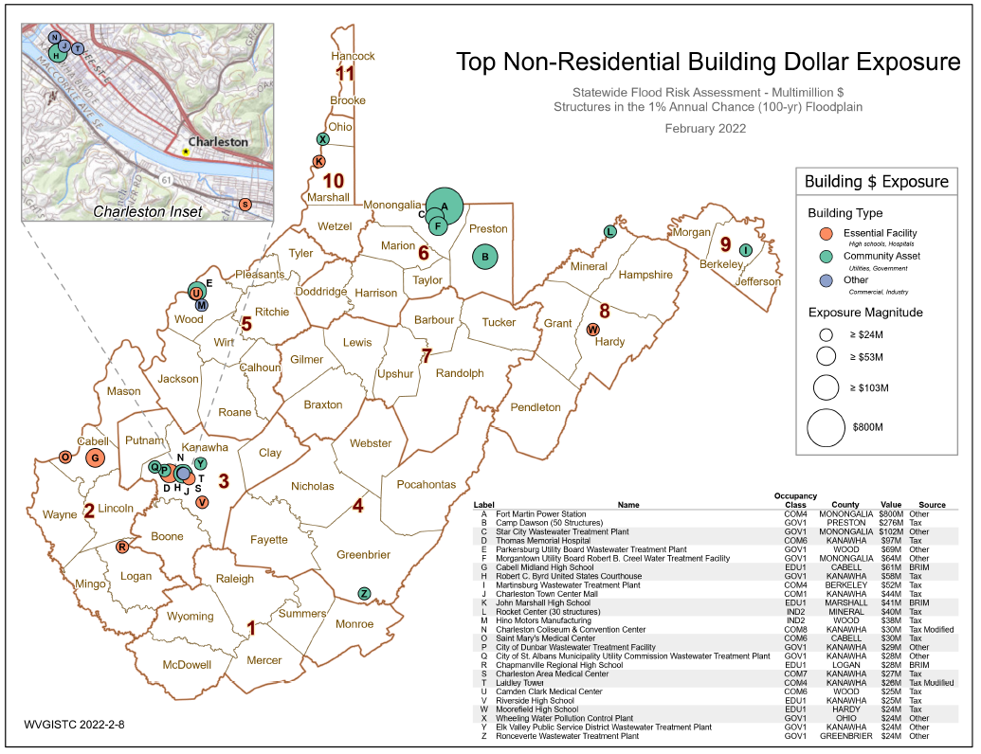
Non-Residential Building Exposure
Top non-residential structure in the 1%-annual-chance floodplain with the highest building value is the Ronceverte Wastewater Treatment Plant ($24M)
Source Graphic

Slide 30
Non-Residential: High Bldg. Values
Highly valued buildings in 1% Floodplain for Fayette County. Which high-valued-structures are vulnerable to riverine flooding?
FAYETTE COUNTY Community Name | WV Flood Tool Link | FAYETTE COUNTY Owner Name or Building ID | Hazard Occupancy Code | General Occupancy | Building Appraisal
Smithers** | FT | BOARD OF EDUCATION FAY CO | EDU1 | Other | $ 17,343,724
Montgomery** | FT | LAIRD FOUNDATION INC | COM6 | Commercial | $ 5,254,600
Smithers** | FT | BOARD OF EDUCATION FAY CO | EDU1 | Other | $ 4,213,763
Fayette County* | FT | WHITE OAK PUBLIC SERVICE DIST | COM4 | Commercial | $ 4,000,000
Fayette County* | FT | CITY OF MT HOPE | COM4 | Commercial | $ 3,000,000
Montgomery** | FT | LIVING WATERS CHRISTIAN FELLOWSHIP (TRUSTEES) | REL1 | Other | $ 2,214,940
Fayette County* | FT | ARMSTRONG PUB SERV DIST | COM4 | Commercial | $ 2,000,000
Fayette County* | FT | CLONCH INDUSTRIES INC | IND1 | Commercial | $ 1,285,200
* Unincorporated ** Split Community
Region 4: Tabular Building-Level Report Link: data.wvgis.wvu.edu - /pub/RA/State/BL/BLRA/R4_BLRA_Full_List/
Region 4: Top 10% Data Extract of High Building Dollar Exposure: https://data.wvgis.wvu.edu/pub/RA/State/BL/Extract/HighBldgValue/
State Top 100: Building Exposure: https://data.wvgis.wvu.edu/pub/RA/State/BL/Top-List/Top100/
Community Engagement and Verification: Region 4 has a total of 7,123 structures in the 1%-annual-chance floodplain valued at $525,285 million
Building-Level Verification: Verify the highly valued buildings using the building-level risk assessment (BLRA) table, Top 10% data extract high-building dollar exposure, statewide top building exposure listing, and Risk MAP View of the WV Flood Tool. For buildings inventoried in the 1% floodplains, review the most expensive residential and non-residential buildings located in the high-risk flood zones sorted on building appraisal value from largest to smallest value. Identify building-level mitigation and outreach strategies.

Slide 31
Non-Residential: High Bldg. Values
Highly valued buildings in 1% Floodplain for Greenbrier County. Which high-valued-structures are vulnerable to riverine flooding?
GREENBRIER COUNTY Community Name | WV Flood Tool Link | GREENBRIER COUNTY Owner Name or Building ID | Hazard Occupancy Code | General Occupancy | Building Appraisal
Ronceverte | FT | THE CITY OF RONCEVERTE WWP | GOV1 | Other | $24,000,000
White Sulphur Springs | FT | GREENBRIER CO BD OF ED | EDU1 | Other | $ 8,542,982
Greenbrier County* | FT | W V DEPARTMENT OF CORRECTION | GOV1 | Other | $ 4,067,092
Alderson** | FT | BOARD OF EDUCATION | EDU1 | Other | $ 3,508,927
Ronceverte | FT | B A MULLICAN LUMBER & MANUFACT URING CO L P | IND1 | Commercial | $ 2,043,400
Rainelle | FT | PARK CENTER INC | COM1 | Commercial | $ 1,443,900
White Sulphur Springs | FT | BANK OF WHITE SULPHUR SPRINGS | COM5 | Commercial | $ 1,186,700
Greenbrier County* | FT | WHATCOAT UNITED METHODIST CHURCH | REL1 | Other | $ 768,240
* Unincorporated ** Split Community
Region 4: Tabular Building-Level Report Link: data.wvgis.wvu.edu - /pub/RA/State/BL/BLRA/R4_BLRA_Full_List/
Region 4: Top 10% Data Extract of High Building Dollar Exposure: https://data.wvgis.wvu.edu/pub/RA/State/BL/Extract/HighBldgValue/
State Top 100: Building Exposure: https://data.wvgis.wvu.edu/pub/RA/State/BL/Top-List/Top100/

Slide 32
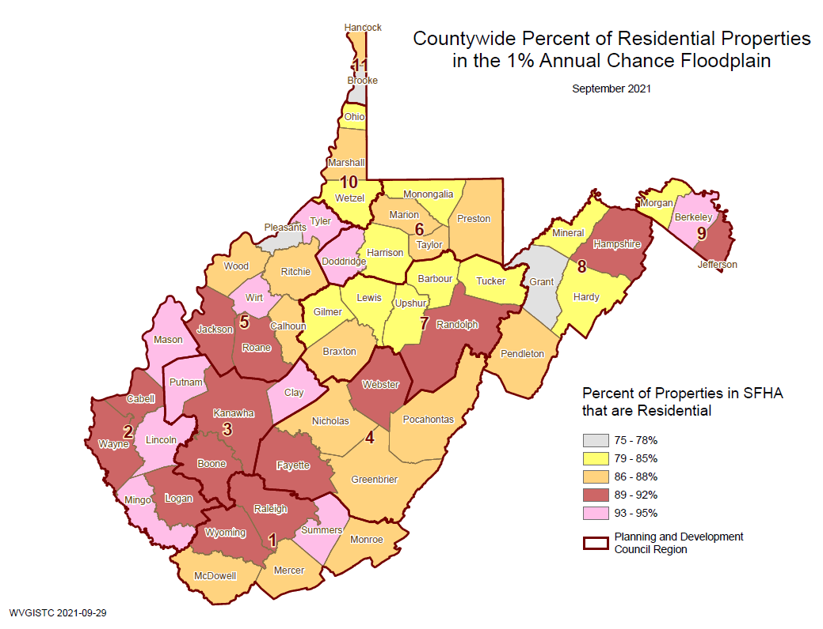
Residential % of Building Stock
Building Stock mostly RESIDENTIAL
Most of the primary buildings in the floodplain are residential: Webster County (92%), Fayette County (91%), Greenbrier County (87%), Nicholas County (86%), and Pocahontas County (85%).
Top Towns high NON-RESIDENTIAL %
Gauley Bridge (53% Non-Residential)
Ronceverte(49%)
Camden-on-Gauley (38%)
Summersville (34%)
Marlinton(25%)
92%
87%
86%
91%
87%

Slide 33
Residential: Single Family Dwellings
Community |  | SINGLE FAMILY HOME |  | MANUFACTURED (MOBILE) HOME |  |  | SINGLE FAMILY TOTAL
Community Name | County | Count | Value ($) | Count | % Count | Value ($) | Count | Value ($) | Group Rank¹
Ansted | FAYETTE | 1 | $66K | 0 | 0.0% | $0K | 1 | $66K | 18
Fayette County* | FAYETTE | 1165 | $44,640K | 239 | 17.0% | $4,131K | 1404 | $48,771K | 2
Gauley Bridge | FAYETTE | 17 | $619K | 1 | 5.6% | $10K | 18 | $629K | 15
Meadow Bridge | FAYETTE | 13 | $551K | 7 | 35.0% | $113K | 20 | $664K | 13
Montgomery** | FAYETTE | 11 | $931K | 1 | 8.3% | $15K | 12 | $945K | 3
Mount Hope | FAYETTE | 31 | $771K | 1 | 3.1% | $16K | 32 | $787K | 12
Oak Hill | FAYETTE | 47 | $2,173K | 2 | 4.1% | $39K | 49 | $2,212K | 7
Pax | FAYETTE | 28 | $827K | 4 | 12.5% | $97K | 32 | $925K | 10
Smithers** | FAYETTE | 54 | $1,802K | 6 | 10.0% | $77K | 60 | $1,879K | 2
 | FAYETTE | 1367 | $52,379K | 261 | 16.0% | $4,499K | 1628 | $56,877K | 2
Alderson** | GREENBRIER | 107 | $5,786K | 10 | 8.5% | $248K | 117 | $6,034K | 1
Falling Springs | GREENBRIER | 2 | $137K | 1 | 33.3% | $20K | 3 | $157K | 17
Greenbrier County* | GREENBRIER | 822 | $96,262K | 264 | 24.3% | $6,626K | 1086 | $102,888K | 1
Rainelle | GREENBRIER | 229 | $7,621K | 16 | 6.5% | $579K | 245 | $8,200K | 3
Ronceverte | GREENBRIER | 29 | $1,138K | 0 | 0.0% | $0K | 29 | $1,138K | 9
Rupert | GREENBRIER | 45 | $1,974K | 11 | 19.6% | $329K | 56 | $2,302K | 6
White Sulphur Springs | GREENBRIER | 338 | $15,856K | 4 | 1.2% | $125K | 342 | $15,981K | 1
 | GREENBRIER | 1572 | $128,774K | 306 | 16.3% | $7,926K | 1878 | $136,699K | 1
Nicholas County* | NICHOLAS | 455 | $17,833K | 165 | 26.6% | $2,939K | 620 | $20,772K | 5
Richwood | NICHOLAS | 217 | $6,725K | 42 | 16.2% | $630K | 259 | $7,356K | 4
Summersville | NICHOLAS | 19 | $1,423K | 3 | 13.6% | $55K | 22 | $1,478K | 8
 | NICHOLAS | 691 | $25,981K | 210 | 23.3% | $3,624K | 901 | $29,605K | 5
Durbin | POCAHONTAS | 15 | $499K | 7 | 31.8% | $130K | 22 | $629K | 14
Marlinton | POCAHONTAS | 244 | $8,263K | 22 | 8.3% | $354K | 266 | $8,617K | 2
Pocahontas County* | POCAHONTAS | 400 | $21,017K | 90 | 18.4% | $1,504K | 490 | $22,521K | 4
 | POCAHONTAS | 659 | $29,779K | 119 | 15.3% | $1,988K | 778 | $31,767K | 3
Addison | WEBSTER | 95 | $3,434K | 11 | 10.4% | $211K | 106 | $3,645K | 5
Camden-On-Gauley | WEBSTER | 9 | $171K | 4 | 30.8% | $92K | 13 | $263K | 16
Cowen | WEBSTER | 13 | $423K | 15 | 53.6% | $391K | 28 | $814K | 11
Webster County* | WEBSTER | 598 | $20,815K | 238 | 28.5% | $4,885K | 836 | $25,700K | 3
 | WEBSTER | 715 | $24,842K | 268 | 27.3% | $5,580K | 983 | $30,422K | 4
SUMMARY |  | 5,004 | $261,756K | 1,164 | 19.6% | $23,616K | 6,168 | $285,371K
Building Dollar Exposure Report:
Single Family Dwellings
¹ Group Rank on Community Type: County, Unincorporated, Incorporated. Table ranking by Region and not Statewide.

Slide 34
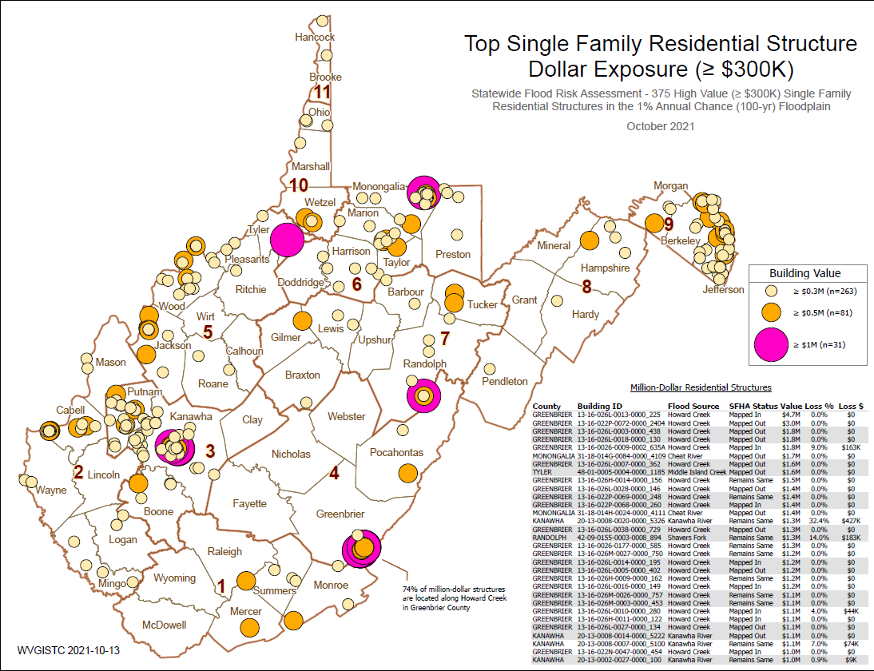
Residential: Top Single-Family $ Exposure
74% of million-dollar RESIDENTIAL structures in State are located along Howard Creek in Greenbrier County
Howard Creek

Slide 35
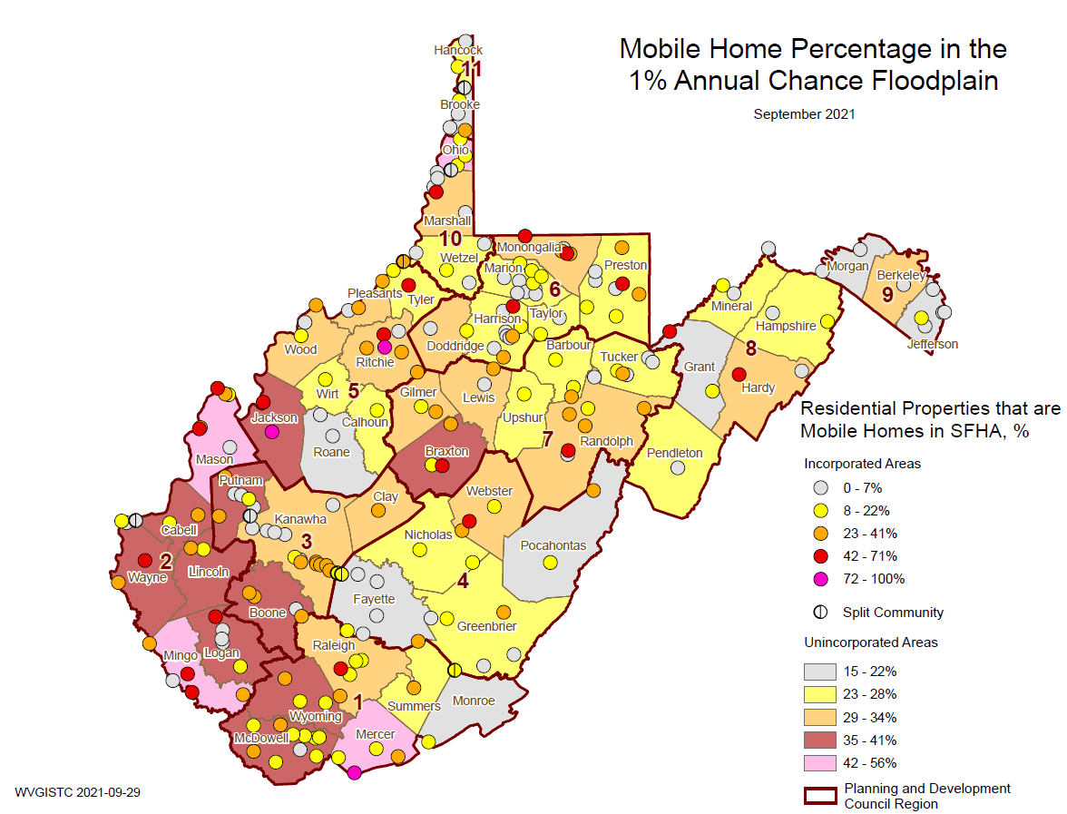
Residential: Mobile Home %
Webster County
Cowen (54%)
Camden-On-Gauley (31%)
Webster Unincorporated (29%)
Manufactured homes are of lightweight construction and more vulnerable to flood damage
Cowen
The town of Cowen and Webster County have the highest percentage of manufactured homes

Slide 36
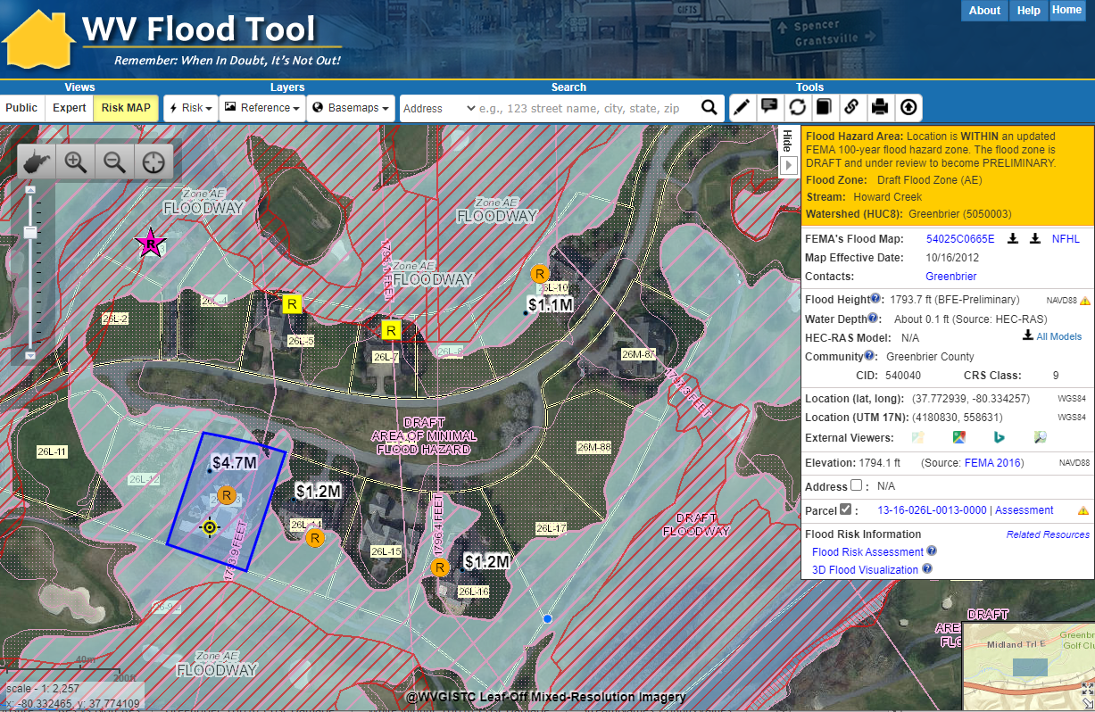
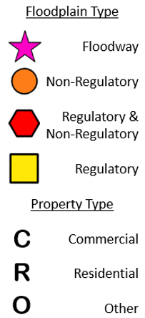
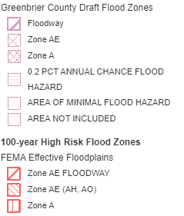
Residential: High Building $ Exposure
Four Homes along Howard Creek with Total Building Value of $8.2 million mapped into new Draft Floodplain. Building status changed when newer Preliminary Floodplain published in 2021.
White Sulphur Springs
Mapped-In Draft Floodplain (Future SFHA)
https://www.mapwv.gov/flood/map/?wkid=102100&x=-8942775&y=4547402&l=11&v=2

Slide 37
R4 Risk Assessment
SIGNIFICANT STRUCTURES OF IMPORTANCE
What critical facilities are at risk?

Slide 38
Essential Facilities
COMMUNITY IDENTIFICATION |  |  | ESSENTIAL FACILITIES
CID | Community Name | County | Police Station | Fire Station | 911 Center | School | Hospital | Nursing Home | TOTAL
540027 | Ansted | FAYETTE | 0 | 0 | 0 | 0 | 0 | 0 | 0
540026 | Fayette County* | FAYETTE | 0 | 3 | 0 | 2 | 0 | 0 | 5
540294 | Gauley Bridge | FAYETTE | 1 | 1 | 0 | 0 | 0 | 0 | 2
540028 | Meadow Bridge | FAYETTE | 0 | 0 | 0 | 0 | 0 | 0 | 0
540029 | Montgomery** | FAYETTE | 1 | 0 | 0 | 0 | 1 | 1 | 3
540280 | Mount Hope | FAYETTE | 0 | 0 | 0 | 0 | 0 | 0 | 0
540031 | Oak Hill | FAYETTE | 0 | 0 | 0 | 0 | 0 | 0 | 0
540032 | Pax | FAYETTE | 0 | 1 | 0 | 0 | 0 | 0 | 1
540033 | Smithers** | FAYETTE | 2 | 1 | 0 | 2 | 0 | 0 | 5
SUM | Ranked 8th in State | FAYETTE | 4 | 6 | 0 | 4 | 1 | 1 | 16
540041 | Alderson** | GREENBRIER | 0 | 0 | 0 | 1 | 0 | 0 | 1
540243 | Falling Springs | GREENBRIER | 0 | 0 | 0 | 0 | 0 | 0 | 0
540040 | Greenbrier County* | GREENBRIER | 0 | 0 | 0 | 0 | 0 | 0 | 0
540228 | Rainelle | GREENBRIER | 0 | 1 | 0 | 0 | 0 | 0 | 1
540043 | Ronceverte | GREENBRIER | 0 | 0 | 0 | 0 | 0 | 0 | 0
540044 | Rupert | GREENBRIER | 0 | 0 | 0 | 0 | 0 | 0 | 0
540045 | White Sulphur Springs | GREENBRIER | 1 | 0 | 0 | 1 | 0 | 0 | 2
SUM |  | GREENBRIER | 1 | 1 | 0 | 2 | 0 | 0 | 4
540146 | Nicholas County* | NICHOLAS | 0 | 1 | 0 | 0 | 0 | 0 | 1
540147 | Richwood | NICHOLAS | 2 | 1 | 0 | 0 | 0 | 0 | 3
540148 | Summersville | NICHOLAS | 0 | 0 | 0 | 0 | 0 | 0 | 0
SUM |  | NICHOLAS | 2 | 2 | 0 | 0 | 0 | 0 | 4
540158 | Durbin | POCAHONTAS | 0 | 0 | 0 | 0 | 0 | 0 | 0
540159 | Marlinton (Ranked 7th for all municipalities in State) | POCAHONTAS | 2 | 1 | 0 | 1 | 0 | 1 | 5
540283 | Pocahontas County* | POCAHONTAS | 0 | 0 | 0 | 0 | 0 | 0 | 0
SUM |  | POCAHONTAS | 2 | 1 | 0 | 1 | 0 | 1 | 5
540204 | Addison (Berkeley Springs) | WEBSTER | 0 | 1 | 1 | 1 | 0 | 0 | 3
540205 | Camden-On-Gauley | WEBSTER | 1 | 0 | 0 | 0 | 0 | 0 | 1
540206 | Cowen | WEBSTER | 0 | 0 | 0 | 1 | 0 | 0 | 1
540203 | Webster County* | WEBSTER | 0 | 2 | 0 | 1 | 0 | 0 | 3
SUM |  | WEBSTER | 1 | 3 | 1 | 3 | 0 | 0 | 8
37 essential facilities

Slide 39
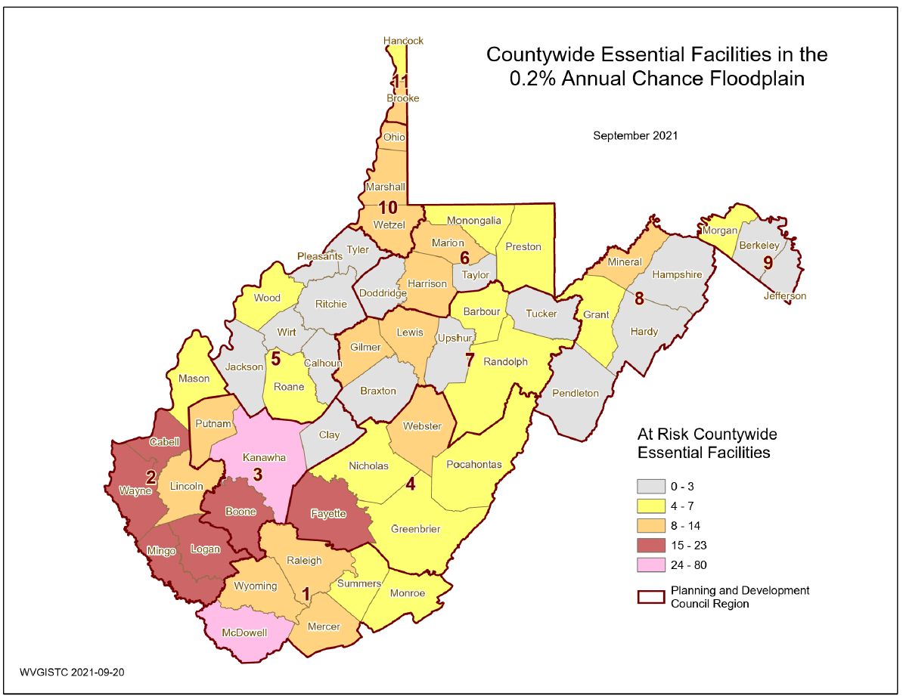
Essential Facilities 0.2% Floodplain
Fayette County is ranked 8th in the State for the most essential facilities. The town of Marlinton is ranked 7th of all incorporated places.
8
4
5
16
4

Slide 40
Essential Facilities
Community Name | County | Facility Name | Facility Type | Flood Tool Link | Flood Depth | Building Damage Percent
Alderson** | GREENBRIER | Alderson Elementary School | School | FT | 3.5 | 8.0
Marlinton | POCAHONTAS | Marlinton Police Department | Police Station | FT | 2.2 | 7.6
Marlinton | POCAHONTAS | Marlinton Volunteer Fire Department | Fire Station | FT | 2.2 | 7.7
Fayette County* | FAYETTE | Loup Creek Volunteer Fire Department - Robson | Fire Station | FT | 1.1 | 0.9
* Unincorporated Area
** Split Community
Community Engagement and Verification: There are 25 facilities in the high risk effective and advisory 1%-annual-chance (100-yr) flood level and 12 facilities in the moderate risk 0.2%-annual-chance (500-yr) flood level. No essential facilities exist in the Regulatory Floodway.
Review the accuracy and completeness of all active essential facilities. Report any facilities that are missing. Verify the facilities and location using the CL Report / Tables, BL Tables, and RiskMAP View of the WV Flood Tool.

Slide 41
More Essential Facilities
Community Name | County | Facility Name | Facility Type | Flood Tool Link | Flood Depth | Building Damage Percent
Alderson** | GREENBRIER | Alderson Elementary School | School | FT | 3.5 | 8.0
Marlinton | POCAHONTAS | Marlinton Police Department | Police Station | FT | 2.2 | 7.6
Marlinton | POCAHONTAS | Marlinton Volunteer Fire Department | Fire Station | FT | 2.2 | 7.7
Fayette County* | FAYETTE | Loup Creek Volunteer Fire Department - Robson | Fire Station | FT | 1.1 | 0.9
Webster County* | WEBSTER | Erbacon Volunteer Fire Department | Fire Station | FT | 1.0 | 0.0
Marlinton | POCAHONTAS | Pocahontas County 911 Center | Police Station | FT | 1.0 | 0.0
Marlinton | POCAHONTAS | Marlinton Elementary School | School | FT | 0.8 | 0.0
Fayette County* | FAYETTE | Armstrong Creek Volunteer Fire Department | Fire Station | FT | 0.8 | 0.0
Fayette County* | FAYETTE | Covenant Promise Christian Academy | School | FT | 0.5 | 0.0
Webster County* | WEBSTER | Hacker Valley Elementary School | School | FT | 0.4 | 0.0
White Sulphur Springs | GREENBRIER | White Sulphur Springs Police Department | Police Station | FT | 0.2 | 0.0
Webster County* | WEBSTER | Hacker Valley Volunteer Fire Department | Fire Station | FT | 0.1 | 0.0
Addison | WEBSTER | Webster County Office of Emergency Services/ E-911 | 911 Center | FT | 0.1 | 0.0
Richwood | NICHOLAS | Richwood Police Department | Police Station | FT | 0.1 | 0.0
Rainelle | GREENBRIER | Rainelle Volunteer Fire Department | Fire Station | FT | 0.1 | 0.0
Pax | FAYETTE | Pax Volunteer Fire Department | Fire Station | FT | 0.1 | 0.0
Building-Level Report
Degree of Risk?
* Unincorporated Community
** Split Community

Slide 42
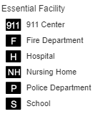
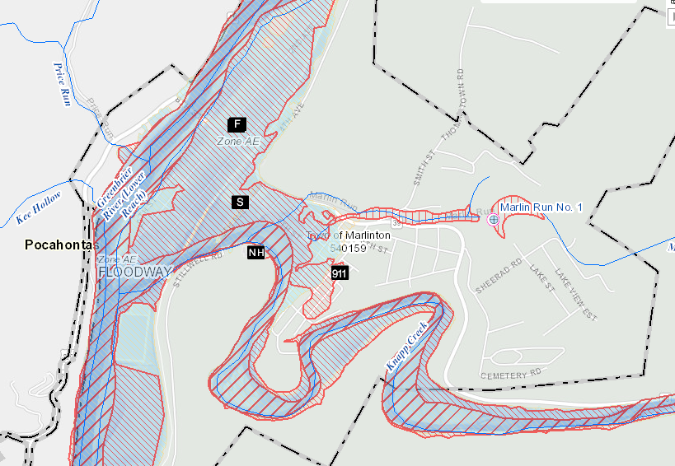
Essential Facilities
Marlinton
Risk Assessment
58% or 15 of the 26 flood-prone communities in Region 4 have essential facilities vulnerable to flooding. The county with the most essential facilities is Fayette County (ranked 8th for all counties), while the incorporated town with the highest number of facilities is Marlinton (ranked 7th for all municipalities in State) in Pocahontas County. Hospitals and nursing homes with immobile patients or residents are particularly vulnerable to a flood disaster. Small towns situated mostly in the floodplain are more challenged than unincorporated areas or larger cities to identify suitable sites that provide a high level of protection from flooding.
The town of Marlinton (Pocahontas County) and Fayette County have a large number of essential facilities
WV Flood Tool Map Link: https://www.mapwv.gov/flood/map/?wkid=102100&x=-8915613&y=4610416&l=8&v=2
R4 Essential Facilities Report

Slide 43
Community Assets
Non-Historical Community Assets: Fayette County has the largest number of inventoried community resources (n=53) and ranked 12th in the State of which the majority are religious buildings. Fayette Unincorporated is ranked 10th of all unincorporated areas. The town of Marlinton is ranked 8th of all incorporated areas in the State with the most community assets.
Historical Community Assets: Greenbrier County is ranked 7th in the State as having the most historical buildings (n=56) in the high-risk floodplain of which the majority are in the city of Ronceverte (ranked 14th of all incorporated areas). The split community of Alderson and the city of Mount Hope also have significant numbers of historical buildings in the high-risk floodplain (18 and 16 respectively).
Mitigation: A designated historic structure can obtain the benefit of subsidized flood insurance through the NFIP even if it has been substantially improved or substantially damaged so long as the building maintains its historic designation.

Slide 44
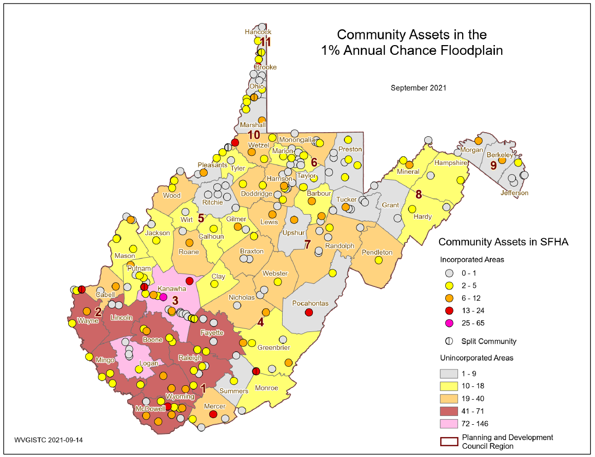
Community Assets (Non-Historical)
Region 4 Communities
Fayette Unincorporated (45)
Webster Unincorporated (24)
Nicholas Unincorporated (23)
Marlinton (13)
Alderson (8)
Richwood (8)
A total of 170 community assets (non-historical) and 102 historical buildings were inventoried in the 1%-annual-chance floodplain for the Region 4. Fayette County has the largest number of inventoried community resources (n=53) of which the majority are religious buildings. The town of Marlinton (ranked 3rd of all incorporated areas) has six government and two utility buildings (ranked 5th) located in the floodplain.
Marlinton

Slide 45
Community Assets
Community Name | County | Historical Place | Facility Type | Flood Tool Link | Flood Depth | Building Damage Percent
Ronceverte | GREENBRIER | Ronceverte Water Treatment Plant | Utilities | FT | 9.6 | 21%
Fayette County* | FAYETTE | United States Postal Service Office | Government | FT | 7.0 | 15%
Webster County* | WEBSTER | United States Postal Service | Government | FT | 5.5 | 7%
Webster County* | WEBSTER | Craigsville Public Service District | Utilities | FT | 5.1 | 29%
Fayette County* | FAYETTE | New River Gorge Visitor Contact Center | Government | FT | 4.8 | 14%
* Unincorporated Area
** Split Community
Community Engagement and Verification: A total of 170 community assets (non-historical) and 102 historical buildings were inventoried in the 1%-annual-chance floodplain for the Region 4
Review the accuracy and completeness of all active community assets. Report any structures that are missing. Verify the buildings and location using the CL Report / Tables, BL Tables, and Risk MAP View of the WV Flood Tool. Review and identify mitigation strategies for the community assets vulnerable to flooding.

Slide 46
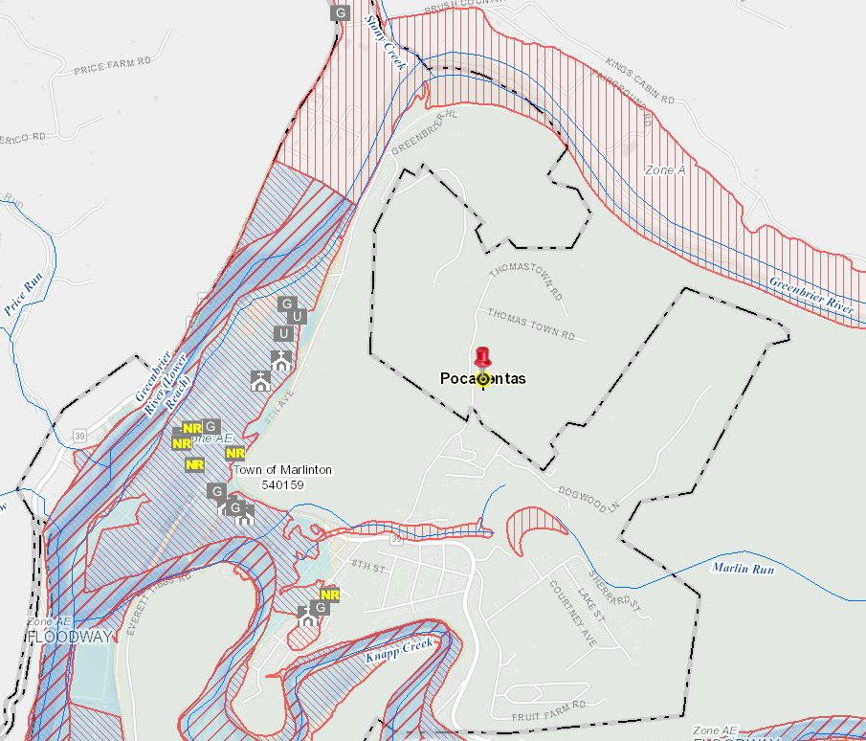
Community Assets
Marlinton
Risk Assessment
Community Assets: A total of 170 community assets (non-historical) were inventoried in the 1%-annual-chance floodplain for the Region 4 Planning and Development Council. Fayette County has the largest number of inventoried community resources (n=53) of which the majority are religious buildings. The town of Marlinton (ranked 3rd of all incorporated areas) has six government and two utility buildings (ranked 5th) located in the floodplain.
The town of Marlinton (Pocahontas County) and Fayette County have a large number of community assets
R4 Community Assets Report
WV Flood Tool Map Link:
https://www.mapwv.gov/flood/map/?wkid=102100&x=-8914626&y=4611336&l=8&v=2

Slide 47
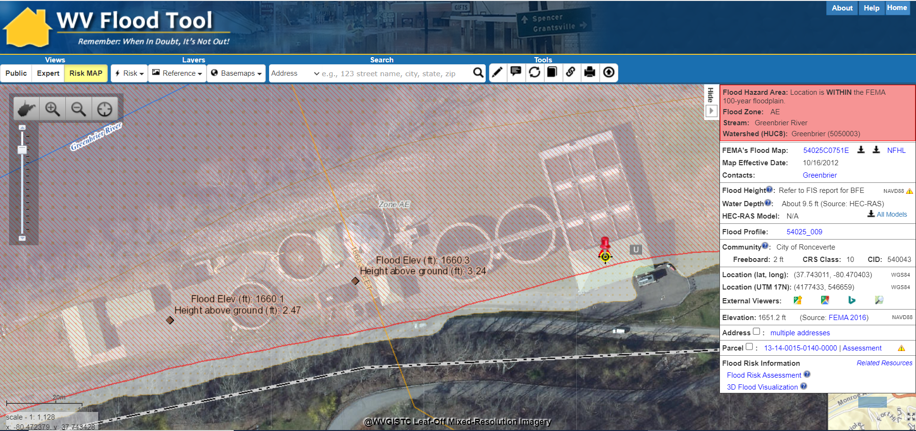
Highly Valued ($) Utility
$24M Ronceverte Wastewater Treatment Plant (on the State’s Top 100 List)
Mitigation: Examples of mitigation measures for utilities include:
Emergency response plan
Barriers around key assets
Elevated electrical equipment
Emergency generators
Bolted down chemical tanks
The Ronceverte Wastewater Treatment Plant is the highest valued, non-residential flood-prone structure inventoried for Region 4.
Flood Tool Map Link
Risk Assessment: In 2018, the new Ronceverte's wastewater treatment plant was constructed at a cost of $24 million. All structures of the wastewater treatment plant are in the effective high-risk floodplain at a 1% (100-year) estimated flood inundation depth of 9.5 feet. At the treatment plant location, the 0.2% (500-year) estimated flood inundation depth is about two feet higher than that of the 1% floodplain. The USGS high water marks show the maximum inundation of 3.24 feet above the ground at the facility site for the 2016 flood event. The structures are also located in a preliminary floodplain at a 1% (100-year) estimated inundation depth of 6.5 feet. The preliminary floodplain delineated based on the new flood study is under review to become effective.

Slide 48
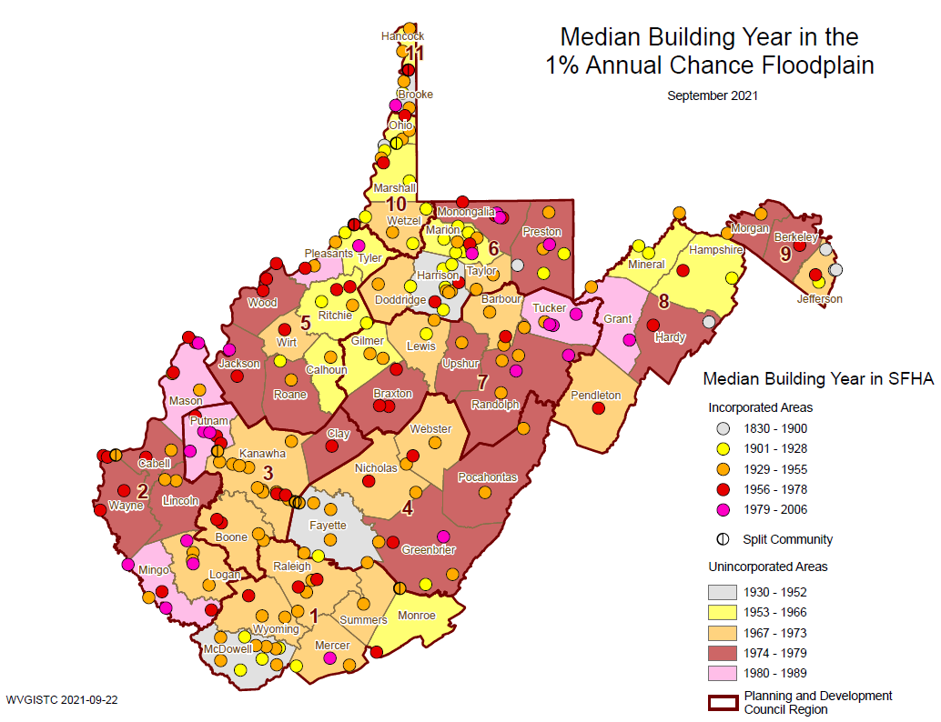
Historical Structures (Building Year)
The towns of Mount Hope and Ronceverte are two of the oldest communities in the region with building year median values of 1920
Mount Hope
Ronceverte

Slide 49
Historical Community Assets
Historical Buildings (Region 4)
Community Name | County | Facility Name | Facility Type | Flood Tool Link | Flood Depth | Building Damage Percent
Mount Hope | FAYETTE | Mount Hope Historic District | National Register | FT | 6.8 | 46%
Fayette County* | FAYETTE | Bank of Glen Jean | National Register | FT | 4.8 | 14%
Alderson** | GREENBRIER | Alderson Historic District | National Register | FT | 4.8 | 14%
Ronceverte | GREENBRIER | Ronceverte Historic District | National Register | FT | 4.4 | 43%
Mount Hope | FAYETTE | Mount Hope Historic District | National Register | FT | 4.3 | 13%
Alderson** | GREENBRIER | Alderson Historic District | National Register | FT | 4.2 | 27%
Source Data: https://data.wvgis.wvu.edu/pub/RA/State/BL/CommunityAsset/
* Unincorporated Area
** Split Community
Risk Assessment: Buildings identified within National Register Areas or registered historic districts are older than 1930. Greenbrier County is ranked 7th in the State as having the most historical buildings (n=56) in the high-risk floodplain of which the majority are located in the city of Ronceverte (ranked 14th of all incorporated areas). The split community of Alderson and the city of Mount Hope also have significant numbers of historical buildings in the high-risk floodplain (18 and 16 rank respectively).
Mitigation: A designated historic structure can obtain the benefit of subsidized flood insurance through the NFIP even if it has been substantially improved or substantially damaged so long as the building maintains its historic designation.

Slide 50
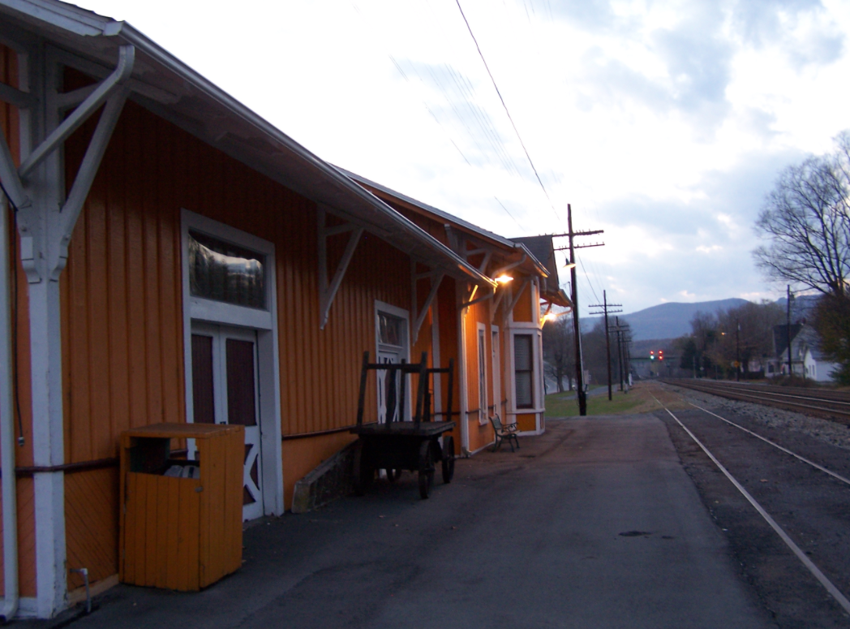
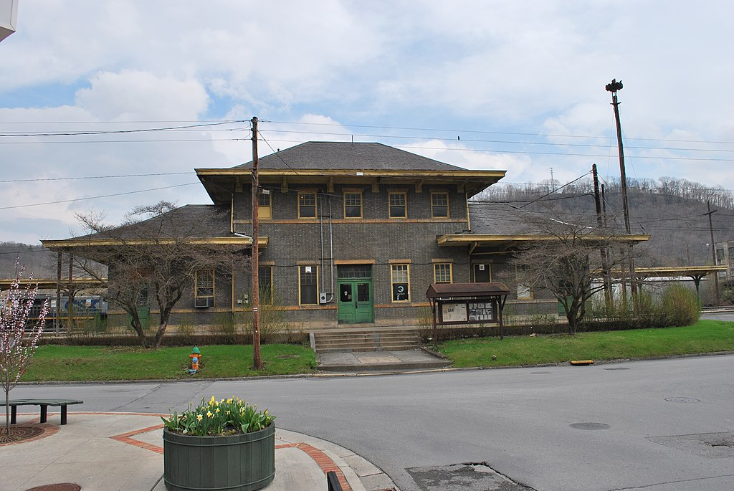
National Register Areas
National Register Areas (Region 4)
Community Name | County | Historic Name | # Bldg. Points in NR Area (estimate) | Flood Tool Link
Alderson** | GREENBRIER | Alderson Historic District | 45 | FT
Ronceverte | GREENBRIER | Ronceverte Historic District | 35 | FT
Mount Hope | FAYETTE | Mount Hope Historic District | 18 | FT
Richwood | NICHOLAS | Downtown Richwood Historic District | 10 | FT
Risk Assessment: For communities with the most National Register Areas in the State that intersect the 1% floodplain, Greenbrier County (12 NR Areas) is ranked 4th and Fayette County (7 NR Areas) ranked 7th
Alderson Historic District
Ronceverte Historic District

Slide 51
Risk Assessment
COMMUNITY ENGAGMENT &
DATA VERIFICATION
What mitigation actions can be identified

Slide 52
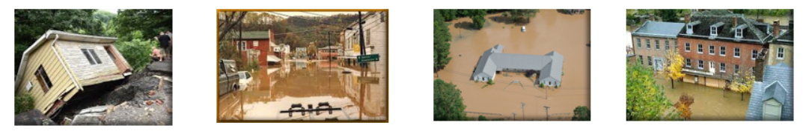
Data Verification
Use Building-Level (BL) Tables to identify Most Vulnerable Structures
Statewide BLRA (GIS)
BLRA County Tables organized by region
BLRA Data Extract Tables: High Building Value, High Damage Loss, High Minus Ratings
BLRA Statewide Top Lists: Building Value, Flood Depth, Damage Loss $, Damage Loss %, Minus Rated, Mitigated Structures

Slide 53
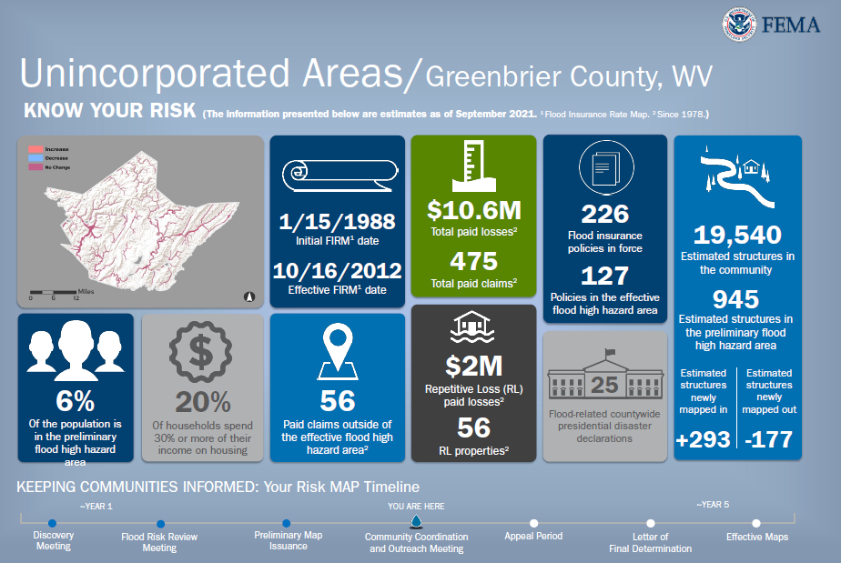
Community Level Risk Profiles
Use Community-Level (CL) Tables
to supplement FEMA’s Jurisdictional Flood Risk Dashboards
Example Jurisdictional Dashboards
Refer to the Risk Matrices EXPOSURE and DAMAGE LOSS to develop community risk profiles

Slide 54
Local Community Engagement
COMMUNITY ENGAGMENT & VERIFICATION
Floodplain Building Risk Inventory
Essential Facilities & Community Assets
Mitigated Structures
Buyout Properties
Areas of Mitigation Interest
Other Mitigation Activities
Local Hazard Mitigation Plan
+
Risk Assessment Data for Community Engagement, Verification, and Identifiable Mitigation Actions incorporated into Local Hazard Plans
Primary Objective: Incorporating Mitigation Actions in Local Hazard Mitigation Planning

