Slide 1
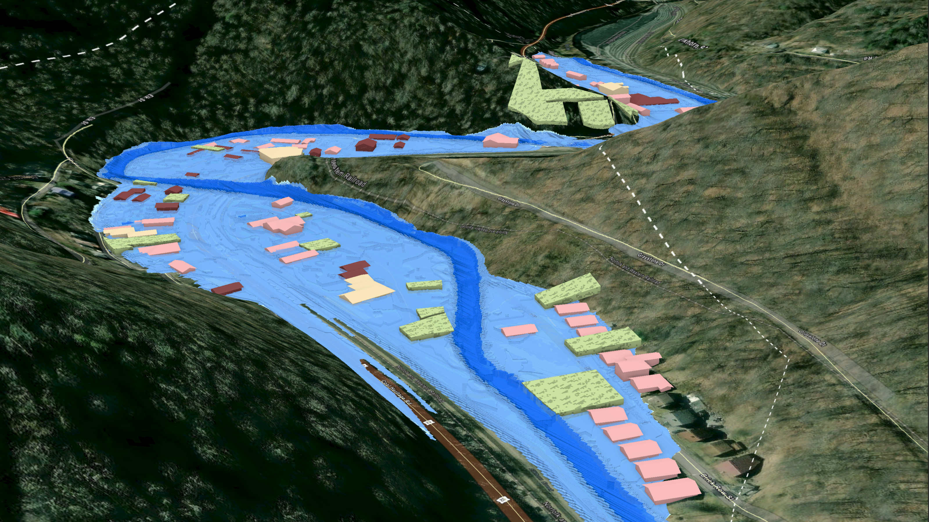
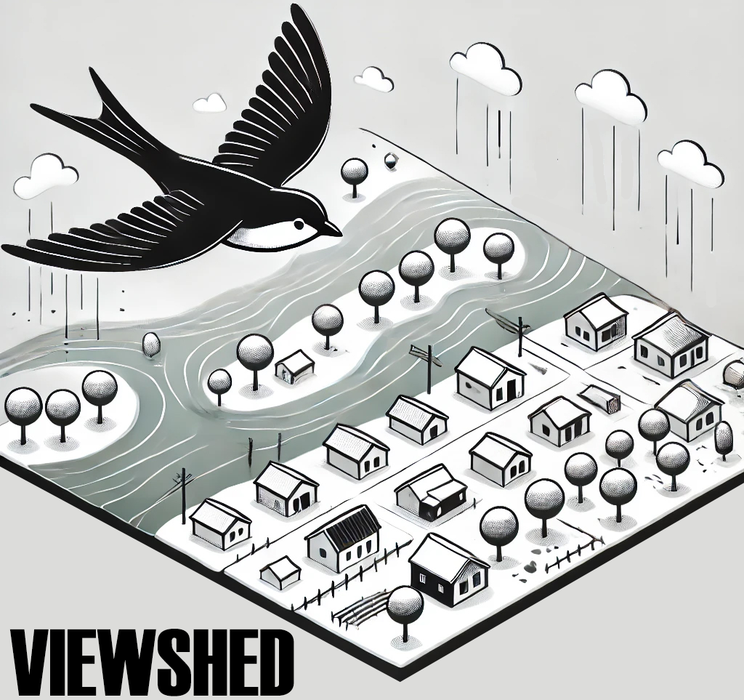
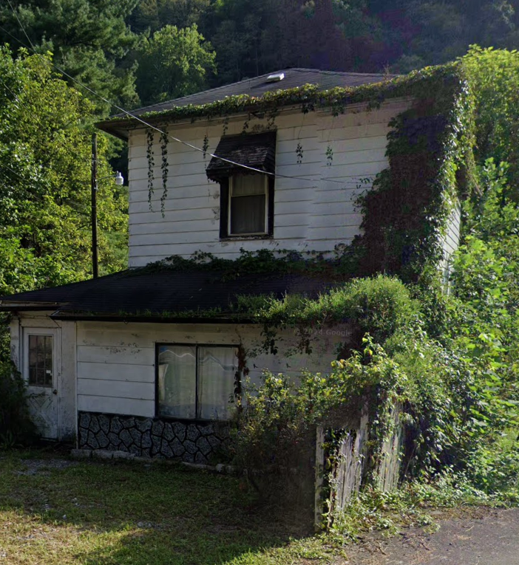
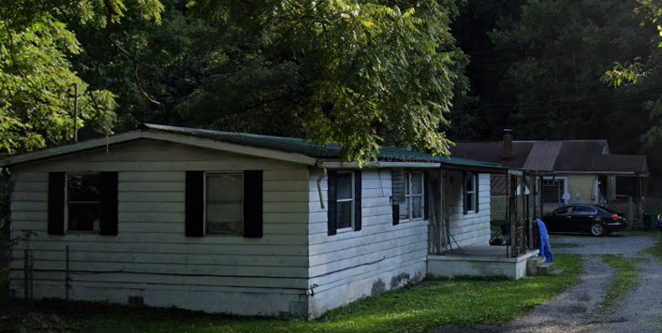
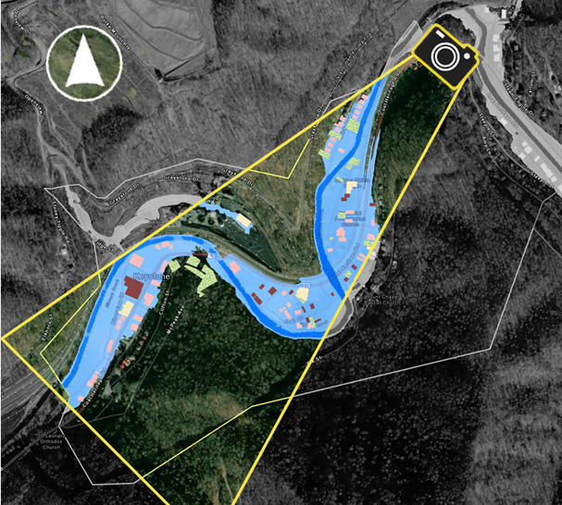
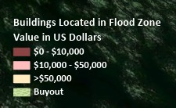
FEMA 1% +Annual Chance (100-year)
Keystone, WV
Elkhorn Creek
Key Plan
Properties
Elkhorn Creek

Slide 2
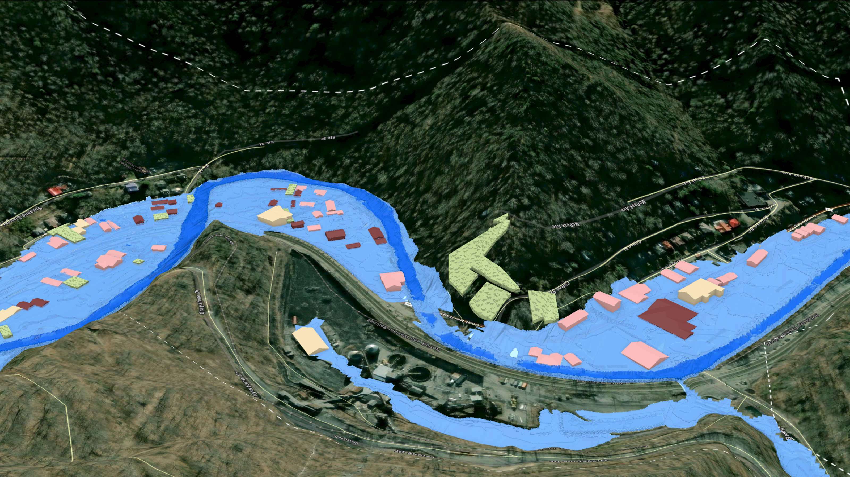
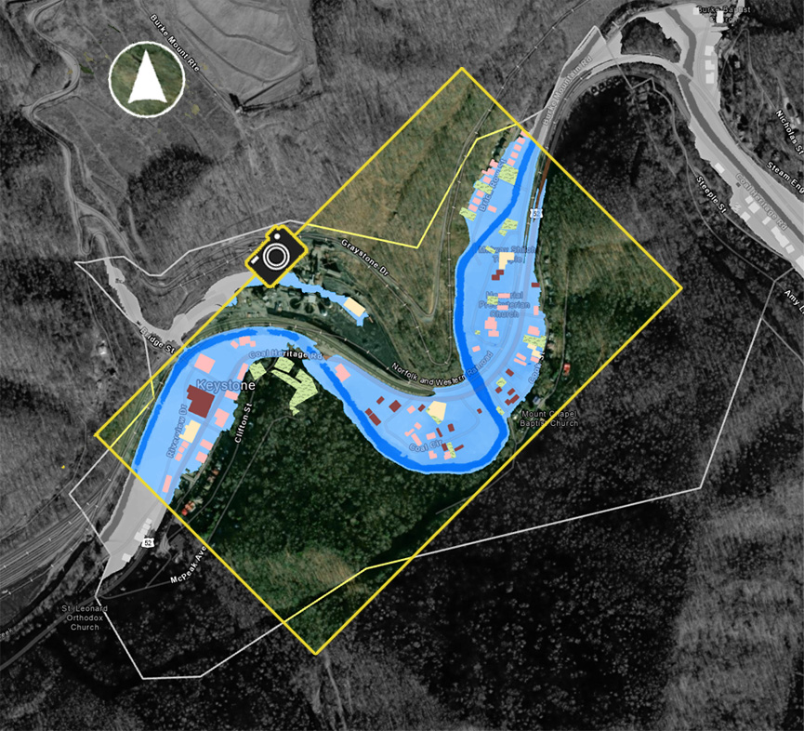
FEMA 1% +Annual Chance (100-year)
Keystone, WV
Elkhorn Creek
Key Plan
Elkhorn Creek
Elkhorn Creek
Properties

