Slide 1
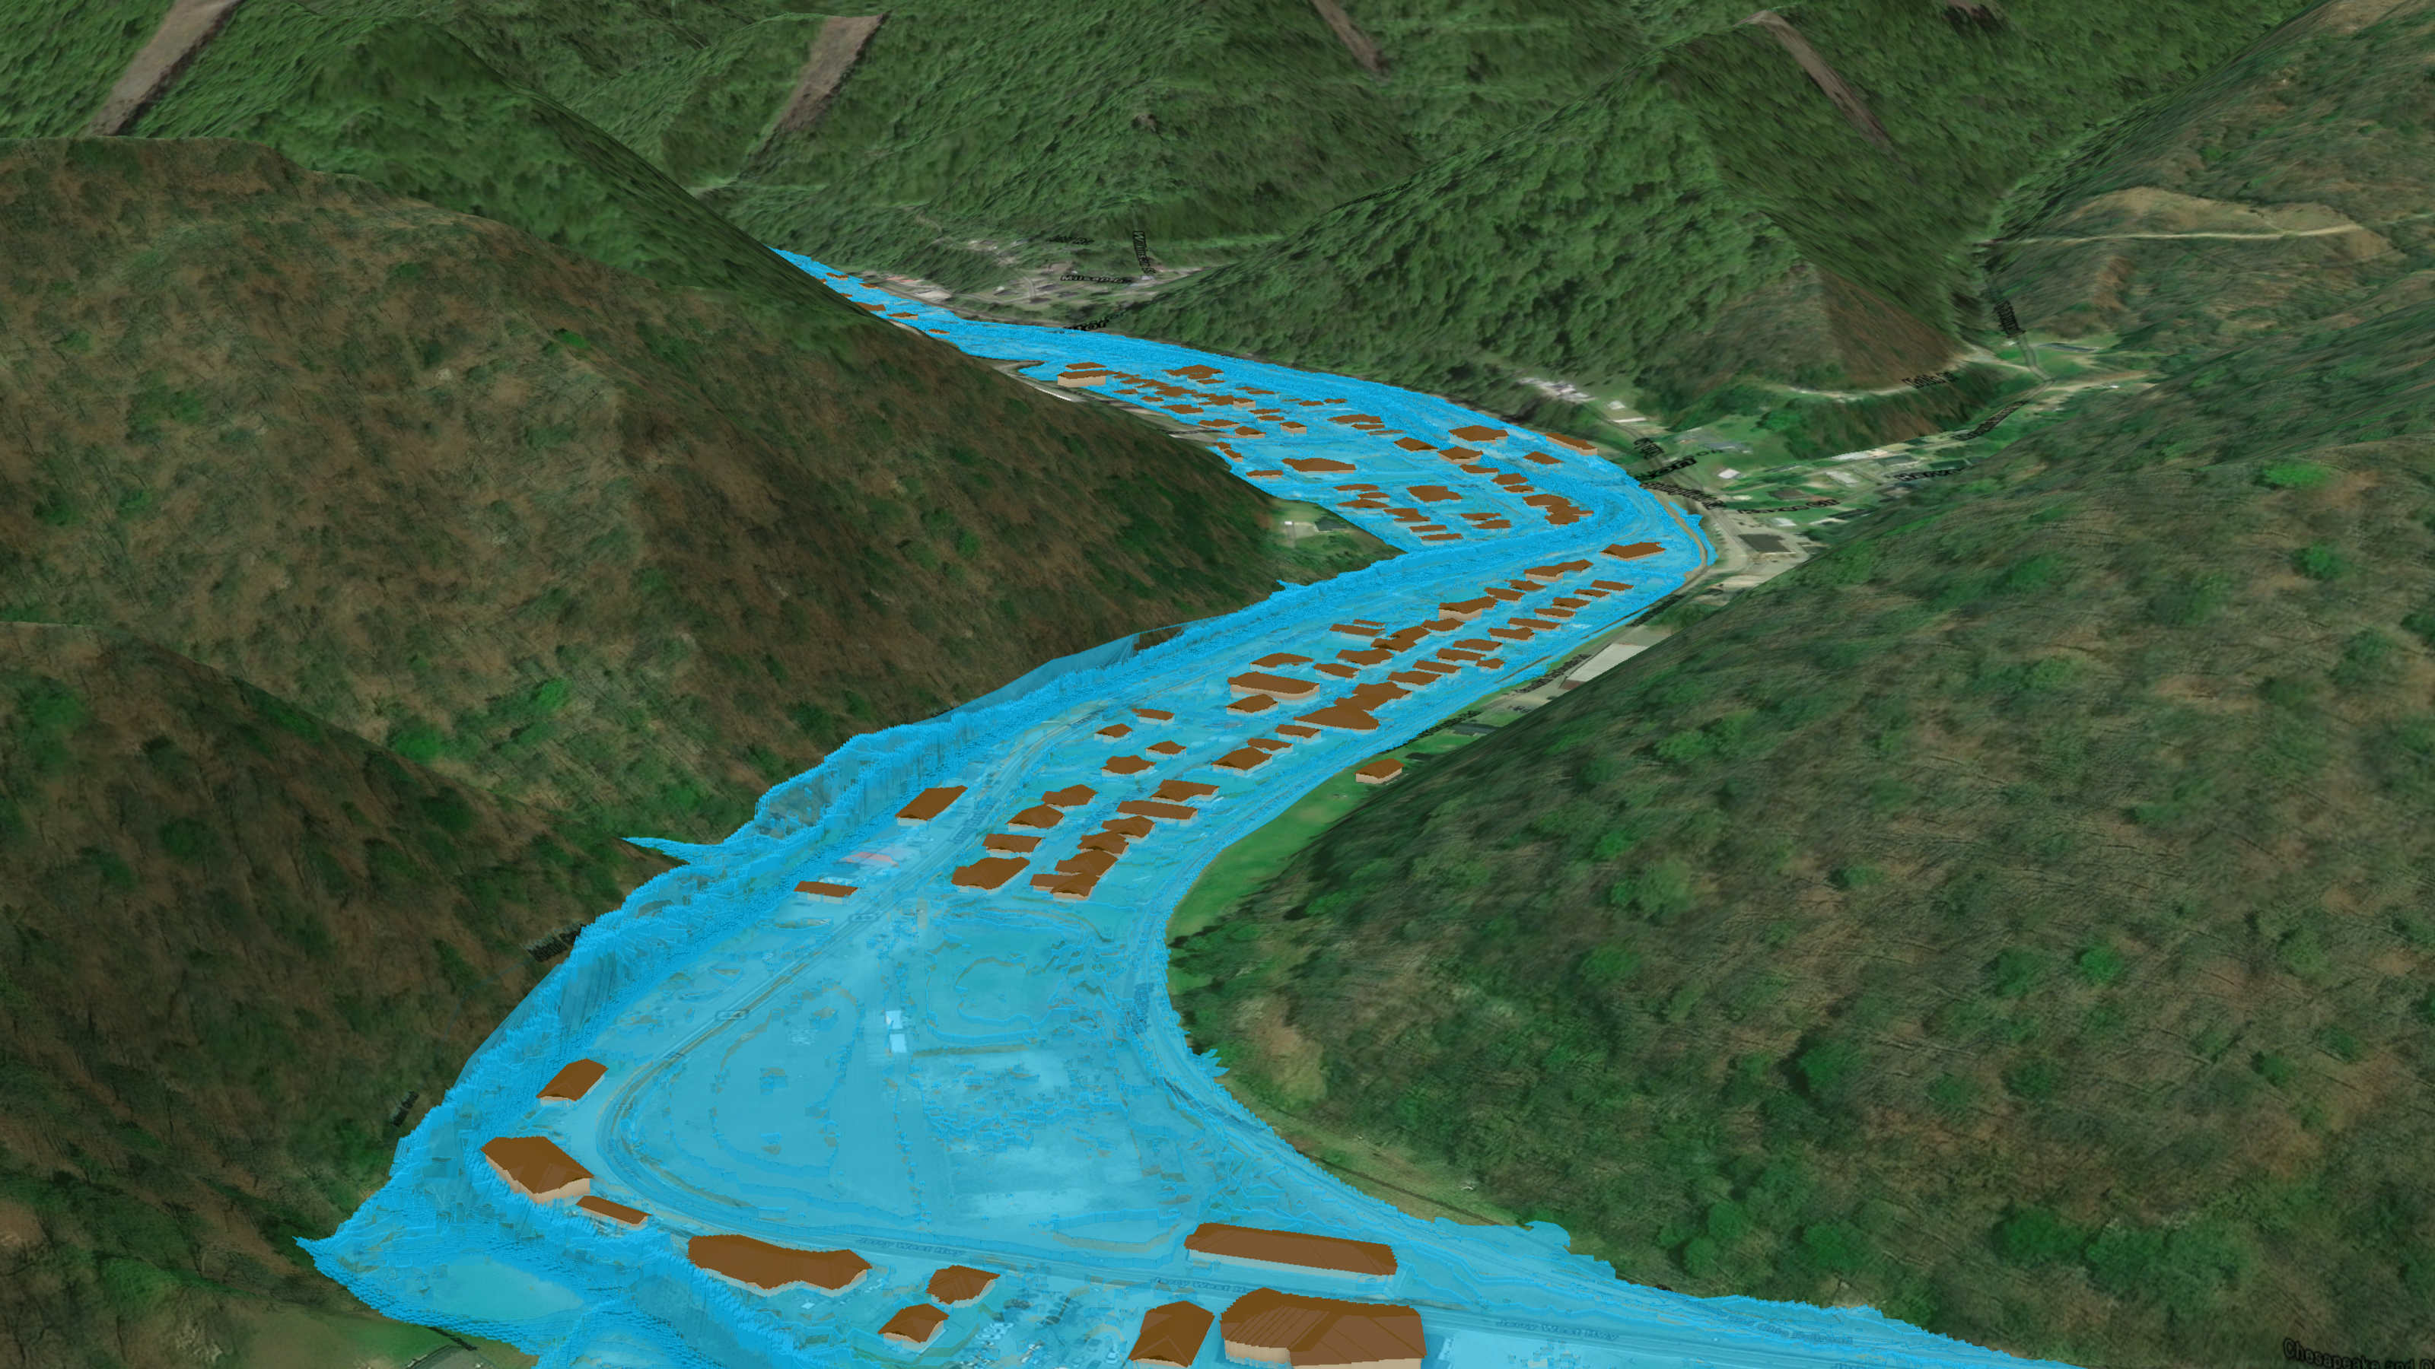
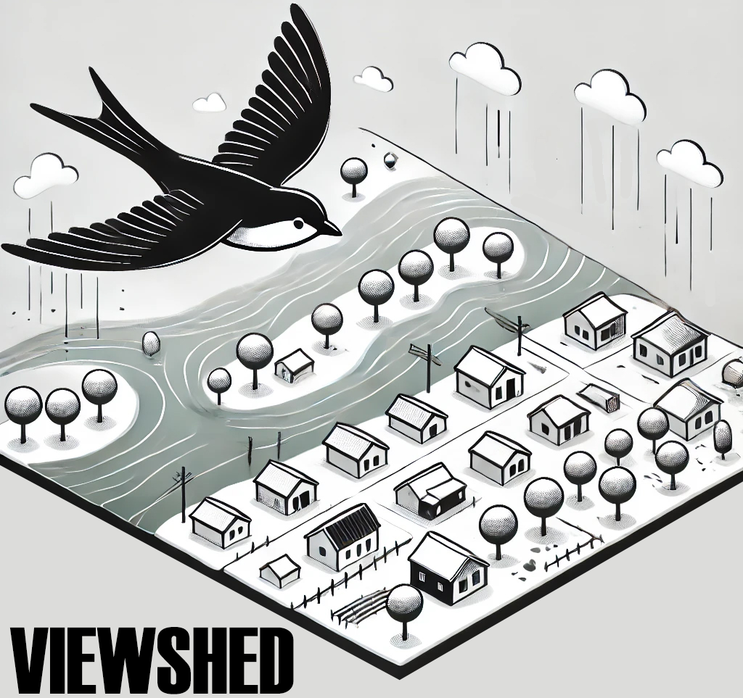
FEMA 1% Annual Chance (100-year)
Island Creek, Logan, WV
26% probability of flooding at least once over 30 years

