Slide 1
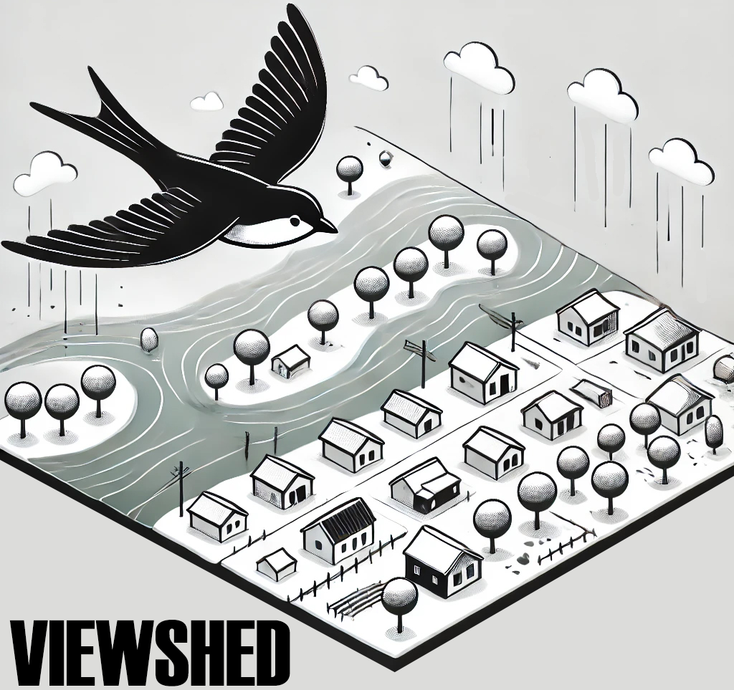
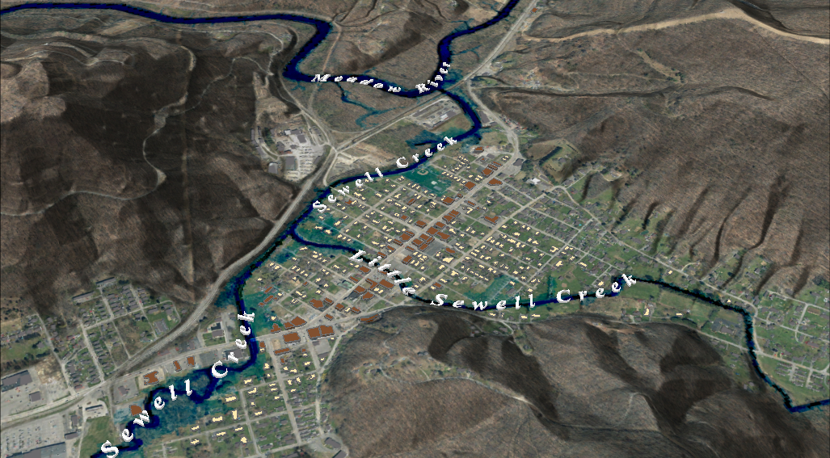
FEMA 10% Annual Chance (10-year)
Rainelle, WV
0.1 ft.
FLOOD DEPTH
30 ft.
Residential
Non-Residential
96% probability of flooding at least once over 30 years
13% Rainelle is in the 10% Annual Flood Chance
Notes:
FEMA 10year Aerial

Slide 2
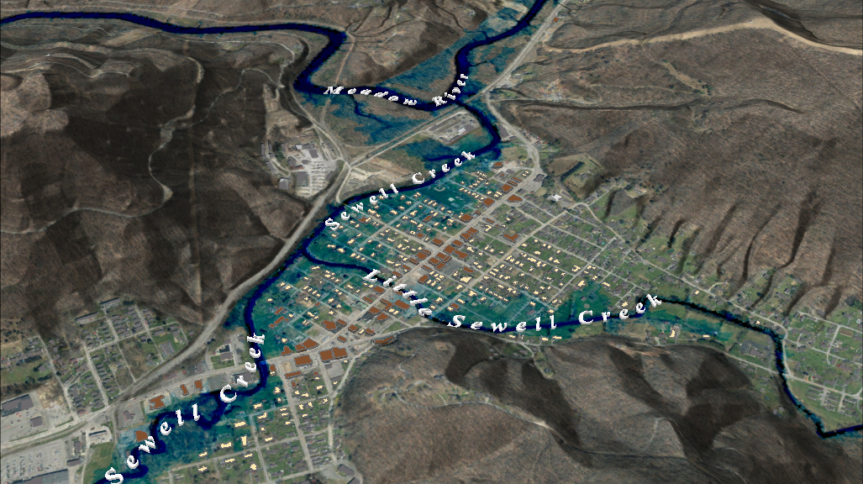
FEMA 4% Annual Chance (25-year)
Rainelle, WV
0.1 ft.
FLOOD DEPTH
30 ft.
Residential
Non-Residential
71% probability of flooding at least once over 30 years
20% Rainelle is in the 4% Annual Flood Chance
Notes:
FEMA 25year Aerial

Slide 3
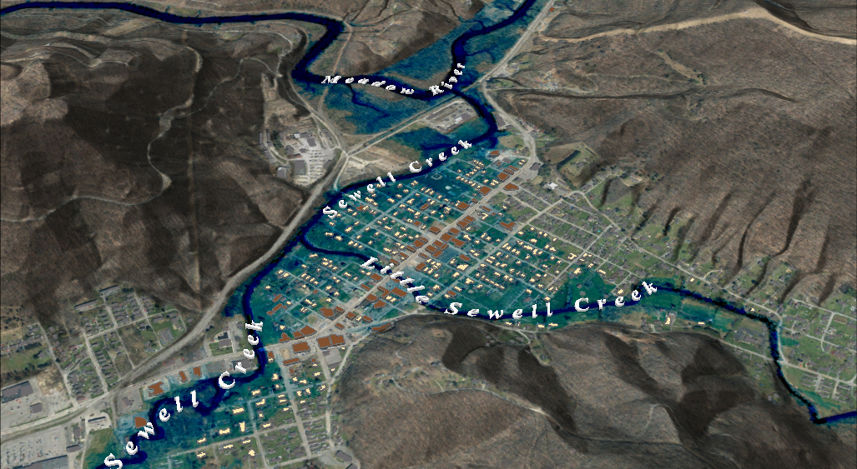
FEMA 2% Annual Chance (50-year)
FEMA 2% Annual Chance (50-year)
Rainelle, WV
Rainelle, WV
0.1 ft.
FLOOD DEPTH
30 ft.
Residential
Non-Residential
45% probability of flooding at least once over 30 years
26% Rainelle is in the 2% Annual Flood Chance
Notes:
FEMA 50year Aerial

Slide 4
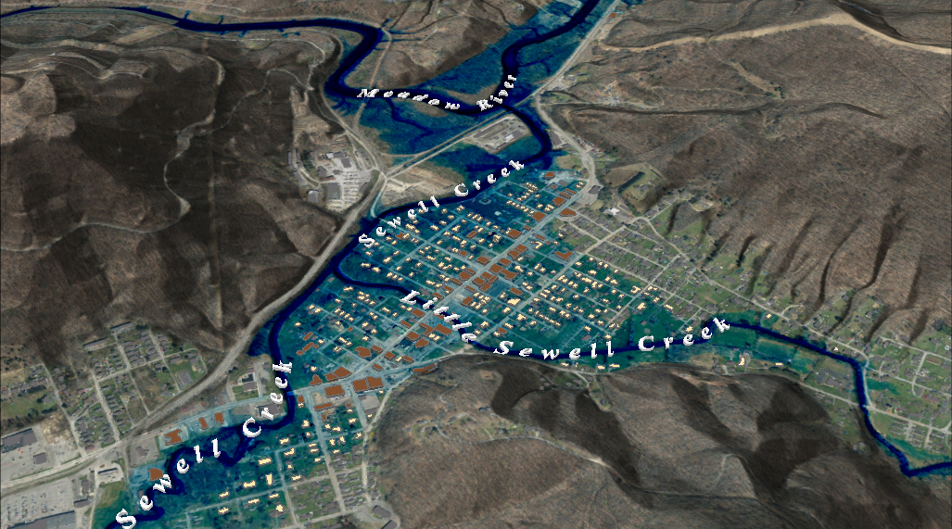
FEMA 2% Annual Chance (50-year)
FEMA 1% Annual Chance (100-year)
Rainelle, WV
Rainelle, WV
0.1 ft.
FLOOD DEPTH
30 ft.
Residential
Non-Residential
26% probability of flooding at least once over 30 years
31% Rainelle is in the 1% Annual Flood Chance
Notes:
FEMA 100year Aerial

Slide 5
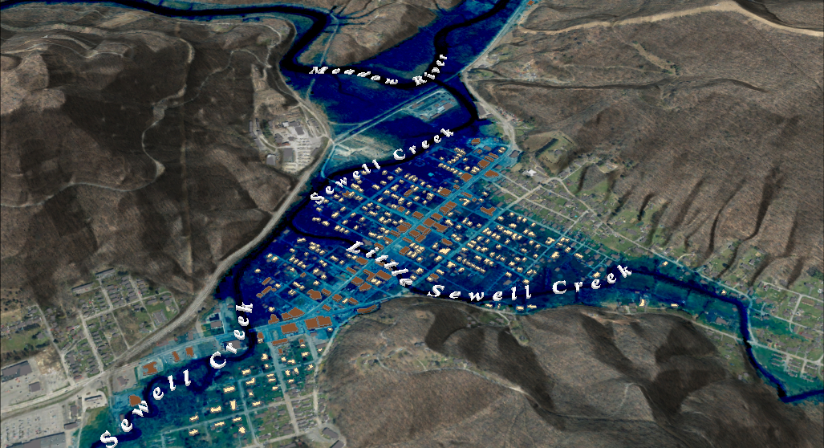
FEMA 2% Annual Chance (50-year)
FEMA 1%+ Annual Chance (100-year)
Rainelle, WV
Rainelle, WV
Climate
Change
0.1 ft.
FLOOD DEPTH
30 ft.
Residential
Non-Residential
26% probability of flooding at least once over 30 years
31% Rainelle is in the 1% + Annual Flood Chance
Notes:
FEMA 100year PLUS Aerial

Slide 6
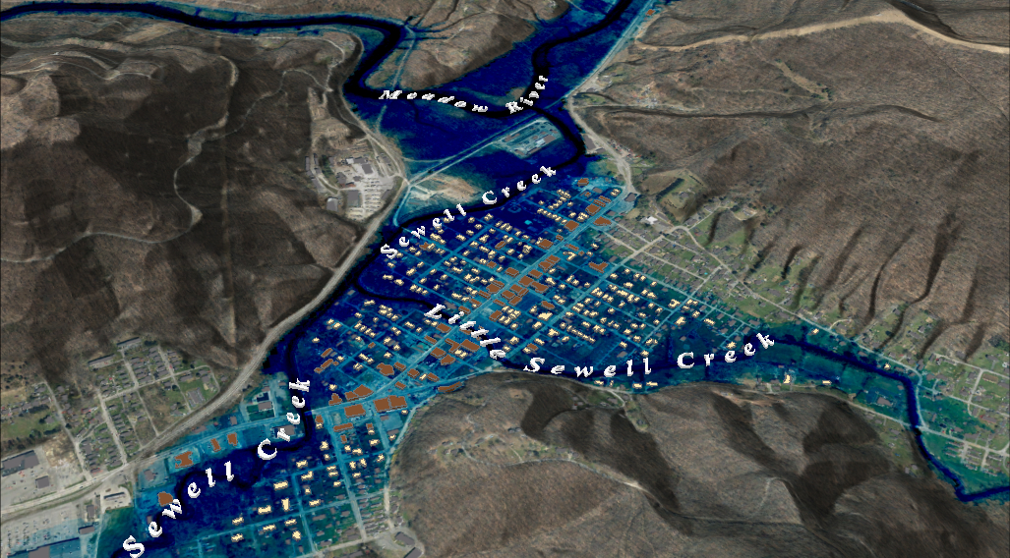
FEMA 2% Annual Chance (50-year)
FEMA 0.2% Annual Chance (100-year)
Rainelle, WV
Rainelle, WV
0.1 ft.
FLOOD DEPTH
30 ft.
Residential
Non-Residential
6% probability of flooding at least once over 30 years
37% Rainelle is in the 0.2% Annual Flood Chance
Notes:
FEMA 500year Aerial

