Slide 1
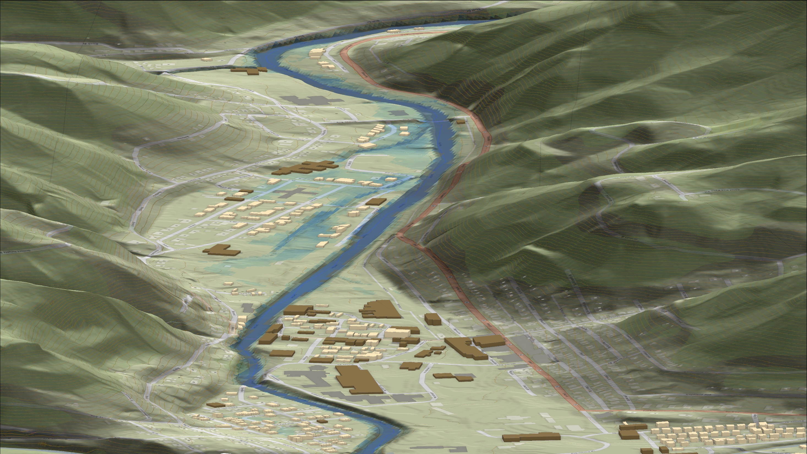
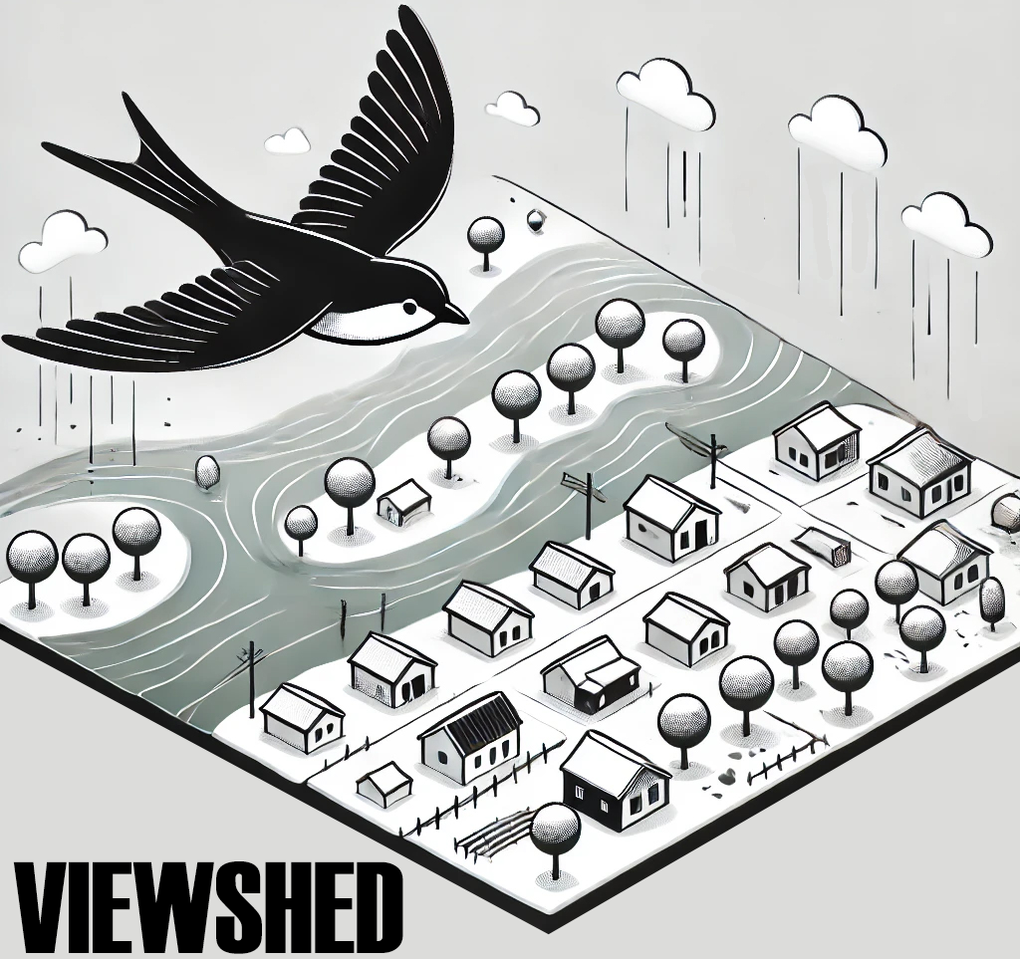
FEMA 10% Annual Chance (10-year)
Richwood, WV
0.1 ft.
FLOOD DEPTH
11.8 ft.
Cherry River
Residential
Non-Residential
7% of Richwood is in the 10% Annual Flood Chance
96% probability of flooding at least once over 30 years

Slide 2
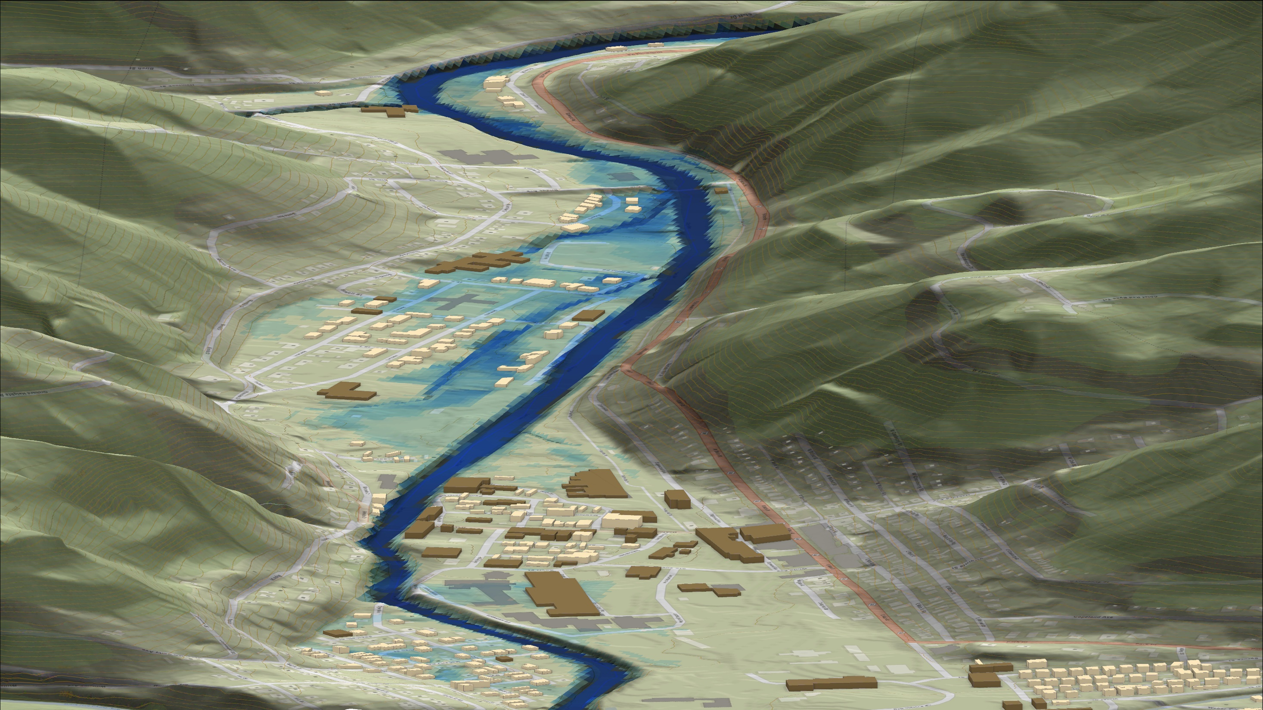
FEMA 4% Annual Chance (25-year)
Richwood, WV
0.1 ft.
FLOOD DEPTH
14.7 ft.
Cherry River
Residential
Non-Residential
11% of Richwood is in the 4% Annual Flood Chance
71% probability of flooding at least once over 30 years

Slide 3
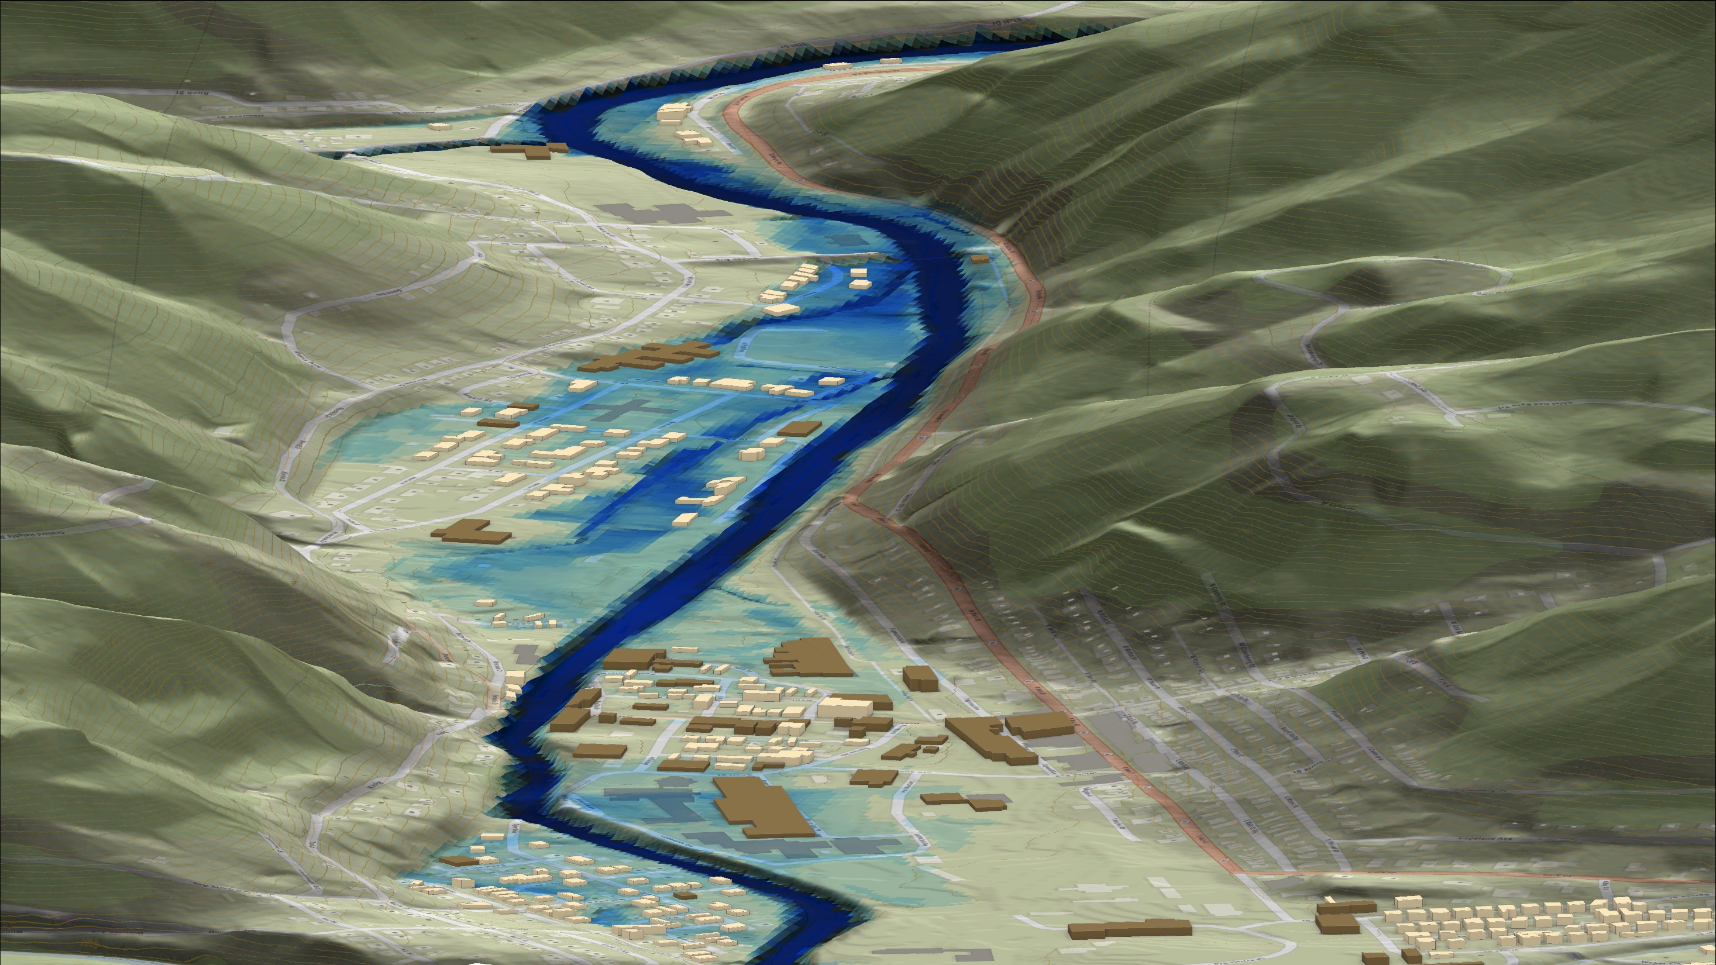
FEMA 2% Annual Chance (50-year)
Richwood, WV
0.1 ft.
FLOOD DEPTH
17.3 ft.
Cherry River
Residential
Non-Residential
16% of Richwood is in the 2% Annual Flood Chance
45% probability of flooding at least once over 30 years

Slide 4
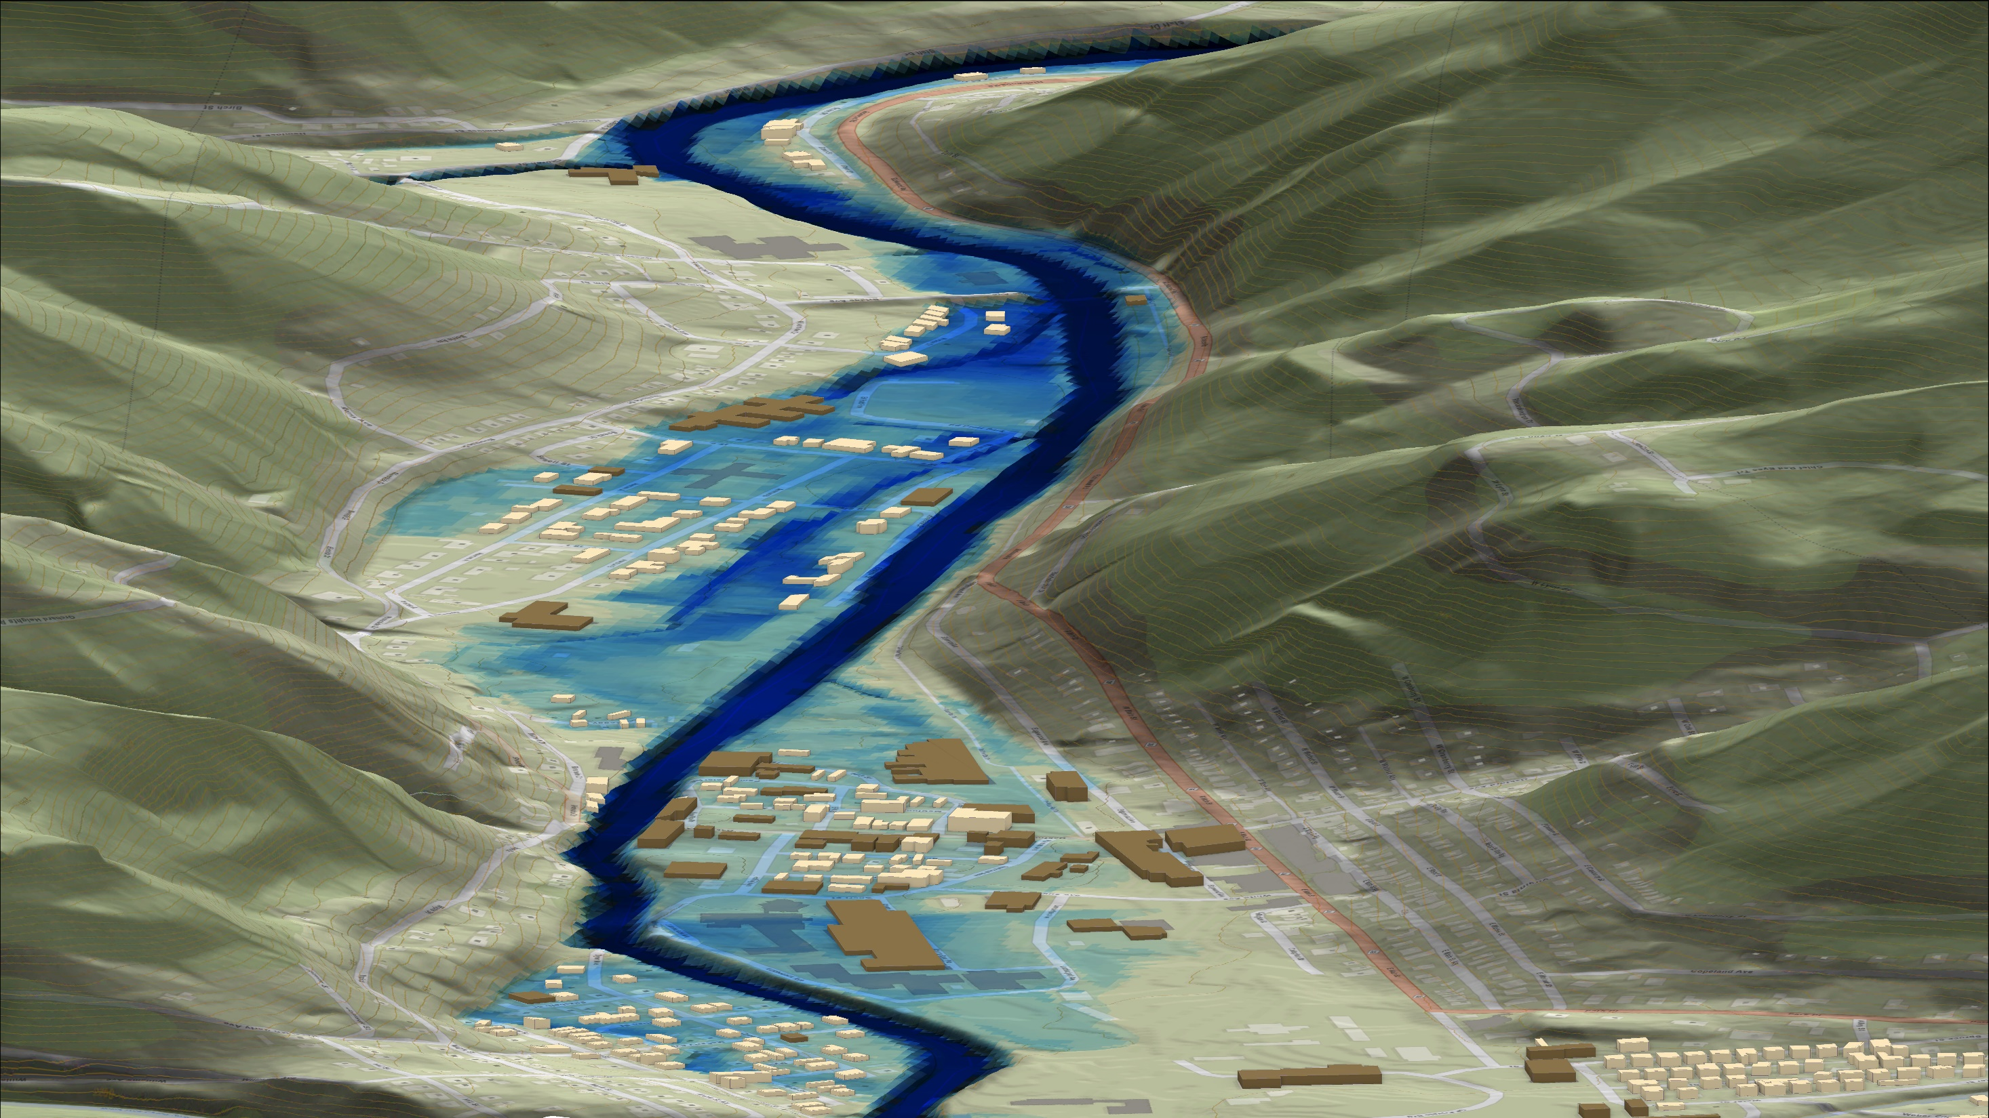
FEMA 1% Annual Chance (100-year)
Richwood, WV
0.1 ft.
FLOOD DEPTH
17.9 ft.
Cherry River
Residential
Non-Residential
18% of Richwood is in the 1% Annual Flood Chance
26% probability of flooding at least once over 30 years

Slide 5
FEMA 1%+ Annual Chance (100-year)
Richwood, WV
Climate
Change
0.1 ft.
FLOOD DEPTH
26.7 ft.
Cherry River
Residential
Non-Residential
22% of Richwood is in the 1%+ Annual Flood Chance
26% probability of flooding at least once over 30 years

Slide 6
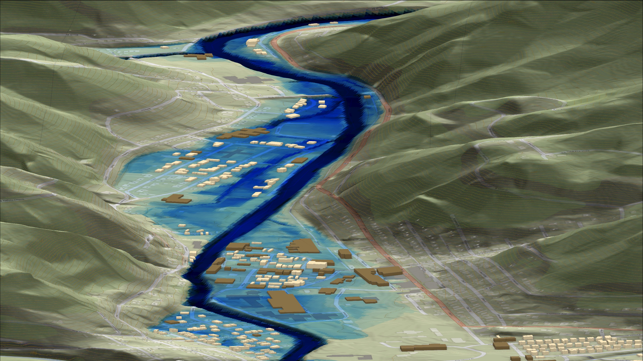
FEMA 0.2% Annual Chance (500-year)
Richwood, WV
0.1 ft.
FLOOD DEPTH
28.6 ft.
Cherry River
Residential
Non-Residential
22% of Richwood is in the 0.2% Annual Flood Chance
6% probability of flooding at least once over 30 years

