Slide 1
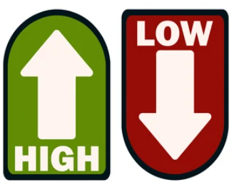
Tool Usage by Stakeholder Groups
Stakeholder Groups of anticipated usage of Risk Tools and Hazard Library
 |  | Property-Level Scale |  |  |  | All Geographic Scales
# | Stakeholders | Property Viewer | Flood Tool |  |  | Risk Explorer Tools | Hazard Library³
 |  |  | Public | Expert | RiskMAP
1 | Floodplain Managers ¹ – FM (includes surveyors and engineers) | FM |  | FM | FM | FM | FM-Learning
2 | Risk Reduction Associates - RRA (planners, researchers, mitigation specialists, etc.) | RRA |  | RRA | RRA | RRA | RRA-Studies
3 | Emergency Responders – ER | ER |  |  | ER | ER | ER-Learning
4 | Local Officials | Officials | Officials |  |  | Officials | Off-Learning
5 | Public (includes realtors and insurance officials) | Public | Public |  |  |  | Pub-Learning
6 | Volunteers – Vols. (VOAD, Charities, etc.) | Vols. | Vols. |  |  |  | Vol-Learning
Popularity of Tools ² by Stakeholder Group
¹ Floodplain Managers may be representatives of other stakeholder groups such as E-911 Directors or Mayors.
² Floodplain Managers and Risk Reduction Associates stakeholders have the highest demand for flood resiliency tools.
³ All Stakeholders benefit by using the Hazard Library which is broadly categorized into learning, study, and reference resources. The primary stakeholder group for the WV Property Viewer is the Public, while the main stakeholder group for WV Flood Tool is the Floodplain Managers, and for the WV Risk Explorer various Risk Reduction Specialists.

Slide 2
Comparison of Risk Tools
WV Flood Tool | WV Risk Explorer
Determine the degree of flood risk for a specific area or property using the Public and Expert Views. View building risk assessments and mitigation measures using the Risk Map View. | View and analyze riverine flood risk at the aggregate level for community, county, region, watershed, and stream scales. Compare risk among different geographic entities, complete with risk scores and rankings, from the building level to state scales.
Primary Components: Public View Expert View (Floodplain Management) RiskMap View (Risk Reduction) Reference Layers & Basemaps Property Search Tools Links to External Viewers & Resources | Primary Components: Risk Maps Tool Risk Reports Tool Risk & Mitigation Dashboard Tools Building Level Risk Tools Flood Visualization Tools Data linkages WV Flood Tool & Hazard Library
Applications: Flood Risk Determinations at Property Level Floodplain Management Mitigation Measures Damage Assessments Property Identification Flood Visualizations & Risk Communications CRS Map Credits Other Hazards | Applications: Plans (Resiliency, Emergency Operations, Hazard Mitigation) Risk Studies (Risk MAP, Risk Reduction, Community Focused) Mitigation Measures, Tracking & Monitoring Flood Visualizations & Risk Communications CRS Programming Variables Other Hazards

Slide 3
Applications
GEOGRAPHIC SCALES |  | MITIGATION APPLICATIONS |  |  |  | WVFRF TOOLS
Geographic Unit | # Units | Floodplain Management | FEMA Mapping | Risk Planning | Disaster Management | WV Risk Tools (WV Flood Tool & WV Explorer) | Flood Visualization Tools | Hazard Library (Document Center Tool)
PROPERTY LEVEL
Structures¹ | 98,000 | X | X | X | X | Yes | Yes | Yes
Parcels | 275,000 | X | X | X | X | Yes |  | Yes
Other Features² |  | X | X | X | X | Yes |  | Yes
COMMUNITY LEVEL
Incorporated Places | 211 | X | X | X | X | Yes | Yes | Yes
Unincorporated Areas | 55 | X | X | X | X | Yes | Yes | Yes
Communities (NFIP)³ | 266 | X | X | X | X | Yes | Yes | Yes
COUNTY-REGION-STATE LEVEL
Counties | 55 | X | X | X | X | Yes | Yes | Yes
Regions (RPDCs) | 11 | X | X | X | X | Yes |  | Yes
State | 1 | X | X | X | X | Yes |  | Yes
DRAINAGE LEVEL
Watersheds | 32 | X | X | X | X | Yes |  | Yes
Streams (named) | 6,748 | X | X | X | X | Yes | Yes | Yes
NOTES:
¹ Primary structures located in high-risk effective and advisory floodplains (1%-annual-chance flood)
² Other Features include roads, bridges, National Register Areas, flood mitigation structures (dams, levees, floodwalls)
³ Total 284 communities in state: 266 NFIP; 18 incorporated places not in NFIP

Slide 4
Risk Assessments at Multiple Scales
GEOGRAPHIC SCALES | MITIGATION APPLICATIONS |  |  |  | WVFRF TOOLS
Geographic Unit | Floodplain Management | FEMA Mapping | Risk Planning | Disaster Management | WV Property Advanced Search Tool | Risk Communications & Community Engagement | Hazard Library (Document Center Tool)
WV Property Viewer |  |  |  |  | Yes | Yes | Yes
WV Flood Tool | X | X | X | X | Yes | Yes | Yes
WV Risk Explorer | X |  | X |  | Yes | Yes | Yes
WV Hazard Library | X | X | X | X | Yes | Yes | Yes
 | X | X | X | X | Yes | Yes | Yes
^{FEMA Risk MAP} | X | X | X | X | Yes | Yes | Yes
Risk Recuction Consultations | X | X | X | X | Yes | Yes | Yes
Emergency Operations | X | X | X | X | Yes |  | Yes
 | X | X | X | X | Yes |  | Yes
 | X | X | X | X | Yes |  | Yes
 | X | X | X | X | Yes | Yes | Yes

Slide 5
Tools for Stakeholders
 |  |  | Property-Level Scale |  |  |  | All Geographic Scales
Stakeholders | Label in Hazard Library |  | Flood Tool |  |  | Property Viewer | Risk Explorer Tools | Hazard Library
 |  |  | Public | Expert | RiskMAP
Emergency Responders | Emergency Responders | 3 |  |  | ER | ER | ER | ALL-Learning
Floodplain Managers (& Surveyors) | Floodplain Managers | 1 |  | FM | FM | FM | FM | ALL-Learning
Local Officials | Local Officials | 4 |  |  |  | LO | LO | ALL-Learning
Public (including realtors and insurance officials) | Public | 5 | Public |  |  | Public |  | ALL-Learning
Risk Reduction Associates (Planners, Researchers, Mitigation Specialists, etc.) | Risk Reduction Associates | 2 |  | RRA | RRA | RRA | RRA | ALL-Studies
Volunteers (VOAD, Charities, etc.) | Volunteers | 6 |  |  |  |  |  | ALL-Learning

Slide 6
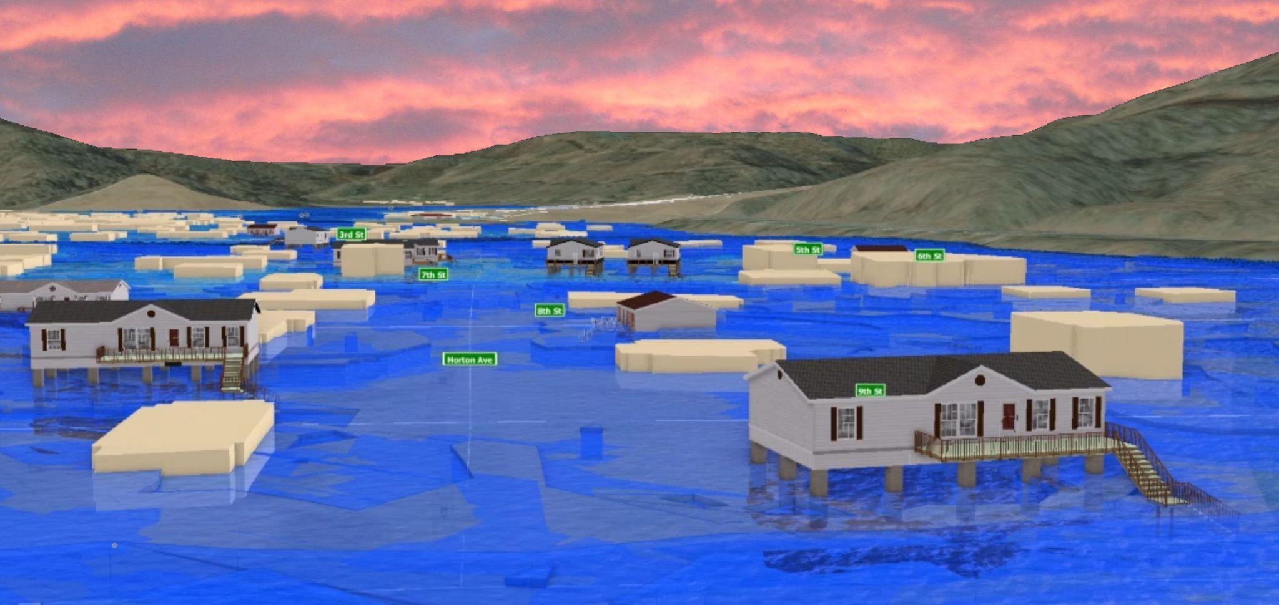
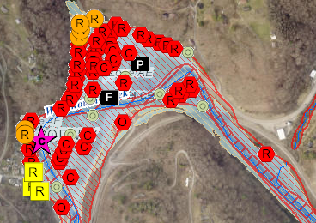
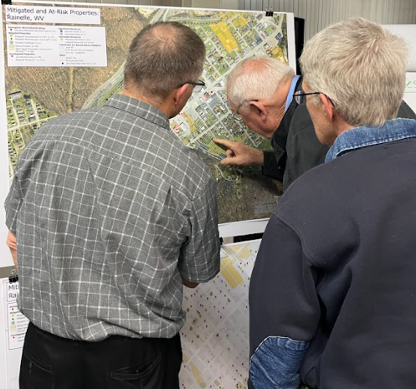
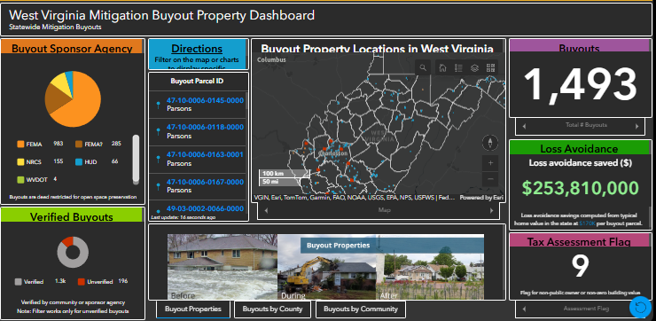
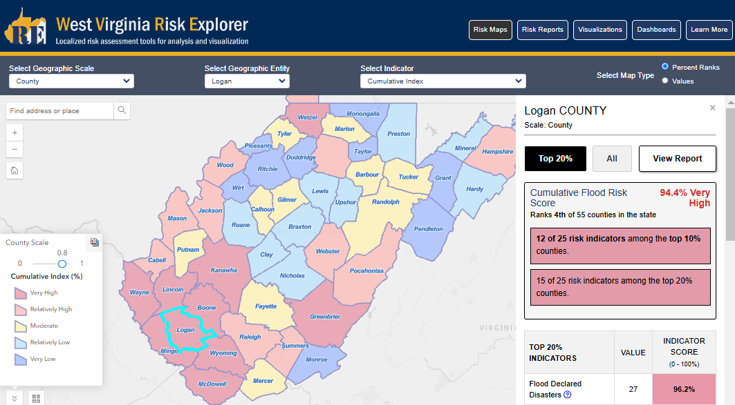
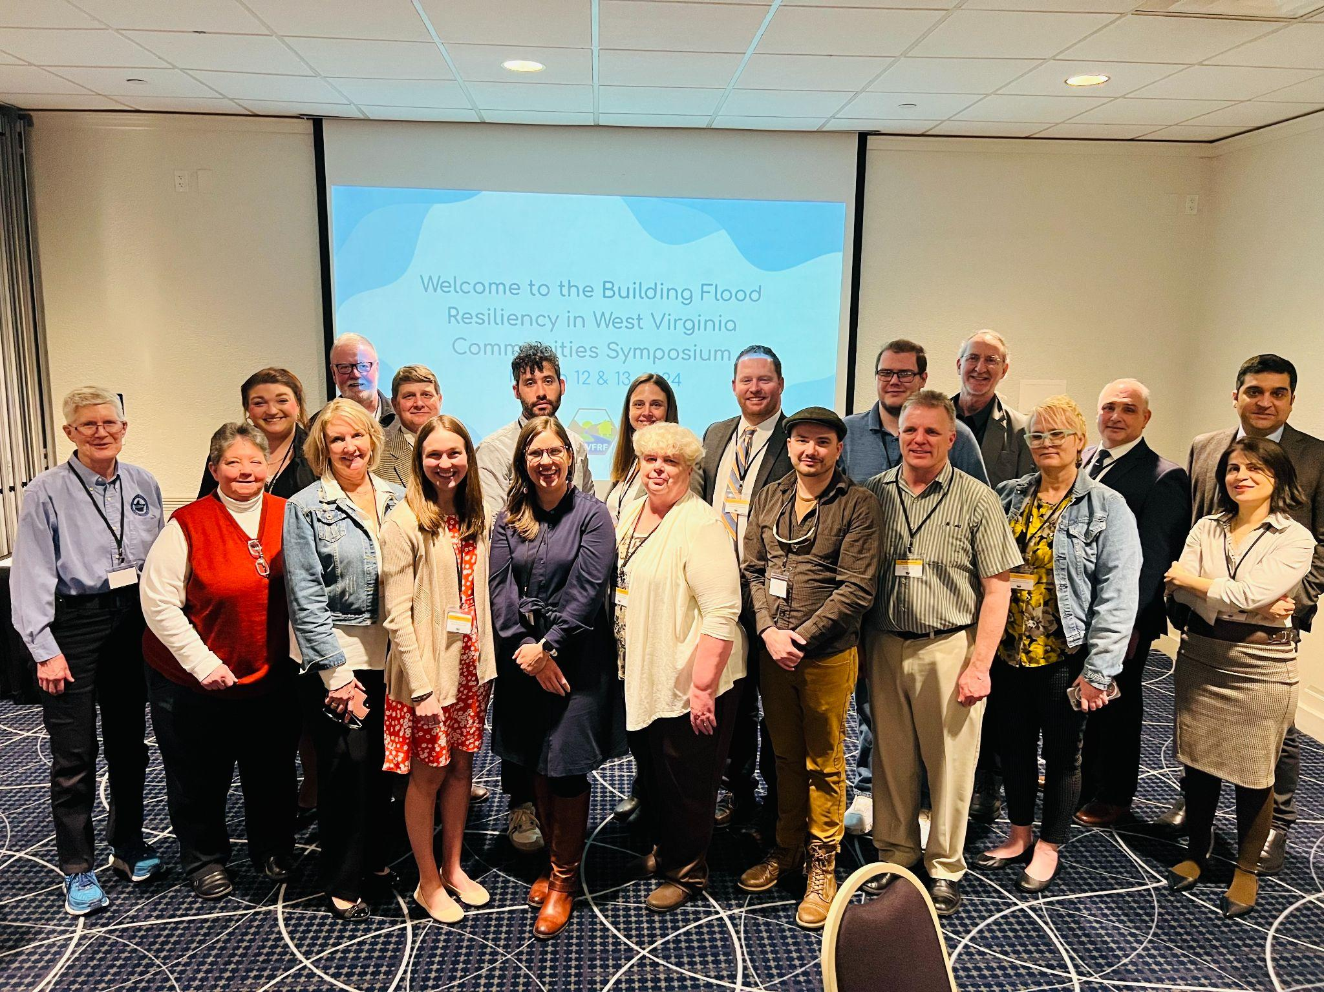
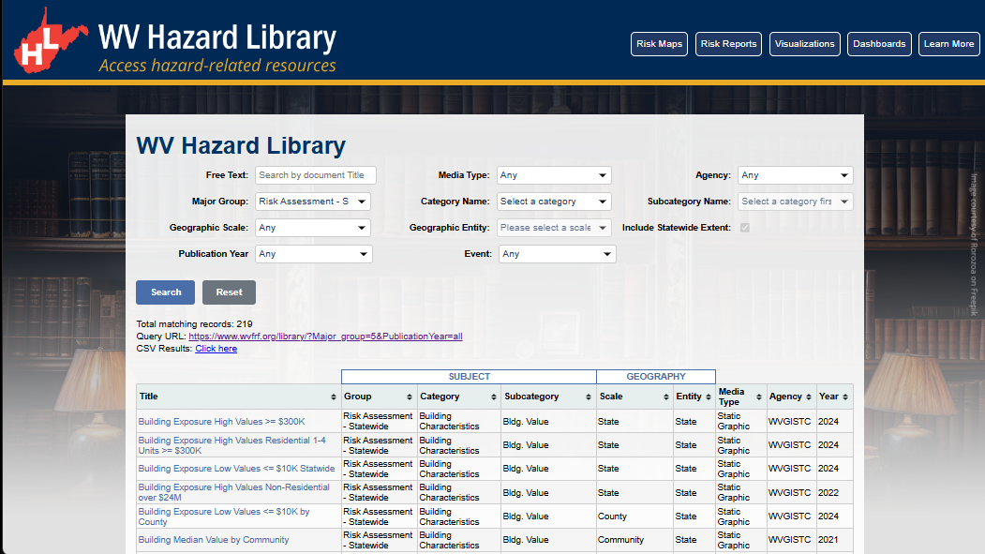
WV Flood Resiliency Framework
A virtual hub of risk assessment, visualization, planning, and training resources for building community flood resiliency in WV
COMMUNITY ENGAGEMENT
Focused Outreach Meetings
Resiliency Tools & Products
Learning Resources & Reports
STAKEHOLDERS Emergency Responders
Floodplain Managers
Local Officials
Risk Reduction Associates
Volunteers
Public
RISK TOOLS
• WV Risk Explorer • WV Flood Tool
10 Geographic Scales Risk Maps, Risk Reports, Visualizations, Dashboards
HAZARD LIBRARY
Search online hazard resources by title, subject, media, event, geography, stakeholder, downloadable data, etc.
Visualization Tool
WV Flood Tool
Dashboard Tool
Risk Explorer Tool
Community Engagement Meeting
Risk Tools
Hazard Library
Flood Symposium Stakeholders

Slide 7
WV Risk Tools
UPDATE__A virtual hub of risk assessment, visualization, planning, and training resources for building community flood resiliency in WV
WV RISK TOOLS
2 KEY FLOOD RISK TOOLS | 10 GEOGRAPHIC SCALES
<< Aggregate & Property Levels >> WV Risk Explorer Risk Maps Risk Reports Dashboards Visualizations Building Risk Tool Data Access ----------------------------------- << Property Level >> WV Flood Tool WV Property Viewer | << Political Boundaries >> 1) State 2) Region 3) County 4) Community 5) Incorporated Place 6) Unincorporated Area ----------------------------------- << Drainage Areas / Streams >> 7) Watershed 8) Stream/River ----------------------------------- << Property Levels >> 9A) Parcel 9B) Building
WV RISK FACTORS
RISK INDICATORS | ENVIRONMENTS
Floodplain Characteristics Building Exposure Building Characteristics Critical Infrastructure Community Assets People/Social Vulnerabilities Other Hazards | Physical Human Social Economic Institutional Manmade
Analytical & Visualization Tools at multiple scales
Risk Factors for riverine hazard assessments

Slide 8
WV Hazard Library
WV HAZARD LIBRARY
TOPICS | MEDIA TYPES |  | SEARCH TYPES
Risk Assessment & Planning State Risk Assessments Local Risk Assessments Planning Resources Web Tools Mitigation Mitigation Measures Floodplain Mapping Floodplain Management Flood Insurance Flood Disaster Flood Event Flood Research Flood Forecast | 3D Movie Bldg. Profile Dashboard Data Download Flyer Graphic Guide Letter Multiple/Media Map Metadata Plan | Poster Report Slides Story Map Study Survey Table Video Viewshed Web App Website | Agency Downloadable Data Event Disaster Event Meeting Geographic Scale Entity Media Type Publication Date Subject Major Group Category Subcategory cross-indexing Stakeholder Type Title (free text search)
Hazard Library of documents and visual media relevant to West Virginia

Slide 9
Community Engagement
A virtual hub of risk assessment, visualization, planning, and training resources for building community flood resiliency in WV
COMMUNITY ENGAGEMENT METHODS
Focused Outreach Meetings Risk Communications Risk Reduction Meetings Resiliency Tools & Products Risk Assessments (Detailed or Summarized) Mitigation Measures (Planned or Implemented) Flood Visualizations Learning Resources & Published Reports Best Practice Guides and Training Materials Lessons Learned Planning Documents Research and Policy Papers Risk information communicated via WV Risk Tools, WV Hazard Library, and other resources.
Flood Symposium Stakeholders
Community Engagement modes to convey risk

Slide 10
Meeting Outreach
A virtual hub of risk assessment, visualization, planning, and training resources for building community flood resiliency in WV
MEETING OUTREACH METHODS
Focused Outreach Meetings Community-Level Risk Assessments (summary) Building-Level Risk Assessments (detailed) Flood Visualizations Hazard Library Resources online Mitigation Measures Historical Floods Other Hazards
Flood Symposium Stakeholders
Community Engagement modes to convey risk

Slide 11
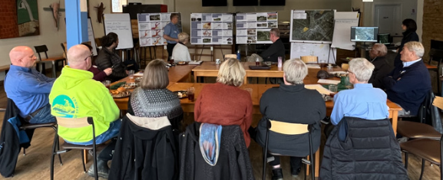
Community Engagement
White Sulphur Springs, WV (11/17/2022)
Rainelle, WV (11/18/2022)
Feedback desired from Focus Groups:
What lessons were learned from the immediate response and longer-term recovery from the 2016 flood?
What priorities are needed for a stronger flood response and recovery plan in the event of a future flood?
Feedback of Flood Study Products:
Flood Characteristics and Models
Flood Risk Assessment (vulnerability, exposure, loss)
Mitigation Maps
Flood Visualization Tools
Notes:
The last partnership example with other university faculty highlights social scientist Jamie Shinn’s National Science Foundation research about the recovery and resiliency of two small communities in Greenbrier County – White Sulphur Springs and Rainelle – that were devastated by the 2016 flood. This research also supports a Community Outreach and Mitigation Strategies (COMS) project sponsored by FEMA Region III and the State Emergency Management Division to evaluate how various flood protection measures like mitigation reconstruction will adapt to the future impacts of climate change.
Last week, focus group meetings were led by Professor Shinn for these two communities to assess lessons learned from the 2016 flood and to identify ways to build resilience to future floods. The WV GIS Technical Center provided support by quantifying various risk factors facing these disadvantaged communities. This included presenting flood characteristics and new flood maps, vulnerability analysis, and quantifying mitigation measures implemented to date.

Slide 12
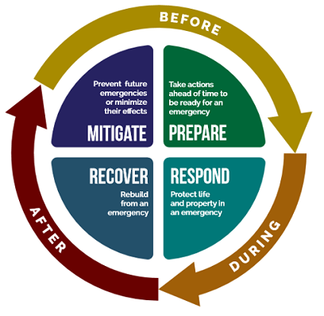
Four Phases of Emergency Management
The "Four Phases" of Emergency Management
Emergency management professionals typically break down their responsibilities into four phases, which form a cycle. This four-phase cycle applies to you too.
It begins with PREPAREDNESS activities that get a community ready before an emergency (including planning, training, and exercising).
Next are the RESPONSE actions that help protect lives and property during a disaster.
RECOVERY efforts are how we build back after a disaster.
MITIGATION projects reduce future risks from hazards – these may be put in place before or after a disaster, but they are always intended to improve conditions before the next event.
White Sulphur Springs, WV (11/17/2022)
Rainelle, WV (11/18/2022)
https://www.fairfaxcounty.gov/emergencymanagement/cerg
Notes:
The last partnership example with other university faculty highlights social scientist Jamie Shinn’s National Science Foundation research about the recovery and resiliency of two small communities in Greenbrier County – White Sulphur Springs and Rainelle – that were devastated by the 2016 flood. This research also supports a Community Outreach and Mitigation Strategies (COMS) project sponsored by FEMA Region III and the State Emergency Management Division to evaluate how various flood protection measures like mitigation reconstruction will adapt to the future impacts of climate change.
Last week, focus group meetings were led by Professor Shinn for these two communities to assess lessons learned from the 2016 flood and to identify ways to build resilience to future floods. The WV GIS Technical Center provided support by quantifying various risk factors facing these disadvantaged communities. This included presenting flood characteristics and new flood maps, vulnerability analysis, and quantifying mitigation measures implemented to date.

Slide 13
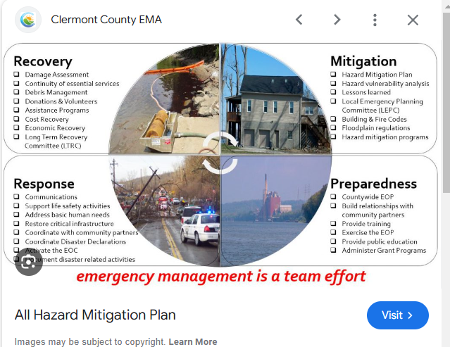
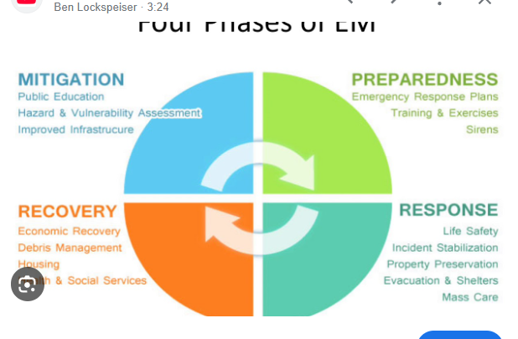
Four Phases of Emergency Management
White Sulphur Springs, WV (11/17/2022)
Rainelle, WV (11/18/2022)
Notes:
The last partnership example with other university faculty highlights social scientist Jamie Shinn’s National Science Foundation research about the recovery and resiliency of two small communities in Greenbrier County – White Sulphur Springs and Rainelle – that were devastated by the 2016 flood. This research also supports a Community Outreach and Mitigation Strategies (COMS) project sponsored by FEMA Region III and the State Emergency Management Division to evaluate how various flood protection measures like mitigation reconstruction will adapt to the future impacts of climate change.
Last week, focus group meetings were led by Professor Shinn for these two communities to assess lessons learned from the 2016 flood and to identify ways to build resilience to future floods. The WV GIS Technical Center provided support by quantifying various risk factors facing these disadvantaged communities. This included presenting flood characteristics and new flood maps, vulnerability analysis, and quantifying mitigation measures implemented to date.

Slide 14
Stakeholders
Stakeholders | Sta |  | Topic 1 Priority | Topic 2 Priority | Topic 3 Priority | Training 1 Priority | Training 2 Priority
Emergency Responders | Emergency Responders |  | RA-P | FD | MIT | Learning | Studies
Floodplain Managers (& Surveyors) | Floodplain Managers |  | MIT | RA-P | FD | Learning | Studies
Local Officials | Local Officials |  | RA-P | MIT | FD | Learning | Studies
Public (including realtors and insurance officials) | Public |  | RA-P | MIT | FD | Learning | Studies
Risk Reduction Associates (Planners/Coordinators, Mitigation Specialists, Researchers, etc.) | Risk Reduction Associates |  | RA-P | MIT | FD | Studies | Learning
Volunteers (VOAD, Charities, etc.) | Volunteers |  | RA-P | FD | MIT | Learning | Studies

