Slide 1

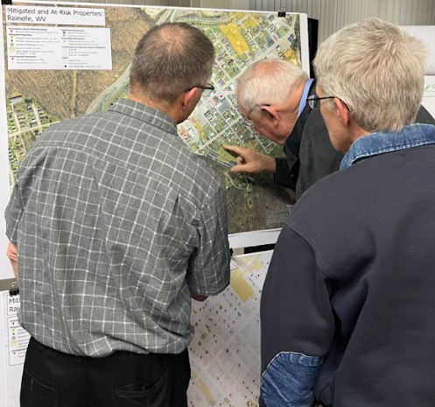
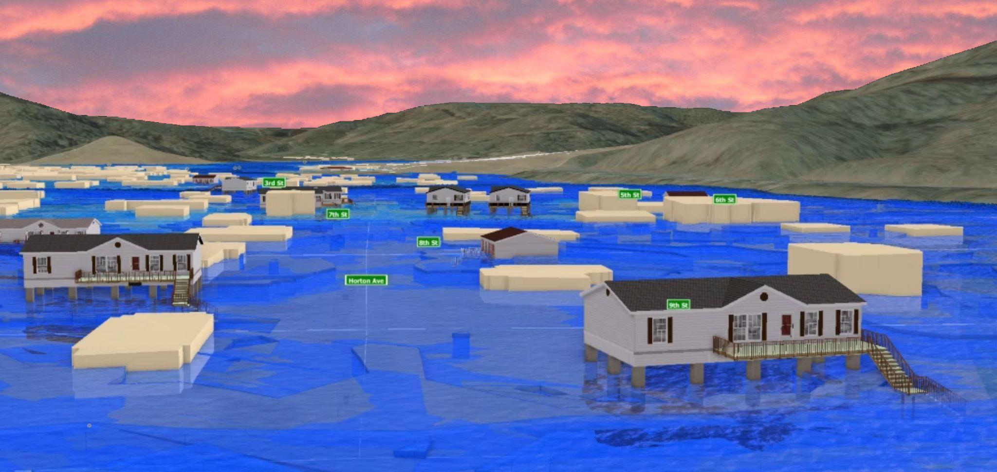
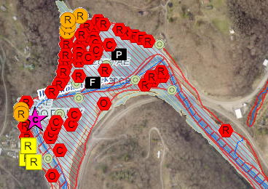
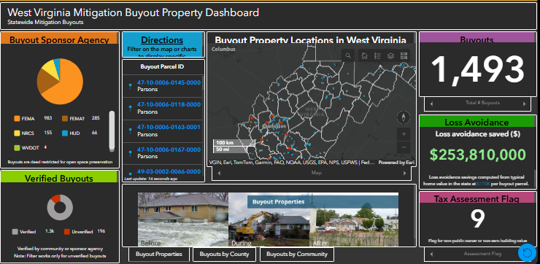
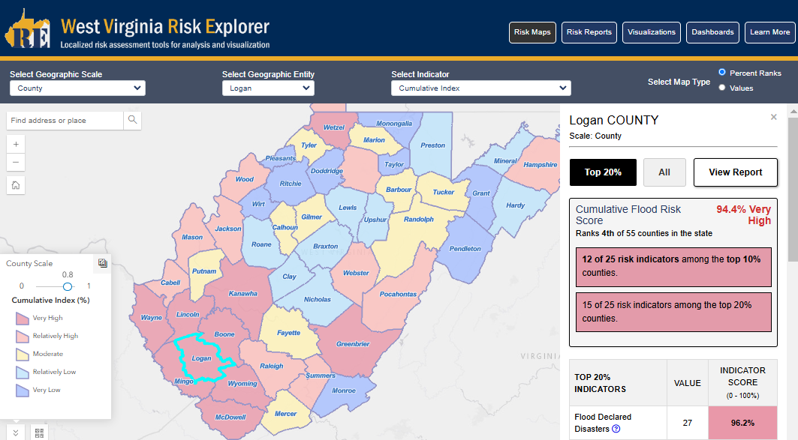
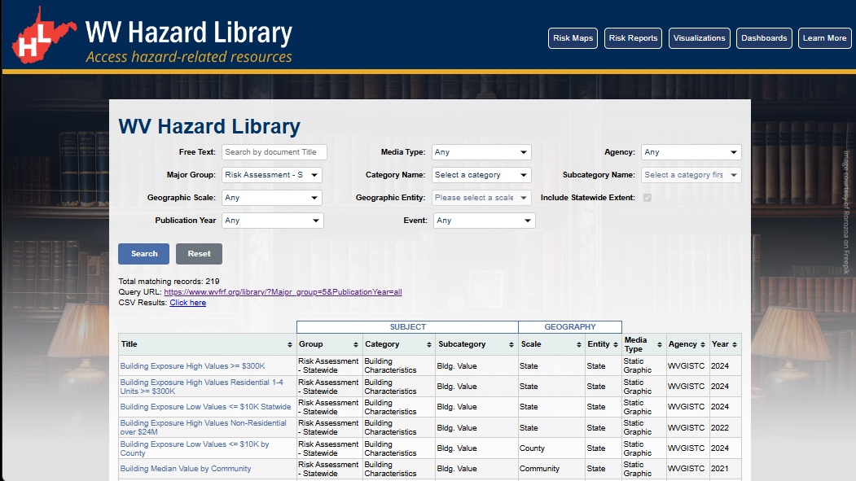
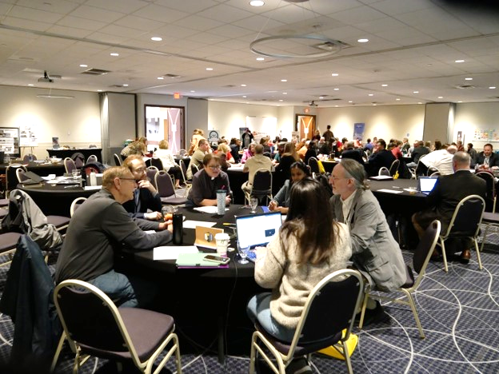
WV Flood Resiliency Framework
A virtual hub of risk assessment, visualization, planning, and training resources for building community flood resiliency in WV
Flood Visualizations
WV Flood Tool
COMMUNITY
ENGAGEMENT
• Focused Outreach Meetings
• Flood Symposium
• Resiliency Tools & Products
• Learning Resources & Reports
RISK TOOLS
• WV Risk Explorer
• WV Flood Tool
• Visualizations
• Dashboards
9 Geographic Scales
Flood Dashboards
WV Risk Explorer
Community Engagement Meeting
Risk Tools
HAZARD LIBRARY
Search online hazard resources by title, subject, media, event, geography, data, etc.
STAKEHOLDERS
• Risk Reduction Associates
• Emergency Responders
• Floodplain Managers
• Local Officials
• Volunteers
• Public
Hazard Library
Flood Symposium Stakeholders
Notes:
The WV Flood Resiliency Framework employs risk assessment, visualization, and resource discovery tools to engage communities and stakeholders in building flood resiliency.

Slide 2
WVFRF Tools at Multiple Scales
GEOGRAPHIC SCALES |  | APPLICATIONS |  |  |  | WVFRF TOOLS
Geographic Unit | # Units | Floodplain Management & Mitigation | FEMA Mapping | Risk Planning | Disaster Management | WV Risk Tools (WV Flood Tool & WV Explorer) | Flood Visualization Tools | Hazard Library (Document Center Tool)
PROPERTY LEVEL
Structures¹ | 98,000 | X | X | X | X | Yes | Yes | Yes
Parcels | 275,000 | X | X | X | X | Yes |  | Yes
Other Features² |  | X | X | X | X | Yes |  | Yes
COMMUNITY LEVEL
Incorporated Places | 211 | X | X | X | X | Yes | Yes | Yes
Unincorporated Areas | 55 | X | X | X | X | Yes | Yes | Yes
Communities (NFIP)³ | 266 | X | X | X | X | Yes | Yes | Yes
COUNTY-REGION-STATE LEVEL
Counties | 55 | X | X | X | X | Yes | Yes | Yes
Regions (RPDCs) | 11 | X | X | X | X | Yes |  | Yes
State | 1 | X | X | X | X | Yes |  | Yes
DRAINAGE LEVEL
Watersheds | 32 | X | X | X | X | Yes |  | Yes
Streams (named) | 6,748 | X | X | X | X | Yes | Yes | Yes
NOTES:
¹ Primary structures located in high-risk effective and advisory floodplains (1%-annual-chance flood)
² Other Features include roads, bridges, National Register Areas, flood mitigation structures (dams, levees, floodwalls)
³ Total 284 communities in state: 266 NFIP; 18 incorporated places not in NFIP
Notes:
The WV Flood Resiliency Framework Tools support flood visualization and analytical tools for hazard risk planning, floodplain management, flood zone mapping, and disaster management at nine geographic scales, ranging from the building level to community to region to state scales as well as stream and watershed scales. Additionally, the WVFRF Tools are integrated together in that the WV Risk Explorer, for example, links with the WV Flood Tool and Hazard Library.

Slide 3
WV Risk Tools
Analytical & Visualization Tools at multiple scales
Risk Factors for riverine hazard assessments
WV RISK TOOLS
2 KEY FLOOD RISK TOOLS | 9 GEOGRAPHIC SCALES
<< Aggregate & Property Levels >> WV Risk Explorer Risk Maps Risk Reports Bldg. Risk Tool Dashboards Visualizations Data Access ----------------------------------- << Property Level >> WV Flood Tool WV Property Viewer | << Political Boundaries >> 1) State 2) Region 3) County 4) Community 5) Incorporated Place 6) Unincorporated Area ----------------------------------- << Drainage Areas / Streams >> 7) Watershed 8) Stream/River ----------------------------------- << Property Levels >> 9a) Parcel 9b) Building
WV RISK FACTORS
RISK INDICATORS | ENVIRONMENTS
Floodplain Characteristics Building Exposure Building Characteristics Critical Infrastructure Community Assets People/Social Vulnerabilities Other Hazards | Physical (Flood Factors, Topography, Hydrology, Hydraulics) Human (People) Social Economic Institutional Manmade (Buildings, Roads)
Notes:
The WV Flood Tool and WV Risk Explorer applications quantify riverine flood risk at the building and summary geographic levels, respectively. Cumulative risk rankings at different geographic scales and entities are computed from various risk indicators, including building, people, and social-economic factors

Slide 4


Risk Tools Comparison
WV Flood Tool | WV Risk Explorer
Determine the degree of flood risk for a specific area or property using the Public and Expert Views. View building risk assessments and mitigation measures using the Risk Map View. | View and analyze riverine flood risk at the aggregate level for community, county, region, watershed, and stream scales. Compare risk among different geographic entities, complete with risk scores and rankings, from the building level to state scales.
Primary Components: Public View Expert View (Floodplain Management) RiskMap View (Risk Reduction) Reference Layers & Basemaps Property Search Tools Links to External Viewers & Resources | Primary Components: Risk Maps Tool Risk Reports Tool Risk & Mitigation Dashboard Tools Building Level Risk Tools Flood Visualization Tools Data linkages WV Flood Tool & Hazard Library
Applications: Flood Risk Determinations at Property Level Floodplain Management Mitigation Measures Damage Assessments Property Identification Flood Visualizations & Risk Communications CRS Map Credits Other Hazards | Applications: Plans (Resiliency, Emergency Operations, Hazard Mitigation) Risk Studies (Risk MAP, Risk Reduction, Community Focused) Mitigation Measures, Tracking & Monitoring Flood Visualizations & Risk Communications CRS Programming Variables Other Hazards
Notes:
The WV Flood Tool and WV Risk Explorer applications allow for risk assessment at the building and summary geographic levels, respectively.

Slide 5

WV Hazard Library
Hazard Library of documents and visual media relevant to West Virginia
WV HAZARD LIBRARY
TOPICS | MEDIA TYPES |  | SEARCH TYPES
Risk Assessment & Planning State Risk Assessments Local Risk Assessments Planning Resources Web Tools Mitigation Mitigation Measures Floodplain Mapping Floodplain Management Flood Insurance Flood Disaster Flood Event Flood Research Flood Forecast | 3D Movie Bldg. Profile Dashboard Data Flyer Graphic Guide Letter Multiple Types Map Metadata News Article Plan | Poster Report Slides Story Map Study Survey Table Video Viewshed Web App Website | Agency Downloadable Data Event Disaster Event Meeting Geographic Scale Entity Media Type Publication Date Subject Major Group Category Subcategory cross-indexing Stakeholder Type Title (free text search) Resource Type (learning, study, reference)
Notes:
The WV Hazard Library contains more than 24 media resource types relevant to West Virginia. Resources are organized into three major topics: risk assessment/planning, mitigation, and flood disaster. Users can search online hazard resources by title, subject, media, event, geography, data, stakeholder type, etc.

Slide 6
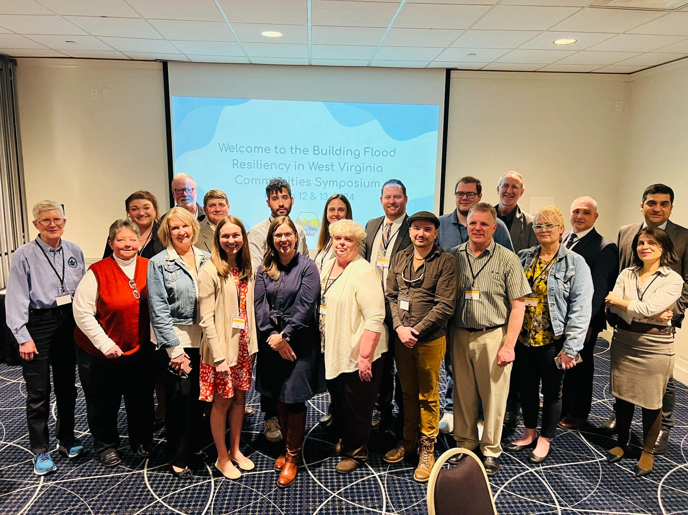
Community Engagement
Community Engagement modes to convey flood risk and build resiliency
COMMUNITY ENGAGEMENT METHODS
Focused Outreach Meetings Risk Communications Risk Reduction Meetings Resiliency Tools & Products Risk Assessments (Detailed or Summarized) Mitigation Measures (Planned or Implemented) Flood Visualizations Learning Resources & Published Reports Best Practice Guides and Training Materials Lessons Learned Planning Documents Research and Policy Papers Risk information communicated via WV Risk Tools, WV Hazard Library, and other resources.
Flood Symposium Stakeholders
Flood Symposium Project Team
Notes:
Communicating flood risk and resiliency to stakeholder groups of varying subject knowledge in an effective manner can be challenging. Community engagement methods may include focused outreach meetings, resiliency tools, learning resources, etc.

Slide 7
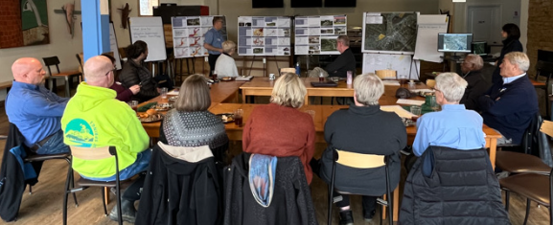
Community Engagement
White Sulphur Springs, WV (11/17/2022)
Rainelle, WV (11/18/2022)
Feedback desired from Focus Groups:
  What lessons were learned from the immediate response and longer-term recovery from the 2016 flood?
  What priorities are needed for a stronger flood response and recovery plan in the event of a future flood?
Feedback of Flood Study Products:
  Flood Characteristics and Models
  Flood Risk Assessment (vulnerability, exposure, loss)
  Mitigation Maps
  Flood Visualization Tools
Notes:
Examples of community outreach meetings for two small communities in Greenbrier County – White Sulphur Springs and Rainelle – that were devastated by the 2016 flood. The WVFRF Tools allow for the engagement of floodprone communities with tailored risk assessments and mitigation strategies.

Slide 8
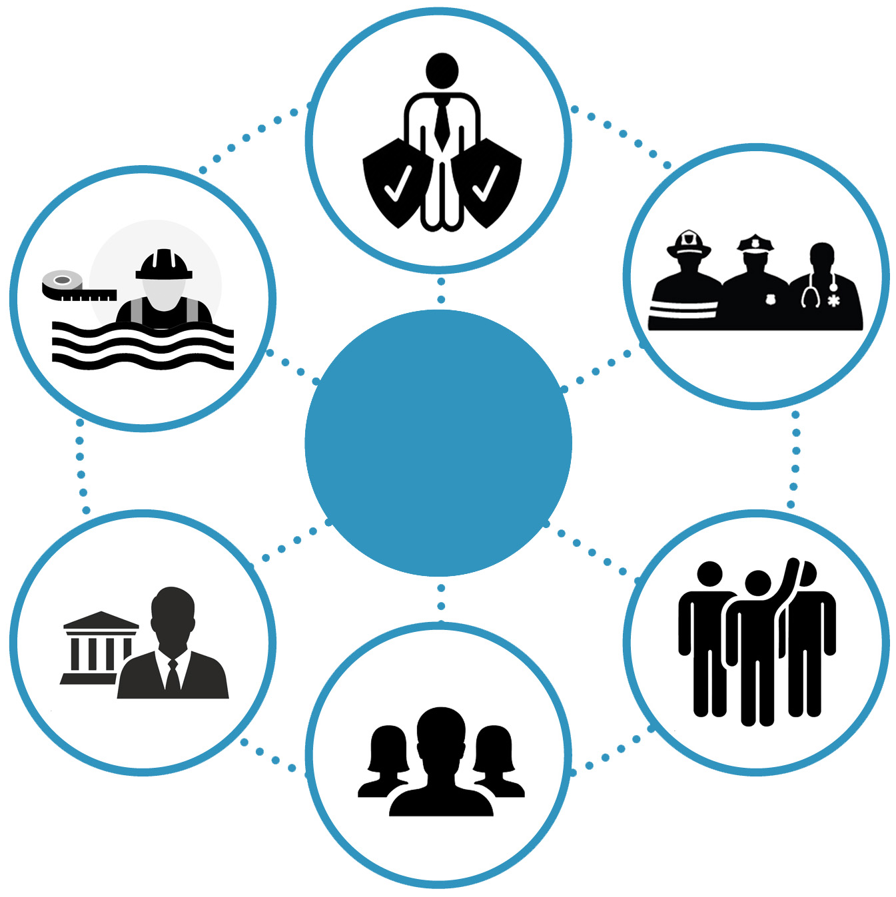
Stakeholders
Risk Reduction Associates
Floodplain Managers
Emergency Responders
Stakeholders
Local Officials
Volunteers
Public
Notes:
Six targeted stakeholder groups for WVFRF tools and hazard library resources.

Slide 9
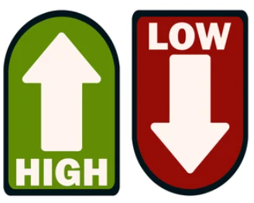
Tool Usage by Stakeholder Groups
Stakeholder Groups of anticipated usage of Risk Tools and Hazard Library
 |  | Property-Level Scale |  |  |  | All Geographic Scales
# | Stakeholders | Property Viewer | Flood Tool |  |  | Risk Explorer Tools | Hazard Library³
 |  |  | Public | Expert | RiskMAP
1 | Floodplain Managers ¹ – FM (includes surveyors and engineers) | FM |  | FM | FM | FM | FM-Learning
2 | Risk Reduction Associates - RRA (planners, researchers, mitigation specialists, etc.) | RRA |  | RRA | RRA | RRA | RRA-Studies
3 | Emergency Responders – ER | ER |  |  | ER | ER | ER-Learning
4 | Local Officials | Officials | Officials |  |  | Officials | Off-Learning
5 | Public (includes realtors and insurance officials) | Public | Public |  |  |  | Pub-Learning
6 | Volunteers – Vols. (VOAD, Charities, etc.) | Vols. | Vols. |  |  |  | Vol-Learning
Popularity of Tools ² by
Stakeholder Group
¹ Floodplain Managers may be representatives of other stakeholder groups such as E-911 Directors or Mayors.
² Floodplain Managers and Risk Reduction Associates stakeholders have the highest demand for flood resiliency tools.
³ All Stakeholders benefit by using the Hazard Library which is broadly categorized into learning, study, and reference resources. The primary stakeholder group for the WV Property Viewer is the Public, while the main stakeholder group for WV Flood Tool is the Floodplain Managers, and for the WV Risk Explorer various Risk Reduction Specialists.
Notes:
Risk Reduction Associates and Floodplain Managers are the two primary stakeholder groups of the WV Flood Tool and WV Risk Explorer.

