Slide 1
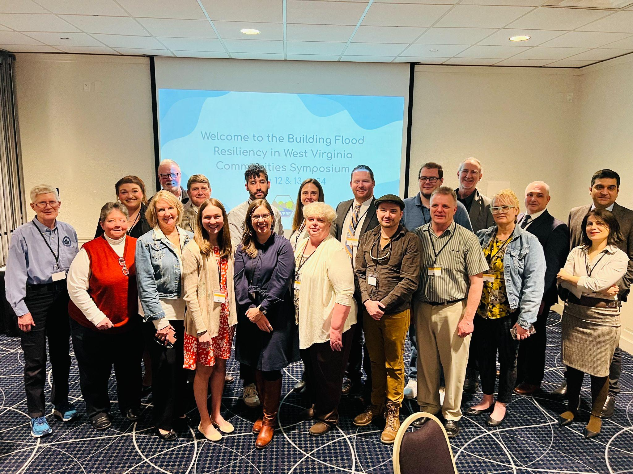
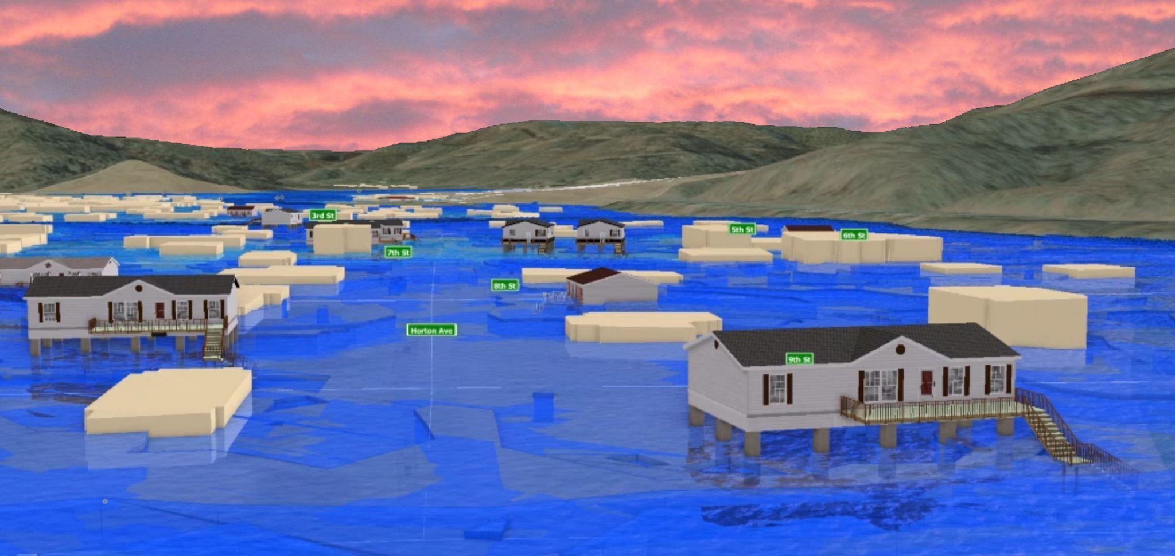
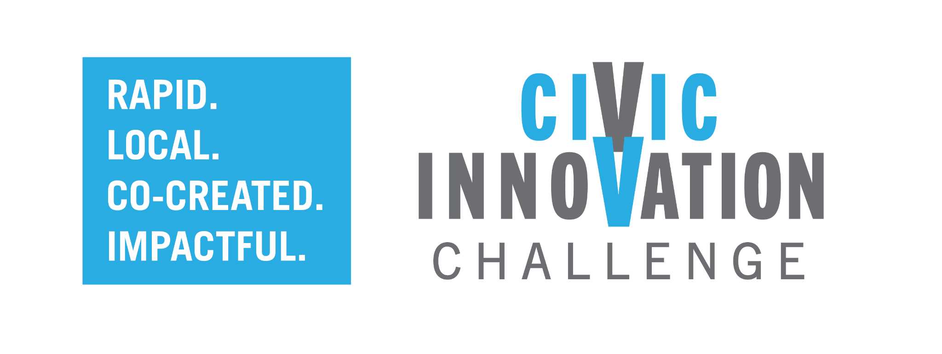
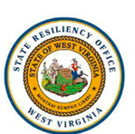
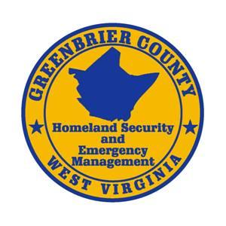
Creating the West Virginia Flood Resiliency Framework for comprehensive disaster response and long-term community recovery
West Virginia
NSF Award ID: 2228492
PI: Jamie Shinn, SUNY College of Environmental Science and Forestry (ESF)
Project Challenge
West Virginia has extremely high flood risk and lacks adequate resources for disaster preparation, response, and recovery. The West Virginia Flood Resiliency Framework (WVFRF) is a freely available online toolkit that is designed to serve as a hub of information to assist communities across the disaster management cycle from understanding flood risk to preparation for and management of a flood disaster.
Civic Partners:
WV GIS Technical Center
WV State Resiliency Office
WVU Land Use & Sustainable Development Law Clinic
WV Voluntary Organizations Active in Disasters
Meadow River Valley Association
Greenbrier County Homeland Security & Emergency Management
Research Questions
How fully have West Virginians recovered from past floods, and how resilient are they against future flooding?
What flood risk knowledge is needed to promote resiliency in WV?
What are best practices for flood response and recovery in WV?
WVFRF Team at Flood Symposium
Inundation scenario of a 1%-annual-chance (100-year) flood in Rainelle, WV
Research Partners:
Aaron Maxwell, West Virginia University
Julian Levine, WV School of Osteopathic Medicine
Pilot Outcomes
The West Virginia Flood Resiliency Framework contains:
Results of a statewide flood vulnerability survey
A best practices guide for disaster preparation and flood response
Floodplain management trainings
The WV Risk Explorer tool that can be used to understand and visualize riverine flood risk at nine geographic scales
2022-2024 Civic Innovation Challenge

