Slide 1
Flood Frequency
Frequency: Probability that a flood of a specific size will be equaled or exceeded in any given year.
FEMA
Flood Recurrence Interval and Flood Size | Annual Probability | Cumulative Probability - Flooding at least once over 30 years | FEMA Risk Description
500 yr (1 in 500) | 0.2% | 6% | Moderate Risk
100 yr (1 in 100) Plus confidence error | 1%+
100 yr (1 in 100) | 1% | 26% | High Risk
50 yr (1 in 50) | 2% | 45% | High Risk
25 yr (1 in 25) | 4% | 71% | High Risk
10 yr (1 in 10) | 10% | 96% | High Risk
Climate scenarios generated from BFE + 1 ft. or 1%+ Recurrence interval
5-, 10-, 20-, 25-, 50-, 100-, and 500-year flood elevations (above sea level) refer to expected water levels of the 20%, 10%, 5%, 4%, 2%, 1%, and 0.2% annual chance flood events.
The Differences between FEMA Flood Maps and Flood Risk Factors by FSF
Differences | FEMA | (FSF)
Scale of Flood Risk | Mapping Risk by Zones | Identifying the Risk on Property Level
Future Risk | Maps are not Adjusting based on Climate Change & and its impact on Future Floods | Considering the effect of Sea level Rise & Atmospheric Change in the next 30 years on Flood Risk
Insurance Rates | Maps are Intended to Inform Flood Insurance Rates | Does not Determine Whether the Property Needs Flood Insurance
Development Requirement | Determining Development for the Areas at Risk | Assessing Risk for an Individual Property
First Street Foundation (FSF)
Flood Recurrence Interval and Flood Size (2022, 2037, 2052)* | Annual Probability (flooding at least 1 cm) | Cumulative Probability - Flooding at least once over 30 years | First Street Risk Description
500 yr (1 in 500) | 0.2% | >0% | Any Risk
100 yr (1 in 100) | 1% | >26% | Substantial Risk
20 yr (1 in 20) | 5% | > 85%
5 yr (1 in 5) | 20% | >99% | Almost Certain Risk
Climate scenarios available for 3 flood depth years (2022-today, 2037-15 years, 2052-30 years)
2022 Flood Study Sources: FEMA and First Street Foundation (FSF)

Slide 2
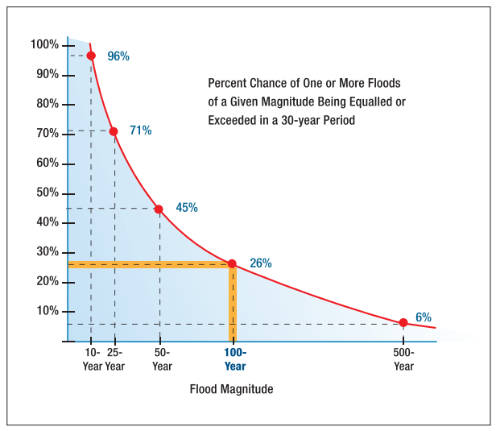
Flood Characteristics
Frequency: Probability that a flood of a specific size will be equaled or exceeded in any given year
5-, 10-, 20-, 25-, 50-, 100-, and 500-year flood elevations (above sea level) refer to expected water levels of the 20%, 10%, 5%, 4%, 2%, 1%, and 0.2% annual chance flood events. A 1000-yr flood has a 0.1% chance of happening in any given year.
FEMA’s 1%+ flood elevations measures how high the 100-year flood could be given the statistical uncertainties in flood modeling. It represents the upper 84-percent confidence limit of the statistical error for calculating the 1-percent annual chance event.
The relative frequency of any given flood (e.g., 5-year or 10-year) serves as a useful reference point when selecting a mitigation options and evaluating cost effectiveness.
Depth: Flood depth or water surface elevation above the ground surface
Critical during design considerations, as it is often the primary factor in evaluating the potential for flood damage
Flood depth sources include flood models and high water marks which measure the degree of flooding
Velocity: Speed at which the floodwaters are flowing
Flowing water often causes erosion and scour, as well as debris impacts and hydrodynamic forces.
FEMA’s detailed engineering studies provide river/stream flows
Duration: Measure of how long water remains above normal levels.
Prolonged contact with floodwaters may make some mitigation measures, including dry flood-proofing, inappropriate because of the increased chance of seepage and potential structural failure.
Long periods of inundation are more likely to cause greater damage to structural members and finishes than short periods of flooding.
Rate of Floodwater Rise and Fall: Floodwater that rises very quickly with little or now warning
Steep topography and locations with small drainage areas may experience flash flooding in which floodwater can rise very quickly with little or no warning.
High-velocity water flows usually accompany flash floods and preclude certain types of flood mitigation measures, especially those requiring human intervention
Rapid rates of the rise and fall of floodwater can also lead to unequal hydrostatic pressures on a building. The probability of unequal hydrostatic pressures increases when building exteriors are designed to be watertight
Historical Information: Use past information like the high-water marks of the 2016 Flood as an indication of the nature and severity of effects likely to occur during future events.
Flood Characteristics Impacting Community
Flood Models and Studies
Relationship between flood recurrence intervals and the probability of an event occurring within a given period

Slide 3
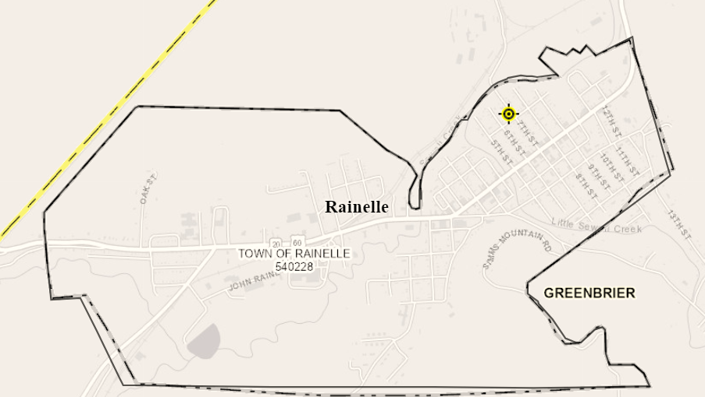
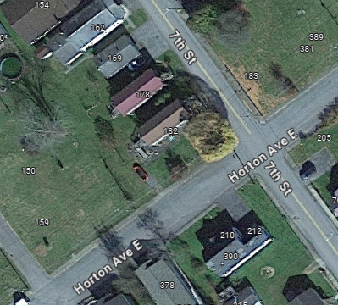
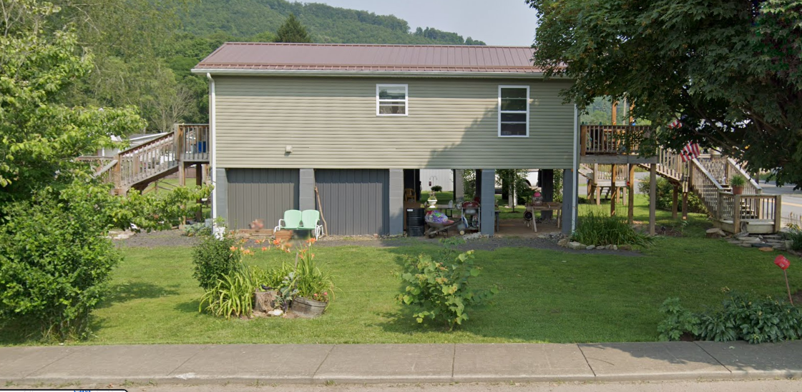
Rainelle
182 SEVENTH ST, Rainelle, WV, 25962
Building Flood Profile
13-13-0001-0054-0000_182

Slide 4
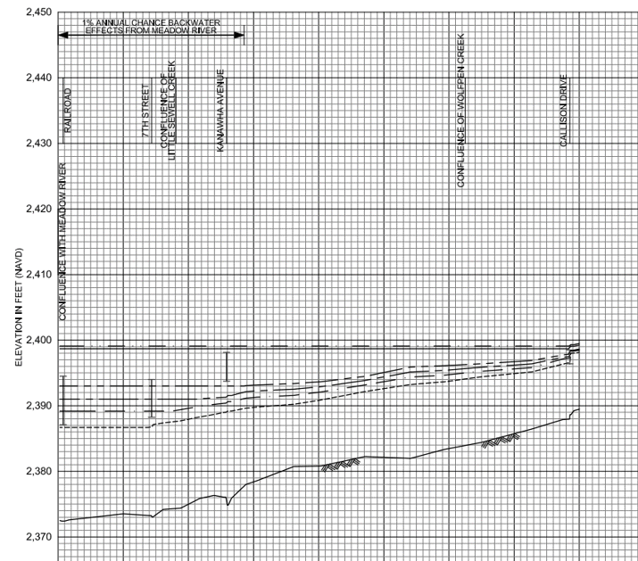
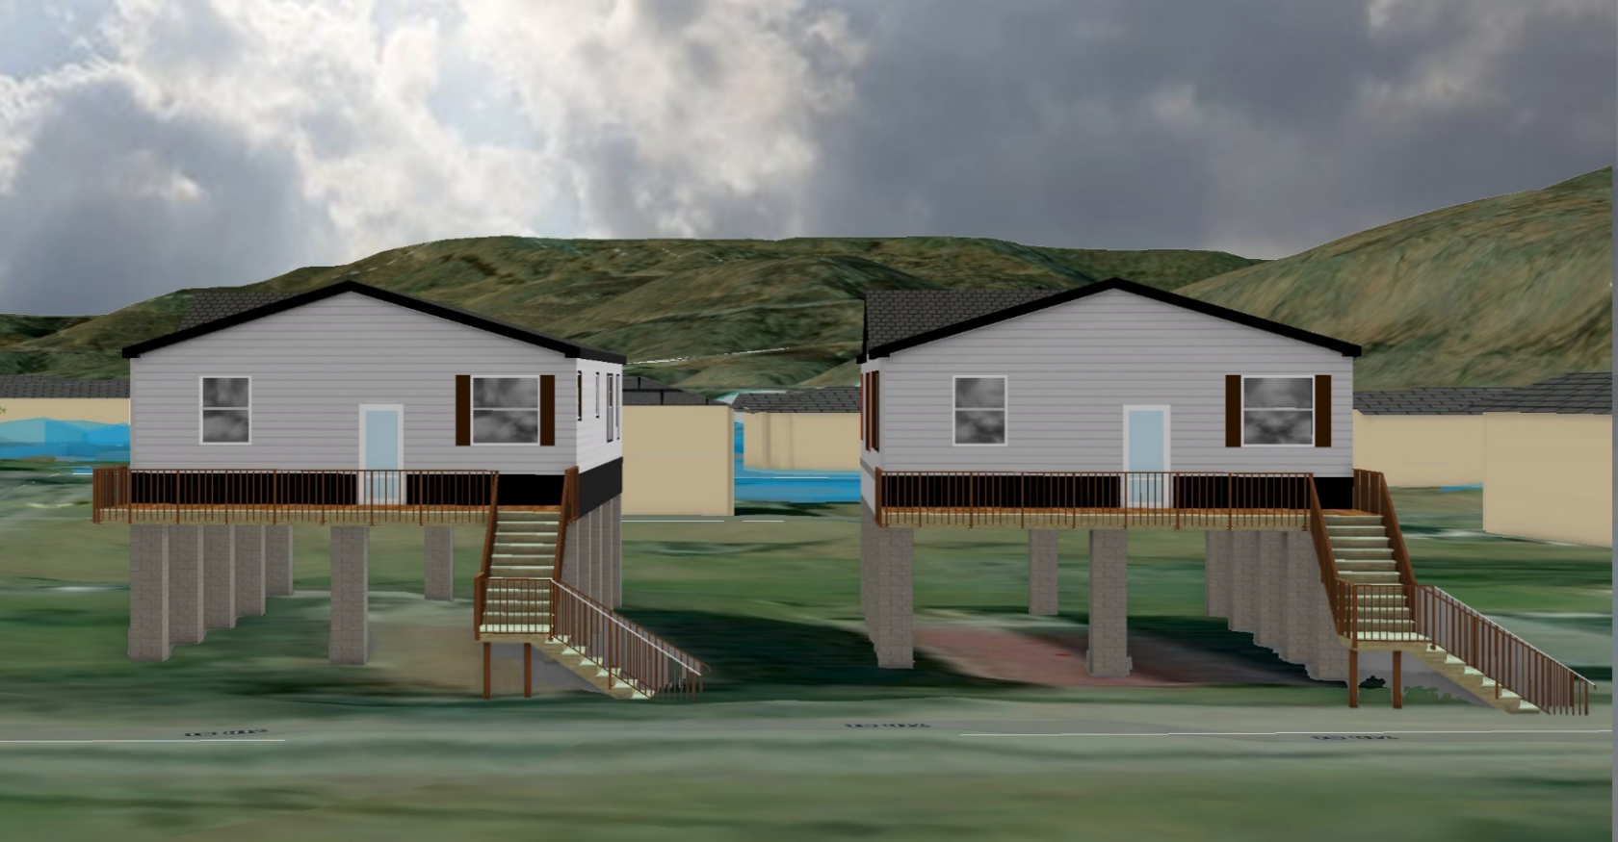
10% Probability of Flood in a year (10-year flood)
Building’s Ground Elevation
No Inundation

Slide 5
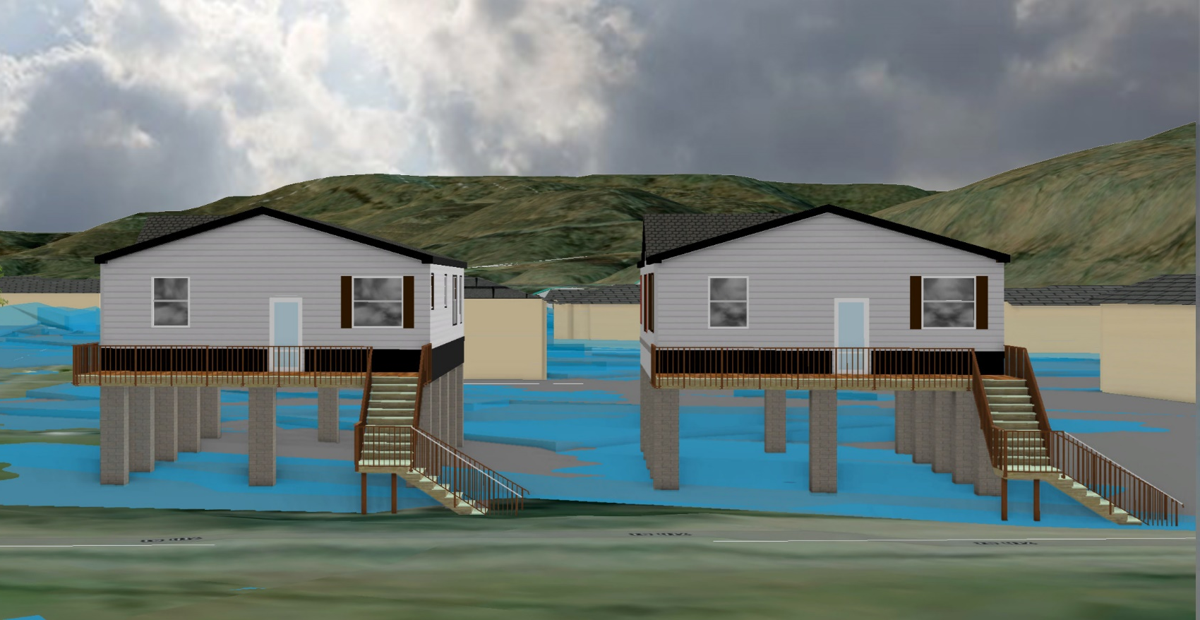
4% Probability of Flood in a year (25-year flood)
0’ (FEMA 4% / 25-Yr)

Slide 6
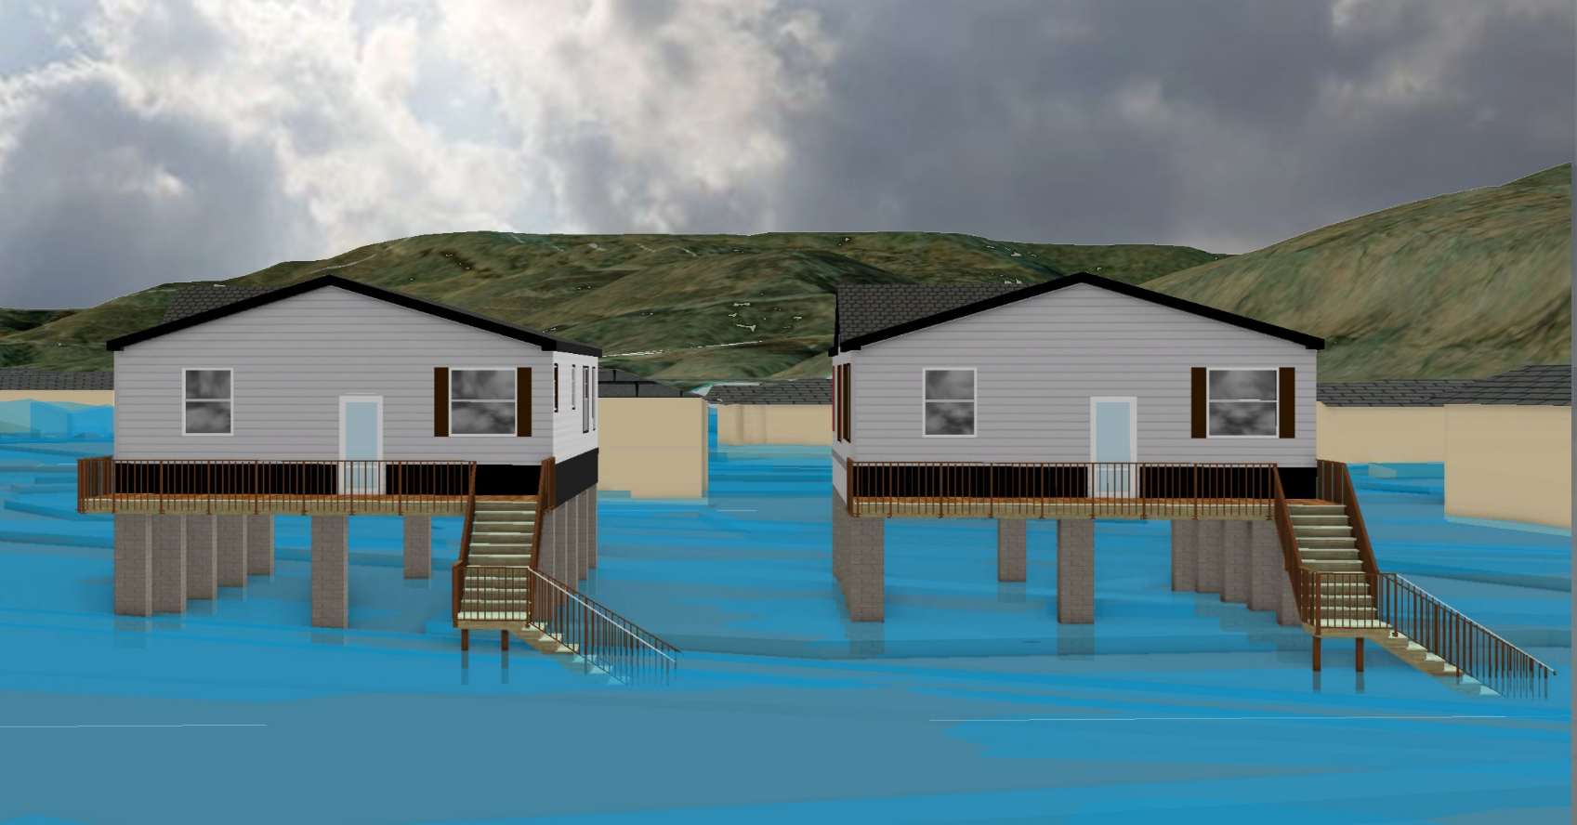
2% Probability of Flood in a year (50-year flood)
1.9’ (FEMA 2% / 50-Yr)

Slide 7
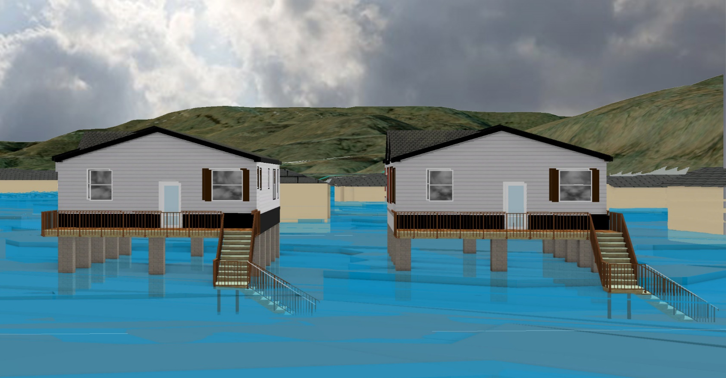
1% Probability of Flood in a year (100-year flood)
3.1’ (FEMA 1% /100-Yr)

Slide 8
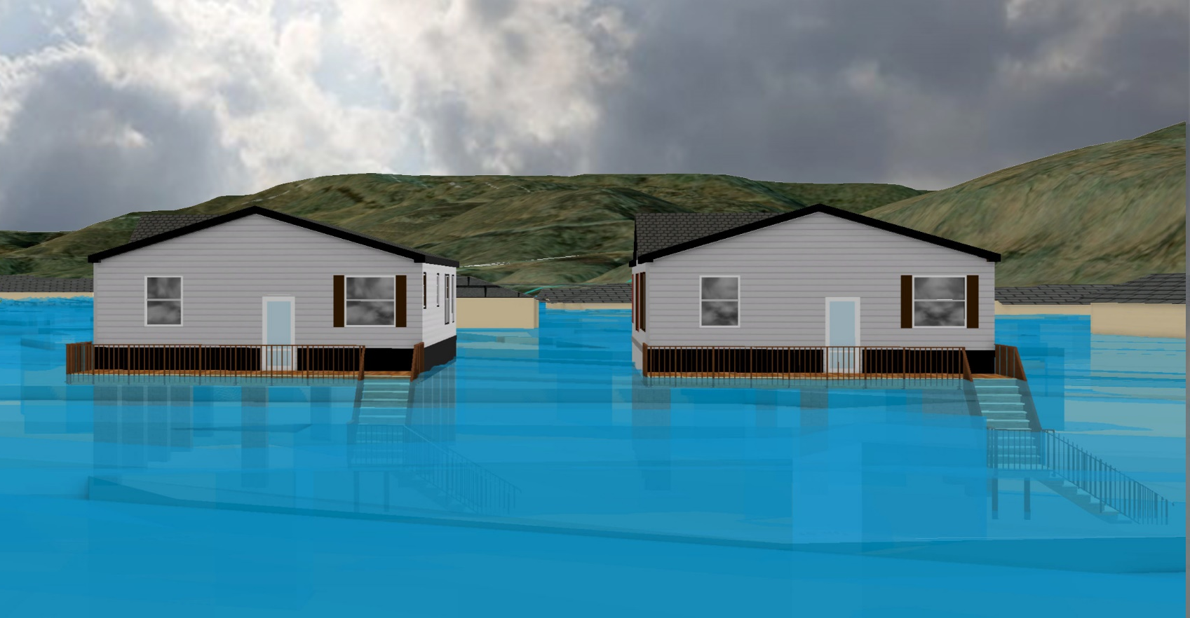
0.2% Probability of Flood in a year (500-year flood)
9.9’ (FEMA 1% +/ 84% CL)
9.9’ (FEMA 0.2% /500-Yr)

Slide 9
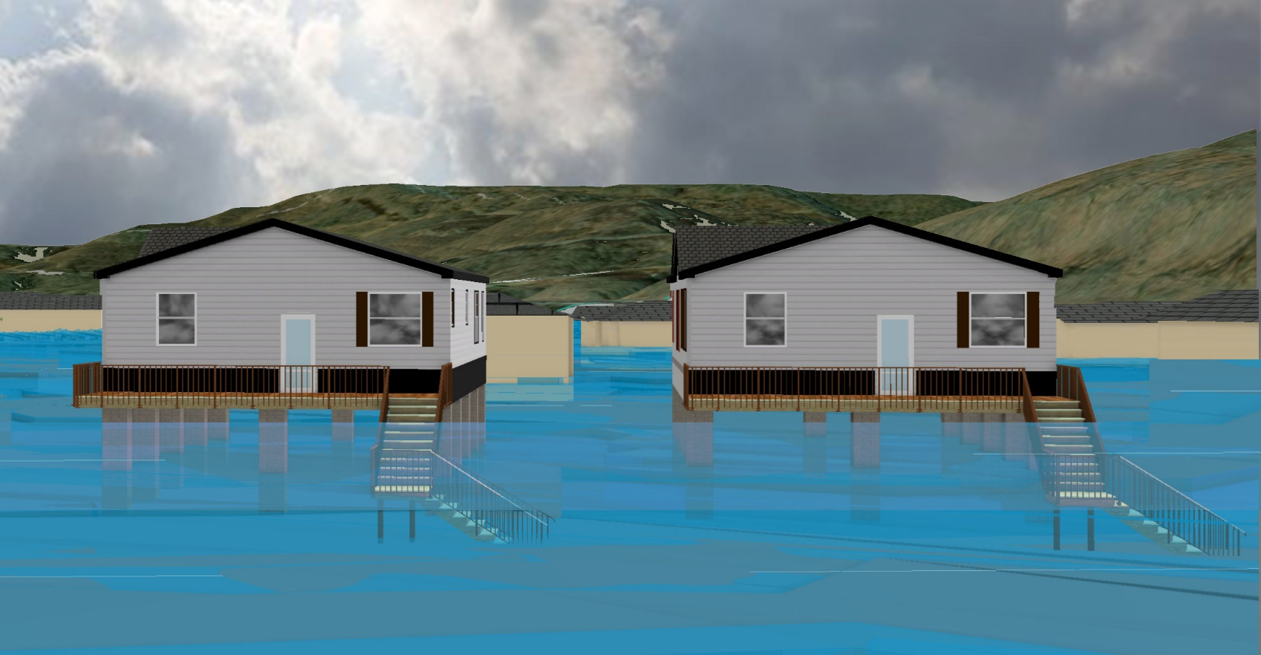
2016 High Watermark
High Watermark
7.5’ (2016 High Water)

Slide 10
 | HEIGHT (ft.)
BUILDING
First Floor Height | 9
Freeboard (FBD) | 2
FLOOD DEPTH
FEMA 10% (10-Yr) | NA
FEMA 4% (25-Yr) | NA
FEMA 2% (50-Yr) | 1.9
2016 Flood HWM
FEMA 1% (100-Yr)
FEMA 100-Yr + FBD
FEMA 1%+ (84% CL)
FEMA 0.2% (500-Yr)
FSF 0.2% (500-Yr) Climate
1.9’ (FEMA 10% / 10-Yr)
Building: 13-13-0001-0054-0000_182
182 Seventh Street, Rainelle, WV, 25962
FLOOD DEPTHS:
FEMA
First Street Foundation (FSF)
USGS 2016 Flood High Water Mark

Slide 11
 | HEIGHT (ft.)
BUILDING
First Floor Height | 9
Freeboard (FBD) | 2
FLOOD DEPTH
FEMA 10% (10-Yr) | NA
FEMA 4% (25-Yr) | NA
FEMA 2% (50-Yr) | 1.9
2016 Flood HWM
FEMA 1% (100-Yr) | 3.1
FEMA 100-Yr + FBD
FEMA 1%+ (84% CL)
FEMA 0.2% (500-Yr)
FSF 0.2% (500-Yr) Climate
3.1’ (FEMA 1% / 100-Yr)
1.9’ (FEMA 10% / 10-Yr)
Building: 13-13-0001-0054-0000_182
182 Seventh Street, Rainelle, WV, 25962
FLOOD DEPTHS:
FEMA
First Street Foundation (FSF)
USGS 2016 Flood High Water Mark

Slide 12
 | HEIGHT (ft.)
BUILDING
First Floor Height | 9
Freeboard (FBD) | 2
FLOOD DEPTH
FEMA 10% (10-Yr) | NA
FEMA 4% (25-Yr) | NA
FEMA 2% (50-Yr) | 1.9
2016 Flood HWM
FEMA 1% (100-Yr) | 3.1
FEMA 100-Yr + FBD | 5.1
FEMA 1%+ (84% CL) | 9.9
FEMA 0.2% (500-Yr)
FSF 0.2% (500-Yr) Climate
9.9’ FEMA 1%+ (84% CL)
3.1’ (FEMA 1% / 100-Yr)
1.9’ (FEMA 10% / 10-Yr)
Building: 13-13-0001-0054-0000_182
182 Seventh Street, Rainelle, WV, 25962
FLOOD DEPTHS:
FEMA
First Street Foundation (FSF)
USGS 2016 Flood High Water Mark

Slide 13
 | HEIGHT (ft.)
BUILDING
First Floor Height | 9
Freeboard (FBD) | 2
FLOOD DEPTH
FEMA 10% (10-Yr) | NA
FEMA 4% (25-Yr) | NA
FEMA 2% (50-Yr) | 1.9
2016 Flood HWM | 7.5
FEMA 1% (100-Yr) | 3.1
FEMA 100-Yr + FBD | 5.1
FEMA 1%+ (84% CL) | 9.9
FEMA 0.2% (500-Yr)
FSF 0.2% (500-Yr) Climate
9.9’ FEMA 1%+ (84% CL)
7.5’ (2016 High Water)
3.1’ (FEMA 1% / 100-Yr)
1.9’ (FEMA 10% / 10-Yr)
Building: 13-13-0001-0054-0000_182
182 Seventh Street, Rainelle, WV, 25962
FLOOD DEPTHS:
FEMA
First Street Foundation (FSF)
USGS 2016 Flood High Water Mark

Slide 14
 | HEIGHT (ft.)
BUILDING
First Floor Height | 9
Freeboard (FBD) | 2
FLOOD DEPTH
FEMA 10% (10-Yr) | NA
FEMA 4% (25-Yr) | NA
FEMA 2% (50-Yr) | 1.9
2016 Flood HWM | 7.5
FEMA 1% (100-Yr) | 3.1
FEMA 100-Yr + FBD | 5.1
FEMA 1%+ (84% CL) | 9.9
FEMA 0.2% (500-Yr) | 9.9
FSF 0.2% (500-Yr) Climate
9.9’ (FEMA 0.2% / 500-Yr )
9.9’ FEMA 1%+ (84% CL)
7.5’ (2016 High Water)
3.1’ (FEMA 1% / 100-Yr)
1.9’ (FEMA 10% / 10-Yr)
Building: 13-13-0001-0054-0000_182
182 Seventh Street, Rainelle, WV, 25962
FLOOD DEPTHS:
FEMA
First Street Foundation (FSF)
USGS 2016 Flood High Water Mark

Slide 15
 | HEIGHT (ft.)
BUILDING
First Floor Height | 9
Freeboard (FBD) | 2
FLOOD DEPTH
FEMA 10% (10-Yr) | NA
FEMA 4% (25-Yr) | NA
FEMA 2% (50-Yr) | 1.9
2016 Flood HWM | 7.5
FEMA 1% (100-Yr) | 3.1
FEMA 100-Yr + FBD | 5.1
FEMA 1%+ (84% CL) | 9.9
FEMA 0.2% (500-Yr) | 9.9
FSF 0.2% (500-Yr) Climate | 12.2
12.2’ (FSF 0.2% / 500-Yr)
9.9’ (FEMA 0.2% / 500-Yr )
9.9’ FEMA 1%+ (84% CL)
7.5’ (2016 High Water)
3.1’ (FEMA 1% / 100-Yr)
1.9’ (FEMA 10% / 10-Yr)
Building: 13-13-0001-0054-0000_182
182 Seventh Street, Rainelle, WV, 25962
FLOOD DEPTHS:
FEMA
First Street Foundation (FSF)
USGS 2016 Flood High Water Mark

Slide 16
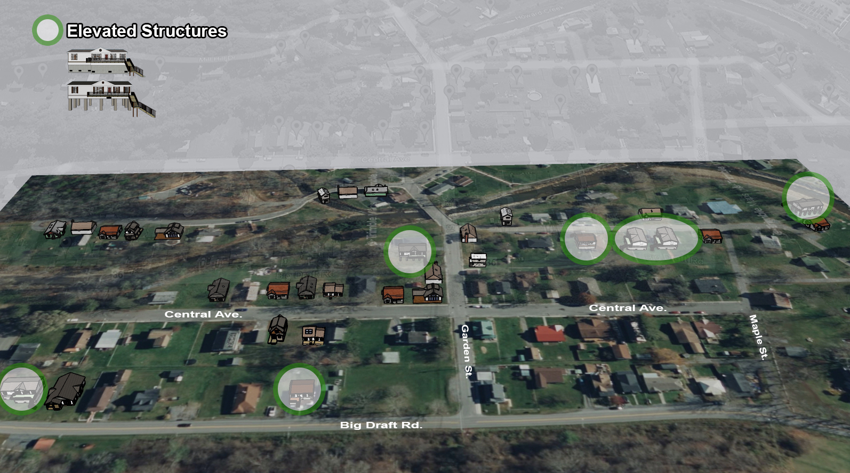
White Sulphur Springs
Building Flood Profile

Slide 17
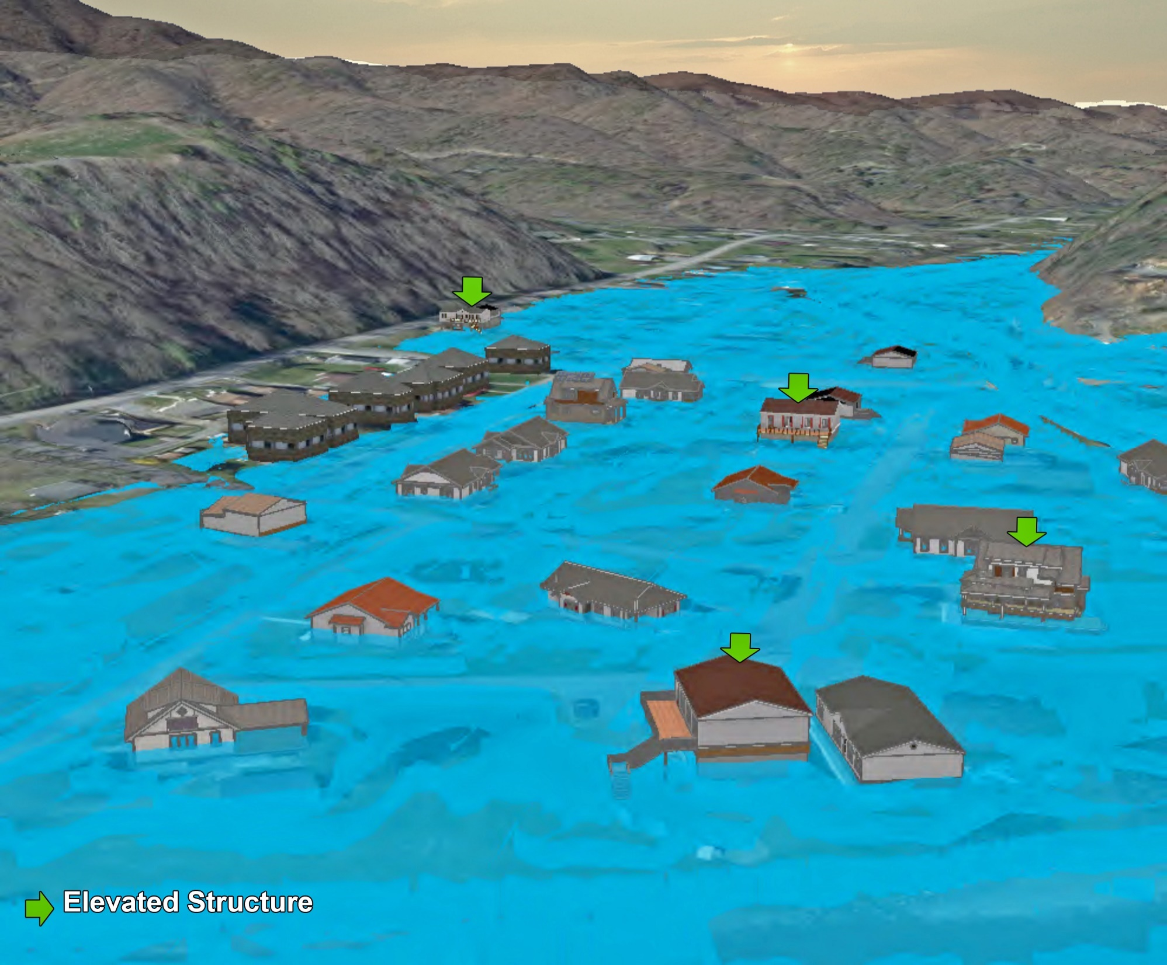
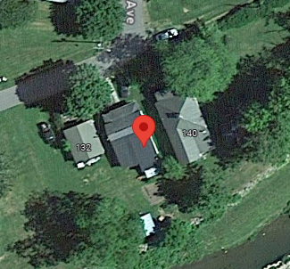
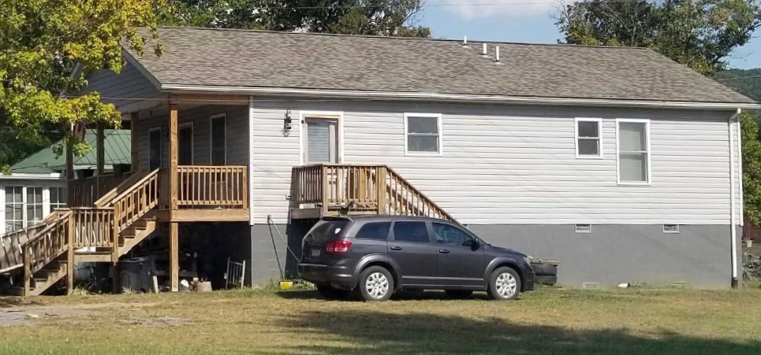
Building Flood Profile

Slide 18
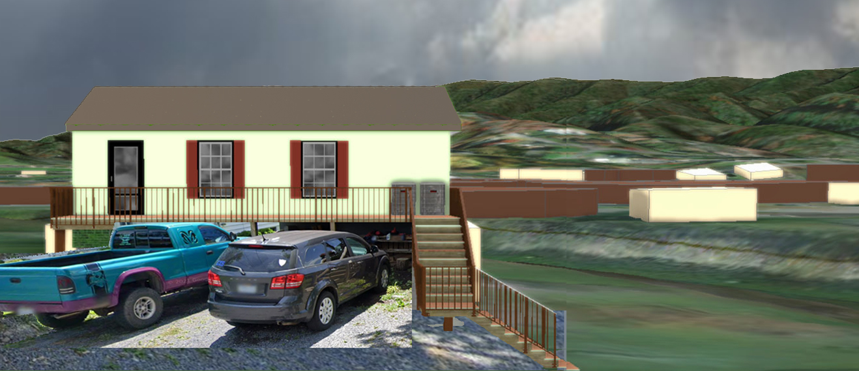
Building Flood Profile
138 Mill Street, White Sulphur Springs, WV, 24986
13-17-0009-0026-0000_138

Slide 19
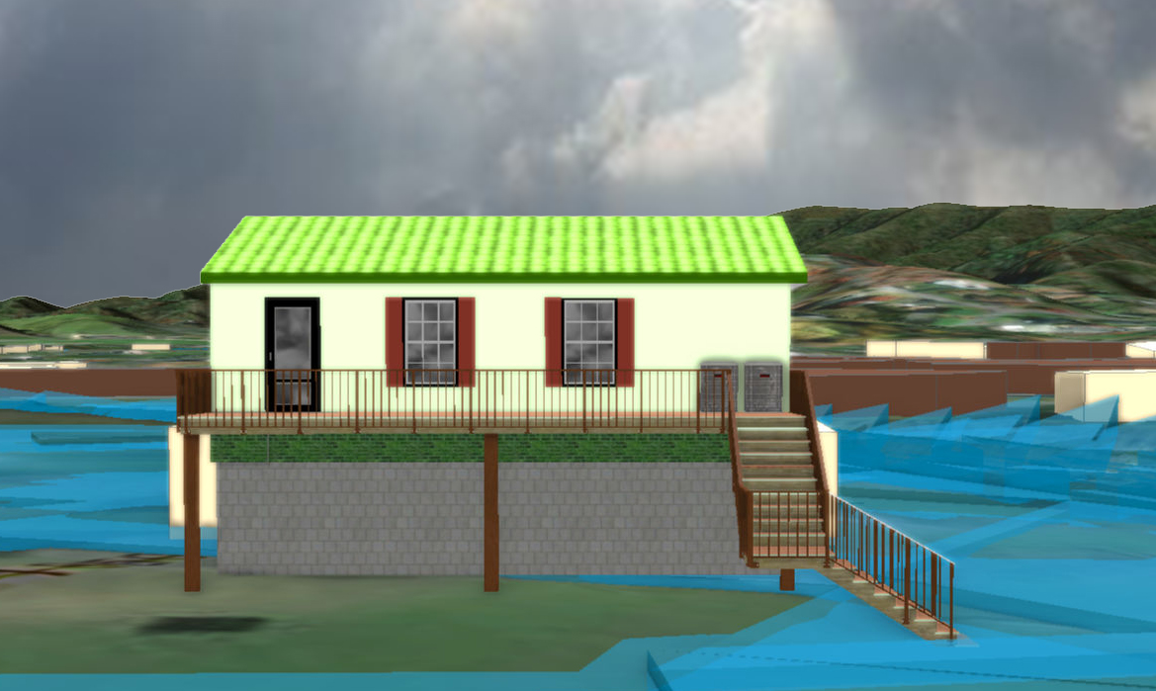
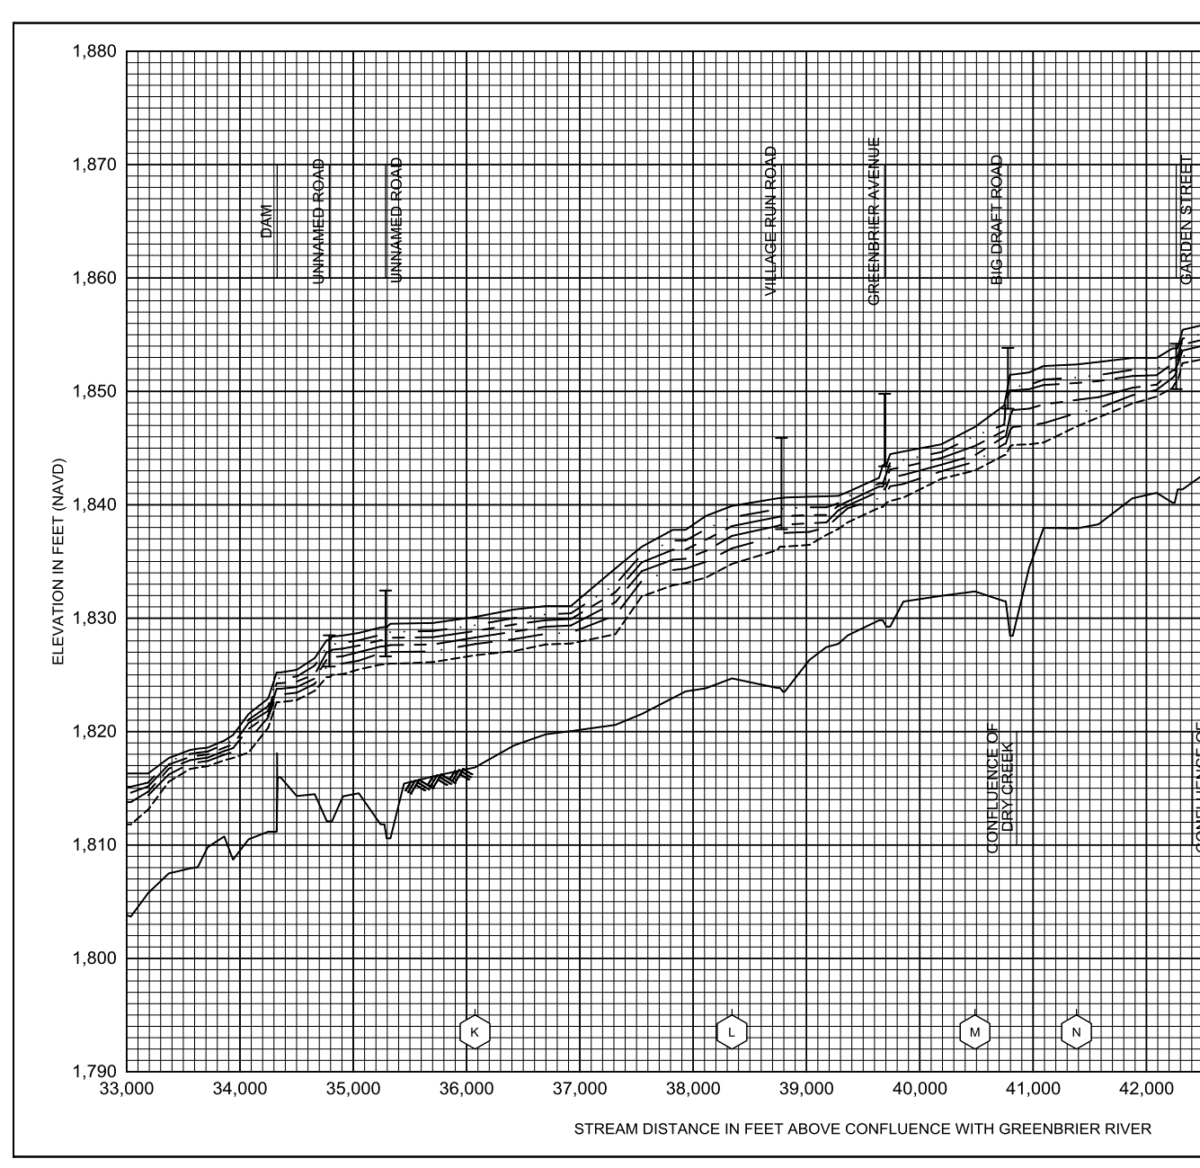
10% Probability of Flood in a year (10-year flood)
1.7’ (FEMA 10% / 10-Yr)
Building’s Ground Elevation

Slide 20
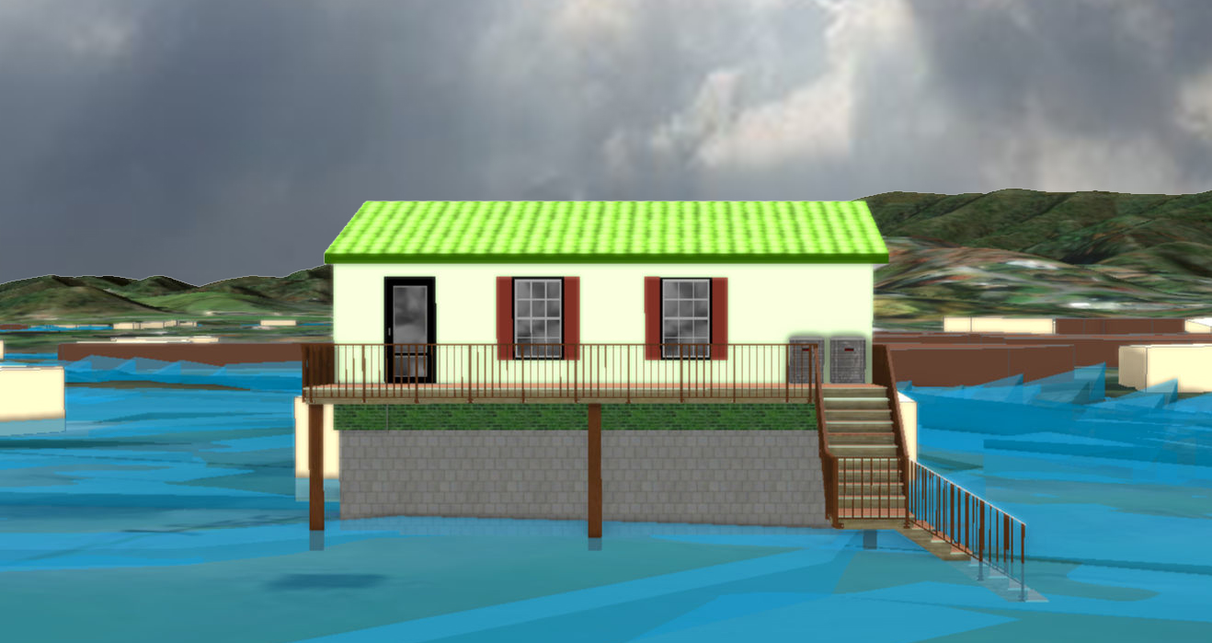
4% Probability of Flood in a year (25-year flood)
2.0’ (FEMA 4% / 25-Yr)

Slide 21
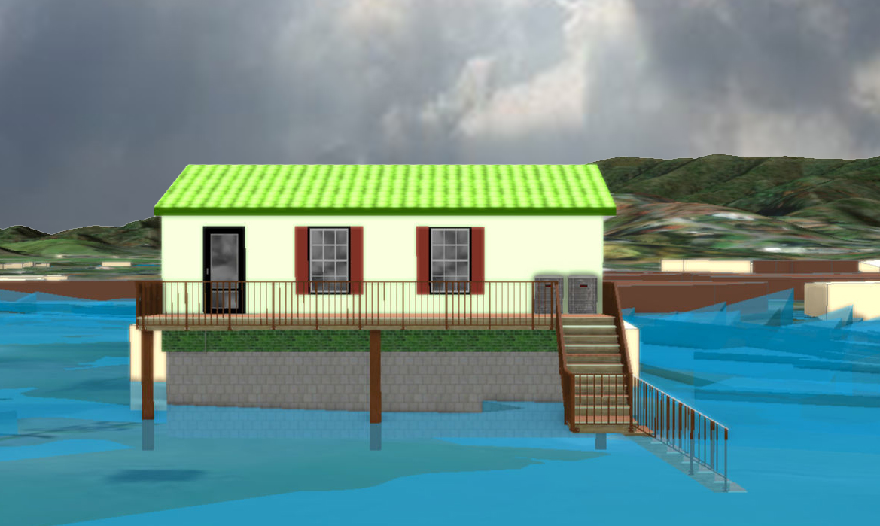
2% Probability of Flood in a year (50-year flood)
3.4’ (FEMA 2% / 50-Yr)

Slide 22
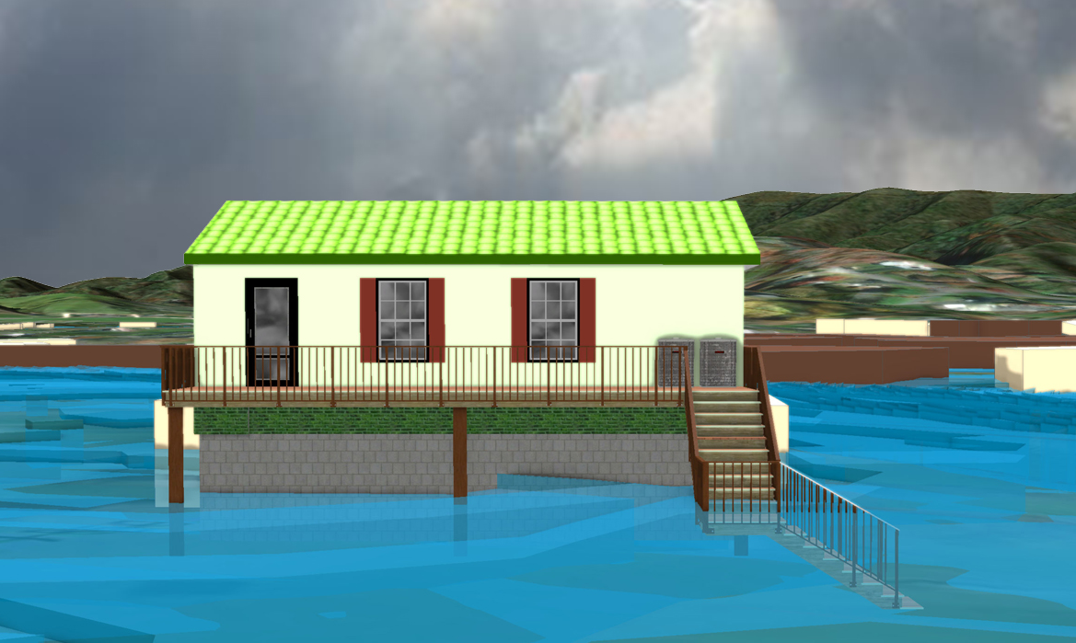
1% Probability of Flood in a year (100-year flood)
5.4’ (FEMA 1% / 100-Yr)

Slide 23
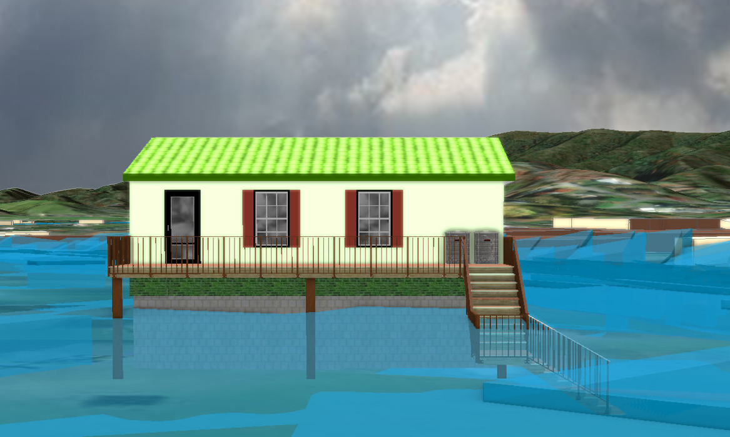
0.2% Probability of Flood in a year (500-year flood)
7.2’ (FEMA 0.2% / 500-Yr)

Slide 24
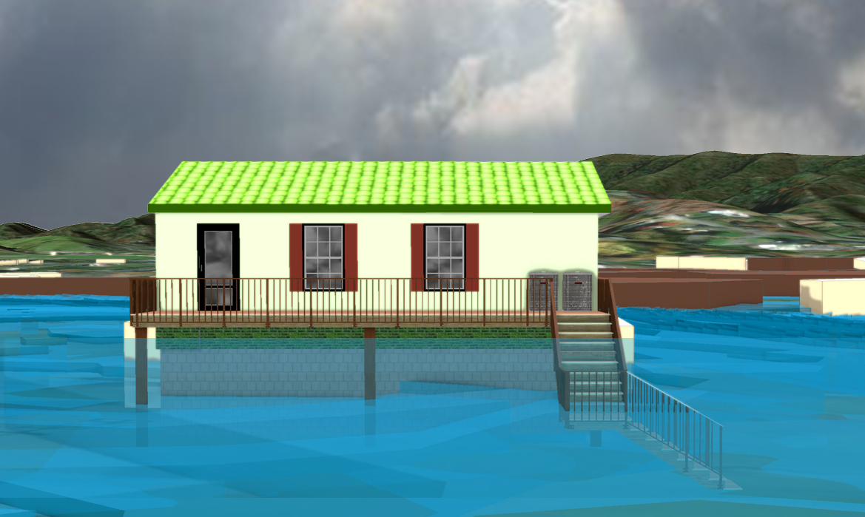
2016 High Watermark
High Watermark
6.5’ (2016 High Water)

Slide 25
The Design Flood Elevation (DFE) should be the BFE plus 2 feet of freeboard. The DFE should also be above the high-water marks of the 2016 flood plus freeboard.
 | HEIGHT (ft.)
BUILDING
First Floor Height | 6.4
Freeboard (FBD) | 2.0
FLOOD DEPTH
FEMA 10% (10-Yr) | 0.7
FEMA 4% (25-Yr)
FEMA 2% (50-Yr)
2016 Flood HWM
FEMA 1% (100-Yr)
FEMA 100-Yr + FBD
FEMA 1%+ (84% CL)
FEMA 0.2% (500-Yr)
FSF 0.2% (500-Yr)
0.7’ (FEMA 10% / 10-Yr)
Building: 13-13-0001-0054-0000_182
182 Seventh Street, Rainelle, WV, 25962
Building 13-17-0009-0026-0000_138
FLOOD DEPTHS:
FEMA
First Street Foundation (FSF)
USGS 2016 Flood High Water Mark

Slide 26
The Design Flood Elevation (DFE) should be the BFE plus 2 feet of freeboard. The DFE should also be above the high-water marks of the 2016 flood plus freeboard.
 | HEIGHT (ft.)
BUILDING
First Floor Height | 6.4
Freeboard (FBD) | 2.0
FLOOD DEPTH
FEMA 10% (10-Yr) | 0.7
FEMA 4% (25-Yr) | 2.0
FEMA 2% (50-Yr)
2016 Flood HWM
FEMA 1% (100-Yr)
FEMA 100-Yr + FBD
FEMA 1%+ (84% CL)
FEMA 0.2% (500-Yr)
FSF 0.2% (500-Yr)
2.0’ (FEMA 4% / 25-Yr)
0.7’ (FEMA 10% / 10-Yr)
Building: 13-13-0001-0054-0000_182
182 Seventh Street, Rainelle, WV, 25962
Building 13-17-0009-0026-0000_138
FLOOD DEPTHS:
FEMA
First Street Foundation (FSF)
USGS 2016 Flood High Water Mark

Slide 27
The Design Flood Elevation (DFE) should be the BFE plus 2 feet of freeboard. The DFE should also be above the high-water marks of the 2016 flood plus freeboard.
 | HEIGHT (ft.)
BUILDING
First Floor Height | 6.4
Freeboard (FBD) | 2.0
FLOOD DEPTH
FEMA 10% (10-Yr) | 0.7
FEMA 4% (25-Yr) | 2.0
FEMA 2% (50-Yr) | 3.4
2016 Flood HWM
FEMA 1% (100-Yr)
FEMA 100-Yr + FBD
FEMA 1%+ (84% CL)
FEMA 0.2% (500-Yr)
FSF 0.2% (500-Yr)
3.4’ (FEMA 2% / 50-Yr)
2.0’ (FEMA 4% / 25-Yr)
0.7’ (FEMA 10% / 10-Yr)
Building: 13-13-0001-0054-0000_182
182 Seventh Street, Rainelle, WV, 25962
Building 13-17-0009-0026-0000_138
FLOOD DEPTHS:
FEMA
First Street Foundation (FSF)
USGS 2016 Flood High Water Mark

Slide 28
The Design Flood Elevation (DFE) should be the BFE plus 2 feet of freeboard. The DFE should also be above the high-water marks of the 2016 flood plus freeboard.
 | HEIGHT (ft.)
BUILDING
First Floor Height | 6.4
Freeboard (FBD) | 2.0
FLOOD DEPTH
FEMA 10% (10-Yr) | 0.7
FEMA 4% (25-Yr) | 2.0
FEMA 2% (50-Yr) | 3.4
2016 Flood HWM
FEMA 1% (100-Yr) | 5.4
FEMA 100-Yr + FBD | 7.4
FEMA 1%+ (84% CL) | 6.4
FEMA 0.2% (500-Yr)
FSF 0.2% (500-Yr)
6.4’ FEMA 1%+ (84% CL)
5.4’ (FEMA 1% / 100-Yr)
3.4’ (FEMA 2% / 50-Yr)
2.0’ (FEMA 4% / 25-Yr)
0.7’ (FEMA 10% / 10-Yr)
Building: 13-13-0001-0054-0000_182
182 Seventh Street, Rainelle, WV, 25962
Building 13-17-0009-0026-0000_138
FLOOD DEPTHS:
FEMA
First Street Foundation (FSF)
USGS 2016 Flood High Water Mark

Slide 29
The Design Flood Elevation (DFE) should be the BFE plus 2 feet of freeboard. The DFE should also be above the high-water marks of the 2016 flood plus freeboard.
 | HEIGHT (ft.)
BUILDING
First Floor Height | 6.4
Freeboard (FBD) | 2.0
FLOOD DEPTH
FEMA 10% (10-Yr) | 0.7
FEMA 4% (25-Yr) | 2.0
FEMA 2% (50-Yr) | 3.4
2016 Flood HWM | 6.5
FEMA 1% (100-Yr) | 5.4
FEMA 100-Yr + FBD | 7.4
FEMA 1%+ (84% CL) | 6.4
FEMA 0.2% (500-Yr)
FSF 0.2% (500-Yr)
6.5’ (2016 High Water)
6.4’ FEMA 1%+ (84% CL)
5.4’ (FEMA 1% / 100-Yr)
3.4’ (FEMA 2% / 50-Yr)
2.0’ (FEMA 4% / 25-Yr)
0.7’ (FEMA 10% / 10-Yr)
Building: 13-13-0001-0054-0000_182
182 Seventh Street, Rainelle, WV, 25962
Building 13-17-0009-0026-0000_138
FLOOD DEPTHS:
FEMA
First Street Foundation (FSF)
USGS 2016 Flood High Water Mark

Slide 30
The Design Flood Elevation (DFE) should be the BFE plus 2 feet of freeboard. The DFE should also be above the high-water marks of the 2016 flood plus freeboard.
 | HEIGHT (ft.)
BUILDING
First Floor Height | 6.4
Freeboard (FBD) | 2.0
FLOOD DEPTH
FEMA 10% (10-Yr) | 0.7
FEMA 4% (25-Yr) | 2.0
FEMA 2% (50-Yr) | 3.4
2016 Flood HWM | 6.5
FEMA 1% (100-Yr) | 5.4
FEMA 100-Yr + FBD | 7.4
FEMA 1%+ (84% CL) | 6.4
FEMA 0.2% (500-Yr) | 7.2
FSF 0.2% (500-Yr)
7.2’ (FEMA 0.2% / 500-Yr )
6.5’ (2016 High Water)
6.4’ FEMA 1%+ (84% CL)
5.4’ (FEMA 1% / 100-Yr)
3.4’ (FEMA 2% / 50-Yr)
2.0’ (FEMA 4% / 25-Yr)
0.7’ (FEMA 10% / 10-Yr)
Building: 13-13-0001-0054-0000_182
182 Seventh Street, Rainelle, WV, 25962
Building 13-17-0009-0026-0000_138
FLOOD DEPTHS:
FEMA
First Street Foundation (FSF)
USGS 2016 Flood High Water Mark

Slide 31
The Design Flood Elevation (DFE) should be the BFE plus 2 feet of freeboard. The DFE should also be above the high-water marks of the 2016 flood plus freeboard.
 | HEIGHT (ft.)
BUILDING
First Floor Height | 6.4
Freeboard (FBD) | 2.0
FLOOD DEPTH
FEMA 10% (10-Yr) | 0.7
FEMA 4% (25-Yr) | 2.0
FEMA 2% (50-Yr) | 3.4
2016 Flood HWM | 6.5
FEMA 1% (100-Yr) | 5.4
FEMA 100-Yr + FBD | 7.4
FEMA 1%+ (84% CL) | 6.4
FEMA 0.2% (500-Yr) | 7.2
FSF 0.2% (500-Yr) | 7.4
7.4’ (FSF 0.2% / 500-Yr)
7.2’ (FEMA 0.2% / 500-Yr )
6.5’ (2016 High Water)
6.4’ FEMA 1%+ (84% CL)
5.4’ (FEMA 1% / 100-Yr)
3.4’ (FEMA 2% / 50-Yr)
2.0’ (FEMA 4% / 25-Yr)
0.7’ (FEMA 10% / 10-Yr)
Building: 13-13-0001-0054-0000_182
182 Seventh Street, Rainelle, WV, 25962
Building 13-17-0009-0026-0000_138
FLOOD DEPTHS:
FEMA
First Street Foundation (FSF)
USGS 2016 Flood High Water Mark

Slide 32
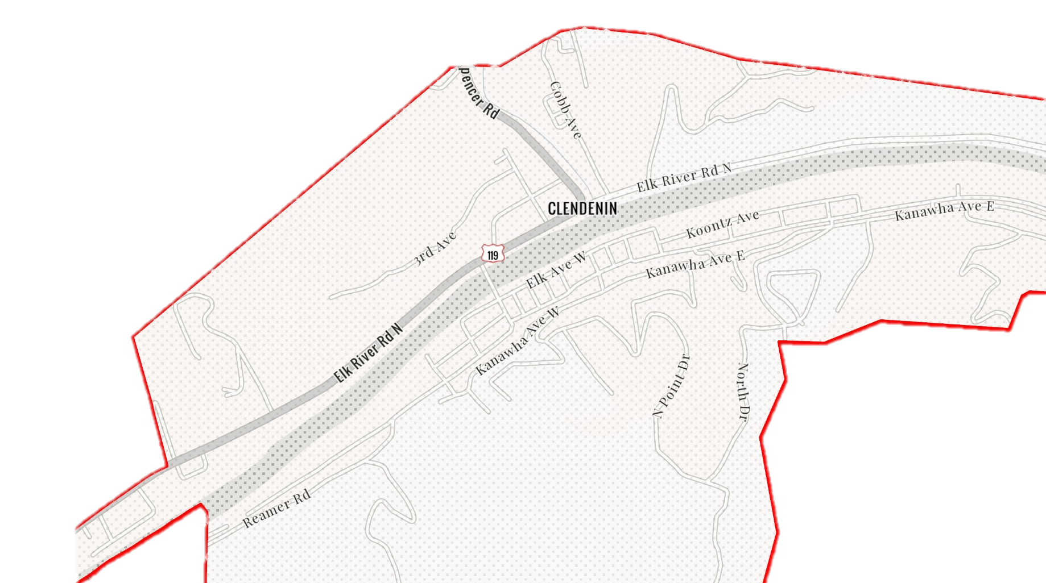
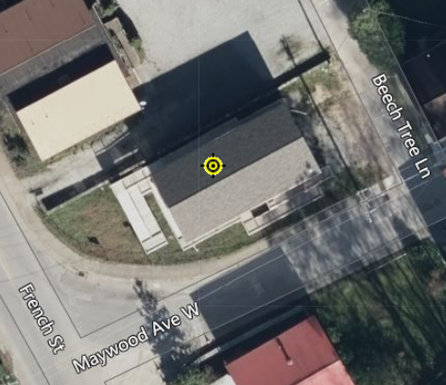
Clendenin
20-02-0006-0044-0000_306
306 Maywood Ave., Clendenin, WV, 25045
Building Flood Profile

Slide 33
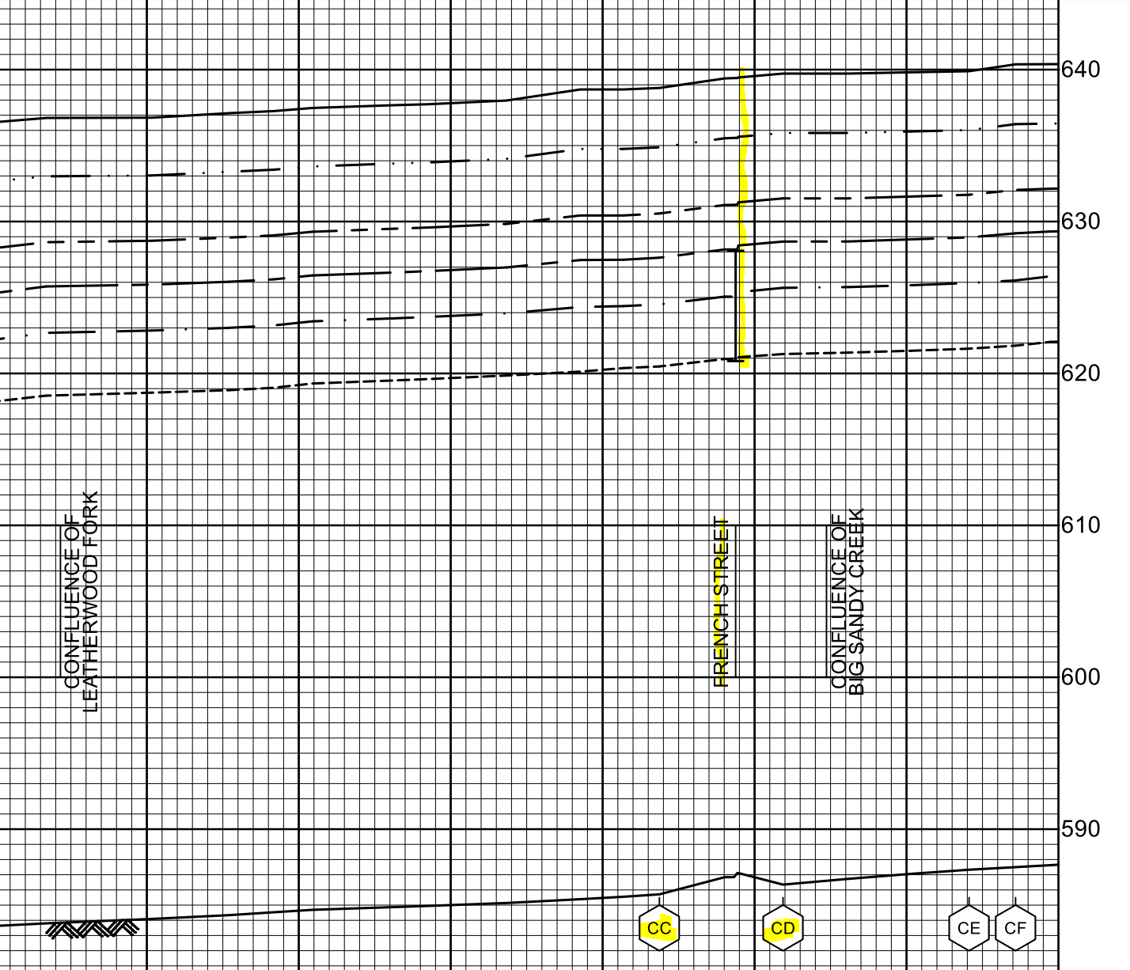
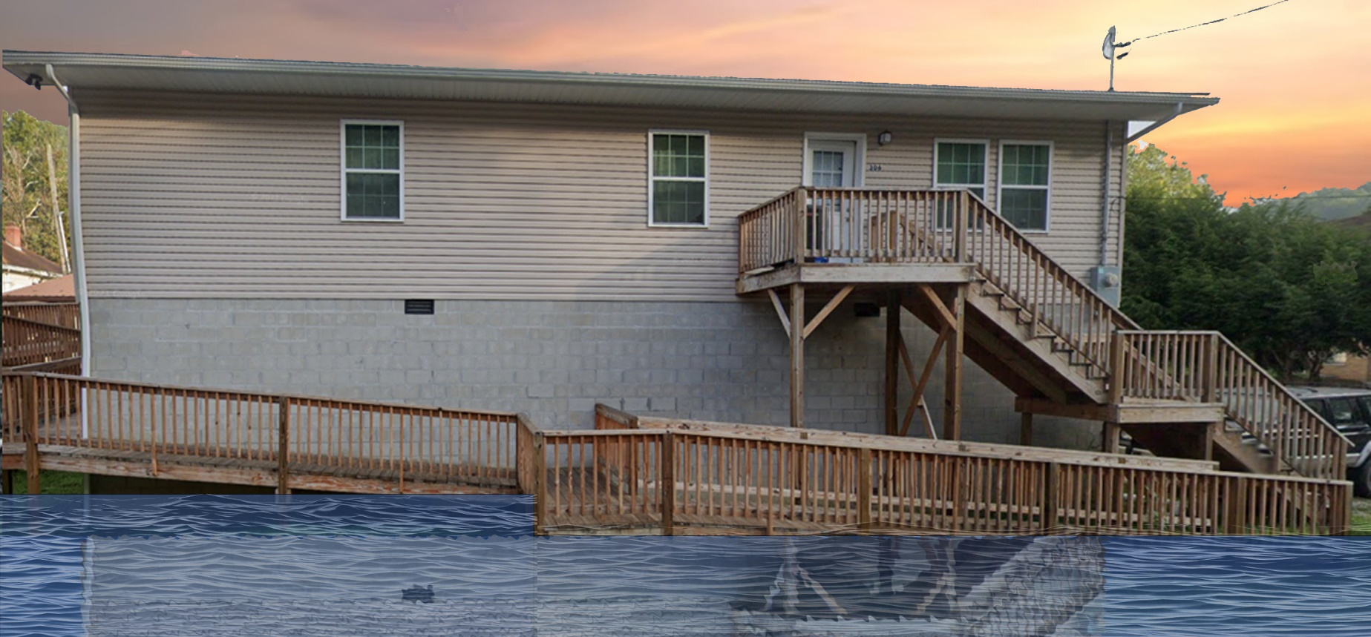
10% Probability of Flood in a year (10-year flood)
2.0’ (FEMA 10% / 10-Yr)
Building’s Ground Elevation

Slide 34
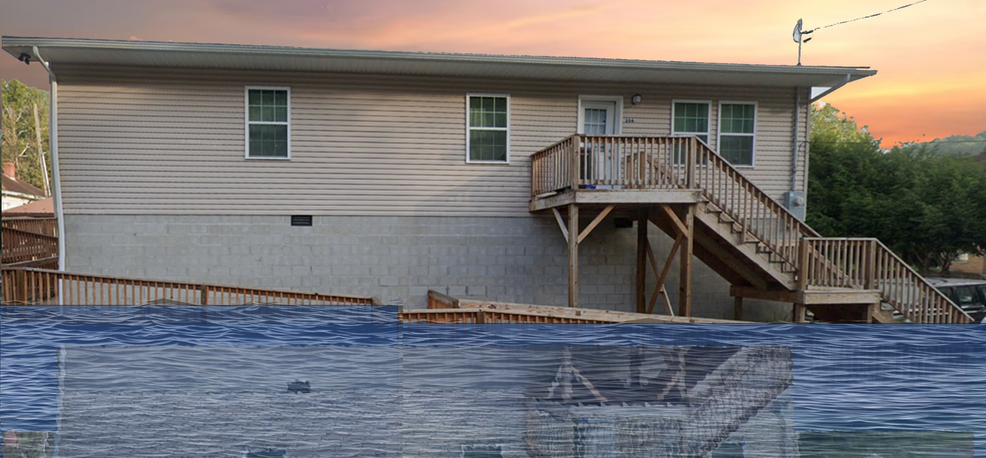
4% Probability of Flood in a year (25-year flood)
6.0’ (FEMA 4% / 25-Yr)

Slide 35
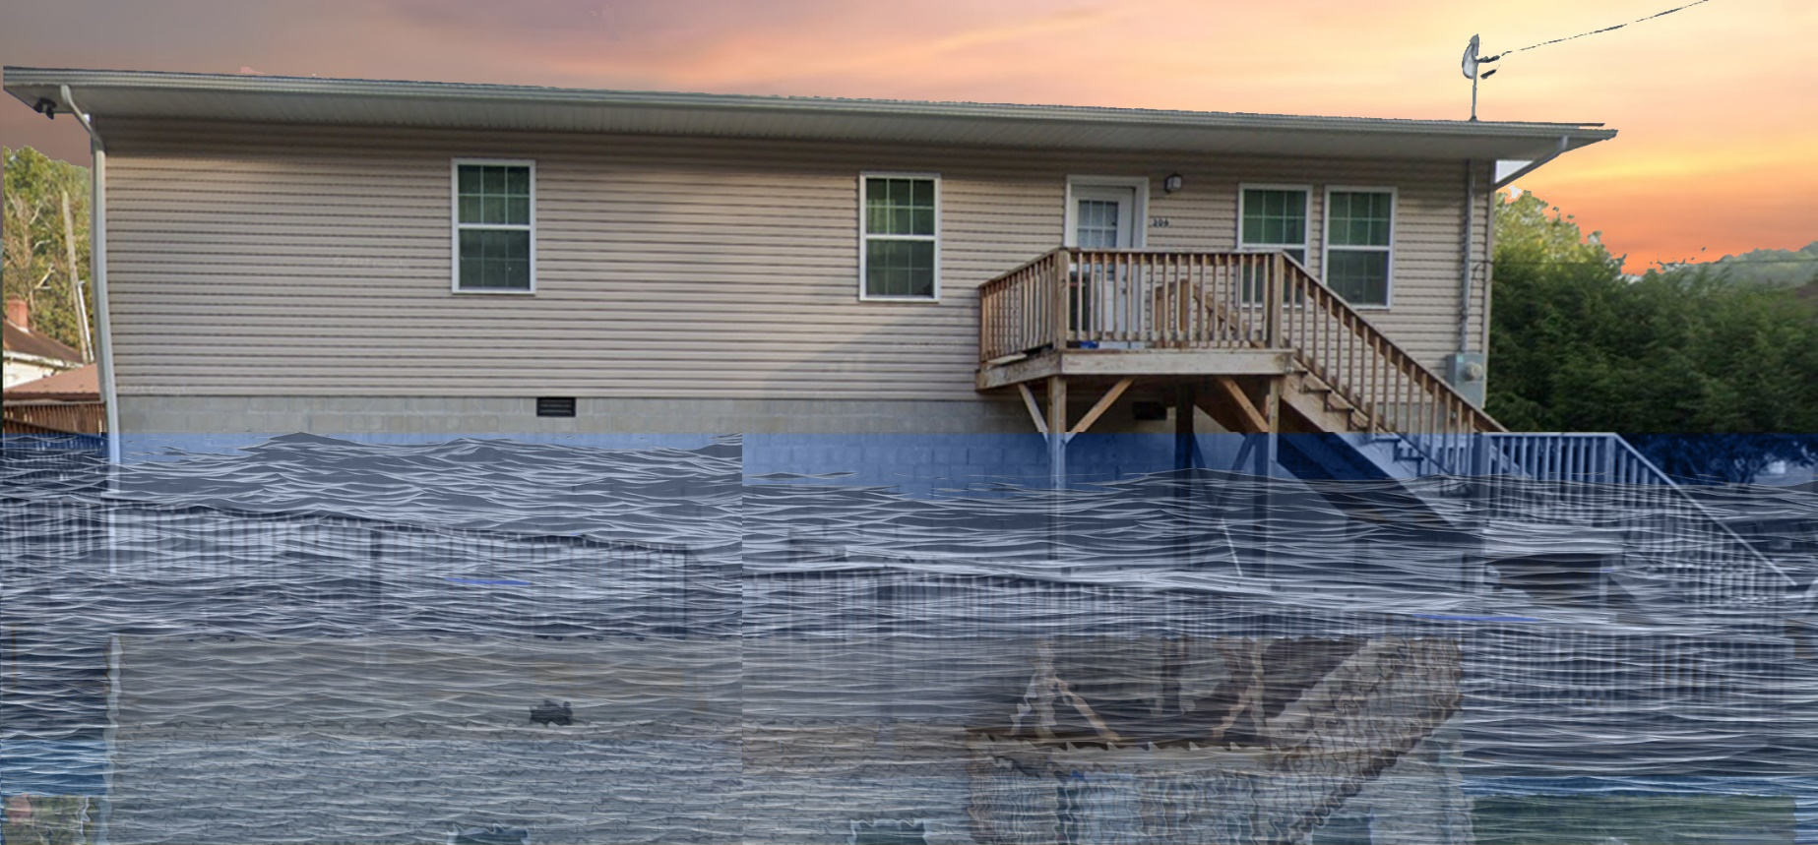
2% Probability of Flood in a year (50-year flood)
9.5’ (FEMA 2% / 50-Yr)

Slide 36
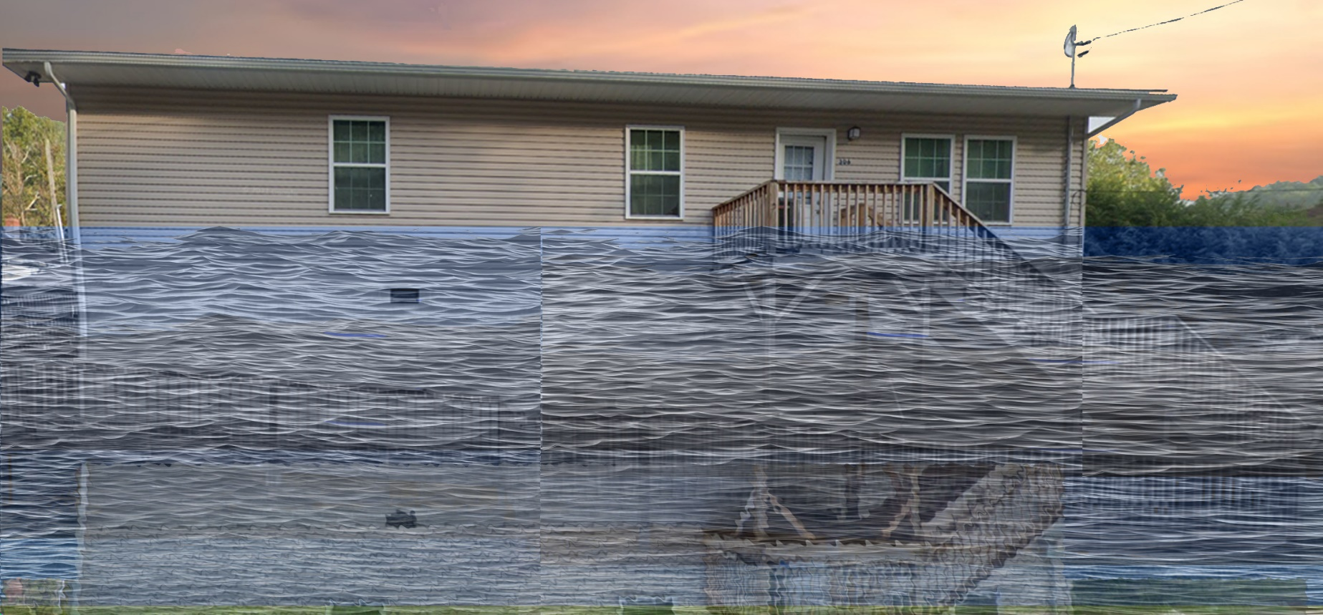
1% Probability of Flood in a year (100-year flood)
12.3’ (FEMA 2% / 50-Yr)

Slide 37
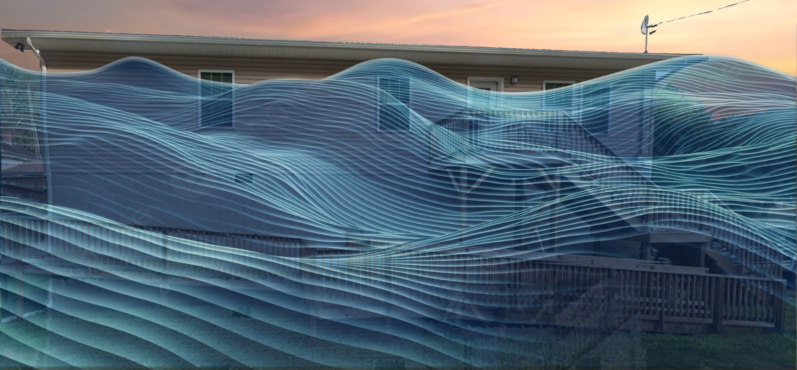
0.2% Probability of Flood in a year (500-year flood)
20.5’ (FEMA 0.2% / 500-Yr)

Slide 38
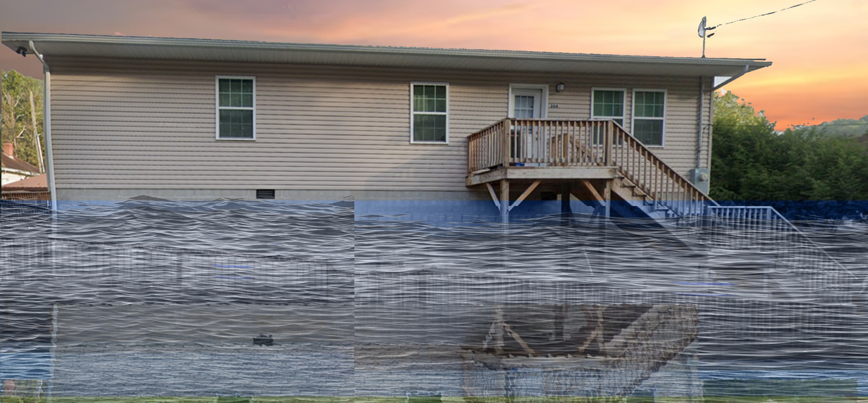
2016 High Watermark
High Watermark
9.5’ (FEMA 2% / 50-Yr)
10.5’ (2016 High Water)

Slide 39
The Design Flood Elevation (DFE) should be the BFE plus 2 feet of freeboard. The DFE should also be above the high-water marks of the 2016 flood plus freeboard.
 | HEIGHT (ft.)
BUILDING
First Floor Height | 12.0
Freeboard (FBD) | 2.0
FLOOD DEPTH
FEMA 10% (10-Yr) | 2.0
FEMA 4% (25-Yr)
FEMA 2% (50-Yr)
2016 Flood HWM
FEMA 1% (100-Yr)
FEMA 100-Yr + FBD
FEMA 1%+ (84% CL)
FEMA 0.2% (500-Yr)
FSF 0.2% (500-Yr)
306 Maywood Ave., Clendenin, WV, 25045
2.0’ (FEMA 10% / 10-Yr)
Building 20-02-0006-0044-0000_306
FLOOD DEPTHS:
FEMA
First Street Foundation (FSF)
USGS 2016 Flood High Water Mark

Slide 40
The Design Flood Elevation (DFE) should be the BFE plus 2 feet of freeboard. The DFE should also be above the high-water marks of the 2016 flood plus freeboard.
 | HEIGHT (ft.)
BUILDING
First Floor Height | 12.0
Freeboard (FBD) | 2.0
FLOOD DEPTH
FEMA 10% (10-Yr) | 2.0
FEMA 4% (25-Yr) | 6.0
FEMA 2% (50-Yr)
2016 Flood HWM
FEMA 1% (100-Yr)
FEMA 100-Yr + FBD
FEMA 1%+ (84% CL)
FEMA 0.2% (500-Yr)
FSF 0.2% (500-Yr)
306 Maywood Ave., Clendenin, WV, 25045
6.0’ (FEMA 4% / 25-Yr)
2.0’ (FEMA 10% / 10-Yr)
Building 20-02-0006-0044-0000_306
FLOOD DEPTHS:
FEMA
First Street Foundation (FSF)
USGS 2016 Flood High Water Mark

Slide 41
The Design Flood Elevation (DFE) should be the BFE plus 2 feet of freeboard. The DFE should also be above the high-water marks of the 2016 flood plus freeboard.
 | HEIGHT (ft.)
BUILDING
First Floor Height | 12.0
Freeboard (FBD) | 2.0
FLOOD DEPTH
FEMA 10% (10-Yr) | 2.0
FEMA 4% (25-Yr) | 6.0
FEMA 2% (50-Yr) | 9.5
2016 Flood HWM
FEMA 1% (100-Yr)
FEMA 100-Yr + FBD
FEMA 1%+ (84% CL)
FEMA 0.2% (500-Yr)
FSF 0.2% (500-Yr)
306 Maywood Ave., Clendenin, WV, 25045
9.5’ (FEMA 2% / 50-Yr)
6.0’ (FEMA 4% / 25-Yr)
2.0’ (FEMA 10% / 10-Yr)
Building 20-02-0006-0044-0000_306
FLOOD DEPTHS:
FEMA
First Street Foundation (FSF)
USGS 2016 Flood High Water Mark

Slide 42
The Design Flood Elevation (DFE) should be the BFE plus 2 feet of freeboard. The DFE should also be above the high-water marks of the 2016 flood plus freeboard.
 | HEIGHT (ft.)
BUILDING
First Floor Height | 12.0
Freeboard (FBD) | 2.0
FLOOD DEPTH
FEMA 10% (10-Yr) | 2.0
FEMA 4% (25-Yr) | 6.0
FEMA 2% (50-Yr) | 9.5
2016 Flood HWM | 10.5
FEMA 1% (100-Yr)
FEMA 100-Yr + FBD
FEMA 1%+ (84% CL)
FEMA 0.2% (500-Yr)
FSF 0.2% (500-Yr)
306 Maywood Ave., Clendenin, WV, 25045
10.5’ (2016 High Water)
9.5’ (FEMA 2% / 50-Yr)
6.0’ (FEMA 4% / 25-Yr)
2.0’ (FEMA 10% / 10-Yr)
Building 20-02-0006-0044-0000_306
FLOOD DEPTHS:
FEMA
First Street Foundation (FSF)
USGS 2016 Flood High Water Mark

Slide 43
The Design Flood Elevation (DFE) should be the BFE plus 2 feet of freeboard. The DFE should also be above the high-water marks of the 2016 flood plus freeboard.
 | HEIGHT (ft.)
BUILDING
First Floor Height | 12.0
Freeboard (FBD) | 2.0
FLOOD DEPTH
FEMA 10% (10-Yr) | 2.0
FEMA 4% (25-Yr) | 6.0
FEMA 2% (50-Yr) | 9.5
2016 Flood HWM | 10.5
FEMA 1% (100-Yr) | 12.3
FEMA 100-Yr + FBD | 14.3
FEMA 1%+ (84% CL) | 16.5
FEMA 0.2% (500-Yr)
FSF 0.2% (500-Yr)
306 Maywood Ave., Clendenin, WV, 25045
16.5’ FEMA1%+ (84% CL)
12.3’ (FEMA 1% / 100-Yr)
10.5’ (2016 High Water)
9.5’ (FEMA 2% / 50-Yr)
6.0’ (FEMA 4% / 25-Yr)
2.0’ (FEMA 10% / 10-Yr)
Building 20-02-0006-0044-0000_306
FLOOD DEPTHS:
FEMA
First Street Foundation (FSF)
USGS 2016 Flood High Water Mark

Slide 44
The Design Flood Elevation (DFE) should be the BFE plus 2 feet of freeboard. The DFE should also be above the high-water marks of the 2016 flood plus freeboard.
 | HEIGHT (ft.)
BUILDING
First Floor Height | 12.0
Freeboard (FBD) | 2.0
FLOOD DEPTH
FEMA 10% (10-Yr) | 2.0
FEMA 4% (25-Yr) | 6.0
FEMA 2% (50-Yr) | 9.5
2016 Flood HWM | 10.5
FEMA 1% (100-Yr) | 12.3
FEMA 100-Yr + FBD | 14.3
FEMA 1%+ (84% CL) | 16.5
FEMA 0.2% (500-Yr) | 20.5
FSF 0.2% (500-Yr)
306 Maywood Ave., Clendenin, WV, 25045
20.5’ (FEMA 0.2% / 500-Yr)
16.5’ FEMA1%+ (84% CL)
12.3’ (FEMA 1% / 100-Yr)
10.5’ (2016 High Water)
9.5’ (FEMA 2% / 50-Yr)
6.0’ (FEMA 4% / 25-Yr)
2.0’ (FEMA 10% / 10-Yr)
Building 20-02-0006-0044-0000_306
FLOOD DEPTHS:
FEMA
First Street Foundation (FSF)
USGS 2016 Flood High Water Mark

Slide 45
The Design Flood Elevation (DFE) should be the BFE plus 2 feet of freeboard. The DFE should also be above the high-water marks of the 2016 flood plus freeboard.
 | HEIGHT (ft.)
BUILDING
First Floor Height | 12.0
Freeboard (FBD) | 2.0
FLOOD DEPTH
FEMA 10% (10-Yr) | 2.0
FEMA 4% (25-Yr) | 6.0
FEMA 2% (50-Yr) | 9.5
2016 Flood HWM | 10.5
FEMA 1% (100-Yr) | 12.3
FEMA 100-Yr + FBD | 14.3
FEMA 1%+ (84% CL) | 16.5
FEMA 0.2% (500-Yr) | 20.5
FSF 0.2% (500-Yr) | 24.6
306 Maywood Ave., Clendenin, WV, 25045
24.6’ (FSF 0.2% / 500-Yr)
20.5’ (FEMA 0.2% / 500-Yr)
16.5’ FEMA1%+ (84% CL)
12.3’ (FEMA 1% / 100-Yr)
10.5’ (2016 High Water)
9.5’ (FEMA 2% / 50-Yr)
6.0’ (FEMA 4% / 25-Yr)
2.0’ (FEMA 10% / 10-Yr)
Building 20-02-0006-0044-0000_306
FLOOD DEPTHS:
FEMA
First Street Foundation (FSF)
USGS 2016 Flood High Water Mark

Slide 46
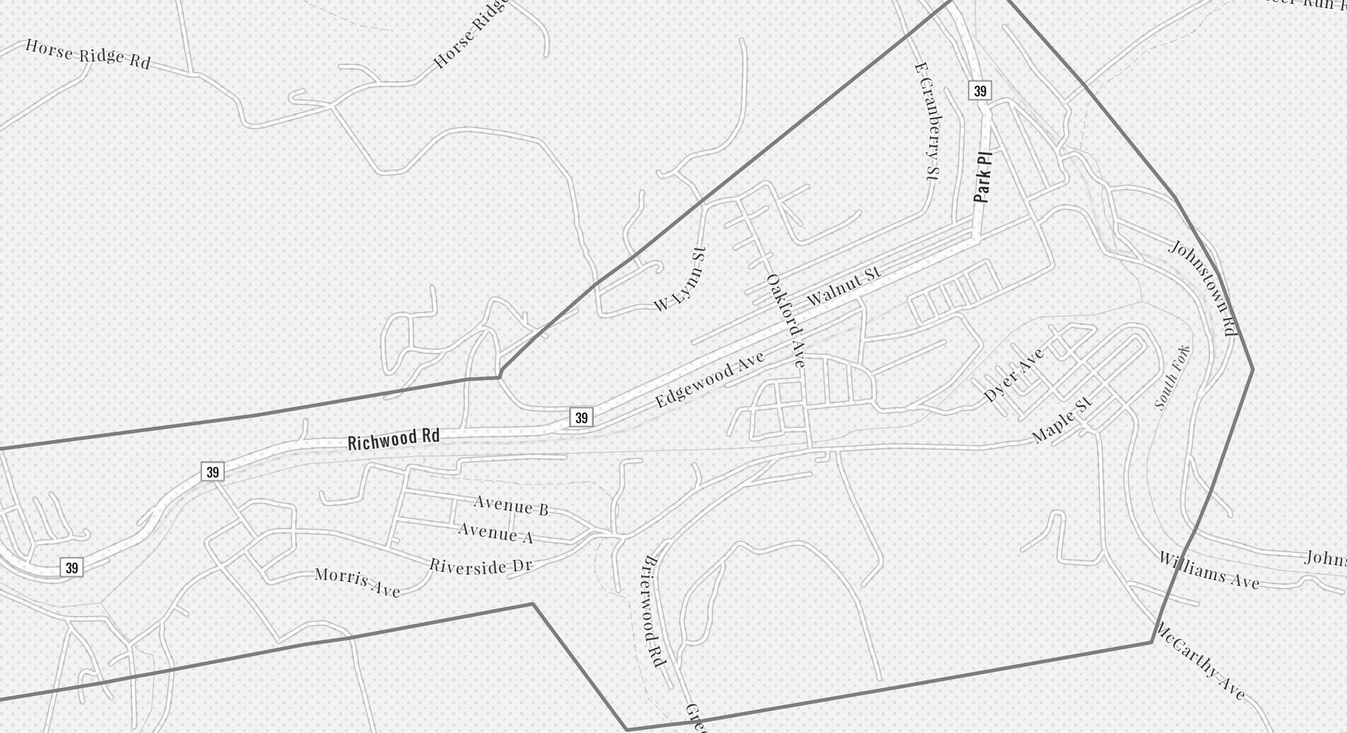
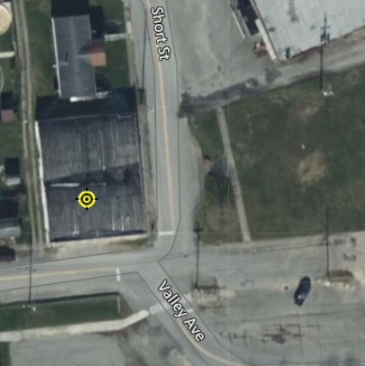
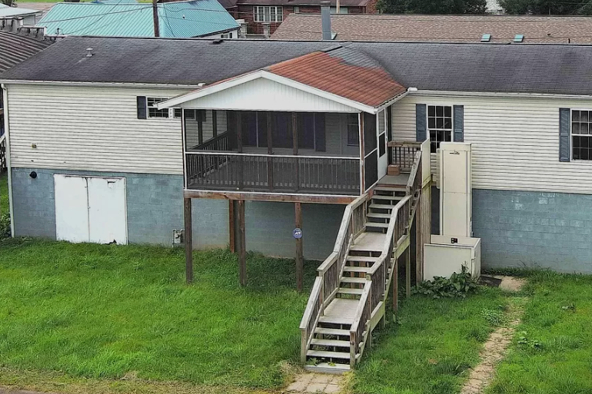
Richwood
34-06-0011-0090-0000_113
113 Valley Ave, Richwood, WV
Building Flood Profile

Slide 47
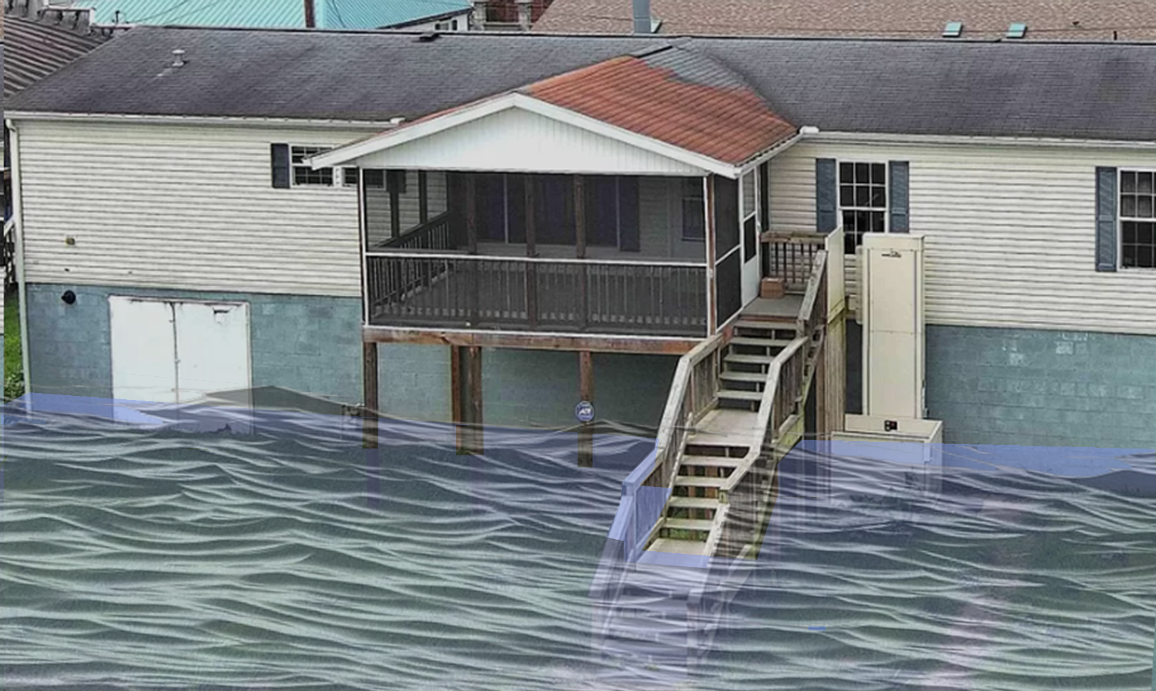
2% Probability of Flood in a year (50-year flood)
2.8’ (FEMA 2% / 50-Yr)
Building’s Ground Elevation

Slide 48
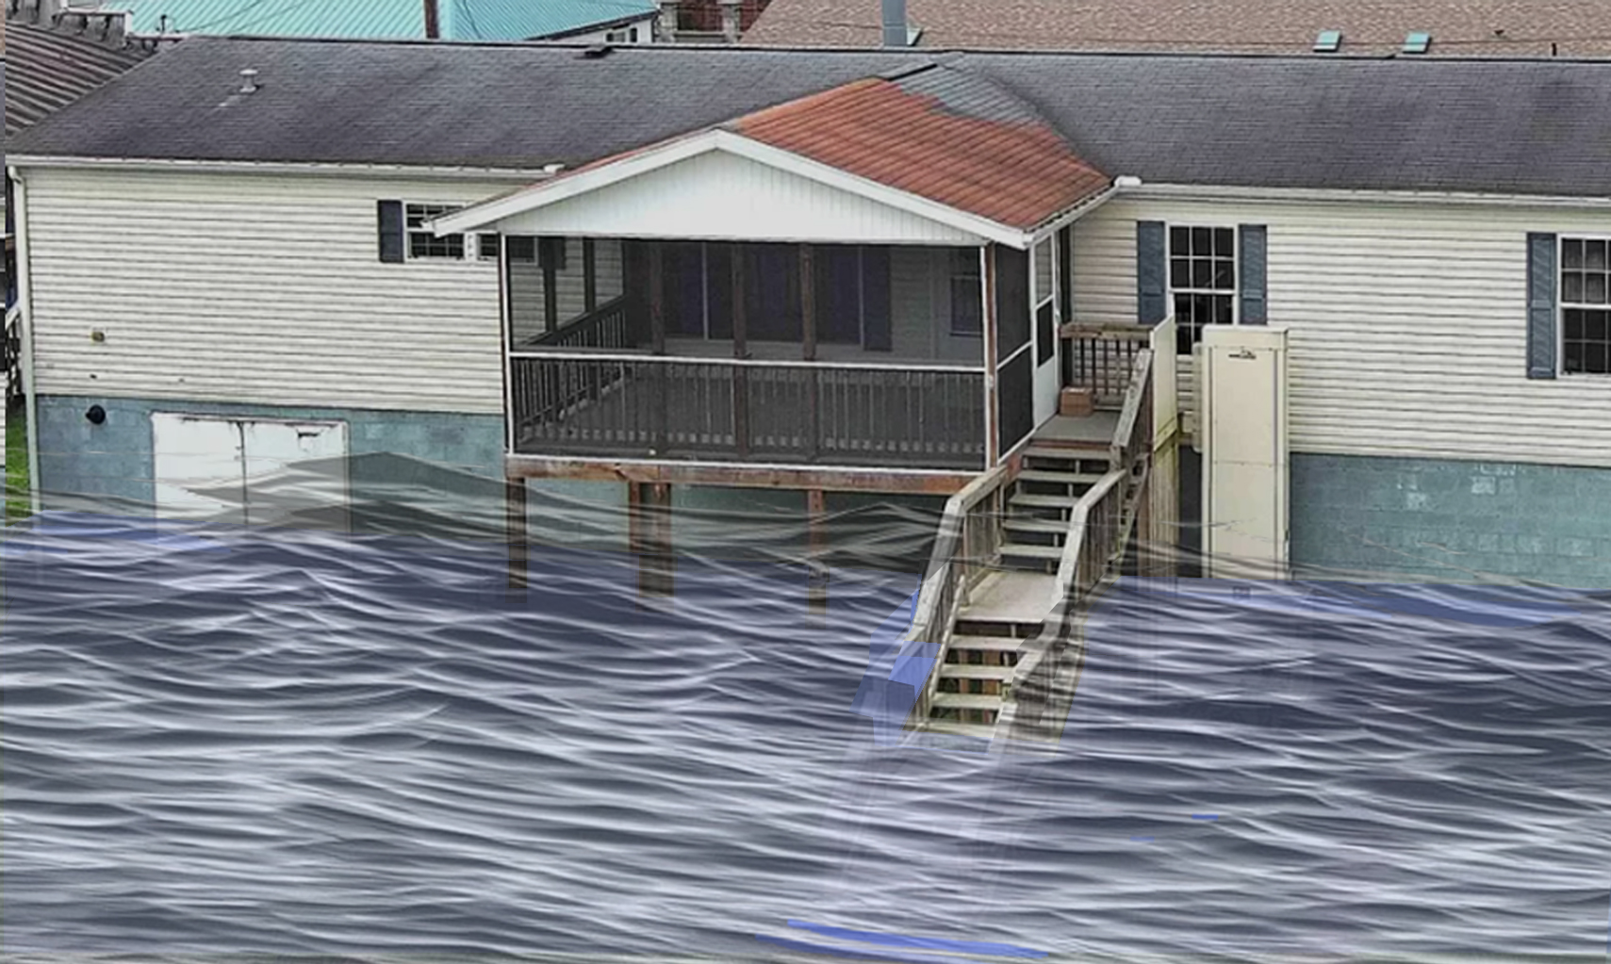
1% Probability of Flood in a year (100-year flood)
3.5’ (FEMA 1% / 100-Yr)

Slide 49
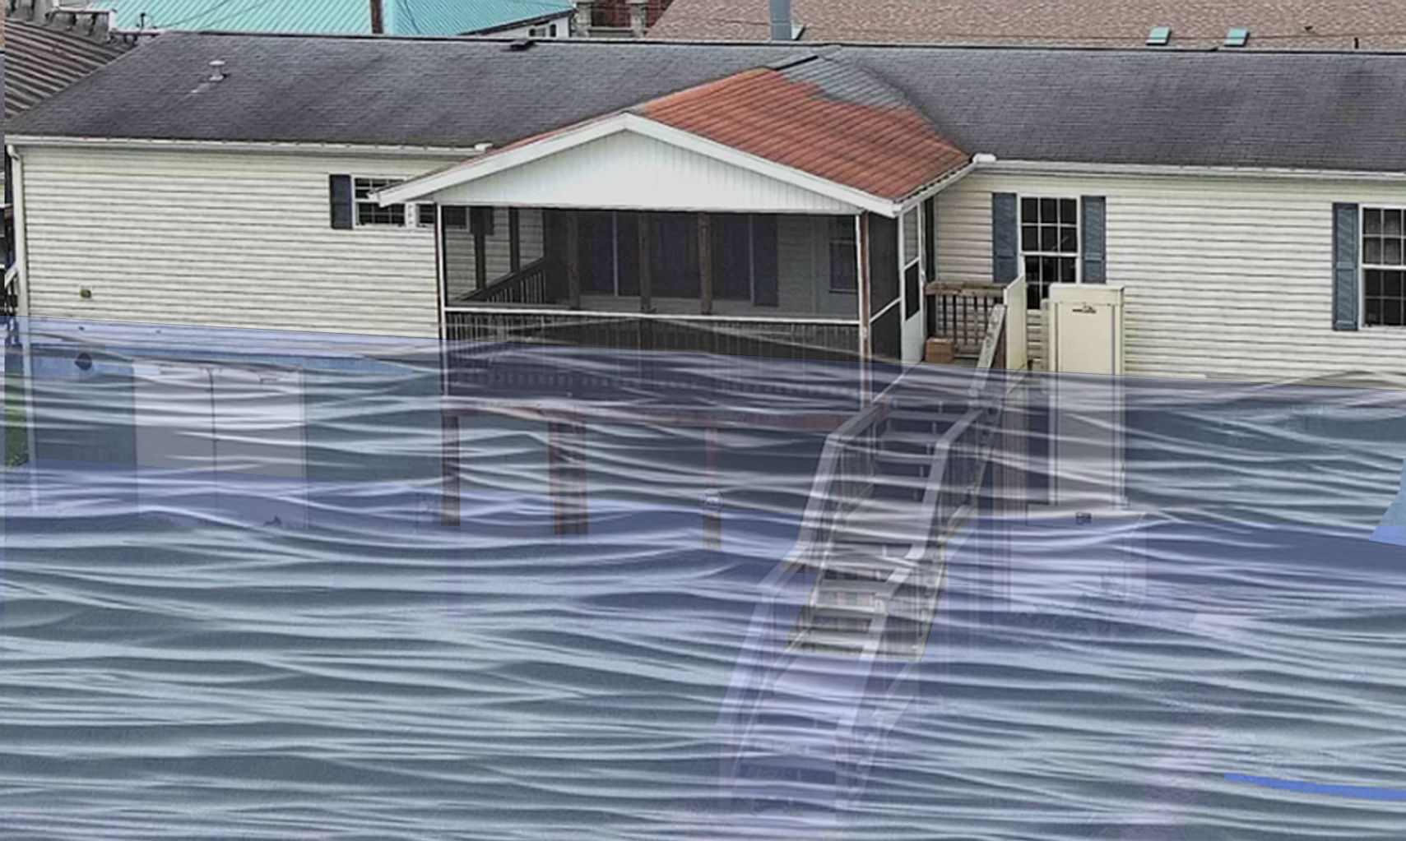
0.2% Probability of Flood in a year (500-year flood)
8.3’ (FEMA 0.2% / 500-Yr)

Slide 50
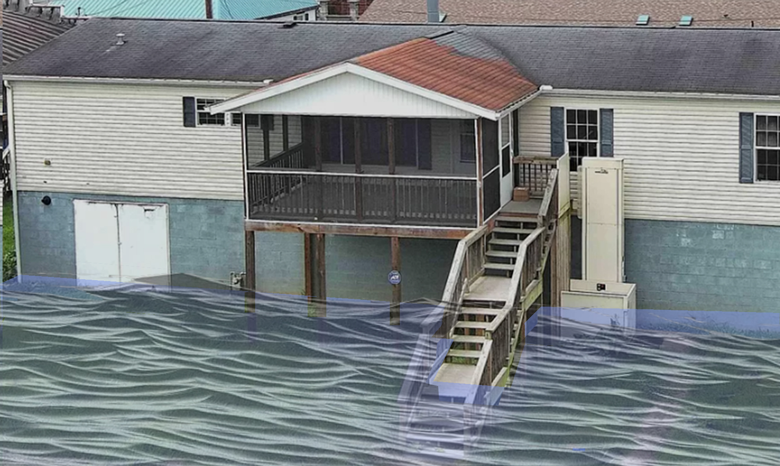
2016 High Watermark
High Watermark
1.0’ (2016 High Water)
Building’s Ground Elevation

Slide 51
The Design Flood Elevation (DFE) should be the BFE plus 2 feet of freeboard. The DFE should also be above the high-water marks of the 2016 flood plus freeboard.
113 Valley Ave, Richwood, WV
 | HEIGHT (ft.)
BUILDING
First Floor Height | 8
Freeboard (FBD) | 2
FLOOD DEPTH
FEMA 10% (10-Yr) | NA
FEMA 4% (25-Yr) | NA
FEMA 2% (50-Yr)
2016 Flood HWM | 1.0
FEMA 1% (100-Yr)
FEMA 100-Yr + FBD
FEMA 1%+ (84% CL)
FEMA 0.2% (500-Yr)
FSF 0.2% (500-Yr)
1.0’ (2016 High Water)
Building 34-06-0011-0090-0000_113
Building 34-06-0011-0090-0000_113
FLOOD DEPTHS:
FEMA
First Street Foundation (FSF)
USGS 2016 Flood High Water Mark

Slide 52
The Design Flood Elevation (DFE) should be the BFE plus 2 feet of freeboard. The DFE should also be above the high-water marks of the 2016 flood plus freeboard.
113 Valley Ave, Richwood, WV
 | HEIGHT (ft.)
BUILDING
First Floor Height | 8
Freeboard (FBD) | 2
FLOOD DEPTH
FEMA 10% (10-Yr) | NA
FEMA 4% (25-Yr) | NA
FEMA 2% (50-Yr) | 2.8
2016 Flood HWM | 1.0
FEMA 1% (100-Yr)
FEMA 100-Yr + FBD
FEMA 1%+ (84% CL)
FEMA 0.2% (500-Yr)
FSF 0.2% (500-Yr)
2.8’ (FEMA 2% / 50-Yr)
1.0’ (2016 High Water)
Building 34-06-0011-0090-0000_113
FLOOD DEPTHS:
FEMA
First Street Foundation (FSF)
USGS 2016 Flood High Water Mark

Slide 53
The Design Flood Elevation (DFE) should be the BFE plus 2 feet of freeboard. The DFE should also be above the high-water marks of the 2016 flood plus freeboard.
113 Valley Ave, Richwood, WV
 | HEIGHT (ft.)
BUILDING
First Floor Height | 8
Freeboard (FBD) | 2
FLOOD DEPTH
FEMA 10% (10-Yr) | NA
FEMA 4% (25-Yr) | NA
FEMA 2% (50-Yr) | 2.8
2016 Flood HWM | 1.0
FEMA 1% (100-Yr) | 3.5
FEMA 100-Yr + FBD | 5.5
FEMA 1%+ (84% CL) | 9.0
FEMA 0.2% (500-Yr)
FSF 0.2% (500-Yr)
9.0’ FEMA1%+ (84% CL)
3.5’ (FEMA 1% / 100-Yr)
2.8’ (FEMA 2% / 50-Yr)
1.0’ (2016 High Water)
Building 34-06-0011-0090-0000_113
FLOOD DEPTHS:
FEMA
First Street Foundation (FSF)
USGS 2016 Flood High Water Mark

Slide 54
The Design Flood Elevation (DFE) should be the BFE plus 2 feet of freeboard. The DFE should also be above the high-water marks of the 2016 flood plus freeboard.
113 Valley Ave, Richwood, WV
 | HEIGHT (ft.)
BUILDING
First Floor Height | 8
Freeboard (FBD) | 2
FLOOD DEPTH
FEMA 10% (10-Yr) | NA
FEMA 4% (25-Yr) | NA
FEMA 2% (50-Yr) | 2.8
2016 Flood HWM | 1.0
FEMA 1% (100-Yr) | 3.5
FEMA 100-Yr + FBD | 5.5
FEMA 1%+ (84% CL) | 9.0
FEMA 0.2% (500-Yr) | 8.3
FSF 0.2% (500-Yr)
9.0’ FEMA1%+ (84% CL)
8.3’ (FEMA 0.2% / 500-Yr)
3.5’ (FEMA 1% / 100-Yr)
2.8’ (FEMA 2% / 50-Yr)
1.0’ (2016 High Water)
Building 34-06-0011-0090-0000_113
FLOOD DEPTHS:
FEMA
First Street Foundation (FSF)
USGS 2016 Flood High Water Mark

Slide 55
The Design Flood Elevation (DFE) should be the BFE plus 2 feet of freeboard. The DFE should also be above the high-water marks of the 2016 flood plus freeboard.
113 Valley Ave, Richwood, WV
 | HEIGHT (ft.)
BUILDING
First Floor Height | 8
Freeboard (FBD) | 2
FLOOD DEPTH
FEMA 10% (10-Yr) | NA
FEMA 4% (25-Yr) | NA
FEMA 2% (50-Yr) | 2.8
2016 Flood HWM | 1.0
FEMA 1% (100-Yr) | 3.5
FEMA 100-Yr + FBD | 5.5
FEMA 1%+ (84% CL) | 9.0
FEMA 0.2% (500-Yr) | 8.3
FSF 0.2% (500-Yr) | 6.7
9.0’ FEMA1%+ (84% CL)
8.3’ (FEMA 0.2% / 500-Yr)
6.7’ (FSG 0.2% / 500-Yr)
3.5’ (FEMA 1% / 100-Yr)
2.8’ (FEMA 2% / 50-Yr)
1.0’ (2016 High Water)
Building 34-06-0011-0090-0000_113
FLOOD DEPTHS:
FEMA
First Street Foundation (FSF)
USGS 2016 Flood High Water Mark

Slide 56
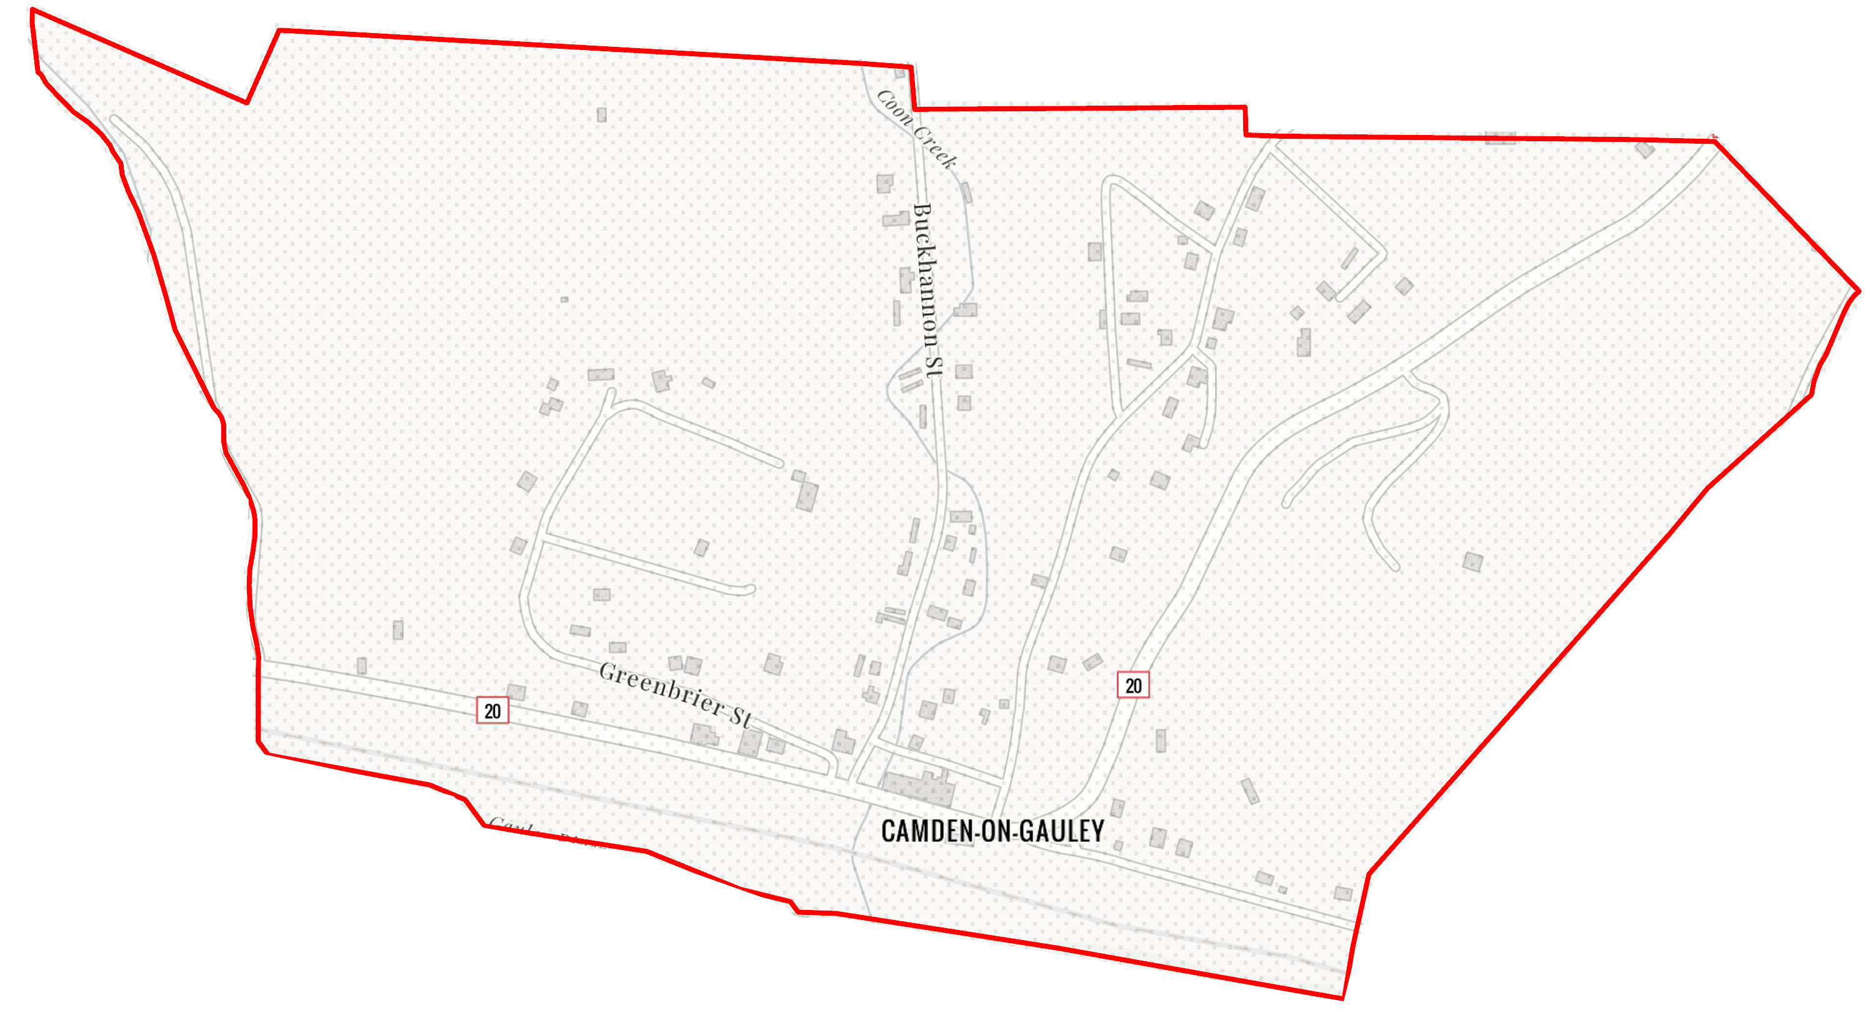
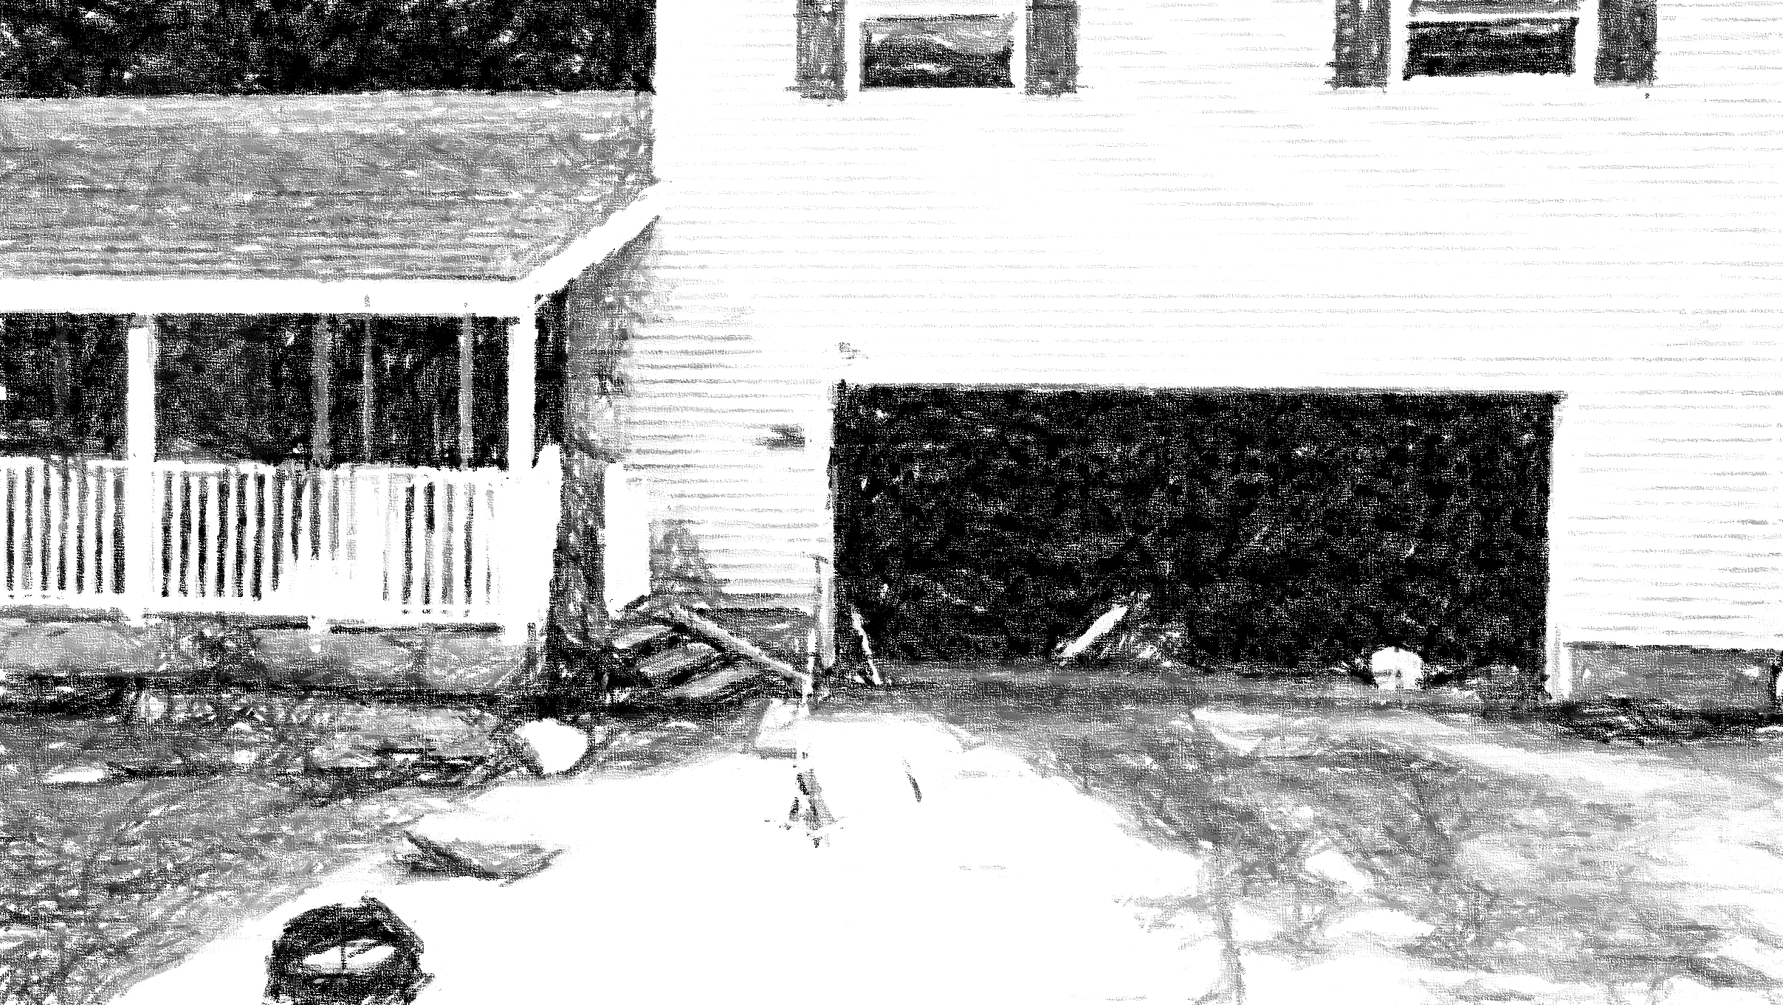
Camden on Gauley
51-04-0003-0006-0000_81
81 RIVERSIDE DR, Camden On Gauley, WV, 26208
Building Flood Profile
91 RIVERSIDE DR, Camden On Gauley, WV, 26208
Building: 51-04-0003-0006-0000_81
FLOOD DEPTHS:
FEMA
First Street Foundation (FSF)
USGS 2016 Flood High Water Mark

Slide 57
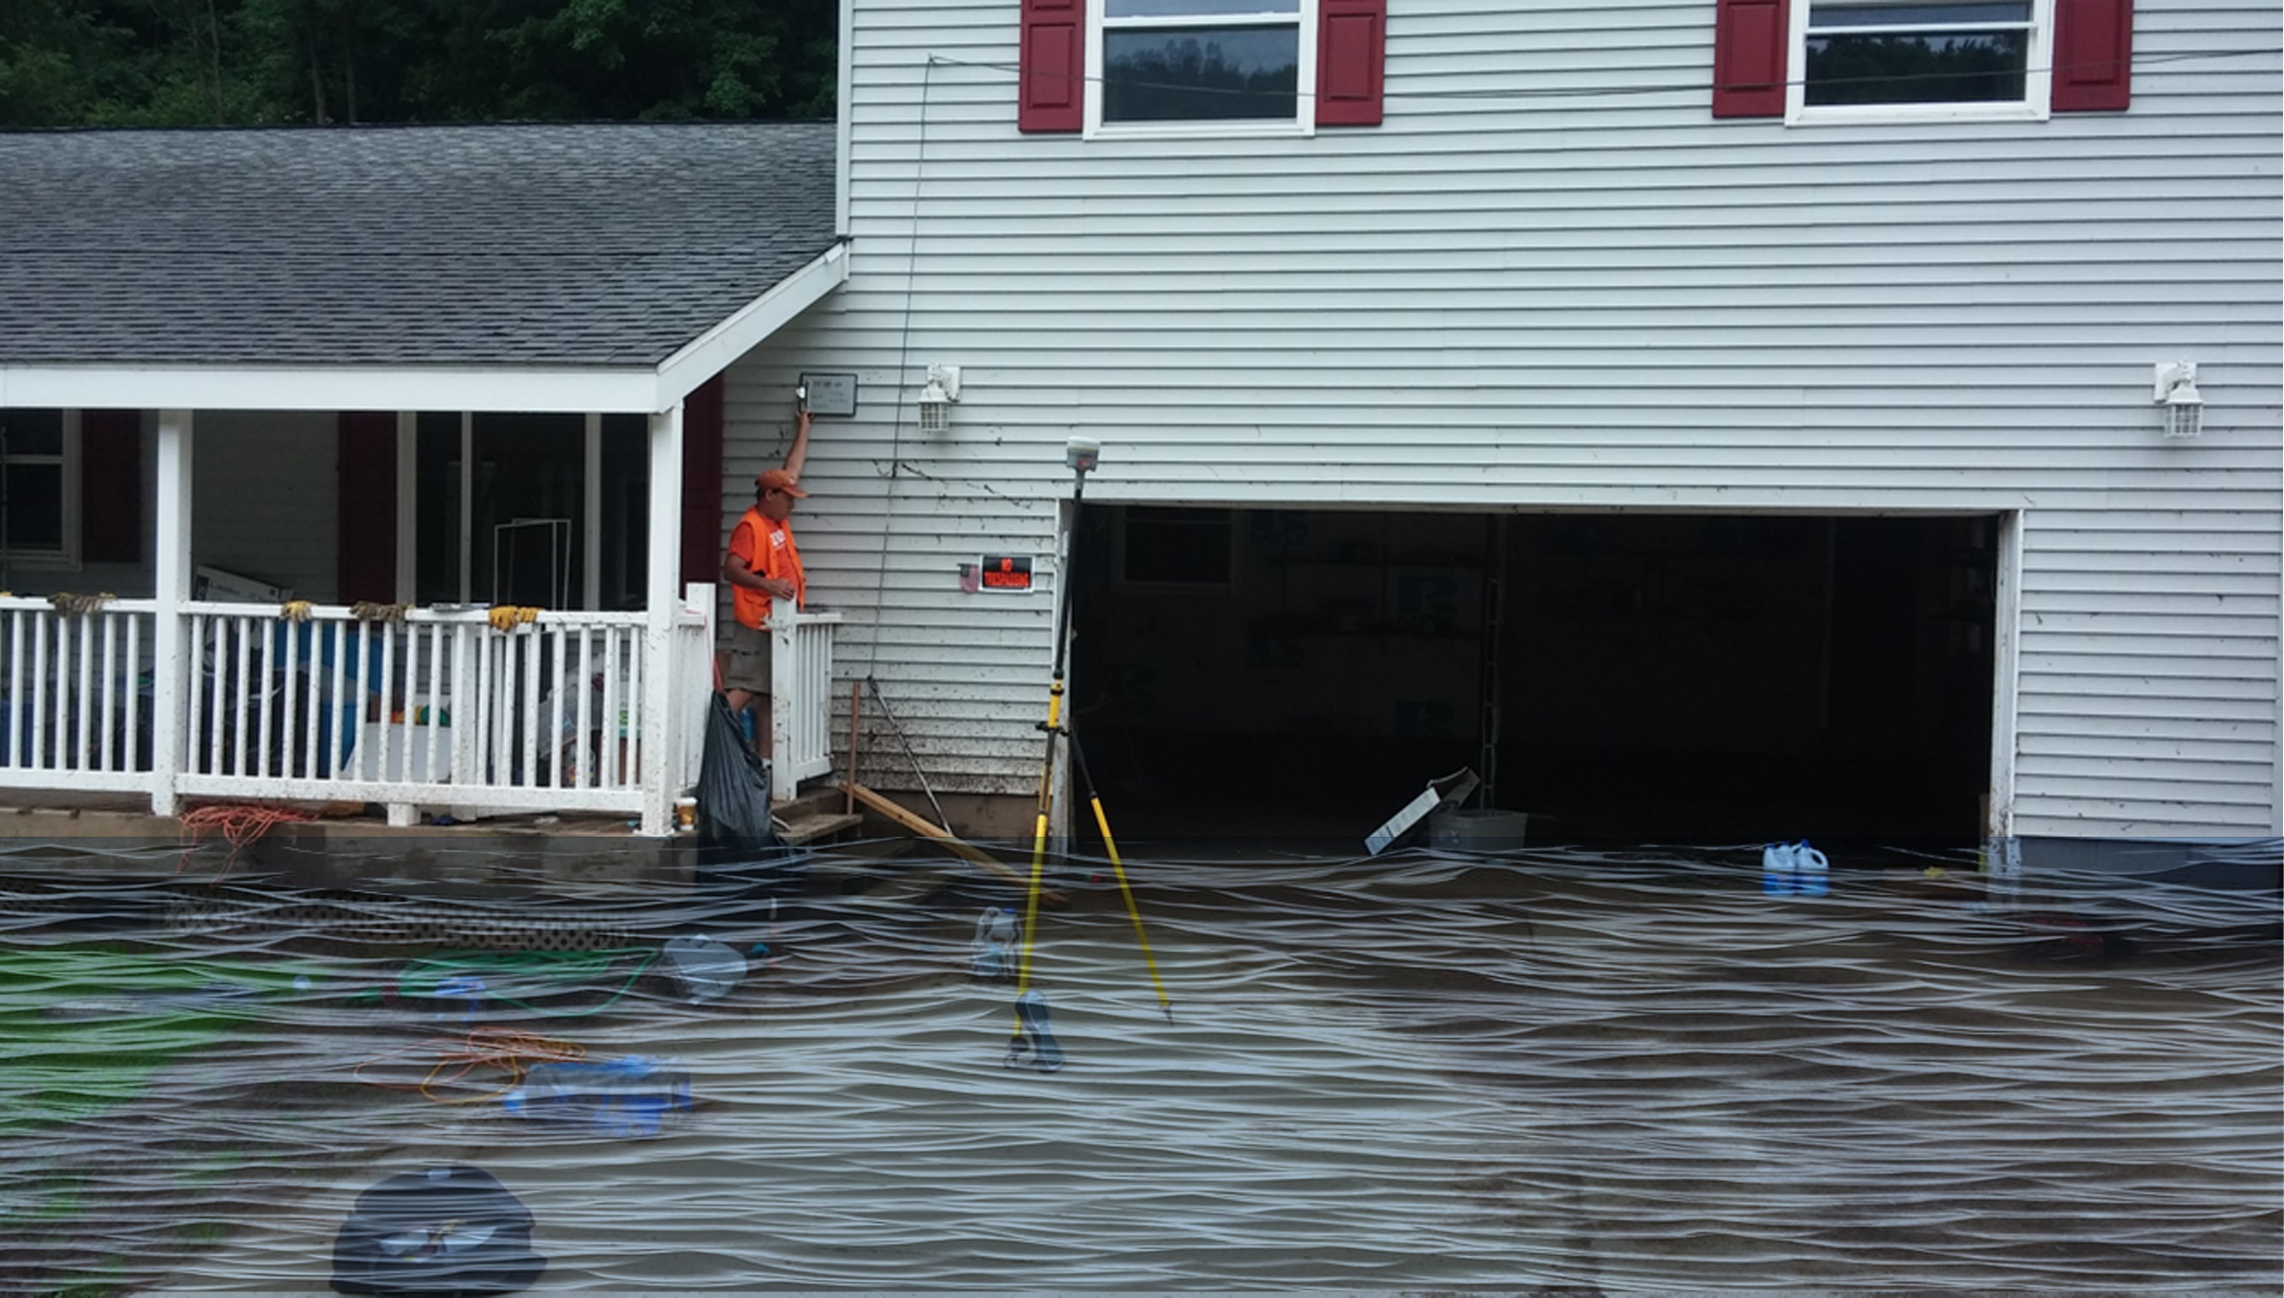
 | HEIGHT (ft.)
BUILDING
First Floor Height | 4
Freeboard (FBD) | 2
FLOOD DEPTH
FEMA 10% (10-Yr) | 1.9
FEMA 4% (25-Yr)
FEMA 2% (50-Yr)
2016 Flood HWM
FEMA 1% (100-Yr)
FEMA 100-Yr + FBD
FEMA 1%+ (84% CL)
FEMA 0.2% (500-Yr)
FSF 0.2% (500-Yr)
51-04-0003-0006-0000_81
81 RIVERSIDE DR, Camden On Gauley, WV, 26208
1.9’ (FEMA 10% / 10-Yr)
Building: 51-04-0003-0006-0000_81
FLOOD DEPTHS:
FEMA
First Street Foundation (FSF)
USGS 2016 Flood High Water Mark

Slide 58
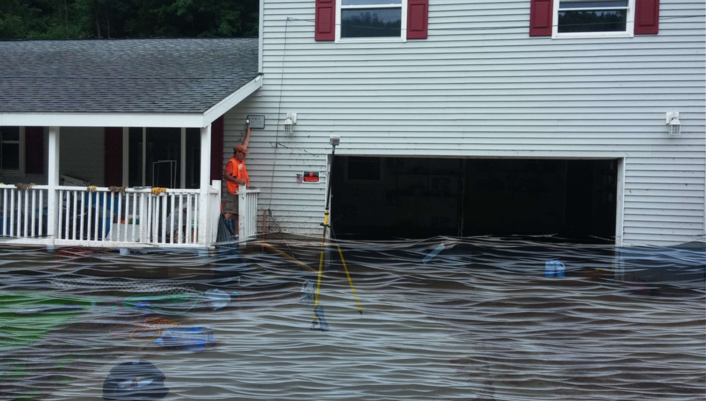
 | HEIGHT (ft.)
BUILDING
First Floor Height | 4
Freeboard (FBD) | 2
FLOOD DEPTH
FEMA 10% (10-Yr) | 1.9
FEMA 4% (25-Yr) | 4.4
FEMA 2% (50-Yr)
2016 Flood HWM
FEMA 1% (100-Yr)
FEMA 100-Yr + FBD
FEMA 1%+ (84% CL)
FEMA 0.2% (500-Yr)
FSF 0.2% (500-Yr)
51-04-0003-0006-0000_81
81 RIVERSIDE DR, Camden On Gauley, WV, 26208
4.4’ (FEMA 4% / 25-Yr)
1.9’ (FEMA 10% / 10-Yr)
Building: 51-04-0003-0006-0000_81
FLOOD DEPTHS:
FEMA
First Street Foundation (FSF)
USGS 2016 Flood High Water Mark

Slide 59
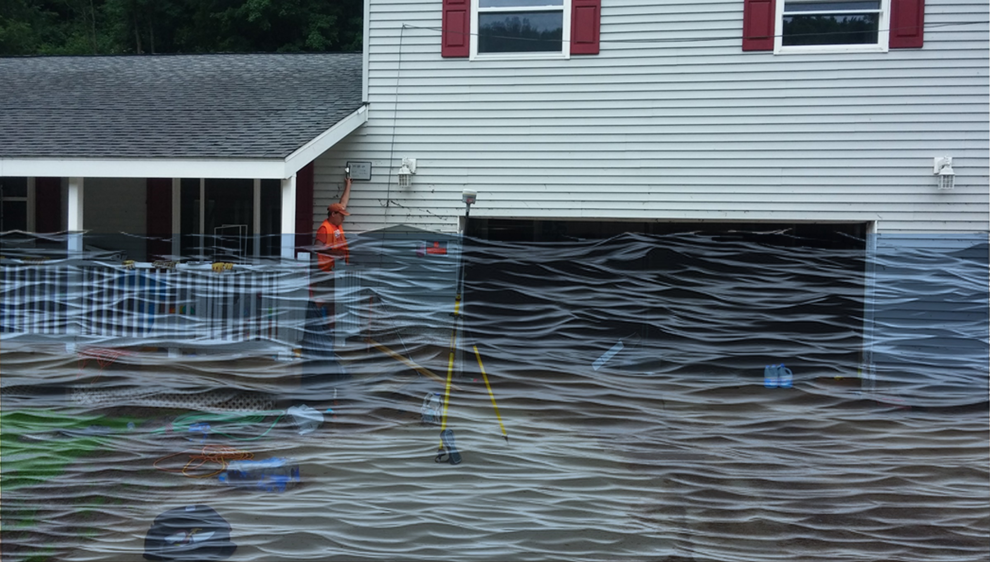
 | HEIGHT (ft.)
BUILDING
First Floor Height | 4
Freeboard (FBD) | 2
FLOOD DEPTH
FEMA 10% (10-Yr) | 1.9
FEMA 4% (25-Yr) | 4.4
FEMA 2% (50-Yr) | 6.7
2016 Flood HWM
FEMA 1% (100-Yr)
FEMA 100-Yr + FBD
FEMA 1%+ (84% CL)
FEMA 0.2% (500-Yr)
FSF 0.2% (500-Yr)
51-04-0003-0006-0000_81
81 RIVERSIDE DR, Camden On Gauley, WV, 26208
6.7’ (FEMA 2% / 50-Yr)
4.4’ (FEMA 4% / 25-Yr)
1.9’ (FEMA 10% / 10-Yr)
Building: 51-04-0003-0006-0000_81
FLOOD DEPTHS:
FEMA
First Street Foundation (FSF)
USGS 2016 Flood High Water Mark

Slide 60
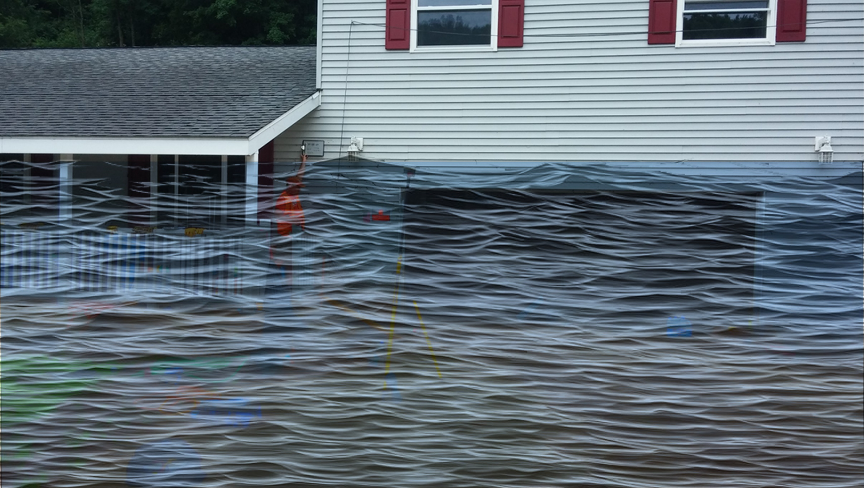
 | HEIGHT (ft.)
BUILDING
First Floor Height | 4
Freeboard (FBD) | 2
FLOOD DEPTH
FEMA 10% (10-Yr) | 1.9
FEMA 4% (25-Yr) | 4.4
FEMA 2% (50-Yr) | 6.7
2016 Flood HWM
FEMA 1% (100-Yr) | 8.3
FEMA 100-Yr + FBD | 10.3
FEMA 1%+ (84% CL)
FEMA 0.2% (500-Yr)
FSF 0.2% (500-Yr)
51-04-0003-0006-0000_81
81 RIVERSIDE DR, Camden On Gauley, WV, 26208
8.3’ (FEMA 1% / 100-Yr)
6.7’ (FEMA 2% / 50-Yr)
4.4’ (FEMA 4% / 25-Yr)
1.9’ (FEMA 10% / 10-Yr)
Building: 51-04-0003-0006-0000_81
FLOOD DEPTHS:
FEMA
First Street Foundation (FSF)
USGS 2016 Flood High Water Mark

Slide 61
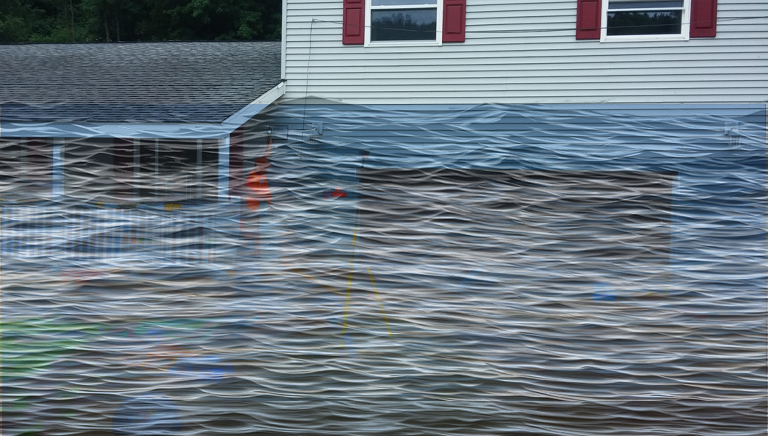
 | HEIGHT (ft.)
BUILDING
First Floor Height | 4
Freeboard (FBD) | 2
FLOOD DEPTH
FEMA 10% (10-Yr) | 1.9
FEMA 4% (25-Yr) | 4.4
FEMA 2% (50-Yr) | 6.7
2016 Flood HWM
FEMA 1% (100-Yr) | 8.3
FEMA 100-Yr + FBD | 10.3
FEMA 1%+ (84% CL) | 10.7
FEMA 0.2% (500-Yr)
FSF 0.2% (500-Yr)
51-04-0003-0006-0000_81
81 RIVERSIDE DR, Camden On Gauley, WV, 26208
10.7’ FEMA 1%+ (84% CL)
8.3’ (FEMA 1% / 100-Yr)
6.7’ (FEMA 2% / 50-Yr)
4.4’ (FEMA 4% / 25-Yr)
1.9’ (FEMA 10% / 10-Yr)
Building: 51-04-0003-0006-0000_81
FLOOD DEPTHS:
FEMA
First Street Foundation (FSF)
USGS 2016 Flood High Water Mark

Slide 62
 | HEIGHT (ft.)
BUILDING
First Floor Height | 4
Freeboard (FBD) | 2
FLOOD DEPTH
FEMA 10% (10-Yr) | 1.9
FEMA 4% (25-Yr) | 4.4
FEMA 2% (50-Yr) | 6.7
2016 Flood HWM | 9.1
FEMA 1% (100-Yr) | 8.3
FEMA 100-Yr + FBD | 10.3
FEMA 1%+ (84% CL) | 10.7
FEMA 0.2% (500-Yr)
FSF 0.2% (500-Yr)
51-04-0003-0006-0000_81
81 RIVERSIDE DR, Camden On Gauley, WV, 26208
10.7’ FEMA 1%+ (84% CL)
9.1’ (2016 High Water)
8.3’ (FEMA 1% / 100-Yr)
6.7’ (FEMA 2% / 50-Yr)
4.4’ (FEMA 4% / 25-Yr)
1.9’ (FEMA 10% / 10-Yr)
Building: 51-04-0003-0006-0000_81
FLOOD DEPTHS:
FEMA
First Street Foundation (FSF)
USGS 2016 Flood High Water Mark

Slide 63
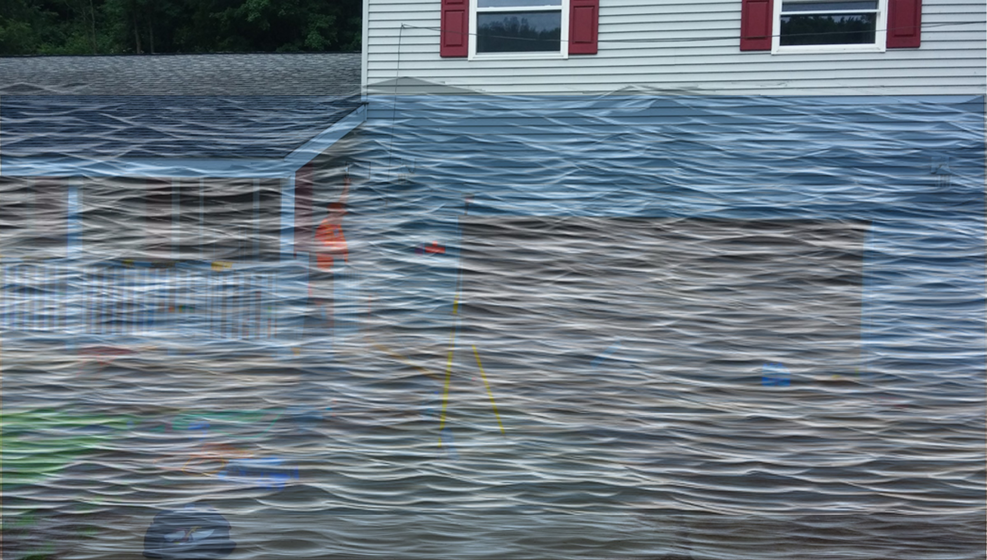
 | HEIGHT (ft.)
BUILDING
First Floor Height | 4
Freeboard (FBD) | 2
FLOOD DEPTH
FEMA 10% (10-Yr) | 1.9
FEMA 4% (25-Yr) | 4.4
FEMA 2% (50-Yr) | 6.7
2016 Flood HWM | 9.1
FEMA 1% (100-Yr) | 8.3
FEMA 100-Yr + FBD | 10.3
FEMA 1%+ (84% CL) | 10.7
FEMA 0.2% (500-Yr) | 12.7
FSF 0.2% (500-Yr)
51-04-0003-0006-0000_81
12.7’ (FEMA 0.2% / 500-Yr )
81 RIVERSIDE DR, Camden On Gauley, WV, 26208
10.7’ FEMA 1%+ (84% CL)
9.1’ (2016 High Water)
8.3’ (FEMA 1% / 100-Yr)
6.7’ (FEMA 2% / 50-Yr)
4.4’ (FEMA 4% / 25-Yr)
1.9’ (FEMA 10% / 10-Yr)
Building: 51-04-0003-0006-0000_81
FLOOD DEPTHS:
FEMA
First Street Foundation (FSF)
USGS 2016 Flood High Water Mark

Slide 64
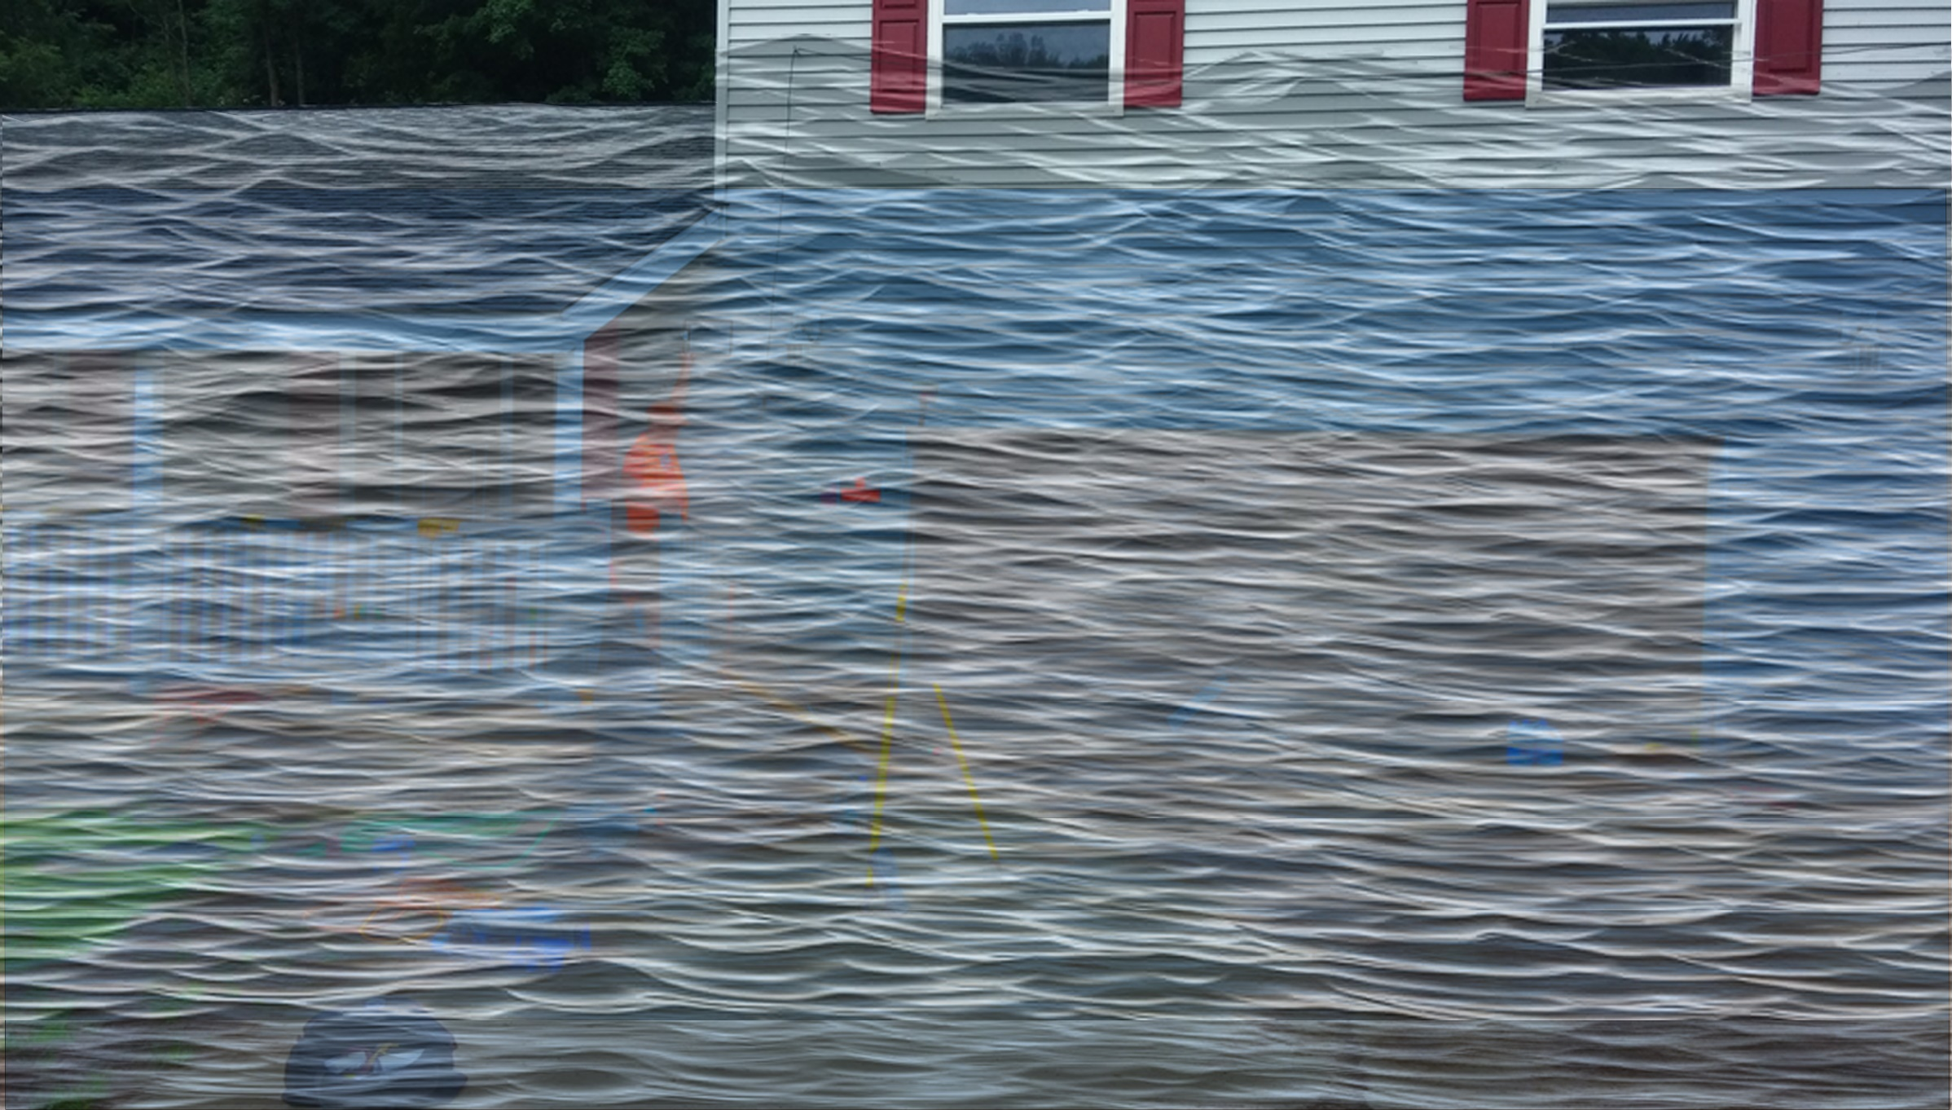
 | HEIGHT (ft.)
BUILDING
First Floor Height | 4
Freeboard (FBD) | 2
FLOOD DEPTH
FEMA 10% (10-Yr) | 1.9
FEMA 4% (25-Yr) | 4.4
FEMA 2% (50-Yr) | 6.7
2016 Flood HWM | 9.1
FEMA 1% (100-Yr) | 8.3
FEMA 100-Yr + FBD | 10.3
FEMA 1%+ (84% CL) | 10.7
FEMA 0.2% (500-Yr) | 12.7
FSF 0.2% (500-Yr) | 14.8
51-04-0003-0006-0000_81
14.8’ (FSF 0.2% / 500-Yr)
12.7’ (FEMA 0.2% / 500-Yr )
81 RIVERSIDE DR, Camden On Gauley, WV, 26208
10.7’ FEMA 1%+ (84% CL)
9.1’ (2016 High Water)
8.3’ (FEMA 1% / 100-Yr)
6.7’ (FEMA 2% / 50-Yr)
4.4’ (FEMA 4% / 25-Yr)
1.9’ (FEMA 10% / 10-Yr)
Building: 51-04-0003-0006-0000_81
FLOOD DEPTHS:
FEMA
First Street Foundation (FSF)
USGS 2016 Flood High Water Mark

Slide 65
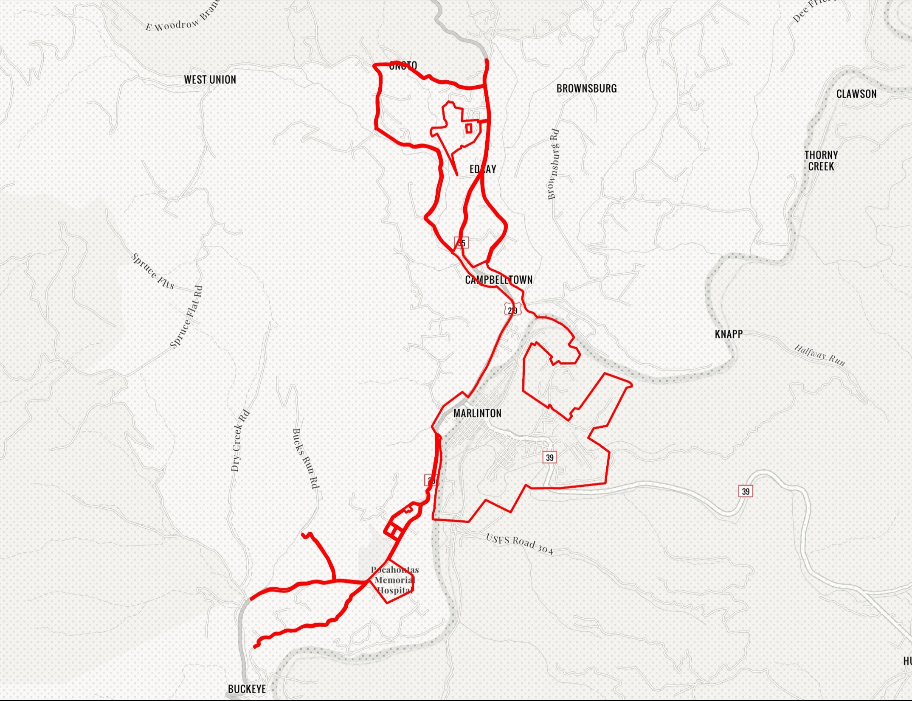
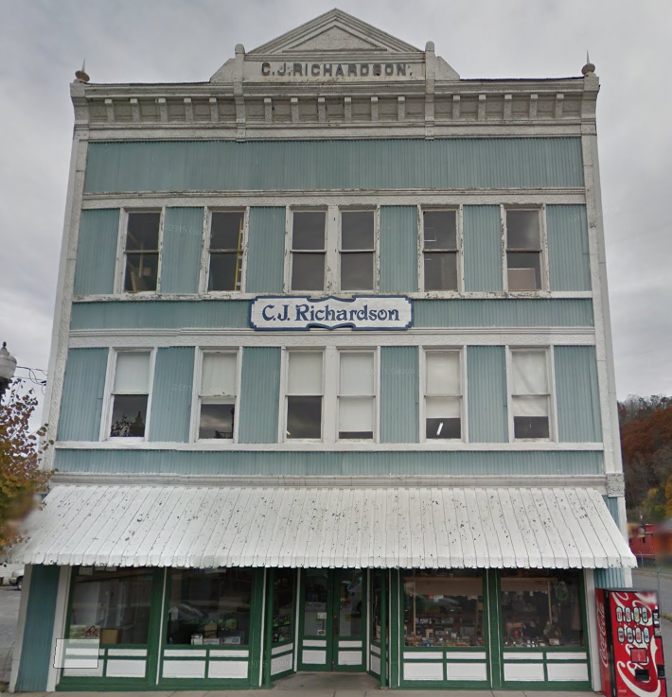
Marlinton
Building: 38-08-0003-0023-0000
Ideally, the Design Flood Elevation (DFE) should be the BFE plus 2 feet of freeboard. The DFE should also be above the high-water marks of the 1985 flood plus freeboard.
1900 Commercial Structure
Flood Intervals | Height (ft.) | Source
FEMA 10% / 10-Yr | 0.4 | Flood Profile (Effective 2010)
FEMA 2% / 50-yr | 2.7 | Flood Profile (Effective 2010)
FEMA 1% / 100-yr | 3.6 | Flood Profile (Effective 2010)
FEMA 100-yr + 2.0 Ft. Freeboard (DFE) | 5.6 | Design flood elevation (DFE)
High Water Mark (1985 Flood) | 7.0 | Picture
FEMA Draft NFHL 100-yr | 4.8 | WV Flood Tool (Draft 2023)
FEMA 500-yr | 8.8 | WV Flood Tool (Draft 2023)
FSF 500-yr | 9.4 | FSF Flood Depth (2022)
309 8th St, Marlinton, WV, 24954
9.4’ (FSF 0.2% / 500-Yr)
8.8’ (FEMA DRAFT NFHL 0.2% / 500-Yr )
7’ (1985 High Water Mark)
4.8’ (FEMA DRAFT NFHL 1% / 100-Yr)
3.6’ (FEMA 1% / 100-Yr)
2.7’ (FEMA 2% / 50-Yr)
1985 Flood High Water Mark
0.4’ (FEMA 10% / 10-Yr)
FLOOD DEPTHS:
FEMA Effective (2010)
FEMA Draft NFHL (2023)
First Street Foundation (FSF)
1985 Flood High Water Mark

Slide 66
FEMA 10% Annual Chance (10-year)
Assessing the Percentage of Inundated Area in Different Flood Intervals
Community Flood Profile
White Sulphur Springs
Notes:
White Sulfur Springs FEMA 10yr Aerial

Slide 67
FEMA 10% Annual Chance (10-year)
White Sulphur Springs, WV
0.1 ft.
FLOOD DEPTH
26 ft.
Residential
Non-Residential
13% of White Sulphur Springs is in the 10% Annual Flood Chance
96% probability of flooding at least once over 30 years
Notes:
White Sulfur Springs FEMA 10yr Aerial

Slide 68
FEMA 4% Annual Chance (25-year)
White Sulphur Springs, WV
0.1 ft.
FLOOD DEPTH
29 ft.
Residential
Non-Residential
17% of White Sulphur Springs is in the 4% Annual Flood Chance
71% probability of flooding at least once over 30 years
Notes:
White Sulfur Springs FEMA 25yr Aerial

Slide 69
FEMA 2% Annual Chance (50-year)
White Sulphur Springs, WV
0.1 ft.
FLOOD DEPTH
30 ft.
Residential
Non-Residential
20% of White Sulphur Springs is in the 2% Annual Flood Chance
45% probability of flooding at least once over 30 years
Notes:
White Sulfur Springs FEMA 50yr Aerial

Slide 70
FEMA 1% Annual Chance (100-year)
White Sulphur Springs, WV
0.1 ft.
FLOOD DEPTH
35 ft.
Residential
Non-Residential
22% of White Sulphur Springs is in the 1% Annual Flood Chance
26% probability of flooding at least once over 30 years
Notes:
White Sulfur Springs FEMA 100yr Aerial

Slide 71
FEMA 1% +Annual Chance (100-year)
White Sulphur Springs, WV
Climate
Change
0.1 ft.
FLOOD DEPTH
35 ft.
Residential
Non-Residential
25% of White Sulphur Springs is in the 1% +Annual Flood Chance
26% probability of flooding at least once over 30 years
Notes:
White Sulfur Springs FEMA 100yr PLUS Aerial

Slide 72
FEMA 0.2% Annual Chance (500-year)
White Sulphur Springs, WV
0.1 ft.
FLOOD DEPTH
18 ft.
Residential
Non-Residential
18% of White Sulphur Springs is in the 0.2% Annual Flood Chance
6% probability of flooding at least once over 30 years
Notes:
White Sulfur Springs FEMA 500yr Aerial

Slide 73
Rainelle

Slide 74
FEMA 10% Annual Chance (10-year)
Rainelle, WV
0.1 ft.
FLOOD DEPTH
30 ft.
Residential
Non-Residential
96% probability of flooding at least once over 30 years
13% Rainelle is in the 10% Annual Flood Chance
Notes:
FEMA 10year Aerial

Slide 75
FEMA 4% Annual Chance (25-year)
Rainelle, WV
0.1 ft.
FLOOD DEPTH
30 ft.
Residential
Non-Residential
71% probability of flooding at least once over 30 years
20% Rainelle is in the 4% Annual Flood Chance
Notes:
FEMA 25year Aerial

Slide 76
FEMA 2% Annual Chance (50-year)
FEMA 2% Annual Chance (50-year)
Rainelle, WV
Rainelle, WV
0.1 ft.
FLOOD DEPTH
30 ft.
Residential
Non-Residential
45% probability of flooding at least once over 30 years
26% Rainelle is in the 2% Annual Flood Chance
Notes:
FEMA 50year Aerial

Slide 77
FEMA 2% Annual Chance (50-year)
FEMA 1% Annual Chance (100-year)
Rainelle, WV
Rainelle, WV
0.1 ft.
FLOOD DEPTH
30 ft.
Residential
Non-Residential
26% probability of flooding at least once over 30 years
31% Rainelle is in the 1% Annual Flood Chance
Notes:
FEMA 100year Aerial

Slide 78
FEMA 2% Annual Chance (50-year)
FEMA 1%+ Annual Chance (100-year)
Rainelle, WV
Rainelle, WV
Climate
Change
0.1 ft.
FLOOD DEPTH
30 ft.
Residential
Non-Residential
26% probability of flooding at least once over 30 years
31% Rainelle is in the 1% + Annual Flood Chance
Notes:
FEMA 100year PLUS Aerial

Slide 79
FEMA 2% Annual Chance (50-year)
FEMA 0.2% Annual Chance (100-year)
Rainelle, WV
Rainelle, WV
0.1 ft.
FLOOD DEPTH
30 ft.
Residential
Non-Residential
6% probability of flooding at least once over 30 years
37% Rainelle is in the 0.2% Annual Flood Chance
Notes:
FEMA 500year Aerial

Slide 80
Clendenin

Slide 81
FEMA 10% Annual Chance (10-year)
Clendenin, WV
0.1 ft.
FLOOD DEPTH
27.8 ft.
Residential
Non-Residential
13.4% of Clendenin is in the 10% Annual Flood Chance
96% probability of flooding at least once over 30 years

Slide 82
FEMA 4% Annual Chance (25-year)
Clendenin, WV
0.1 ft.
FLOOD DEPTH
27.8 ft.
Residential
Non-Residential
19% of Clendenin is in the 4% Annual Flood Chance
71% probability of flooding at least once over 30 years

Slide 83
FEMA 2% Annual Chance (50-year)
Clendenin, WV
0.1 ft.
FLOOD DEPTH
35.2 ft.
Residential
Non-Residential
22.5% of Clendenin is in the 2% Annual Flood Chance
45% probability of flooding at least once over 30 years

Slide 84
FEMA 1% Annual Chance (100-year)
Clendenin, WV
0.1 ft.
FLOOD DEPTH
38.1 ft.
Residential
Non-Residential
23.5% of Clendenin is in the 1% Annual Flood Chance
26% probability of flooding at least once over 30 years

Slide 85
FEMA 1%+ Annual Chance (100-year)
Clendenin, WV
Climate
Change
0.1 ft.
FLOOD DEPTH
42.4 ft.
Residential
Non-Residential
23.5% of Clendenin is in the 1%+ Annual Flood Chance
26% probability of flooding at least once over 30 years

Slide 86
FEMA 0.2% Annual Chance (500-year)
Clendenin, WV
0.1 ft.
FLOOD DEPTH
43.6 ft.
Residential
Non-Residential
25% of Clendenin is in the 0.2% Annual Flood Chance
6% probability of flooding at least once over 30 years

Slide 87
Richwood

Slide 88
FEMA 10% Annual Chance (10-year)
Richwood, WV
0.1 ft.
FLOOD DEPTH
11.8 ft.
Cherry River
Residential
Non-Residential
7% of Richwood is in the 10% Annual Flood Chance
96% probability of flooding at least once over 30 years

Slide 89
FEMA 4% Annual Chance (25-year)
Richwood, WV
0.1 ft.
FLOOD DEPTH
14.7 ft.
Cherry River
Residential
Non-Residential
11% of Richwood is in the 4% Annual Flood Chance
71% probability of flooding at least once over 30 years

Slide 90
FEMA 2% Annual Chance (50-year)
Richwood, WV
0.1 ft.
FLOOD DEPTH
17.3 ft.
Cherry River
Residential
Non-Residential
16% of Richwood is in the 2% Annual Flood Chance
45% probability of flooding at least once over 30 years

Slide 91
FEMA 1% Annual Chance (100-year)
Richwood, WV
0.1 ft.
FLOOD DEPTH
17.9 ft.
Cherry River
Residential
Non-Residential
18% of Richwood is in the 1% Annual Flood Chance
26% probability of flooding at least once over 30 years

Slide 92
FEMA 1%+ Annual Chance (100-year)
Richwood, WV
Climate
Change
0.1 ft.
FLOOD DEPTH
26.7 ft.
Cherry River
Residential
Non-Residential
22% of Richwood is in the 1%+ Annual Flood Chance
26% probability of flooding at least once over 30 years

Slide 93
FEMA 0.2% Annual Chance (500-year)
Richwood, WV
0.1 ft.
FLOOD DEPTH
28.6 ft.
Cherry River
Residential
Non-Residential
22% of Richwood is in the 0.2% Annual Flood Chance
6% probability of flooding at least once over 30 years

Slide 94
Camden-on-Gauley

Slide 95
FEMA 10% Annual Chance (10-year)
Camden-on-Gauley, WV
0.1 ft.
FLOOD DEPTH
22.1 ft.
Residential
Non-Residential
10% of Camden is in the 10% Annual Flood Chance
96% probability of flooding at least once over 30 years

Slide 96
FEMA 4% Annual Chance (25-year)
Camden-on-Gauley, WV
0.1 ft.
FLOOD DEPTH
25.3 ft.
Residential
Non-Residential
12% of Camden is in the 4% Annual Flood Chance
71% probability of flooding at least once over 30 years

Slide 97
FEMA 2% Annual Chance (50-year)
Camden-on-Gauley, WV
0.1 ft.
FLOOD DEPTH
27.3 ft.
Residential
Non-Residential
12% of Camden is in the 2% Annual Flood Chance
45% probability of flooding at least once over 30 years

Slide 98
FEMA 1% Annual Chance (100-year)
Camden-on-Gauley, WV
0.1 ft.
FLOOD DEPTH
29.3 ft.
Residential
Non-Residential
14% of Camden is in the 1% Annual Flood Chance
26% probability of flooding at least once over 30 years

Slide 99
FEMA 1+% Annual Chance (100-year)
Camden-on-Gauley, WV
Climate
Change
0.1 ft.
FLOOD DEPTH
31.5 ft.
Residential
Non-Residential
13% of Camden is in the 1%+ Annual Flood Chance
26% probability of flooding at least once over 30 years

Slide 100
FEMA 0.2% Annual Chance (500-year)
Camden-on-Gauley, WV
0.1 ft.
FLOOD DEPTH
32.5 ft.
Residential
Non-Residential
15% of Camden is in the 0.2% Annual Flood Chance
6% probability of flooding at least once over 30 years

Slide 101
Percentage of Area

Slide 102
Flood Intervals | Percentage of Inundated Area in each Community
 | Camden | Clendenin | Rainelle | Richwood | White Sulphur Springs
10% Probability of Flood in a year (10-year flood) | 10% | 13.4% | 13% | 7% | 13%
4% Probability of Flood in a year (25-year flood) | 12% | 19% | 20% | 11% | 17%
2% Probability of Flood in a year (50-year flood) | 12% | 22.5% | 26% | 16% | 20%
1% Probability of Flood in a year (100-year flood) | 14% | 23.5% | 31% | 18% | 22%
*1+% Probability of Flood in a year (84% Climate Change) | 13% | 23.5% | 31% | 22% | 25%
0.2% Probability of Flood in a year (500-year flood) | 15% | 25% | 37% | 22% | 27%
* The 1-percent-plus flood elevation is defined as a flood elevation derived by using discharges that are at the upper 84-percent confidence limit as calculated in the gage analysis for the 1- percent-annual-chance event for the Flood Risk Project (FEMA, 2019)

