Slide 1
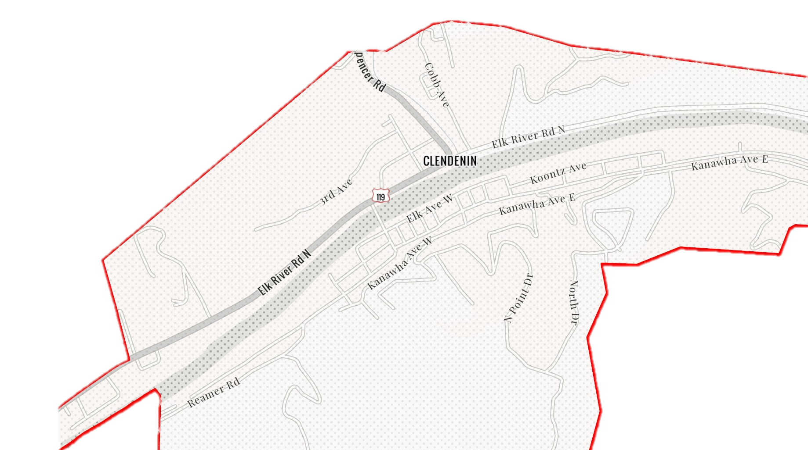
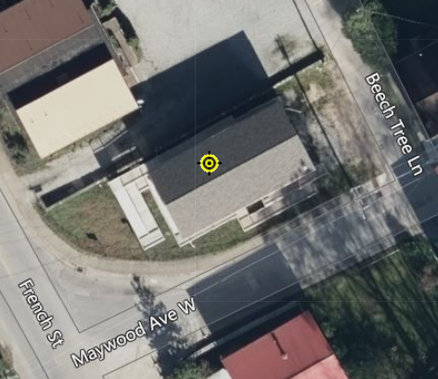
Clendenin
20-02-0006-0044-0000_306
306 Maywood Ave., Clendenin, WV, 25045
Building Flood Profile

Slide 2
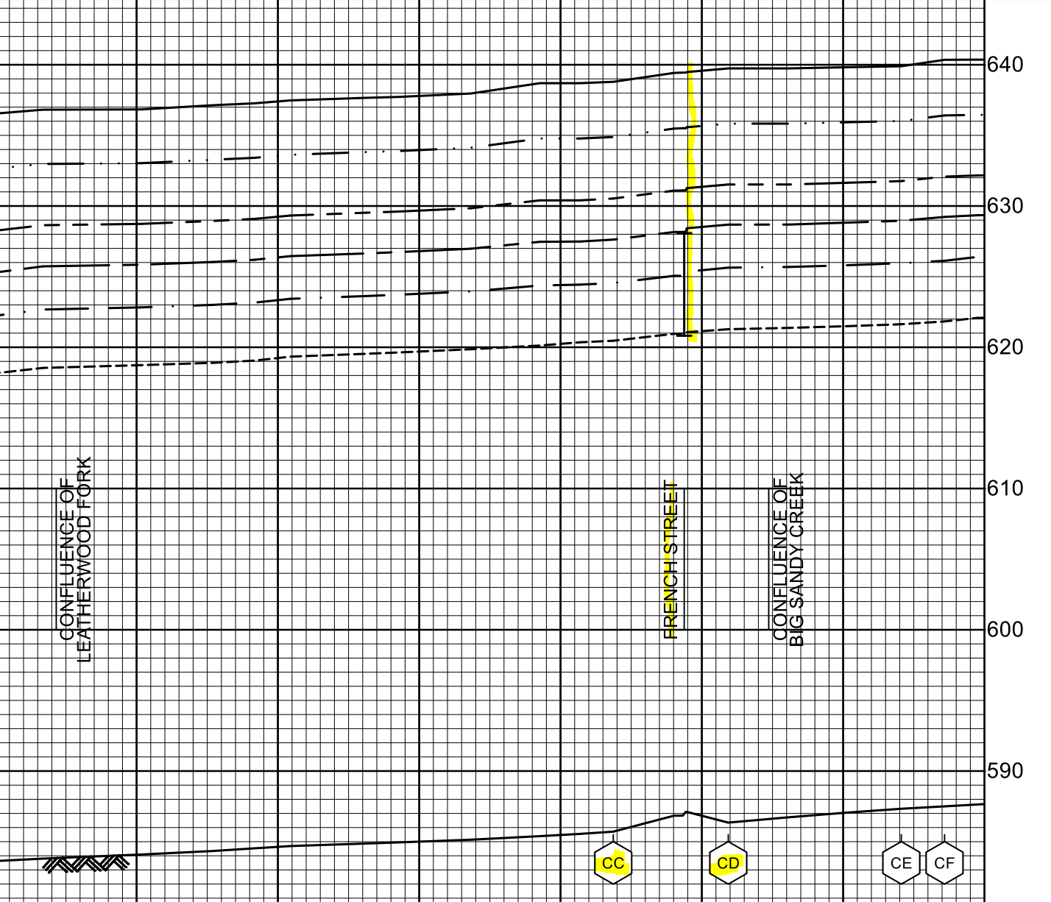
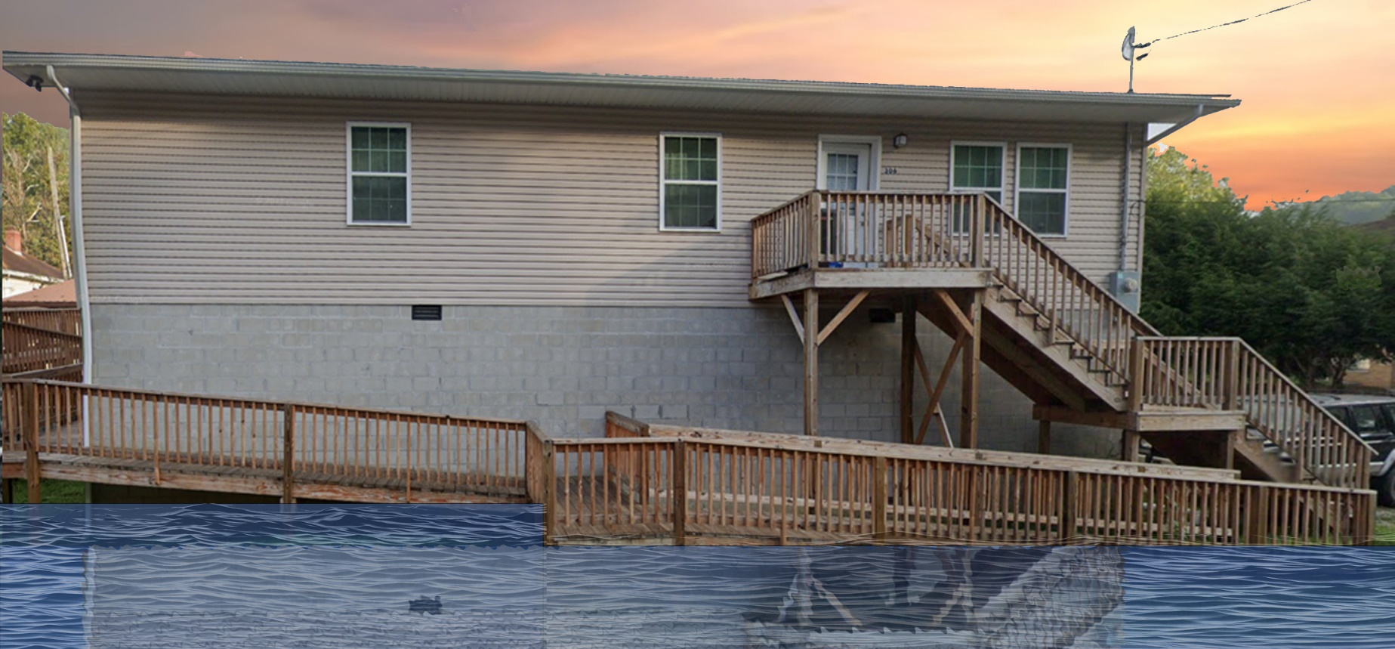
10% Probability of Flood in a year (10-year flood)
2.0’ (FEMA 10% / 10-Yr)
Building’s Ground Elevation

Slide 3
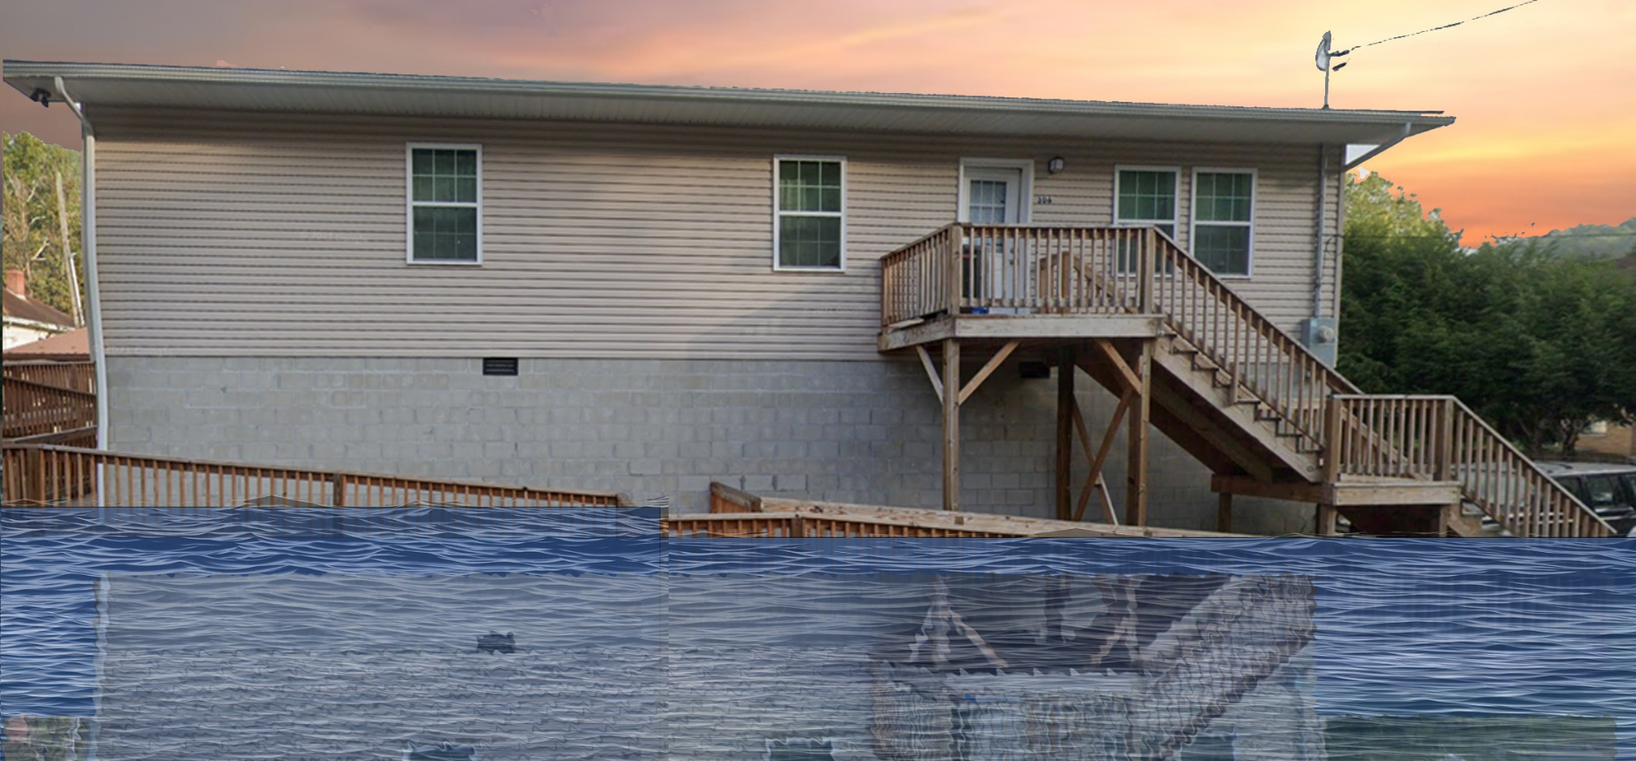
4% Probability of Flood in a year (25-year flood)
6.0’ (FEMA 4% / 25-Yr)

Slide 4
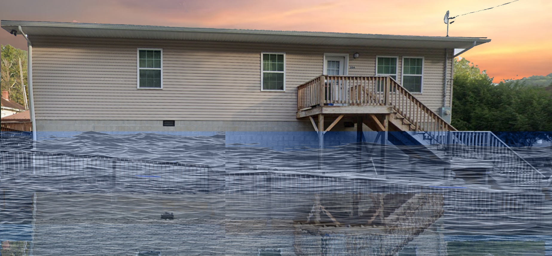
2% Probability of Flood in a year (50-year flood)
9.5’ (FEMA 2% / 50-Yr)

Slide 5
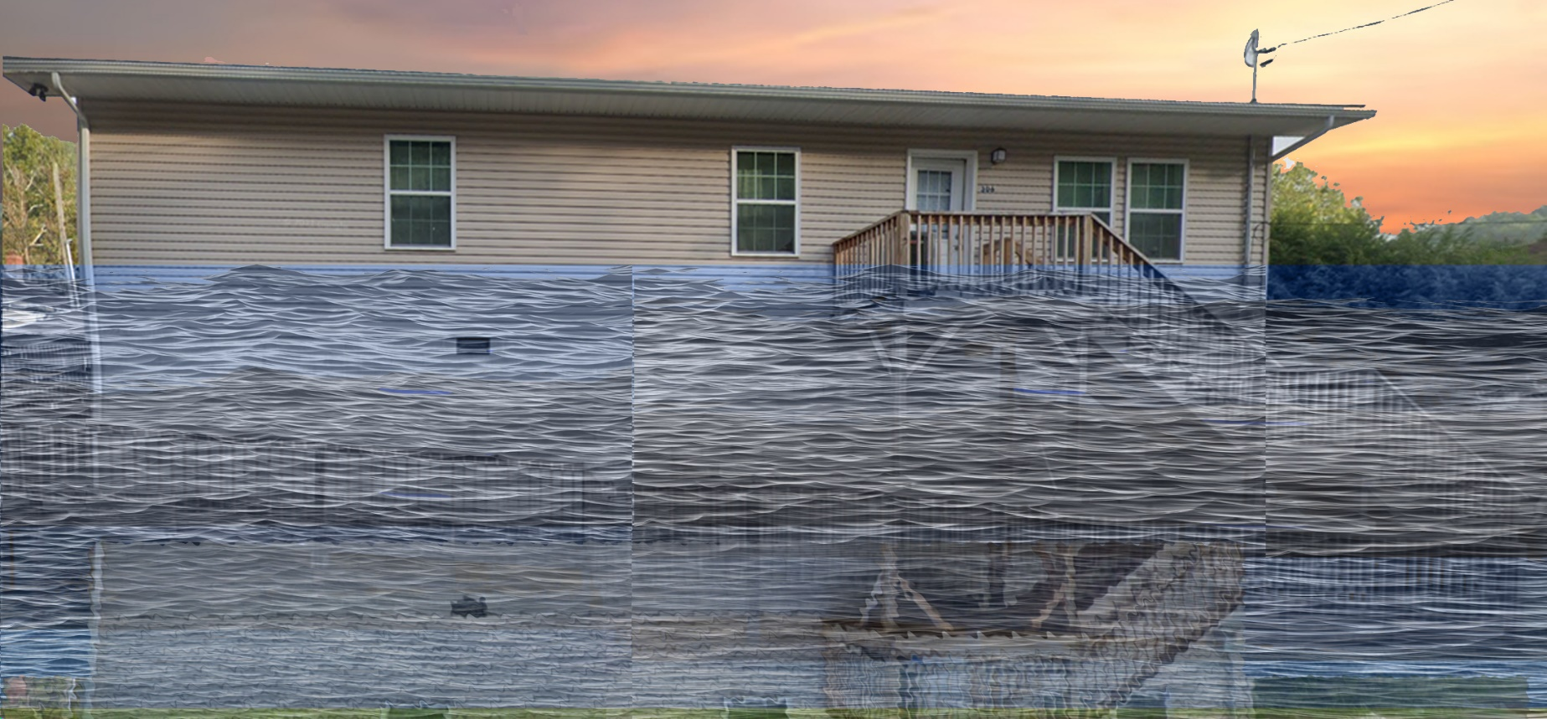
1% Probability of Flood in a year (100-year flood)
12.3’ (FEMA 2% / 50-Yr)

Slide 6
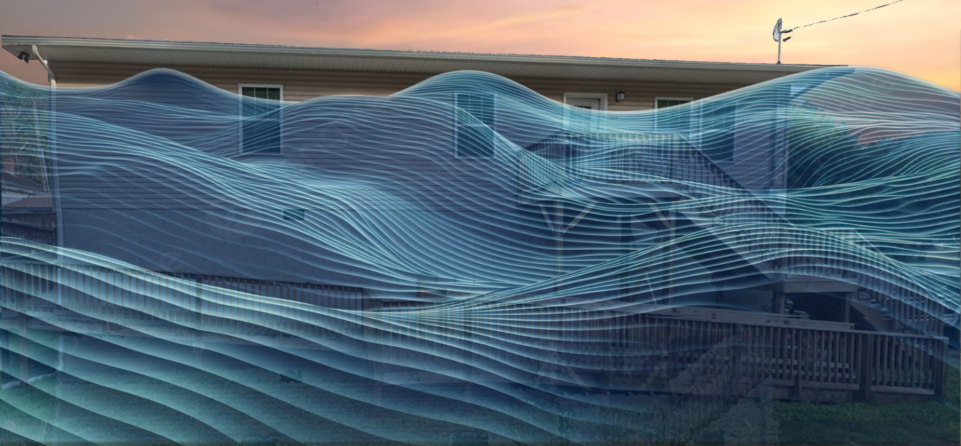
0.2% Probability of Flood in a year (500-year flood)
20.5’ (FEMA 0.2% / 500-Yr)

Slide 7
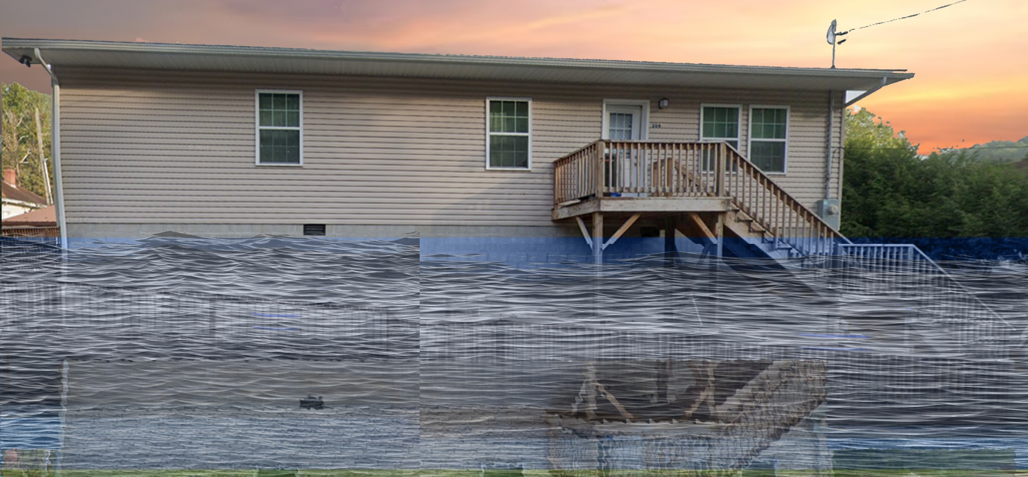
2016 High Watermark
High Watermark
9.5’ (FEMA 2% / 50-Yr)
10.5’ (2016 High Water)

Slide 8
The Design Flood Elevation (DFE) should be the BFE plus 2 feet of freeboard. The DFE should also be above the high-water marks of the 2016 flood plus freeboard.
 | HEIGHT (ft.)
BUILDING
First Floor Height | 12.0
Freeboard (FBD) | 2.0
FLOOD DEPTH
FEMA 10% (10-Yr) | 2.0
FEMA 4% (25-Yr)
FEMA 2% (50-Yr)
2016 Flood HWM
FEMA 1% (100-Yr)
FEMA 100-Yr + FBD
FEMA 1%+ (84% CL)
FEMA 0.2% (500-Yr)
FSF 0.2% (500-Yr)
306 Maywood Ave., Clendenin, WV, 25045
2.0’ (FEMA 10% / 10-Yr)
Building 20-02-0006-0044-0000_306
FLOOD DEPTHS:
FEMA
First Street Foundation (FSF)
USGS 2016 Flood High Water Mark

Slide 9
The Design Flood Elevation (DFE) should be the BFE plus 2 feet of freeboard. The DFE should also be above the high-water marks of the 2016 flood plus freeboard.
 | HEIGHT (ft.)
BUILDING
First Floor Height | 12.0
Freeboard (FBD) | 2.0
FLOOD DEPTH
FEMA 10% (10-Yr) | 2.0
FEMA 4% (25-Yr) | 6.0
FEMA 2% (50-Yr)
2016 Flood HWM
FEMA 1% (100-Yr)
FEMA 100-Yr + FBD
FEMA 1%+ (84% CL)
FEMA 0.2% (500-Yr)
FSF 0.2% (500-Yr)
306 Maywood Ave., Clendenin, WV, 25045
6.0’ (FEMA 4% / 25-Yr)
2.0’ (FEMA 10% / 10-Yr)
Building 20-02-0006-0044-0000_306
FLOOD DEPTHS:
FEMA
First Street Foundation (FSF)
USGS 2016 Flood High Water Mark

Slide 10
The Design Flood Elevation (DFE) should be the BFE plus 2 feet of freeboard. The DFE should also be above the high-water marks of the 2016 flood plus freeboard.
 | HEIGHT (ft.)
BUILDING
First Floor Height | 12.0
Freeboard (FBD) | 2.0
FLOOD DEPTH
FEMA 10% (10-Yr) | 2.0
FEMA 4% (25-Yr) | 6.0
FEMA 2% (50-Yr) | 9.5
2016 Flood HWM
FEMA 1% (100-Yr)
FEMA 100-Yr + FBD
FEMA 1%+ (84% CL)
FEMA 0.2% (500-Yr)
FSF 0.2% (500-Yr)
306 Maywood Ave., Clendenin, WV, 25045
9.5’ (FEMA 2% / 50-Yr)
6.0’ (FEMA 4% / 25-Yr)
2.0’ (FEMA 10% / 10-Yr)
Building 20-02-0006-0044-0000_306
FLOOD DEPTHS:
FEMA
First Street Foundation (FSF)
USGS 2016 Flood High Water Mark

Slide 11
The Design Flood Elevation (DFE) should be the BFE plus 2 feet of freeboard. The DFE should also be above the high-water marks of the 2016 flood plus freeboard.
 | HEIGHT (ft.)
BUILDING
First Floor Height | 12.0
Freeboard (FBD) | 2.0
FLOOD DEPTH
FEMA 10% (10-Yr) | 2.0
FEMA 4% (25-Yr) | 6.0
FEMA 2% (50-Yr) | 9.5
2016 Flood HWM | 10.5
FEMA 1% (100-Yr)
FEMA 100-Yr + FBD
FEMA 1%+ (84% CL)
FEMA 0.2% (500-Yr)
FSF 0.2% (500-Yr)
306 Maywood Ave., Clendenin, WV, 25045
10.5’ (2016 High Water)
9.5’ (FEMA 2% / 50-Yr)
6.0’ (FEMA 4% / 25-Yr)
2.0’ (FEMA 10% / 10-Yr)
Building 20-02-0006-0044-0000_306
FLOOD DEPTHS:
FEMA
First Street Foundation (FSF)
USGS 2016 Flood High Water Mark

Slide 12
The Design Flood Elevation (DFE) should be the BFE plus 2 feet of freeboard. The DFE should also be above the high-water marks of the 2016 flood plus freeboard.
 | HEIGHT (ft.)
BUILDING
First Floor Height | 12.0
Freeboard (FBD) | 2.0
FLOOD DEPTH
FEMA 10% (10-Yr) | 2.0
FEMA 4% (25-Yr) | 6.0
FEMA 2% (50-Yr) | 9.5
2016 Flood HWM | 10.5
FEMA 1% (100-Yr) | 12.3
FEMA 100-Yr + FBD | 14.3
FEMA 1%+ (84% CL) | 16.5
FEMA 0.2% (500-Yr)
FSF 0.2% (500-Yr)
306 Maywood Ave., Clendenin, WV, 25045
16.5’ FEMA1%+ (84% CL)
12.3’ (FEMA 1% / 100-Yr)
10.5’ (2016 High Water)
9.5’ (FEMA 2% / 50-Yr)
6.0’ (FEMA 4% / 25-Yr)
2.0’ (FEMA 10% / 10-Yr)
Building 20-02-0006-0044-0000_306
FLOOD DEPTHS:
FEMA
First Street Foundation (FSF)
USGS 2016 Flood High Water Mark

Slide 13
The Design Flood Elevation (DFE) should be the BFE plus 2 feet of freeboard. The DFE should also be above the high-water marks of the 2016 flood plus freeboard.
 | HEIGHT (ft.)
BUILDING
First Floor Height | 12.0
Freeboard (FBD) | 2.0
FLOOD DEPTH
FEMA 10% (10-Yr) | 2.0
FEMA 4% (25-Yr) | 6.0
FEMA 2% (50-Yr) | 9.5
2016 Flood HWM | 10.5
FEMA 1% (100-Yr) | 12.3
FEMA 100-Yr + FBD | 14.3
FEMA 1%+ (84% CL) | 16.5
FEMA 0.2% (500-Yr) | 20.5
FSF 0.2% (500-Yr)
306 Maywood Ave., Clendenin, WV, 25045
20.5’ (FEMA 0.2% / 500-Yr)
16.5’ FEMA1%+ (84% CL)
12.3’ (FEMA 1% / 100-Yr)
10.5’ (2016 High Water)
9.5’ (FEMA 2% / 50-Yr)
6.0’ (FEMA 4% / 25-Yr)
2.0’ (FEMA 10% / 10-Yr)
Building 20-02-0006-0044-0000_306
FLOOD DEPTHS:
FEMA
First Street Foundation (FSF)
USGS 2016 Flood High Water Mark

Slide 14
The Design Flood Elevation (DFE) should be the BFE plus 2 feet of freeboard. The DFE should also be above the high-water marks of the 2016 flood plus freeboard.
 | HEIGHT (ft.)
BUILDING
First Floor Height | 12.0
Freeboard (FBD) | 2.0
FLOOD DEPTH
FEMA 10% (10-Yr) | 2.0
FEMA 4% (25-Yr) | 6.0
FEMA 2% (50-Yr) | 9.5
2016 Flood HWM | 10.5
FEMA 1% (100-Yr) | 12.3
FEMA 100-Yr + FBD | 14.3
FEMA 1%+ (84% CL) | 16.5
FEMA 0.2% (500-Yr) | 20.5
FSF 0.2% (500-Yr) | 24.6
306 Maywood Ave., Clendenin, WV, 25045
24.6’ (FSF 0.2% / 500-Yr)
20.5’ (FEMA 0.2% / 500-Yr)
16.5’ FEMA1%+ (84% CL)
12.3’ (FEMA 1% / 100-Yr)
10.5’ (2016 High Water)
9.5’ (FEMA 2% / 50-Yr)
6.0’ (FEMA 4% / 25-Yr)
2.0’ (FEMA 10% / 10-Yr)
Building 20-02-0006-0044-0000_306
FLOOD DEPTHS:
FEMA
First Street Foundation (FSF)
USGS 2016 Flood High Water Mark

