Slide 1
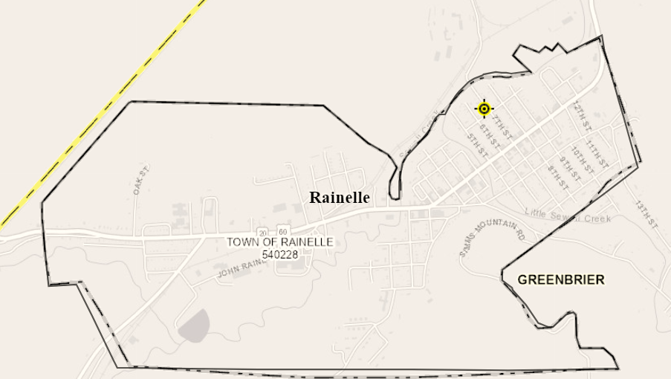
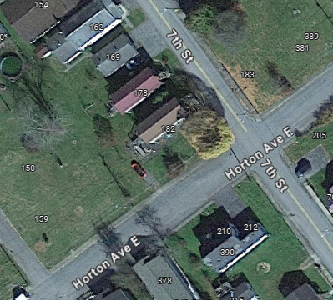
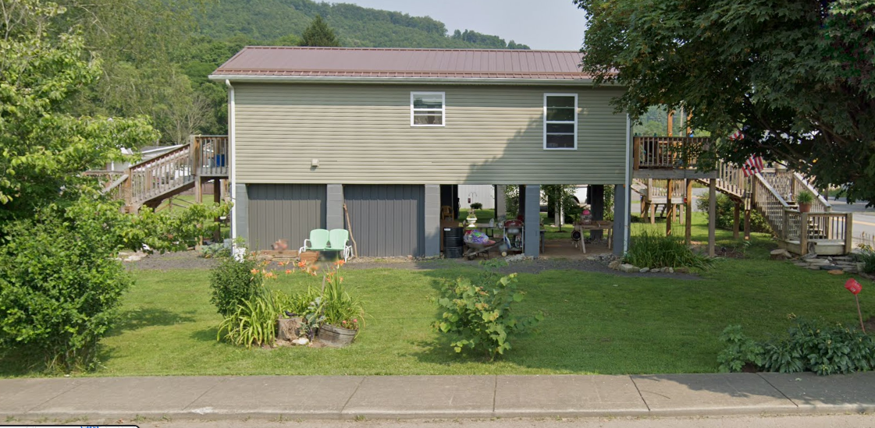
Rainelle
182 SEVENTH ST, Rainelle, WV, 25962
Building Flood Profile
13-13-0001-0054-0000_182

Slide 2
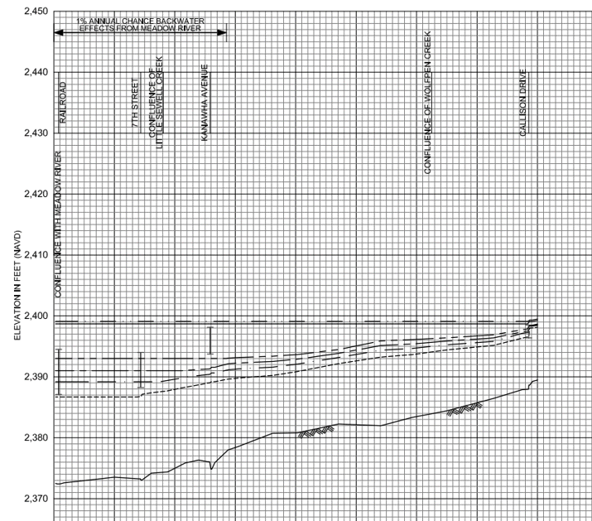
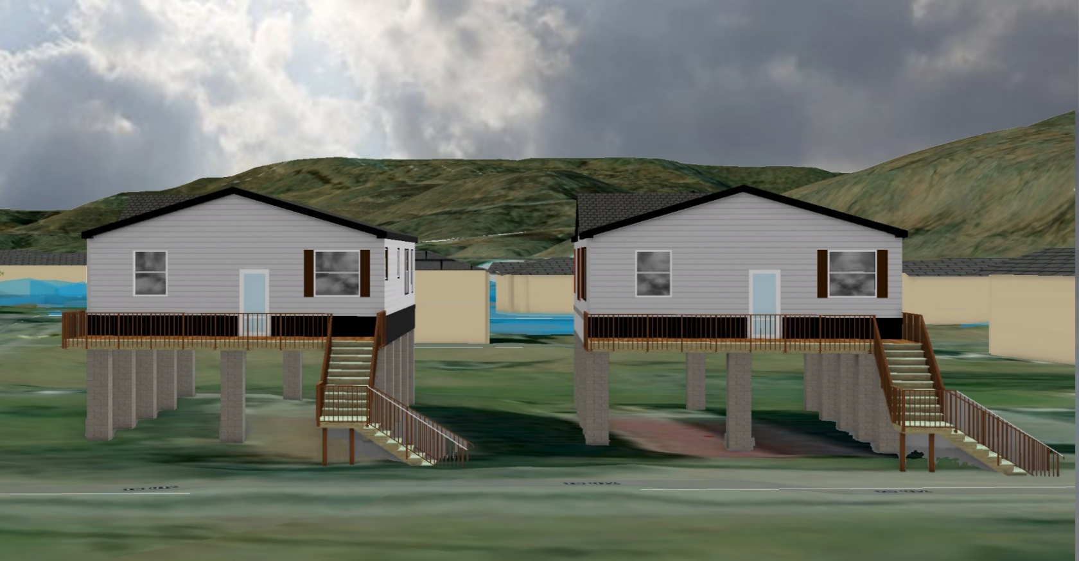
10% Probability of Flood in a year (10-year flood)
Building’s Ground Elevation
No Inundation

Slide 3
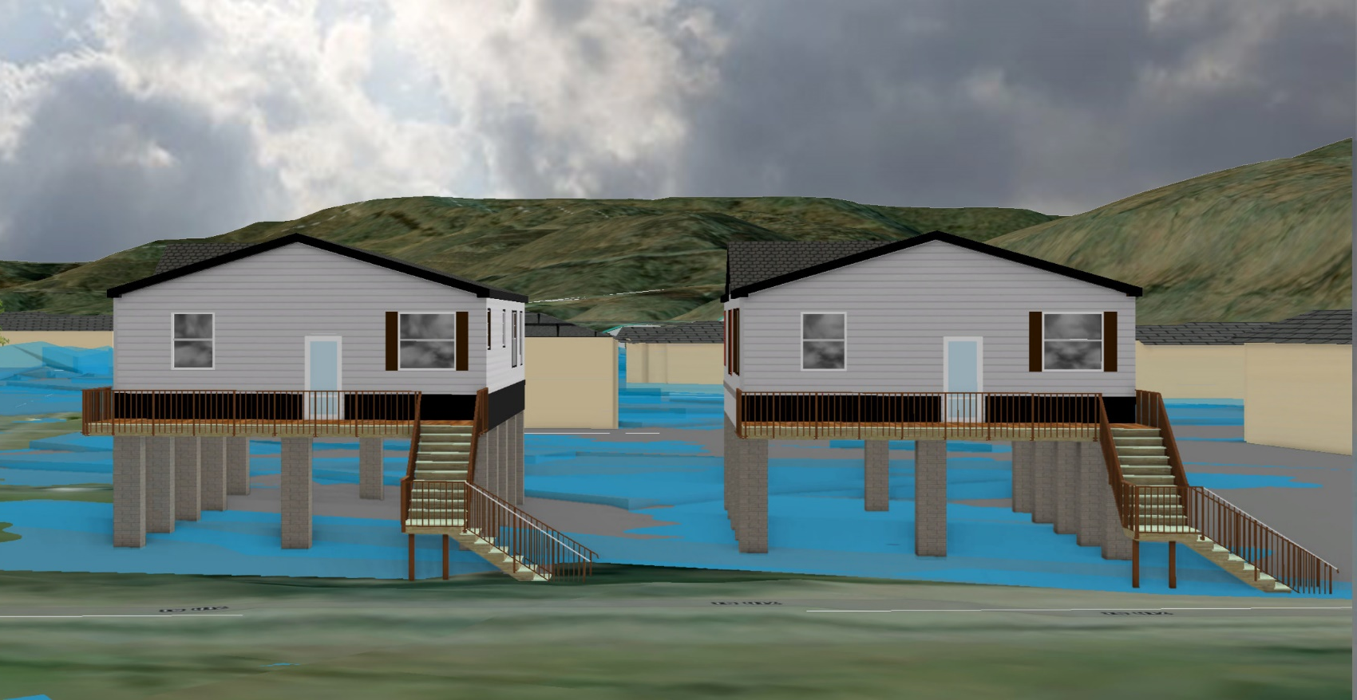
4% Probability of Flood in a year (25-year flood)
0’ (FEMA 4% / 25-Yr)

Slide 4
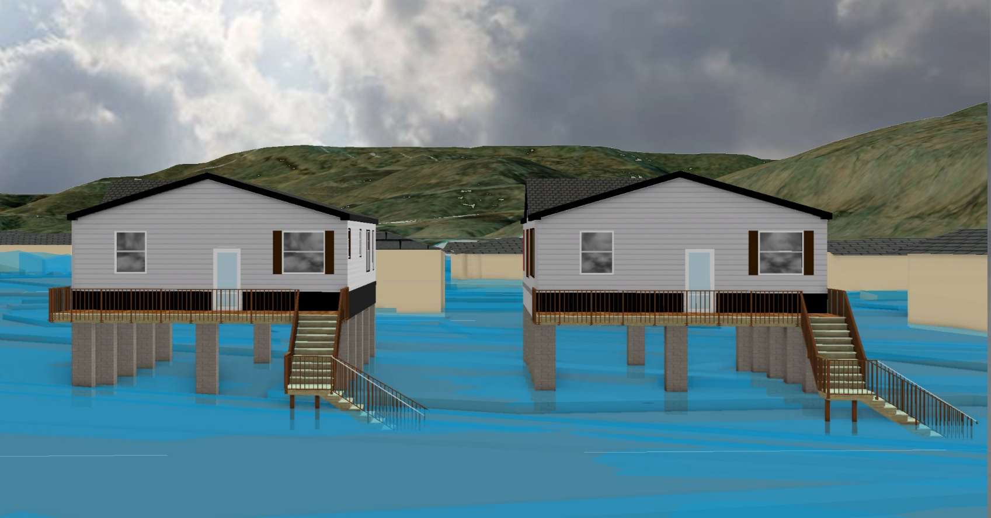
2% Probability of Flood in a year (50-year flood)
1.9’ (FEMA 2% / 50-Yr)

Slide 5
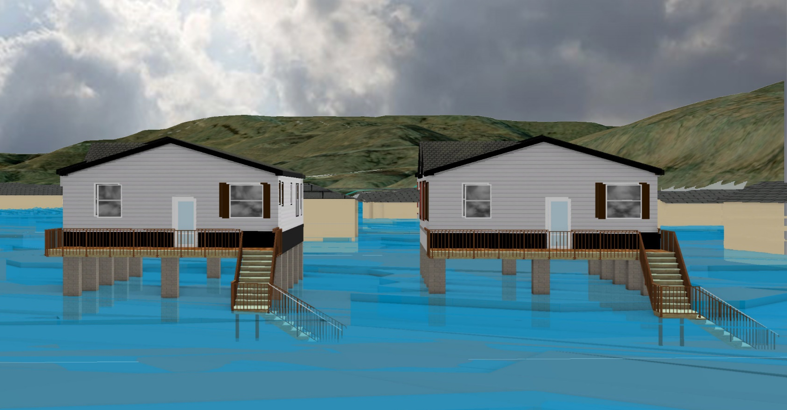
1% Probability of Flood in a year (100-year flood)
3.1’ (FEMA 1% /100-Yr)

Slide 6
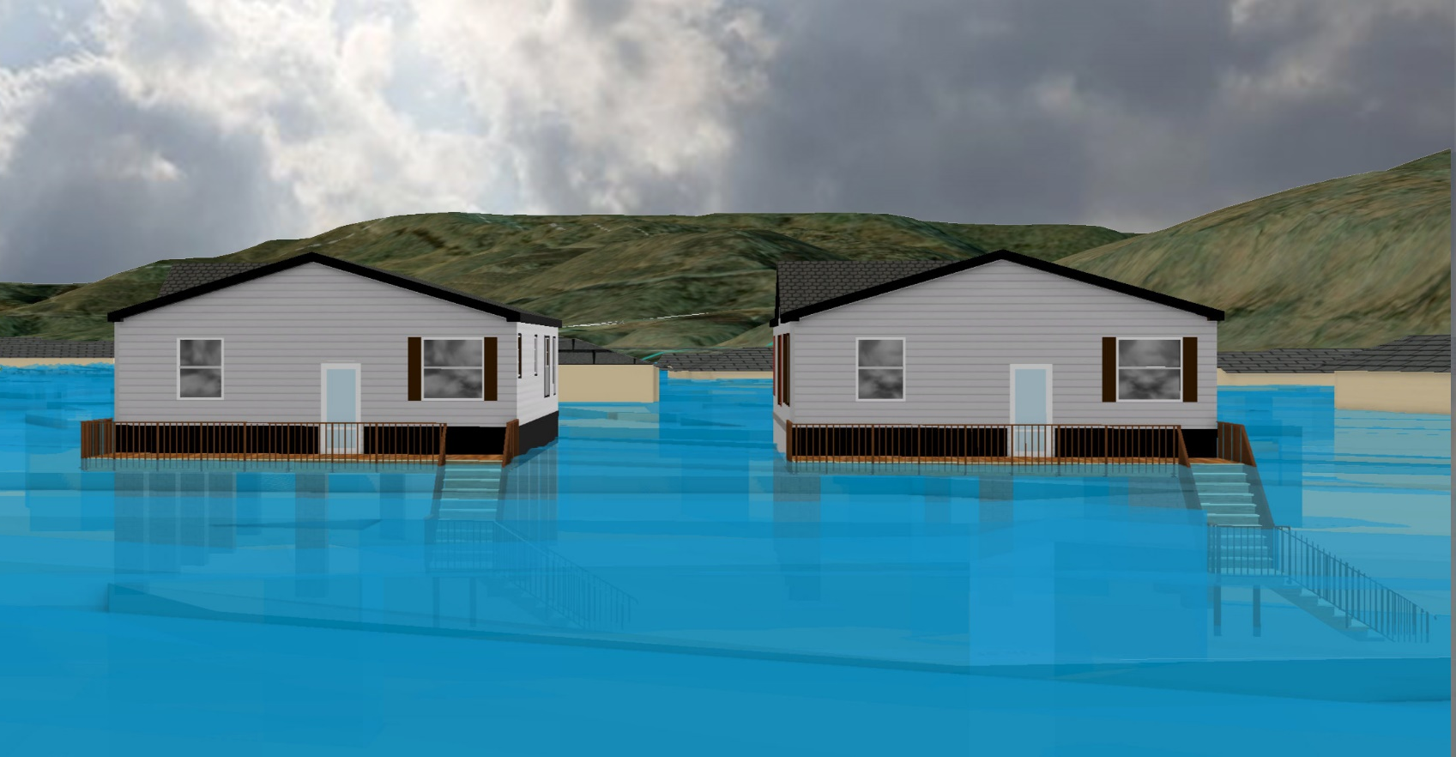
0.2% Probability of Flood in a year (500-year flood)
9.9’ (FEMA 1% +/ 84% CL)
9.9’ (FEMA 0.2% /500-Yr)

Slide 7
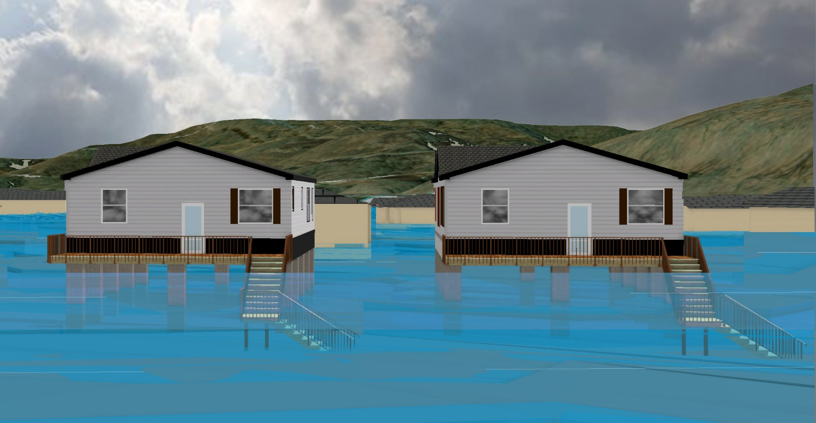
2016 High Watermark
High Watermark
7.5’ (2016 High Water)

Slide 8
 | HEIGHT (ft.)
BUILDING
First Floor Height | 9
Freeboard (FBD) | 2
FLOOD DEPTH
FEMA 10% (10-Yr) | NA
FEMA 4% (25-Yr) | NA
FEMA 2% (50-Yr) | 1.9
2016 Flood HWM
FEMA 1% (100-Yr)
FEMA 100-Yr + FBD
FEMA 1%+ (84% CL)
FEMA 0.2% (500-Yr)
FSF 0.2% (500-Yr)
1.9’ (FEMA 10% / 10-Yr)
Building: 13-13-0001-0054-0000_182
182 Seventh Street, Rainelle, WV, 25962
FLOOD DEPTHS:
FEMA
First Street Foundation (FSF)
USGS 2016 Flood High Water Mark

Slide 9
 | HEIGHT (ft.)
BUILDING
First Floor Height | 9
Freeboard (FBD) | 2
FLOOD DEPTH
FEMA 10% (10-Yr) | NA
FEMA 4% (25-Yr) | NA
FEMA 2% (50-Yr) | 1.9
2016 Flood HWM
FEMA 1% (100-Yr) | 3.1
FEMA 100-Yr + FBD
FEMA 1%+ (84% CL)
FEMA 0.2% (500-Yr)
FSF 0.2% (500-Yr) Climate
3.1’ (FEMA 1% / 100-Yr)
1.9’ (FEMA 10% / 10-Yr)
Building: 13-13-0001-0054-0000_182
182 Seventh Street, Rainelle, WV, 25962
FLOOD DEPTHS:
FEMA
First Street Foundation (FSF)
USGS 2016 Flood High Water Mark

Slide 10
 | HEIGHT (ft.)
BUILDING
First Floor Height | 9
Freeboard (FBD) | 2
FLOOD DEPTH
FEMA 10% (10-Yr) | NA
FEMA 4% (25-Yr) | NA
FEMA 2% (50-Yr) | 1.9
2016 Flood HWM
FEMA 1% (100-Yr) | 3.1
FEMA 100-Yr + FBD | 5.1
FEMA 1%+ (84% CL) | 9.9
FEMA 0.2% (500-Yr)
FSF 0.2% (500-Yr) Climate
9.9’ FEMA 1%+ (84% CL)
3.1’ (FEMA 1% / 100-Yr)
1.9’ (FEMA 10% / 10-Yr)
Building: 13-13-0001-0054-0000_182
182 Seventh Street, Rainelle, WV, 25962
FLOOD DEPTHS:
FEMA
First Street Foundation (FSF)
USGS 2016 Flood High Water Mark

Slide 11
 | HEIGHT (ft.)
BUILDING
First Floor Height | 9
Freeboard (FBD) | 2
FLOOD DEPTH
FEMA 10% (10-Yr) | NA
FEMA 4% (25-Yr) | NA
FEMA 2% (50-Yr) | 1.9
2016 Flood HWM | 7.5
FEMA 1% (100-Yr) | 3.1
FEMA 100-Yr + FBD | 5.1
FEMA 1%+ (84% CL) | 9.9
FEMA 0.2% (500-Yr)
FSF 0.2% (500-Yr) Climate
9.9’ FEMA 1%+ (84% CL)
7.5’ (2016 High Water)
3.1’ (FEMA 1% / 100-Yr)
1.9’ (FEMA 10% / 10-Yr)
Building: 13-13-0001-0054-0000_182
182 Seventh Street, Rainelle, WV, 25962
FLOOD DEPTHS:
FEMA
First Street Foundation (FSF)
USGS 2016 Flood High Water Mark

Slide 12
 | HEIGHT (ft.)
BUILDING
First Floor Height | 9
Freeboard (FBD) | 2
FLOOD DEPTH
FEMA 10% (10-Yr) | NA
FEMA 4% (25-Yr) | NA
FEMA 2% (50-Yr) | 1.9
2016 Flood HWM | 7.5
FEMA 1% (100-Yr) | 3.1
FEMA 100-Yr + FBD | 5.1
FEMA 1%+ (84% CL) | 9.9
FEMA 0.2% (500-Yr) | 9.9
FSF 0.2% (500-Yr) Climate
9.9’ (FEMA 0.2% / 500-Yr )
9.9’ FEMA 1%+ (84% CL)
7.5’ (2016 High Water)
3.1’ (FEMA 1% / 100-Yr)
1.9’ (FEMA 10% / 10-Yr)
Building: 13-13-0001-0054-0000_182
182 Seventh Street, Rainelle, WV, 25962
FLOOD DEPTHS:
FEMA
First Street Foundation (FSF)
USGS 2016 Flood High Water Mark

Slide 13
 | HEIGHT (ft.)
BUILDING
First Floor Height | 9
Freeboard (FBD) | 2
FLOOD DEPTH
FEMA 10% (10-Yr) | NA
FEMA 4% (25-Yr) | NA
FEMA 2% (50-Yr) | 1.9
2016 Flood HWM | 7.5
FEMA 1% (100-Yr) | 3.1
FEMA 100-Yr + FBD | 5.1
FEMA 1%+ (84% CL) | 9.9
FEMA 0.2% (500-Yr) | 9.9
FSF 0.2% (500-Yr) Climate | 12.2
12.2’ (FSF 0.2% / 500-Yr)
9.9’ (FEMA 0.2% / 500-Yr )
9.9’ FEMA 1%+ (84% CL)
7.5’ (2016 High Water)
3.1’ (FEMA 1% / 100-Yr)
1.9’ (FEMA 10% / 10-Yr)
Building: 13-13-0001-0054-0000_182
182 Seventh Street, Rainelle, WV, 25962
FLOOD DEPTHS:
FEMA
First Street Foundation (FSF)
USGS 2016 Flood High Water Mark

