Slide 1
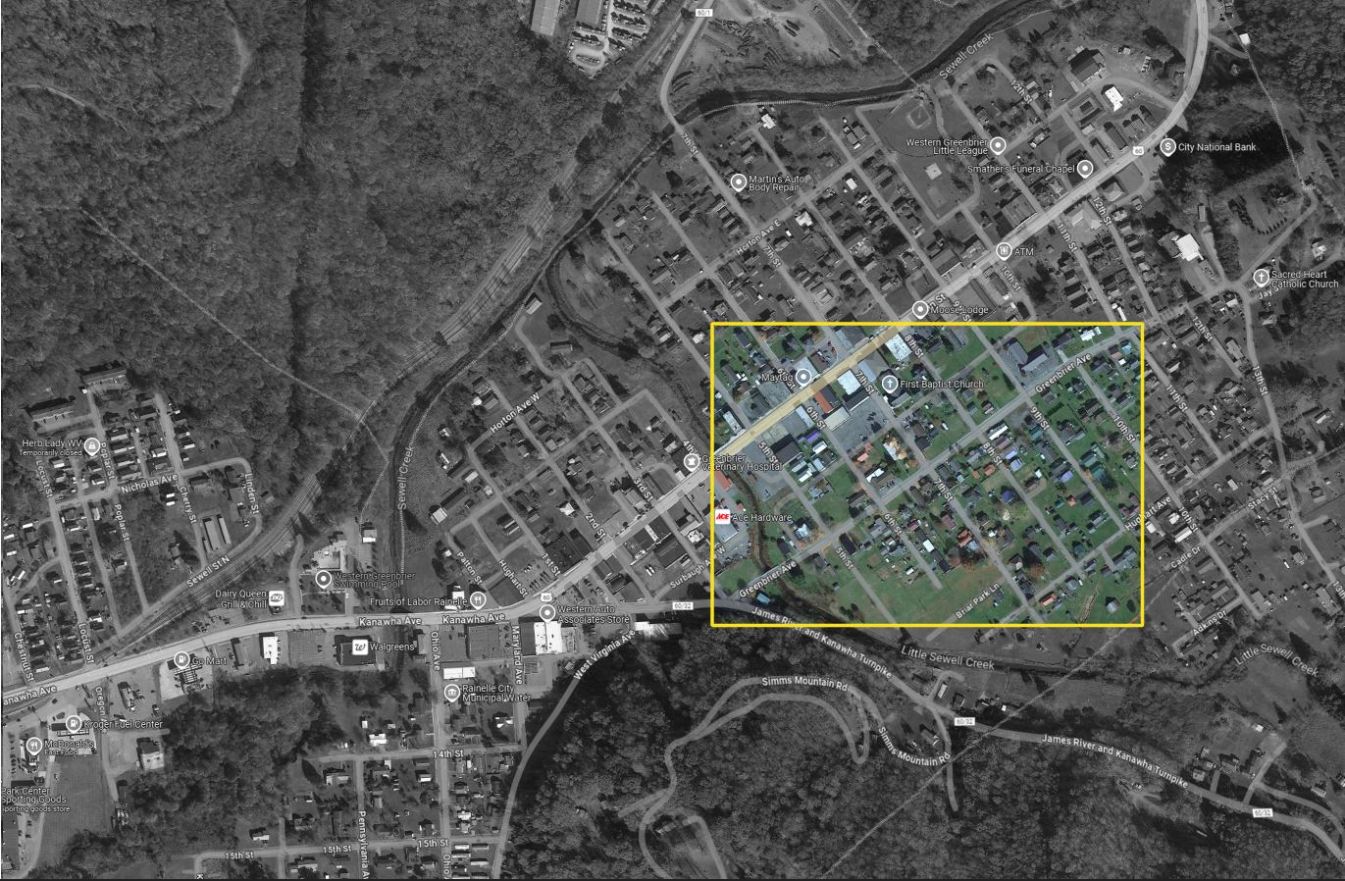
A Bird’s view over:
Neighborhood area near Greenbrier Ave and 7th Street, Rainelle
North

Slide 2
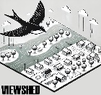
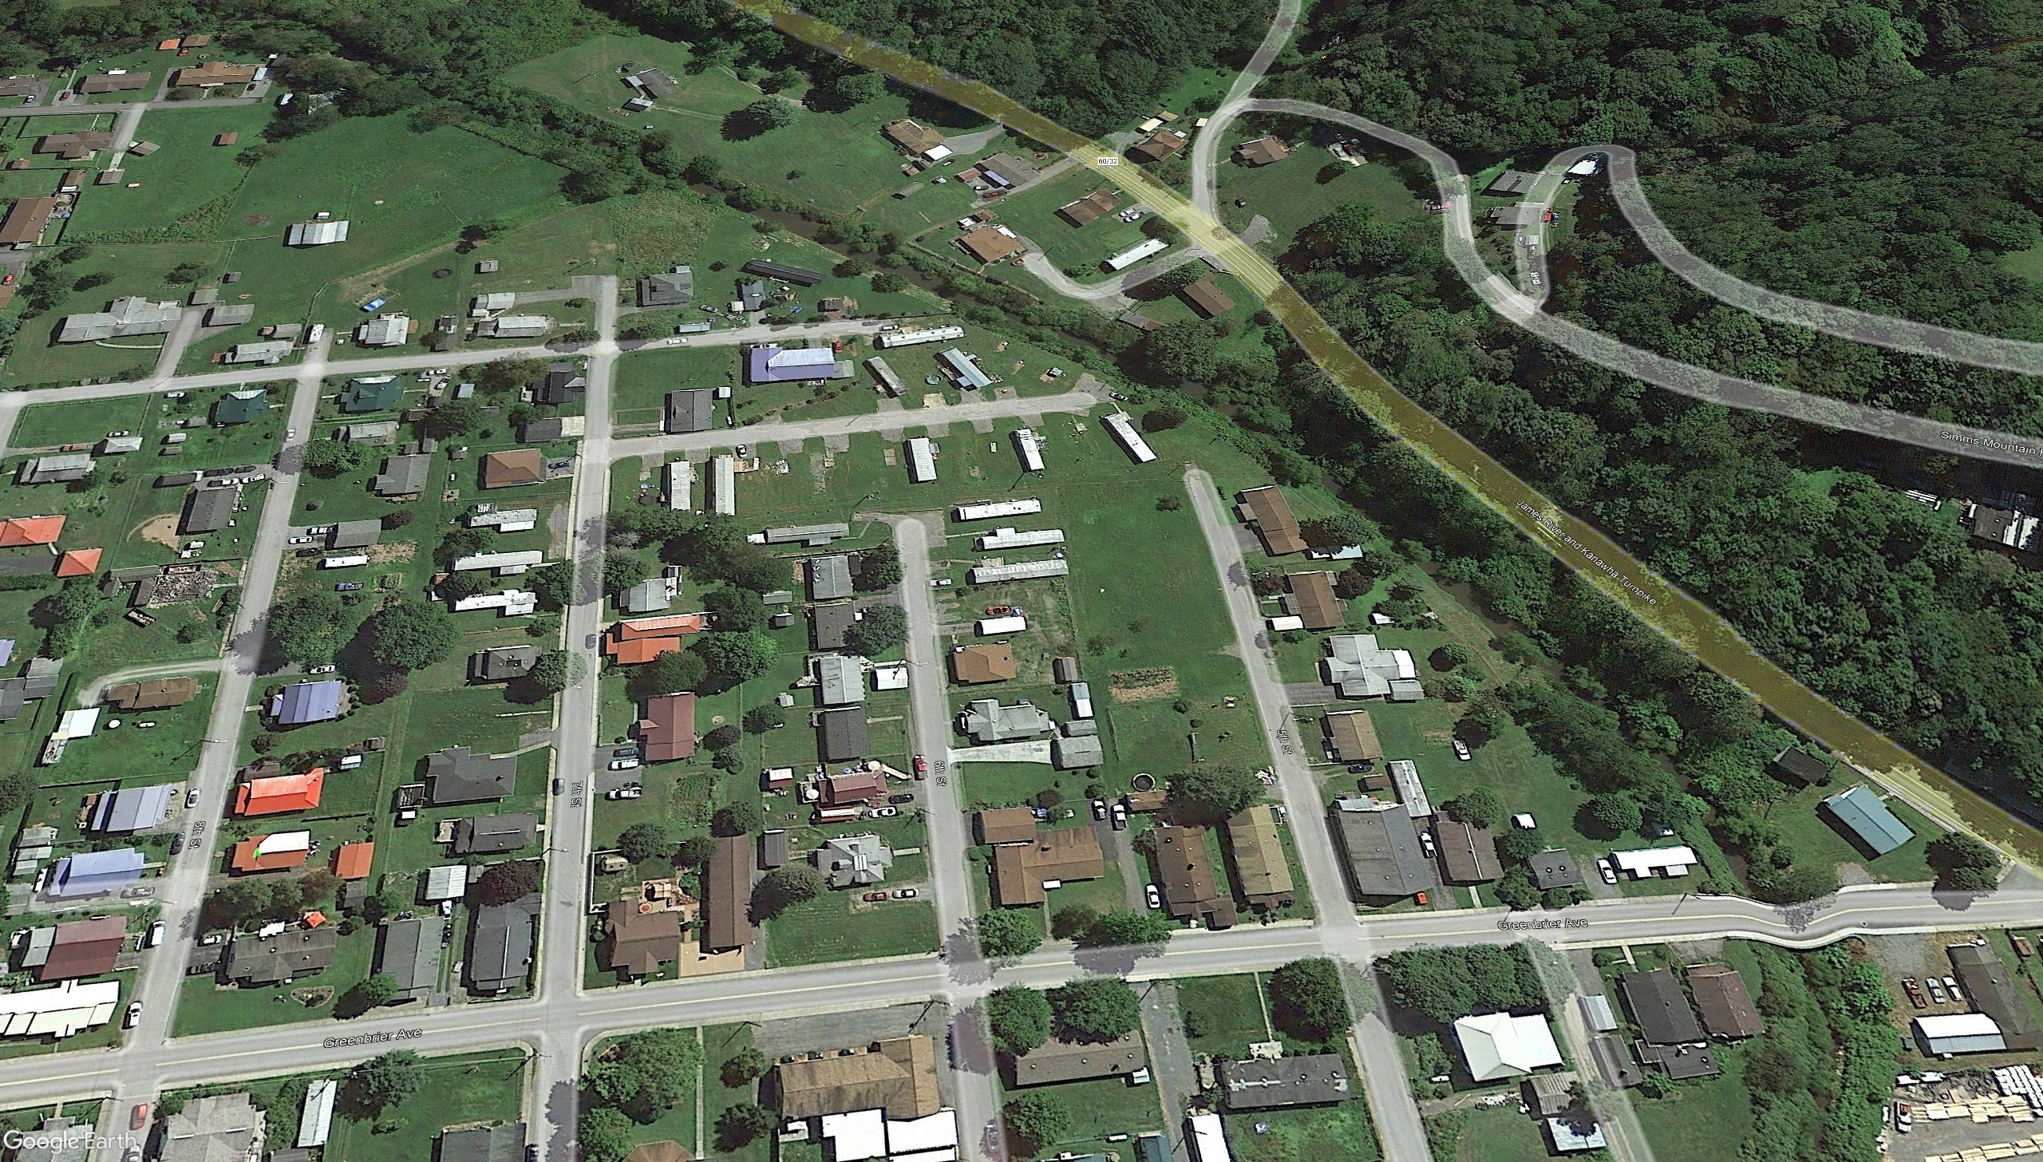

Pre-Disaster Aerial View
Imagery of September 2013
8th St.
7th St.
6th St.
5th St.
Greenbrier Ave.
Greenbrier Ave.
Image courtesy of Google Earth Pro

Slide 3
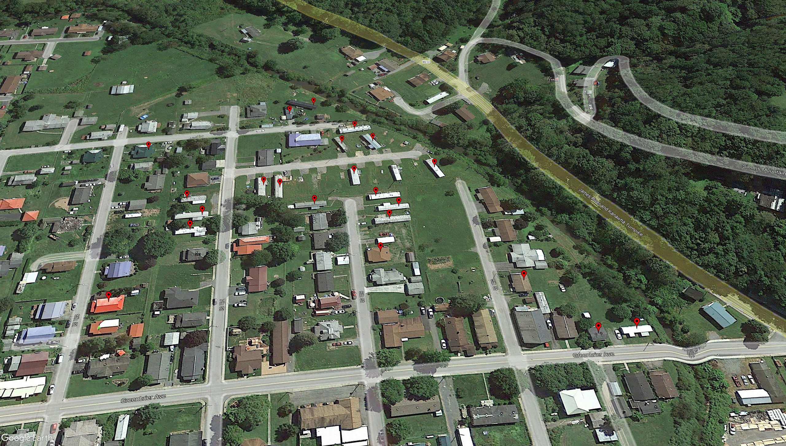
Removed Structure
Imagery of September 2013
Building REMOVED (Vacant Parcel)
Image courtesy of Google Earth Pro

Slide 4
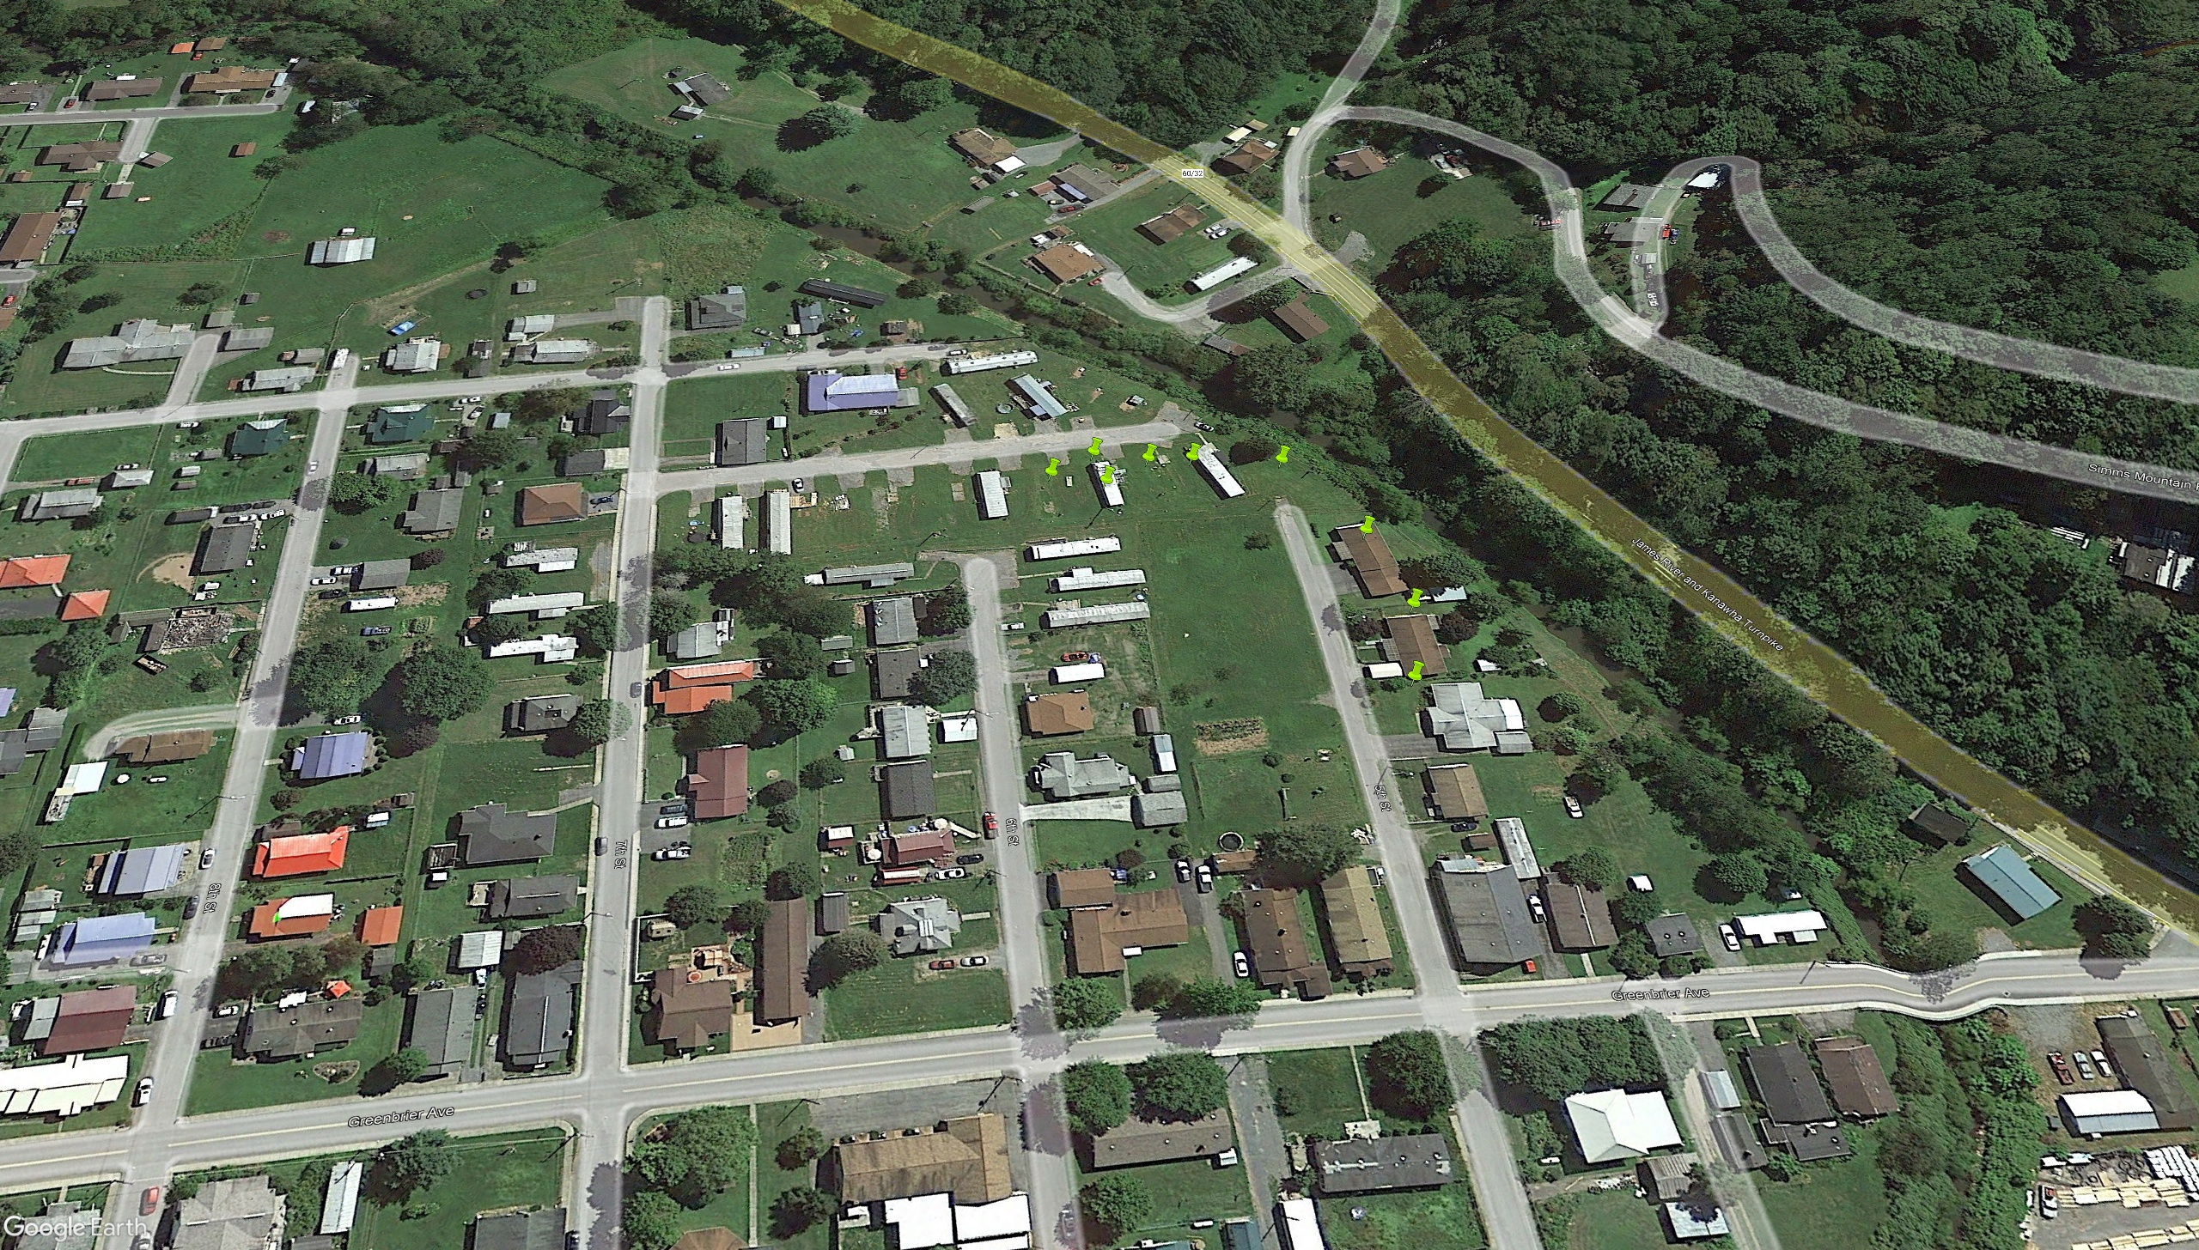
Deed-Restricted Buyout Parcels
Imagery of September 2013
ACQUISITION or Buyout Property
Image courtesy of Google Earth Pro

Slide 5
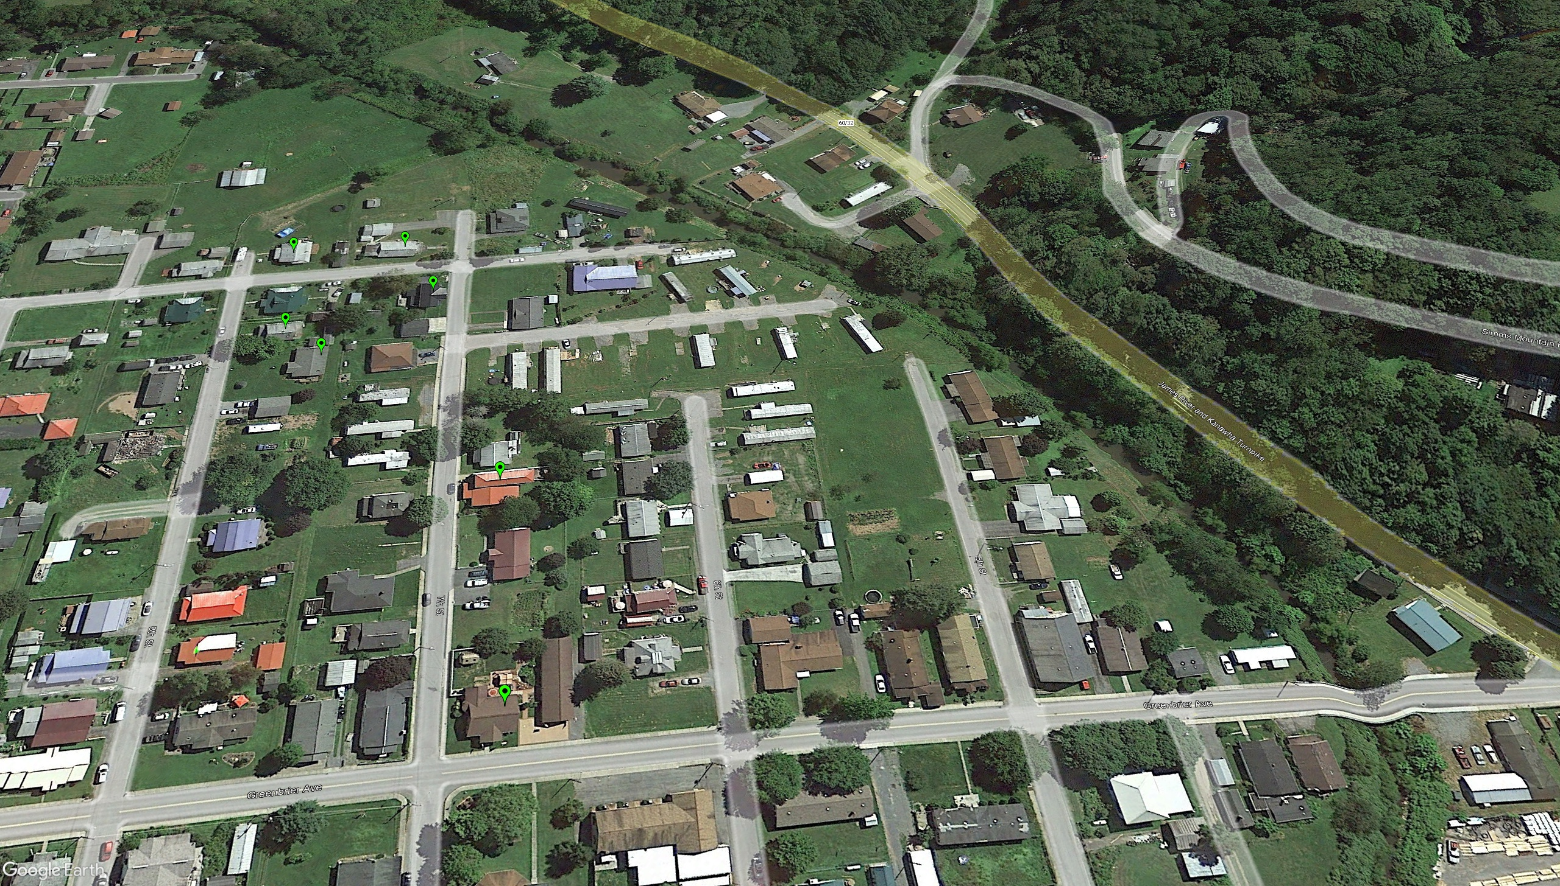
Mitigated Structures
by Elevating to Design Flood Elevation (DFE)
Imagery of September 2013
Mitigation RECONSTRUCTION
Image courtesy of Google Earth Pro

Slide 6
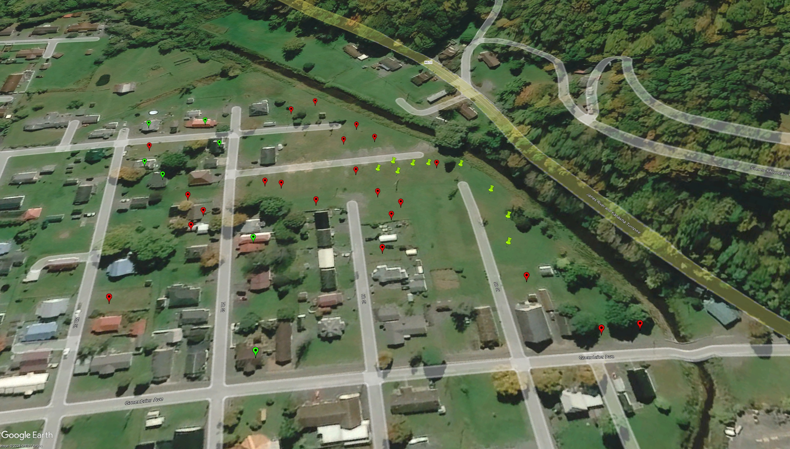



Imagery of October 2020
Building REMOVED (Vacant Parcel)
ACQUISITION or Buyout Property
Image courtesy of Google Earth Pro
Mitigation RECONSTRUCTION

