Slide 1
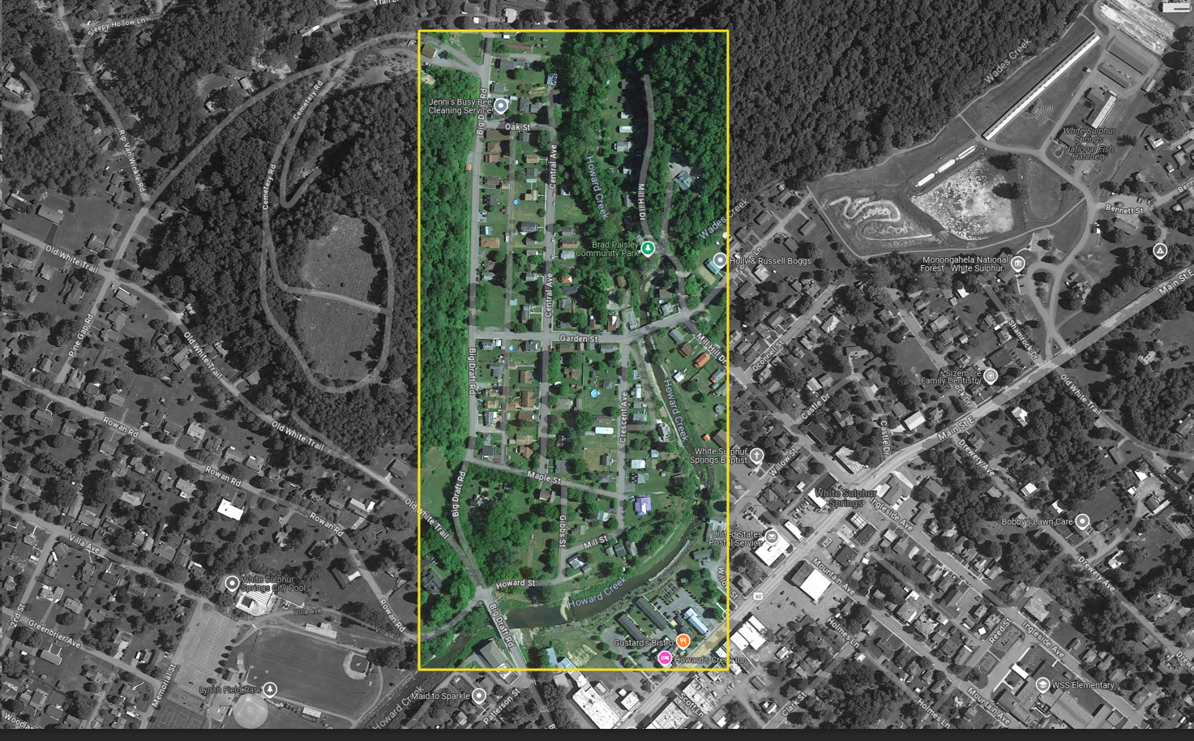
A Bird’s view over:
Howard Creek Neighborhood near Big Draft Road and Garden Street, White Sulphur Springs
North

Slide 2

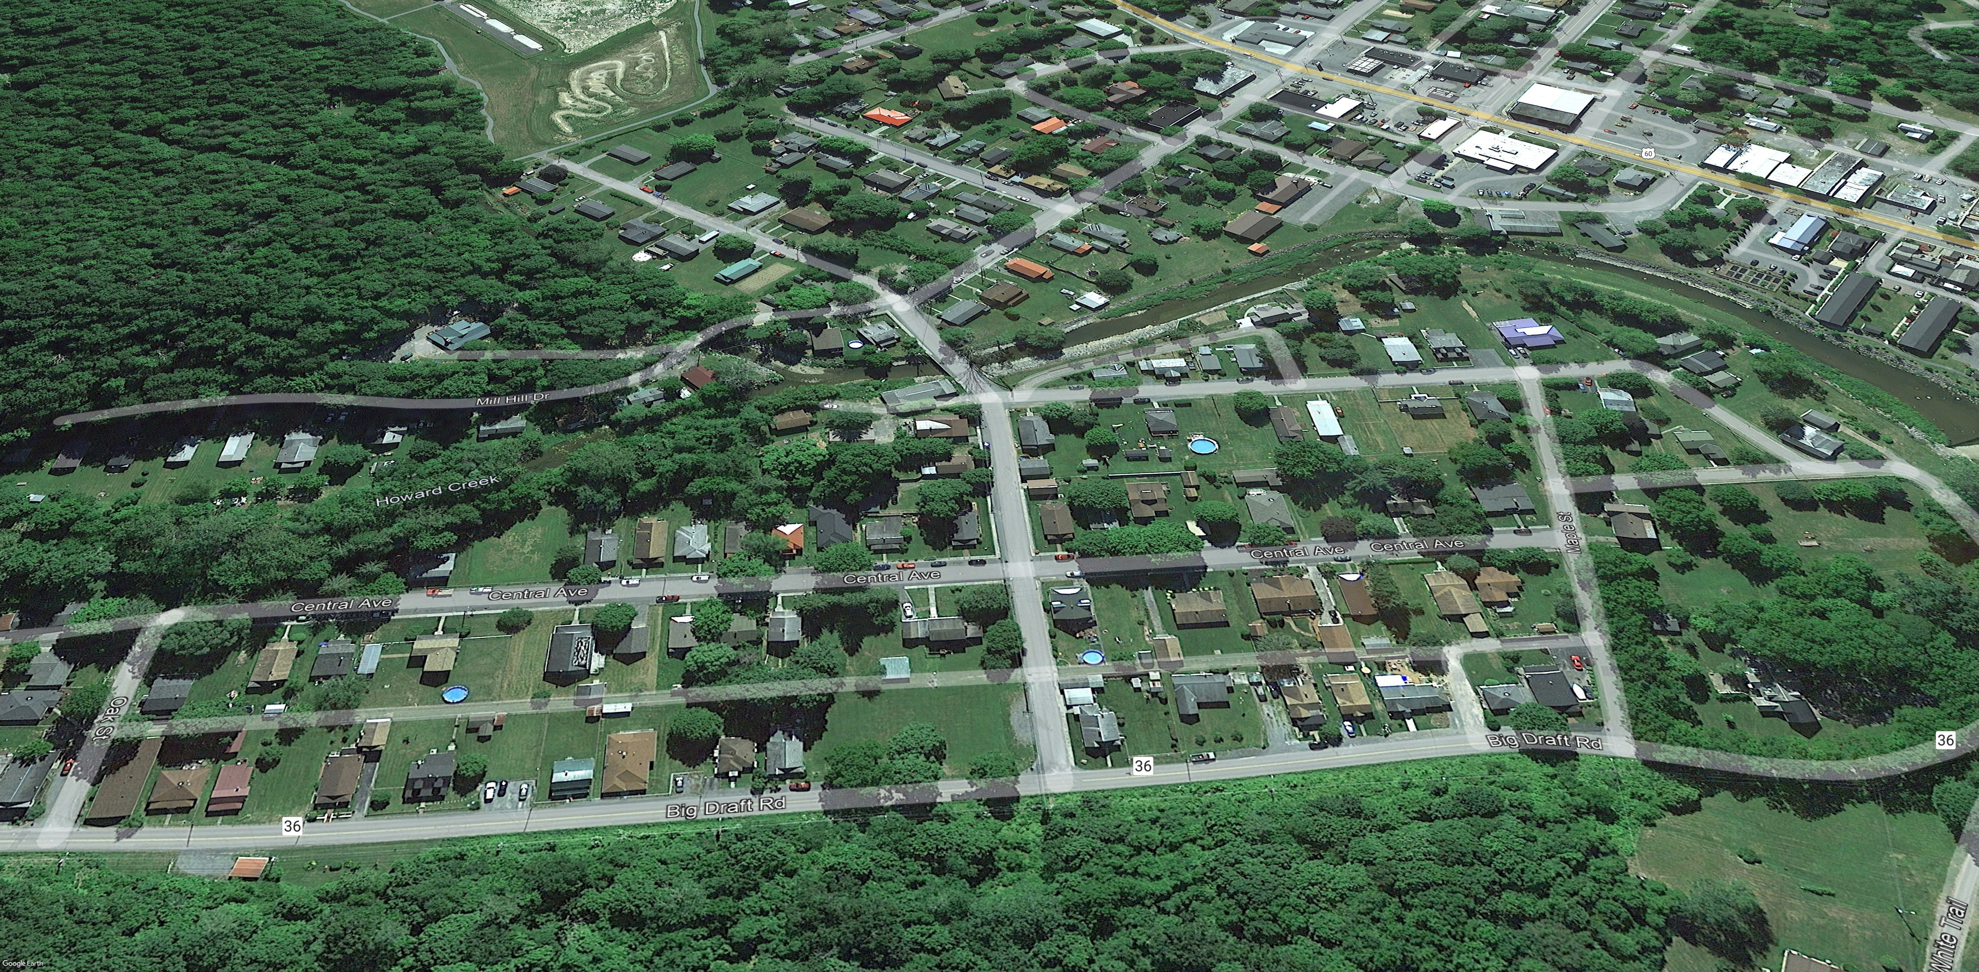

Pre-Disaster Aerial View
Imagery of June 2016
Image courtesy of Google Earth Pro

Slide 3
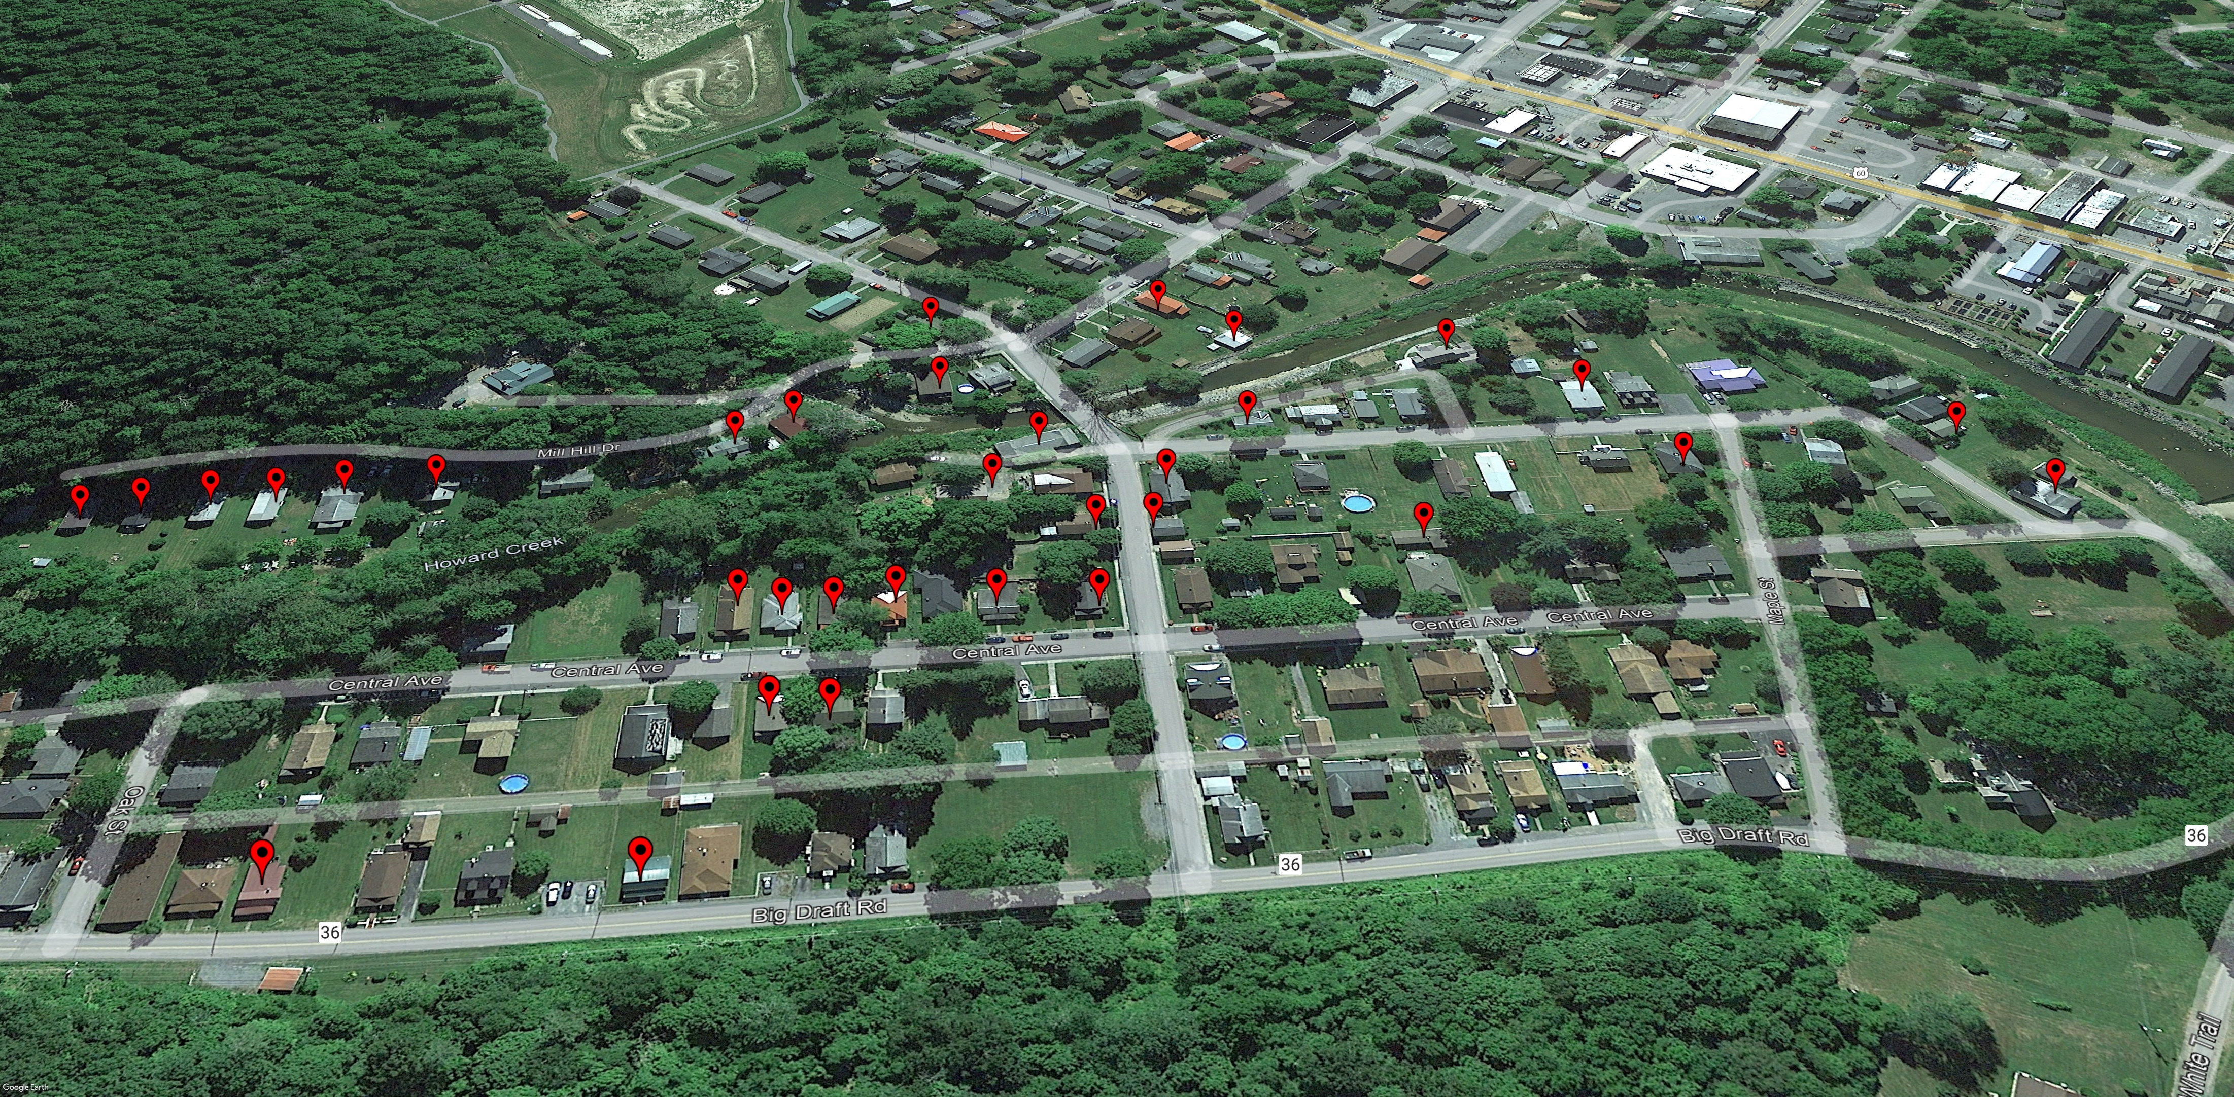
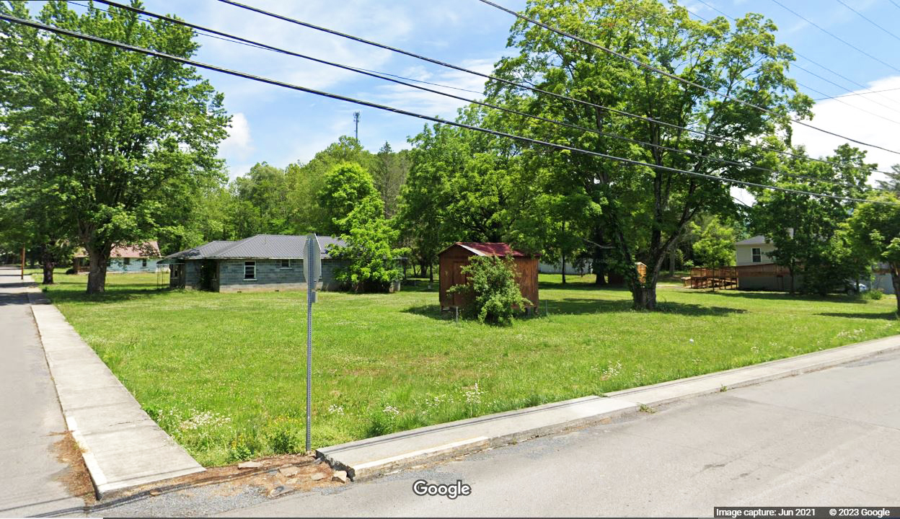

Removed Structures
Imagery of June 2016
Building REMOVED (Vacant Parcel)
Image courtesy of Google Earth Pro & Google Street View

Slide 4
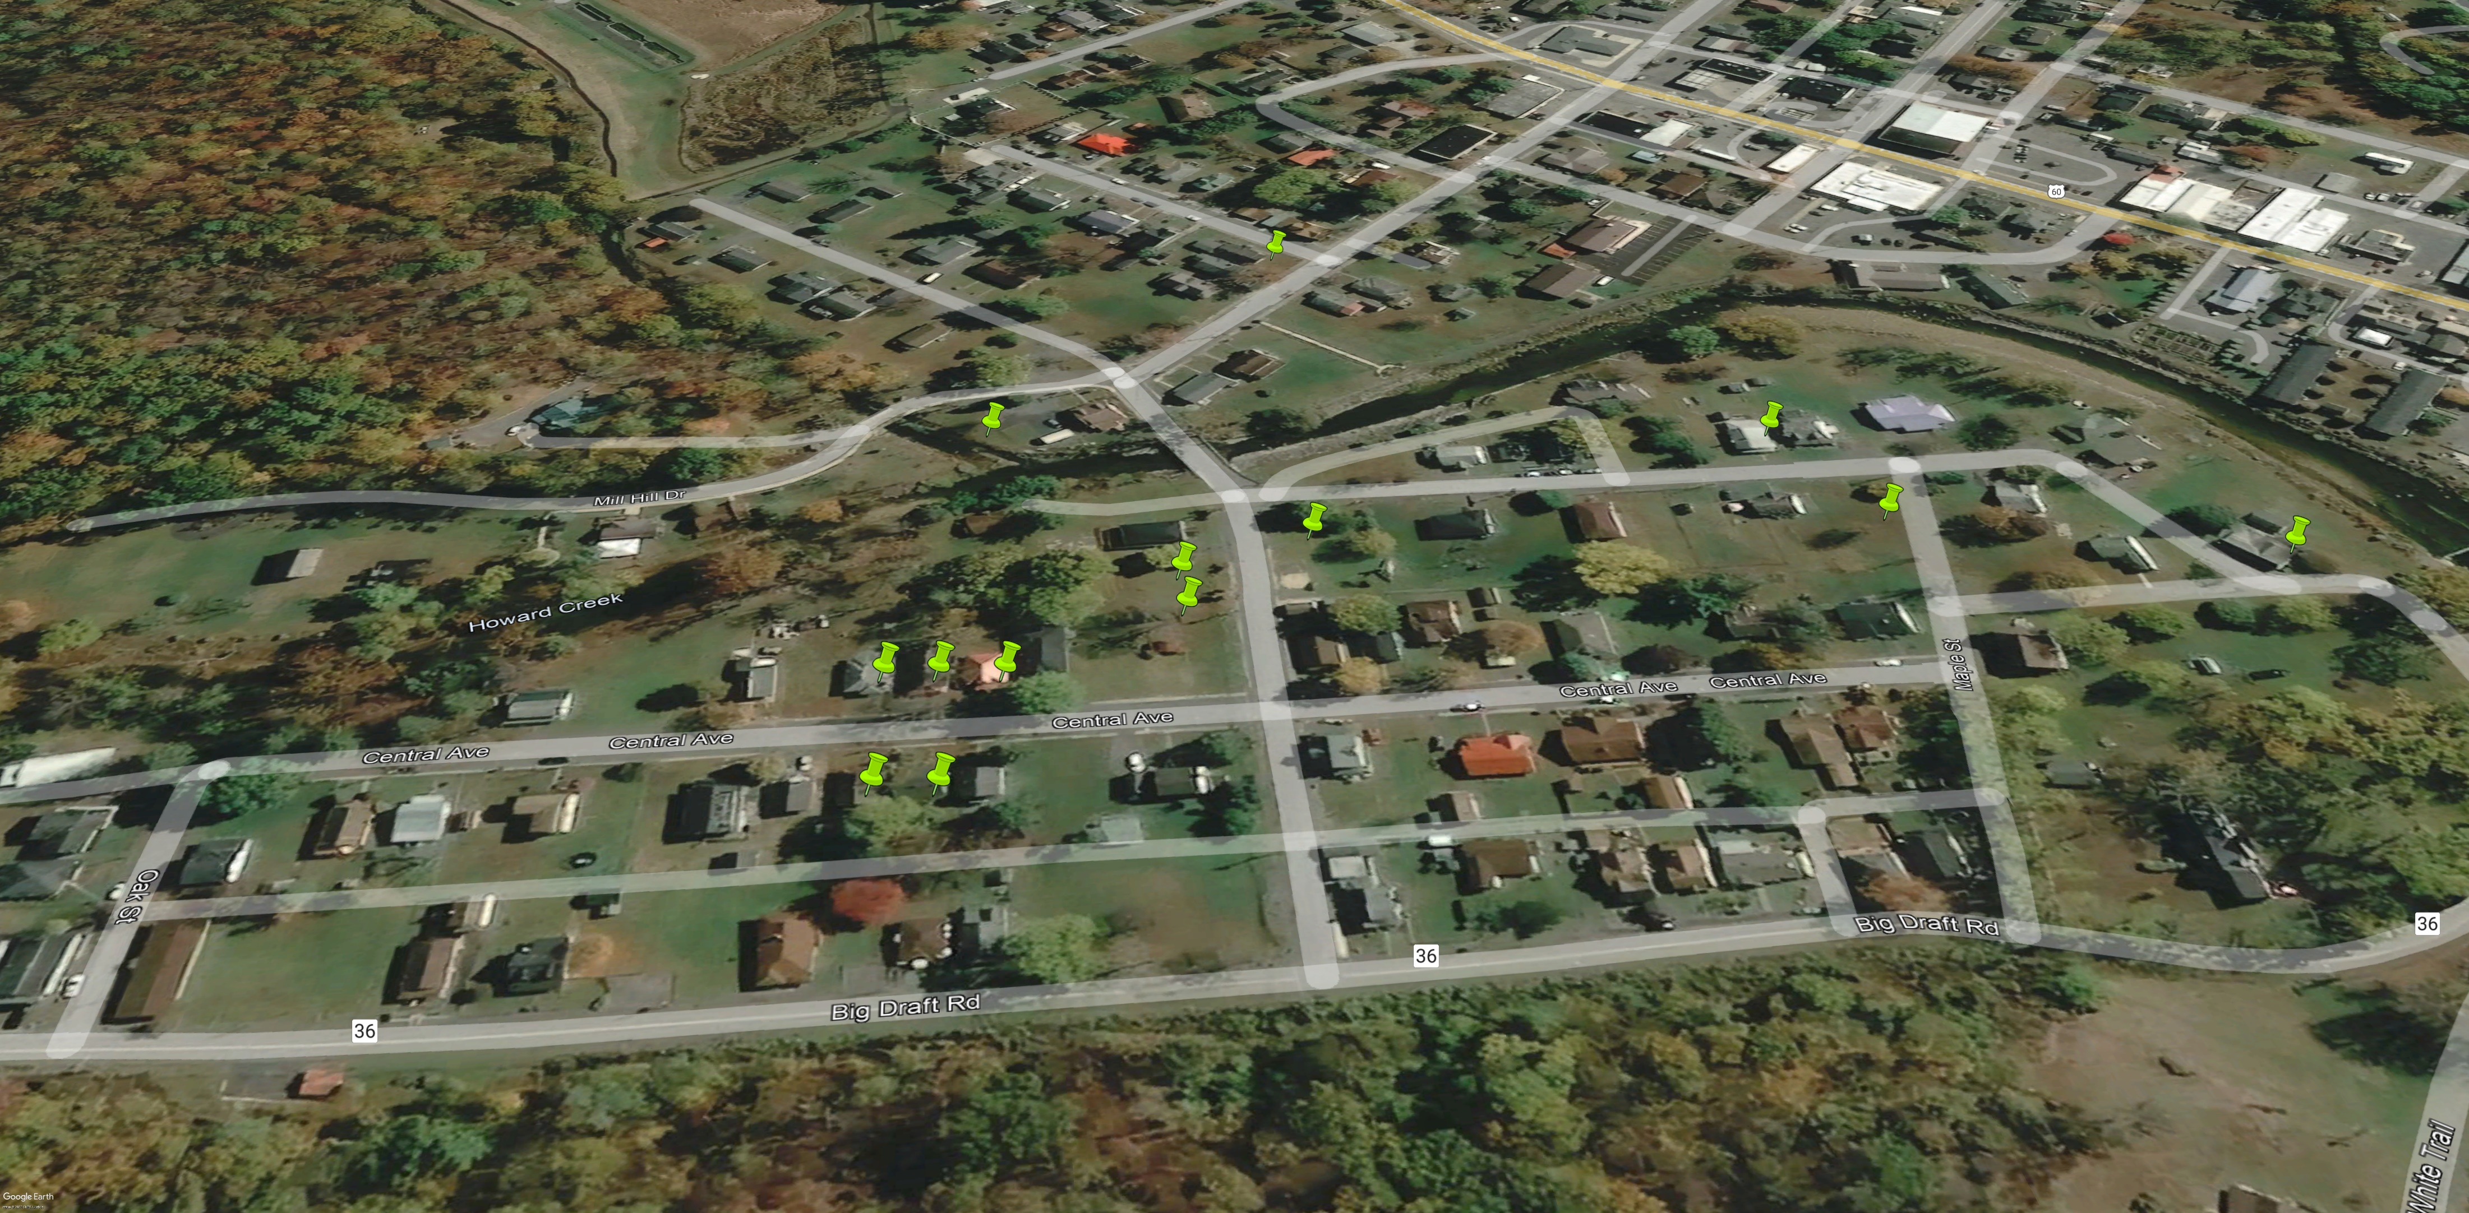
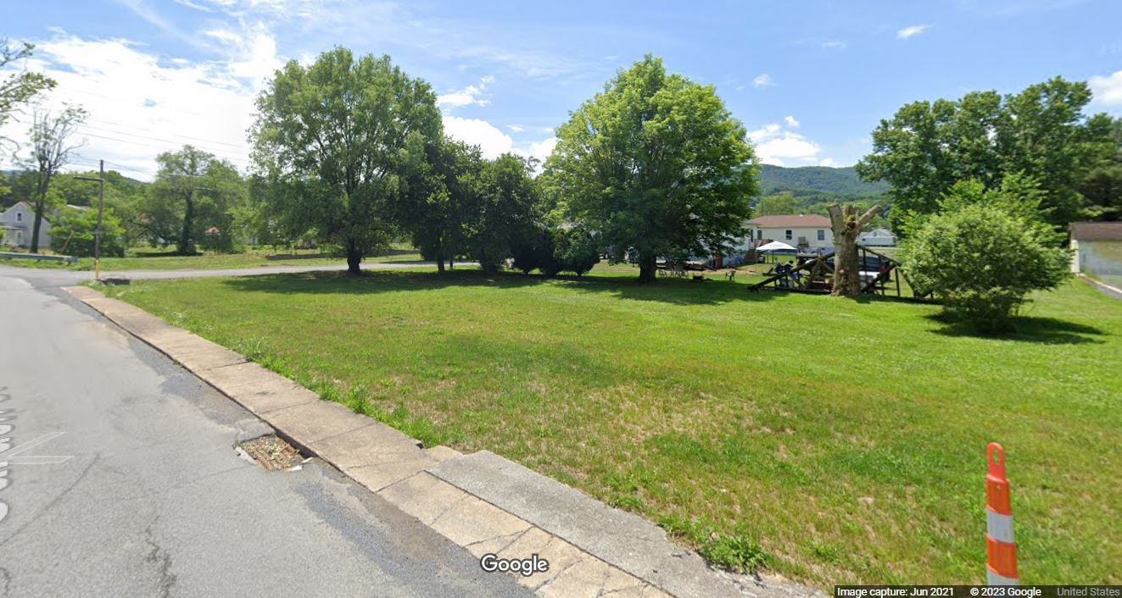

Deed-Restricted Buyout Parcels
Imagery of October 2019
ACQUISITION or Buyout Property
Image courtesy of Google Earth Pro & Google Street View

Slide 5
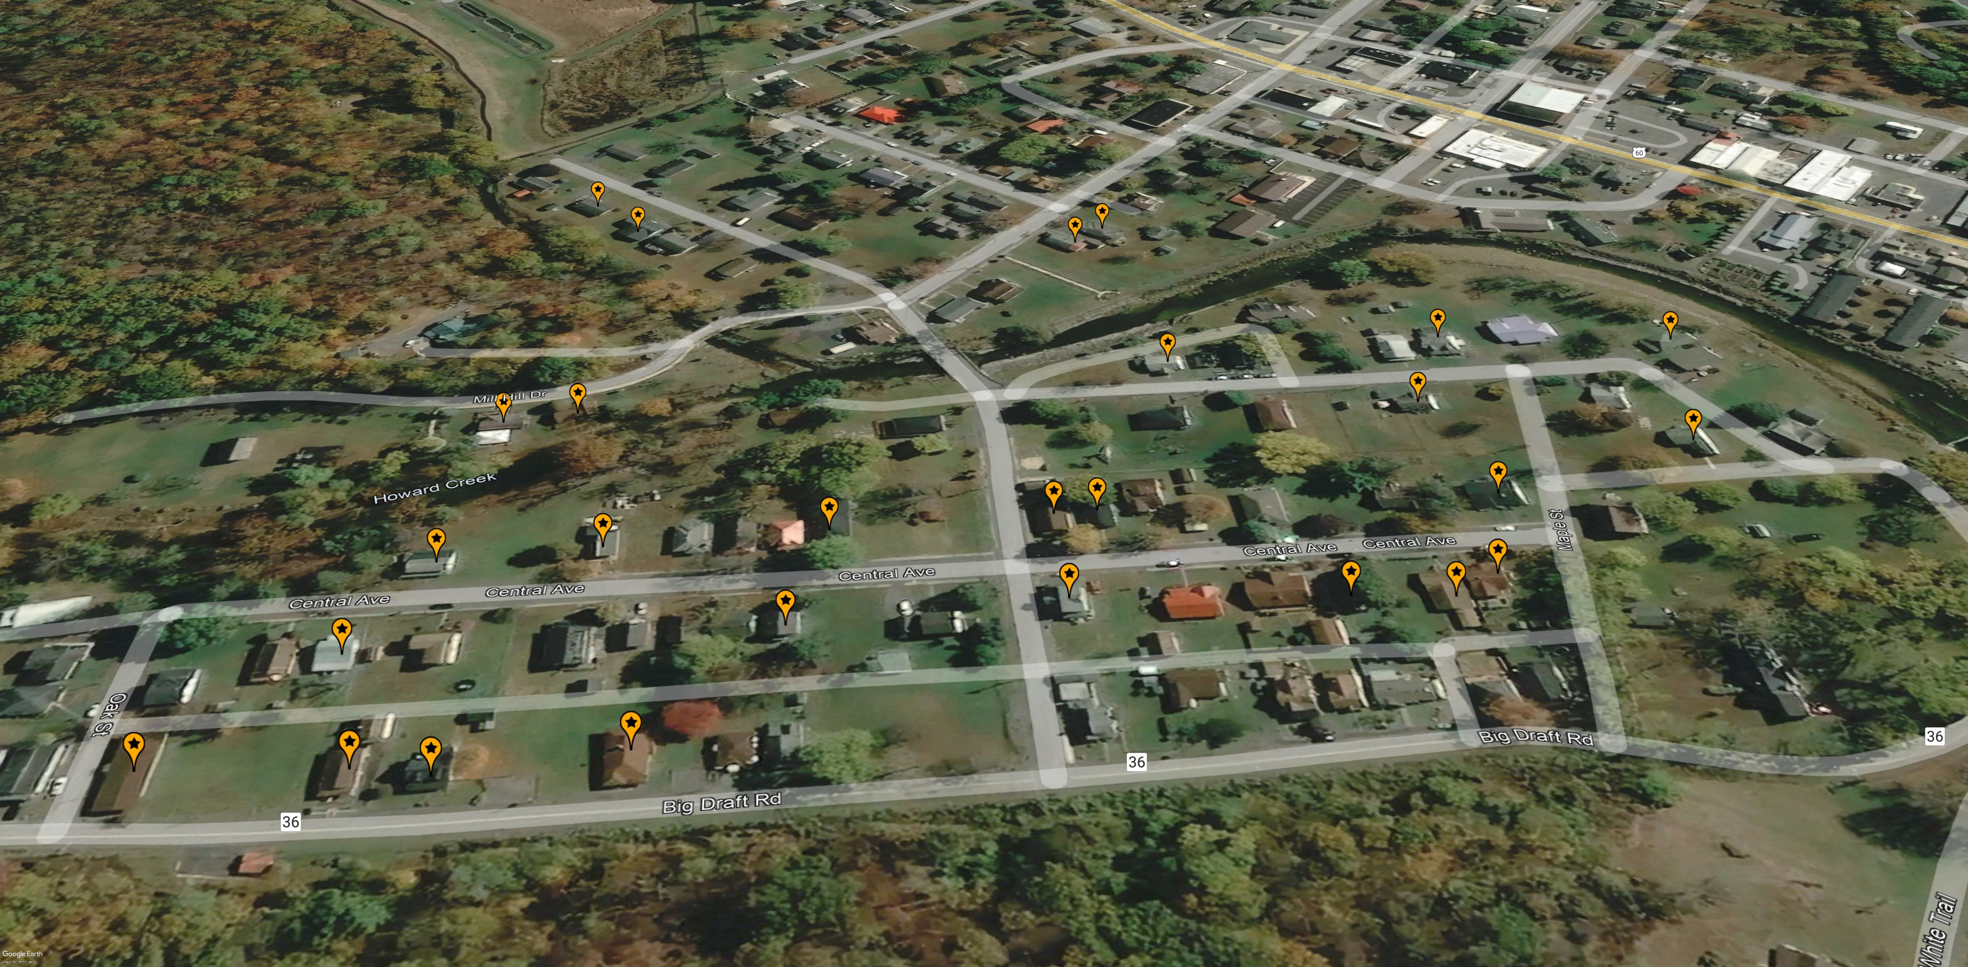
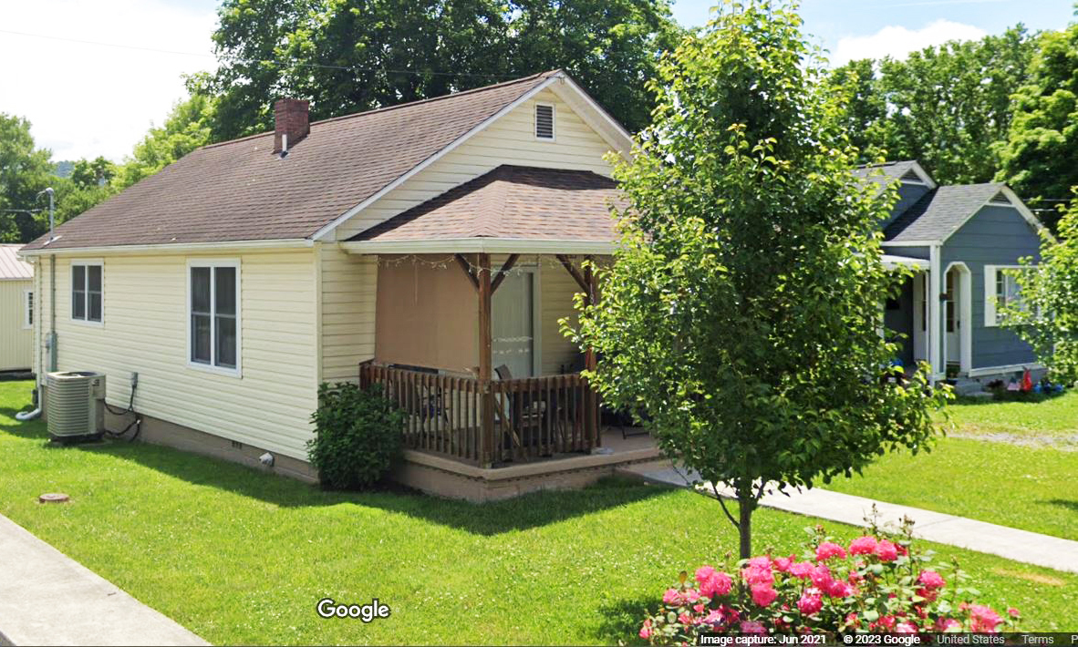

Non-Mitigated Repaired Structures
Imagery of October 2019
REPAIRED of Substantially Damaged (>50%) Building
Image courtesy of Google Earth Pro & Google Street View

Slide 6
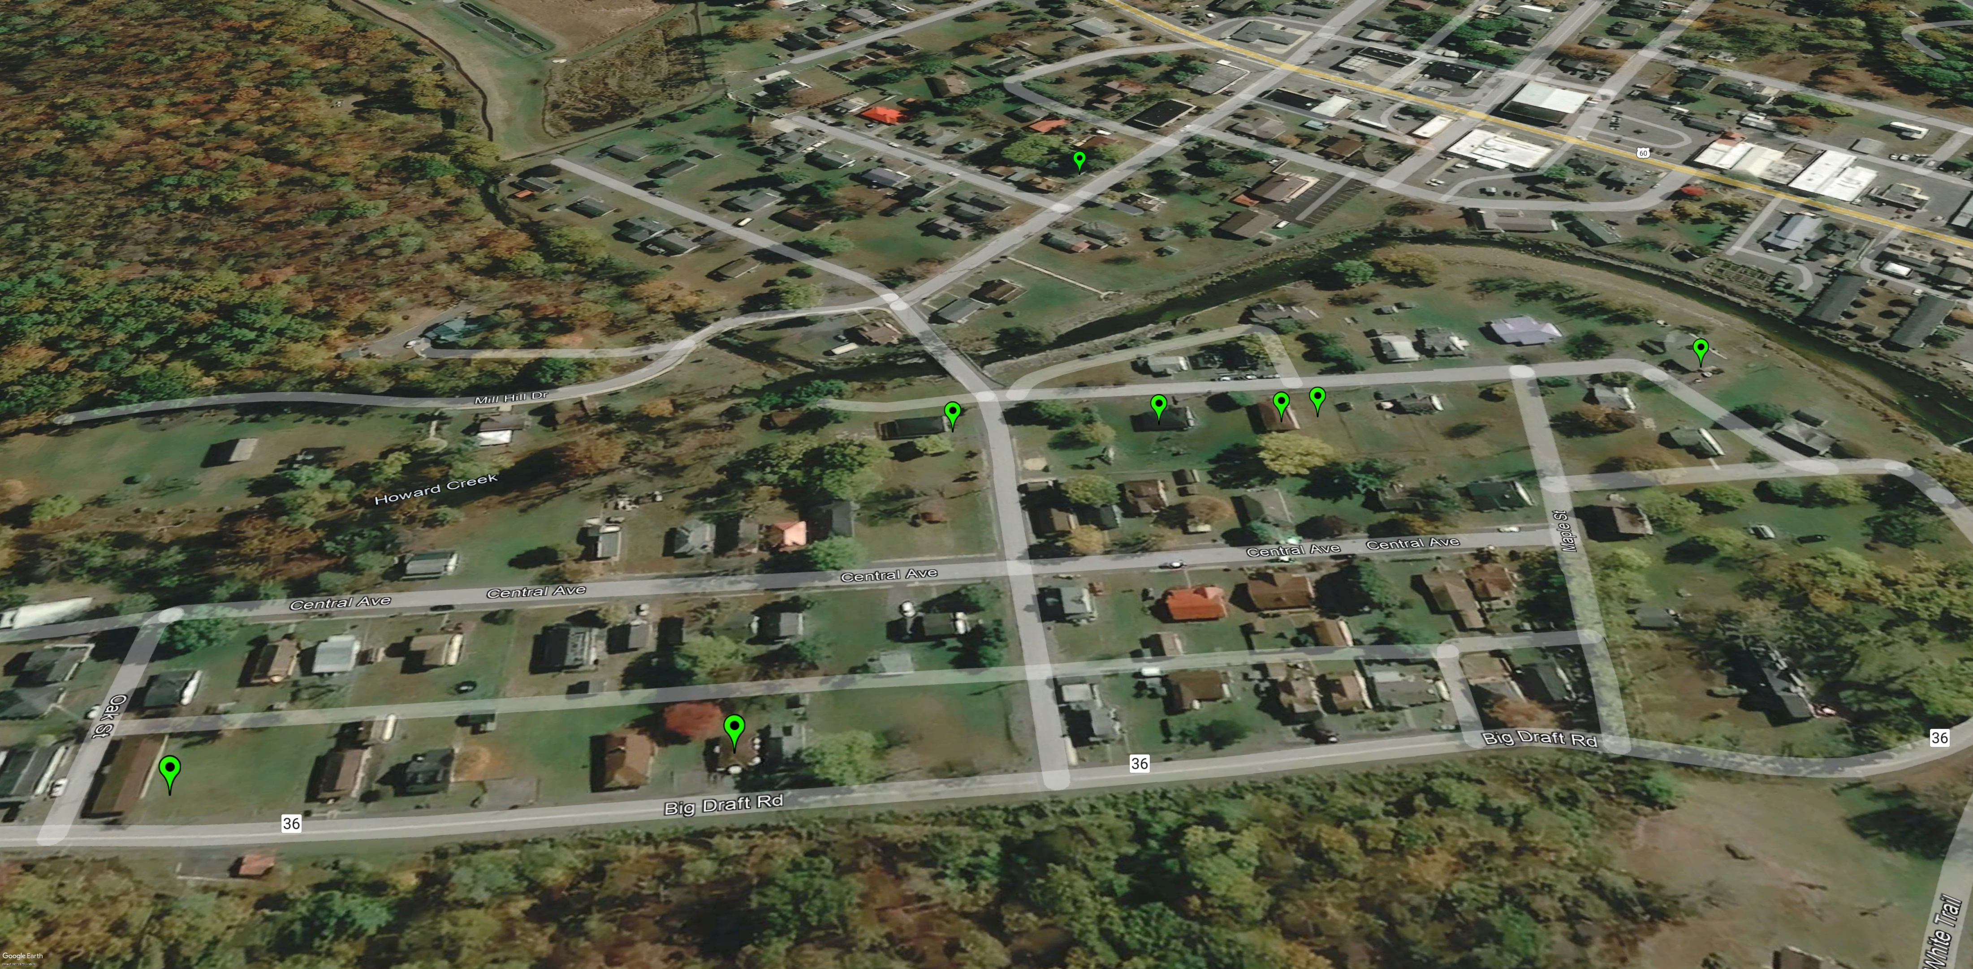
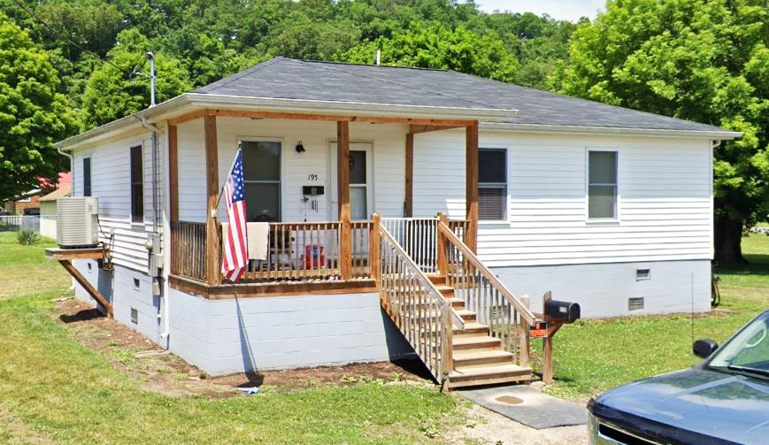

Mitigated Structures, Elevated to Design Flood Elevation (DFE)
Imagery of October 2019
Mitigation RECONSTRUCTION
Image courtesy of Google Earth Pro & Google Street View

Slide 7
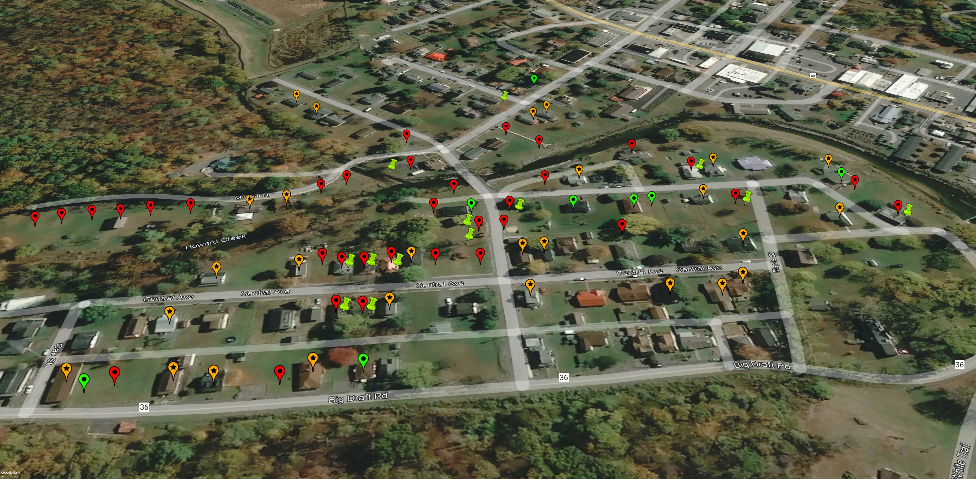
Mitigated & Non-Mitigated Properties
Imagery of October 2019
Building REMOVED (Vacant Parcel)
ACQUISITION or Buyout Property
REPAIRED of Substantially Damaged (>50%) Building
Mitigation RECONSTRUCTION
Image courtesy of Google Earth Pro

Slide 8
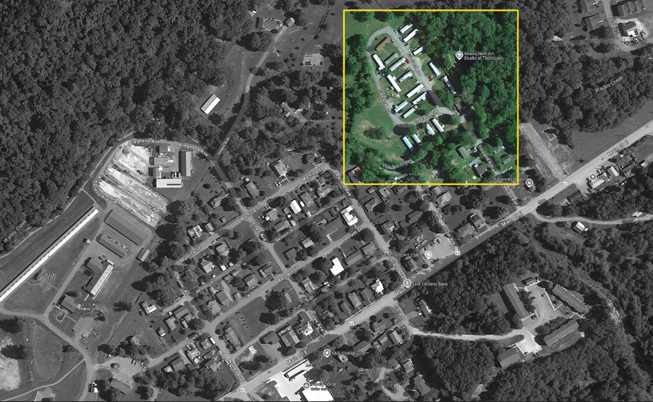
A Bird’s view over:
Freeland Ave, Eastern Main Street, and Wades Creek, White Sulphur Springs
North

Slide 9
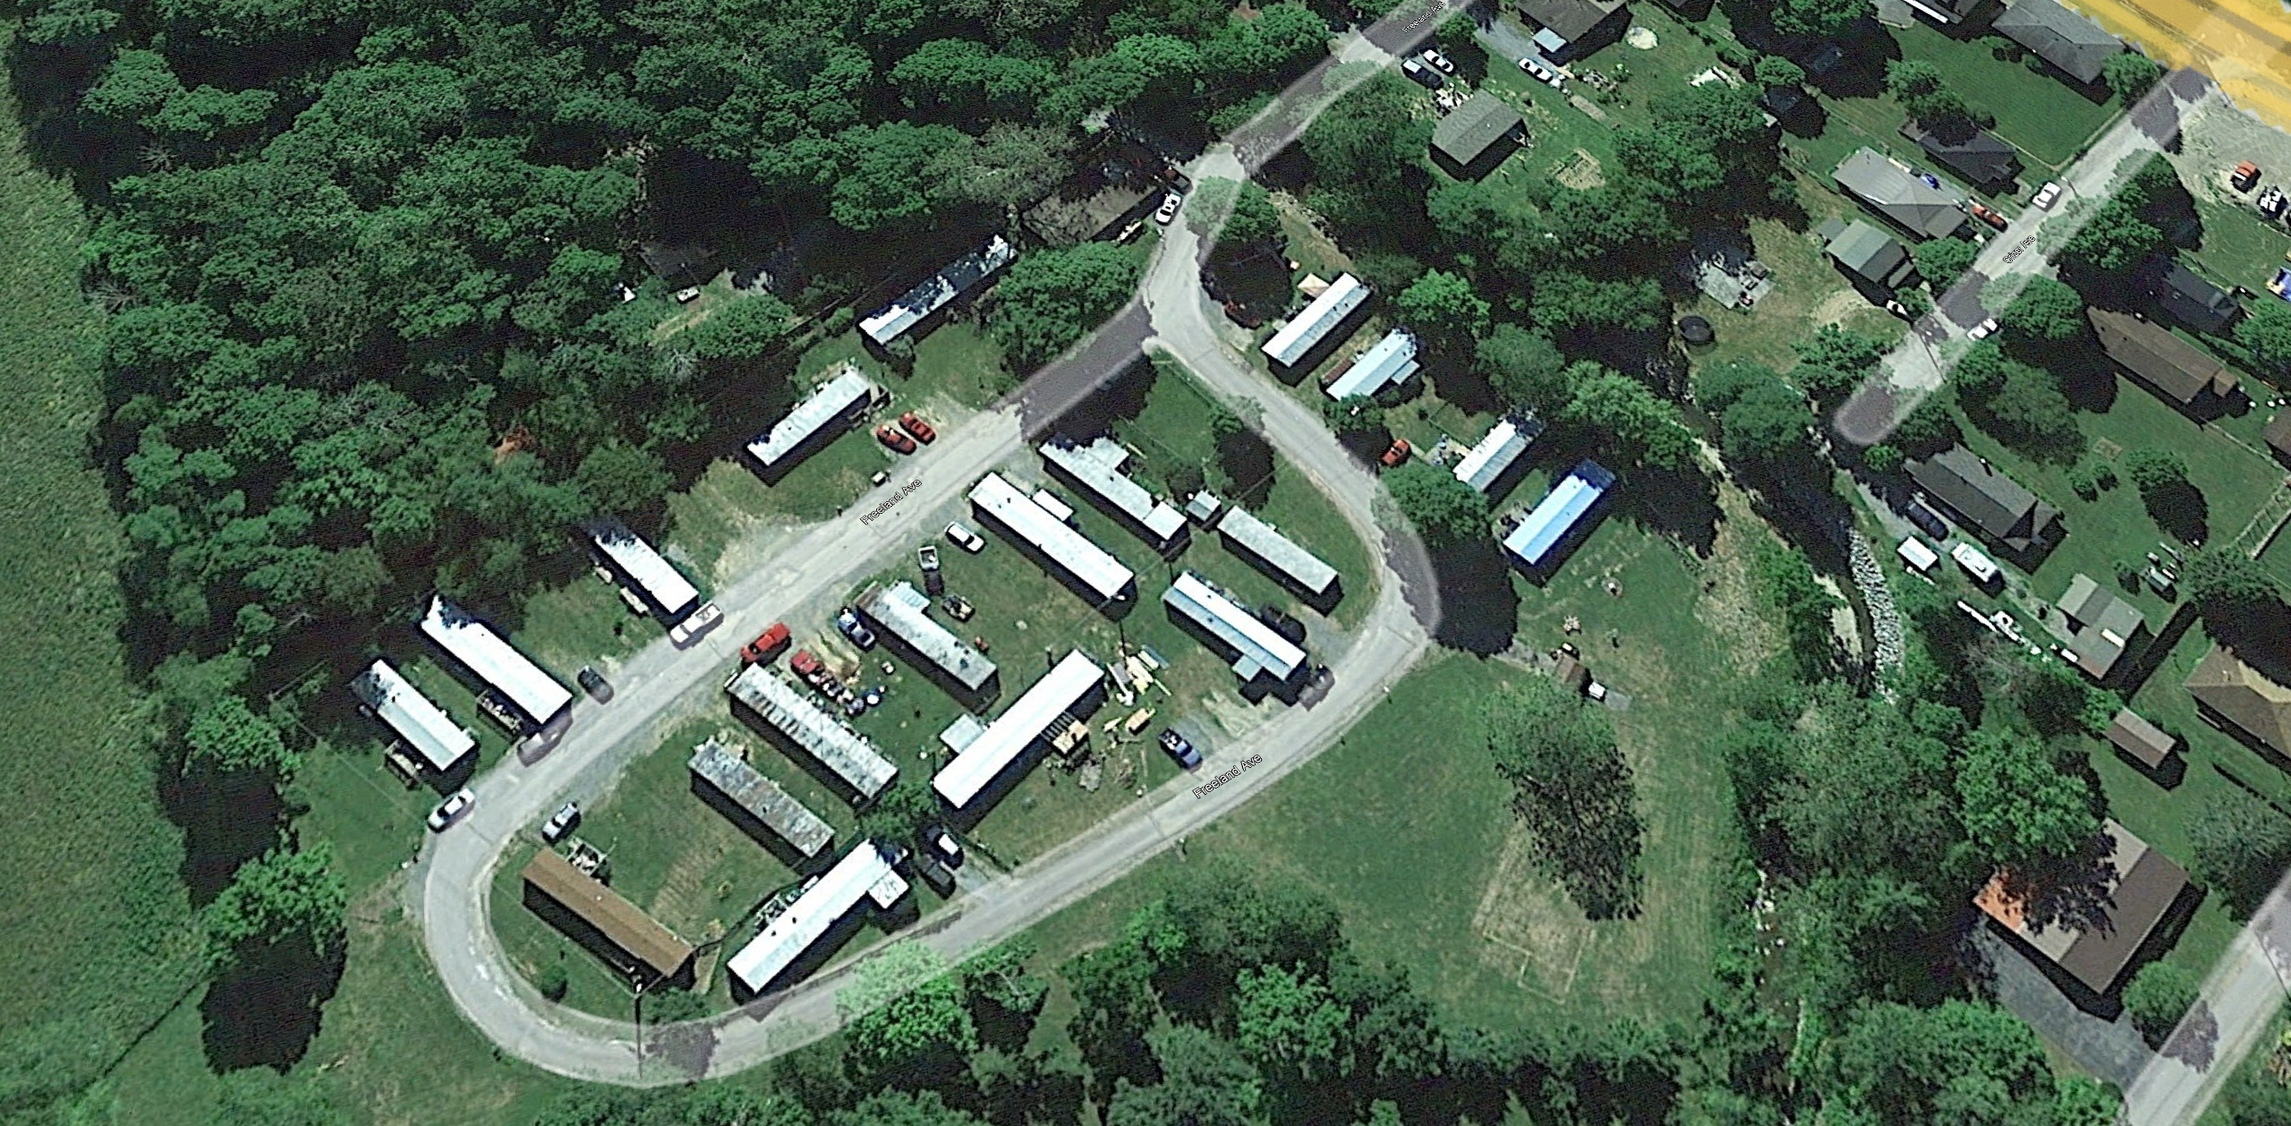
Pre-Disaster Aerial View
Imagery of June 2016
Image courtesy of Google Earth Pro

Slide 10

Removed Structures
Imagery of June 2016
Building REMOVED (Vacant Parcel)
Image courtesy of Google Earth Pro

Slide 11
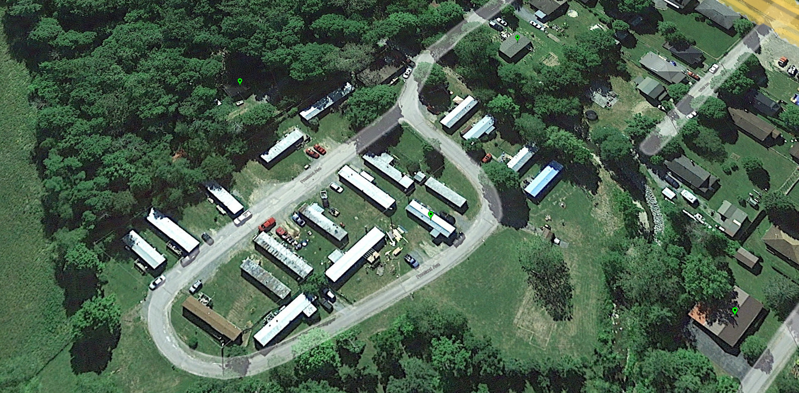
Mitigated Structures
by Elevating to Design Flood Elevation (DFE)
Imagery of June 2016
Mitigation RECONSTRUCTION
Image courtesy of Google Earth Pro

Slide 12
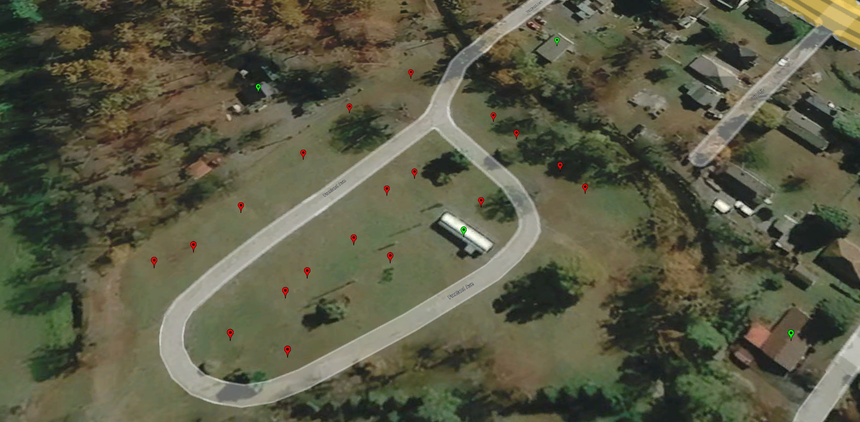
Imagery of October 2019
Building REMOVED (Vacant Parcel)
Image courtesy of Google Earth Pro
Mitigation RECONSTRUCTION

