Slide 1
Clendenin Mitigation Reconstruction
 | HEIGHT (ft.)
BUILDING
First Floor Height | 12.0
Freeboard (FBD) | 2.0
FLOOD DEPTH
FEMA 10% (10-Yr) | 2.0
FEMA 4% (25-Yr) | 6.0
FEMA 2% (50-Yr) | 9.5
2016 Flood HWM | 10.5
FEMA 1% (100-Yr) | 12.3
FEMA 100-Yr + FBD | 14.3
FEMA 1%+ (84% CL) | 16.5
FEMA 0.2% (500-Yr) | 20.5
FSF 0.2% (500-Yr) | 24.6
24.6’ (FSF 0.2% / 500-Yr)
20.5’ (FEMA 0.2% / 500-Yr)
16.5’ FEMA1%+
12.3’ (FEMA 1% / 100-Yr)
10.5’ (2016 High Water)
9.5’ (FEMA 2% / 50-Yr)
6.0’ (FEMA 4% / 25-Yr)
2.0’ (FEMA 10% / 10-Yr)
Building 20-02-0006-0044-0000_306
The Design Flood Elevation (DFE) should be the BFE plus 2 feet of freeboard. The DFE should also be above the high-water marks of the 2016 flood plus freeboard.
306 Maywood Ave., Clendenin, WV, 25045
FLOOD DEPTHS:
FEMA
First Street Foundation (FSF)
USGS 2016 Flood High Water Mark

Slide 2
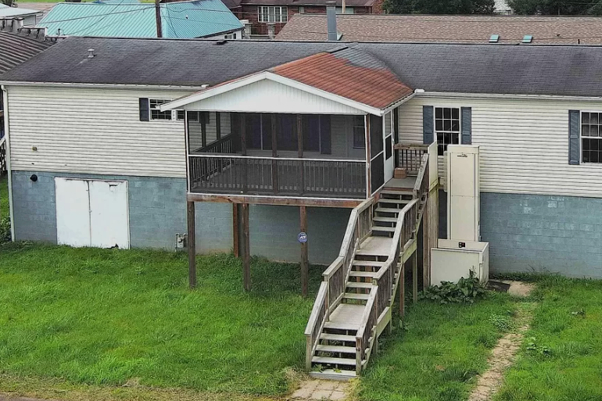
Richwood Mitigation Reconstruction
 | HEIGHT (ft.)
BUILDING
First Floor Height | 8
Freeboard (FBD) | 2
FLOOD DEPTH
FEMA 10% (10-Yr) | 0
FEMA 4% (25-Yr) | 0
FEMA 2% (50-Yr) | 3.1
2016 Flood HWM | 2.8
FEMA 1% (100-Yr) | 3.5
FEMA 100-Yr + FBD | 5.5
FEMA 1%+ (84% CL) | 6.7
FEMA 0.2% (500-Yr) | 8.3
FSF 0.2% (500-Yr) | 6.7
8.3’ (FSF 0.2% / 500-Yr)
6.7’ (FEMA 0.2% / 500-Yr)
6.7’ FEMA1%+
3.5’ (FEMA 1% / 100-Yr)
3.1’ (FEMA 2% / 50-Yr)
2.8’ (2016 High Water)
113 VALLEY AVE, RICHWOOD, WV 26261
The Design Flood Elevation (DFE) should be the BFE plus 2 feet of freeboard. The DFE should also be above the high-water marks of the 2016 flood plus freeboard.
Building ID: 34-06-0011-0090-0000_113
FLOOD DEPTHS:
FEMA
First Street Foundation (FSF)
USGS 2016 Flood High Water Mark

Slide 3
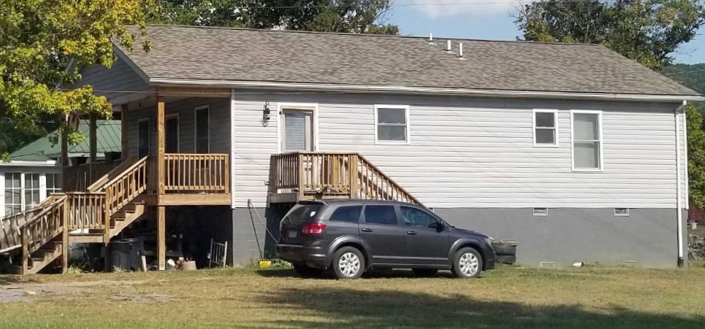
WSS New Reconstruction
 | HEIGHT (ft.)
BUILDING
First Floor Height | 6.4
Freeboard (FBD) | 2.0
FLOOD DEPTH
FEMA 10% (10-Yr) | 1.7
FEMA 4% (25-Yr) | 2.0
FEMA 2% (50-Yr) | 3.4
2016 Flood HWM | 6.5
FEMA 1% (100-Yr) | 5.4
FEMA 100-Yr + FBD | 7.4
FEMA 1%+ (84% CL) | 6.4
FEMA 0.2% (500-Yr) | 7.2
FSF 0.2% (500-Yr) | 7.4
7.4’ (FSF 0.2% / 500-Yr)
7.2’ (FEMA 0.2% / 500-Yr )
6.5’ (2016 High Water)
6.4’ FEMA 1%+
5.4’ (FEMA 1% / 100-Yr)
3.4’ (FEMA 2% / 50-Yr)
2.0’ (FEMA 4% / 25-Yr)
1.7’ (FEMA 10% / 10-Yr)
Building 13-17-0009-0026-0000_138
The Design Flood Elevation (DFE) should be the BFE plus 2 feet of freeboard. The DFE should also be above the high-water marks of the 2016 flood plus freeboard.
138 Mill Street, White Sulphur Springs, WV, 24986
FLOOD DEPTHS:
FEMA
First Street Foundation (FSF)
USGS 2016 Flood High Water Mark

Slide 4
Rainelle Mitigation Reconstruction
 | HEIGHT (ft.)
BUILDING
First Floor Height | 9
Freeboard (FBD) | 2
FLOOD DEPTH
FEMA 10% (10-Yr) | 3.1
FEMA 4% (25-Yr) | 0.1
FEMA 2% (50-Yr) | 1.9
2016 Flood HWM | 7.5
FEMA 1% (100-Yr) | 3.9
FEMA 100-Yr + FBD | 5.9
FEMA 1%+ (84% CL) | 9.9
FEMA 0.2% (500-Yr) | 9.9
FSF 0.2% (500-Yr) Climate | 12.2
The Design Flood Elevation (DFE) should be the BFE plus 2 feet of freeboard. The DFE should also be above the high-water marks of the 2016 flood plus freeboard.
12.2’ (FSF 0.2% / 500-Yr)
9.9’ (FEMA 0.2% / 500-Yr )
7.5’ (2016 High Water)
5.9’ FEMA 1%+
3.9’ (FEMA 1% / 100-Yr)
1.9’ (FEMA 2% / 50-Yr)
0’ (FEMA 4% / 25-Yr)
Building: 13-13-0001-0054-0000_182
182 Seventh Street, Rainelle, WV, 25962
FLOOD DEPTHS:
FEMA
First Street Foundation (FSF)
USGS 2016 Flood High Water Mark

Slide 5
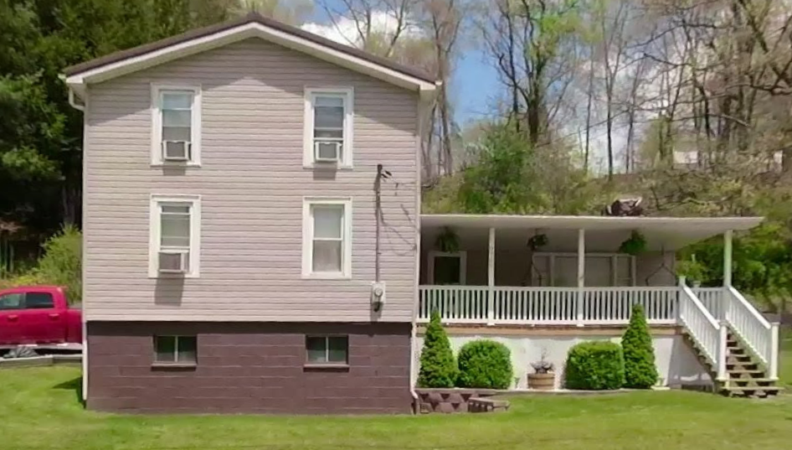
Camden Mitigation Reconstruction
The Design Flood Elevation (DFE) should be the BFE plus 2 feet of freeboard. The DFE should also be above the high-water marks of the 2016 flood plus freeboard.
 | HEIGHT (ft.)
BUILDING
First Floor Height | 4.0
Freeboard (FBD) | 2.0
FLOOD DEPTH
FEMA 10% (10-Yr) | NA
FEMA 4% (25-Yr) | NA
FEMA 2% (50-Yr) | 1.3
2016 Flood HWM | 3.4
FEMA 1% (100-Yr) | 2.2
FEMA 100-Yr + FBD | 4.1
FEMA 1%+ (84% CL) | 3.2
FEMA 0.2% (500-Yr) | 6.3
FSF 0.2% (500-Yr) Climate | 8.7
8.7’ (FSF 0.2% / 500-Yr)
6.3’ (FEMA 0.2% / 500-Yr )
3.1’ (2016 High Water)
3.2’ FEMA 1%+
2.2’ (FEMA 1% / 100-Yr)
1.3’ (FEMA 2% / 50-Yr)
Building: 51-01-0003-0054-0000_9762
9762 WEBSTER RD, Camden On Gauley, WV, 26208
FLOOD DEPTHS:
FEMA
First Street Foundation (FSF)
USGS 2016 Flood High Water Mark

Slide 6
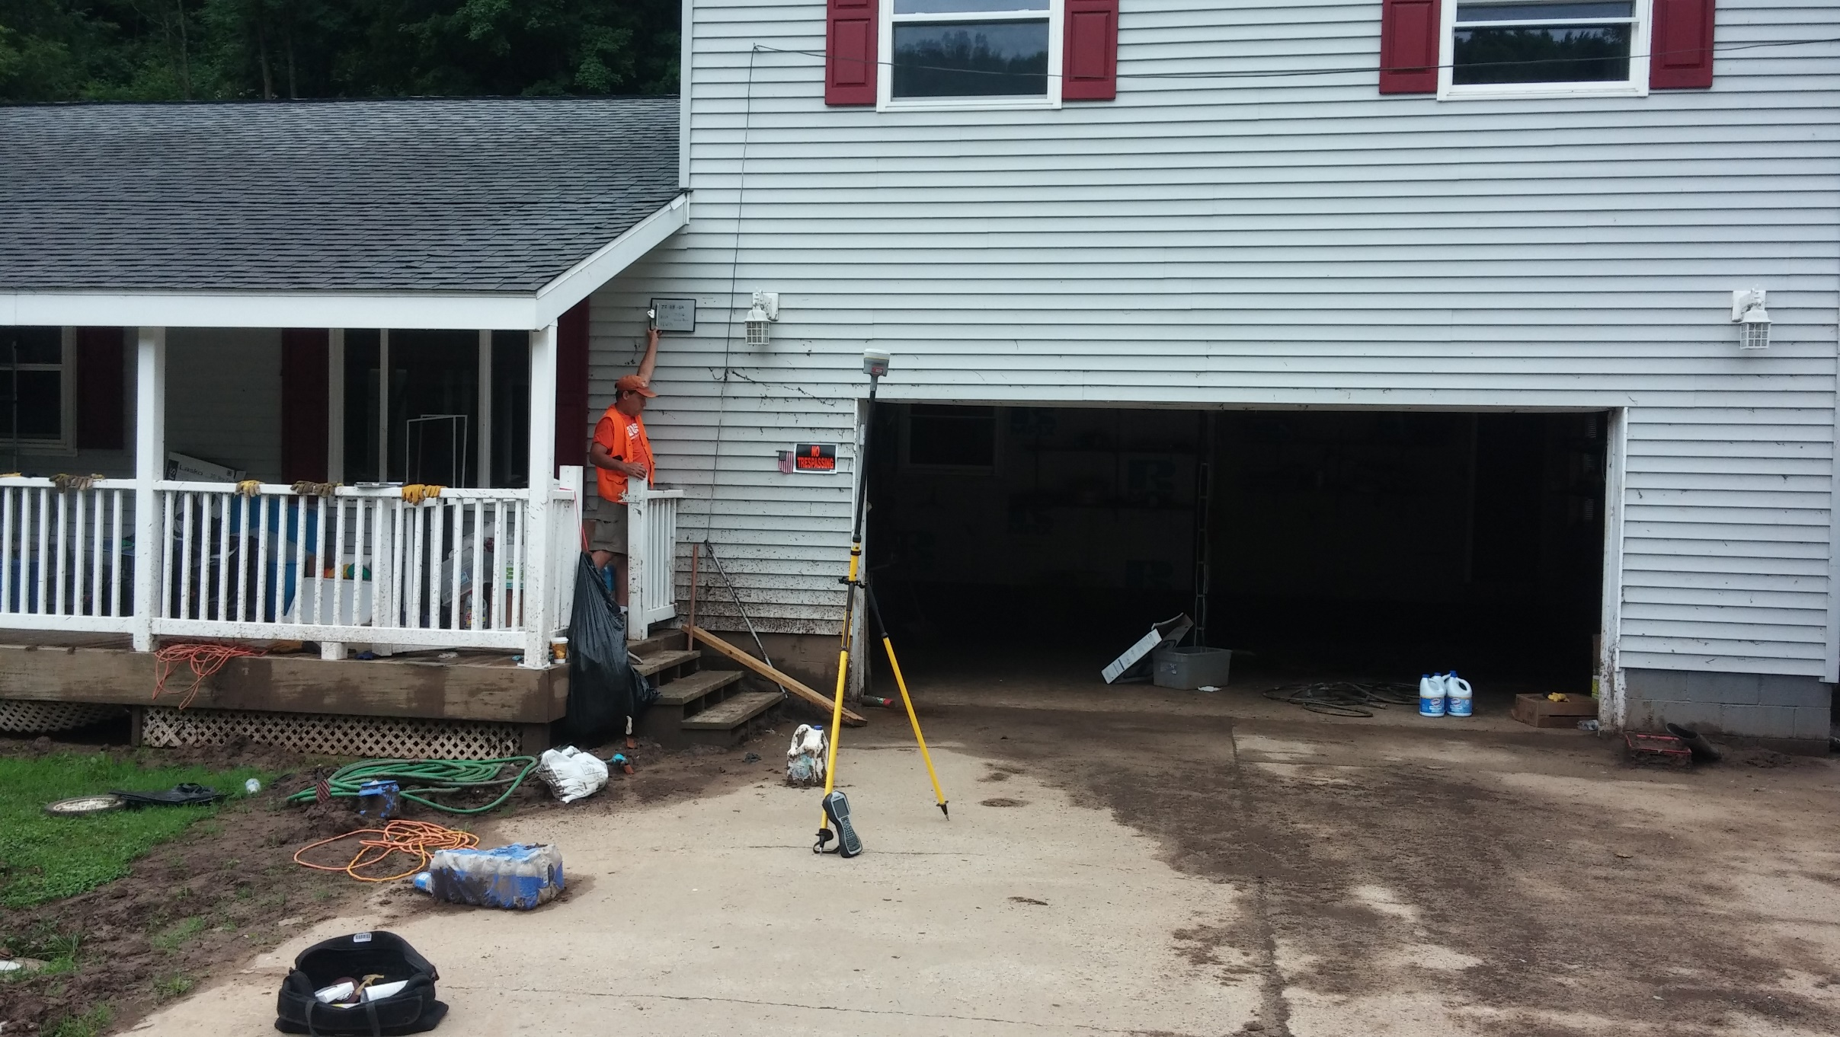
Camden Mitigation Reconstruction
14.8’ (FSF 0.2% / 500-Yr)
 | HEIGHT (ft.)
BUILDING
First Floor Height | 4
Freeboard (FBD) | 2
FLOOD DEPTH
FEMA 10% (10-Yr) | 1.9
FEMA 4% (25-Yr) | 4.4
FEMA 2% (50-Yr) | 6.7
2016 Flood HWM | 9.1
FEMA 1% (100-Yr) | 8.3
FEMA 100-Yr + FBD | 10.3
FEMA 1%+ (84% CL) | 10.7
FEMA 0.2% (500-Yr) | 12.7
FSF 0.2% (500-Yr) Climate | 14.8
12.7’ (FEMA 0.2% / 500-Yr )
10.7’ FEMA 1%+
9.1’ (2016 High Water)
8.3’ (FEMA 1% / 100-Yr)
6.7’ (FEMA 2% / 50-Yr)
Building: 51-04-0003-0006-0000_91
91 RIVERSIDE DR, Camden On Gauley, WV, 26208
FLOOD DEPTHS:
FEMA
First Street Foundation (FSF)
USGS 2016 Flood High Water Mark

Slide 7
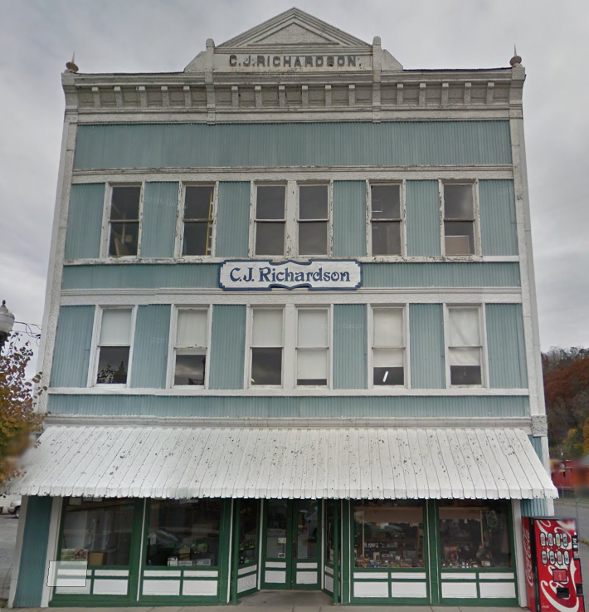
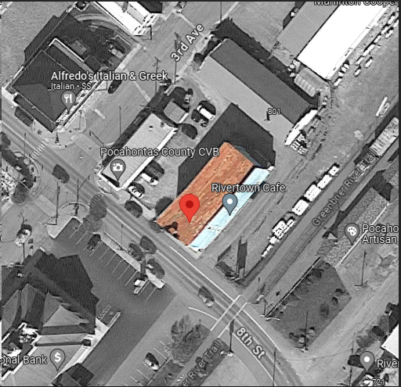
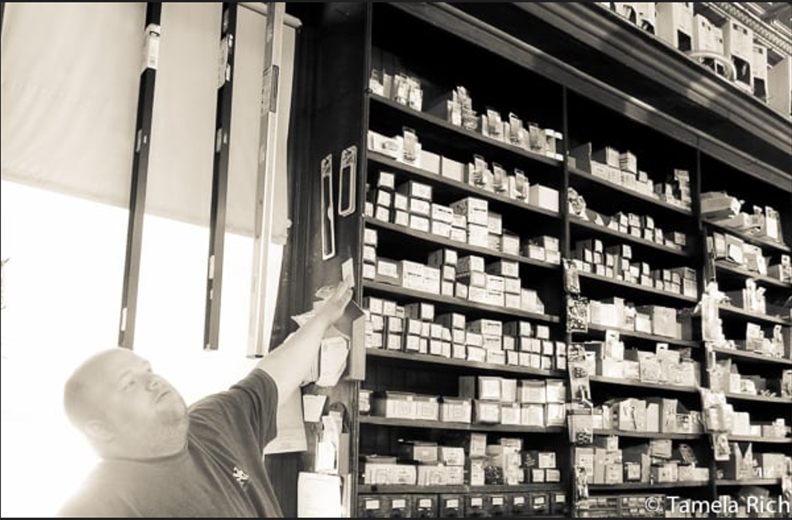
Marlinton, WV (Building Flood Profile)
Building: 38-08-0003-0023-0000
Ideally, the Design Flood Elevation (DFE) should be the BFE plus 2 feet of freeboard. The DFE should also be above the high-water marks of the 1985 flood plus freeboard.
1900 Commercial Structure
Flood Intervals | Height (ft.) | Source
FEMA 10% / 10-Yr | 0.4 | Flood Profile (Effective 2010)
FEMA 2% / 50-yr | 2.7 | Flood Profile (Effective 2010)
FEMA 1% / 100-yr | 3.6 | Flood Profile (Effective 2010)
FEMA 100-yr + 2.0 Ft. Freeboard (DFE) | 5.6 | Design flood elevation (DFE)
High Water Mark (1985 Flood) | 7.0 | Picture
FEMA Draft NFHL 100-yr | 4.8 | WV Flood Tool (Draft 2023)
FEMA 500-yr | 8.8 | WV Flood Tool (Draft 2023)
FSF 500-yr | 9.4 | FSF Flood Depth (2022)
309 8th St, Marlinton, WV, 24954
9.4’ (FSF 0.2% / 500-Yr)
8.8’ (FEMA DRAFT NFHL 0.2% / 500-Yr )
7’ (1985 High Water Mark)
4.8’ (FEMA DRAFT NFHL 1% / 100-Yr)
3.6’ (FEMA 1% / 100-Yr)
2.7’ (FEMA 2% / 50-Yr)
1985 Flood High Water Mark
0.4’ (FEMA 10% / 10-Yr)
FLOOD DEPTHS:
FEMA Effective (2010)
FEMA Draft NFHL (2023)
First Street Foundation (FSF)
1985 Flood High Water Mark

