Slide 1
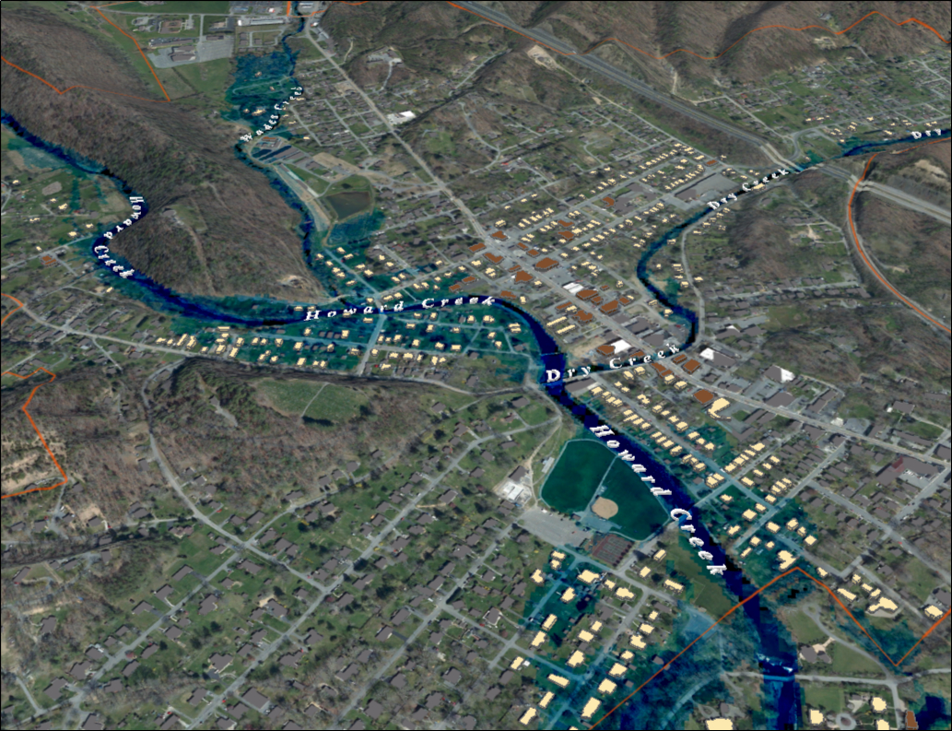

FEMA 10% Annual Chance (10-year) White Sulphur Springs, WV
96% probability of flooding at least once over 30 years
0 ft.
FLOOD DEPTH
35 ft.
Notes:
White Sulfur Springs FEMA 10yr Aerial

Slide 2
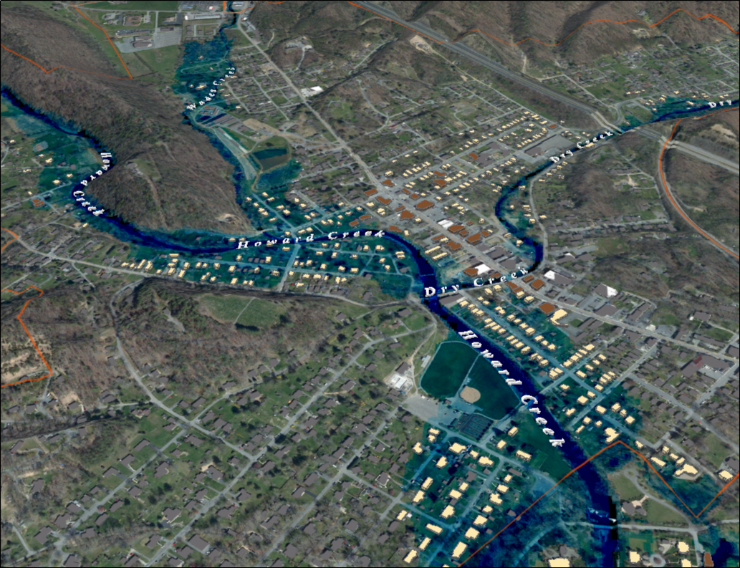
FEMA 4% Annual Chance (25-year) White Sulphur Springs, WV
71% probability of flooding at least once over 30 years
0 ft.
FLOOD DEPTH
35 ft.
Notes:
White Sulfur Springs FEMA 25yr Aerial

Slide 3
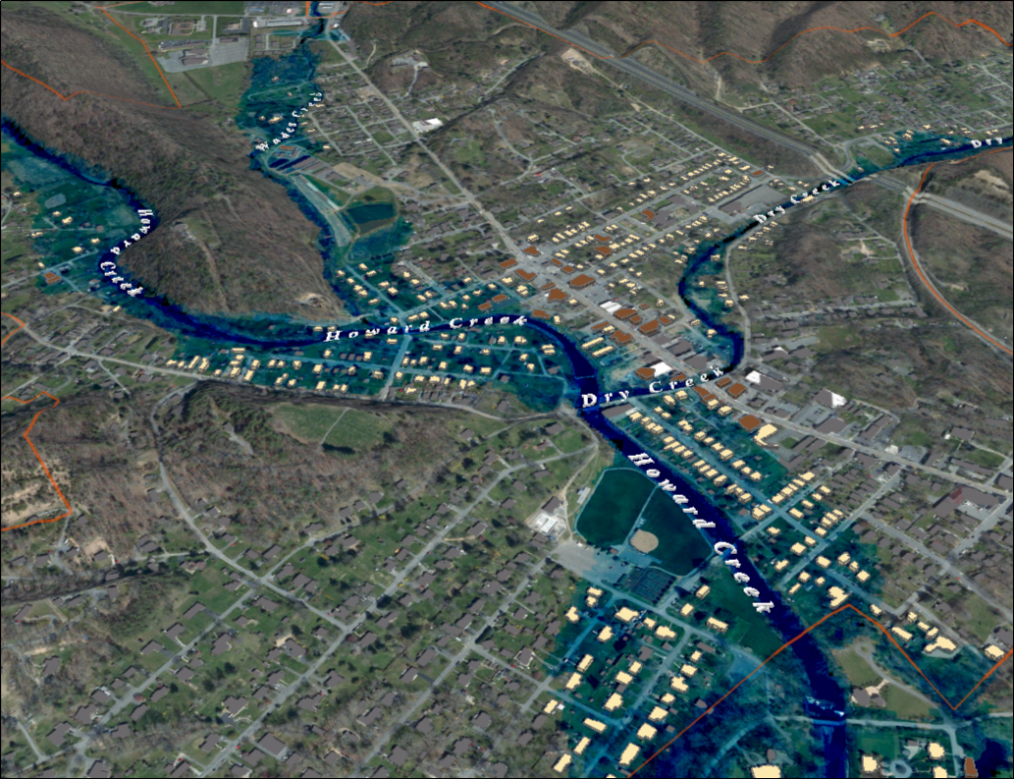
FEMA 2% Annual Chance (50-year) White Sulphur Springs, WV
45% probability of flooding at least once over 30 years
0 ft.
FLOOD DEPTH
35 ft.
Notes:
White Sulfur Springs FEMA 50yr Aerial

Slide 4
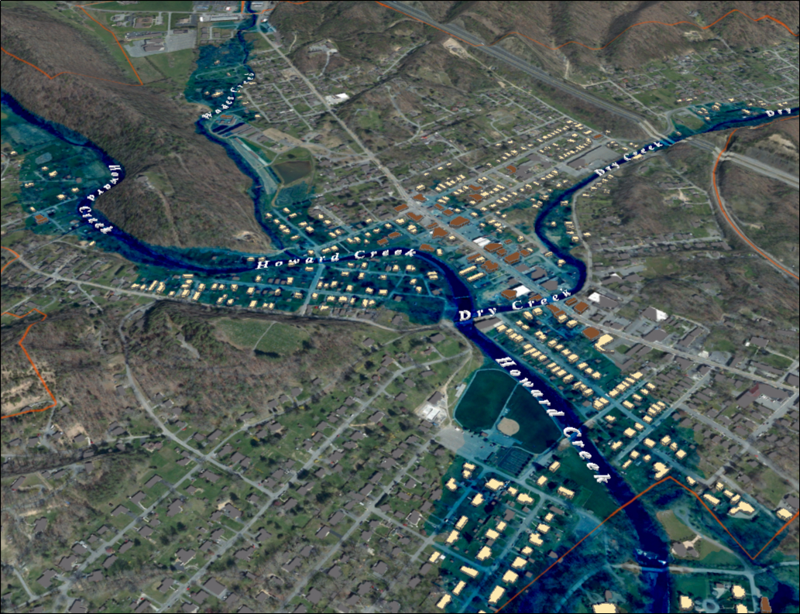
FEMA 1% Annual Chance (100-year) White Sulphur Springs, WV
26% probability of flooding at least once over 30 years
0 ft.
FLOOD DEPTH
35 ft.
Notes:
White Sulfur Springs FEMA 100yr Aerial

Slide 5
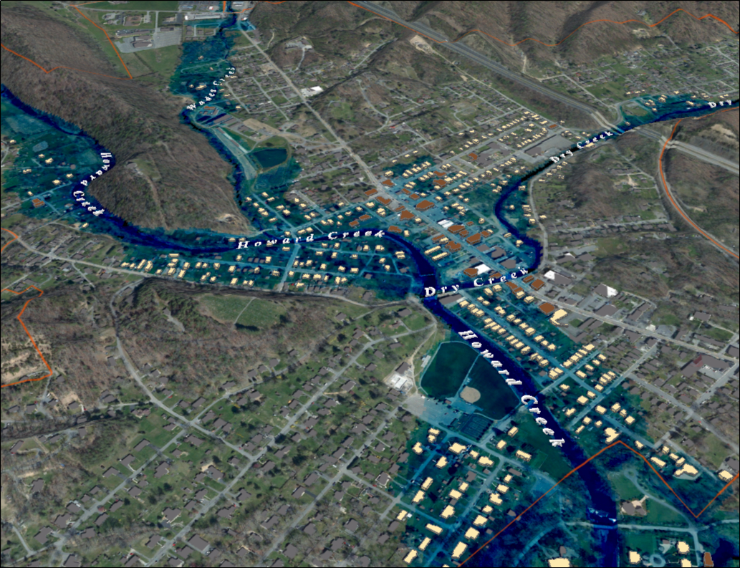
FEMA 1%+ Annual Chance (100-year) White Sulphur Springs, WV
26% probability of flooding at least once over 30 years
Climate
Change
0 ft.
FLOOD DEPTH
35 ft.
Notes:
White Sulfur Springs FEMA 100yr PLUS Aerial

Slide 6
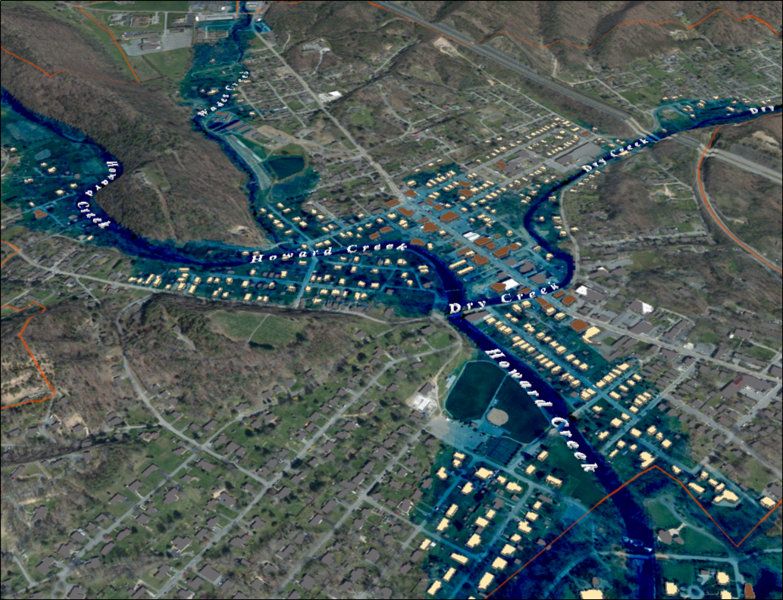
FEMA 0.2% Annual Chance (500-year) White Sulphur Springs, WV
6% probability of flooding at least once over 30 years
0 ft.
FLOOD DEPTH
35 ft.
Notes:
White Sulfur Springs FEMA 500yr Aerial

Slide 7
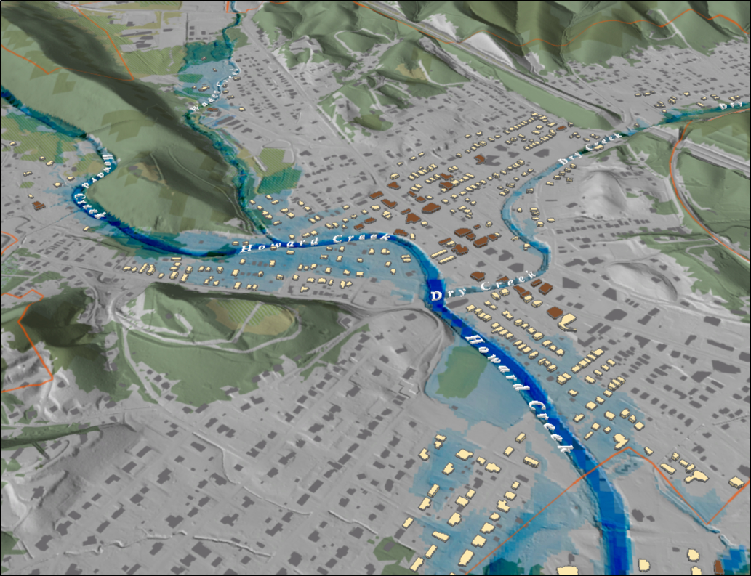
FEMA 10% Annual Chance (10-year) White Sulphur Springs, WV
Notes:
White Sulfur Springs FEMA 10yr Hillshade

Slide 8
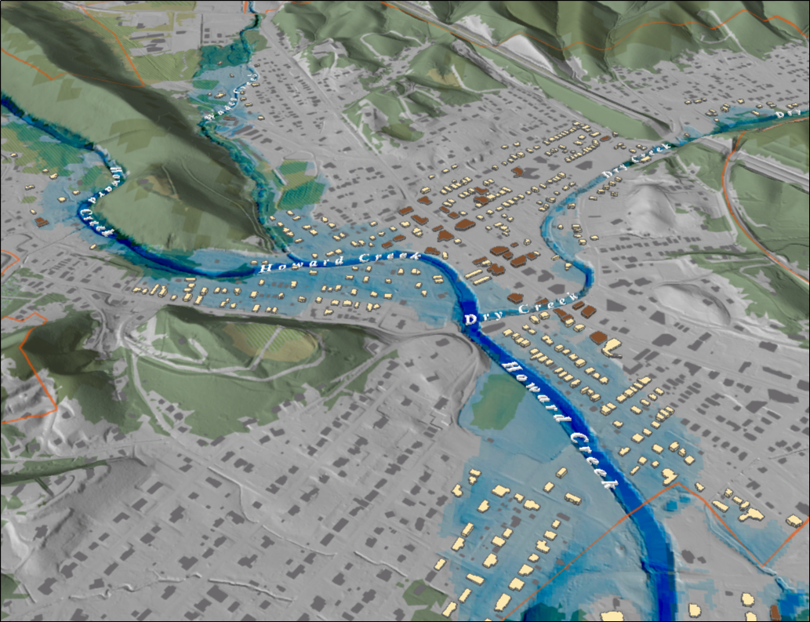
FEMA 4% Annual Chance (25-year) White Sulphur Springs, WV
Notes:
White Sulfur Springs FEMA 25yr Hillshade

Slide 9
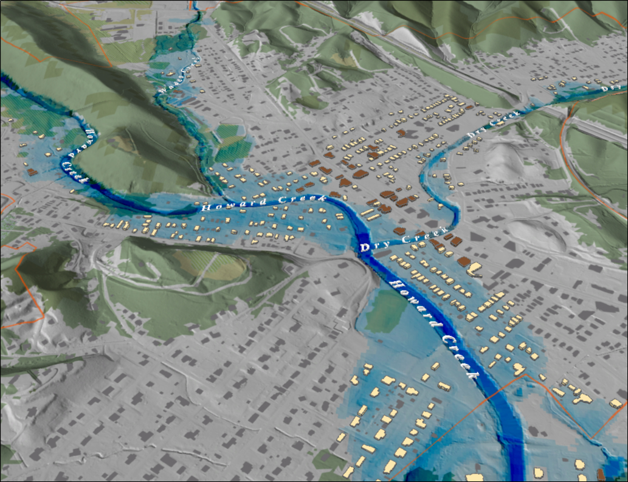
FEMA 2% Annual Chance (50-year) White Sulphur Springs, WV
Notes:
White Sulfur Springs FEMA 50yr Hillshade

Slide 10
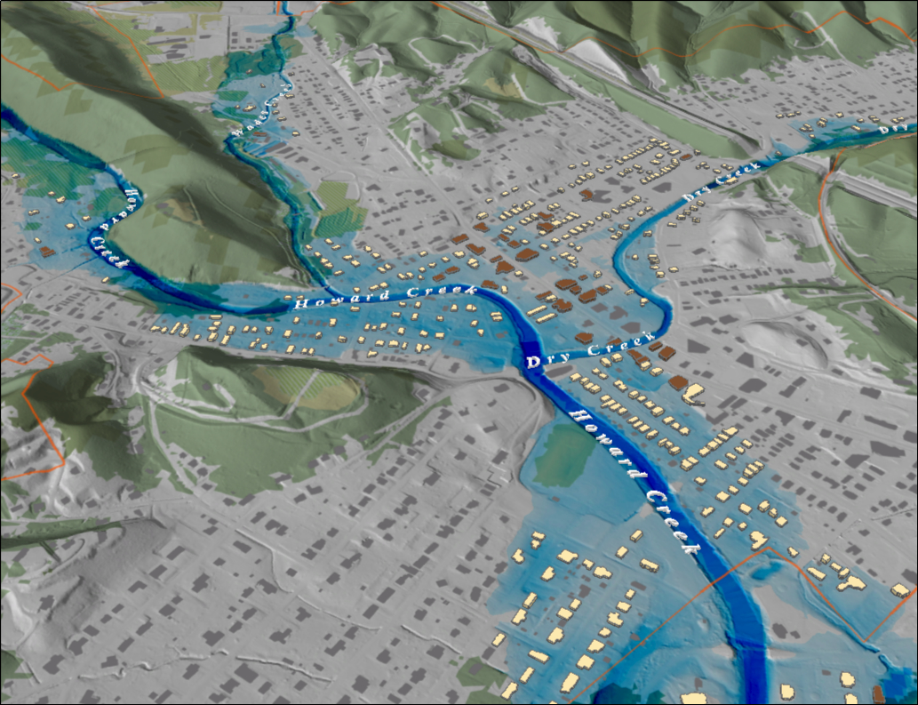
FEMA 1% Annual Chance (100-year) White Sulphur Springs, WV
Notes:
White Sulfur Springs FEMA 100yr Hillshade

Slide 11
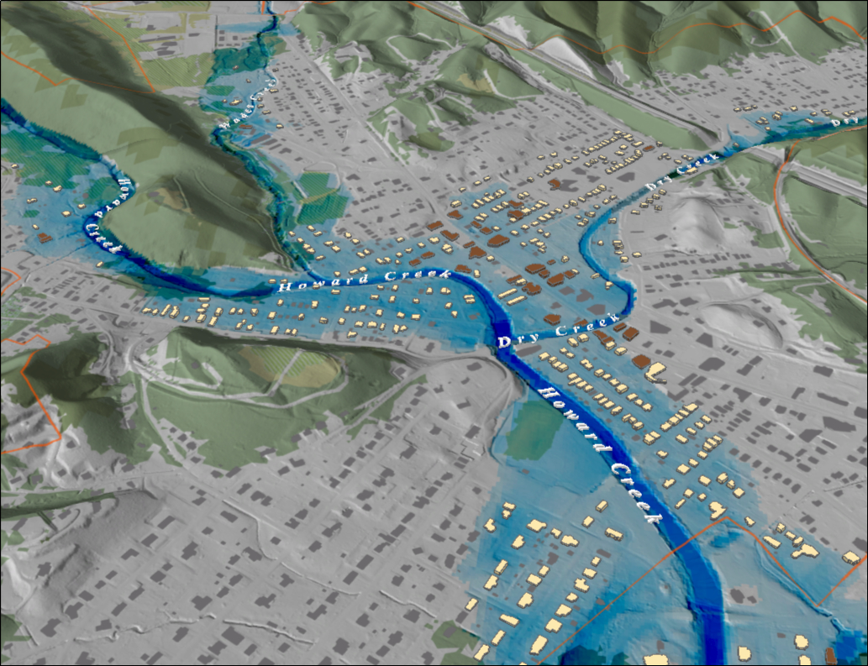
FEMA 1%+ Annual Chance (100-year) White Sulphur Springs, WV
Notes:
White Sulfur Springs FEMA 100yr PLUS Hillshade

Slide 12
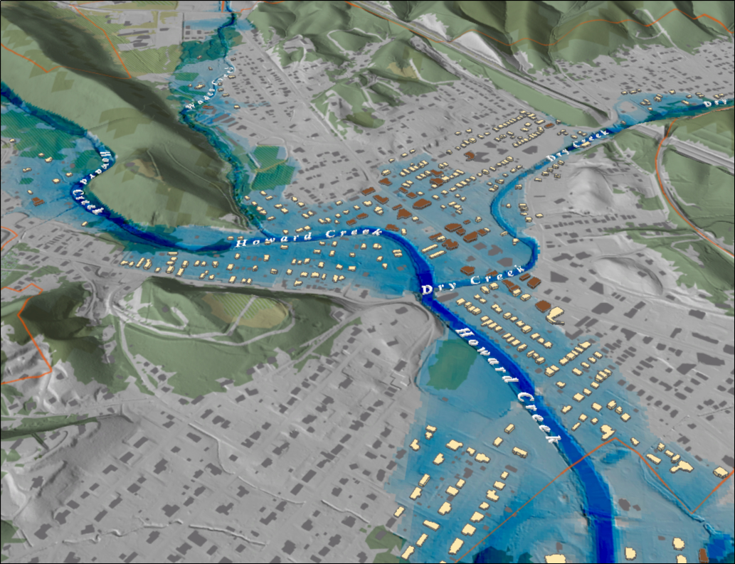
FEMA 0.2% Annual Chance (500-year) White Sulphur Springs, WV
Notes:
White Sulfur Springs FEMA 500yr Hillshade

Slide 13
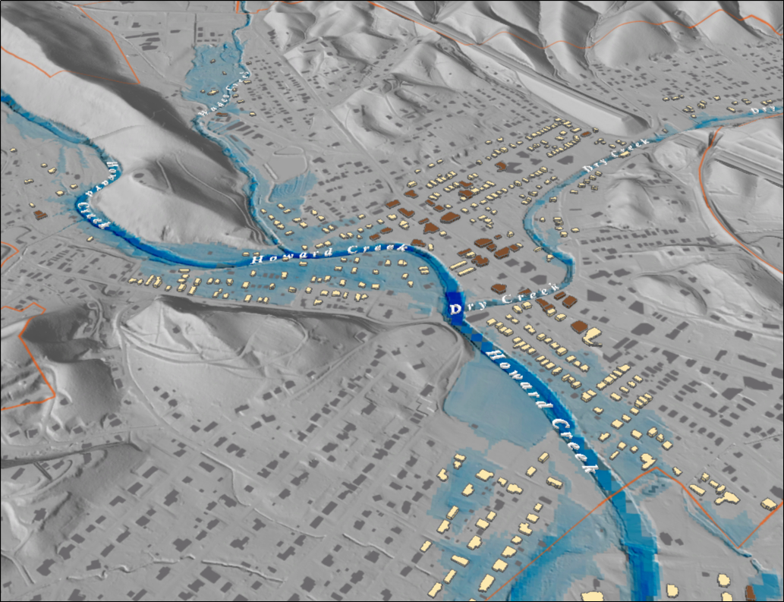
FEMA 10% Annual Chance (10-year) White Sulphur Springs, WV
Notes:
White Sulfur Springs FEMA 10yr Grey

Slide 14
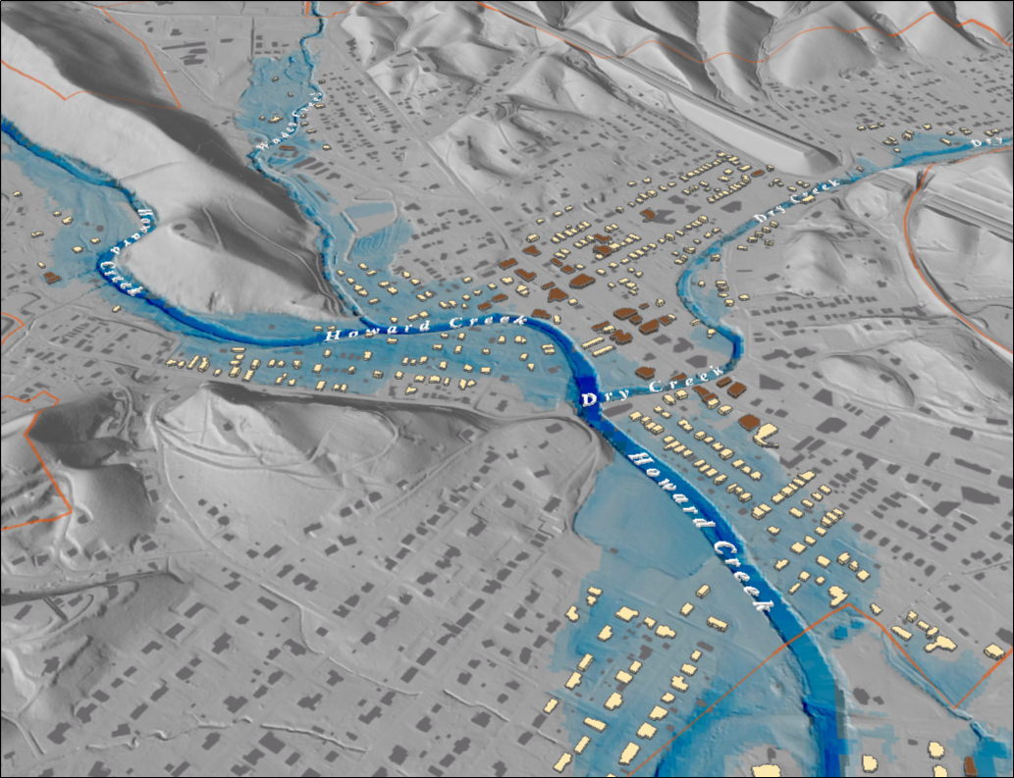
FEMA 4% Annual Chance (25-year) White Sulphur Springs, WV
Notes:
White Sulfur Springs FEMA 25yr Grey

Slide 15
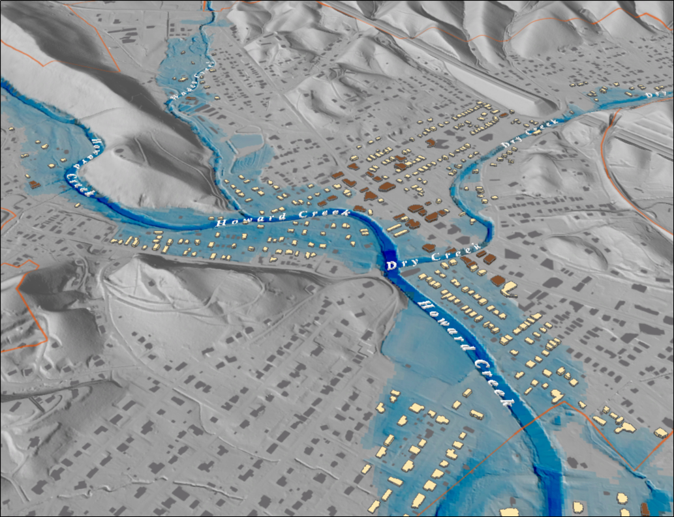
FEMA 2% Annual Chance (50-year) White Sulphur Springs, WV
Notes:
White Sulfur Springs FEMA 50yr Grey

Slide 16
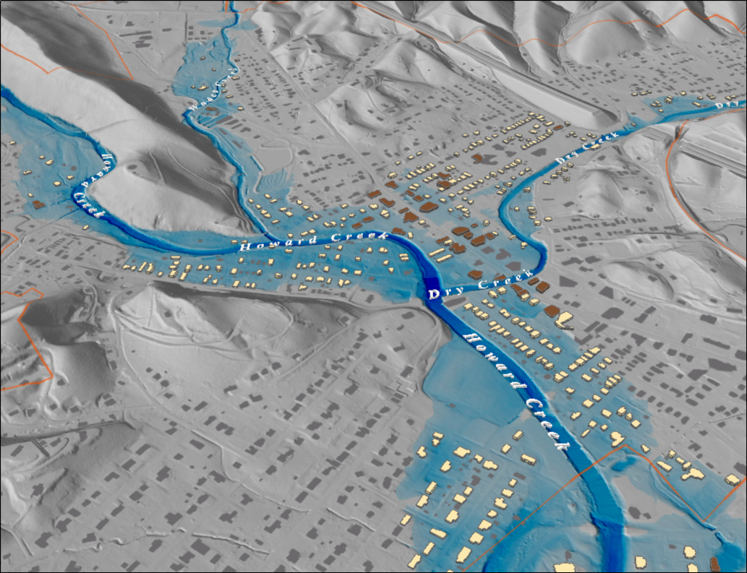
FEMA 1% Annual Chance (100-year) White Sulphur Springs, WV
Notes:
White Sulfur Springs FEMA 100yr Grey

Slide 17
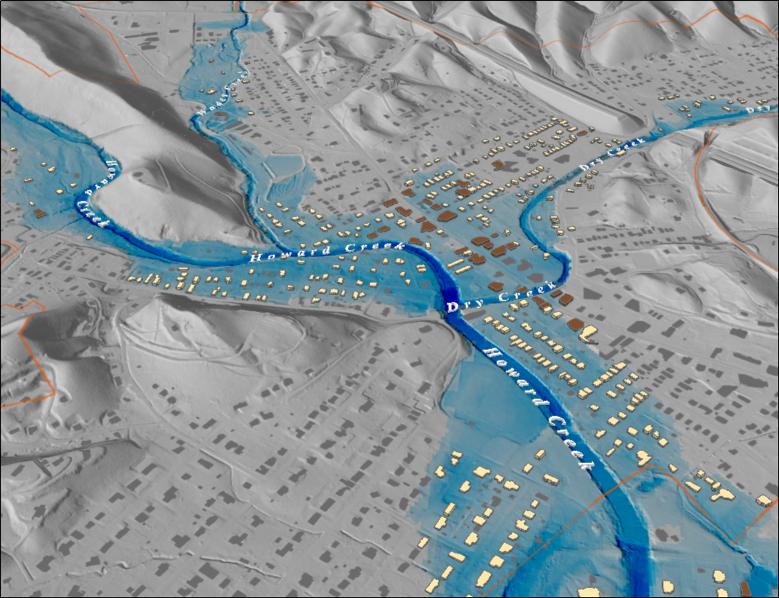
FEMA 1%+ Annual Chance (100-year) White Sulphur Springs, WV
Notes:
White Sulfur Springs FEMA 100yr PLUS Grey

Slide 18

FEMA 0.2% Annual Chance (500-year) White Sulphur Springs, WV
Notes:
White Sulfur Springs FEMA 500yr Grey

