Slide 1
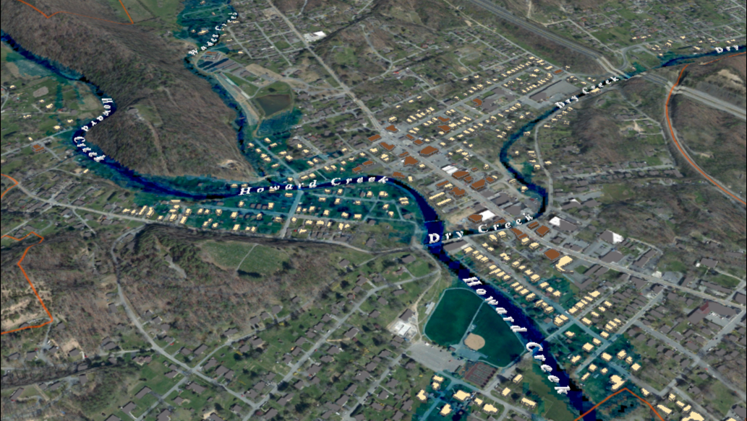
FEMA 10% Annual Chance (10-year)
White Sulphur Springs, WV
0.1 ft.
FLOOD DEPTH
26 ft.
Residential
Non-Residential
13% of White Sulphur Springs is in the 10% Annual Flood Chance
96% probability of flooding at least once over 30 years
Notes:
White Sulfur Springs FEMA 10yr Aerial

Slide 2
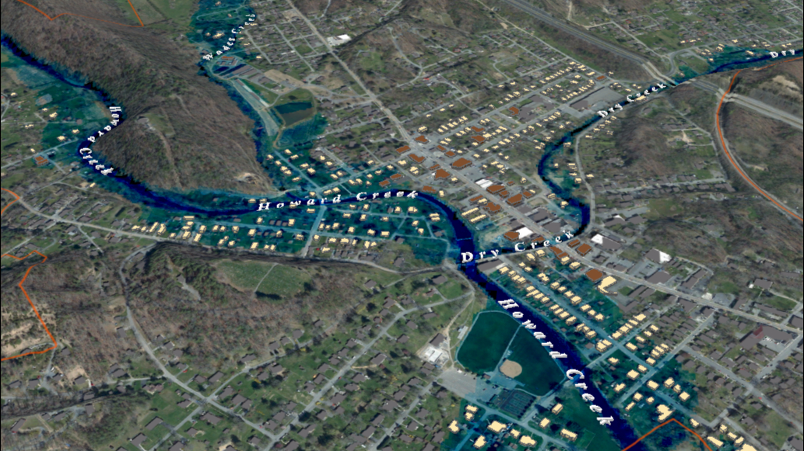
FEMA 4% Annual Chance (25-year)
White Sulphur Springs, WV
0.1 ft.
FLOOD DEPTH
29 ft.
Residential
Non-Residential
17% of White Sulphur Springs is in the 4% Annual Flood Chance
71% probability of flooding at least once over 30 years
Notes:
White Sulfur Springs FEMA 25yr Aerial

Slide 3
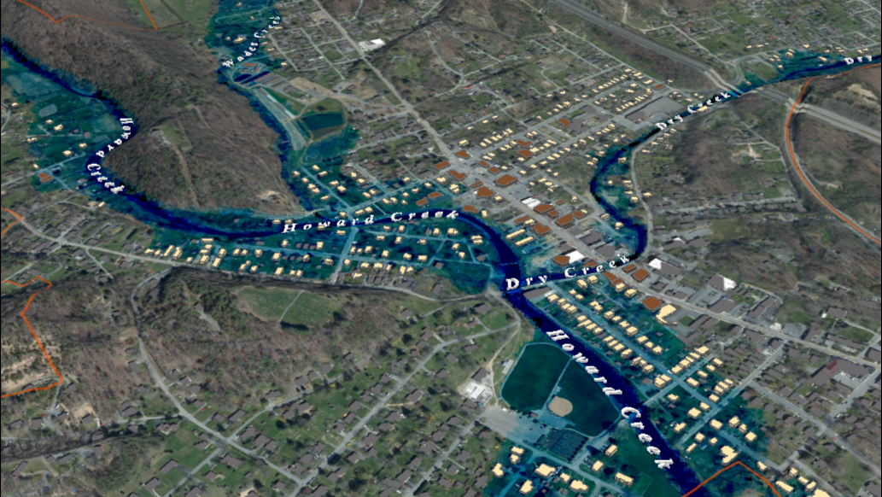
FEMA 2% Annual Chance (50-year)
White Sulphur Springs, WV
0.1 ft.
FLOOD DEPTH
30 ft.
Residential
Non-Residential
20% of White Sulphur Springs is in the 2% Annual Flood Chance
45% probability of flooding at least once over 30 years
Notes:
White Sulfur Springs FEMA 50yr Aerial

Slide 4
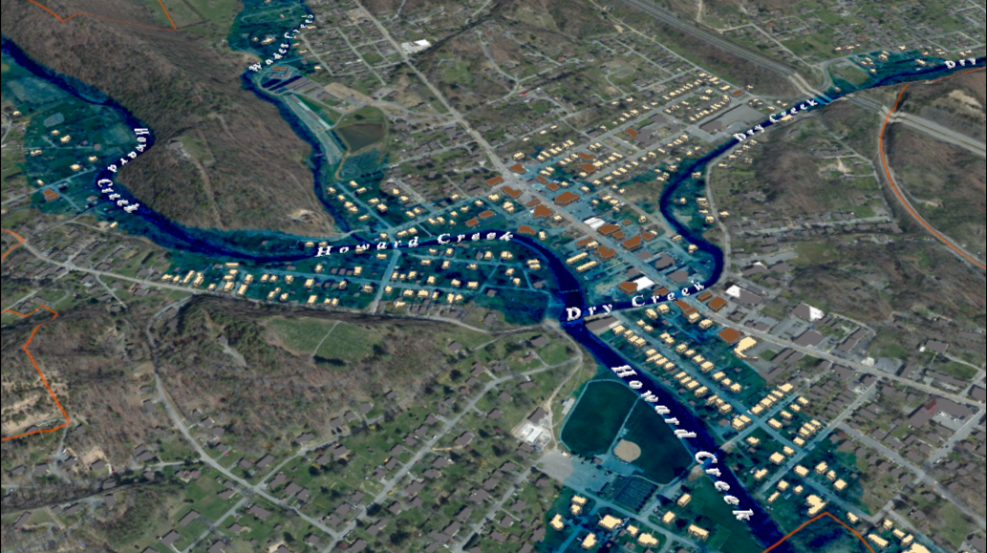
FEMA 1% Annual Chance (100-year)
White Sulphur Springs, WV
0.1 ft.
FLOOD DEPTH
35 ft.
Residential
Non-Residential
22% of White Sulphur Springs is in the 1% Annual Flood Chance
26% probability of flooding at least once over 30 years
Notes:
White Sulfur Springs FEMA 100yr Aerial

Slide 5
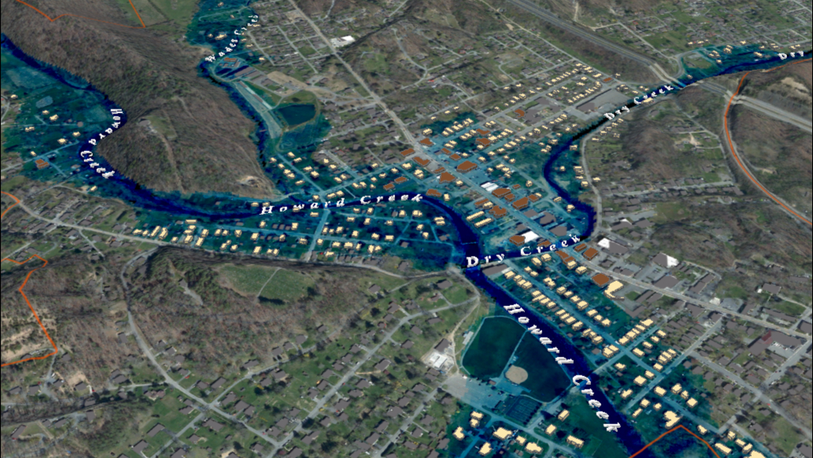
FEMA 1% +Annual Chance (100-year)
White Sulphur Springs, WV
Climate
Change
0.1 ft.
FLOOD DEPTH
35 ft.
Residential
Non-Residential
25% of White Sulphur Springs is in the 1% +Annual Flood Chance
26% probability of flooding at least once over 30 years
Notes:
White Sulfur Springs FEMA 100yr PLUS Aerial

Slide 6
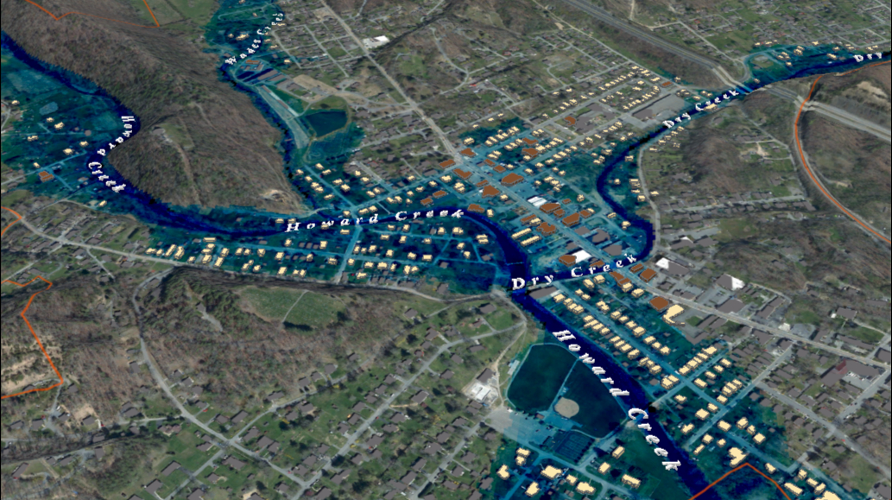
FEMA 0.2% Annual Chance (500-year)
White Sulphur Springs, WV
0.1 ft.
FLOOD DEPTH
18 ft.
Residential
Non-Residential
18% of White Sulphur Springs is in the 0.2% Annual Flood Chance
6% probability of flooding at least once over 30 years
Notes:
White Sulfur Springs FEMA 500yr Aerial

