Slide 1
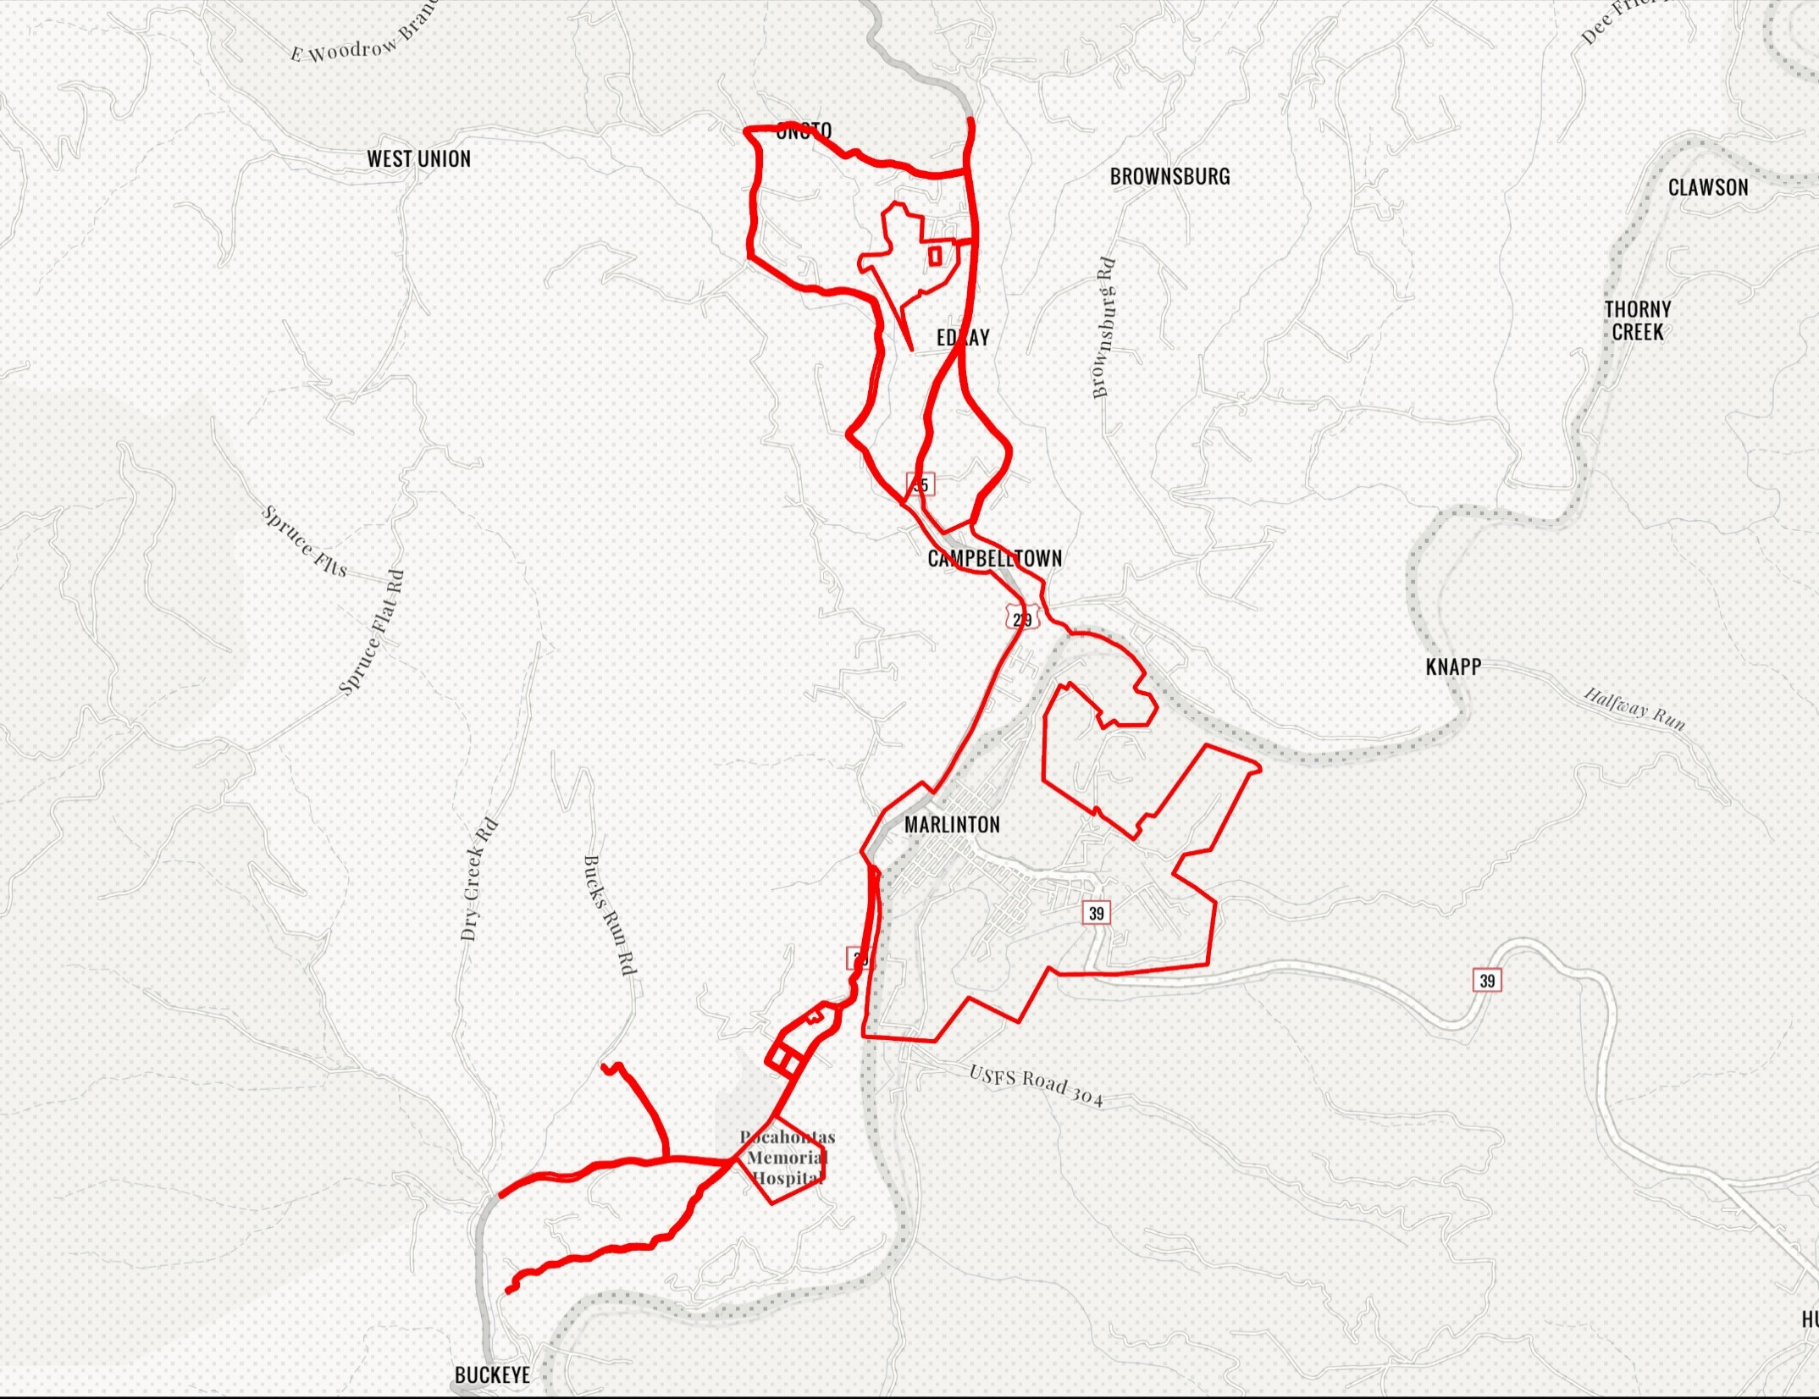
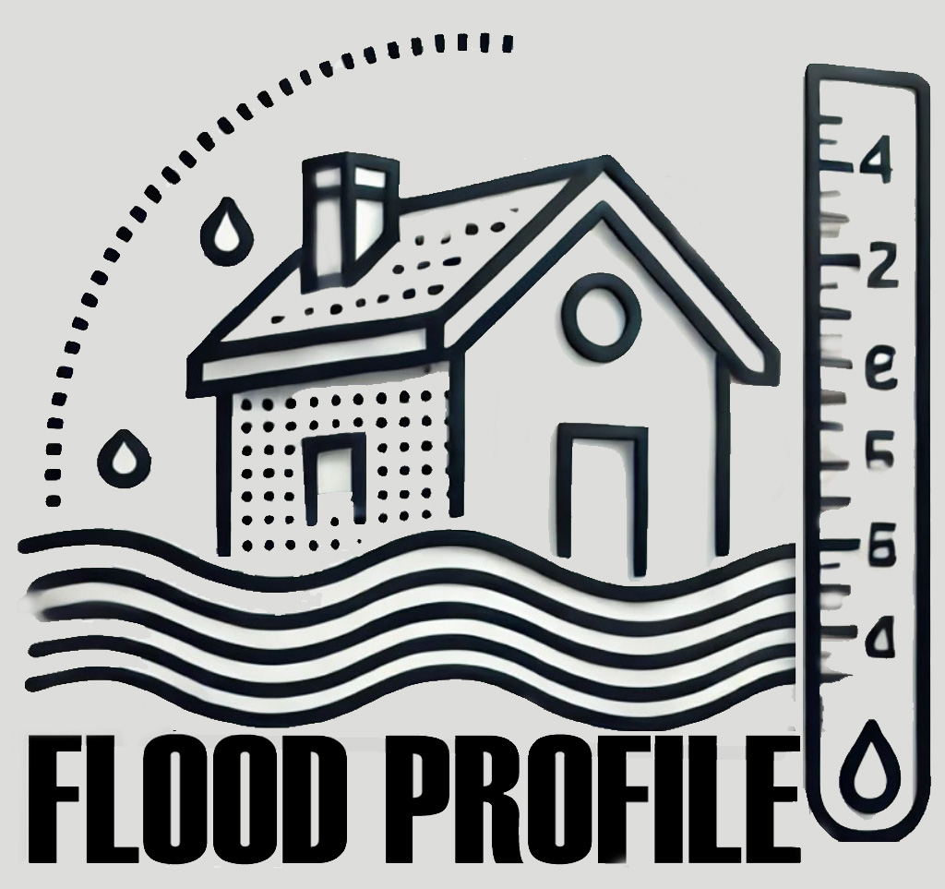
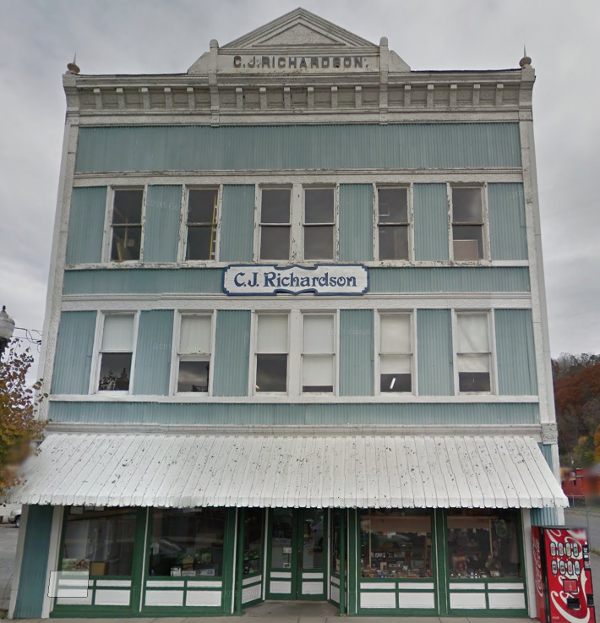
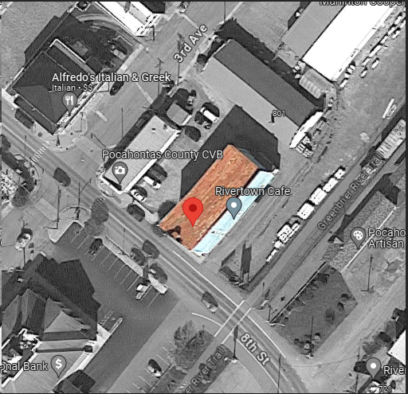
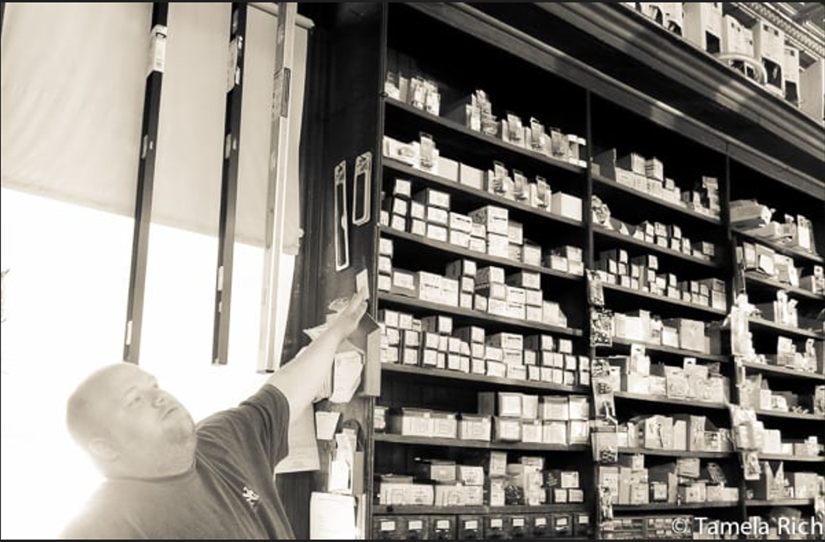
Marlinton
Ideally, the Design Flood Elevation (DFE) should be the BFE plus 2 feet of freeboard. The DFE should also be above the high-water marks of the 1985 flood plus freeboard.
Building: 38-08-0003-0023-0000
1900 Commercial Structure
Flood Intervals | Height (ft.) | Source
FEMA 10% / 10-Yr | 0.4 | Flood Profile (Effective 2010)
FEMA 2% / 50-yr | 2.7 | Flood Profile (Effective 2010)
FEMA 1% / 100-yr | 3.6 | Flood Profile (Effective 2010)
FEMA 100-yr + 2.0 Ft. Freeboard (DFE) | 5.6 | Design flood elevation (DFE)
High Water Mark (1985 Flood) | 7.0 | Picture
FEMA Draft NFHL 100-yr | 4.8 | WV Flood Tool (Draft 2023)
FEMA 500-yr | 8.8 | WV Flood Tool (Draft 2023)
FSF 500-yr | 9.4 | FSF Flood Depth (2022)
Building Flood Profile
309 8th St, Marlinton, WV, 24954
9.4’ (FSF 0.2% / 500-Yr)
8.8’ (FEMA DRAFT NFHL 0.2% / 500-Yr )
7’ (1985 High Water Mark)
4.8’ (FEMA DRAFT NFHL 1% / 100-Yr)
3.6’ (FEMA 1% / 100-Yr)
2.7’ (FEMA 2% / 50-Yr)
1985 Flood High Water Mark
0.4’ (FEMA 10% / 10-Yr)
FLOOD DEPTHS:
FEMA Effective (2010)
FEMA Draft NFHL (2023)
First Street Foundation (FSF, 2022)
1985 Flood High Water Mark

