Slide 1
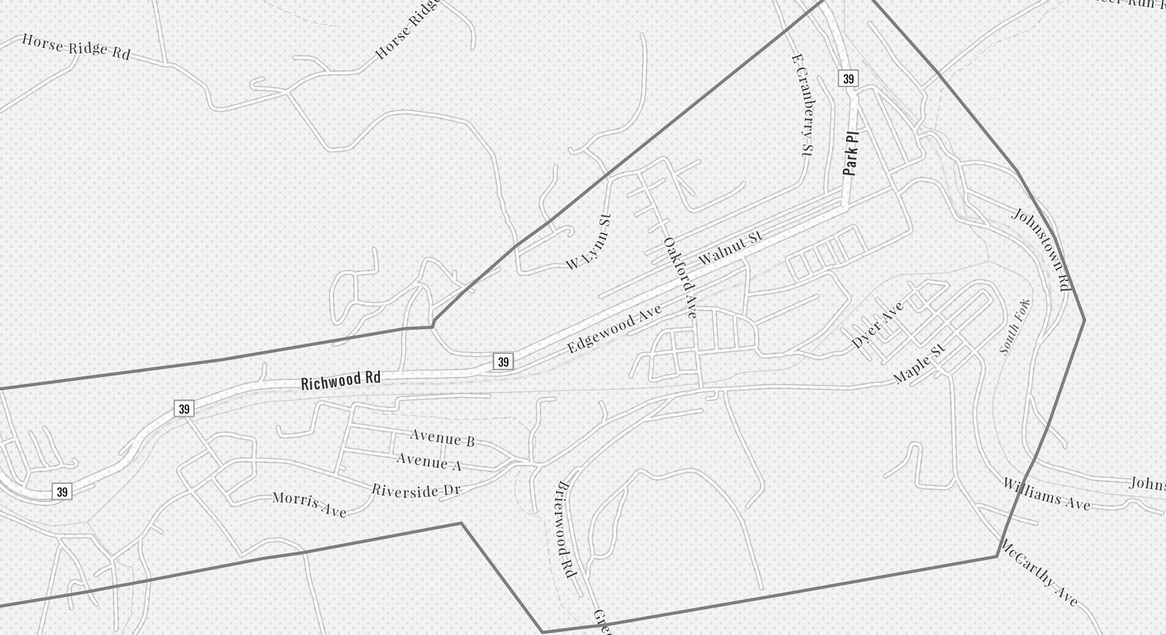
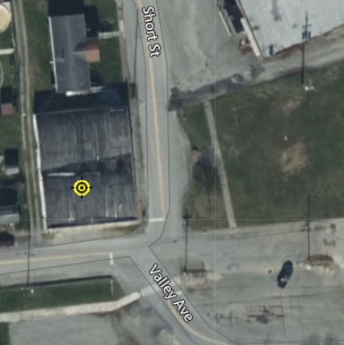
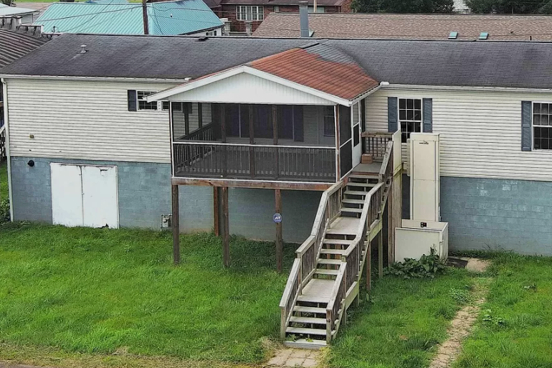
Richwood
34-06-0011-0090-0000_113
113 Valley Ave, Richwood, WV
Building Flood Profile

Slide 2
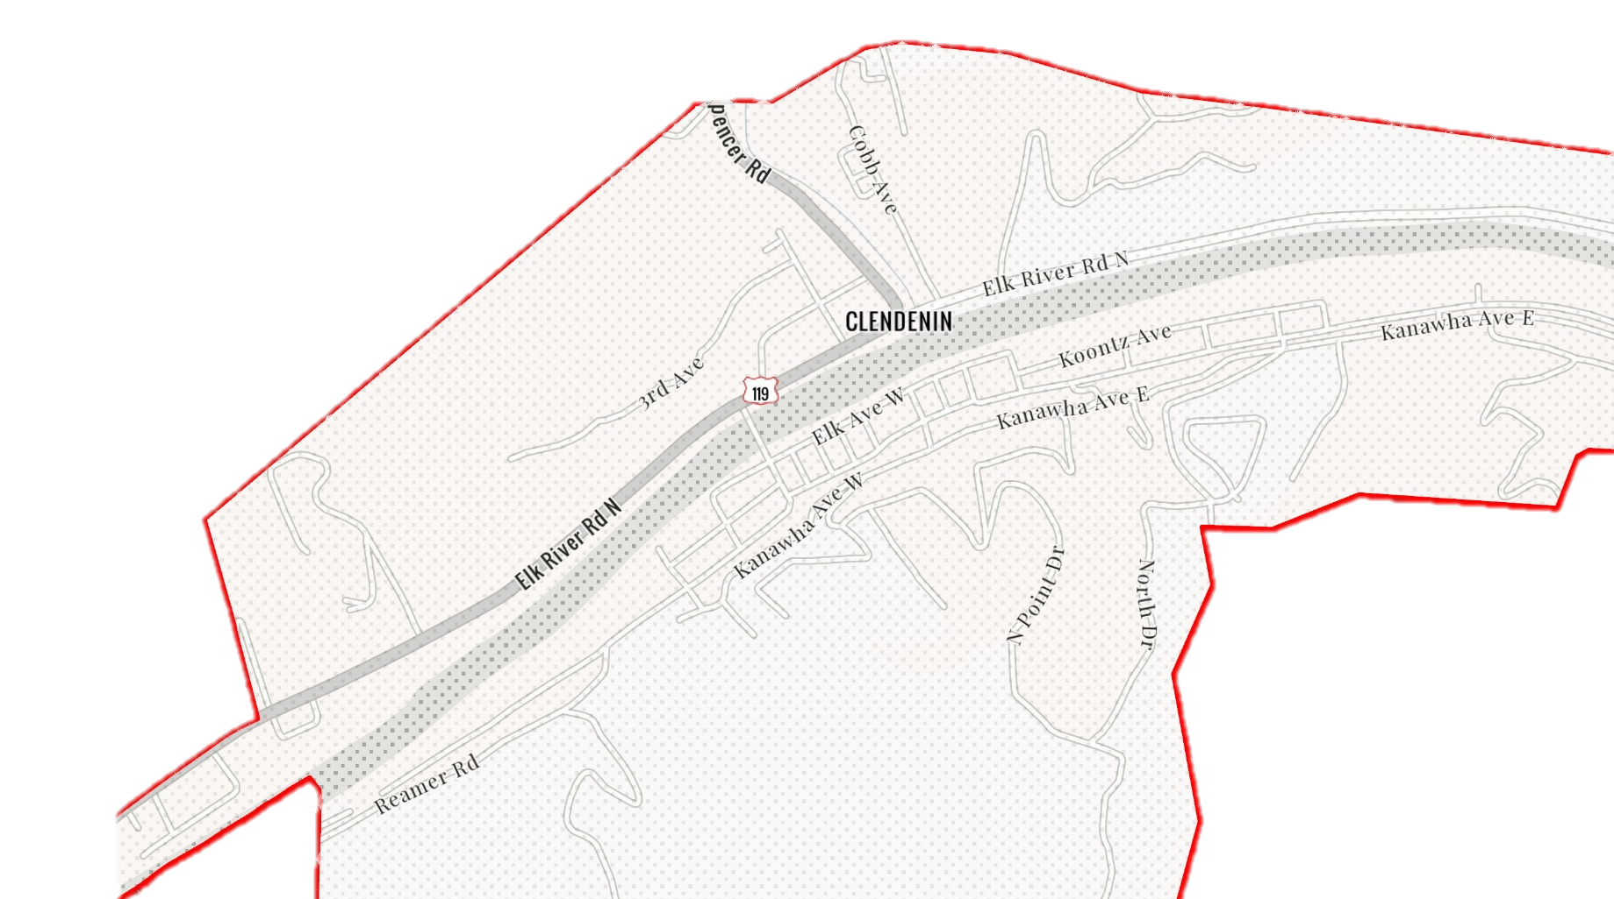
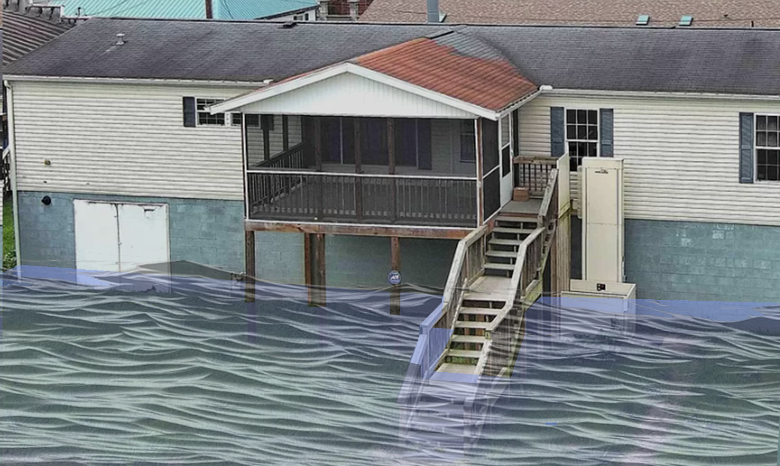
2% Probability of Flood in a year (50-year flood)
2.8’ (FEMA 2% / 50-Yr)
Building’s Ground Elevation

Slide 3
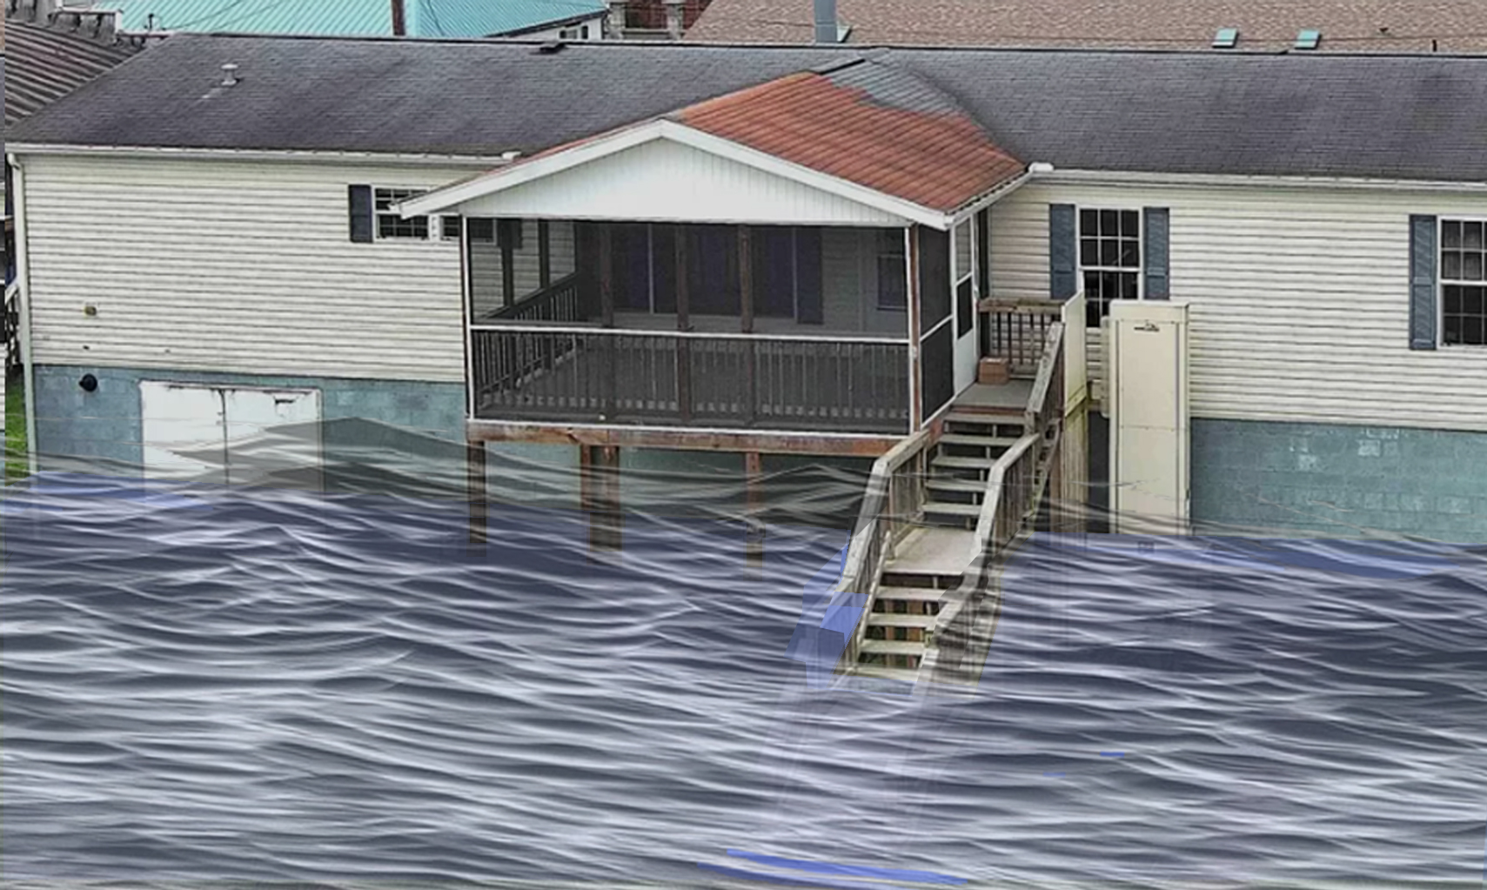
1% Probability of Flood in a year (100-year flood)
3.5’ (FEMA 1% / 100-Yr)

Slide 4
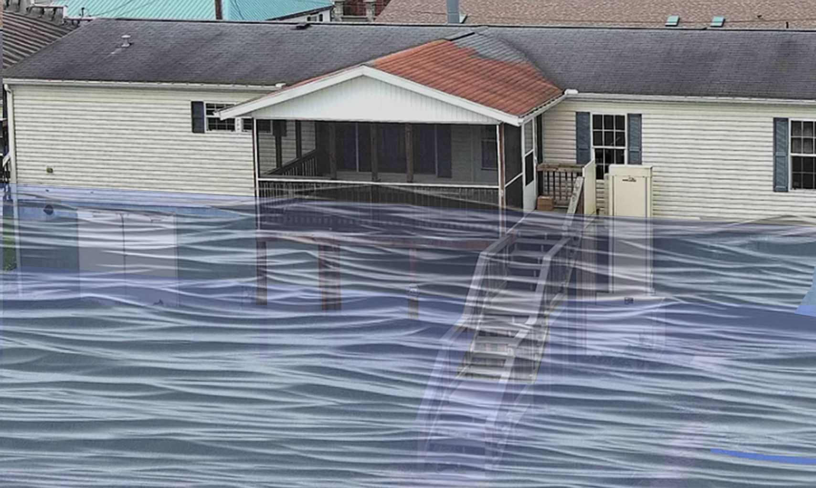
0.2% Probability of Flood in a year (500-year flood)
8.3’ (FEMA 0.2% / 500-Yr)

Slide 5
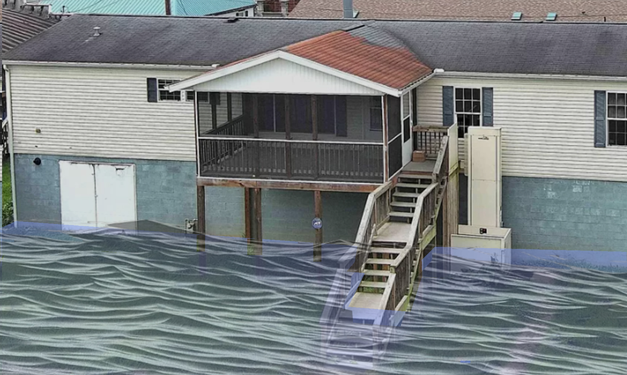
2016 High Watermark
High Watermark
1.0’ (2016 High Water)
Building’s Ground Elevation

Slide 6
The Design Flood Elevation (DFE) should be the BFE plus 2 feet of freeboard. The DFE should also be above the high-water marks of the 2016 flood plus freeboard.
113 Valley Ave, Richwood, WV
 | HEIGHT (ft.)
BUILDING
First Floor Height | 8
Freeboard (FBD) | 2
FLOOD DEPTH
FEMA 10% (10-Yr) | NA
FEMA 4% (25-Yr) | NA
FEMA 2% (50-Yr)
2016 Flood HWM | 1.0
FEMA 1% (100-Yr)
FEMA 100-Yr + FBD
FEMA 1%+ (84% CL)
FEMA 0.2% (500-Yr)
FSF 0.2% (500-Yr)
1.0’ (2016 High Water)
Building 34-06-0011-0090-0000_113
Building 34-06-0011-0090-0000_113
FLOOD DEPTHS:
FEMA, Effective 2021
First Street Foundation (FSF, 2022)
USGS 2016 Flood High Water Mark

Slide 7
The Design Flood Elevation (DFE) should be the BFE plus 2 feet of freeboard. The DFE should also be above the high-water marks of the 2016 flood plus freeboard.
113 Valley Ave, Richwood, WV
 | HEIGHT (ft.)
BUILDING
First Floor Height | 8
Freeboard (FBD) | 2
FLOOD DEPTH
FEMA 10% (10-Yr) | NA
FEMA 4% (25-Yr) | NA
FEMA 2% (50-Yr) | 2.8
2016 Flood HWM | 1.0
FEMA 1% (100-Yr)
FEMA 100-Yr + FBD
FEMA 1%+ (84% CL)
FEMA 0.2% (500-Yr)
FSF 0.2% (500-Yr)
2.8’ (FEMA 2% / 50-Yr)
1.0’ (2016 High Water)
Building 34-06-0011-0090-0000_113
FLOOD DEPTHS:
FEMA, Effective 2021
First Street Foundation (FSF, 2022)
USGS 2016 Flood High Water Mark

Slide 8
The Design Flood Elevation (DFE) should be the BFE plus 2 feet of freeboard. The DFE should also be above the high-water marks of the 2016 flood plus freeboard.
113 Valley Ave, Richwood, WV
 | HEIGHT (ft.)
BUILDING
First Floor Height | 8
Freeboard (FBD) | 2
FLOOD DEPTH
FEMA 10% (10-Yr) | NA
FEMA 4% (25-Yr) | NA
FEMA 2% (50-Yr) | 2.8
2016 Flood HWM | 1.0
FEMA 1% (100-Yr) | 3.5
FEMA 100-Yr + FBD | 5.5
FEMA 1%+ (84% CL) | 9.0
FEMA 0.2% (500-Yr)
FSF 0.2% (500-Yr)
9.0’ FEMA1%+ (84% CL)
3.5’ (FEMA 1% / 100-Yr)
2.8’ (FEMA 2% / 50-Yr)
1.0’ (2016 High Water)
Building 34-06-0011-0090-0000_113
FLOOD DEPTHS:
FEMA, Effective 2021
First Street Foundation (FSF, 2022)
USGS 2016 Flood High Water Mark

Slide 9
The Design Flood Elevation (DFE) should be the BFE plus 2 feet of freeboard. The DFE should also be above the high-water marks of the 2016 flood plus freeboard.
113 Valley Ave, Richwood, WV
 | HEIGHT (ft.)
BUILDING
First Floor Height | 8
Freeboard (FBD) | 2
FLOOD DEPTH
FEMA 10% (10-Yr) | NA
FEMA 4% (25-Yr) | NA
FEMA 2% (50-Yr) | 2.8
2016 Flood HWM | 1.0
FEMA 1% (100-Yr) | 3.5
FEMA 100-Yr + FBD | 5.5
FEMA 1%+ (84% CL) | 9.0
FEMA 0.2% (500-Yr) | 8.3
FSF 0.2% (500-Yr)
9.0’ FEMA1%+ (84% CL)
8.3’ (FEMA 0.2% / 500-Yr)
3.5’ (FEMA 1% / 100-Yr)
2.8’ (FEMA 2% / 50-Yr)
1.0’ (2016 High Water)
Building 34-06-0011-0090-0000_113
FLOOD DEPTHS:
FEMA, Effective 2021
First Street Foundation (FSF, 2022)
USGS 2016 Flood High Water Mark

Slide 10
The Design Flood Elevation (DFE) should be the BFE plus 2 feet of freeboard. The DFE should also be above the high-water marks of the 2016 flood plus freeboard.
113 Valley Ave, Richwood, WV
 | HEIGHT (ft.)
BUILDING
First Floor Height | 8
Freeboard (FBD) | 2
FLOOD DEPTH
FEMA 10% (10-Yr) | NA
FEMA 4% (25-Yr) | NA
FEMA 2% (50-Yr) | 2.8
2016 Flood HWM | 1.0
FEMA 1% (100-Yr) | 3.5
FEMA 100-Yr + FBD | 5.5
FEMA 1%+ (84% CL) | 9.0
FEMA 0.2% (500-Yr) | 8.3
FSF 0.2% (500-Yr) | 6.7
9.0’ FEMA1%+ (84% CL)
8.3’ (FEMA 0.2% / 500-Yr)
6.7’ (FSG 0.2% / 500-Yr)
3.5’ (FEMA 1% / 100-Yr)
2.8’ (FEMA 2% / 50-Yr)
1.0’ (2016 High Water)
Building 34-06-0011-0090-0000_113
FLOOD DEPTHS:
FEMA, Effective 2021
First Street Foundation (FSF, 2022)
USGS 2016 Flood High Water Mark

