Slide 1
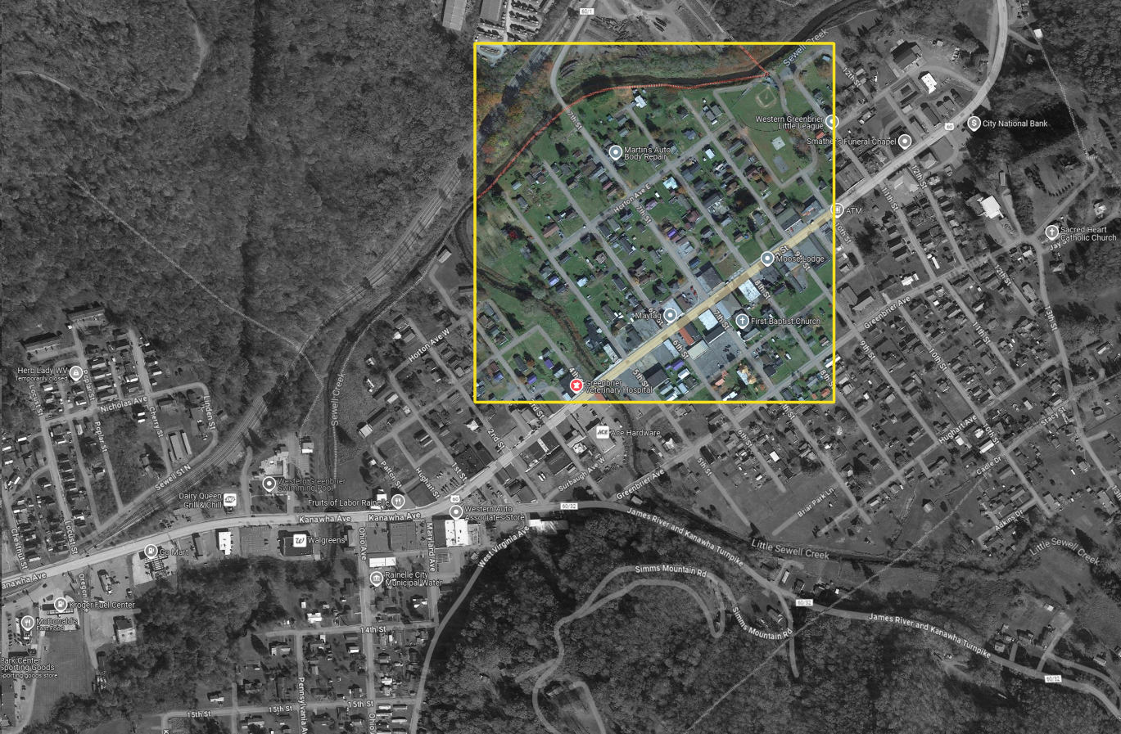
A Bird’s view over:
Central Neighborhood near Horton Ave and 7th Street, Rainelle
North

Slide 2
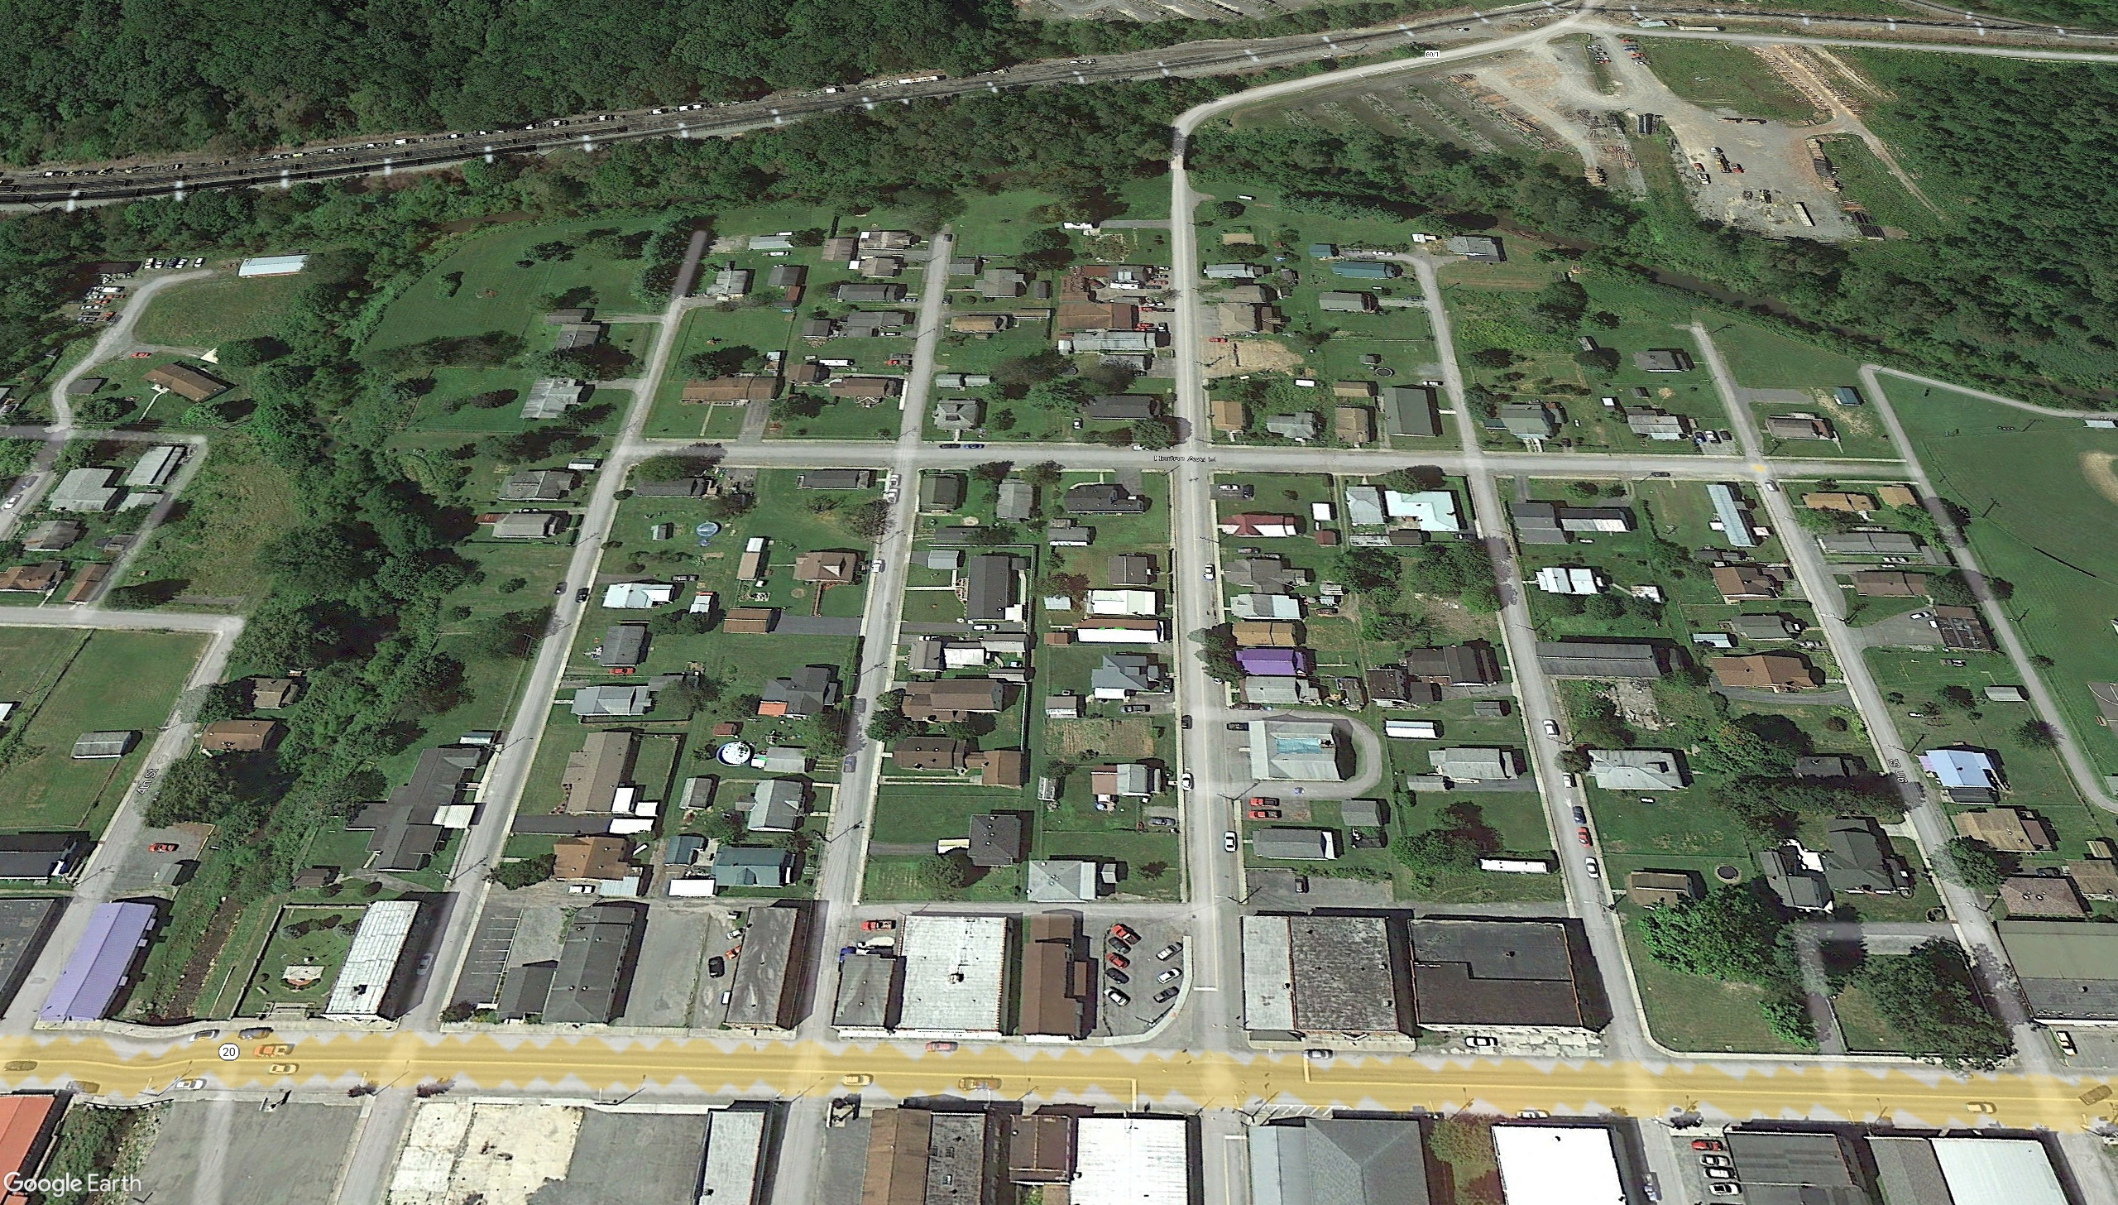


Pre-Disaster Aerial View
Imagery of September 2013
6th St.
7th St.
8th St.
Horton Avenue E.
Horton Avenue E.
6th St.
7th St.
8th St.
Main Street
Main Street
Image courtesy of Google Earth Pro

Slide 3
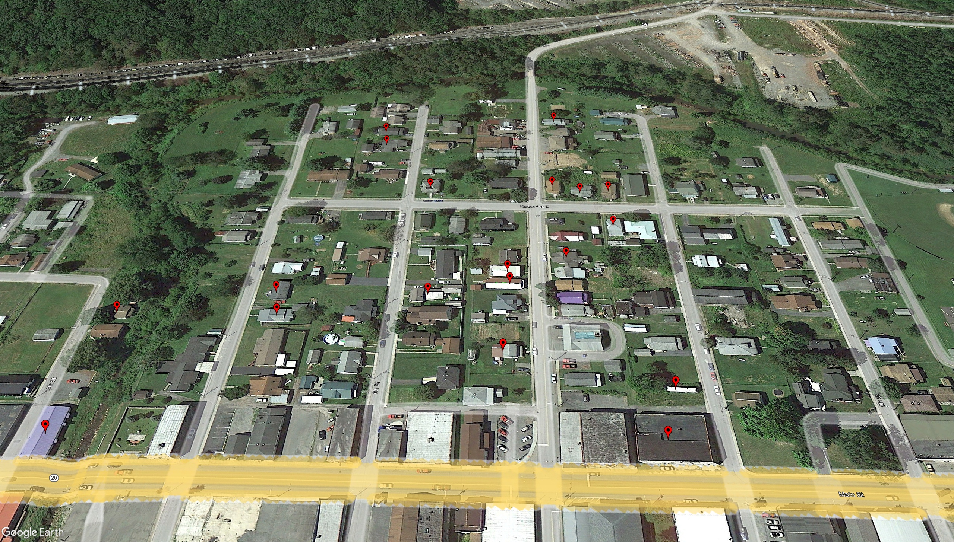
Removed Structure
Imagery of September 2013
Building REMOVED (Vacant Parcel)
Image courtesy of Google Earth Pro

Slide 4

Deed-Restricted Buyout Parcels
Imagery of September 2013
ACQUISITION or Buyout Property
Image courtesy of Google Earth Pro

Slide 5

Imagery of September 2013
Mitigated Structures
by Elevating to Design Flood Elevation (DFE)
Mitigation RECONSTRUCTION
Image courtesy of Google Earth Pro

Slide 6
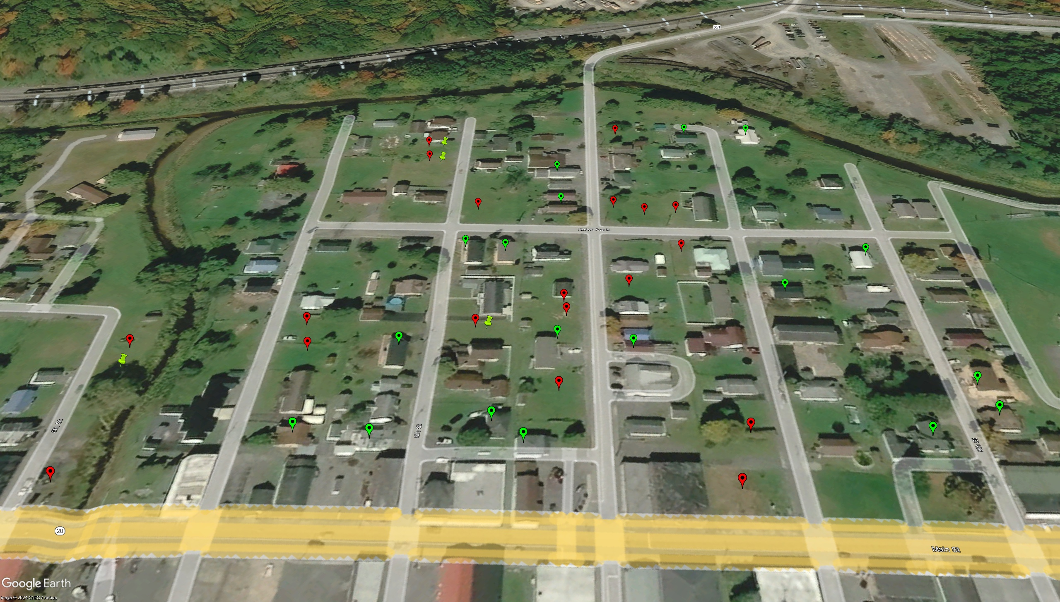



Imagery of October 2020
Building REMOVED (Vacant Parcel)
ACQUISITION or Buyout Property
Image courtesy of Google Earth Pro
Mitigation RECONSTRUCTION

