Slide 1
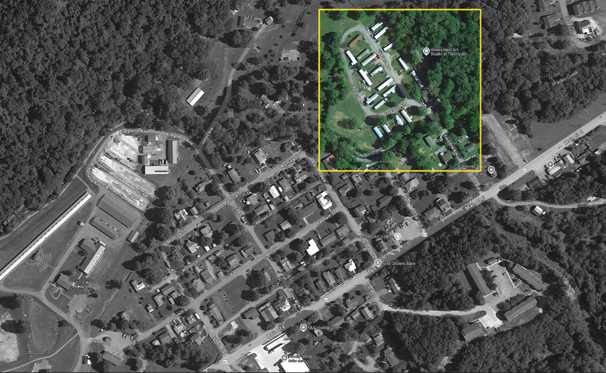
A Bird’s view over:
Freeland Ave, Eastern Main Street, and Wades Creek, White Sulphur Springs
North

Slide 2
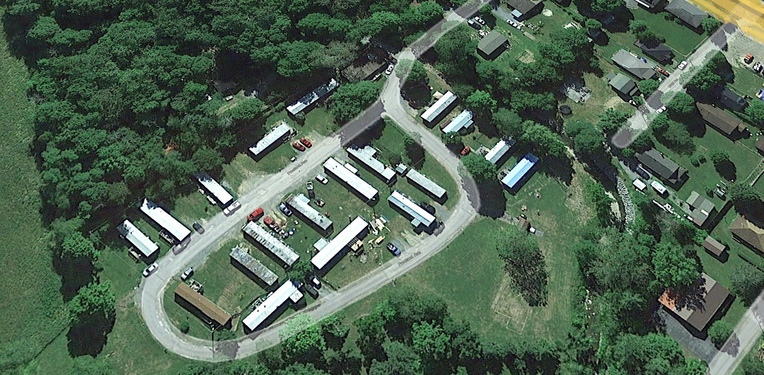

Pre-Disaster Aerial View
Imagery of June 2016
Image courtesy of Google Earth Pro

Slide 3


Removed Structures
Imagery of June 2016
Building REMOVED (Vacant Parcel)
Image courtesy of Google Earth Pro

Slide 4
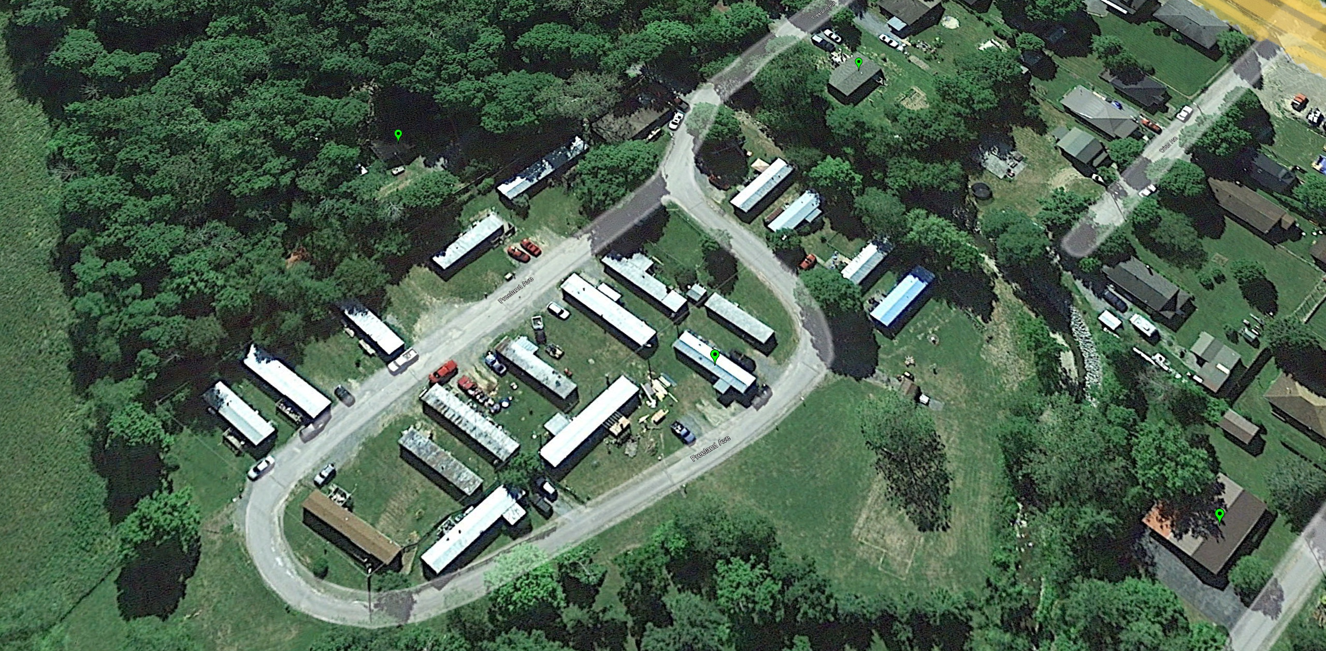

Mitigated Structures
by Elevating to Design Flood Elevation (DFE)
Imagery of June 2016
Mitigation RECONSTRUCTION
Image courtesy of Google Earth Pro

Slide 5
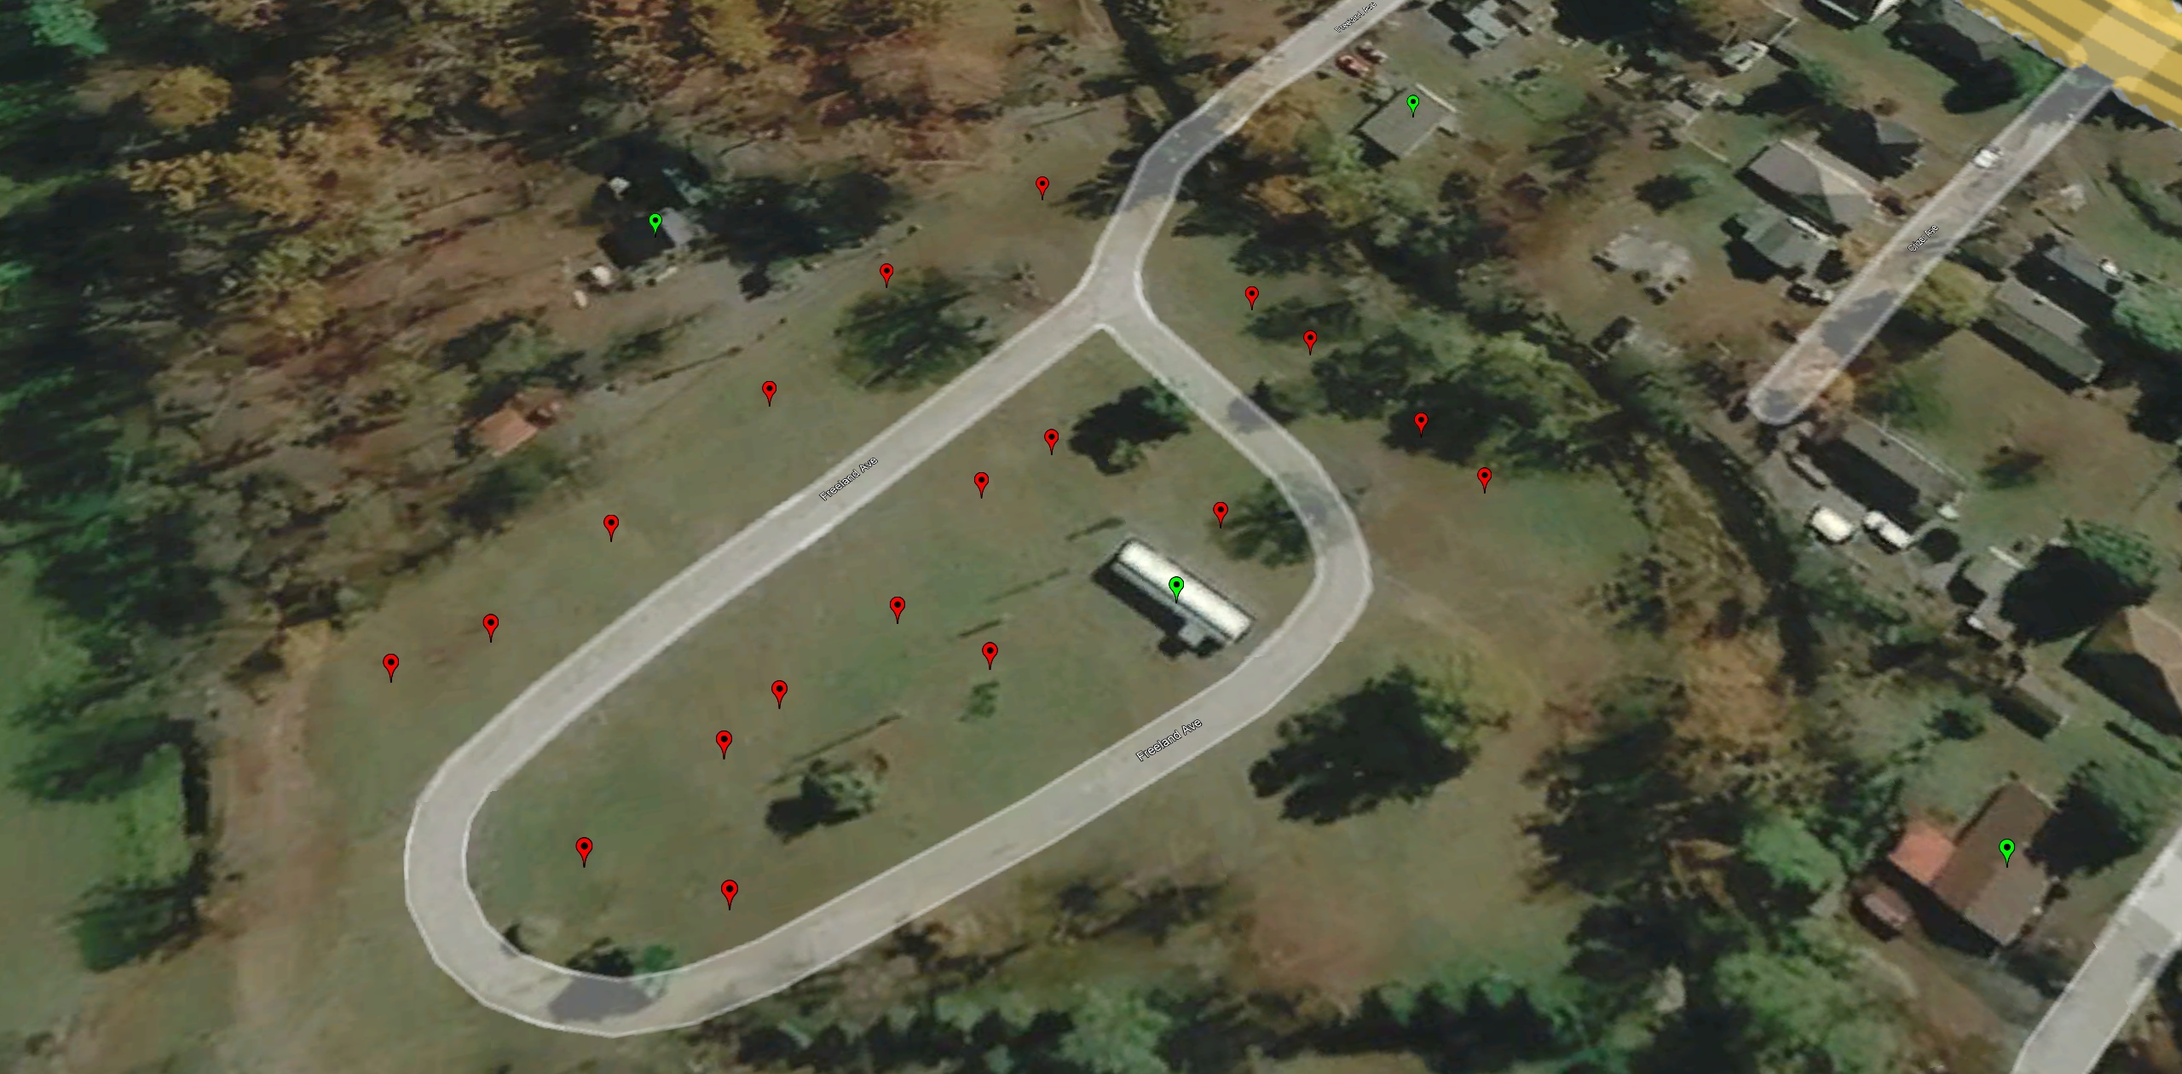
Imagery of October 2019
Building REMOVED (Vacant Parcel)
Image courtesy of Google Earth Pro
Mitigation RECONSTRUCTION

