Slide 1
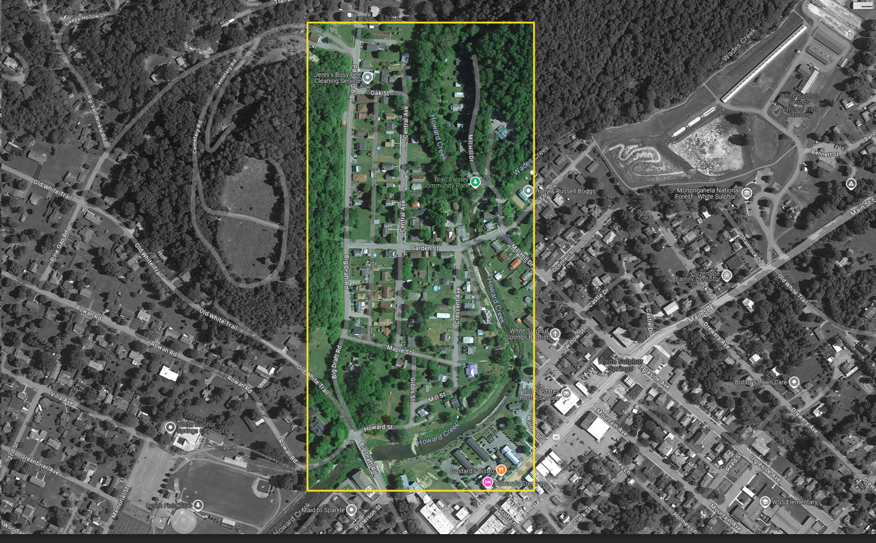
A Bird’s view over:
Howard Creek Neighborhood near Big Draft Road and Garden Street, White Sulphur Springs
North

Slide 2
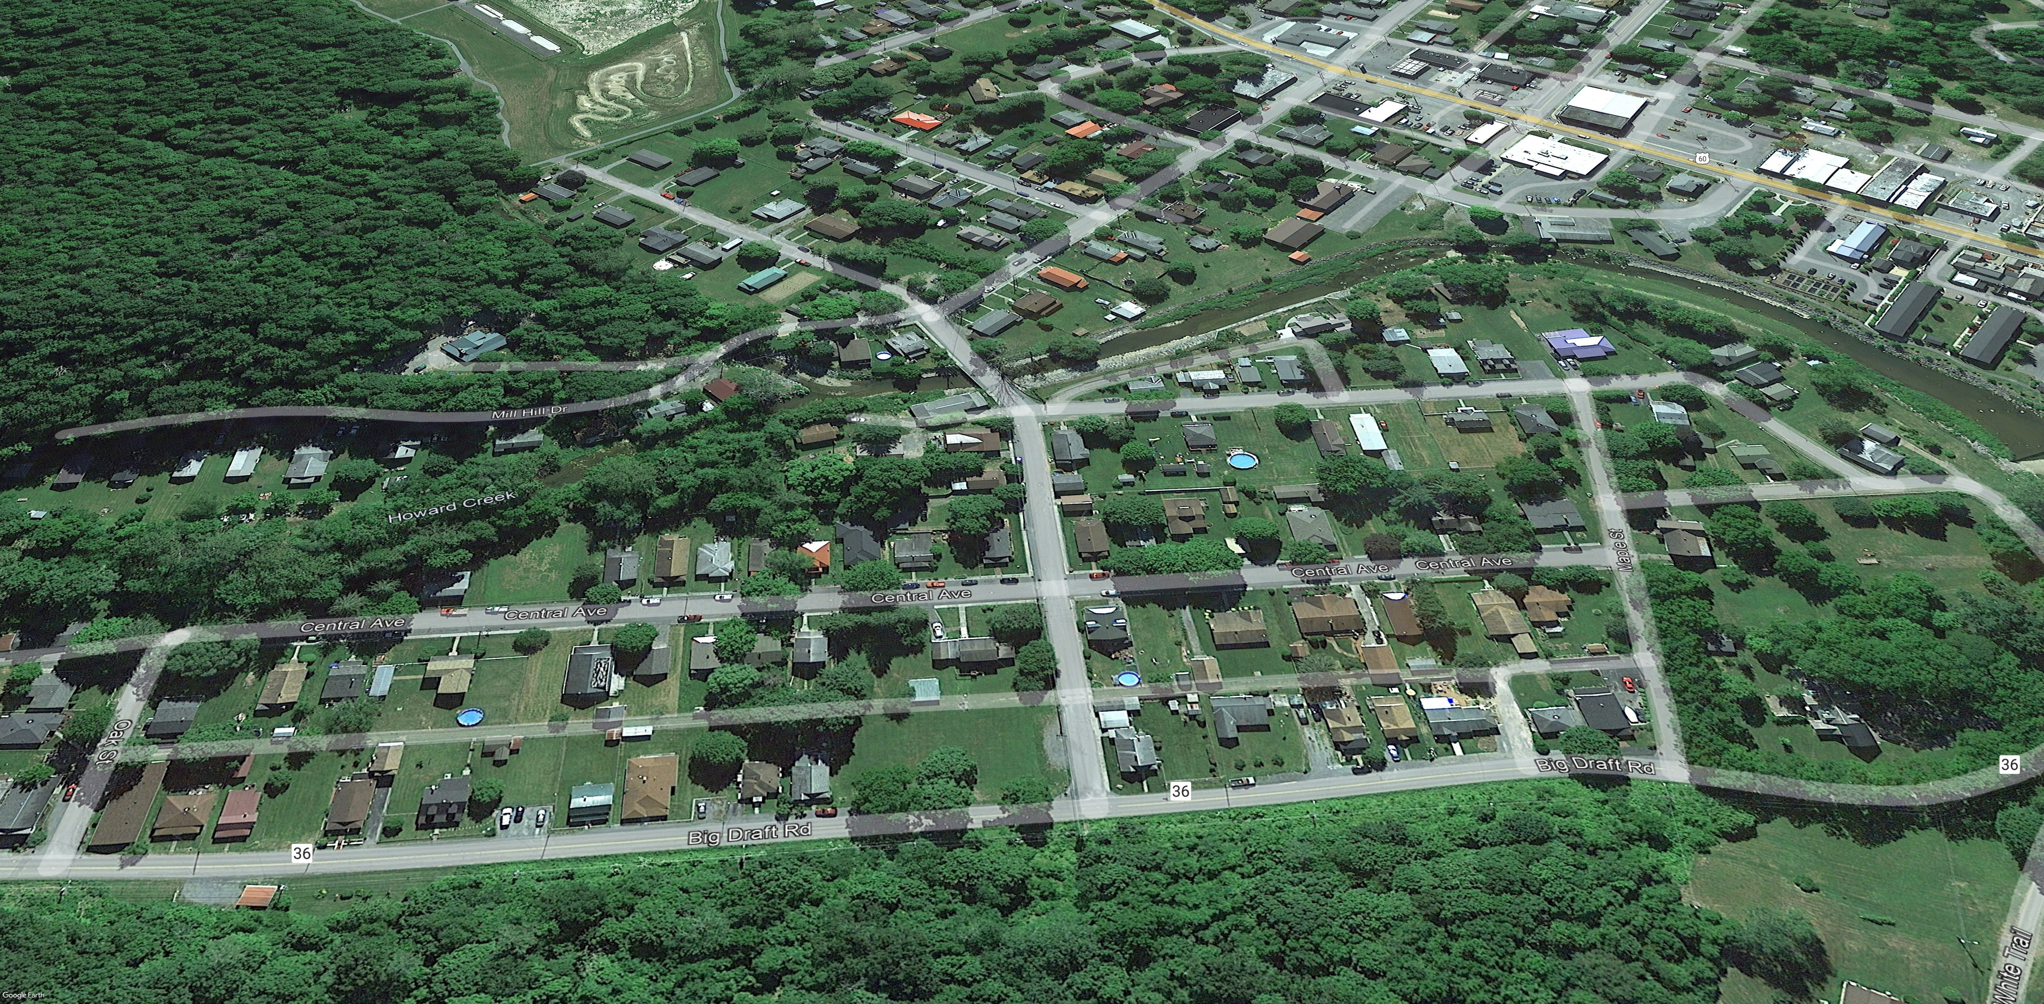

Pre-Disaster Aerial View
Imagery of June 2016
Image courtesy of Google Earth Pro

Slide 3
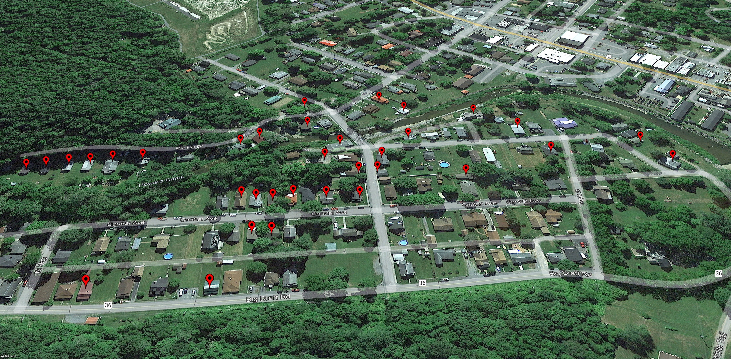
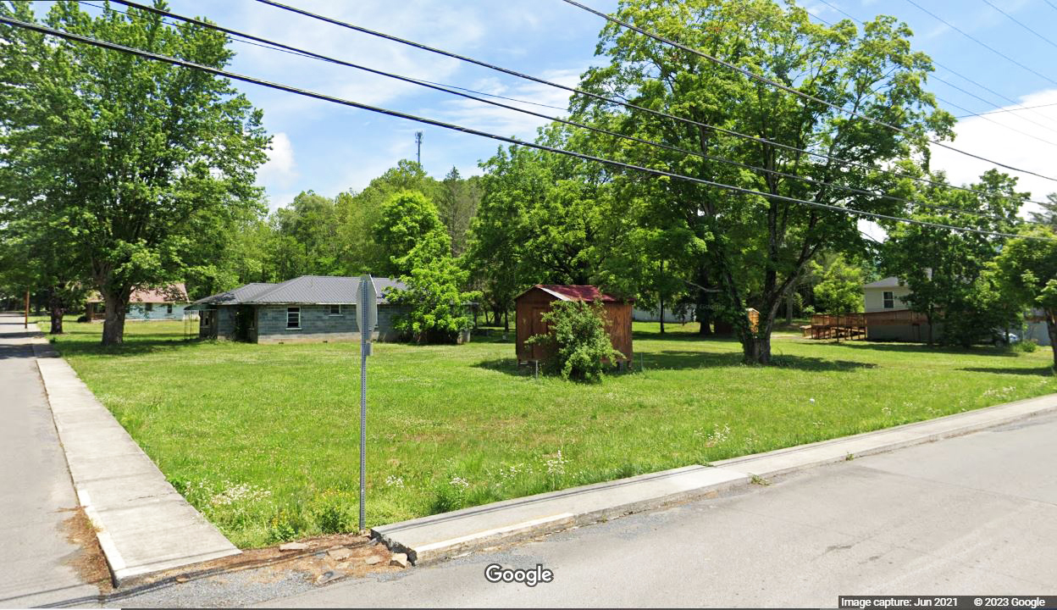

Removed Structures
Imagery of June 2016
Building REMOVED (Vacant Parcel)
Image courtesy of Google Earth Pro & Google Street View

Slide 4
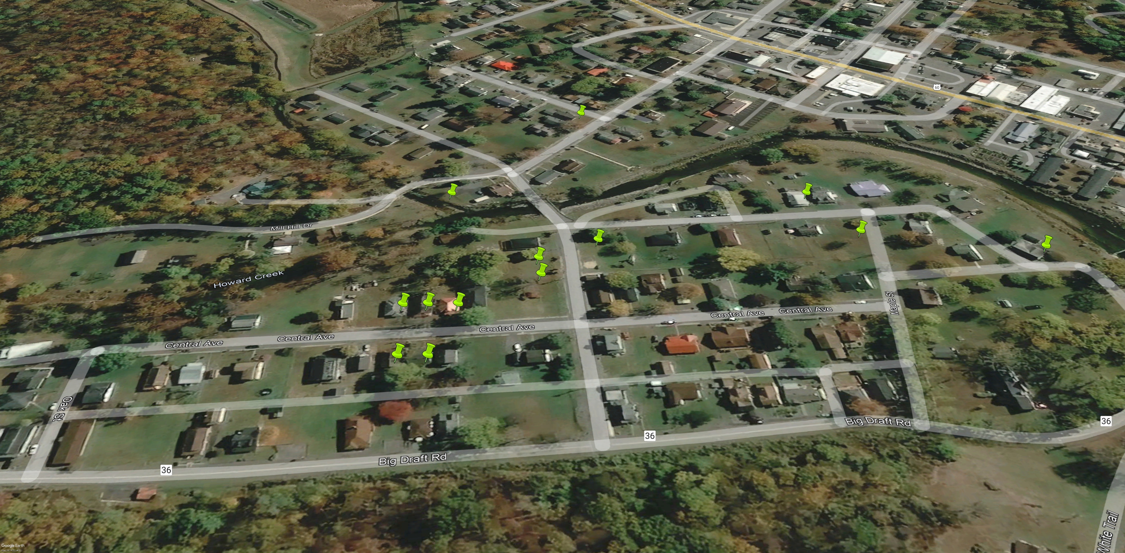
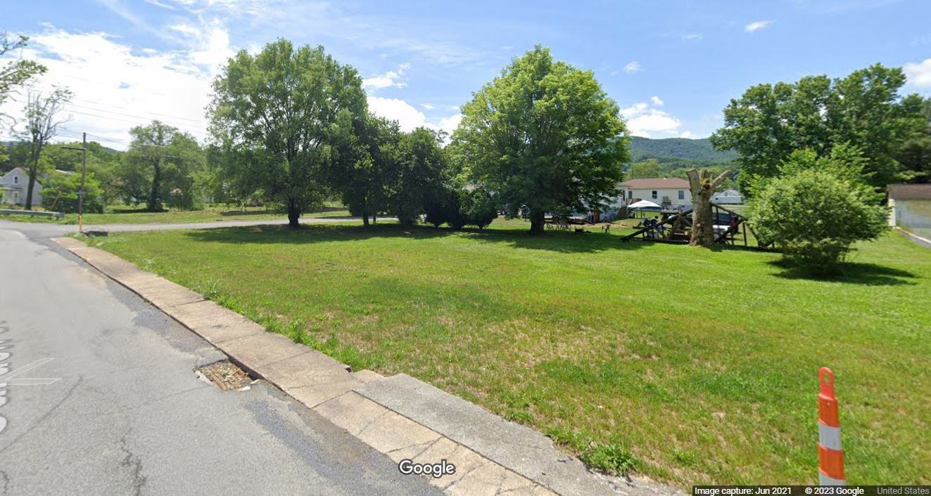

Deed-Restricted Buyout Parcels
Imagery of October 2019
ACQUISITION or Buyout Property
Image courtesy of Google Earth Pro & Google Street View

Slide 5
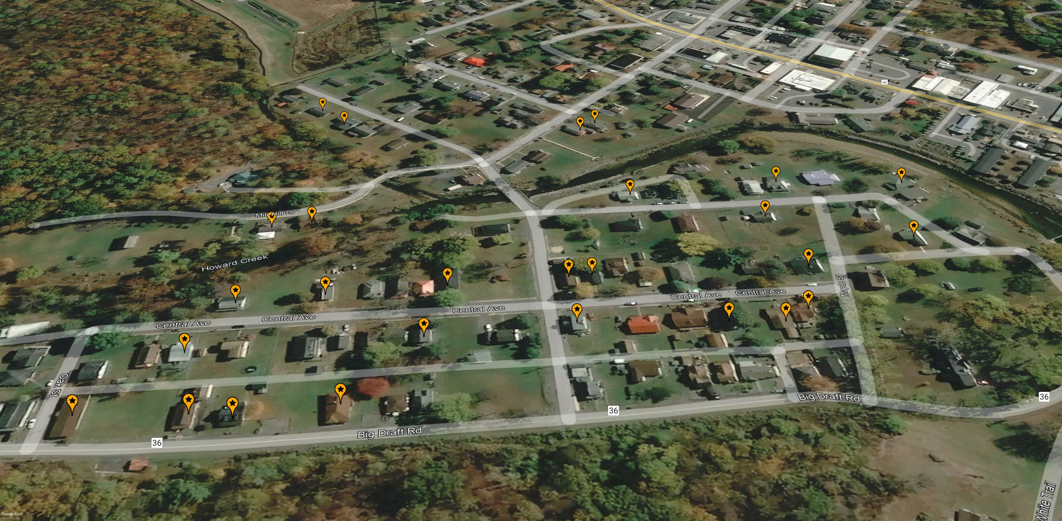
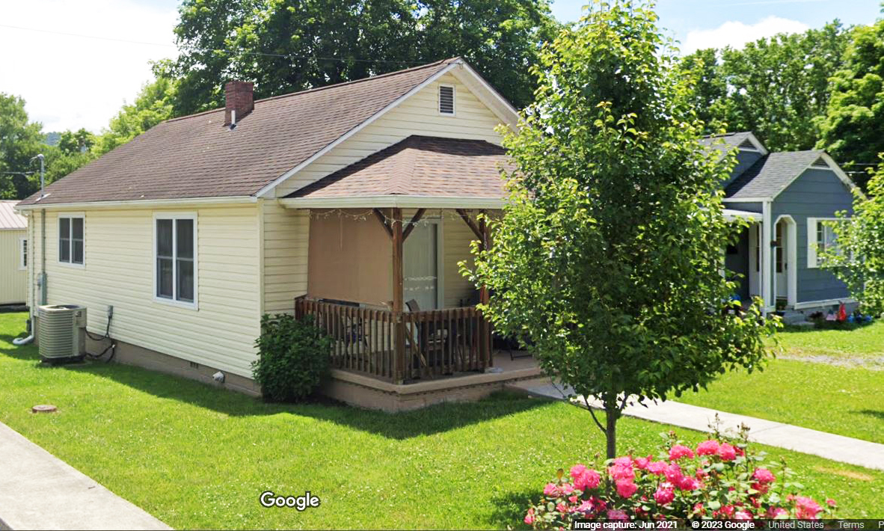

Non-Mitigated Repaired Structures
Imagery of October 2019
REPAIRED of Substantially Damaged (>50%) Building
Image courtesy of Google Earth Pro & Google Street View

Slide 6
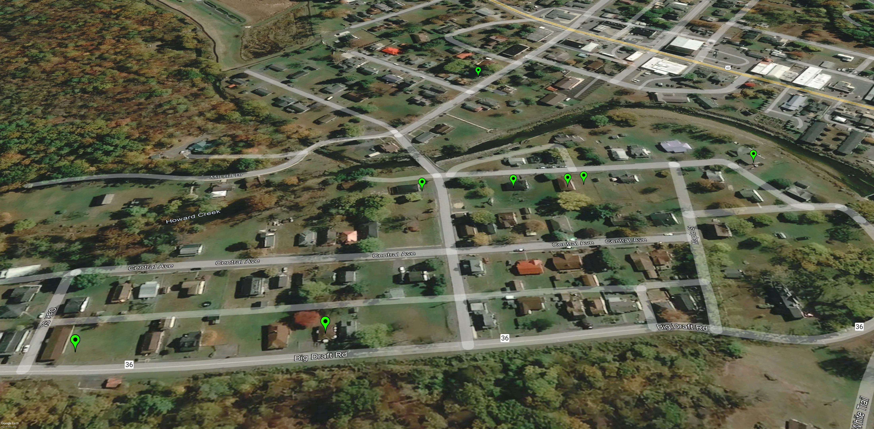
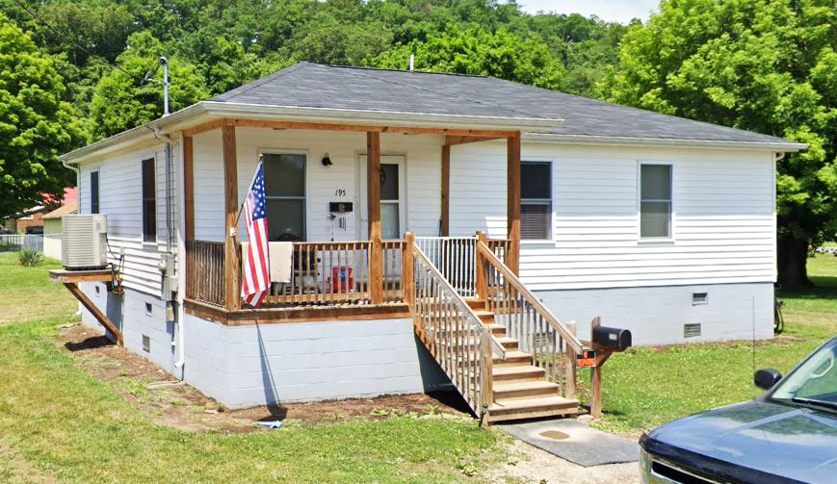

Mitigated Structures, Elevated to Design Flood Elevation (DFE)
Imagery of October 2019
Mitigation RECONSTRUCTION
Image courtesy of Google Earth Pro & Google Street View

Slide 7
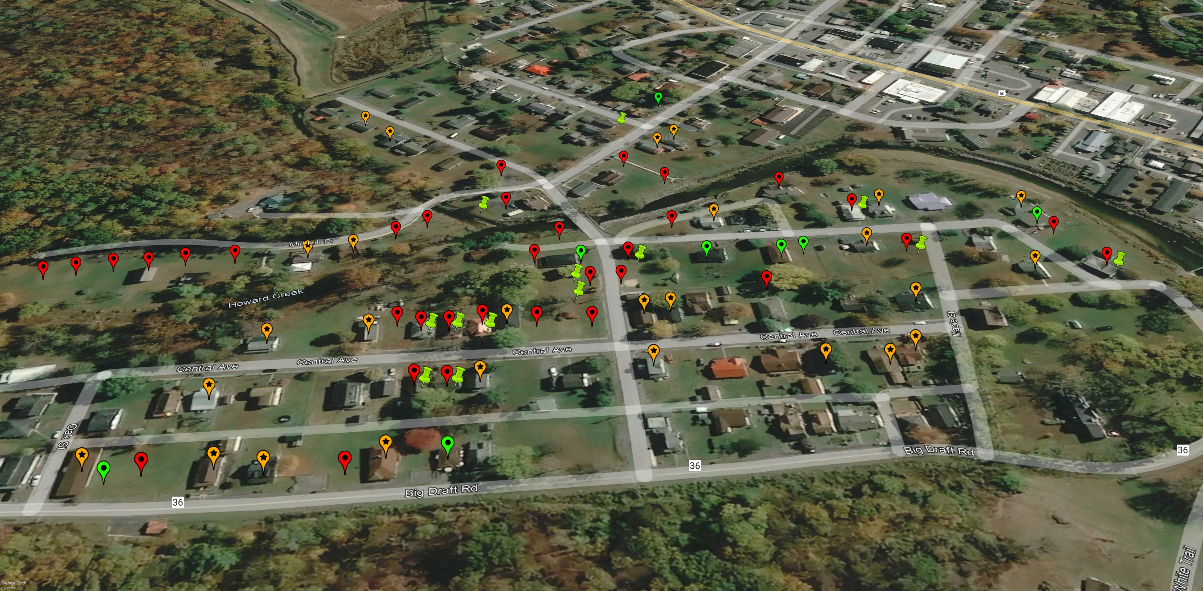
Mitigated & Non-Mitigated Properties
Imagery of October 2019
Building REMOVED (Vacant Parcel)
ACQUISITION or Buyout Property
REPAIRED of Substantially Damaged (>50%) Building
Mitigation RECONSTRUCTION
Image courtesy of Google Earth Pro

