Slide 1
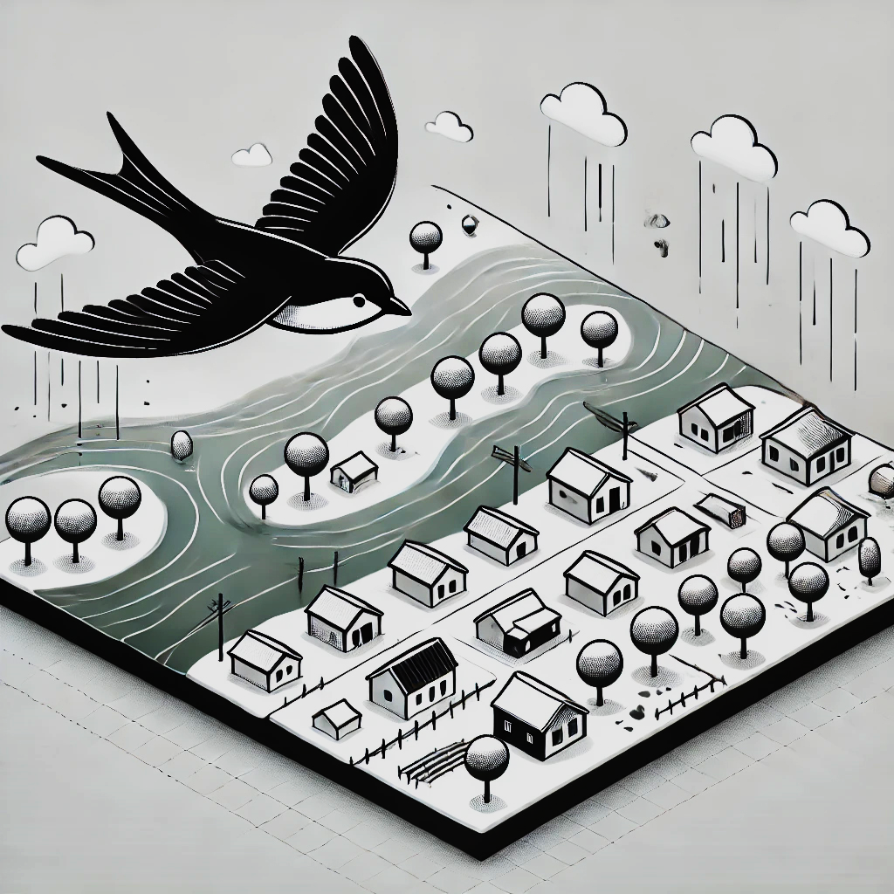
VIEWSHED FLOOD INUNDATED MAP
These inundation maps at the viewshed or bird’s eye level portray riverine flood models of different flood frequencies and magnitudes. Flood models can be visualized at the community or viewshed map scale as seen here.
CAMDEN-ON-GAULEY
CLENDENIN
KEYSTONE
LOGAN UNINCORPORATED AREA
NORTHFORK
MARLINTON
RAINELLE
RICHWOOD
HAMPSHIRE UNINCORPORATD AREA
WHITE SULPHUR SPRINGS
Community-scale flood inundation maps at the viewshed level

Slide 2
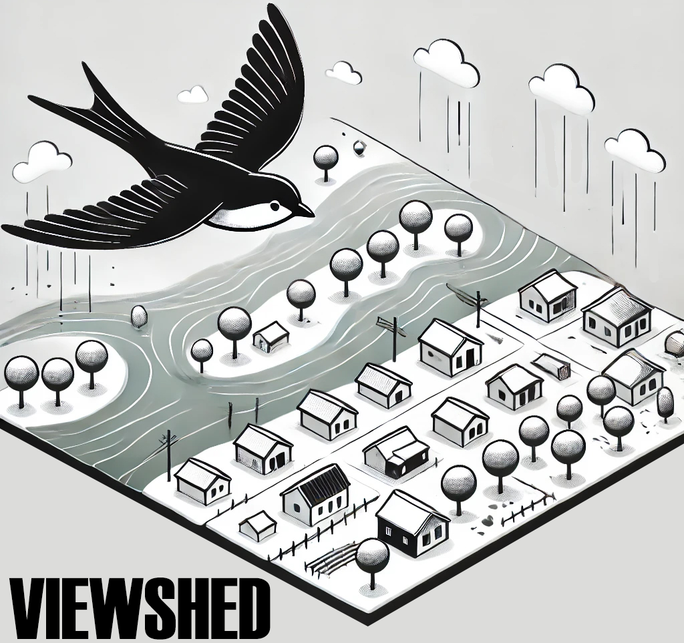
FEMA 10% Annual Chance (10-year)
Camden-on-Gauley, WV
0.1 ft.
FLOOD DEPTH
22.1 ft.
Residential
Non-Residential
FEMA, Effective Date: 2022
10% of Camden is in the 10% Annual Flood Chance
96% probability of flooding at least once over 30 years

Slide 3
FEMA 4% Annual Chance (25-year)
Camden-on-Gauley, WV
0.1 ft.
FLOOD DEPTH
25.3 ft.
Residential
Non-Residential
FEMA, Effective Date: 2022
12% of Camden is in the 4% Annual Flood Chance
71% probability of flooding at least once over 30 years

Slide 4
FEMA 2% Annual Chance (50-year)
Camden-on-Gauley, WV
0.1 ft.
FLOOD DEPTH
27.3 ft.
Residential
Non-Residential
12% of Camden is in the 2% Annual Flood Chance
45% probability of flooding at least once over 30 years

Slide 5
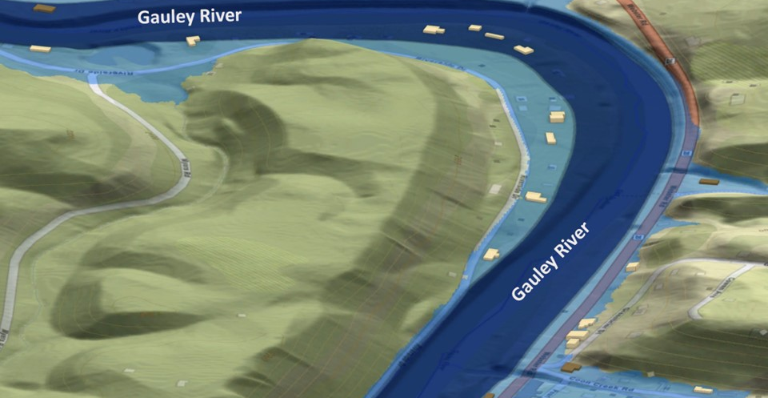
FEMA 1% Annual Chance (100-year)
Camden-on-Gauley, WV
0.1 ft.
FLOOD DEPTH
29.3 ft.
Residential
Non-Residential
FEMA, Effective Date: 2022
14% of Camden is in the 1% Annual Flood Chance
26% probability of flooding at least once over 30 years

Slide 6
FEMA 1+% Annual Chance (100-year)
Camden-on-Gauley, WV
Climate
Change
0.1 ft.
FLOOD DEPTH
31.5 ft.
Residential
Non-Residential
13% of Camden is in the 1%+ Annual Flood Chance
26% probability of flooding at least once over 30 years

Slide 7
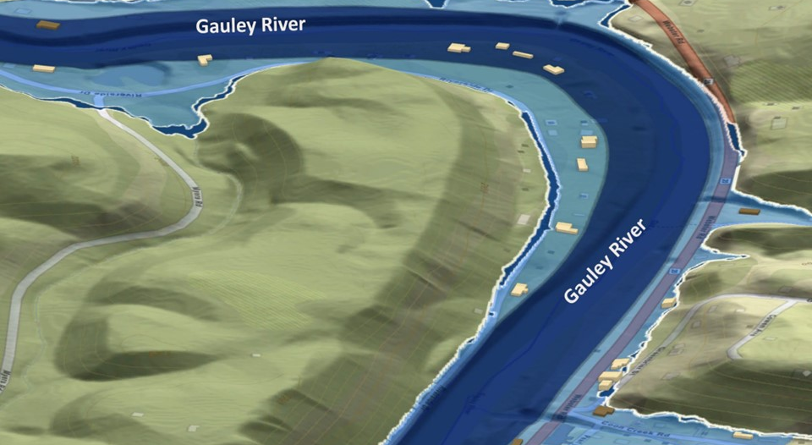
FEMA 0.2% Annual Chance (500-year)
Camden-on-Gauley, WV
0.1 ft.
FLOOD DEPTH
32.5 ft.
Residential
Non-Residential
15% of Camden is in the 0.2% Annual Flood Chance
6% probability of flooding at least once over 30 years

Slide 8
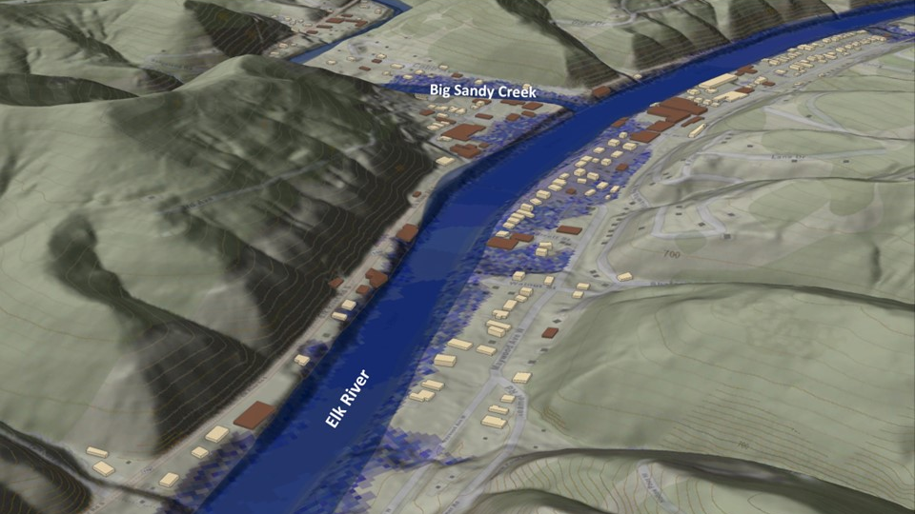
FEMA 10% Annual Chance (10-year)
Clendenin, WV
0.1 ft.
FLOOD DEPTH
27.8 ft.
Residential
Non-Residential
13.4% of Clendenin is in the 10% Annual Flood Chance
96% probability of flooding at least once over 30 years

Slide 9
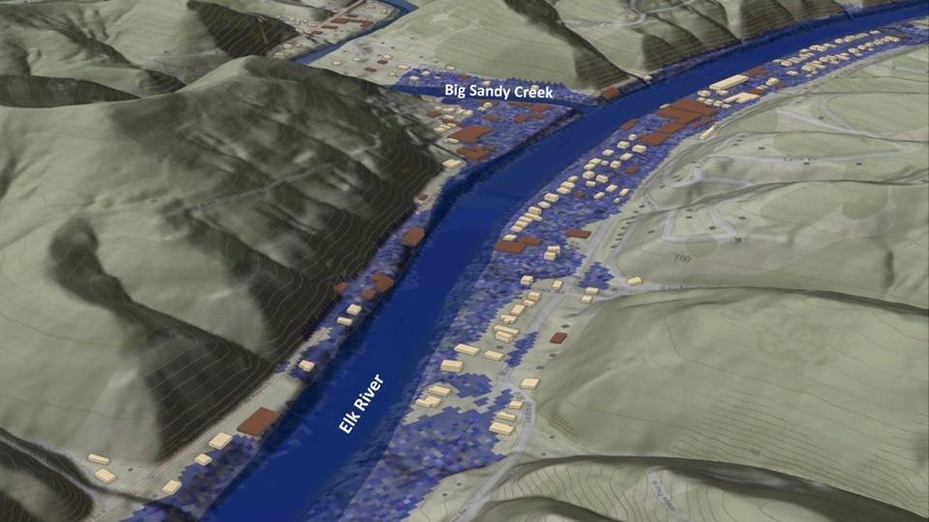
FEMA 4% Annual Chance (25-year)
Clendenin, WV
0.1 ft.
FLOOD DEPTH
27.8 ft.
Residential
Non-Residential
19% of Clendenin is in the 4% Annual Flood Chance
71% probability of flooding at least once over 30 years

Slide 10
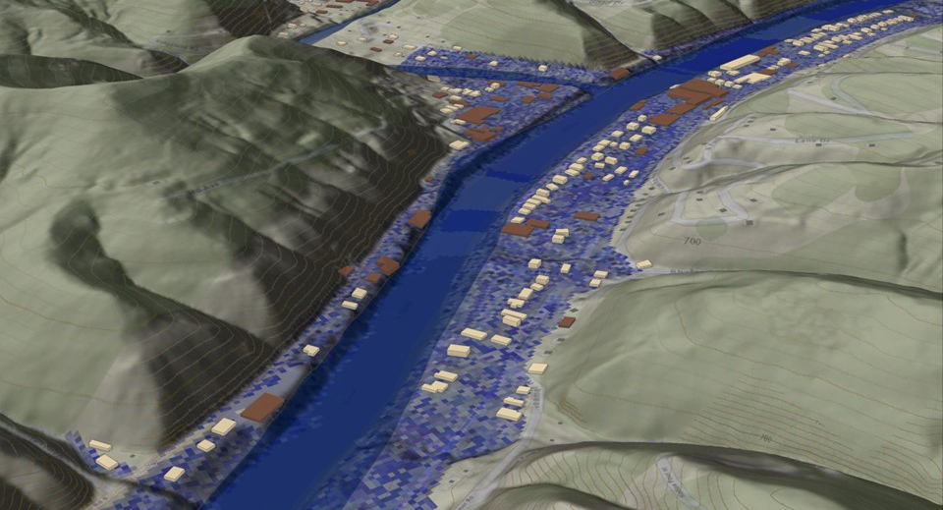
FEMA 2% Annual Chance (50-year)
Clendenin, WV
0.1 ft.
FLOOD DEPTH
35.2 ft.
Residential
Non-Residential
22.5% of Clendenin is in the 4% Annual Flood Chance
45% probability of flooding at least once over 30 years

Slide 11
FEMA 1% Annual Chance (100-year)
Clendenin, WV
0.1 ft.
FLOOD DEPTH
38.1 ft.
Residential
Non-Residential
FEMA, Effective Date: 2023
23.5% of Clendenin is in the 1% Annual Flood Chance
26% probability of flooding at least once over 30 years

Slide 12
FEMA 1%+ Annual Chance (100-year)
Clendenin, WV
Climate
Change
0.1 ft.
FLOOD DEPTH
42.4 ft.
Residential
Non-Residential
23.5% of Clendenin is in the 1%+ Annual Flood Chance
26% probability of flooding at least once over 30 years

Slide 13
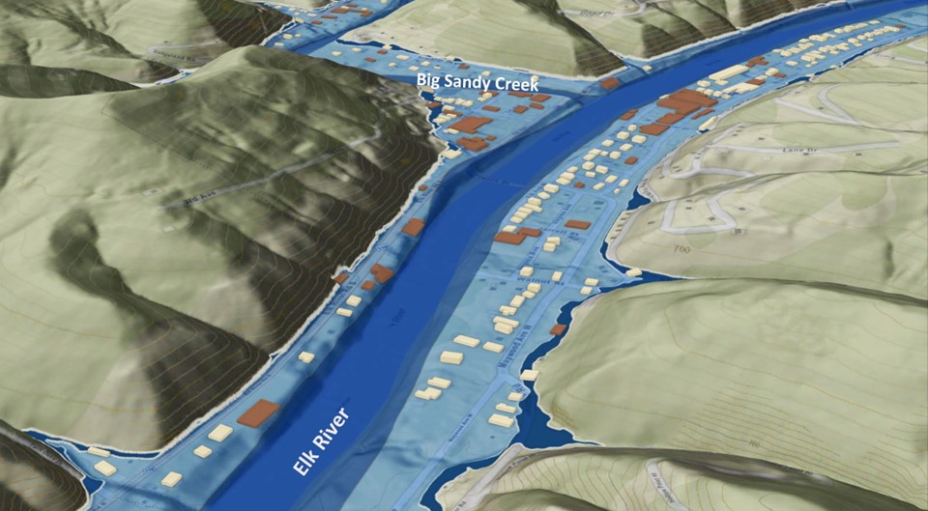
FEMA 0.2% Annual Chance (500-year)
Clendenin, WV
0.1 ft.
FLOOD DEPTH
43.6 ft.
Residential
Non-Residential
25% of Clendenin is in the 0.2% Annual Flood Chance
6% probability of flooding at least once over 30 years

Slide 14
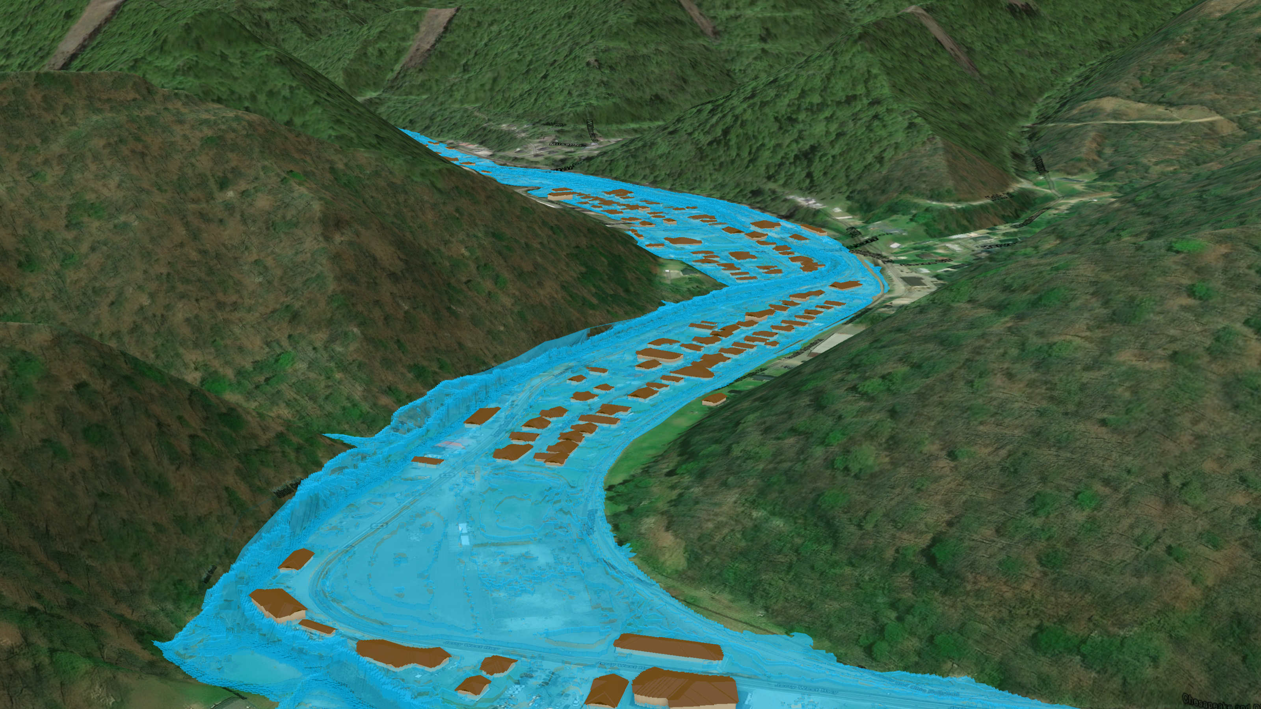
FEMA 1% Annual Chance (100-year)
Island Creek, Logan, WV
26% probability of flooding at least once over 30 years

Slide 15
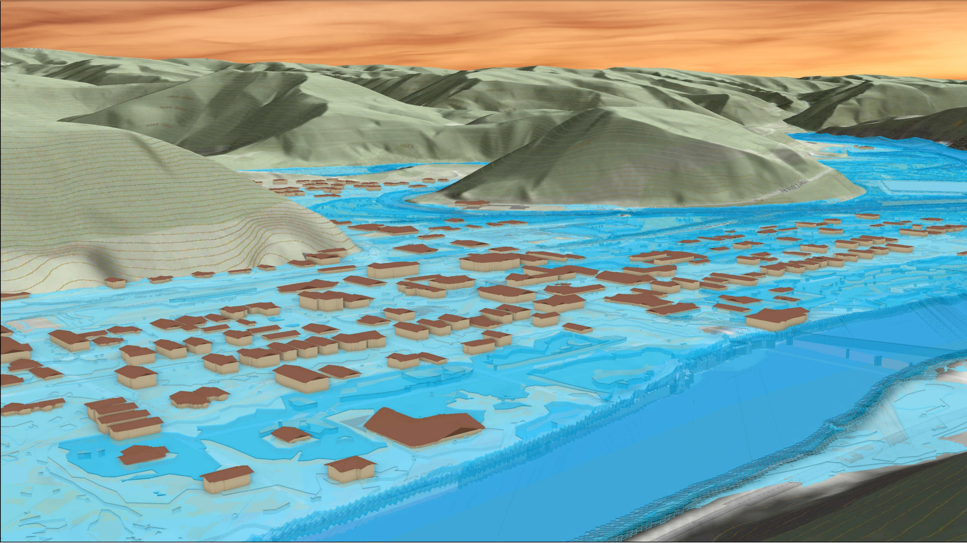
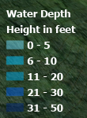
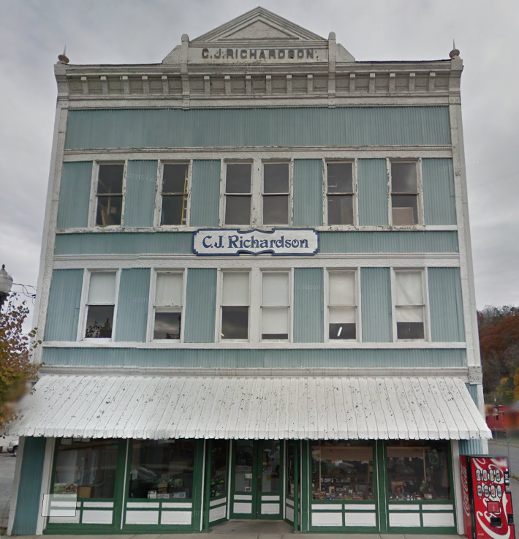
FEMA 1% Annual Chance (100-year)
Marlinton, WV
309 8th St, Marlinton, WV, 24954
Knapp Creek
Greenbrier River

Slide 16
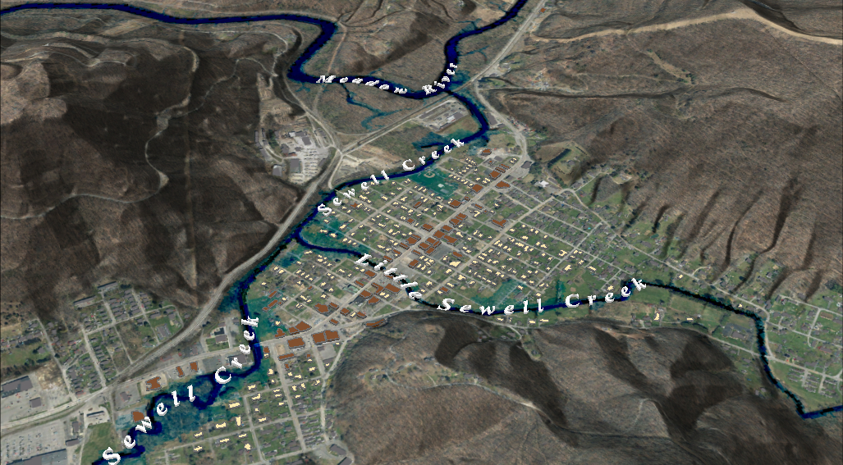
FEMA 10% Annual Chance (10-year)
Rainelle, WV
0.1 ft.
FLOOD DEPTH
30 ft.
Residential
Non-Residential
96% probability of flooding at least once over 30 years
13% Rainelle is in the 10% Annual Flood Chance
Notes:
FEMA 10year Aerial

Slide 17
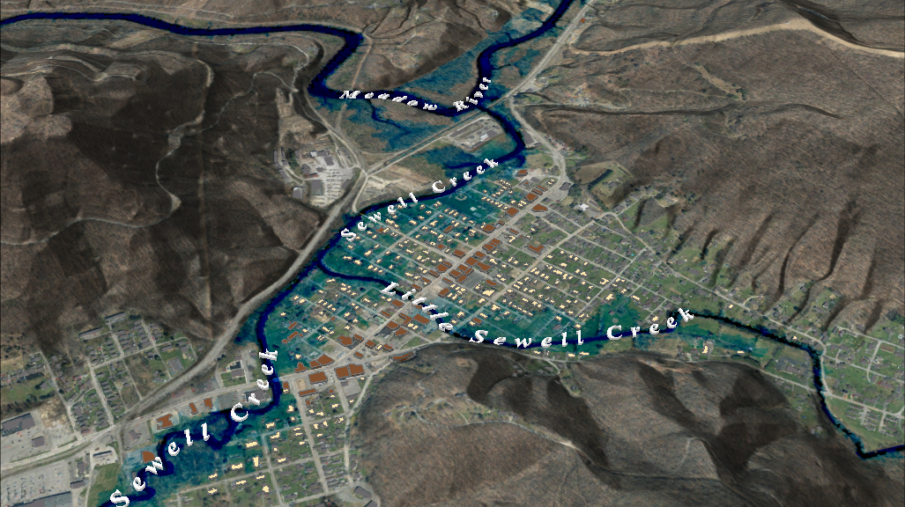
FEMA 4% Annual Chance (25-year)
Rainelle, WV
0.1 ft.
FLOOD DEPTH
30 ft.
Residential
Non-Residential
71% probability of flooding at least once over 30 years
20% Rainelle is in the 4% Annual Flood Chance
Notes:
FEMA 25year Aerial

Slide 18
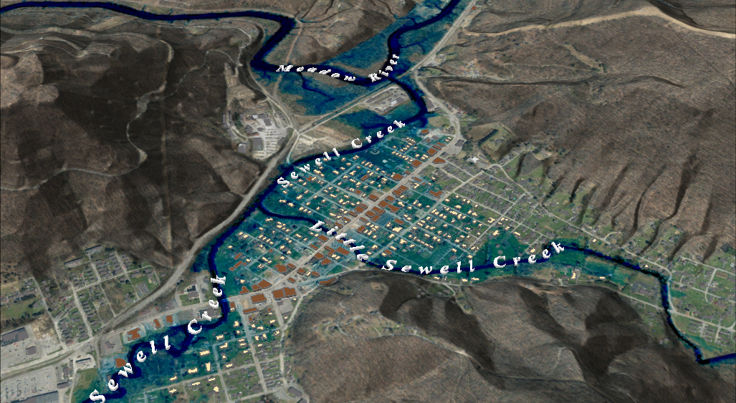
FEMA 2% Annual Chance (50-year)
FEMA 2% Annual Chance (50-year)
Rainelle, WV
Rainelle, WV
0.1 ft.
FLOOD DEPTH
30 ft.
Residential
Non-Residential
45% probability of flooding at least once over 30 years
26% Rainelle is in the 2% Annual Flood Chance
Notes:
FEMA 50year Aerial

Slide 19
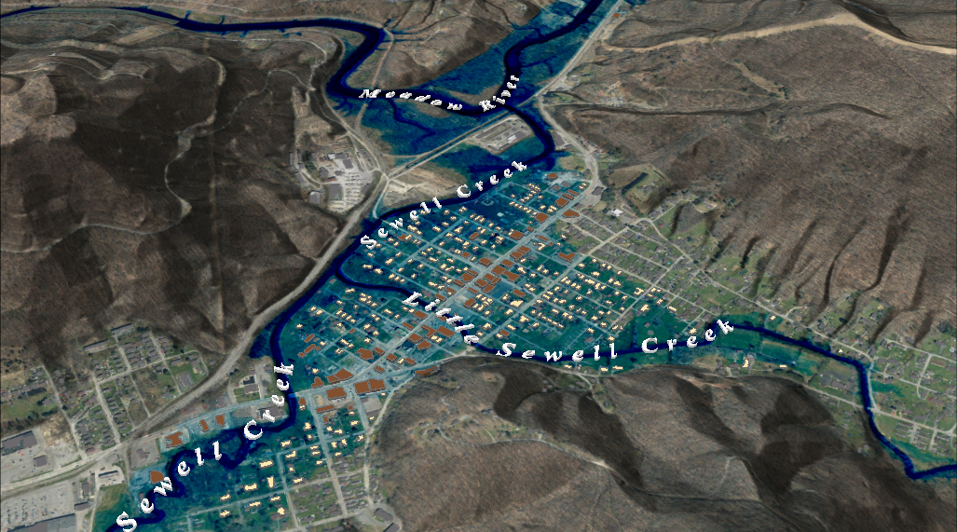
FEMA 2% Annual Chance (50-year)
FEMA 1% Annual Chance (100-year)
Rainelle, WV
Rainelle, WV
0.1 ft.
FLOOD DEPTH
30 ft.
Residential
Non-Residential
26% probability of flooding at least once over 30 years
31% Rainelle is in the 1% Annual Flood Chance
Notes:
FEMA 100year Aerial

Slide 20
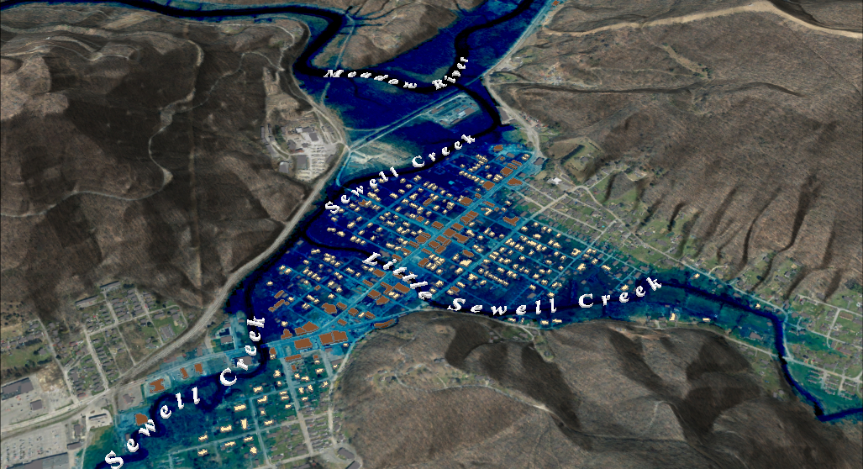
FEMA 2% Annual Chance (50-year)
FEMA 1%+ Annual Chance (100-year)
Rainelle, WV
Rainelle, WV
Climate
Change
0.1 ft.
FLOOD DEPTH
30 ft.
Residential
Non-Residential
26% probability of flooding at least once over 30 years
31% Rainelle is in the 1% + Annual Flood Chance
Notes:
FEMA 100year PLUS Aerial

Slide 21
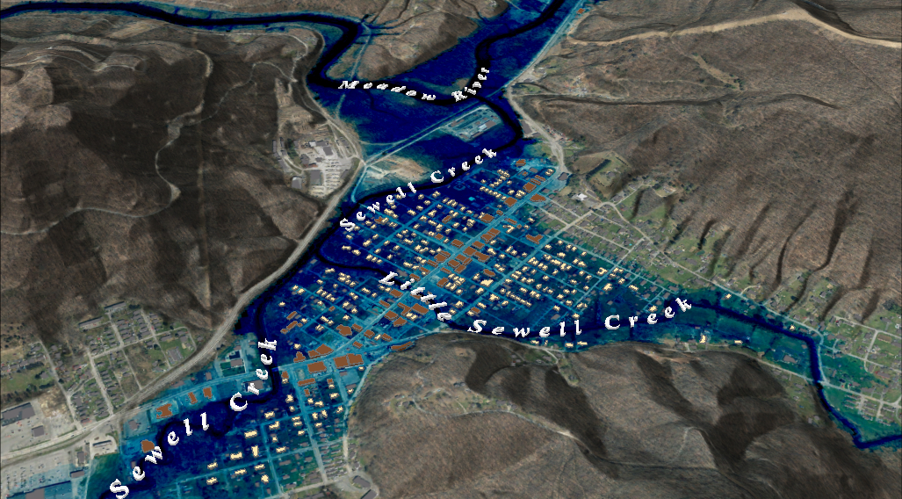
FEMA 2% Annual Chance (50-year)
FEMA 0.2% Annual Chance (100-year)
Rainelle, WV
Rainelle, WV
0.1 ft.
FLOOD DEPTH
30 ft.
Residential
Non-Residential
6% probability of flooding at least once over 30 years
37% Rainelle is in the 0.2% Annual Flood Chance
Notes:
FEMA 500year Aerial

Slide 22
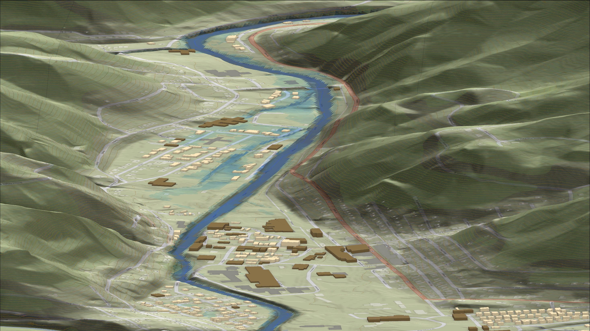
FEMA 10% Annual Chance (10-year)
Richwood, WV
0.1 ft.
FLOOD DEPTH
11.8 ft.
Cherry River
Residential
Non-Residential
7% of Richwood is in the 10% Annual Flood Chance
96% probability of flooding at least once over 30 years

Slide 23
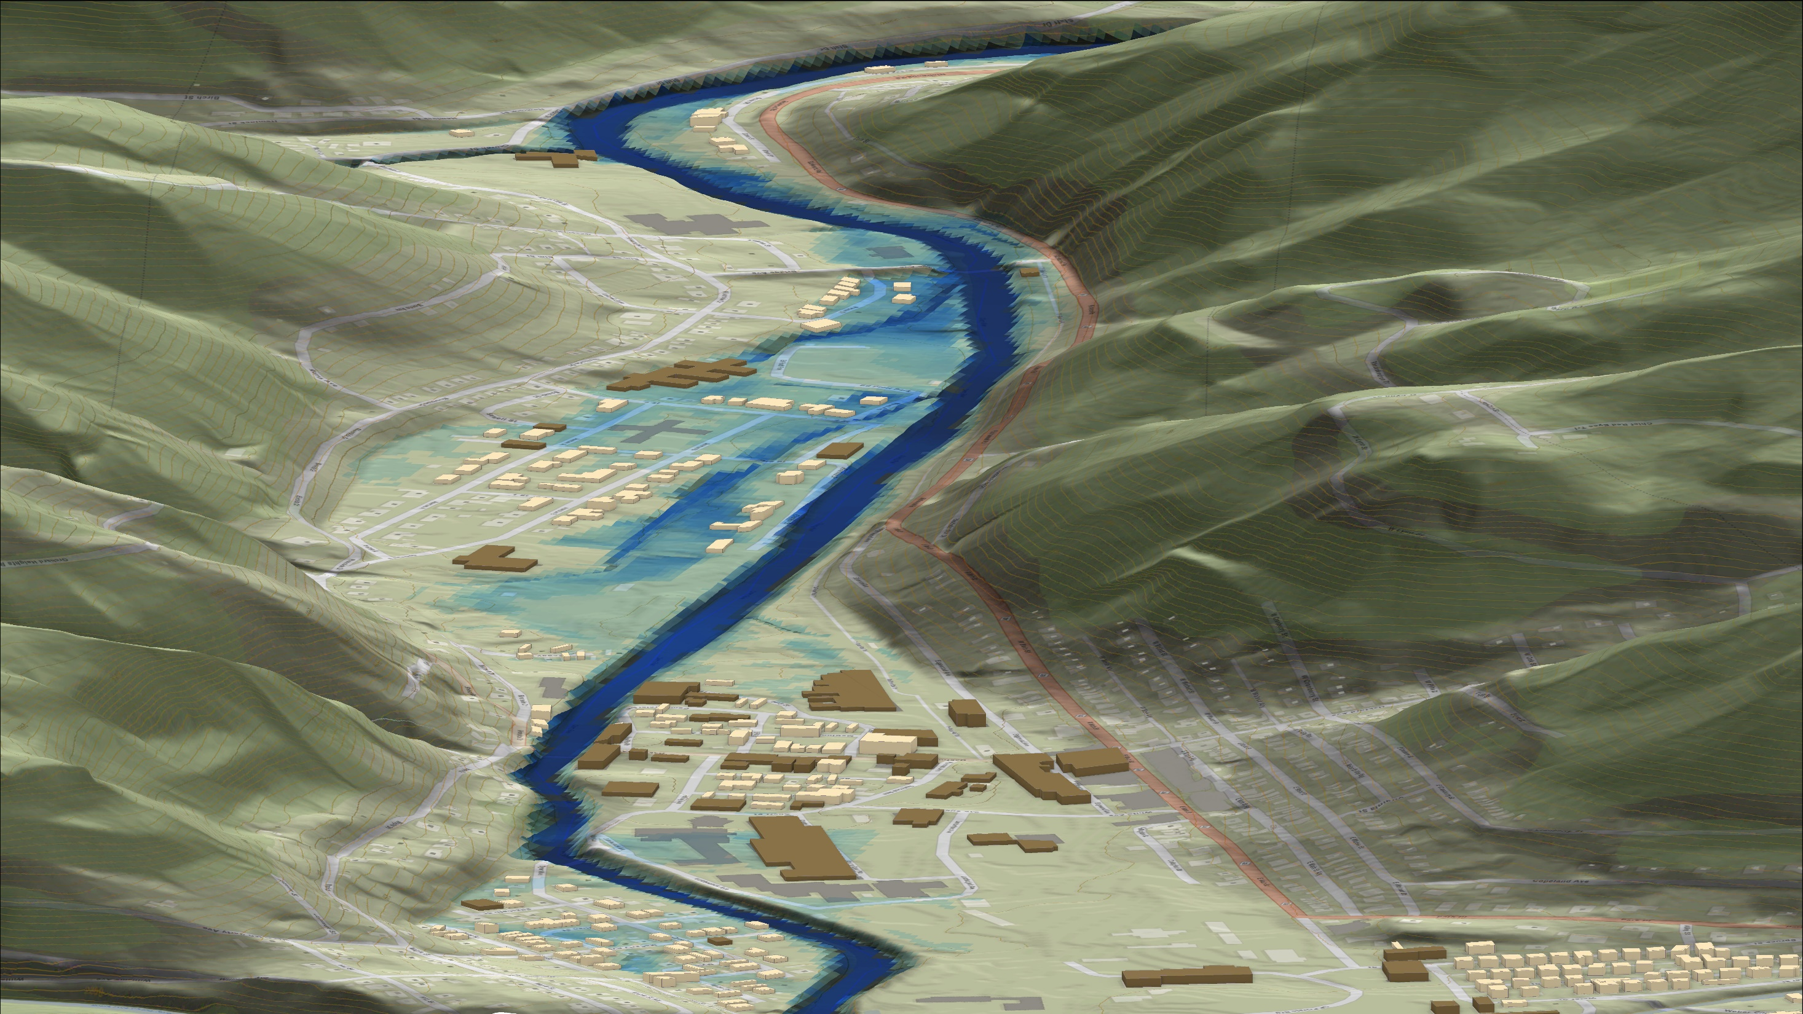
FEMA 4% Annual Chance (25-year)
Richwood, WV
0.1 ft.
FLOOD DEPTH
14.7 ft.
Cherry River
Residential
Non-Residential
11% of Richwood is in the 4% Annual Flood Chance
71% probability of flooding at least once over 30 years

Slide 24
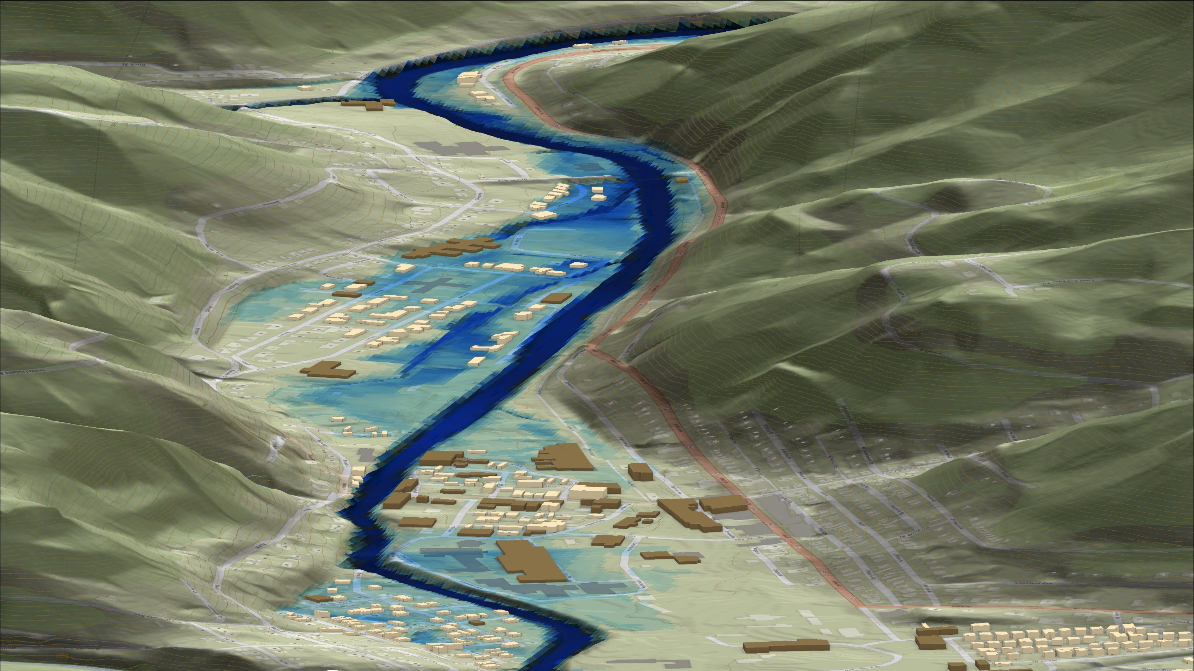
FEMA 2% Annual Chance (50-year)
Richwood, WV
0.1 ft.
FLOOD DEPTH
17.3 ft.
Cherry River
Residential
Non-Residential
16% of Richwood is in the 2% Annual Flood Chance
45% probability of flooding at least once over 30 years

Slide 25
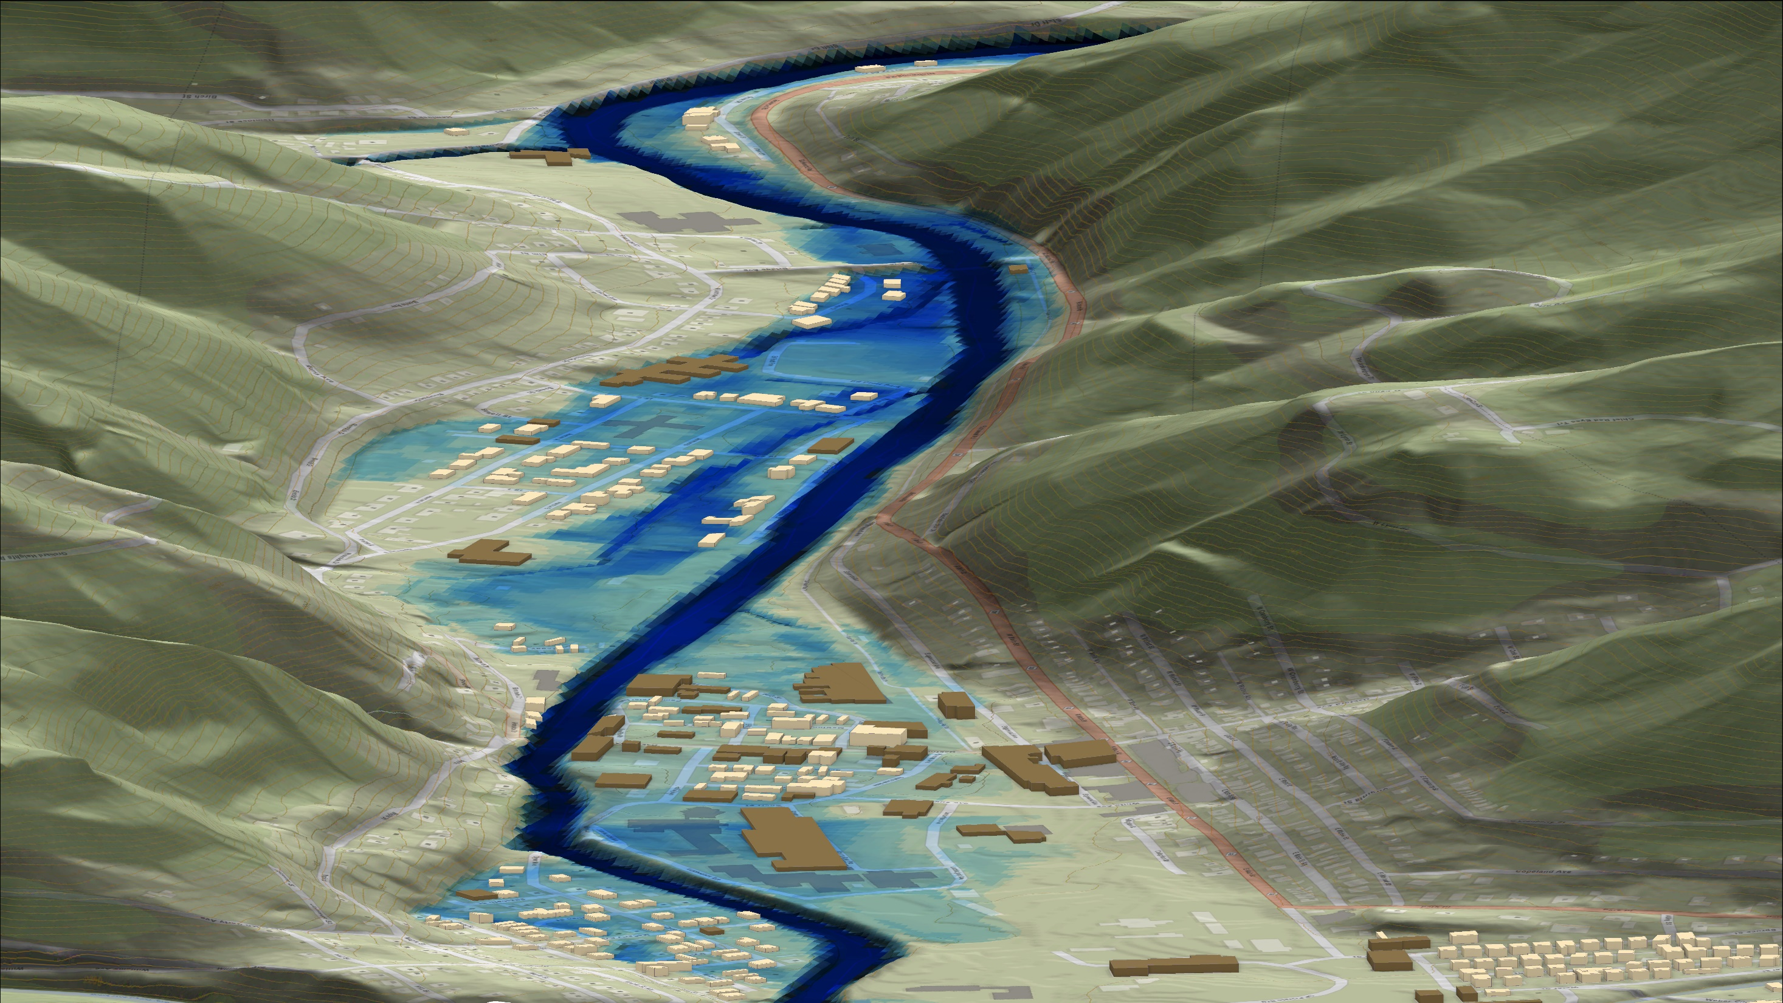
FEMA 1% Annual Chance (100-year)
Richwood, WV
0.1 ft.
FLOOD DEPTH
17.9 ft.
Cherry River
Residential
Non-Residential
18% of Richwood is in the 1% Annual Flood Chance
26% probability of flooding at least once over 30 years

Slide 26
FEMA 1%+ Annual Chance (100-year)
Richwood, WV
Climate
Change
0.1 ft.
FLOOD DEPTH
26.7 ft.
Cherry River
Residential
Non-Residential
22% of Richwood is in the 1%+ Annual Flood Chance
26% probability of flooding at least once over 30 years

Slide 27
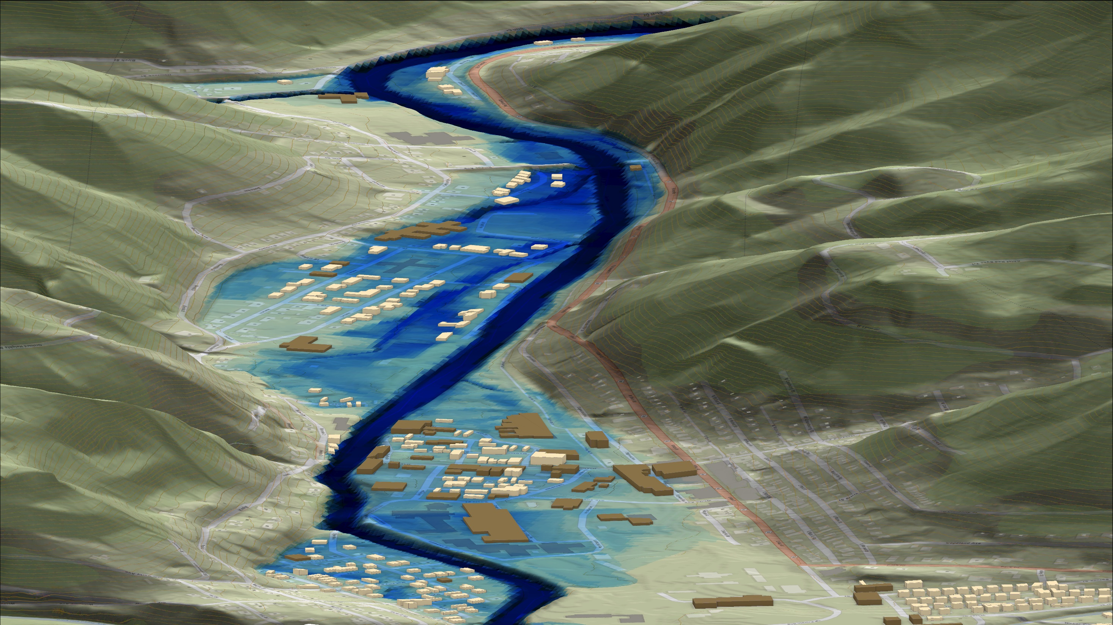
FEMA 0.2% Annual Chance (500-year)
Richwood, WV
0.1 ft.
FLOOD DEPTH
28.6 ft.
Cherry River
Residential
Non-Residential
22% of Richwood is in the 0.2% Annual Flood Chance
6% probability of flooding at least once over 30 years

Slide 28
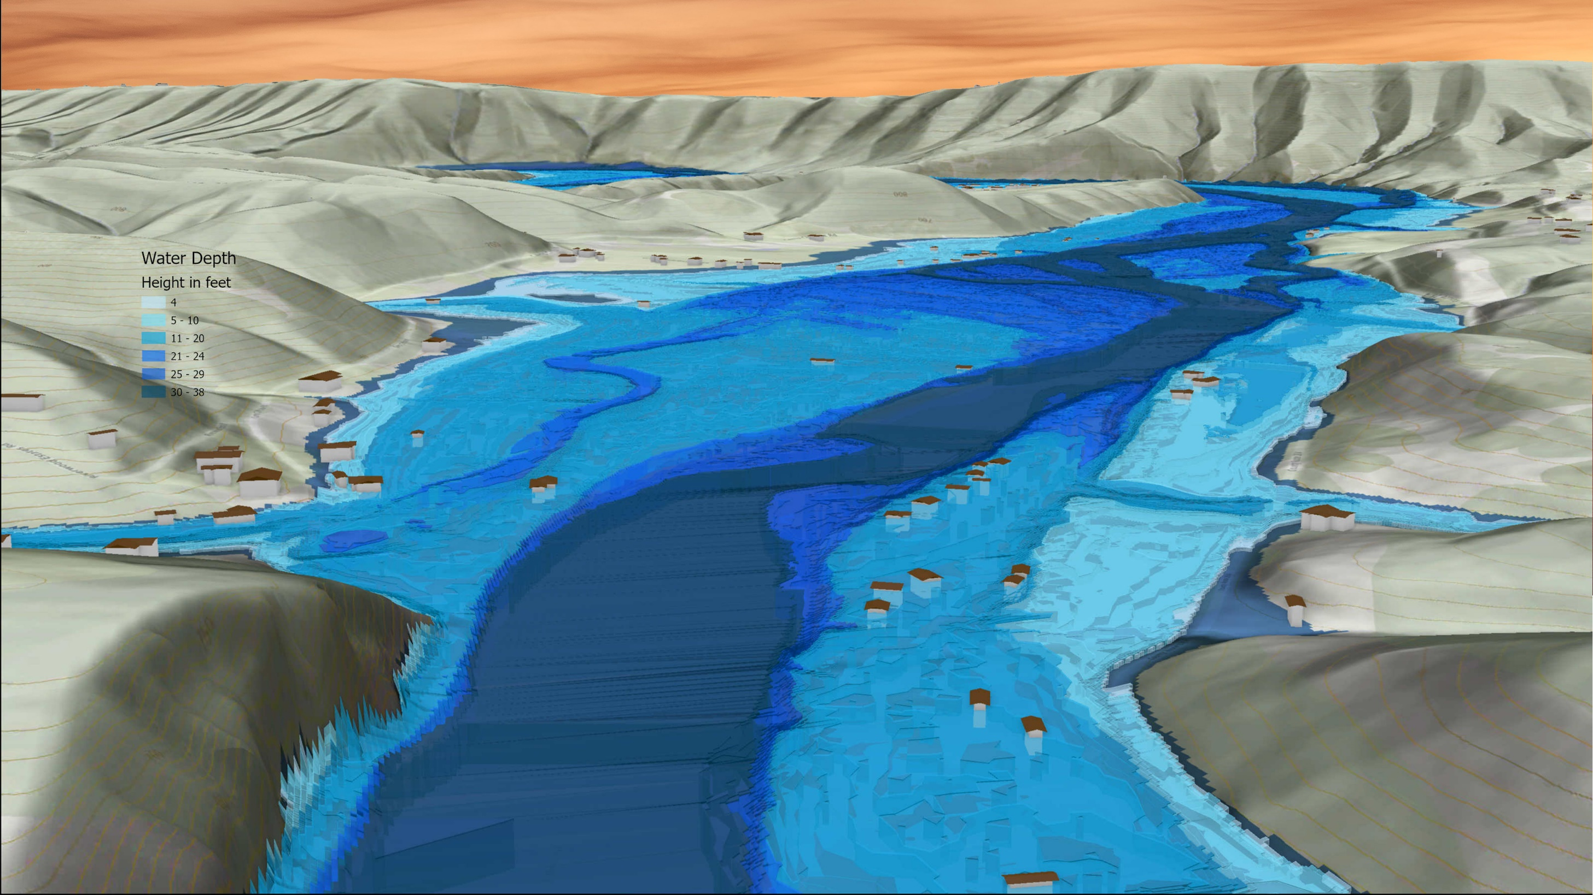
FEMA 1% Annual Chance (100-year)
Hampshire Unincorporated Area, WV
South Branch Potomac River
South Branch Potomac River

Slide 29
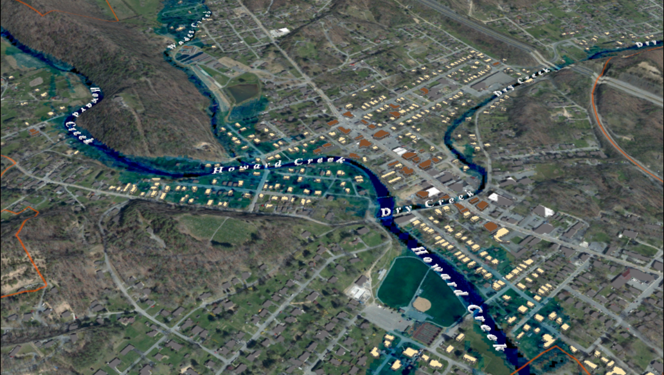
FEMA 10% Annual Chance (10-year)
White Sulphur Springs, WV
0.1 ft.
FLOOD DEPTH
26 ft.
Residential
Non-Residential
13% of White Sulphur Springs is in the 10% Annual Flood Chance
96% probability of flooding at least once over 30 years
Notes:
White Sulfur Springs FEMA 10yr Aerial

Slide 30
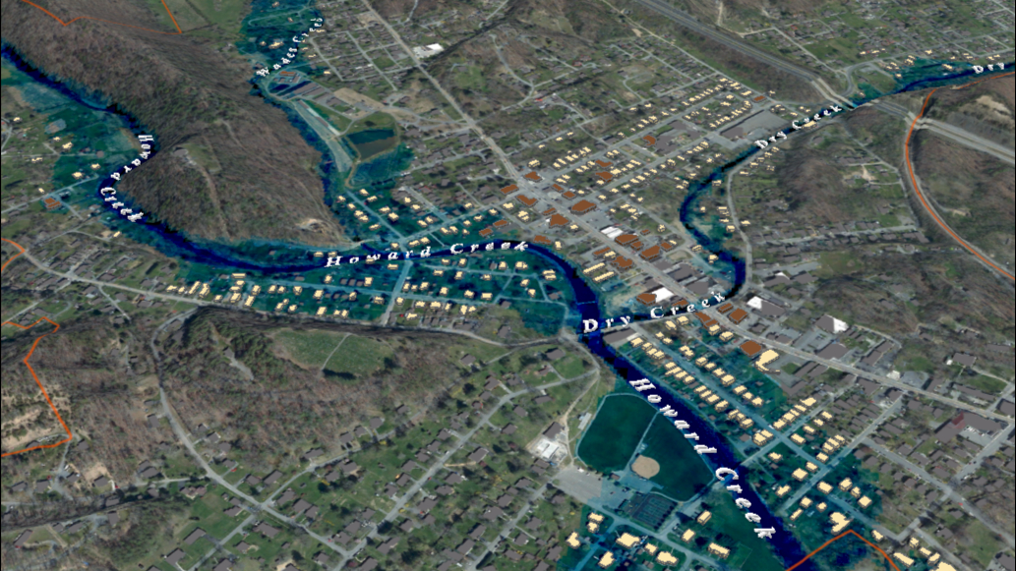
FEMA 4% Annual Chance (25-year)
White Sulphur Springs, WV
0.1 ft.
FLOOD DEPTH
29 ft.
Residential
Non-Residential
17% of White Sulphur Springs is in the 4% Annual Flood Chance
71% probability of flooding at least once over 30 years
Notes:
White Sulfur Springs FEMA 25yr Aerial

Slide 31
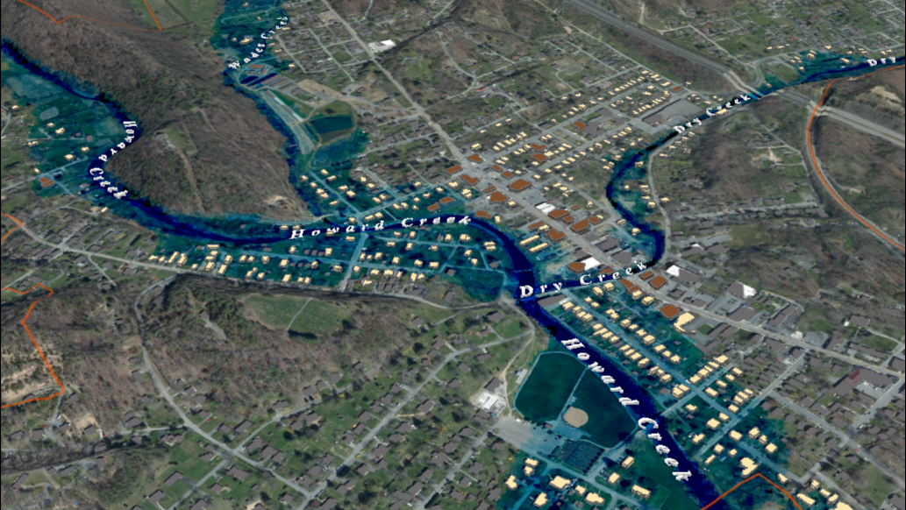
FEMA 2% Annual Chance (50-year)
White Sulphur Springs, WV
0.1 ft.
FLOOD DEPTH
30 ft.
Residential
Non-Residential
20% of White Sulphur Springs is in the 2% Annual Flood Chance
45% probability of flooding at least once over 30 years
Notes:
White Sulfur Springs FEMA 50yr Aerial

Slide 32
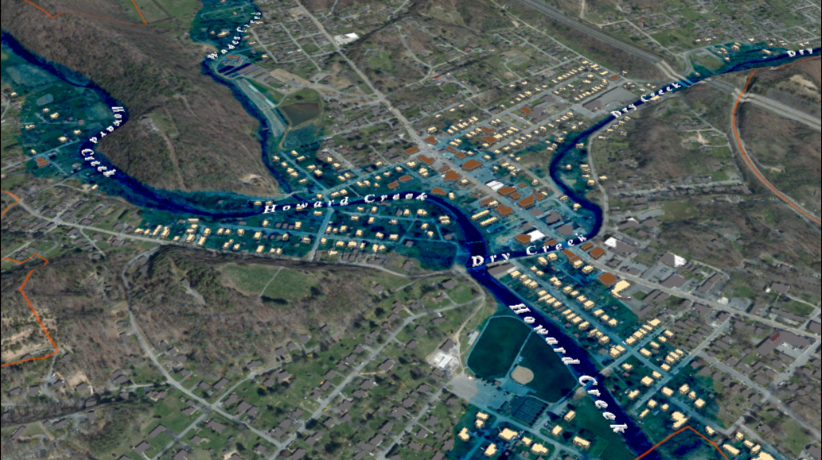
FEMA 1% Annual Chance (100-year)
White Sulphur Springs, WV
0.1 ft.
FLOOD DEPTH
35 ft.
Residential
Non-Residential
22% of White Sulphur Springs is in the 1% Annual Flood Chance
26% probability of flooding at least once over 30 years
Notes:
White Sulfur Springs FEMA 100yr Aerial

Slide 33
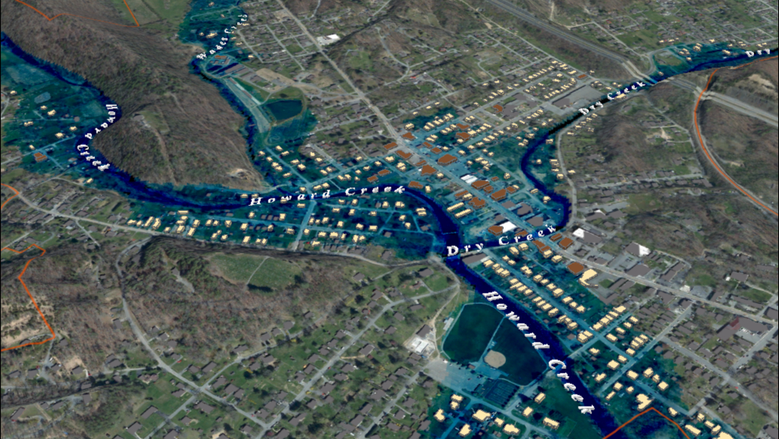
FEMA 1% +Annual Chance (100-year)
White Sulphur Springs, WV
Climate
Change
0.1 ft.
FLOOD DEPTH
35 ft.
Residential
Non-Residential
25% of White Sulphur Springs is in the 1% +Annual Flood Chance
26% probability of flooding at least once over 30 years
Notes:
White Sulfur Springs FEMA 100yr PLUS Aerial

Slide 34
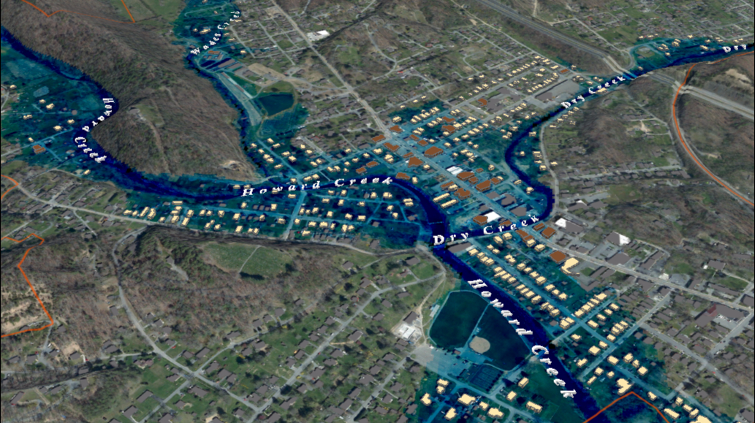
FEMA 0.2% Annual Chance (500-year)
White Sulphur Springs, WV
0.1 ft.
FLOOD DEPTH
18 ft.
Residential
Non-Residential
18% of White Sulphur Springs is in the 0.2% Annual Flood Chance
6% probability of flooding at least once over 30 years
Notes:
White Sulfur Springs FEMA 500yr Aerial

Slide 35
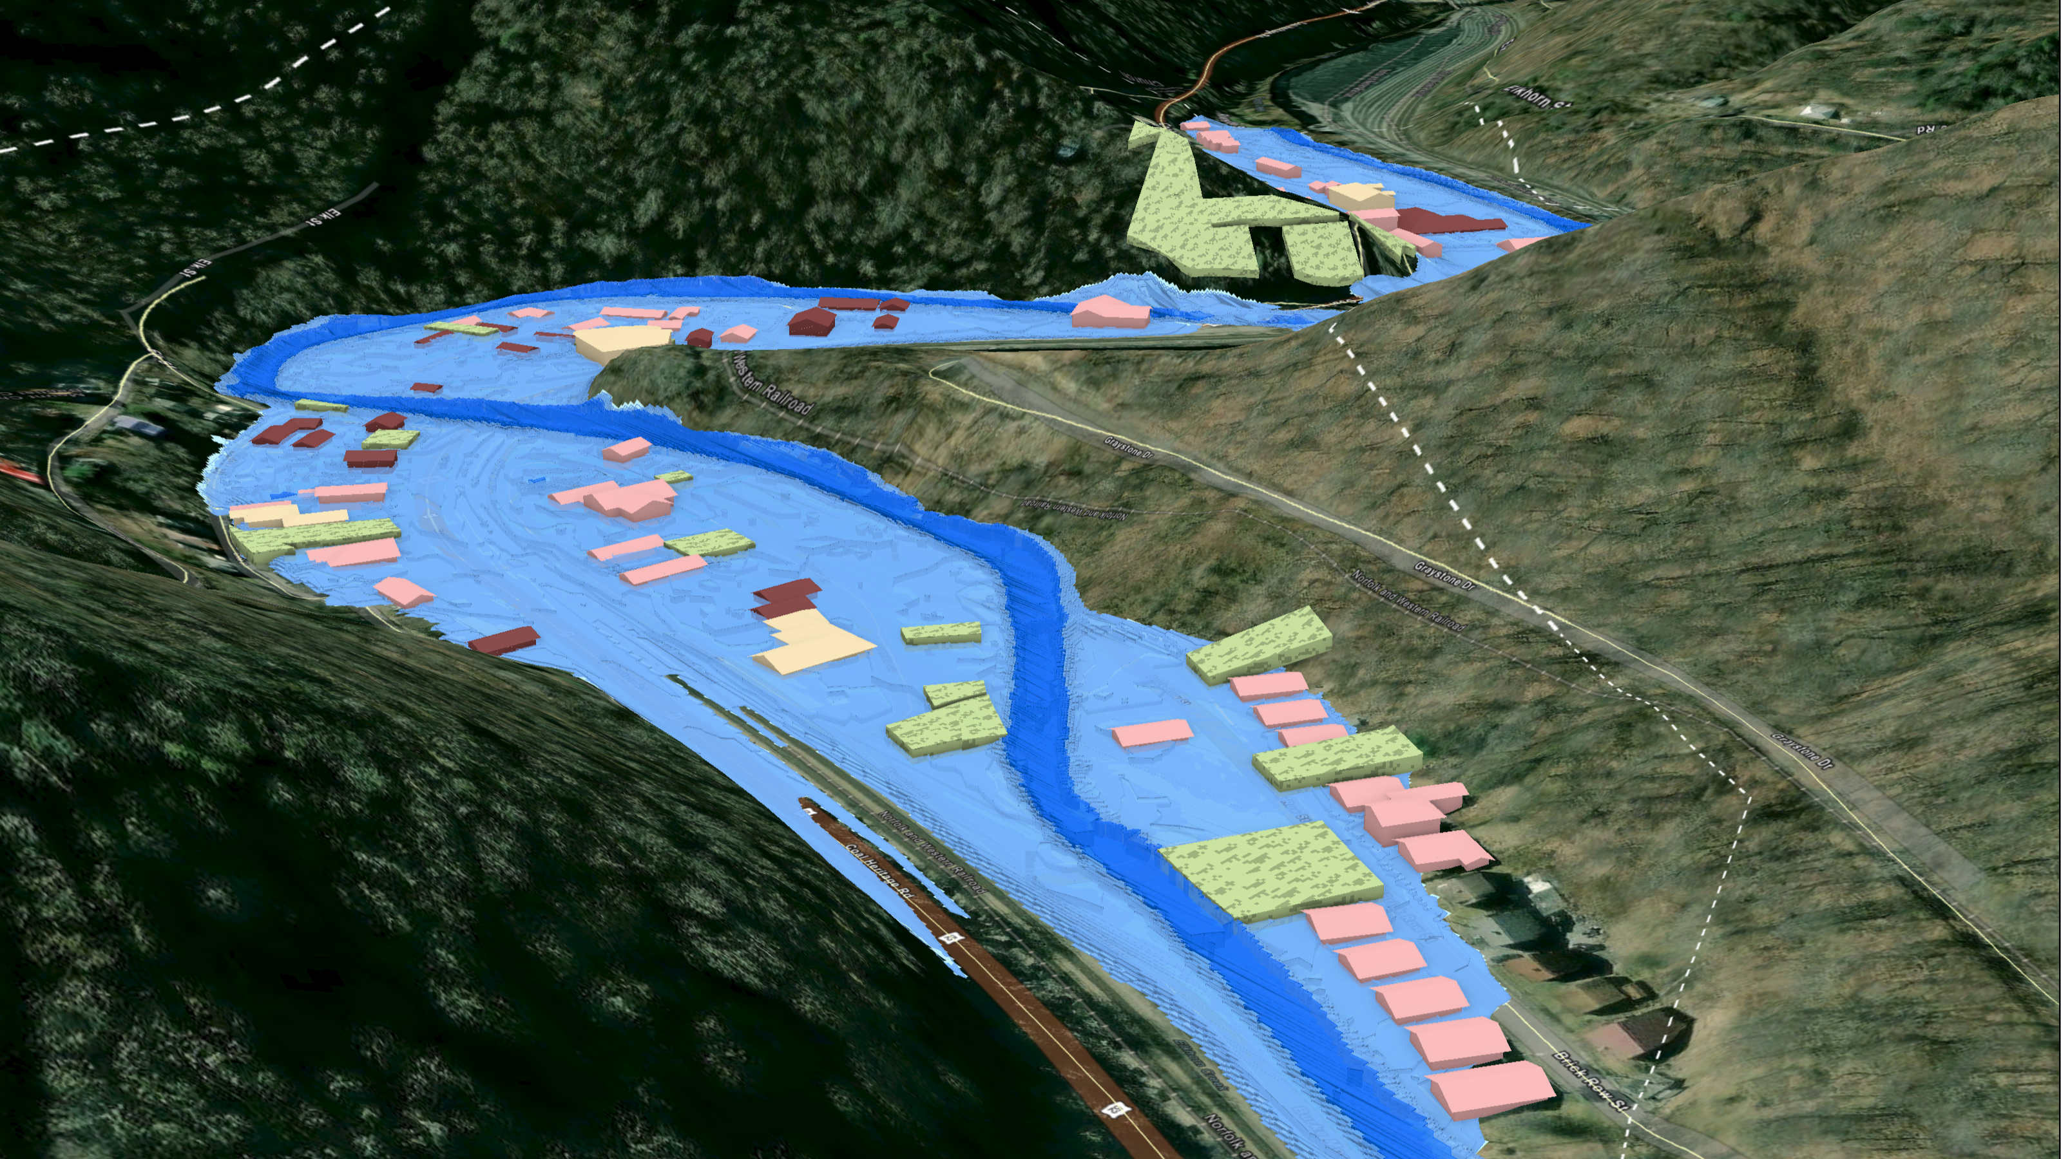
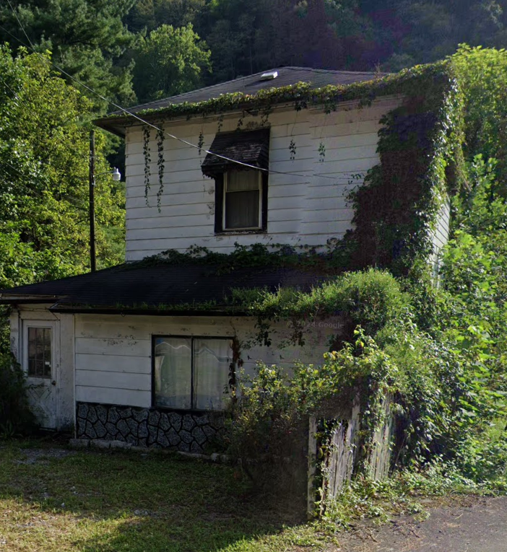
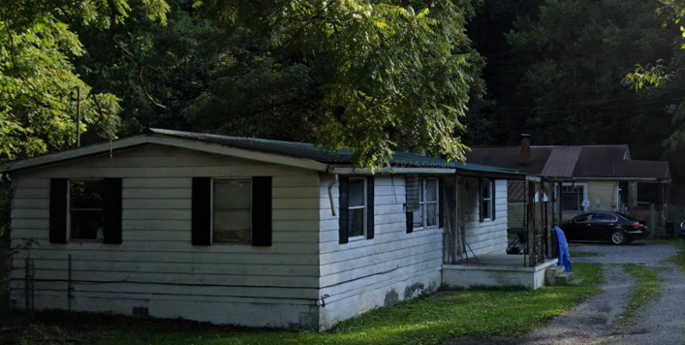
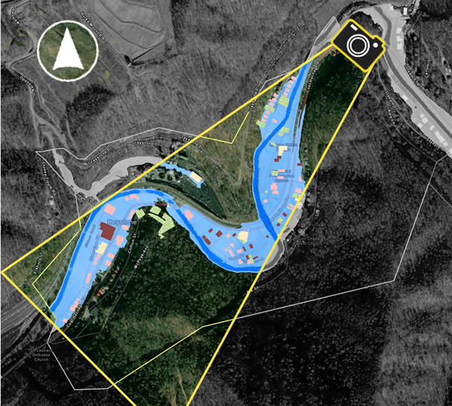
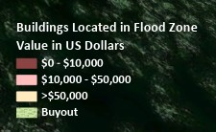
FEMA 1% +Annual Chance (100-year)
Keystone, WV
Elkhorn Creek
Key Plan
Properties
Elkhorn Creek

Slide 36
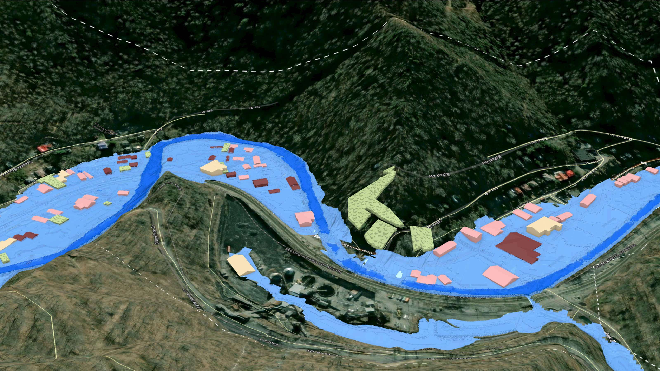
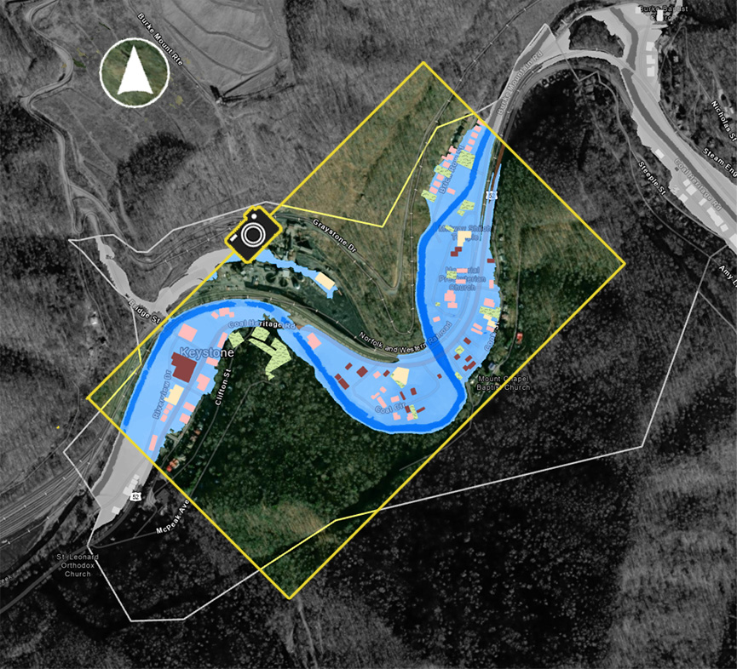
FEMA 1% +Annual Chance (100-year)
Keystone, WV
Elkhorn Creek
Key Plan
Elkhorn Creek
Elkhorn Creek
Properties

Slide 37
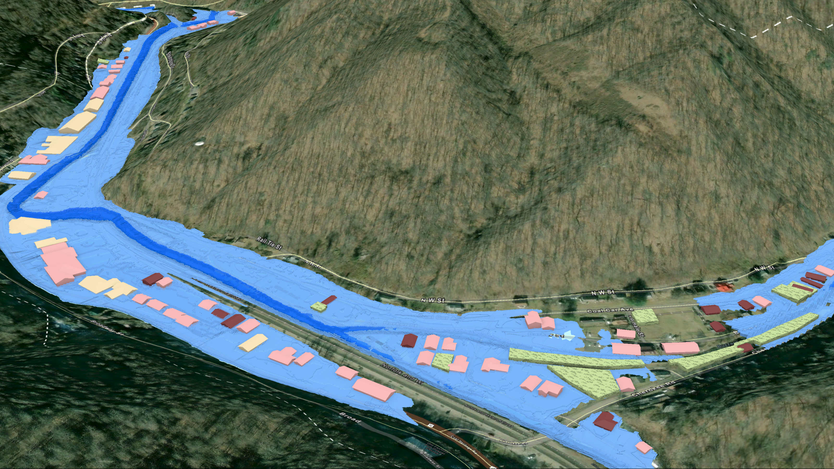
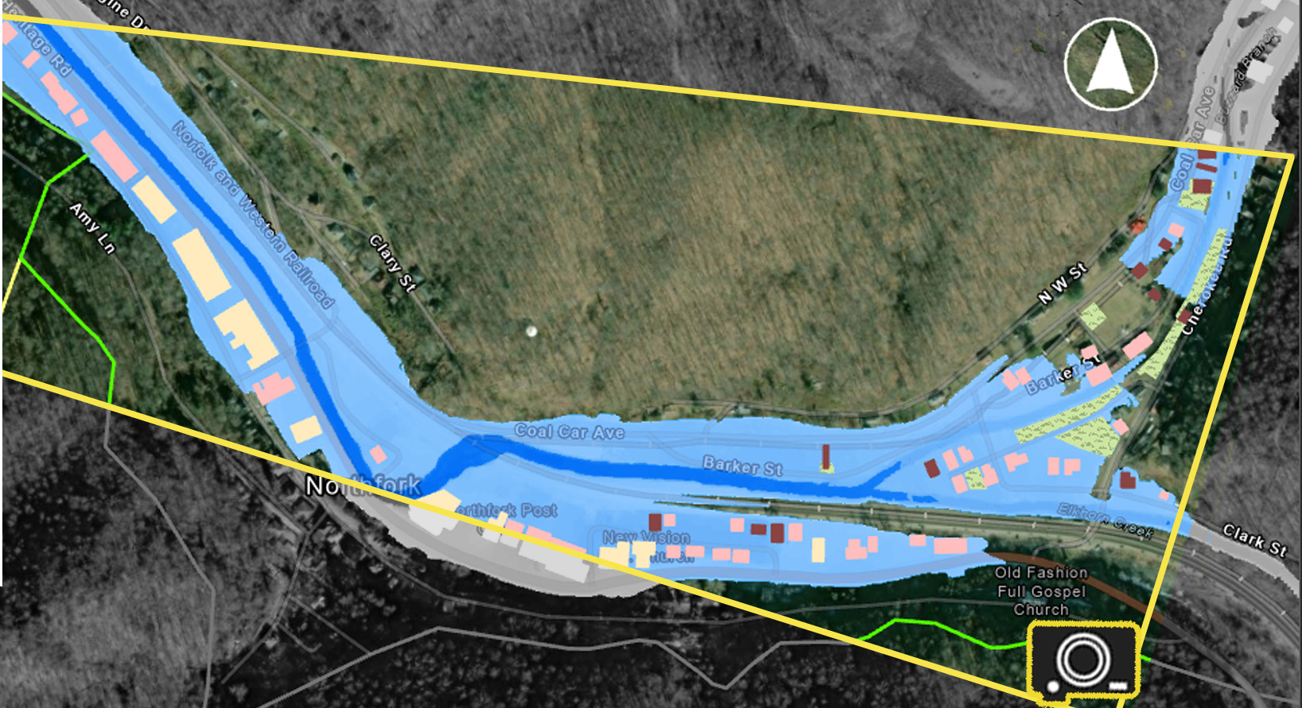
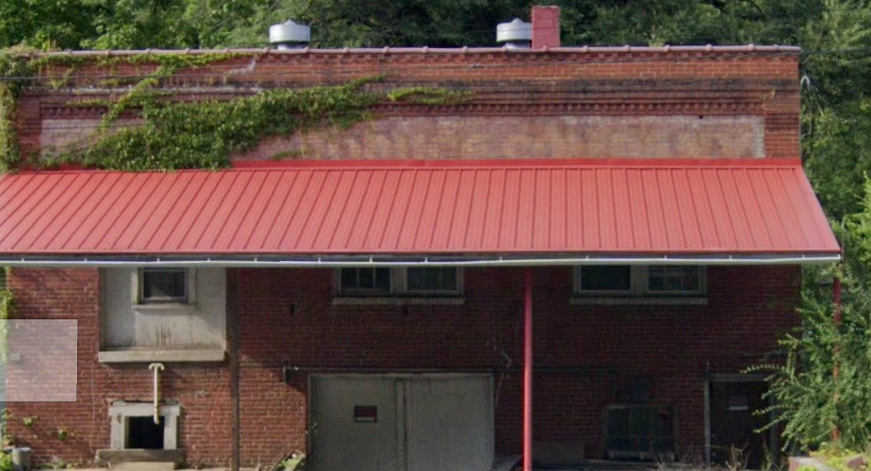
FEMA 1% +Annual Chance (100-year)
Northfork, WV
Key Plan
North Fork Elkhorn Creek
Properties

Slide 38
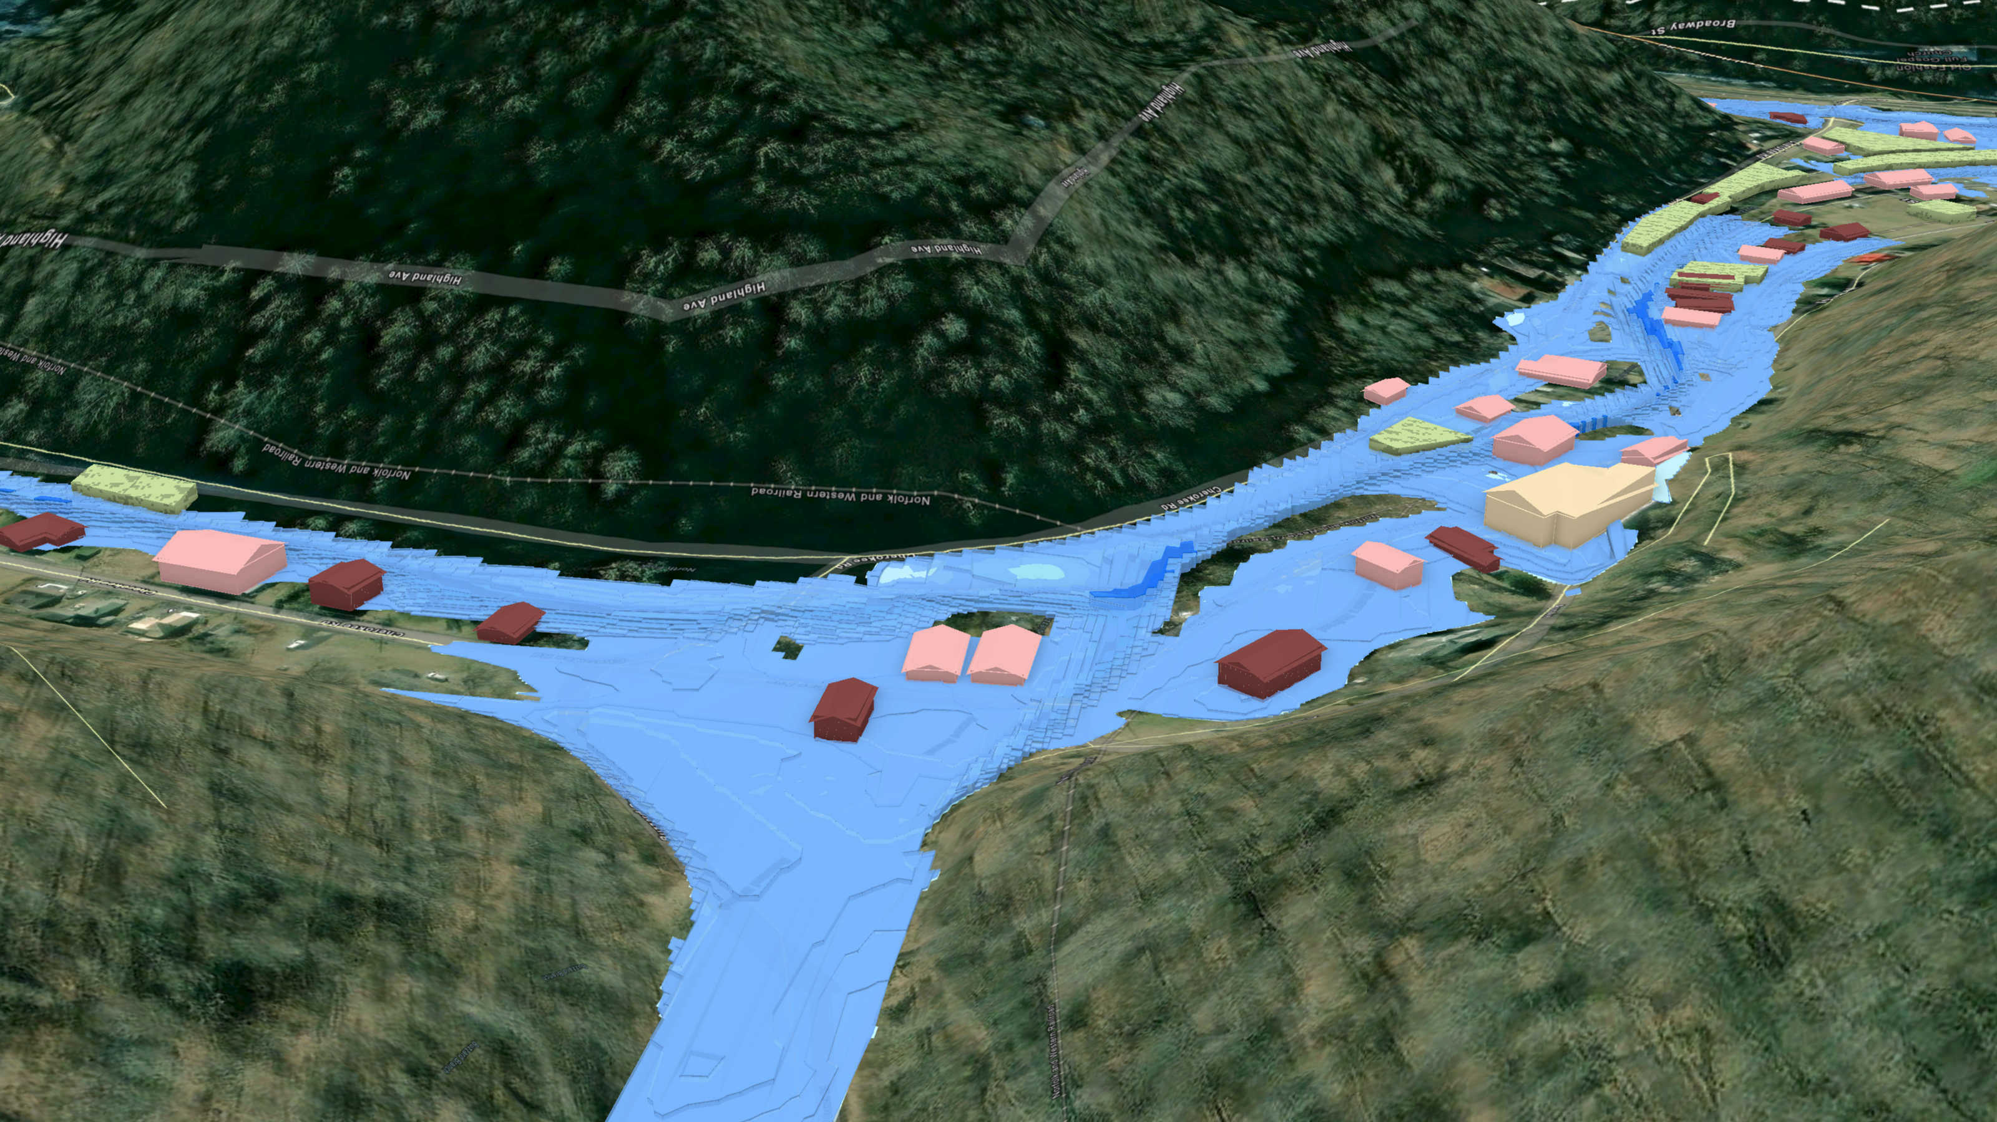
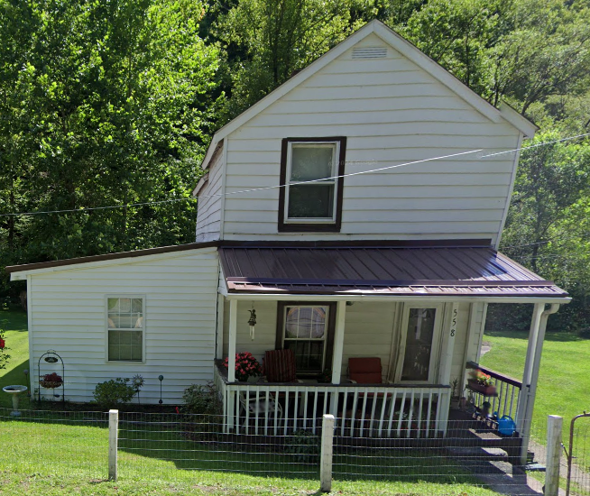
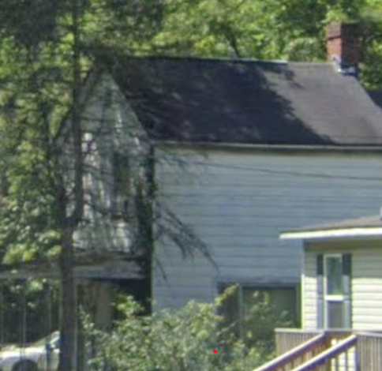
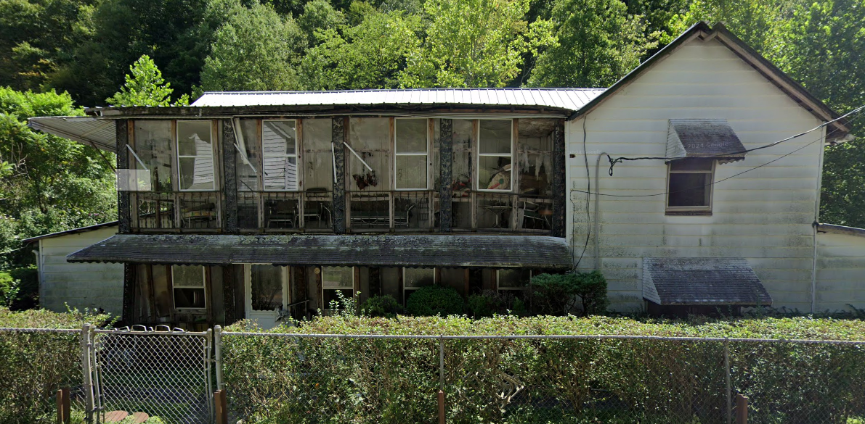
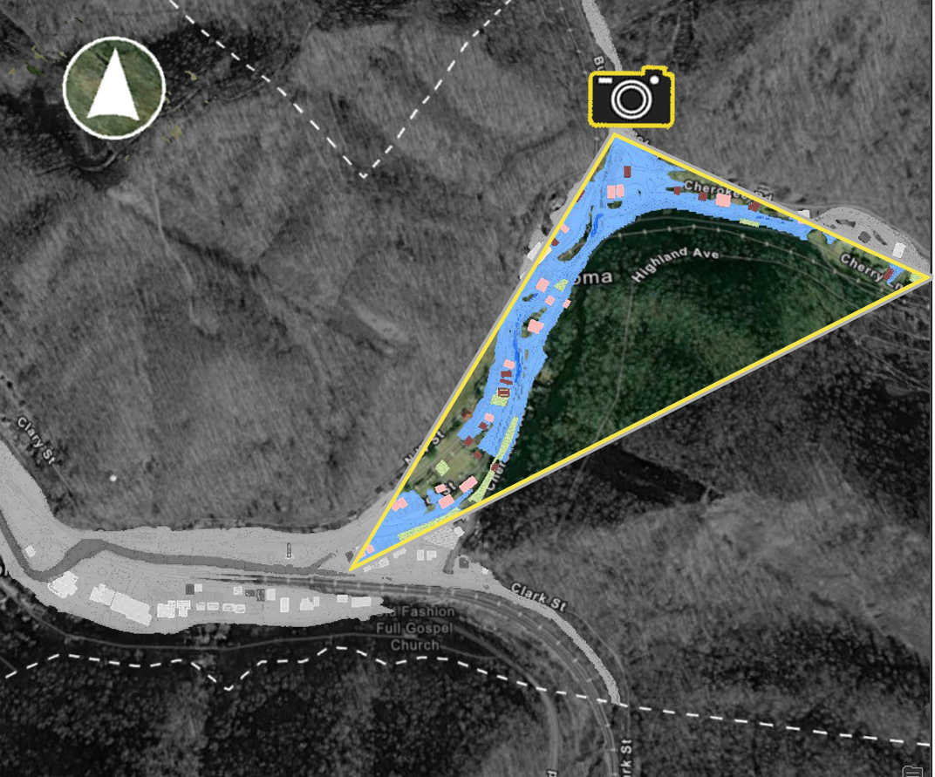
FEMA 1% +Annual Chance (100-year)
Northfork, WV
North Fork Elkhorn Creek
Properties
Key Plan

