Slide 1
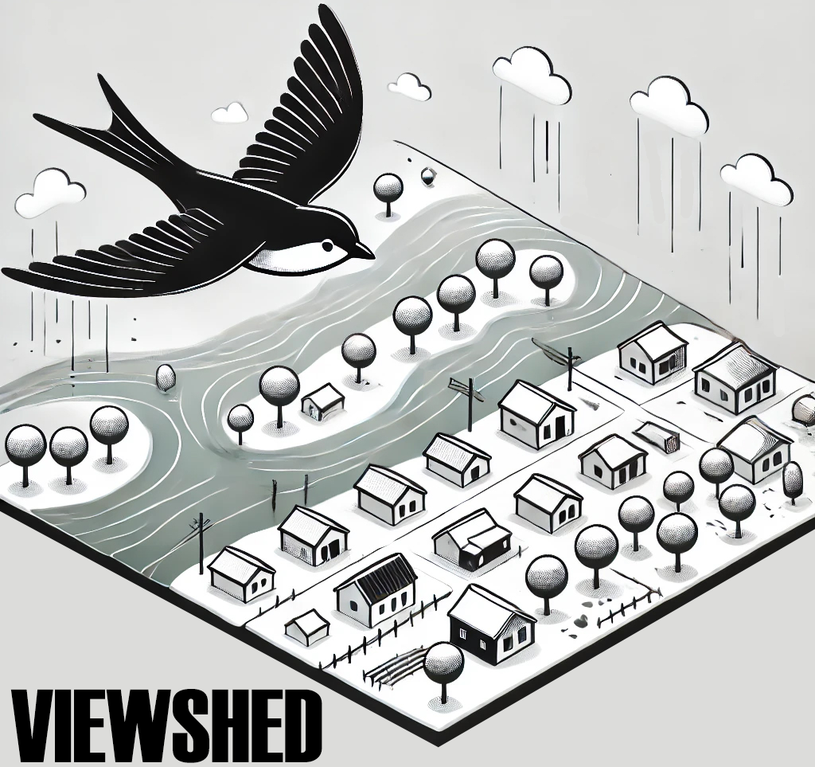
FEMA 10% Annual Chance (10-year)
Camden-on-Gauley, WV
0.1 ft.
FLOOD DEPTH
22.1 ft.
Residential
Non-Residential
FEMA, Effective Date: 2022
10% of Camden is in the 10% Annual Flood Chance
96% probability of flooding at least once over 30 years

Slide 2
FEMA 4% Annual Chance (25-year)
Camden-on-Gauley, WV
0.1 ft.
FLOOD DEPTH
25.3 ft.
Residential
Non-Residential
FEMA, Effective Date: 2022
12% of Camden is in the 4% Annual Flood Chance
71% probability of flooding at least once over 30 years

Slide 3
FEMA 2% Annual Chance (50-year)
Camden-on-Gauley, WV
0.1 ft.
FLOOD DEPTH
27.3 ft.
Residential
Non-Residential
12% of Camden is in the 2% Annual Flood Chance
45% probability of flooding at least once over 30 years

Slide 4
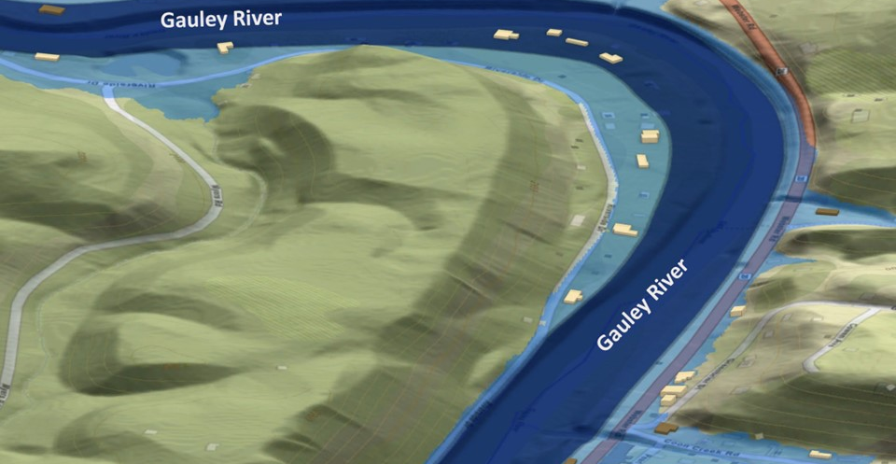
FEMA 1% Annual Chance (100-year)
Camden-on-Gauley, WV
0.1 ft.
FLOOD DEPTH
29.3 ft.
Residential
Non-Residential
FEMA, Effective Date: 2022
14% of Camden is in the 1% Annual Flood Chance
26% probability of flooding at least once over 30 years

Slide 5
FEMA 1+% Annual Chance (100-year)
Camden-on-Gauley, WV
Climate
Change
0.1 ft.
FLOOD DEPTH
31.5 ft.
Residential
Non-Residential
13% of Camden is in the 1%+ Annual Flood Chance
26% probability of flooding at least once over 30 years

Slide 6
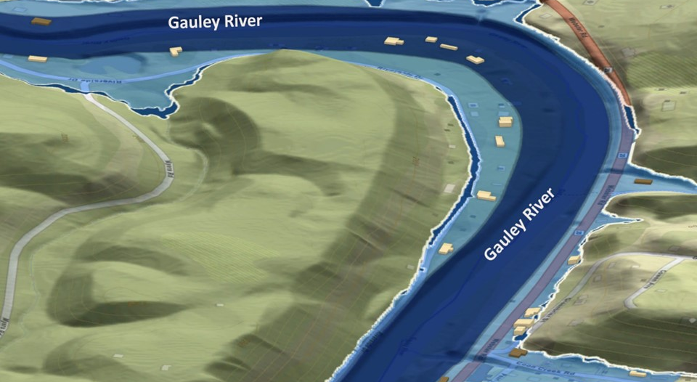
FEMA 0.2% Annual Chance (500-year)
Camden-on-Gauley, WV
0.1 ft.
FLOOD DEPTH
32.5 ft.
Residential
Non-Residential
15% of Camden is in the 0.2% Annual Flood Chance
6% probability of flooding at least once over 30 years

