Slide 1
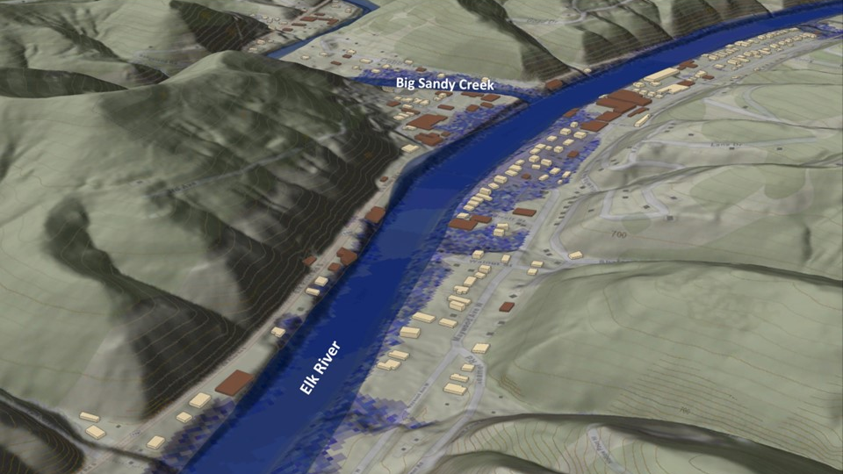
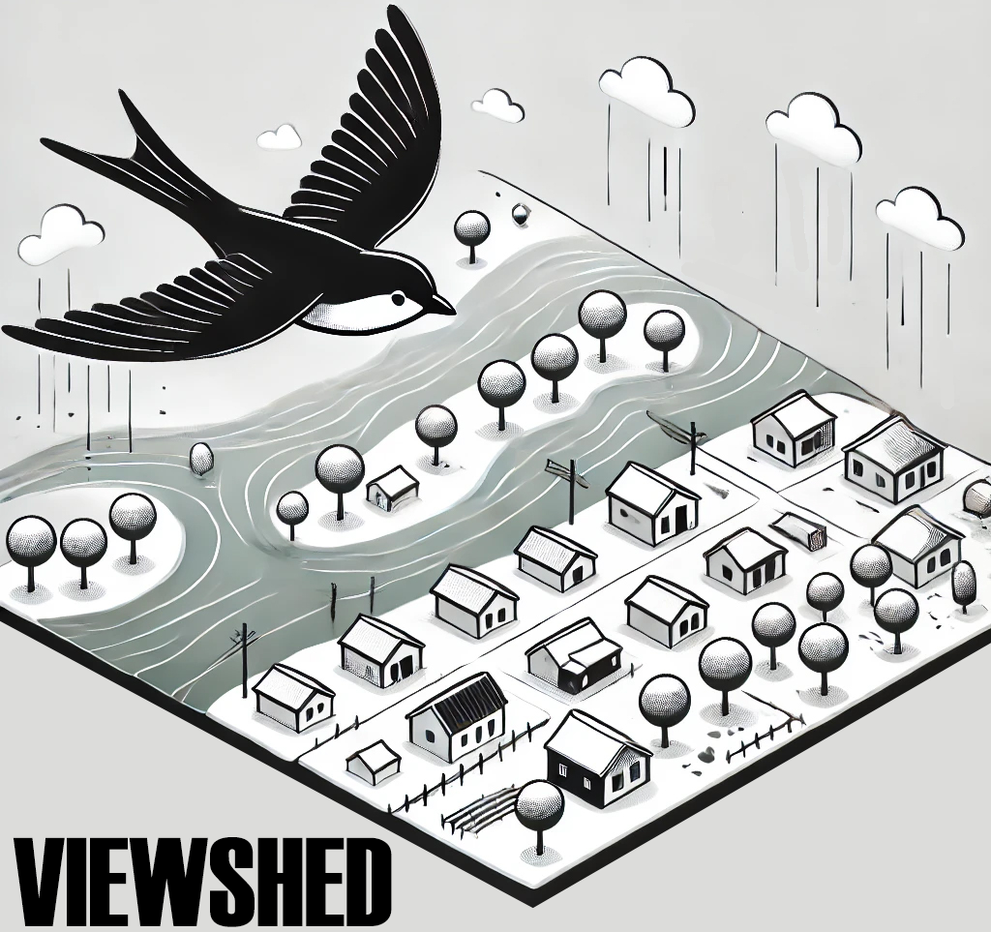
FEMA 10% Annual Chance (10-year)
Clendenin, WV
0.1 ft.
FLOOD DEPTH
27.8 ft.
Residential
Non-Residential
13.4% of Clendenin is in the 10% Annual Flood Chance
96% probability of flooding at least once over 30 years

Slide 2
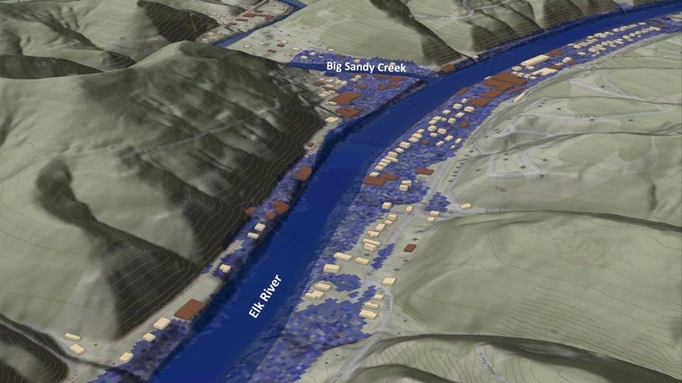
FEMA 4% Annual Chance (25-year)
Clendenin, WV
0.1 ft.
FLOOD DEPTH
27.8 ft.
Residential
Non-Residential
19% of Clendenin is in the 4% Annual Flood Chance
71% probability of flooding at least once over 30 years

Slide 3
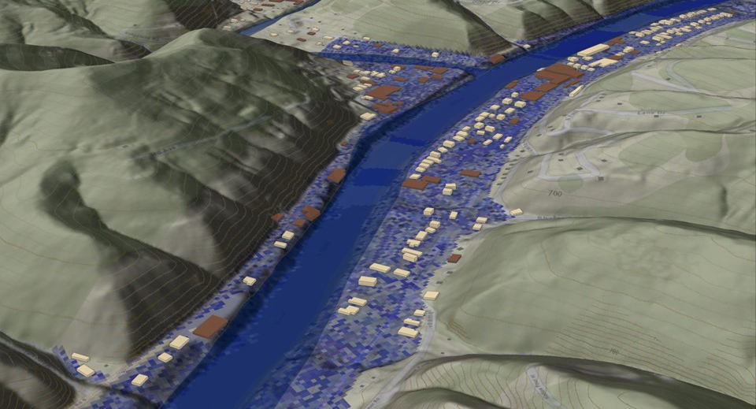
FEMA 2% Annual Chance (50-year)
Clendenin, WV
0.1 ft.
FLOOD DEPTH
35.2 ft.
Residential
Non-Residential
22.5% of Clendenin is in the 4% Annual Flood Chance
45% probability of flooding at least once over 30 years

Slide 4
FEMA 1% Annual Chance (100-year)
Clendenin, WV
0.1 ft.
FLOOD DEPTH
38.1 ft.
Residential
Non-Residential
FEMA, Effective Date: 2023
23.5% of Clendenin is in the 1% Annual Flood Chance
26% probability of flooding at least once over 30 years

Slide 5
FEMA 1%+ Annual Chance (100-year)
Clendenin, WV
Climate
Change
0.1 ft.
FLOOD DEPTH
42.4 ft.
Residential
Non-Residential
23.5% of Clendenin is in the 1%+ Annual Flood Chance
26% probability of flooding at least once over 30 years

Slide 6
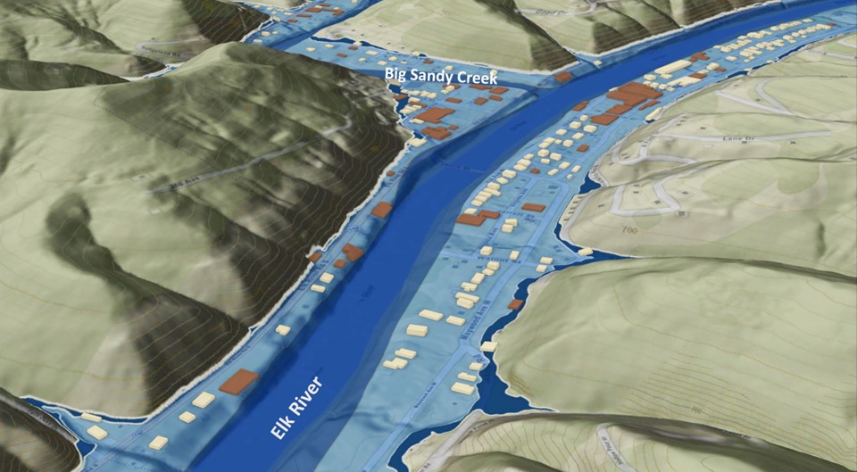
FEMA 0.2% Annual Chance (500-year)
Clendenin, WV
0.1 ft.
FLOOD DEPTH
43.6 ft.
Residential
Non-Residential
25% of Clendenin is in the 0.2% Annual Flood Chance
6% probability of flooding at least once over 30 years

